Slide 1
Improving Outcomes for People with Diabetes
Ori Odugbesan MD MPH
November 11, 2025

Slide 2
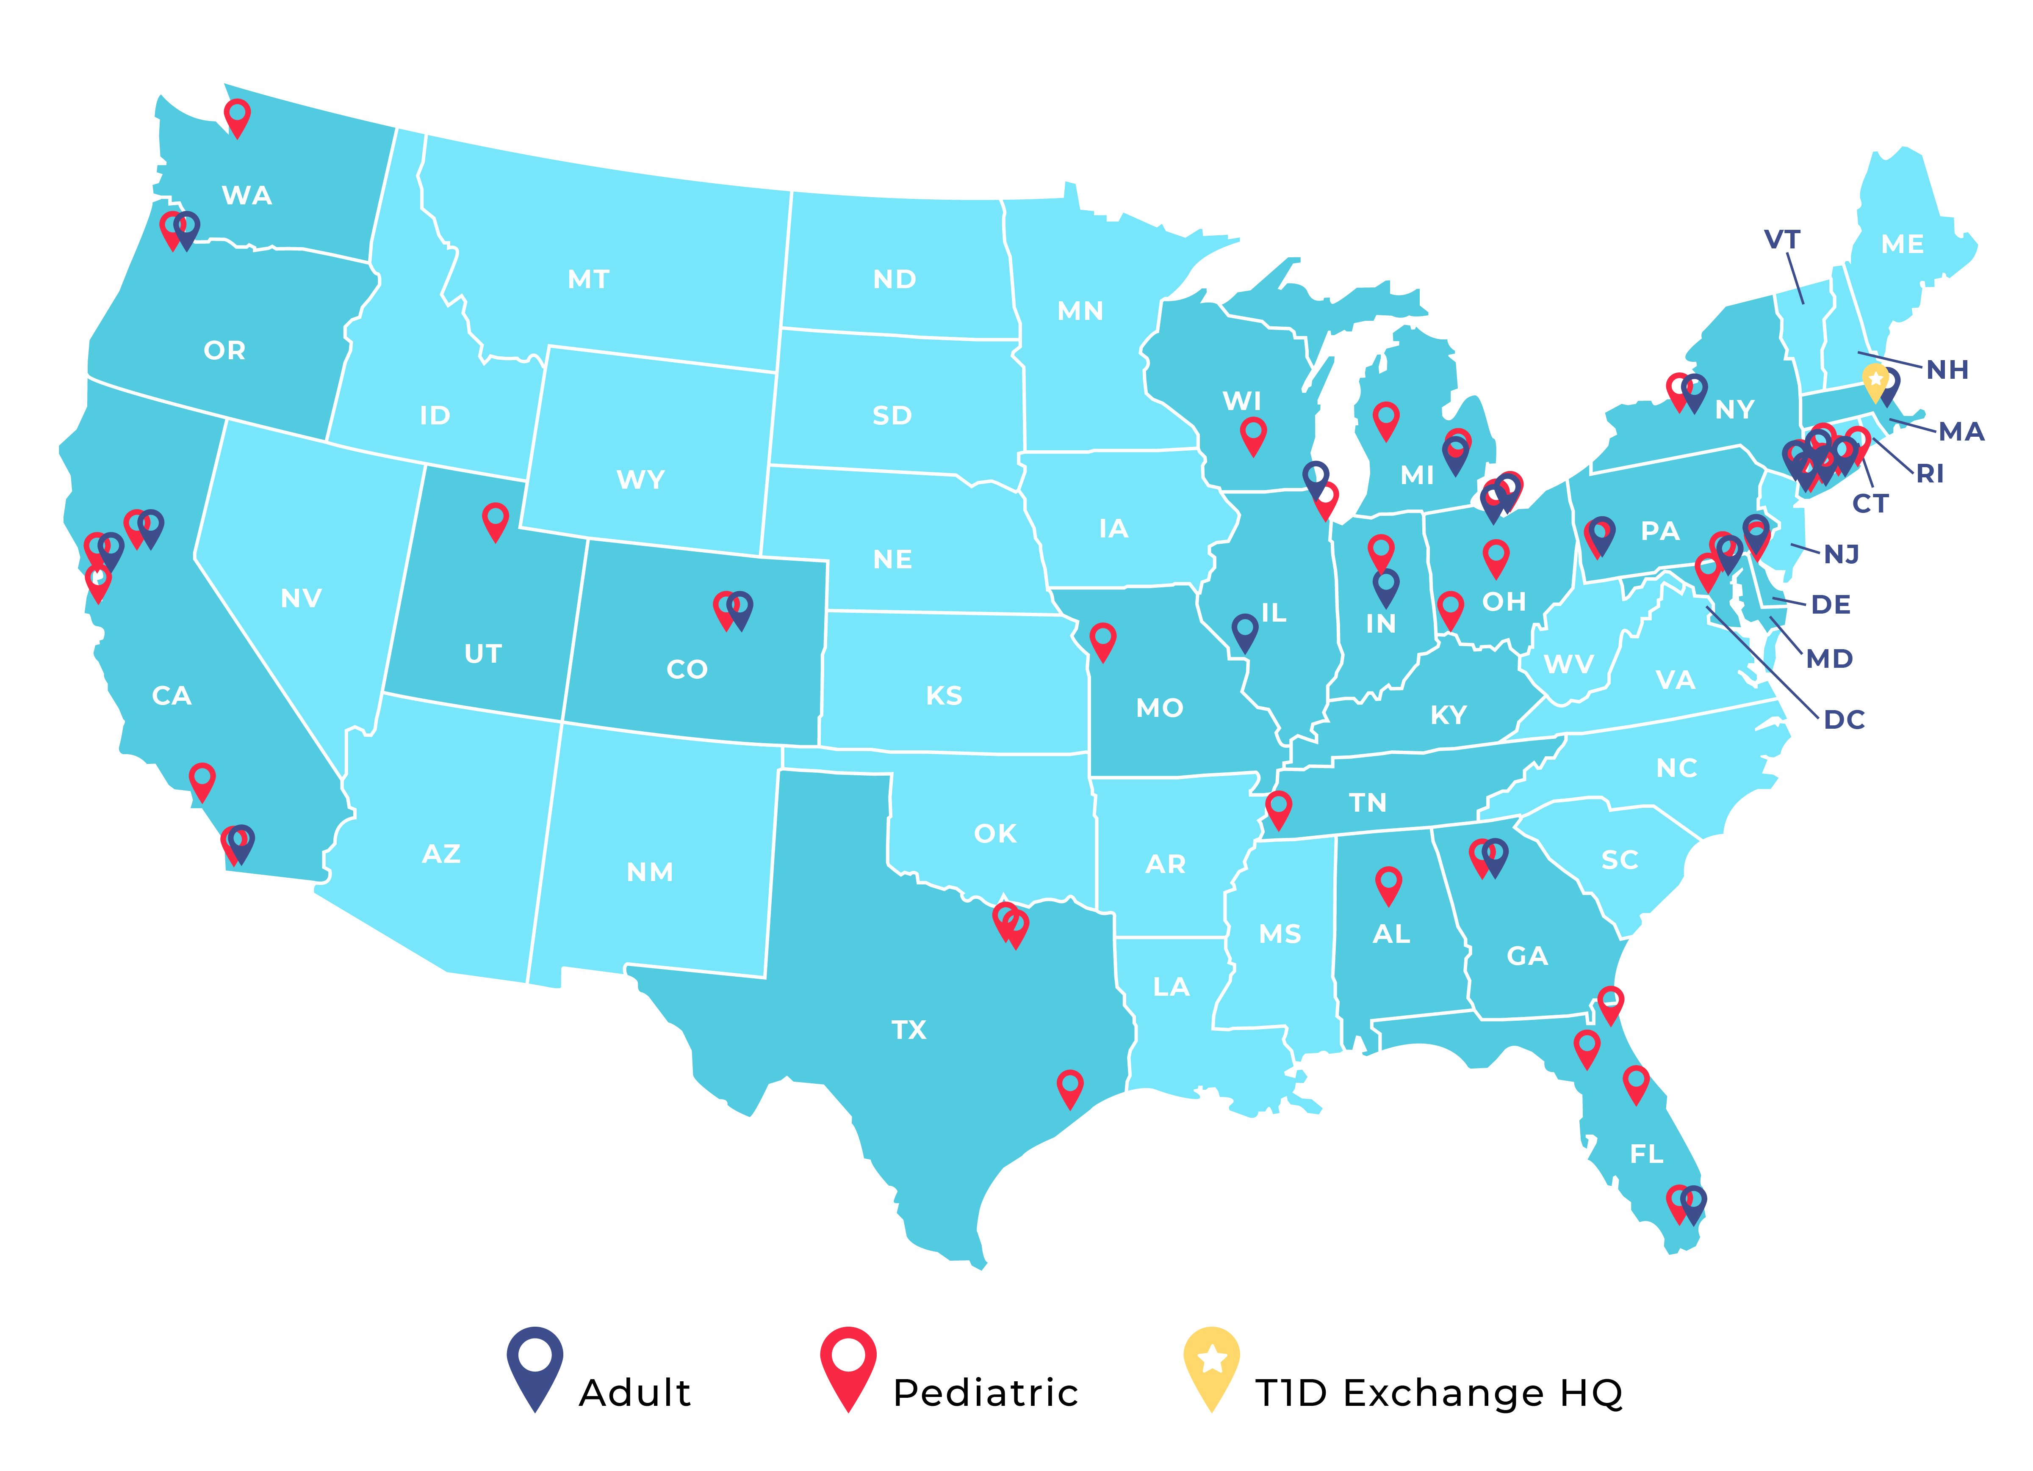
Introduction
The T1DX-QI is a national learning network with centers working to improve outcomes for people with diabetes.
T1DX-QI has grown to a network of 62 T1D and 25 T2D centers
T1DX-QI database currently has approximately 90,000+ People with T1D diabetes and 60,000+ people with T2D across 22 US States.

Slide 3
















Manager, QI Special Projects
Trevon Wright, MHA
Senior Director of Clinical
Partnerships
Nicole Rioles, MA
Associate Director Real World Data,
Susan Thapa, PhD, MPH
Associate Director,
QI & Health Equity
Ori Odugbesan, MD, MPH
Analyst, Real World Data
Dhruvi Vora, BS
T1DX-QI Coordinating Center Team
QI Analyst
Claire Rainey, BA
Associate Director, Quality Programs
Alyssa Cabrera, MPH, CPHQ, PMP
Senior Data Analyst, Real World Data
Emma Ospelt, MPH
QI Analyst
Timothy Bol, BA
Manager, Real World Data
Saketh Rompicherla, MS
Senior QI Consultant,
Don Buckingham, Sr., MBOE, CPHQ
Data Integration Manager
Anton Wirsch, MS
Data Integration Analyst
James Dawson, BS

Slide 4
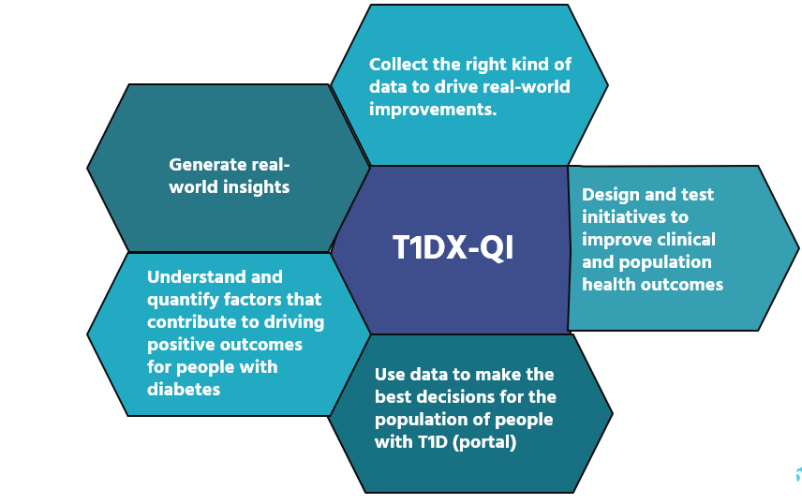
How the T1DX-QI Is Transforming Diabetes Outcomes
Collect the right kind of data to drive real-world improvements.
Use data to make the best decisions for the population of people with diabetes
Understand and quantify factors that contribute to driving positive outcomes for people with diabetes
Design and test initiatives to improve clinical and population health outcomes
Generate real-world insights

Slide 5
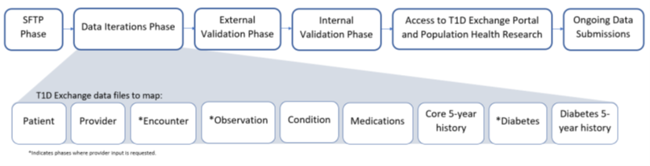
1. Collecting right kind of Data: Data Mapping
T1DX-QI centers work with the coordinating office to map EMR data to variables in the T1DX-QI data specification.
The process begins when centers successfully connect to T1DX-QI secure portal for file sharing and is complete after extensive testing and validation of data
This process can be lengthy, with goal of mapping accurately

Slide 6
T1D Exchange Data Mapping Status
T1D Centers
49 Data Mapped Centers
5 Centers In Progress
T2D Centers
6 Data Mapped Centers
5 In Centers In Progress

Slide 7
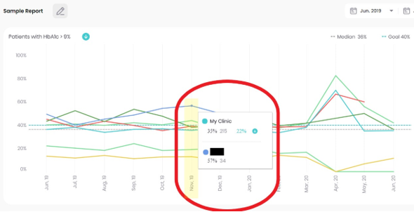
2. Use Data to Make Population Health Decisions: QI Portal
The QI Portal is an EMR-based data platform to review trends and benchmark T1D outcomes
Allow clinics to display data in key T1DX-QI metrics, including
    HbA1c
    CGM use
    Insulin pump use
    Diabetic ketoacidosis events
    Depression screening

Slide 8
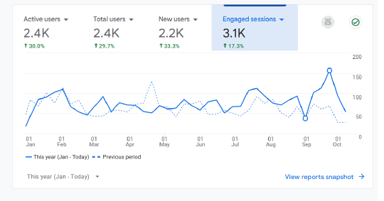

Use Data to Make Population Health Decisions
  Support quality improvement initiatives
  Inform population health insights
  Benchmark outcomes against other T1DX-QI centers
  Display data stratified by race and ethnicity to support health equity initiatives
Increased engagement on the portal from last year.
New Measures & Updates

Slide 9
3. Understand Factors That contribute to Positive Outcomes
Special Projects- 10+ over the last several years
Participating centers & T1DX-QI brainstorm, understand and quantify factors that contribute to driving positive outcomes for people with diabetes
Examples
        CGM Use in T2D
        IMPROVAID Project
        T1D Screening & Monitoring Projects
        Best Practice Advisory (Advance Diabetes Technologies)
        Pediatrics T2D Initiative (WG)

Slide 10
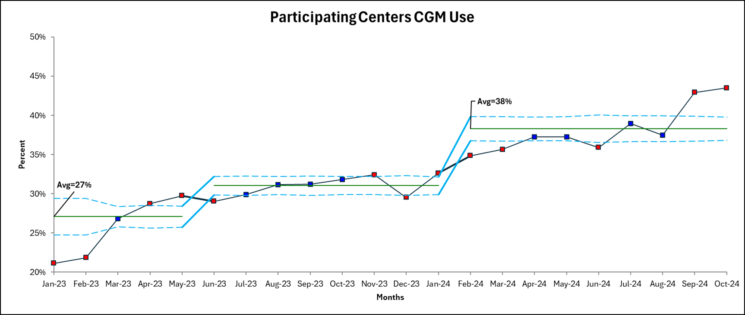


Multicenter QI Project—Increasing CGM Adoption in Adults T2D
Project Aim
Increase the utilization of continuous glucose monitors (CGM) by 10% for adults with T2D by 10/31/24.
Demonstrate reduction in CGM disparities
Project Design
The study was conducted among three adult diabetes centers in the T1DX-QI
Participating centers utilized the T1DX-QI Health Equity Framework to plan and test interventions
Sample Interventions
Use of diabetes technology navigator
Use of CGM Posters & FAQ Fact Sheet
Online CGM Classes
Translation services
Insurance Reference Table
Shared Decision Making
Results
CGM Use Increased by 11%

Slide 11











IMPROVAID Project: 6 Pediatrics and 6 Adults Centers
1. Accelerate AID data collection and conduct AID real world analysis –(Ongoing)
2. Complete qualitative analysis to understand factors that influence diabetes providers recommendations of AID systems (Completed)
3. Increase the percentage of newly diagnosed patients prescribed AID. (Ongoing)

Slide 12
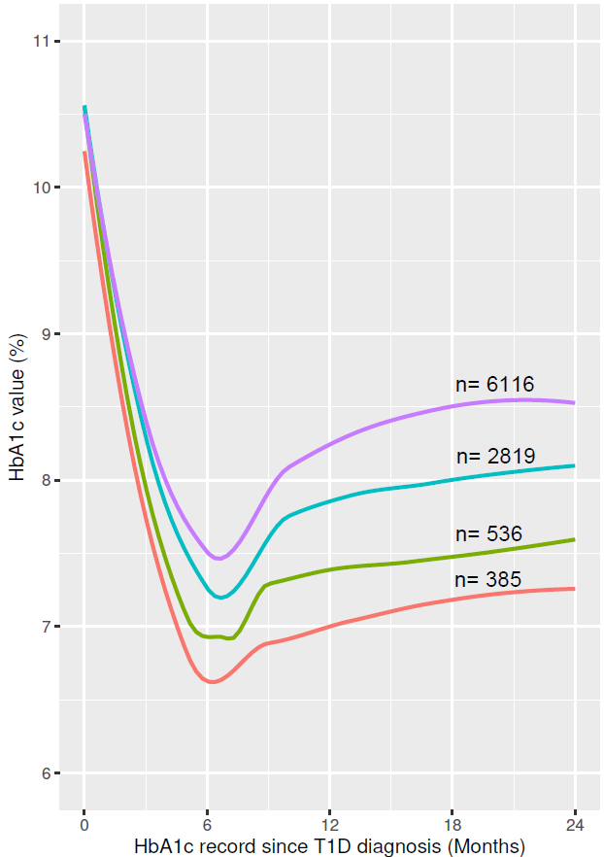



IMPROVAID: Multi-Center Project
Project Design
14 Centers and a total of 40 individuals participated in focus group discussions, including endocrinologists, educators, nurses, and other clinic staff
Transcripts were coded and analyzed for common themes
Participating centers used a 10-Step Equity Framework to test interventions to increase early AID adoption.
Key Findings
Mean HbA1c at 2 years is lowest among PwT1D who Initiated AID <6 months post diagnosis
More evidence is needed to help create standardized guidelines for recommending AID systems, which at present do not really exist among centers.
.
1 oral presentation, 2 posters

Slide 13
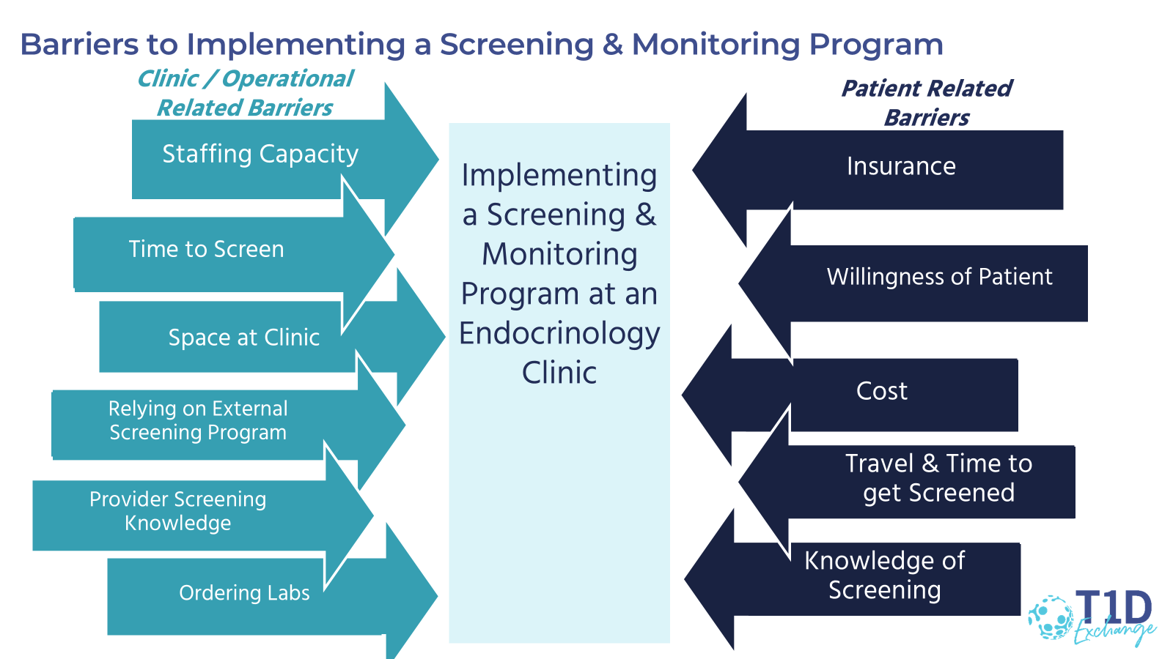
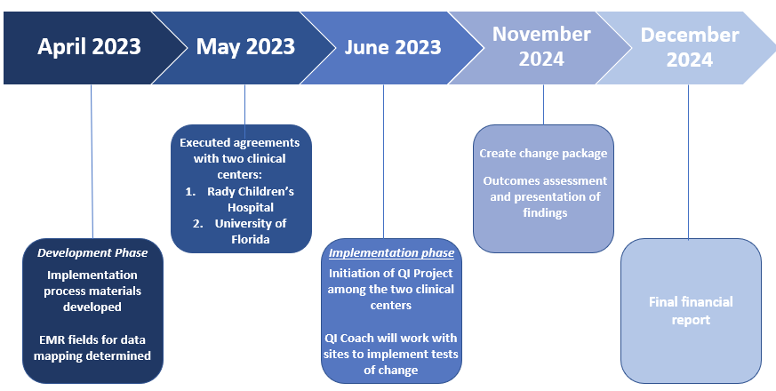


T1D Screening and Monitoring Project
Study Objectives
Develop and test diabetes centers workflows for T1D autoantibody screening and monitoring in the real-world setting.
Identify care team perceptions of operational challenges to the screening and monitoring process.
Preliminary Results
147 individuals screened from two centers
13 individuals screened positive with confirmed results for multiple autoantibodies
8.8% positivity rate of confirmed positive results

Slide 14
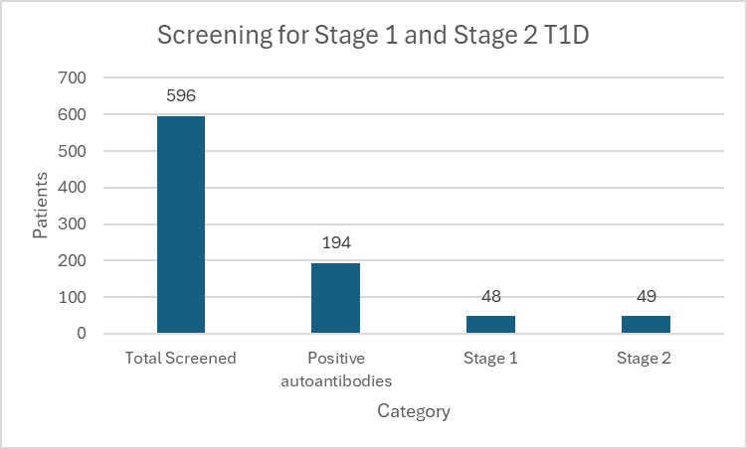
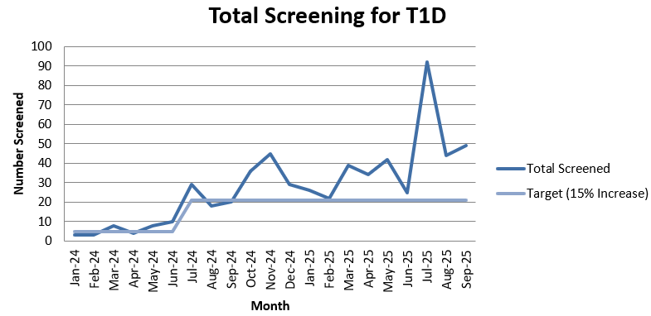


Operationalize Screening for Stage 1 & 2 T1D in Clinics
Project Aim
Increase by at least 15% (from baseline) the proportion of people screened for T1D in 18 months. (June 2024- December 2025)
Increase by at least 30% (from baseline) the proportion of eligible people monitored for progression to stage 3 T1D over 18 months. (June 2024-December 2025)
Preliminary Results
15% increase in number of patients screened from baseline.

Slide 15


Best Practice Advisory (BPA-TECH) Project
Project Aim(s)
1: To develop and implement an EHR-based BPA using stakeholder feedback to standardize the approach for prescribing and documenting advanced diabetes technologies among adult and pediatric PwT1D.
2: To determine the effectiveness of an EMR-based BPA in reducing racial inequities in ADT.
3: To explore the reasons identified for why providers decide to not prescribe ADT and whether decisions were PwT1D or provider-led, and the association between the reason provided and the PwT1D’s race/ethnicity.
Key Accomplishments
Completed focus groups and surveys with key stakeholders.
Completed analysis on results from qualitative findings.
Developed BPA based off of Stakeholder feedback. Each participating center’s BPA has gone live.

Slide 16

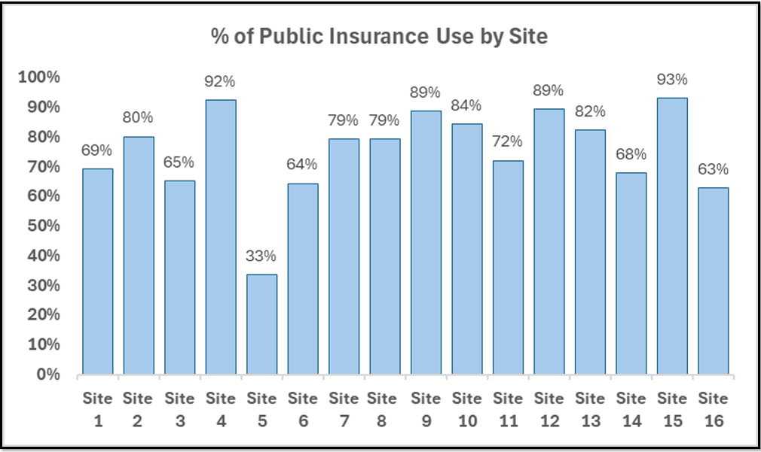
Pediatric T2D Initiative (WG)
5 Posters presented: Key Findings
There is significant variation in demographics and key clinical characteristics across participating centers
GLP-1RA and SGLT2 medications in youth with T2D, uptake remains inconsistent and suboptimal at centers across
The baseline statin therapy average was at 25% for youth with LDL levels >130 mg/dl
Low CGM use among adolescents and youth with T2D
Project Aim
Demonstrate improved patient outcomes in pediatrics type 2 diabetes using QI methodology
Use benchmarking data to illustrate that a collaborative approach for pediatric T2D is feasible
Project Design
25 pediatric centers sharing benchmarking data

Slide 17
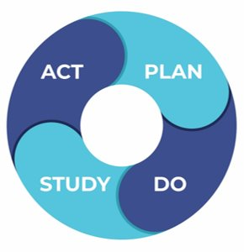
4. Design and Test QI Initiatives to Improve Outcomes: QI
T1DX-QI and participating centers use the IHI Model for Improvement
To understand local clinic processes, identify contributing factors, brainstorm and test possible interventions
Centers rapidly test and scale interventions using Plan-Do-Study-Act Cycles to improve outcomes

Slide 18
Active QI Projects
Transition planning – 10+ Centers
Increasing Continuous glucose monitoring – 30+
Increasing social determinants of health screening- 10+
Increasing AID use- 30+
Improving HbA1c- 40+
Increasing Depression screening rate- 10+
Diabetes distress screening-10+
Psychosocial support/Disordered eating screening- 10+
DKA Education- 10+

Slide 19
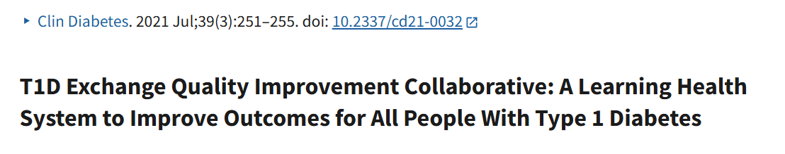
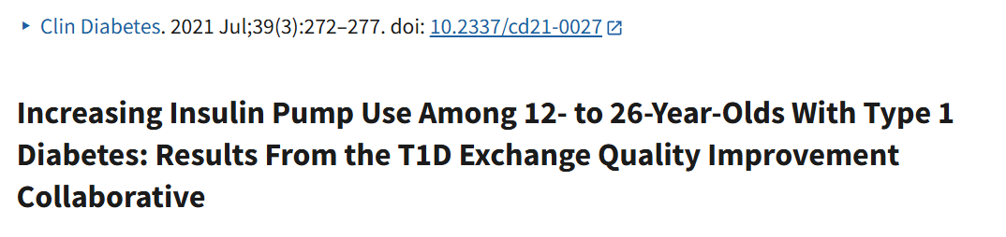
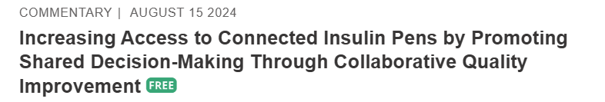
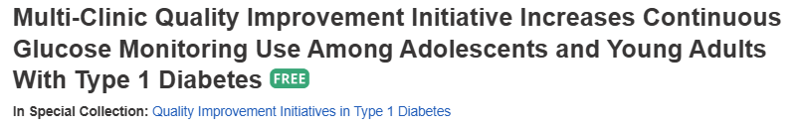
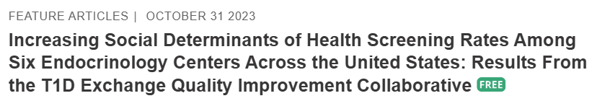
T1DX-QI Use QI Methodology to Improve Outcomes

Slide 20
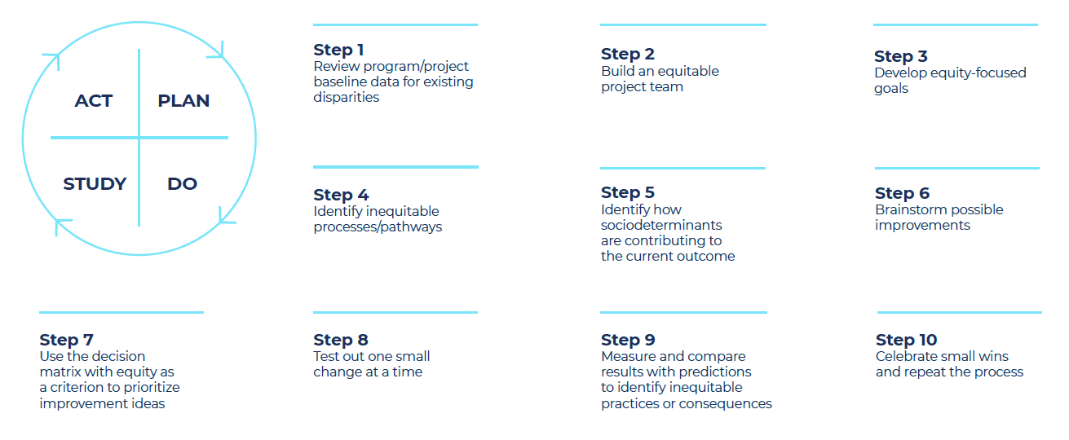
T1DX-QI Equity Framework:

Slide 21
Examples of T1DX-QI Equity QI Projects
Practice Type | Intervention Period (months) | Intervention Examples | Outcome
Pediatric | 24 | Implementation of electronic health record (EHR) flowsheets Prescription workflow changes Patient-facing CGM education Barrier assessment. | 22% Increase in CGM for nonwhite patients. 10% increase in overall center CGM Use.
Pediatric | 24 | Outreach to LTFU | Decrease LTFU among nonwhite by 30% Decrease LTFU by 25% Increase CGM use by 9% among LTFU
Pediatric | 24 | Updated diabetes intake form to inquire about families' interest in insulin pumps Implemented a streamlined pre-pump checklist workflow | Increase in CGM usage among publicly insured children by 32%.
Adult | 24 | Monthly CGM Online Classes Technology Navigator Educational materials. Insurance Reference Table | CGM Use Increased by 20% Among Hispanic PwT2D & by 15% Among NHB The Gap between NHW & Hispanic closed by 6%
Adult | 24 | Diabetes technology navigator Barrier Assessments | Increase CGM use by 7%

Slide 22






QI Change Package

Slide 23
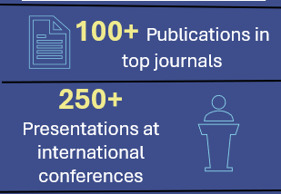
5. Use of Real-World Data To Generate Real-World Insights
Electronic medical record data mapping is completed for 50+ centers
EMR data for 150,000+ patients is available to generate real world data insight
For data request
https://t1d.iad1.qualtrics.com/jfe/form/SV_ba4t5jpizGFneDA

Slide 24
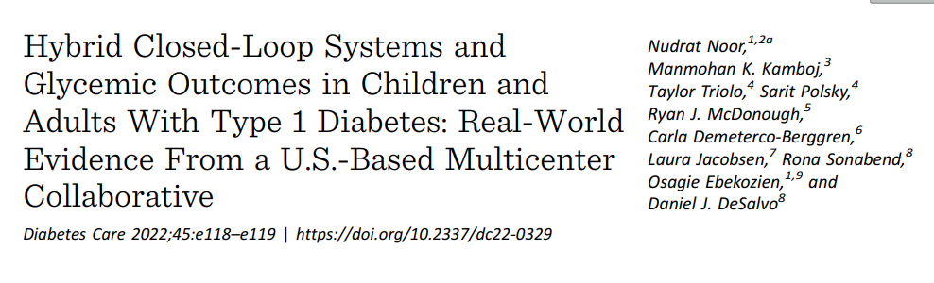
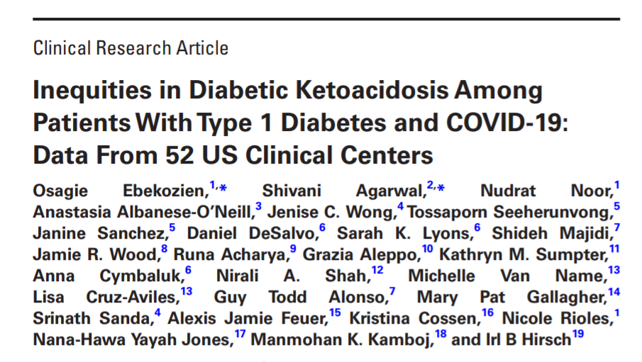
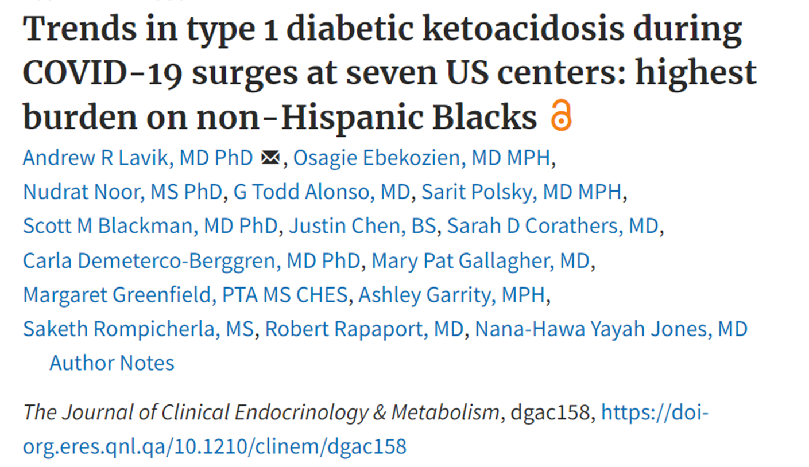
Real World T1DX-QI Health Equity Real World Insight

Slide 25
Conclusion
T1DX-QI is positioned to drive measurable, and sustainable improvement in diabetes outcomes
Sustained collaboration, data sharing, peer learning, evidence-based QI methods, improving care processes together, listening to our populations and understanding their needs.

