Slide 1

Section Header Here Subtitle Here
Workgroup Report Outs
Presented by Co-Chairs
11:10 – 11:55am

Slide 2
Section Header Here Subtitle Here
Hybrid Closed Loop Work Group
Co-Chairs: Dr. Carol Levy and Emily Coppedge

Slide 3

Member Snapshot
Co-Chairs
Carol Levy, MD, Mt. Sinai
Emily Coppedge, CPNP, CDCES, Cornell
T1DX Support Staff
Trevon Wright
30+ working group members 15+ centers represented
Key Topics Discussed
Education and training for pump use and AID systems
DIY systems and community innovation
Carb counting and hybrid closed loop applications
Managing severe insulin resistance, sick days, and ketones
Special populations: young children, elderly, and people who learn differently
Off-label use of adjunctive therapies with HCL
Hybrid Closed Loop Working Group
2025
Focus and Objectives
Rebranding to emphasize practical discussions on hybrid closed loop (HCL) systems, including use in pregnancy and diverse populations
Encourage knowledge sharing and collaboration to inform quality improvement (QI) projects across centers
Support providers with evidence-based insights and real-world experiences using HCL systems
Next steps for 2026
Develop a curriculum for pump training and post-training education
Publish expert opinion papers summarizing practical experiences with HCL systems
Continue presentations and cross-center learning in upcoming meetings
Clinical Interest Areas
Addressing disparities in ADT use.
New ideas for future papers

Slide 4
Section Header Here Subtitle Here
Diabetes Distress Work Group
Co-Chairs: Drs. Alissa Roberts and Devin Steenkamp

Slide 5
What screening practices have been established in the group?
PAID-T screener is being used across the participating pediatric centers
T1DDAS being used across adult centers
(8 item scale)
(28 item scale)
Additional screeners: PAID-PR, PAID-C, P-PAID-C, P-PAID-T, DDS for T2DM
Member Snapshot
Co-Chairs
Alissa Roberts, MD, Seattle Children’s
Devin Steenkamp, MBChB, Boston Medical Center, Adult Endocrinology
21+ committee members 18+ centers represented
T1DX Support Staff
Nicole Rioles
Emma Ospelt
Diabetes Distress Committee
2025
Goals for 2026
Incorporate screeners into monthly data mapping reports
Add DDS into benchmarking measures
Sustainability: multi-center funding proposal submission
2025 Accomplishments
Two DD abstracts published
Commentary submitted to Endocrine Practice
Ten centers have screeners incorporated into EMR
Thirteen screeners being used annually (or for subset of pop.)
New screening workflows, referrals, and training in conversational tools including open-ended questions, active listening, clinical engagement, follow up.
Barriers identified
Limited clinic time
Inadequate resources
Insufficient training

Slide 6
Section Header Here Subtitle Here
Health Care Transitions Work Group
Co-Chairs: Drs. Sarah Corathers and Jennifer Iyengar

Slide 7
Member Snapshot
Committee Co-Chairs
Sarah Corathers, MD, Cincinnati Children’s Hospital
Jennifer Iyengar, MD, University of Michigan Adult
T1DX-QI Support Staff
Timothy Bol
70+ committee members 40+ centers represented
What specific transitions in healthcare work is being done by T1DX-QI?
Engaging in shared learning across pediatric and adult centers to improve transition processes
Pediatric centers are focusing on ensuring documentation of a transition plan
Adult centers are focusing on patient tracking and improving retention rates after care transfer
Health Care Transitions Work Group
2025
Clinical Interest Areas
Transition readiness
Future publications
Medical Devices
Technology
Pregnancy
2025 Accomplishments
READDY 2.0 paper published
READDY 2.0 survey tool released
Welcomed a new Adult co-chair
Finalization of adult and pediatric transition measures
Engaging center presentations
Six Core Elements of health care transition for adults and pediatrics
Goals for 2026
Initiate new Transition Measure
Utilize new measures to improve transitions for all young adults
Initiate a retention-related metric
Best practice sharing among centers
Review transition results from the annual T1DX-QI Center Survey

Slide 8
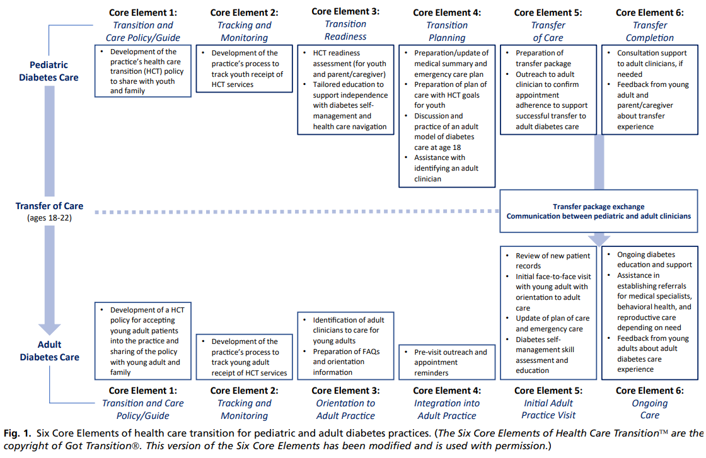

Slide 9
Section Header Here Subtitle Here
Pediatric T2D Work Group
Co-Chairs: Drs. Monica Bianco and Tamara Hannon

Slide 10
Member Snapshot
Co-Chairs
Mónica Bianco, MD, Lurie Children’s Hospital
Tamara Hannon, MD, Riley Children’s Hospital
T1DX Support Staff
Timothy Bol
45+ committee members
15+ centers represented
What specific Pediatric T2D work is being done by T1DX-QI?
Established a T2D Pediatric Registry
Baseline statin use was determined using this registry
Benchmarking non-insulin medications and HbA1c outcomes
Clinical Interest Areas
Non-insulin medications
PES Survey Development
Improve HA1c targets in Pediatric patients with T2D
Improve cholesterol screening, diagnosis, and treatment
Patient Education
Pediatric T2D Committee
2025
2025 Accomplishments
4 Papers
17 Conference Oral Presentations/Abstracts
Growing member enrollment
Pediatric Endocrine Society (PES) Survey development
T2D Representation on T1D Collab Call
Increased prescribing of GLP-1s and SGLT-2s
Goals for 2026
Continue growing membership
Data map additional centers
Publish more journal articles
Publish abstracts for conferences
Datamap additional T2D centers
Improve A1c values for young adults

