Slide 1






Type 1 Diabetes Education and Support (T1DES): A Behavioral Intervention to Improve Diabetes Distress among Black Young Adults at an Integrated Network and Public Hospital
Teaniese L. Davis, PhD, MPH
Center for Research and Evaluation
Kaiser Permanente Georgia, Atlanta, Georgia
T1D Exchange, November 2025
Notes:
Authors:
Keiva Cheney, Atlanta, GA
Antoinette Watkins, Atlanta, GA
Jasmine Barrow, Storrs, CT
Whitney Rice, Emory University, Atlanta, GA
Ilana Graetz, Emory University, Atlanta, GA
Laura Gonzalez Paz, Kaiser Permanente Georgia, Atlanta, GA
Courtney McCracken, Kaiser Permanente Georgia, Atlanta, GA
Teaniese L. Davis, Kaiser Permanente Georgia, Atlanta, GA
Teaniese Davis, Kaiser Permanente Georgia Center for Research and Evaluation, Atlanta, Georgia
Courtney McCracken, Kaiser Permanente Georgia Center for Research and Evaluation, Atlanta, Georgia
Larry Fisher, Behavioral Diabetes Institute, San Francisco, California
Ilana Graetz, Emory University Rollins School of Public Health, Atlanta, Georgia
Joshua Barzilay, Kaiser Permanente Georgia Center for Research and Evaluation, The Southeast Permanente Medical Group, Atlanta, Georgia
Marsha Wright, Kaiser Permanente Georgia Center for Research and Evaluation, Atlanta, Georgia
Priyathama Vellanki, Emory School of Medicine, Atlanta, Georgia
Sonya Haw, Emory School of Medicine, Atlanta, Georgia
Laura Gonzalaz Paz, Kaiser Permanente Georgia Center for Research and Evaluation, Atlanta, Georgia
Rachel Wolf, Emory School of Medicine, Atlanta, Georgia
Swathi Sekar, Emory University Rollins School of Public Health, Atlanta, Georgia
Mackenzie Crawford, Kaiser Permanente Georgia Center for Research and Evaluation, Atlanta, Georgia

Slide 2
Funding Acknowledgements
NIDDK/NIH Funding: 5R01DK128236
Helmsley Charitable Trust Funding: 2310-06383
Kaiser Permanente Georgia Community Health Pilot Funding
Notes:
I have no disclosures and you’re welcome to take pictures.

Slide 3

Agenda
Background
Methods
Results
Discussion

Slide 4
Background
Background
Methods
Results
Discussion
Diabetes Self-Management Support
Racial Disparities in Disease Burden and Intervention Research
Diabetes Distress
Notes:
Diabetes self-management support
Providers have described diabetes education, the primary source for patient education and support, as too generic and lacking sensitivity to the needs of ethnically minority communities, namely Black African and Caribbean communities.²⁰ Culturally tailored interventions improve health outcomes for ethnic minorities with diabetes and other chronic conditions;²¹⁻²⁵ these interventions are emic in structure and emphasize unique practices common to a specific culture and especially necessary when existing interventions are Eurocentric in nature²⁶ or developed with Eurocentric groups. Using the tested ADAPT-ITT framework,²⁷⁻³⁰ our study would be the first to systematically adapt and evidence-based intervention to be culturally competent and tailored for Black young adults with T1D.
In a recent position statement, the American Diabetes Association (ADA) recommended that all people with diabetes should participate in education and support for diabetes self-management, which should include knowledge and skills-building. Continued education and support are also essential for implementing skills and behavior maintenance over time
Racial disparities in disease burden
Recent research has demonstrated the racial and ethnic-based disparities among young adults with T1D. After accounting for socio-economic status (SES), diabetes distress, diabetes self-management, and diabetes technology use were the largest contributors to the disparity in glycemic control between Black and White young adults (YA) with T1D, with Black YA having poor glycemic control
Tools for working through Diabetes distress
. Diabetes distress is the negative emotional effect of living with diabetes.³¹ Diabetes management requires consistent monitoring, complex navigation of social situations to remain adherent to self-management, and high engagement with health care providers, including the recommended blood draw to monitor HbA_{1c} levels every three months. Diabetes distress addresses the additional stressors and emotional impact a person with diabetes experiences that is specific to diabetes.
Diabetes distress has also been identified as one of the largest contributors to racial disparities between Black and White young adults ages 18-25 years with type 1 diabetes.⁸ Our study will address diabetes distress among Black young adults by tailoring an intervention relevant to their experiences managing T1D.

Slide 5
Study Aims
Background
Methods
Results
Discussion
Feasibility of T1DES by measuring acceptability, demand, practicality, and implementation fidelity
Effect of T1DES on diabetes outcomes by comparing changes in A1c, diabetes distress, diabetes management
Notes:
Study Aims
Our team will refine the OnTrack intervention for Black adults with T1D using the ADAPT-ITT model, which will become the Type 1 Diabetes Education and Support (T1DES) intervention. Our specific aims are to:
Aim 1: Assess feasibility of the culturally tailored intervention T1DES by measuring intervention acceptability, demand (retention, completed > 80% of sessions), practicality, and implementation fidelity through participant surveys and key informant interviews with participants and the health care delivery team.
Aim 2: Evaluate the effect of the T1DES intervention on diabetes outcomes in a pilot randomized clinical trial among N=40 Black young adults age 18-26 years with T1D and elevated HbA_{1c} (>7.5%) by comparing changes in HbA_{1c}, diabetes distress, and self-management from baseline to 6-months post-baseline among participants randomized to T1DES compared to the diabetes education-only control condition. We hypothesize T1DES participants will demonstrate improved HbA_{1c}, reduced diabetes distress, and increased self-management over time compared to controls. Results will be used to generate effect sizes and support an application for larger, fully powered, longer term trial to evaluate the impact of T1DES on health outcomes and disparities. More research is critically needed on effective strategies that are both inclusive of Black young adults and tailored to their unique challenges.²² Our goal is to provide diabetes education and emotion regulation support tailored for Black young adults’ experiences that will result in sustained glycemic control and can be incorporated into adult endocrinology practices.

Slide 6
Methods

Slide 7

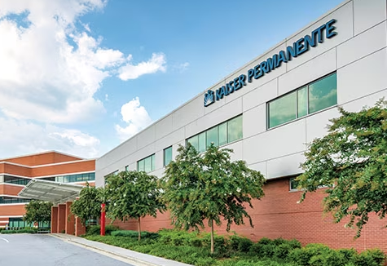

Sample & Setting
Background
Methods
Results
Discussion
Inclusion Criteria (N=84)
Diagnosed T1D
Black (self-reported)
Aged 18-30 years
HbA1c > 7.5%
Notes:
Recruitment:
EMR data pull for patients who meet eligibility criteria
Patients without an A1c in the EMR were invited to come and could attend the baseline session and complete a point-of-care A1c to determine eligibility
Email, Call, Text, Provider referral
KP Provider referral: used EMR to get a list of eligible members with appointment in the following 3 weeks. Our team scheduled an email to go to providers the day of the appointment, it gave 3 bullets that could serve as a brief script for the provider during the in-person or virtual visit. Then it had a QR code the provider could show the member for them to reach our study team (linked them to an online interest form that just asked for name number and preferred communication mode that came into our REDCap
Text recruitment took a while to get IRB on board but it was very successful. They allowed us to text after sending an initial email

Slide 8
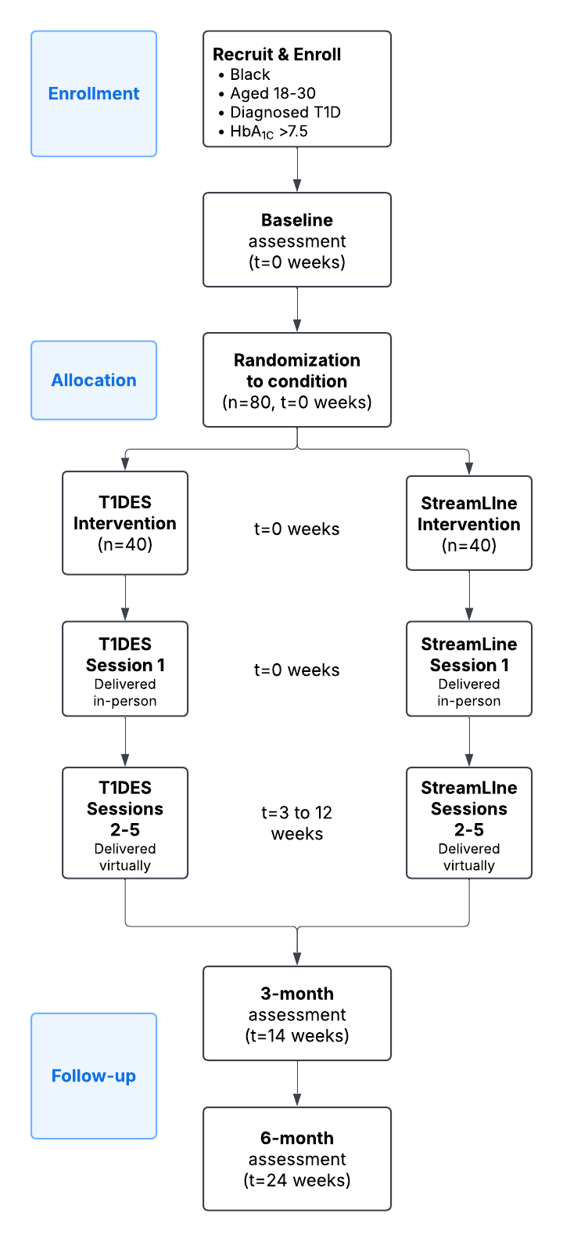
Study Design
Background
Methods
Results
Discussion
Notes:
Assess feasibility of T1DES (Aim 1)
Evaluate efficacy of TIDES in RCT with N=80 Black young adults with T1D (Aim 2)
Enrollment goal was 80 across both sites. We completed enrollment at the end of summer. Enrolled 84.
The full study participation is 6 months:
Baseline
3 months of sessions (intervention and comparison group)
3-month follow up
6-month follow up (completed monthly retention contact between 3 and 6 month visits to ensure we kept the line warm and confirmed contact information
Upon study completion, we invited interested participants to join our advisory board (we placed a check box on the consent form asking if they’d like to be contacted for future research – so we have successfully used that to continue to nofity people directly about upcoming opportunities for other studies or advisory board participation)

Slide 9
Diabetes Distress
5-Steps
Background
Methods
Results
Discussion
Recognize
Recognize Diabetes Distress
Tell
Tell your Diabetes Distress Story
Stand
Stand next to your story
Develop
Develop a more compassionate and helpful response
Explore
Explore other choices
Notes:
SAY: The Summary & Review
The 5-Step T1DES Program:
Recognize the presence of DD (run, hide, flight), and the event or circumstance that triggered it.
Tell your diabetes distress story: I feel…, I think…, I believe…
Stand next to your story; I see that you …, I hear that you feel …, I hear that you think …, I understand that you believe…
Develop a more accurate and compassionate explanation of the facts: Is it true that…? How accurate is it that…? If not, what is?
Explore other choices – you are the boss - although the feelings may remain

Slide 10
Kiera’s Narrative from T1DES
Background
Methods
Results
Discussion
She has been working hard on her diabetes management.
Her A1c has dropped from 9.5% to 8.2%.
She says, “I am lazy, I guess.”
Doctor says, “You need to try harder.”
She is so discouraged. She gets an ice cream cone after the doctor visit.
Kiera’s doctor says, “Your A1c is still too high, you really need to exercise more. Why haven’t you been exercising?”
She feels defeated and discouraged. Her efforts did not seem to really matter. She feels like she is failing at managing diabetes.
Notes:
T1DES uses Kiera’s narrative to work through the steps for T1DES. The advisory board adapted the previous narrative to resonate with their experiences. These represent experiences they’ve had.
Has been working hard on his diabetes management.
Her A1c has dropped from 9.5% to 8.2%.
Her doctor says, “Your A1c is still too high, you really need to exercise more. Why haven’t you been exercising?”
Kiera says, “I am lazy, I guess.”
Doctor says, “You need to try harder.”
Kiera feels defeated and discouraged, her efforts did not seem to really matter and he feels like she is failing at managing diabetes.
Kiera is so discouraged, she gets an ice cream cone after the doctor visit.

Slide 11

Kiera stands next to her story
Background
Methods
Results
Discussion
Her story is scary.
She still sees that she thinks that her story is real but is willing to consider the possibility that it is not real.
She struggles between what is real (facts) vs what she feels is real (story).
She tries to fight, flight, freeze it, but it does not go away.
She remains upset and distressed.
It affects her diabetes management.
Her story “puts herself down”
She cannot switch off her feelings.
She realizes she has to stop fighting the story. It is exhausting.
Once Kiera accepts that it is only a story,
it will be less distressing.
But it remains hard to see it only as a story.
Notes:
Step 3 of T1DES 5-step program is “standing next to your story”. This is an example of how Kiera does that.

Slide 12
Retention AASAP Protocol
Background
Methods
Results
Discussion
Participant Concern | Examples: | Potential Response following AASAP Protocol
Childcare | My kids are home from school that day. | I see how that could be an issue. Is there a family member who might be willing to take care of them that day?
Work | I have to work that day. | I realize work is very important, but is there any flexibility to move your shift around?
Time/length of session | Its too long. I cannot stay till the end. | We make the sessions really engaging and they only last around an hour.
Family event or emergency | I had a death in the family and will not be able to attend. | I’m so sorry to hear this, we can work with your schedule and find an alternate time that works for you.
Transportation | My car broke down. | It can be very challenging to get around without reliable transportation. Are there any other forms of transportation you could use to get here?
Illness | I got sick with COVID. | I’m so sorry to hear this. we can work with your schedule and find an alternate time that works for you.
Notes:
This is a five (5) steps of AASAP for recruiting and retaining harder-to-reach populations:
anticipate,
acknowledge,
standardize,
accept, and
plan
AASAP uses motivational interviewing during recruitment and retention calls with participants.
Staff are trained to reflect on what the participants’ concerns are regarding their attendance at upcoming appointments and guide participants to consider alternatives.
For example, if a participant cannot attend due to childcare or work, staff acknowledge the issue and ask if there can be alternate accommodations made to allow the member to attend.
Using the AASAP method and continuously monitoring our recruitment and retention messages with the staff and advisory board, we have been able to maintain retention rates above 85% for intervention sessions and follow-up study appointments.

Slide 13
Measures
Background
Methods
Results
Discussion
 | Measure | Description | Timing | Data Collection Method
Feasibility (Aim 1 ) | Acceptability | Patient satisfaction with T1DES | Baseline, 3m, 6m | Survey and exit interviews
 | Demand | Recruitment and retention rates | Baseline – 6m | Recruitment & retention database
 | Practicality | Participants’ facilitators and barriers to participation | Baseline – 6m | Exit interviews
 | Implementation Fidelity | 1) Facilitator feedback on session implementation 2) Observer checklist of activities to measure adherence & exposure; session length | Sessions 1-5 | Facilitator self-evaluation Observer checklist
Effectiveness (Aim 2) | Diabetes Distress | Level of self-reported diabetes distress: powerlessness, management distress, hypoglycemia distress, negative social perceptions, eating distress, physician distress, and family/friend distress | Baseline, 3m, 6m | Type 1 Diabetes Distress Scale (T1-DDS)
 | Glycemic control | Average blood sugar level over the past 3-months | Baseline, 3m, 6m | Point-of-care A1c
 | Diabetes self-management | Diabetes self-care behaviors from past 8 weeks: dietary control, medication adherence, BG monitoring, Physical activity, physician | Baseline, 3m, 6m | Diabetes Self-Management Questionnaire (DSMQ)
Notes:
Our evaluation is guided by the REAIM Framework.
Aim 1 feasibility will include information from participants, session facilitators, and independent observers (we call them raters) that completed a checklist of intervention activities to understand participant satisfaction, practicality, and implementation fidelity

Slide 14
Preliminary Results

Slide 15
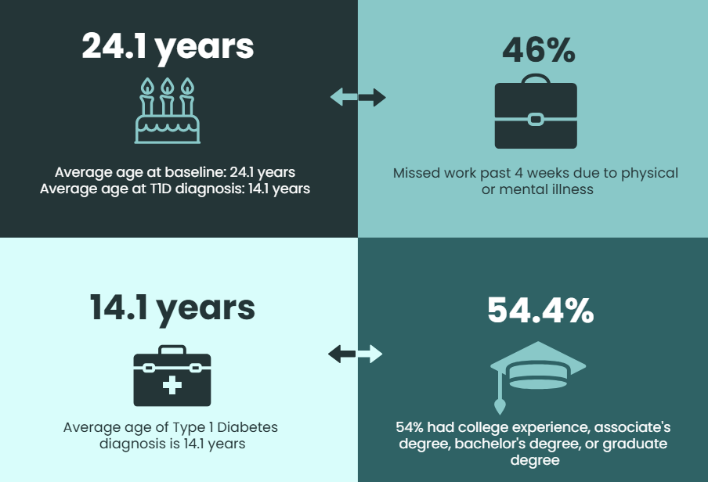
Results: T1DES Sample (N=84)
Background
Methods
Results
Discussion
Notes:
Age (baseline): average age at baseline was 24.1 years; age ranged from 18 to 30 years
Age average age at diagnosis was 14.1 years: ranged from 2-27 years
Race: as part of the study screening to confirm eligibility, we asked participants how they self-identify their race. 100% identify as Black, of whom 17.9% are multi-racial
Our sample is 62% identify as female
education: 54% of our sample had some college, associates degree, bachelor’s degree, or graduate degree. 46% reported having some high school education or having completed high school

Slide 16
Feasibility of T1DES (Aim 1)
Background
Methods
Results
Discussion
Notes:
We wanted to share some of our satisfaction scores participants complete after the first session that’s in-person and about 4 hours long.
Participants in both study conditions enjoyed their sessions.
T1DES is diabetes distress. T1DES tended to run right at 4-4.5 hours.
Streamline is diabetes education and decision-making. StreamLine tended to run a little shorter than T1DES (maybe 30-45 minutes shorter depending on group size)
This bar graph highlights both groups felt the sessions were excellent overall and some slight differences in enjoyment.
However, when you look at people who responded the session was “good” or “excellent”, overwhelmingly participants all enjoyed their sessions.

Slide 17
Participant Satisfaction
Background
Methods
Results
Discussion
“I would say that I do agree talking to other diabetics, even if we’re just chatting for an hour once a month or something, it’s a nice reminder that you’re not the only person going through this, you’re not the only person in your age going through this. There’s other people, other 20-something year old young Black women, very, very… I felt represented, like I felt like I am not the only… a lot of times if I walk into a room even if it’s a room full of diabetics most of the people are either going to be like guys, or not Black, I am going to be different in some way. So being in a room of Black women that are also diabetic, that’s 3 different specific demographic things that I don’t get often so it’s nice to relate on that level.”
~ T1DES Intervention Participant
Notes:
We conduct exit focus groups or interviews for all participants upon completion of the 6-month appointment.
A participant in the T1DES group stated:
“T1DES really did do that. Because, she, even though we was slacking off some stuff, she[the facilitator] made us feel that ONE thing that you did was the world. And then we had to focus on the next step” - T1DES Condition Participant
“I would say that I do agree talking to other diabetics, even if we’re just chatting for an hour once a month or something, it’s a nice reminder that you’re not the only person going through this, you’re not the only person in your age going through this. There’s other people, other 20-something year old young Black women, very, very… I felt represented, like I felt like I am not the only… a lot of times if I walk into a room even if it’s a room full of diabetics most of the people are either going to be like guys, or not Black, I am going to be different in some way. So being in a room of Black women that are also diabetic, that’s 3 different specific demographic things that I don’t get often so it’s nice to relate on that level.”
What they liked best:
Engagement and Sharing personal experiences with someone like you.
Having open conversation.
The presenter was dynamic and would listen.
Education/Learning
Something new they learned:
Learning about Diabetes Distress.
There is a community of people like you.
Being self-compassionate with oneselves.
Change mental state/ positive mindset.
T1DES- 5 step process.
Diabetes Education,
Management and Resources.
Additional quotes:
Everyone was well engaged and spoke about themselves. I was shocked by how easy it felt.
I enjoyed the freedom of discussion and validation on how I have been feeling
The acknowledgment of mental health, and how difficult diabetes truly is to manage.

Slide 18
Diabetes Outcomes (Aim 2)
Background
Methods
Results
Discussion
 | Total Sample n(%) | T1DES n(%) | StreamLine n(%)
HbA1c, M(SD) | 10.1 (2.2) | 9.9 (2.1) | 10.3 (2.3)
Diabetes Complications, M(SD), range 0-8 | 2.8 (2.3) | 3.2 (2.3) | 2.4 (2.3)
Diabetes Distress, M(SD) | 3.1 (1.0) | 3.1 (1.0) | 3.1 (1.0)
Diabetes Self-Management, M(SD) | 5.3 (1.7) | 5.2 (1.9) | 5.3 (1.6)
Use Continuous Glucose Monitor, Yes | 60 (71.4%) | 33.0 (76.8%) | 27.0 (65.9%)
Ration/not take insulin due to cost*
Never | 36 (42.9%) | 18 (41.9%) | 18 (43.9%)
At least 1/year | 24 (28.6%) | 11 (25.6%) | 13 (31.7%)
At least 1/month or 1/week or daily | 24.0 (28.6%) | 14.0 (32.6%) | 10.0 (24.4%)
Insulin cost concerns, 12m*
Skipped due to cost | 28 (33.3%) | 17 (39.5%) | 11 (26.8%)
Took less insulin than needed | 34 (40.5%) | 21 (48.8%) | 13 (31.7%)
Delayed buying due to save money | 39 (46.4%) | 24 (55.8%) | 15 (36.6%)
Missed medical appointments for:
Transportation | 20 (23.8%) | 11 (25.6%) | 9 (22.0%)
Work | 16 (19.1%) | 6 (14.0%) | 10 (24.4%)
Notes:
We just completed our final baseline in July and I’m sharing some information on the baseline measures. Aim 2 is evaluating diabetes-related outcomes for T1DES.
Point of care A1c: average for the full sample.
Diabetes Distress: 3.1. Scores >3 represent “high” distress distress. When you look at the subscales, we see high distress scores in:
Management distress (3.4): “feeling that I don’t give my diabetes as much attention as I probably should.”
Hypoglycemia distress (3.51): “feeling that I can’t ever be safe from the possibility of a serious hypoglycemic event.”
Powerlessness (3.3): “feeling that no matter how hard I try with my diabetes, it will never be good enough.”
Eating Distress (3.24): “feeling that thoughts about food and eating control my life.”
We also want to highlight some of the social needs reported.
This table highlights aspects of diabetes management impacted by cost.
42% reported that they have never rationed their insulin
However, when we ask about insulin cost concerns, we do see that young adult patients have either
skipped insulin doses,
taken less insulin than needed or
delayed buying their insulin due to cost concerns.
The NEXT slide will look at social needs in greater detail.

Slide 19


Social Needs by Condition
Background
Methods
Results
Discussion
Social needs |  | T1DES | StreamLine
Food | 44.2% |  |  | 34.2%
Housing | 20.9% |  |  | 24.4%
Utilities | 18.6% |  |  | 19.5%
Finances | 53.5% |  |  | 56.1%
Transportation | 41.9% |  |  | 36.6%
Loneliness or isolation | 27.9% |  |  | 17.1%
Personal safety | 4.7% |  |  | 2.4%
Childcare | 7.0% |  |  | 7.3%
None | 32.6% |  |  | 24.4%
Notes:
This figure shows people in T1DES in dark blue and people in StreamLine in light blue
For the full sample, the average # of social needs was 2.4 (T1DES 2.5 and StreamLine 2.3) needs.
Food, finances, and transportation were most reported across the board, followed by social isolation, housing, and utilities
~28% of the full sample reported not having any social needs.
Social Needs for the full baseline sample
Food 39.3%
Housing 22.6%
Utilities 19.1%
Finances 54.8%
Transportation 39.3%
Loneliness or isolation 22.6%
Personal safety 3.6%
Childcare 7.1%
None 28.6%
Other 3.6%

Slide 20
Discussion

Slide 21
Discussion
Background
Methods
Results
Discussion
Sustained Outcomes
Clinical Collaboration
Community Connection
Social Needs Support
Research Engagement
Notes:
Of we see that T1DES has an impact on diabetes distress and diabetes management, we hope to do a larger, multi-site trial of T1DES.
Sustained outcomes:
Long term, we need to think about how to integrate T1DES. Where does it live? How does it continue. And more importantly, what is the mechanism that can exist long-term to help sustain reduced diabetes distress, reduce feelings of social isolation.
Clinical Collaboration
Our hypothesis is that T1DES helps reduce some of the psychological barriers, provide emotion regulation tools which hopefully opens a door and allows patients to re-engage in their clinical care and diabetes management. We wrote T1DES thinking about it as a tool INSIDE endocrinology practices and diabetes centers. That’s how we embed T1DES.
Community Connection
However, I think sustained outcomes for people with type 1 diabetes come with thinking about how we help sustain avenues for connection. For discussion – not only about diabetes, but just about life..
Social Needs Support
Of critical importance for many people are addressing social needs with really are instrumental to survival. Unmet social needs will interrupt people’s ability to engage in health care practices and diabetes management practices as they would like to.
Research Engagement
Our team will continue to engage our growing advisory board in this work as we think about next steps for embedding T1DES and implementing at additional health systems.
We will continue to push for creative and effective ways to communicate with more patients and ensure we engage groups who have been traditionally underrepresented in research. It’s imperative we develop interventions and programs that have been tested with and are responsive to a representative sample of patients.
WE will continue to refine our strategies using the AASAP retention method
Employing and working closely with an advisory board strengthens intervention adaptation, study recruitment, study engagement, and improves perceived appropriateness and satisfaction of the intervention content. CAB members must be compensated for their time and need clear, concise meeting agendas and goals ahead of each meeting.

Slide 22

Thank You
Teaniese “Tina” Davis, PhD, MPH
Senior Investigator
Center for Research and Evaluation
Kaiser Permanente Georgia
Teaniese.L.Davis@kp.org

