Slide 1


The Convergence Era in Diabetes: Therapies and Technologies Redefining T1D and T2D
Francisco J. Pasquel, MD, MPH
Associate Professor
Emory University School of Medicine
Rollins School of Public Health
Notes:
Change design to be more specific to diabetes technology?

Slide 2
Conflicts of Interest (last 3 years) and Research Support
External Industry Relationships * | Company Name(s) / Institution | Role (compensation)
Equity, stock, or options in biomedical industry companies or publishers | JAMA Network Open (active) Diabetes Care (active) | Associate Editor (salary support)
Industry Advisory/Consultant activities | Dexcom (2023 –completed) | Consultant (personal fees)
 | Insulet (2024 - completed) | Consultant (fees to Emory)
Industry Funds for Research | Insulet* (active) Dexcom* (active) Ideal Medical Technologies Novo Nordisk (active) Tandem Diabetes Care (active) | PI or site PI (funds to Emory) *support with devices for my research
Federal Funds for Research | NIDDK P30DK111024 (active) NIDDK R01DK138366 (active) | PI or Core Co-Director (funds to Emory)

Slide 3


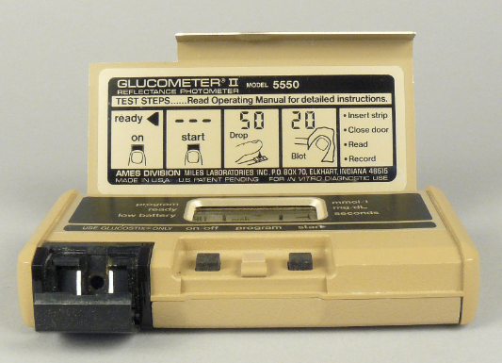
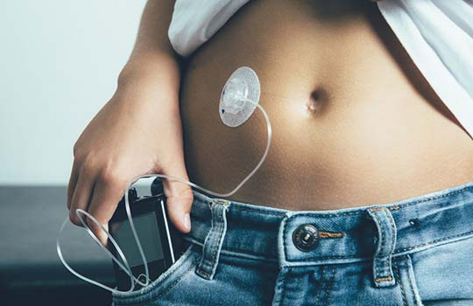
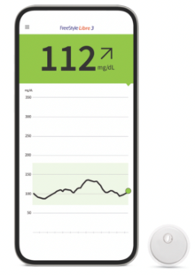
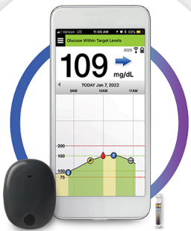
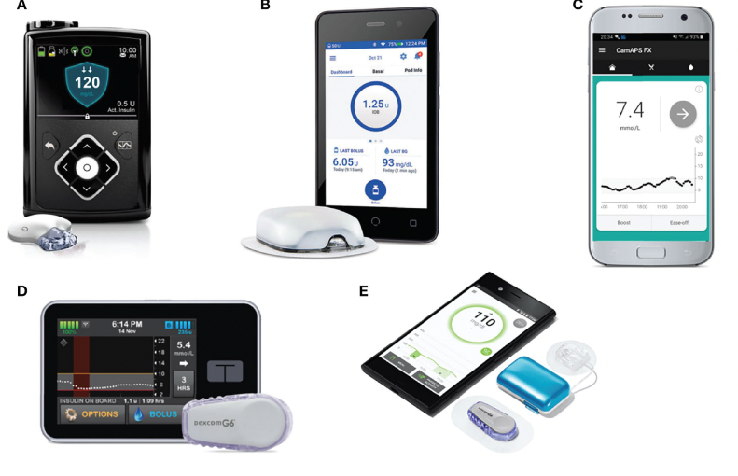
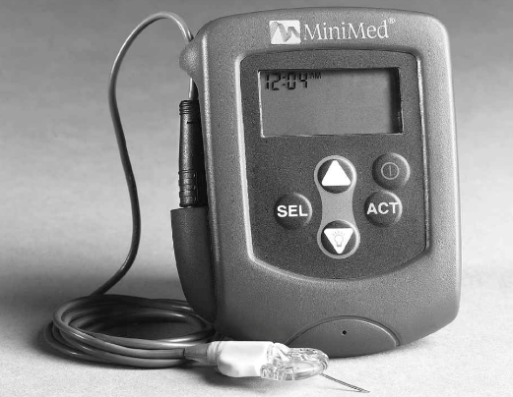

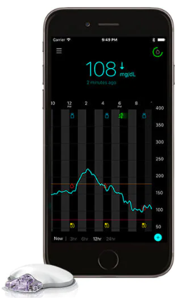
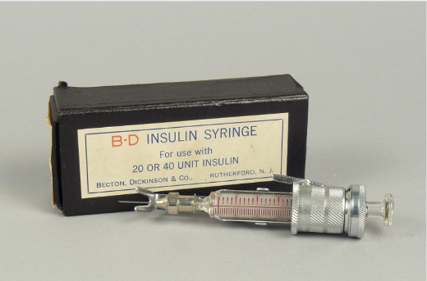
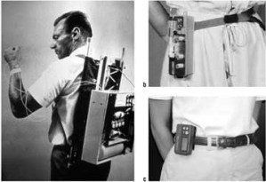
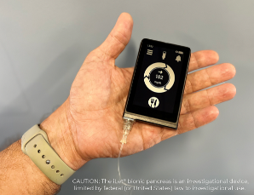
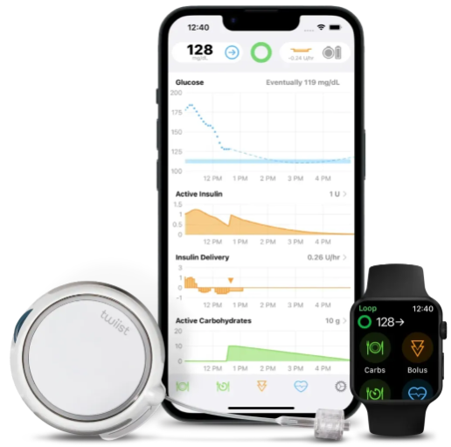
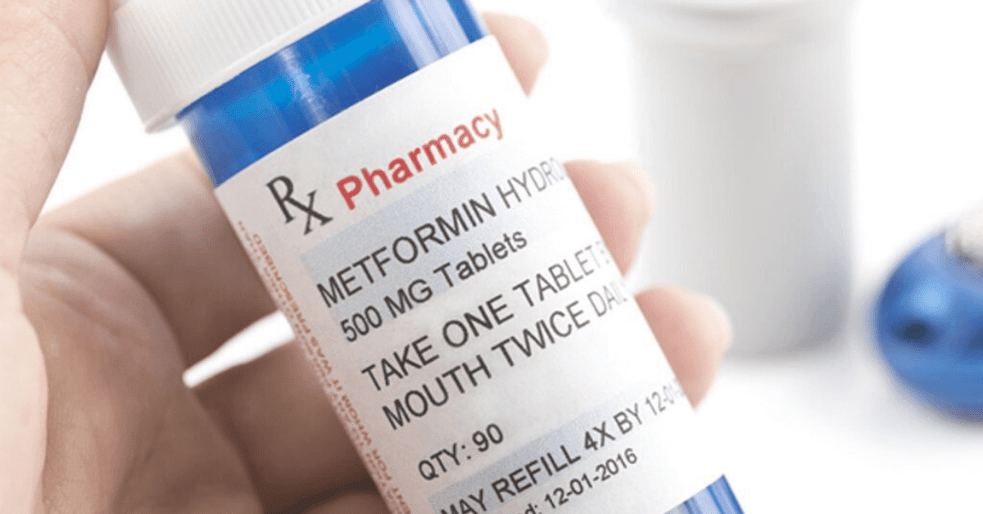
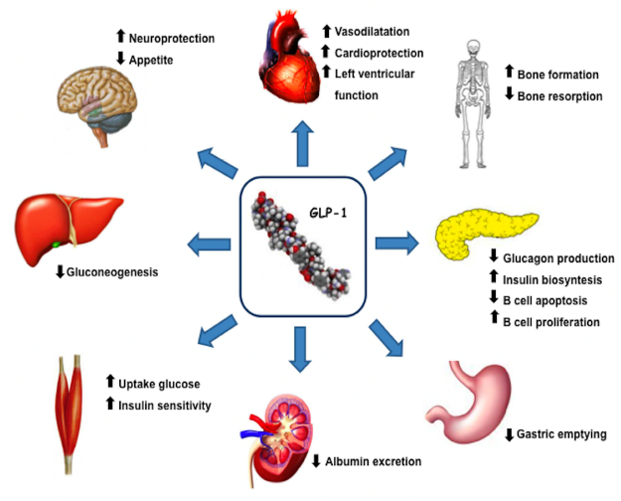
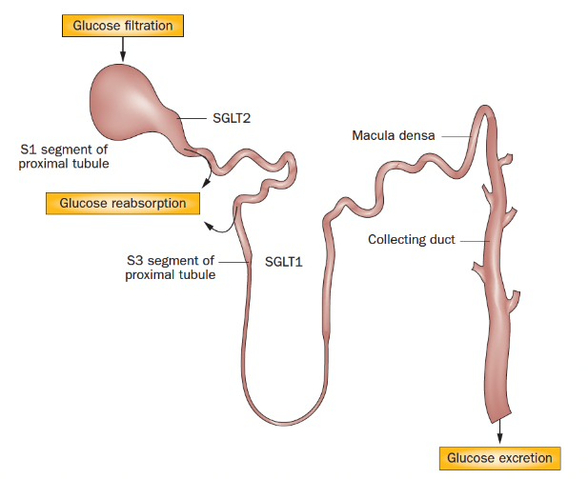
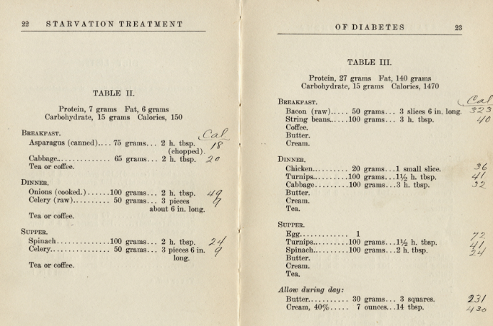
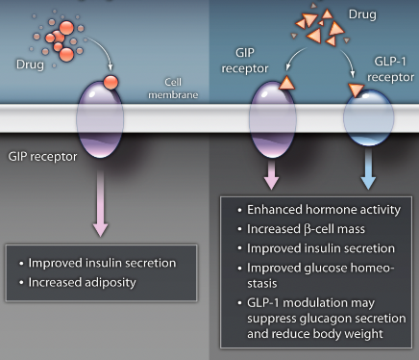
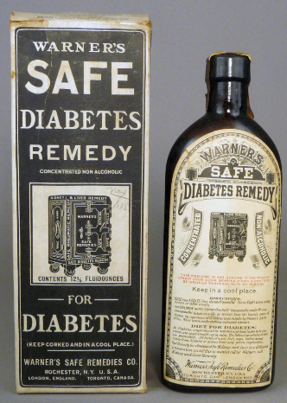
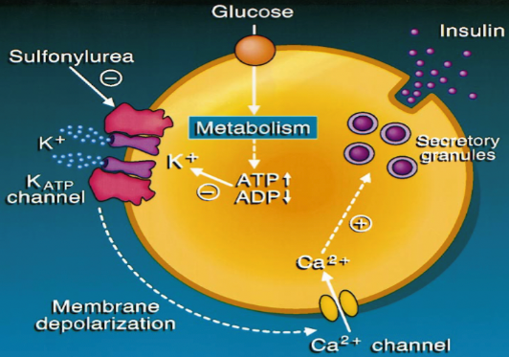
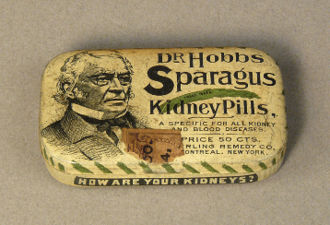

c
This Photo by Unknown Author is licensed under CC BY
Image:www.freestyleprovider. abbott/us-en/home.html/ 30 Oct 2022.
Image:www.ascensiadiabetes.com/eversense/ 30 Oct 2022.
c
c
This Photo by Unknown Author is licensed under CC BY-SA
Templer S. Front Endocrinol (Lausanne). 2022.
This Photo by Unknown Author is licensed under CC BY-NC-ND
Image: www.dexcom.com/en-us/compare-g6-and-g7/7 Jun 2023
Image: https://www.medtronicdiabetes.com/ treatments/continuous-glucose-monitoring/ 6 Jun 2023
Image: https://www.nih.gov/news-events/nih-research-matters/bionic-pancreas-simplifies-management-type-1-diabetes.30 Oct 2022.
Image: https://www.twiist.com/hcp-home/ 31 Oct 2025.
Gross TM, et al. Diabetes Technol Ther. 2000.
1920 1940
1950 1980
1990 2000
2010 2020
And beyond…
This Photo by Unknown Author is licensed under CC BY-SA
Kulkarni R. Sci Transl Med . 2010 .
Ceccarelli E, et al. Front Endocrinol (Lausanne). 2013.
Ferrannini E, et al. Nat Rev Endocrinol. 2012.
Expanding Therapeutics → CVOT → Cardiorenal Benefit
Starvation Diet Detail, from The Starvation Treatment of Diabetes by Lewis Webb Bill, M.D. and Rena S. Eckman, Dietician. 1915.
Brady PA, et al. J Am Coll Cardiol. 1998.

Slide 4
The Historic Divide Between T1D (Autoimmune Insulin Deficiency) and T2D (Insulin Resistance)
Shared pathophysiology
Beta-cell stress, inflammation, insulin resistance
Overlapping therapies
Converging technologies
Objective: Explore how innovations initially developed for one form of diabetes are transforming care in the other.

Slide 5
Pharmacologic Convergence – T2D Drugs in T1D
SGLT2 inhibitors – improved A1c, lower insulin dose, higher DKA risk
GLP-1 receptor agonists – reduced weight, insulin
Dual incretins (GLP-1/GIP) – off-label exploration in T1D with obesity

Slide 6
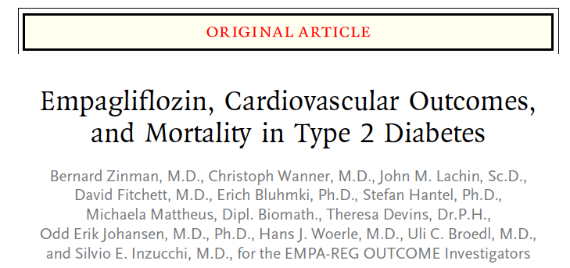
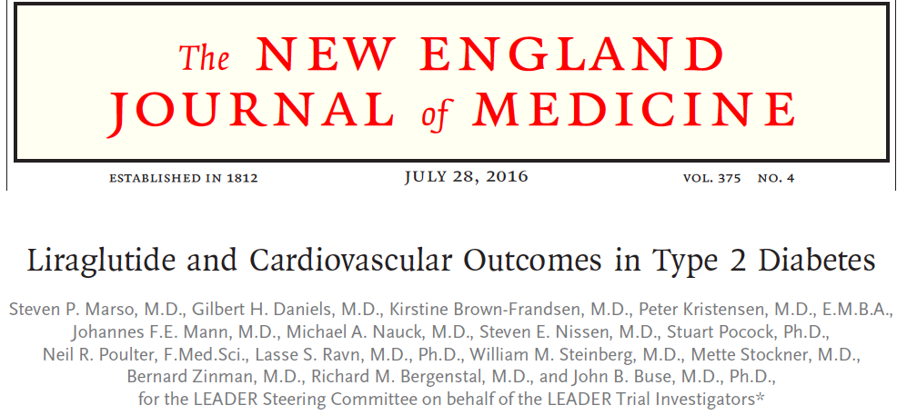
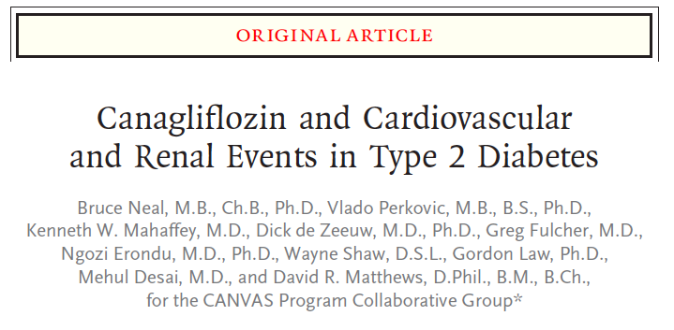
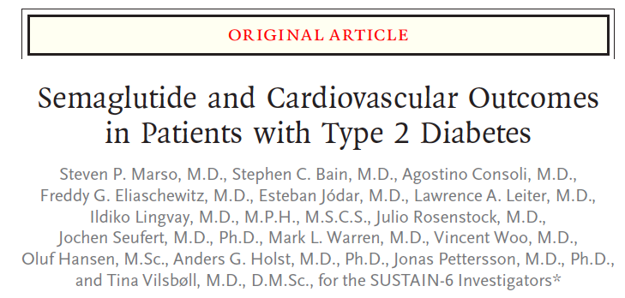
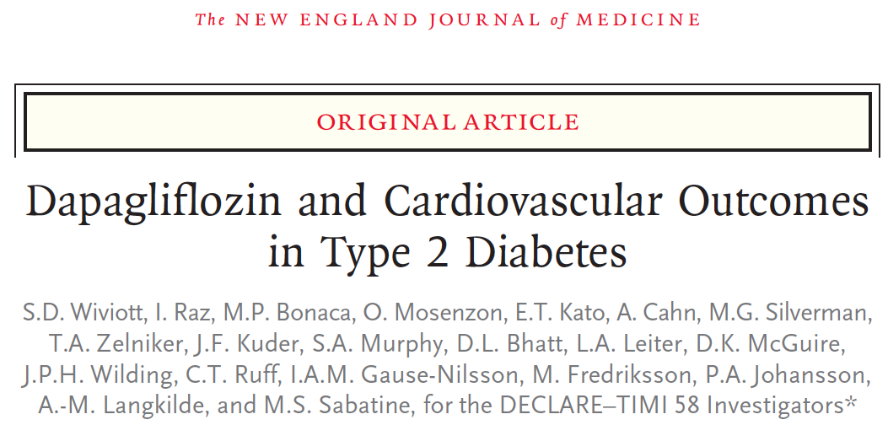
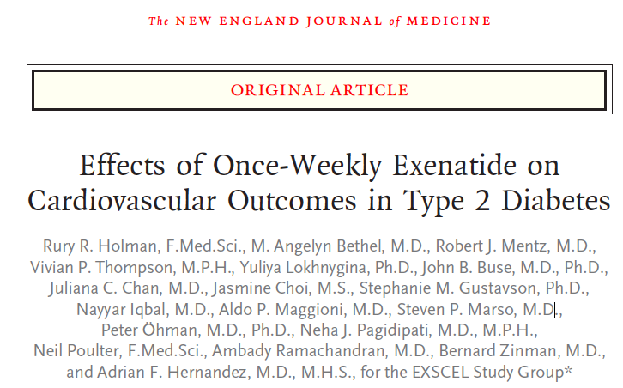
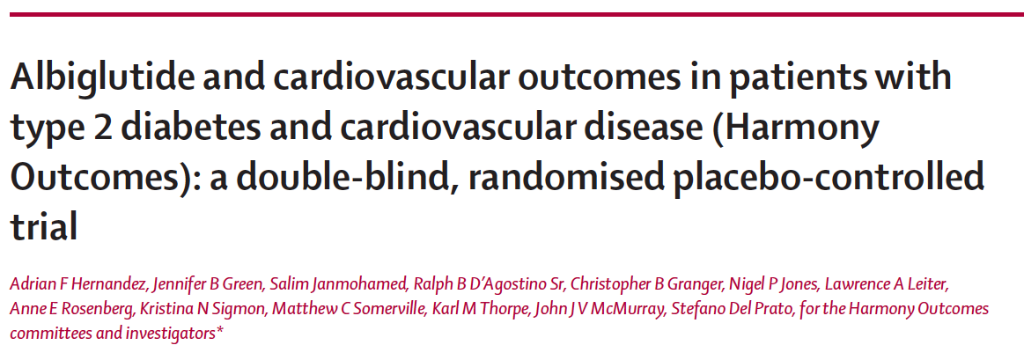
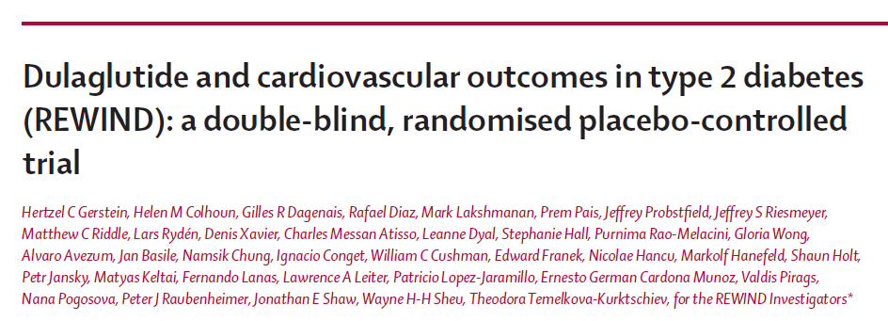
CARDIOVASCULAR RISK REDUCTION
SGLT-2 Inhibitors
GLP-1 RA

Slide 7
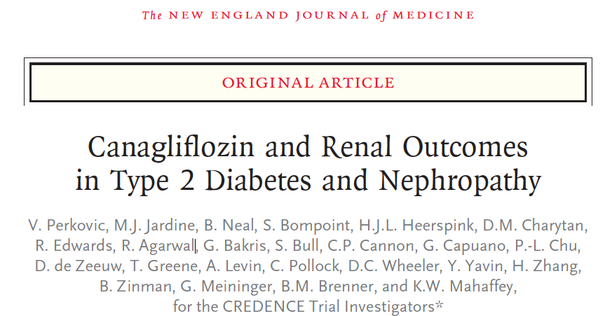
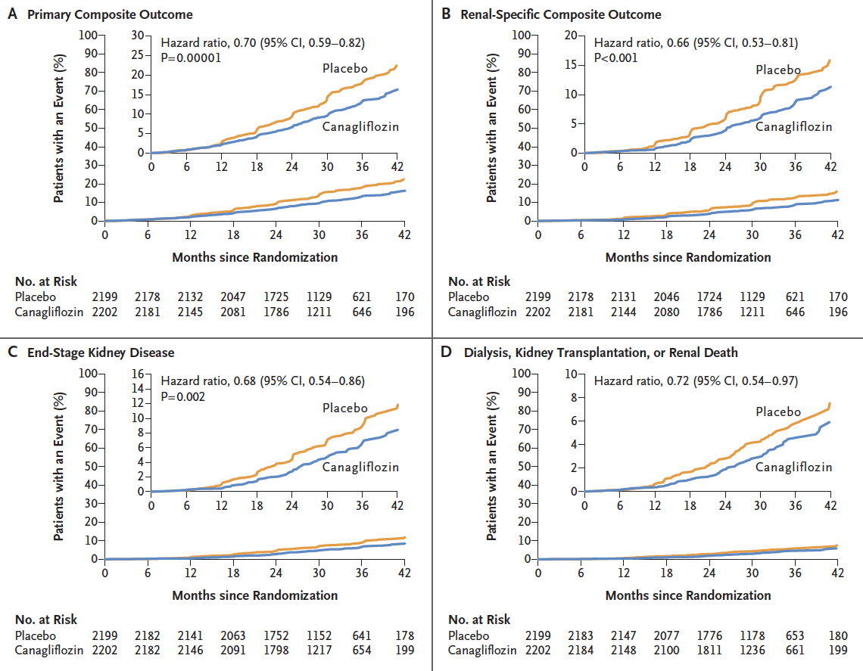
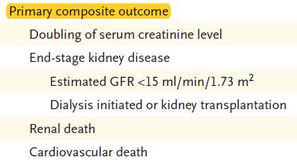
Renal outcomes with Canagliflozin (SGLT2-i)
Inclusion:
>30 yrs, T2D, A1c 6.5-12%
CKD (eGFR 30-90) At least 60% with GFR 30-60
+ Albuminuria (ACR >300 mg/g)
The canagliflozin group also had:
-- Lower risk of CV death, MI, or stroke (hazard ratio, 0.80; 95% CI, 0.67 to 0.95
-- Less hospitalizations for heart failure (hazard ratio, 0.61; 95% CI, 0.47 to 0.80; P<0.001).
N Engl J Med. 2019 Apr 14. doi: 10.1056 [Epub ahead of print]

Slide 8
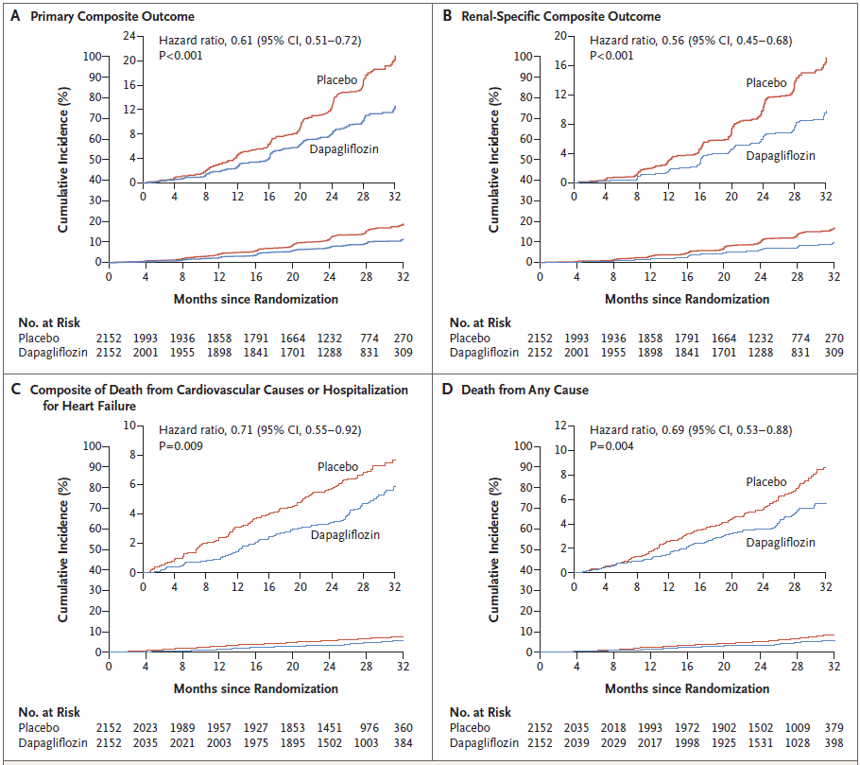
DAPA CKD
The primary outcome was a composite of:
Decline GFR > 50%,
ESKD, or
Death from renal
or CV causes
N Engl J Med. 2020 Oct 8;383(15):1436-1446

Slide 9
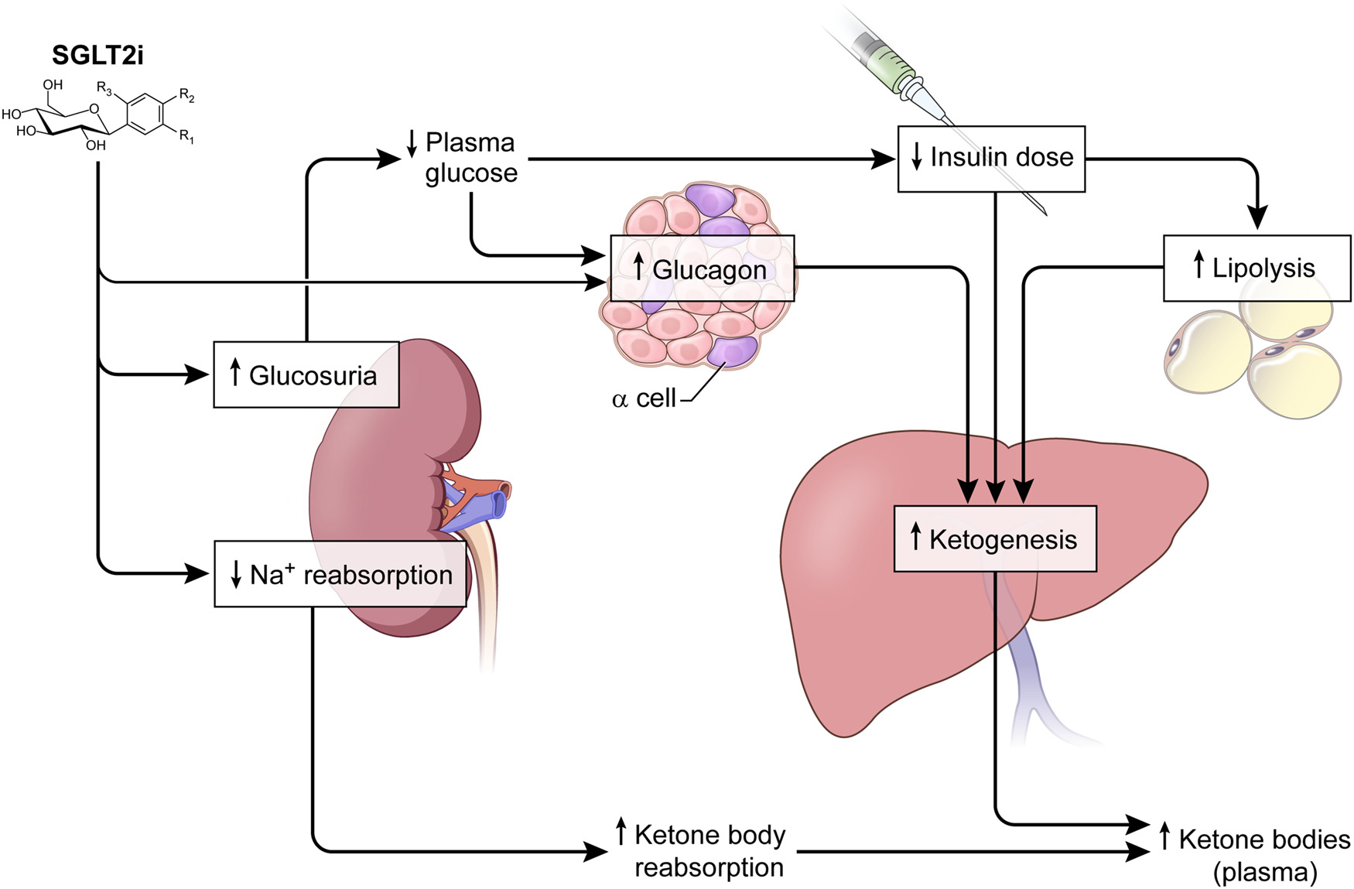
SGLT2 Inhibitors May Predispose to Ketoacidosis
Taylor et al. J Clin Endocrinol Metab, August 2015, 100(8):2849–2852

Slide 10
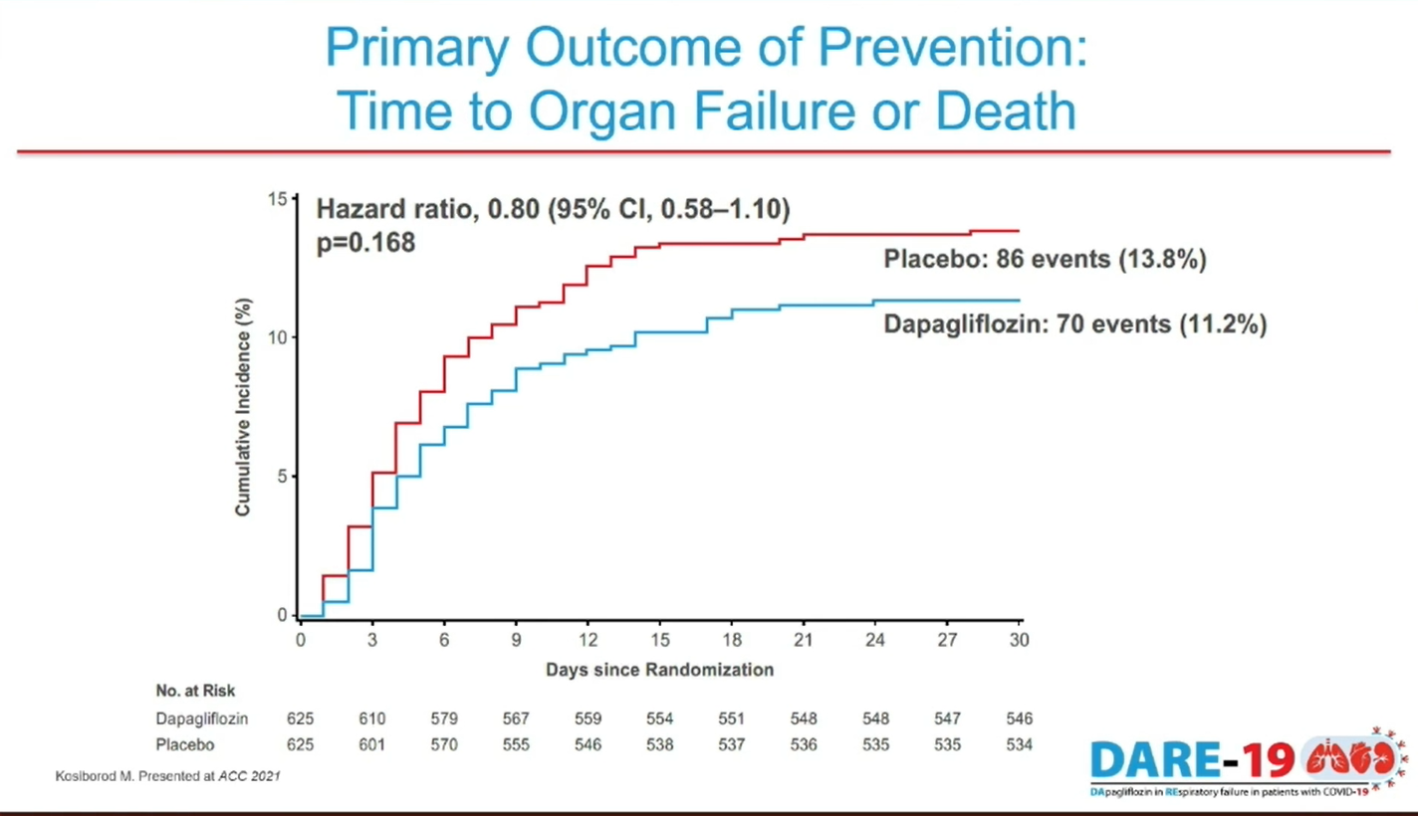
2019 Research Day

Slide 11
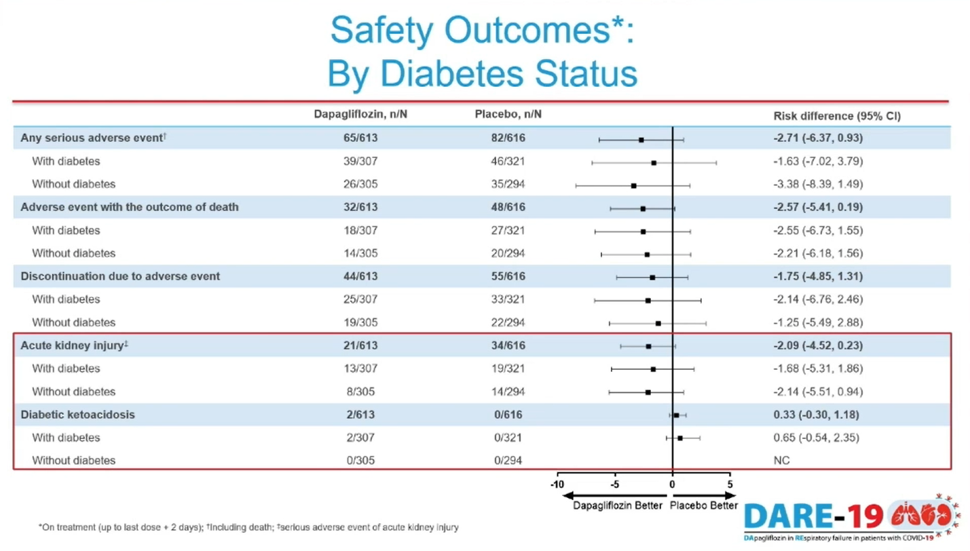
2019 Research Day

Slide 12
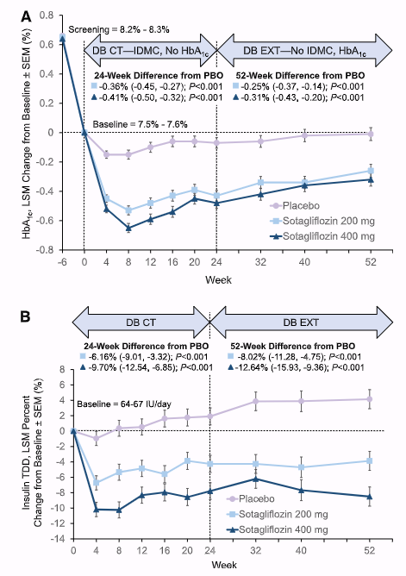
Dapagliflozin in T1D
“inTandem-1”
52-week, phase 3, double-blind RCT
Adults with T1D on optimized insulin therapy (NCT02384941)
Comparing sotagliflozin 200 mg or 400 mg daily vs placebo.
Main results: placebo-adjusted HbA1c reductions were 0.36% and 0.41% with sotagliflozin 200 and 400 mg
Safety: Adjudicated diabetic ketoacidosis (DKA) occurred in 9 (3.4%) and 11 (4.2%) patients receiving sotagliflozin 200 and 400 mg
Buse JB et al. Diabetes Care 2018;41(9):1970–1980

Slide 13
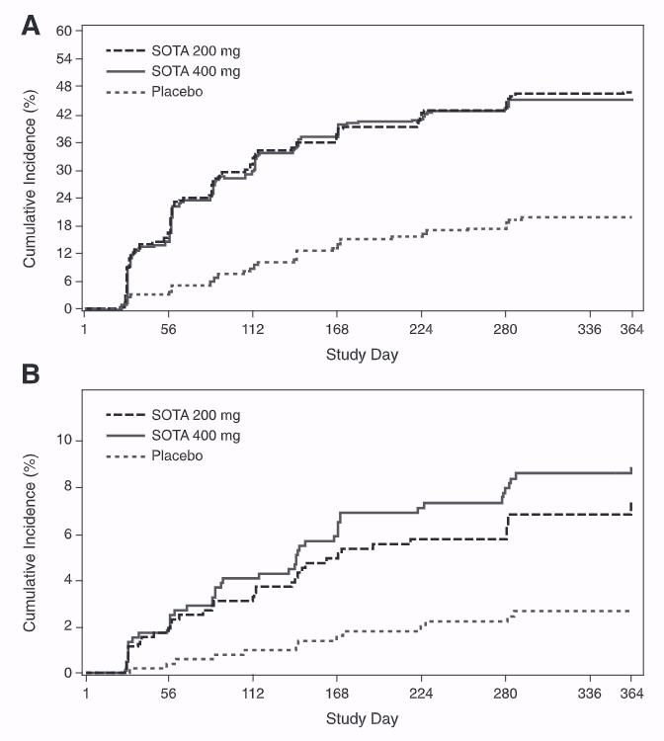
DKA and Related Events With Sotagliflozin Added to Insulin in Adults With Type 1Diabetes: A Pooled Analysis of the inTandem 1 and 2 Studies
A total of 191 ketosis-related AEs were reported, and 98 underwent adjudication.
DKA events: 37 cases (36 patients) Incidence rates (per 100 patient-years): 0.2 (placebo), 3.1 (sotagliflozin 200 mg), 4.2 (sotagliflozin 400 mg)
No DKA-related deaths
BHB increase: small median rise (~0.05 mmol/L over 52 weeks)
Elevated BHB levels: 47% > 0.6 mmol/L; 7% > 1.5 mmol/L (vs 20% and 2% with placebo)
Risk-mitigation plan: reduced annualized DKA incidence in both sotagliflozin groups
Peters et al. Diabetes Care. 2020 Nov;43(11):2713-2720

Slide 14
Major Clinical Trials of SGLT Inhibitors in Type 1 Diabetes
Trial | Agent | Population (n) | Region | Duration | Δ HbA1c | Δ Weight | DKA rate (drug vs placebo)
DEPICT-1 | Dapagliflozin 5 mg & 10 mg (SGLT2i) | 833 adults with T1D | Global (multi-region) | 24 wk (+ 52 wk extension) | −0.45 % | −3.0 kg | 1.0 -2.0 % vs 1.0 %
DEPICT-2 | Dapagliflozin 5 mg & 10 mg (SGLT2i) | 815 adults with T1D | North America + Europe + Japan | 24–52 wk | −0.42 % | −3.7% | 2.2–2.6 % vs 0 %
inTandem 1 | Sotagliflozin 200 mg & 400 mg (Dual SGLT1/2i) | 793 adults with T1D | North America (US & Canada) | 52 wk | −0.41 % | −3.1 kg | 3.4–4.2 % vs 0.4 %
inTandem 2 | Sotagliflozin 200 mg & 400 mg (Dual SGLT1/2i) | 782 adults with T1D | Europe (UK, France, Germany etc.) | 52 wk | −0.37% | −2.9 kg | 2.3–3.4 % vs 0 %
inTandem 3 | Sotagliflozin 400 mg (Dual SGLT1/2i) | 1,402 adults with T1D | Global (10 countries) | 24 wk | −0.46 % | −3.0 kg | 3.0 % vs 0.6 %
Dandona P et al., Lancet Diabetes Endocrinol 2017; 5:864–876; Mathieu C et al., Diabetes Care 2018; 41:1938–1946, Buse JB et al., Diabetes Care 2018; 41:1970–1980, Danne T et al., Diabetes Care 2018; 41:1981–1990, Garg SK et al., NEJM 2017; 377:2337–2348,

Slide 15
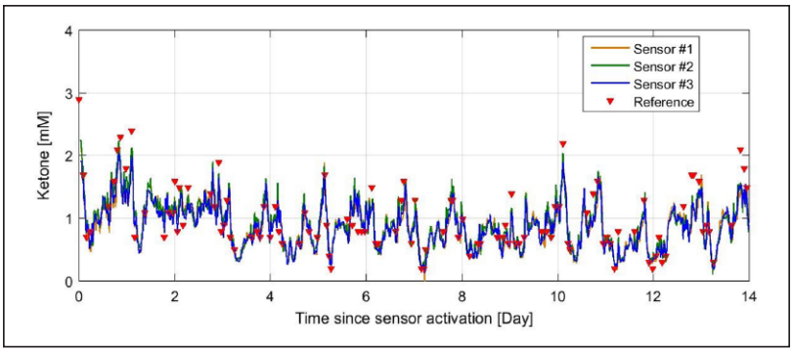
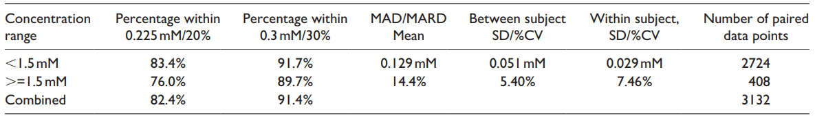
Continuous Ketone Monitoring
Subcutaneous CKM
12 patients without diabetes on low carb diet
14-day sensor wear
Sensor ketone measurements compared to capillary ketone values
Device integration with CGM
Applications in T1D (SGLT2i)
Alva et al. J Diabetes Sci Techol. 2021.

Slide 16
NIDDK-Funded Trials on SGLT Inhibitors and DKA Mitigation in Type 1 Diabetes
PI / Institution | Project Title (Short) | Focus / Theme
R. Bergenstal (HealthPartners) | Mitigating DKA on SGLT1/2 Inhibitor | Risk factors + enhanced glucose-ketone reporting
A. Haidar (McGill Univ.) | Continuous Ketone Monitoring + SGLT2i (T1D) | CKM validation to detect early ketosis
D. O’Neal (Univ. of Melbourne) | Response Thresholds for CKM with Sotagliflozin | Optimizing CKM alert thresholds
J. Pettus (UC San Diego) | CKM for Safe SGLT Use in T1D | Real-world feasibility and DKA reduction
R. Pratley / S. Taylor (AdventHealth) | KARMA: Ketone Monitoring for DKA Risk Mitigation | Structured monitoring algorithms for safety
Source: NIH RePORTER

Slide 17
What about GLP-1RA or Dual GIP/GLP-1RA in T1D?

Slide 18
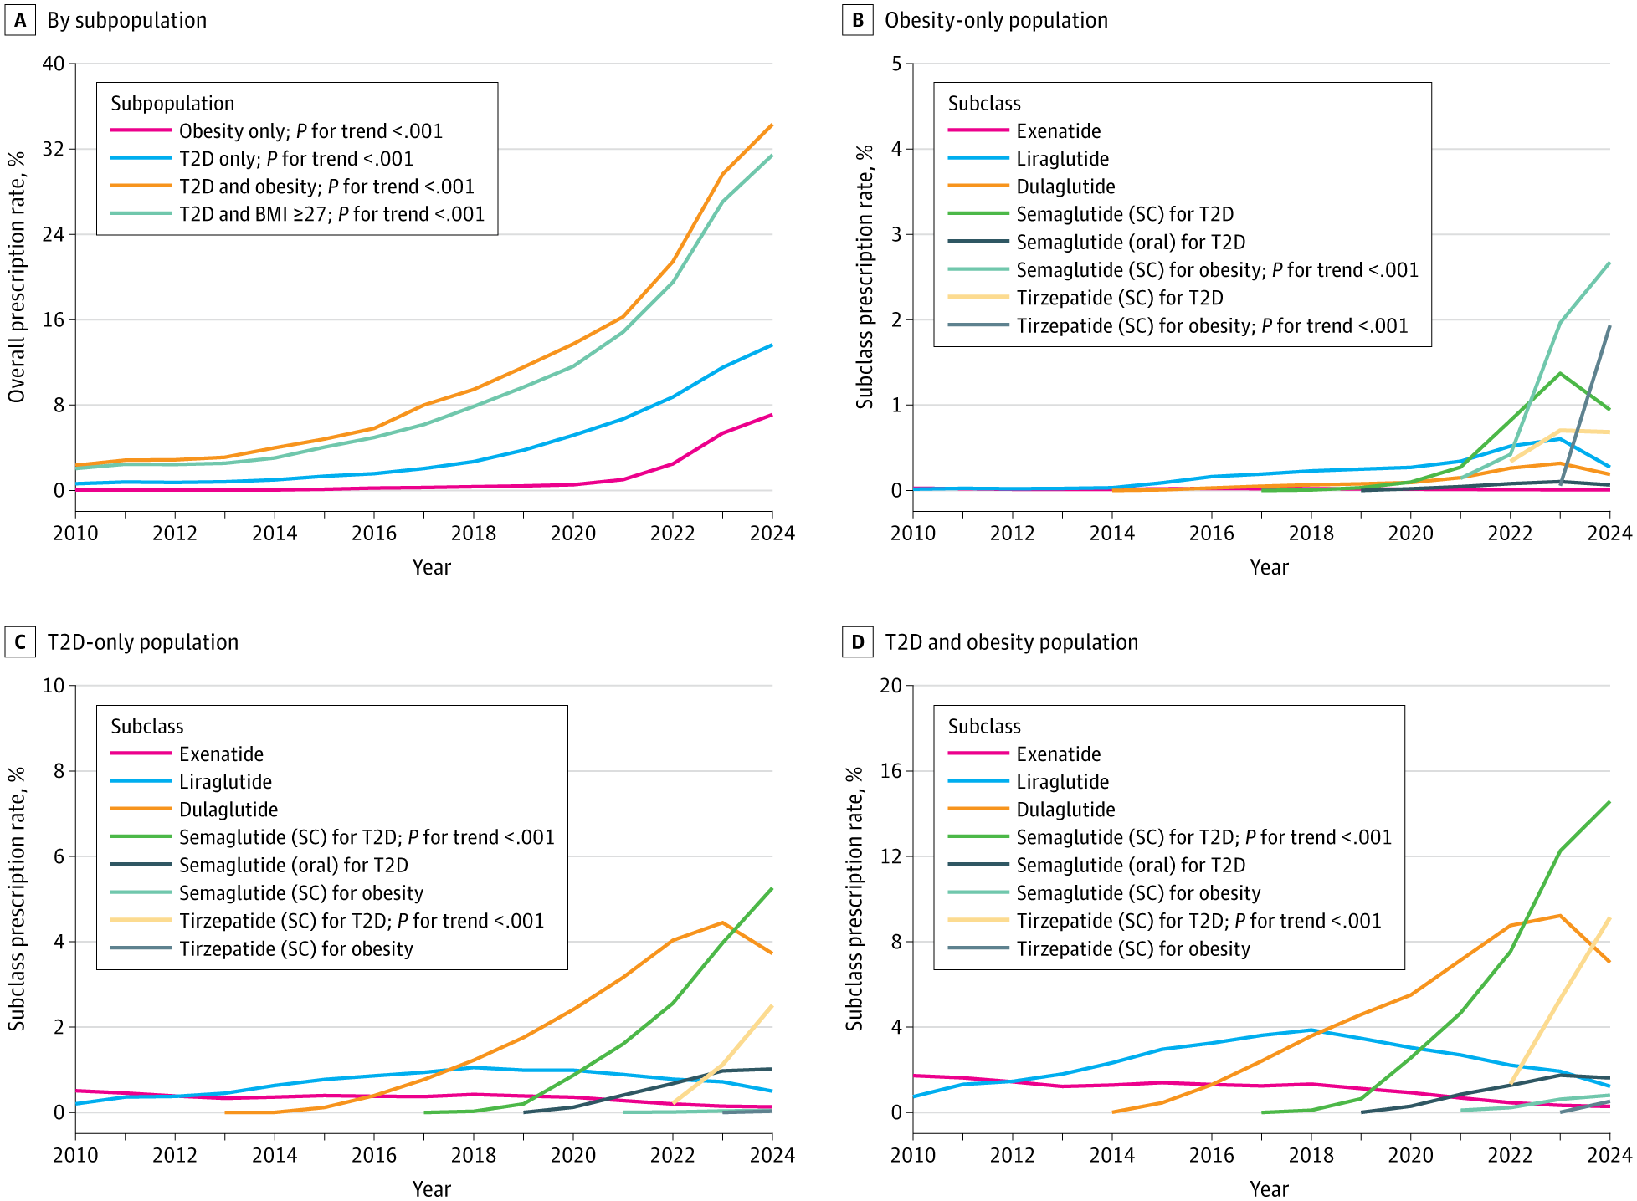
Annual GLP-1RA or Dual GIP/GLP-1RA Prescriptions Rates Among Different Subpopulations, 2010 to 2024
Li et al. JAMA Network Open 2025

Slide 19
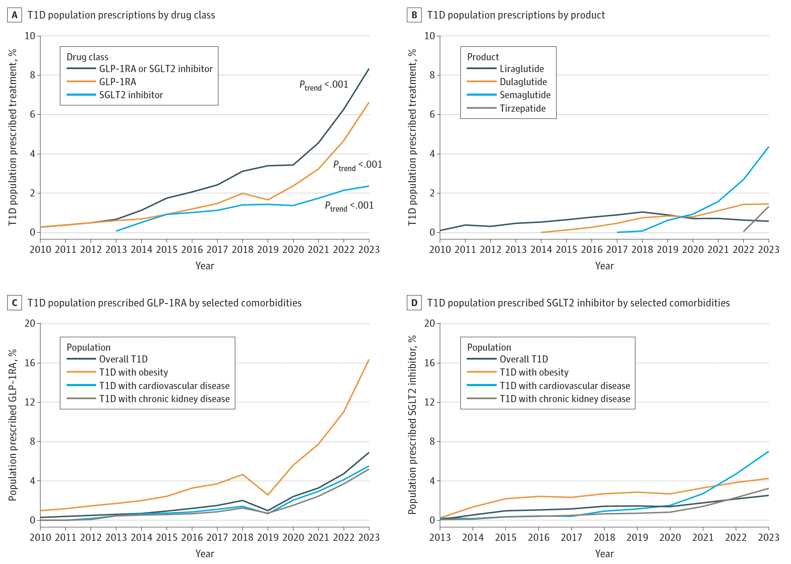
Trends in GLP-1 and SGLT-I Prescribed Among People With Type 1 Diabetes (T1D), 2010-2023
GLP-1 RA by comorbidities
SGLT-2i by comorbidities
Li et al. JAMA 2024

Slide 20
Major Phase 3 Trials of Liraglutide in T1D
Trial | Agent | Population (n) | Duration | Key Findings
ADJUNCT ONE | Liraglutide 0.6, 1.2, or 1.8 mg daily | 1,398 adults with T1D (BMI ≥ 20 kg/m²) | 52 weeks | HbA1c ↓ ~0.2–0.15% weight ↓ ~4.9 kg TDI ↓ ~5%. ↑ GI side effects; ↑ DKA events (8) ketosis (plasma ketone level >1.5 mmol/L) 11.2%, 7.5%, and 6.3% vs 6.9%
ADJUNCT TWO | Liraglutide 0.6, 1.2, or 1.8 mg daily | 835 adults with T1D (BMI ≥ 20 kg/m²) | 26 weeks | HbA1c ↓ ~0.2%; weight ↓ ~5.1kg; TDI ↓ ~10%; ↑ Ketosis (0.5 vs. 0.1 events/patient/year; P = 0.01) 1 case of DKA
Mathieu C et al. Diabetes Care 2016;39(10):1702–1710
Ahren B et al. Diabetes Care 2016;39(10):1693–1701

Slide 21
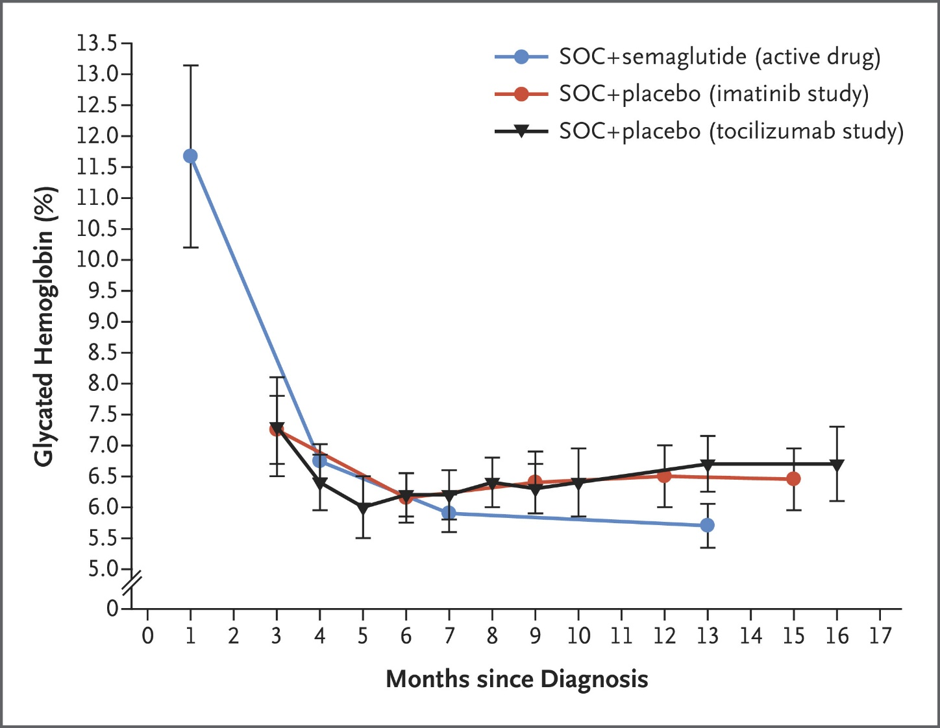
Glycated Hemoglobin Levels in Patients with Recently Diagnosed Type 1 Diabetes.
N=10 adults with new-onset T1D treated with semaglutide + SOC insulin.
HbA1c: ↓ from ~11.7 → ~5.7% by 12 mo.
Most stopped prandial insulin by 3 mo; 7/10 stopped basal by 6 mo.
No DKA; uncontrolled single-center series.
Potential for near-normoglycemia with early GLP-1 RA use?
Dandona et al. N Engl J Med 2023;389:958-959

Slide 22
How about weight loss, time in range, and no hypoglycemia???? That would be a nice study!

Slide 23
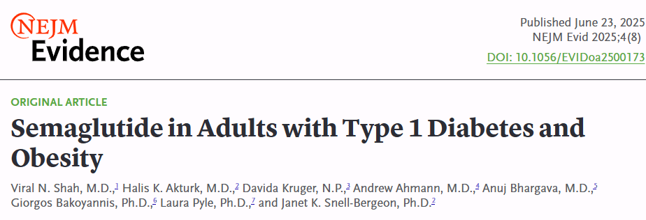
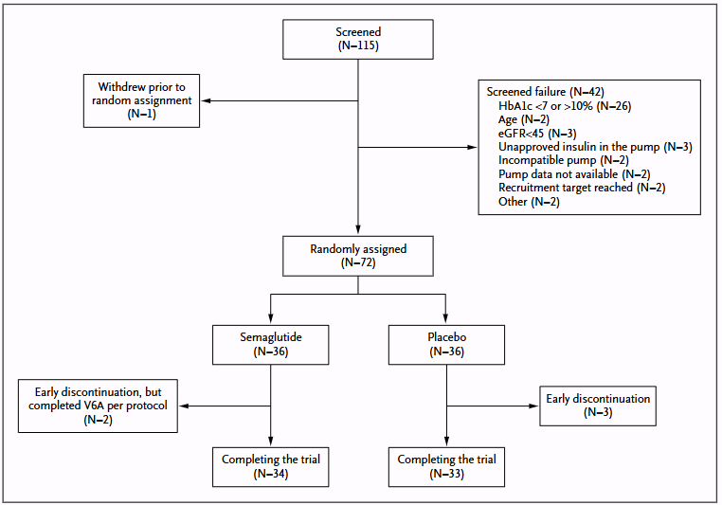
Primary endpoint: % meeting all:
70% TIR (70–180 mg/dL)
<4% time <70 mg/dL
≥5% weight loss

Slide 24
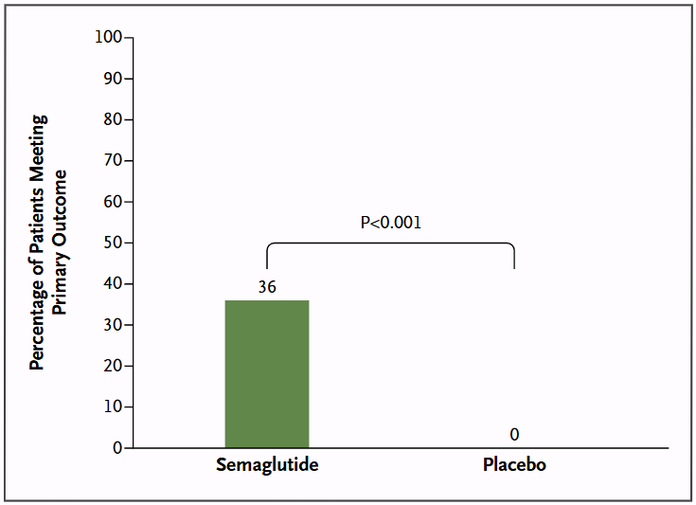
Percentage of Patients Achieving the Primary Composite Outcome in Semaglutide versus Placebo Groups
Shah et al. NEJM Evid 2025;4(8)

Slide 25
How about technologies in T2D

Slide 26

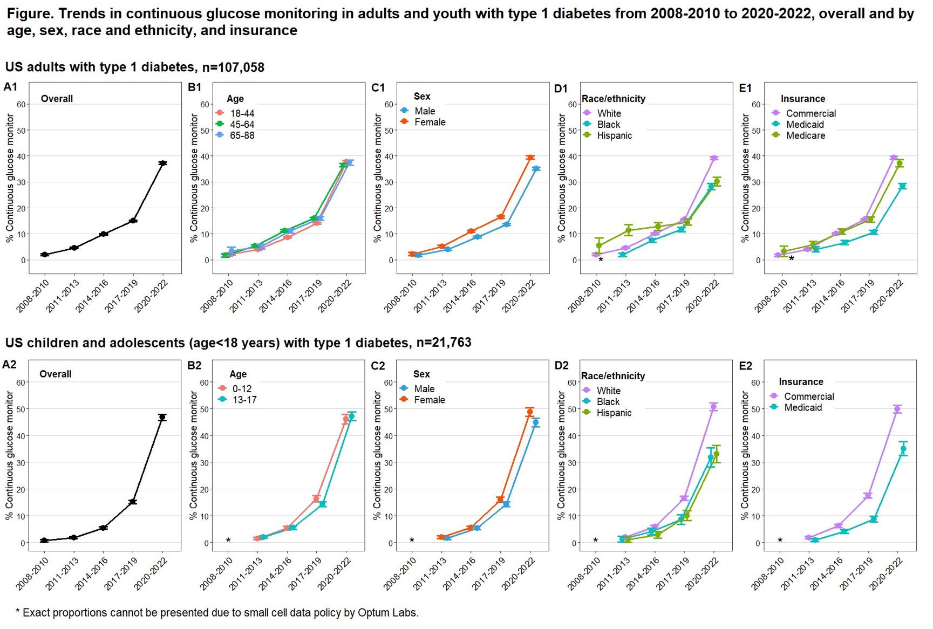
From: 1444-P: Trends and Disparities in Continuous Glucose Monitoring Use in U.S. Youth and Adults with Type 1 Diabetes—2008–2022
Diabetes. 2024;73(Supplement_1). doi:10.2337/db24-1444-P
Date of Download: 11/11/2024
Copyright © 2024 American Diabetes Association. All rights reserved.

Slide 27
Continuous Glucose Monitoring (CGM)

Slide 28
Patient Selection for CGM Therapy
International Consensus¹ | AACE² | American Diabetes Association³
All patients with T1D T2D on multiple daily injections (MDI) not meeting goals Problematic hypoglycemia | All patients with diabetes treated with intensive insulin therapy A Problematic hypoglycemia A Pregnancy/GDM on insulin therapy A* | rtCGM A or isCGM B for adults with diabetes on MDI or insulin pump therapy rtCGM A or isCGM C can be used in adults with diabetes on basal insulin As an adjunct to pre/postprandial blood glucose monitoring in pregnancy B
A—Clear evidence from well-conducted, generalizable randomized controlled trials that are adequately powered
B—Supportive evidence from well-conducted cohort studies
C—Supportive evidence from poorly controlled or uncontrolled studies
E—Expert consensus or clinical experience
*Intermediate-High Strength of Evidence
Danne et al. Diabetes Care 2017; 40:1631-1640.
Grunberger et al. Endocr Pract. 2021 Jun;27(6):505-537.
ADA Professional Practice Committee. Diabetes Care.
2022 Jan 1;45(Suppl 1):S97-S112.

Slide 29
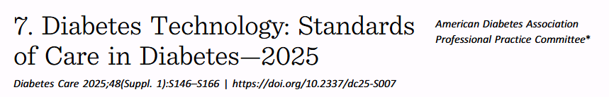
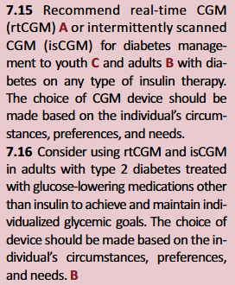
7.2 Initiation of continuous glucose monitoring (CGM) should be offered to people with type 1 diabetes early in the disease, even at time of diagnosis. A

Slide 30
Current FDA-Approved CGM Devices
 | Freestyle Libre 2 | Freestyle Libre 2 Plus | Freestyle Libre 3 (Plus) | G6 | G7 | Guardian 3 | Guardian 4 | Simplera Sync | Eversense E3# | Lingo / Stelo**
Sensor warm up time (hours) | 1 | 1 | 1 | 2 | 0.5 | 2 | 2 | 2 | 24 | 0.5
Required Calibrations | No | No | No | No | No | 2/day (min) | No | No | 2/day (21 days); 1/day | No
Alarms/Alerts | Yes | Yes | Yes | Yes | Yes | Yes | Yes | Yes | Yes | No/Yes
Duration of wear (days) | 14 | 15 | 14/15 | 10 | 10 | 7 | 7 | 7 | 180 -> 365 | 15
AID Integration | None | t:slim X2 | Ilet | t:slim X2, Omnipod 5 | t:slim X2, iLet, Omnipod 5 | MiniMed 630G, 770G | MiniMed 780G | Yes | None | None
**Stelo: Only for T2D (not on insulin) – no Rx required Limit 70-250
**Lingo: Metabolic/health wellness – no Rx range 55-200
# Eversense: iCGM designation (authorizing its compatibility) – no integration yet
Available at: https://diatribe.org/continuous-glucose-monitors-cgm

Slide 31
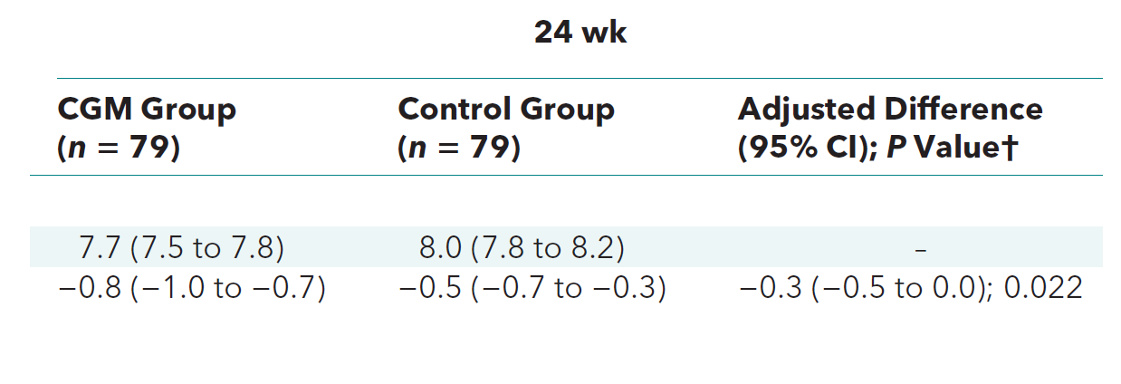
CGM in T2D Patients on MDI: DIAMOND
Prospective RCT in adults with T2D on MDI comparing the effect of CGM vs. fingerstick glucose monitoring on glycemic control at 24 weeks (N=158)
T2D for median of 17 years
Mean baseline HbA1c 8.5%
Mean HbA1c
Mean ∆ HbA1c
No difference in hypoglycemia or QOL
High CGM satisfaction scores
Beck RW, et al. Ann Intern Med. 2018.

Slide 32
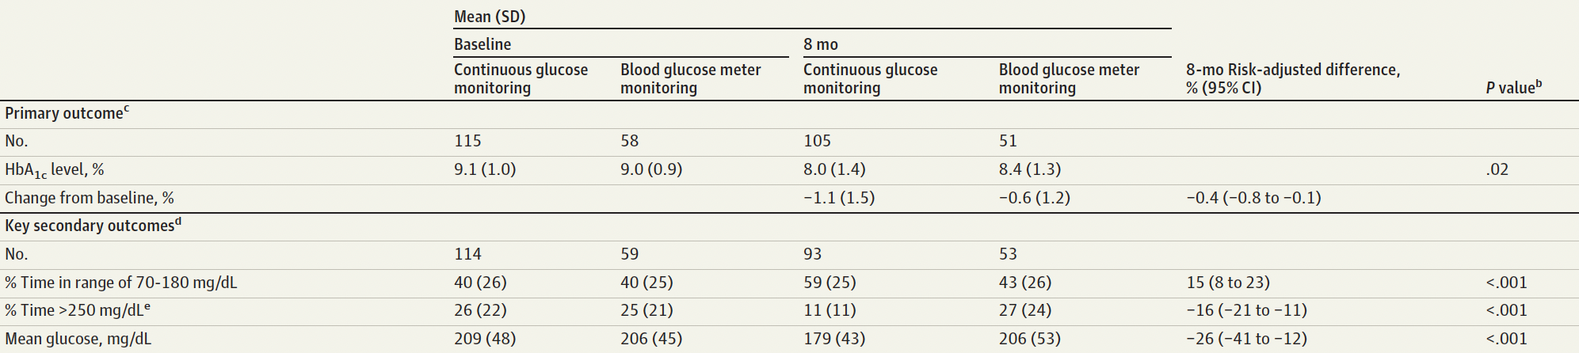
CGM in T2D Patients on Basal Insulin: MOBILE
Multicenter RCT in adults with T2D managed by primary care clinician on basal insulin (N=175)
2:1 Randomization to real-time CGM vs. fingerstick blood glucose monitoring (BGM)
Glucose data and recommendations sent to primary care clinician following visits
Martens T, et al. JAMA. 2021.

Slide 33
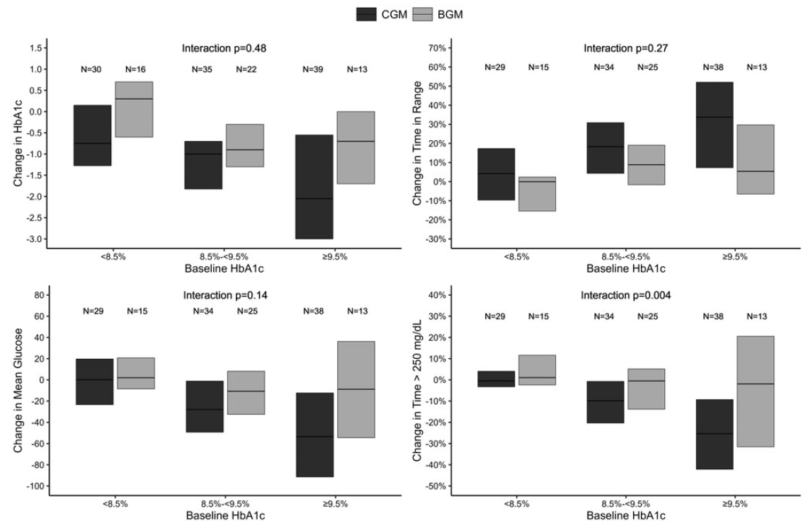
Change in Glycemic Outcomes with CGM by Baseline HbA1c
Change in HbA1c, TIR, mean glucose, and TAR (>250 mg/dL) by baseline HbA1c
Davis G, et al. Diabetes Technol Ther, 2022.

Slide 34
Continuous Subcutaneous Insulin Infusion (CSII)

Slide 35



CSII in T2D: OpT2mise Trial
Multinational RCT in adults with poorly-controlled T2D on MDI (N=331)
Persistent HbA1c elevation (8-12%) after 2-month dose-optimization run-in
Randomized to CSII vs. MDI
Primary Outcome: change in mean HbA1c
Reznik Y, et al. Lancet. 2014.

Slide 36

CSII vs MDI in T2D, Meta-analysis
Pickup JC, et al. Diabetes Care 2017.

Slide 37





Available AID Systems in the U.S.
 | SmartGuard | Control-IQ | Omnipod 5 | iLet Bionic Pancreas | Twiist
Integrated CGM | Guardian 4 (Medtronic) | G6, G7 (Dexcom) Libre 2 Plus (Abbott) | G6, G7 (Dexcom) | G6, G7 (Dexcom) | iCGM (Libre)
Compatible Insulin Pump | MiniMed 780G (Medtronic) | t:slim X2 (Tandem) | Omnipod 5 ACE pump (Insulet) | iLet pump (Beta Bionics) | Deka insulin pump Loop algorithm (Tidepool)
Modifiable Settings in AID | -Glucose target (110-120) -I:C ratio -Active insulin time | -Glucose target (set at 110) -I:C ratio -Correction factor -Basal rate -Sleep/Activity Active insulin time (fixed at 5hrs) | -Glucose target (110-150) -I:C ratio -Correction factor -Activity mode -Active insulin time | -Glucose target (100-130) -Simplified meal announcement (no carb counting) | -Glucose target (down to 87 mg/dL) -More specific meal entry options
Table adapted from: Phillip et al. Endocr Rev. 2022
Images from: https://t1dexchange.org/automated-insulin-delivery-systems-technology/ and https://diatribe.org/fda-clears-twiist-automated-insulin-delivery-system
Legend: I:C, insulin-to-carb

Slide 38
Integrating CGM and CSII: Automated Insulin Delivery (AID)

Slide 39

Real World AID Data
Retrospective analysis of 9451 AID users (Control-IQ) on system >12 months
At least 2 weeks of pre-AID CGM glucose data
Adults and children
Type 1 and Type 2 diabetes
Breton MD, et al. Diabetes Technol Ther. 2021.

Slide 40


Breton MD, et al. Diabetes Technol Ther. 2021.

Slide 41

Real World AID Data
Retrospective analysis of 5575 AID users (Control-IQ) with Medicare or Medicaid coverage
At least 30 days of pre-AID CGM glucose data and >30 days post-AID initiation
Type 1 (n=5075) and Type 2 diabetes (n=500)
Forlenza G et al. Diabetes Technol Ther. 2022

Slide 42


Single arm, multicenter trial in adults with T2D treated with insulin (basal only or basal-bolus)
Initial 2-week standard therapy phase, followed by 13 weeks of AID (Omnipod 5)
Primary outcome: HbA1c at 13 weeks compared to baseline
Pasquel et al. JAMA Netw Open. 2025.

Slide 43


Baseline Characteristics
Pasquel et al. JAMA Netw Open. 2025.

Slide 44

Primary and Secondary Outcomes by Initial Insulin Regimen
Pasquel et al. JAMA Netw Open. 2025.

Slide 45


Change in HbA1c by Demographic and Clinical Subgroups
Pasquel et al. JAMA Netw Open. 2025.

Slide 46

Change in HbA1c by Demographic and Clinical Subgroups
Pasquel et al. JAMA Netw Open. 2025.

Slide 47

Multicenter RCT in adults with T2D treated with basal-bolus insulin
Randomized 2:1 to AID (Control-IQ) or continuation of current regimen
Primary outcome: HbA1c at 13 weeks compared to baseline
Kudva et al. N Engl J Med . 2025.

Slide 48


Baseline Characteristics
Kudva et al. N Engl J Med . 2025.

Slide 49

Primary and Secondary Hierarchical Efficacy Outcomes
Kudva et al. N Engl J Med . 2025.

Slide 50

Time In Range Data Over 13-week Study Period
Kudva et al. N Engl J Med . 2025.

Slide 51
Considerations surrounding AID use for T2D Management
T2D population
Who would benefit most?
Algorithm and device capabilities for management of T2D
High insulin requirements/insulin resistance
Carbohydrate entry
Educational and training needs
Carbohydrate counting
Device training and follow up
Health literacy
Technology requirements
Potential burdens
Implementation and Expansion
Care setting and providers
Cost/Coverage

Slide 52
Is AID an option in the hospital?
Templer S. Front Endocrinol (Lausanne). 2022.

Slide 53


Individualized Antihyperglycemic Therapy in Hospitalized Patients With Diabetes
4+ POC tests in non-ICU
Hourly POC tests in the ICU
*Consider OAD if no contraindications (only DPP-4 inhibitors have been studied in randomized controlled trials).
BG, blood glucose; DKA, diabetic ketoacidosis; HHS, hyperosmolar hyperglycemic syndrome; ICU, intensive care unit; OAD, oral antidiabetic drug; POC, point of care; TDD, total daily dose.
Pasquel FJ, et al. Lancet Diabetes Endocrinol. 2021.
Notes:
Pasquel FJ, Lansang MC, Dhatariya K, Umpierrez GE. Management of diabetes and hyperglycaemia in the hospital. Lancet Diabetes Endocrinol. 2021 Mar;9(3):174-188. doi: 10.1016/S2213-8587(20)30381-8. Epub 2021 Jan 27. PMID: 33515493.

Slide 54

CGM in the Hospital During the COVID-19 Pandemic
25
Galindo RJ, et al. J Diabetes Sci Technol. 2020.

Slide 55

Protocol for Remote Glucose Management During the COVID-19 Pandemic
EHR, electronic health record; FGM, flash glucose monitoring.
Pasquel FJ, et al. Lancet Diabetes Endocrinol. 2021.
Notes:
Pasquel FJ, Lansang MC, Dhatariya K, Umpierrez GE. Management of diabetes and hyperglycaemia in the hospital. Lancet Diabetes Endocrinol. 2021 Mar;9(3):174-188. doi: 10.1016/S2213-8587(20)30381-8. Epub 2021 Jan 27. PMID: 33515493.

Slide 56


AID For T2D Management in the Hospital
Non-critically ill adult patients with T2D requiring inpatient insulin therapy (N=136)
Followed for up to 15 days
Algorithm-based insulin delivery→ no prandial bolus/carb entry
%TIR: 74.0±19.3 (closed-loop) vs. 54.2±25.1 (conventional therapy), P<0.001
Bally L, et al. N Engl J Med. 2018.

Slide 57



Electronic Health Record (EHR) Documentation and Validation
A
flowsheet shows upper and lower 20% range of POC to document validation (yes/no)
B) remote EHR access to documented CGM values trend (green) and POC values.
B
Davis GM et al Diabetes Care. 2021.

Slide 58



Technology Set-Up
Smartphone receiving Bluetooth signal within 20 feet from patient
Externalized pump set up for hourly adjustment of insulin (optional), in accordance with the hospital approved protocol for medication pump externalization during COVID-19
Glucose telemetry in nursing station with alarms
Davis GM, et al Diabetes Care. 2021. (Supplementary Material).
Notes:
Davis GM, Faulds E, Walker T, Vigliotti D, Rabinovich M, Hester J, Peng L, McLean B, Hannon P, Poindexter N, Saunders P, Perez-Guzman C, Tekwani SS, Martin GS, Umpierrez G, Agarwal S, Dungan K, Pasquel FJ. Remote Continuous Glucose Monitoring With a Computerized Insulin Infusion Protocol for Critically Ill Patients in a COVID-19 Medical ICU: Proof of Concept. Diabetes Care. 2021 Apr;44(4):1055-1058. doi: 10.2337/dc20-2085. Epub 2021 Feb 9. PMID: 33563655; PMCID: PMC7985417.

Slide 59

Davis et al. Diabetes Care. 2021.

Slide 60

Image/information from: Automated Insulin Delivery for INpatients With DysGlycemia (AIDING) Feasibility - Full Text View - ClinicalTrials.gov; accessed 4 Nov 2022.

Slide 61





Automated Insulin Delivery for INpatients with DysGlycemia (AIDING): Feasibility Study

Slide 62














Remote Monitoring (Study Team)
Secure Cloud
Storage (AID
and CGM data)
+
Automated Insulin Delivery (AID) System
Personal Diabetes Manager (PDM)
CGM + AID data
Remote CGM
CGM alerts:
Hypoglycemia
Hyperglycemia
Glucose Trends
Pod
(with AID algorithm)
Real-time
CGM
PT1
Integrated communication
PT2
Device image from: Omnipod 5 for Healthcare Provider | Omnipod; Accessed 7 Nov 2022.

Slide 63

48 y/o AA patient with Type 1 Diabetes
(AIDING-Feasibility Trial participant )
MDI
AID + RT-CGM
MDI
>500 mg/dl
40 mg/dl
Insulin Detemir
Insulin Lispro

Slide 64


Davis et al. Diab Tech and Ther, 2023

Slide 65













AIDING RCT (N=130 – 3 Sites) – AID vs CGM in the Hospital - Recruitment Completed Nov 2025
Remote Monitoring (Study Team)
Secure Cloud
Storage (AID
and CGM data)
AID System
AID + CGM data
Remote RT-CGM
Disposable Pod
(with AID algorithm)
Real-time CGM
CGM alerts:
Hypoglycemia
Hyperglycemia
Glucose Trends
PT1
Integrated communication
PT2
ClinicalTrials.Gov NCT06418880

Slide 66
It’s not only about drugs and tech

Slide 67


Adapting and testing an integrated care model for treatment of Type 1 diabetes and mental health co- morbidities
PI: Leslie Johnson, PhD, MPH, MLitt

Slide 68
Mental & Physical Health Co-morbidities in Type 1 Diabetes
Depression and anxiety are common in people with diabetes — rates are equal or higher in T1D than in T2D.
Poor psychological health is linked to:
Poor glycemic control
Missed medications/appointments
Lower self-management
Reduced life expectancy
Despite this, mental-health treatment uptake in diabetes care remains low.
Evidence-based interventions (EBIs) improve both mood and metabolic outcomes, yet T1D-specific studies are lacking.
Grigsby et al., 2002; van der Feltz-Cornelis et al., 2020

Slide 69
Extending Collaborative Care Models to Adults with T1D
Integrated collaborative care models combining behavioral-health and diabetes teams improve:
A1c (–0.4 to –0.6%)
Depression outcomes
Quality of life (Katon et al., 2004; Lin et al., 2012; Ali et al., 2020)
Participants receiving collaborative care were 1.5× more likely to show dual improvements in mood and glycemia at 12 months; benefits sustained ≥ 36 months.
T1D adaptation:
Using participatory mixed-methods to tailor workflow and delivery.
Ongoing single-site RCT (n = 82 adults with T1D).
Preliminary findings: high feasibility and acceptability.
Provides a framework for scaling integrated mental-health support across diabetes programs.

Slide 70
The Convergence Era: Shared Therapies and Integrated Care
Pharmacologic convergence
GLP-1 receptor agonists (GLP-1 RAs) and SGLT2 inhibitors are increasingly used in Type 1 Diabetes
Evidence emerging on how to use safely – efforts on DKA prevention (CKM)
Multiple trials in progress — stay tuned
Technology convergence
Continuous Glucose Monitoring (CGM) now standard of care (SOC) in T2D
Automated Insulin Delivery (AID) expanding beyond T1D
Early clinical data in T2D with promising outcomes
Future directions: integration of drugs + technology (AID + GLP-1/SGLT2i) to optimize glycemic control, variability, and weight outcomes across the diabetes spectrum.
Collaborative models to address mental health are essential for both!

Slide 71

Thanks for your attention!
fpasque@emory.edu
Acknowledgement: G Davis, L Johnson

