Slide 1

Marissa Hitchcock, PWD, BSN, RN, CDCES
Clinical Director, Children with Diabetes
Community Diabetes Educator, Cincinnati Children’s Hospital

Slide 2
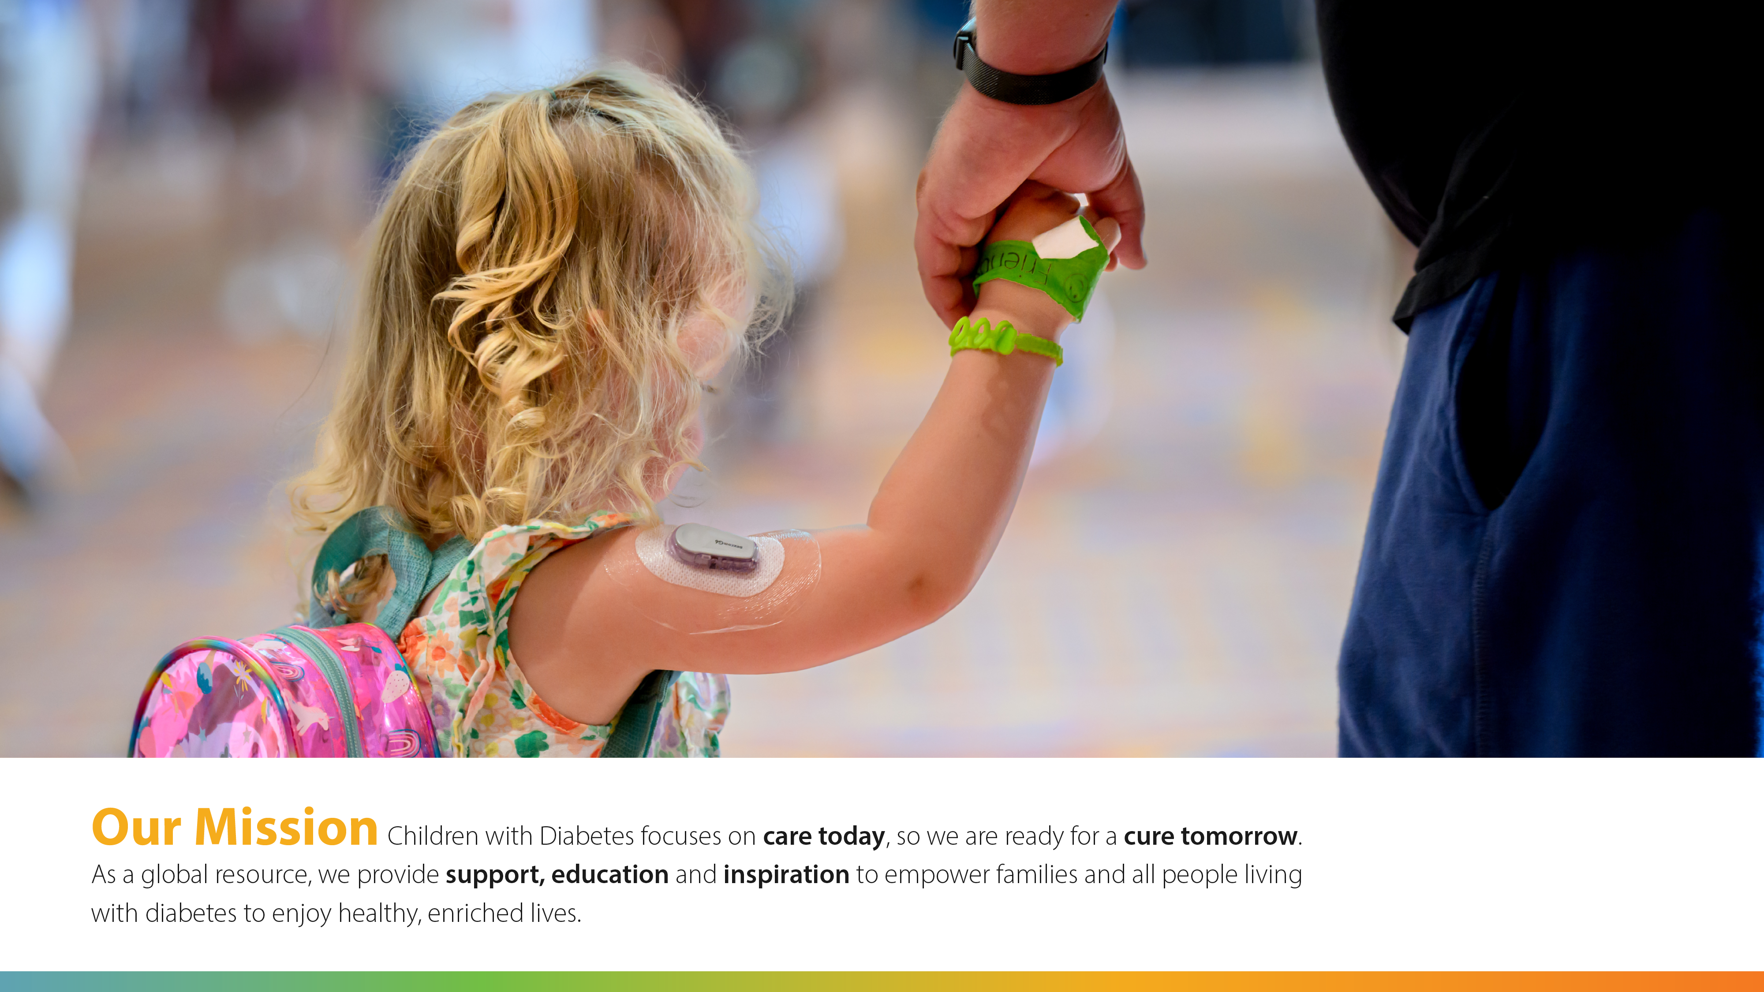

Slide 3
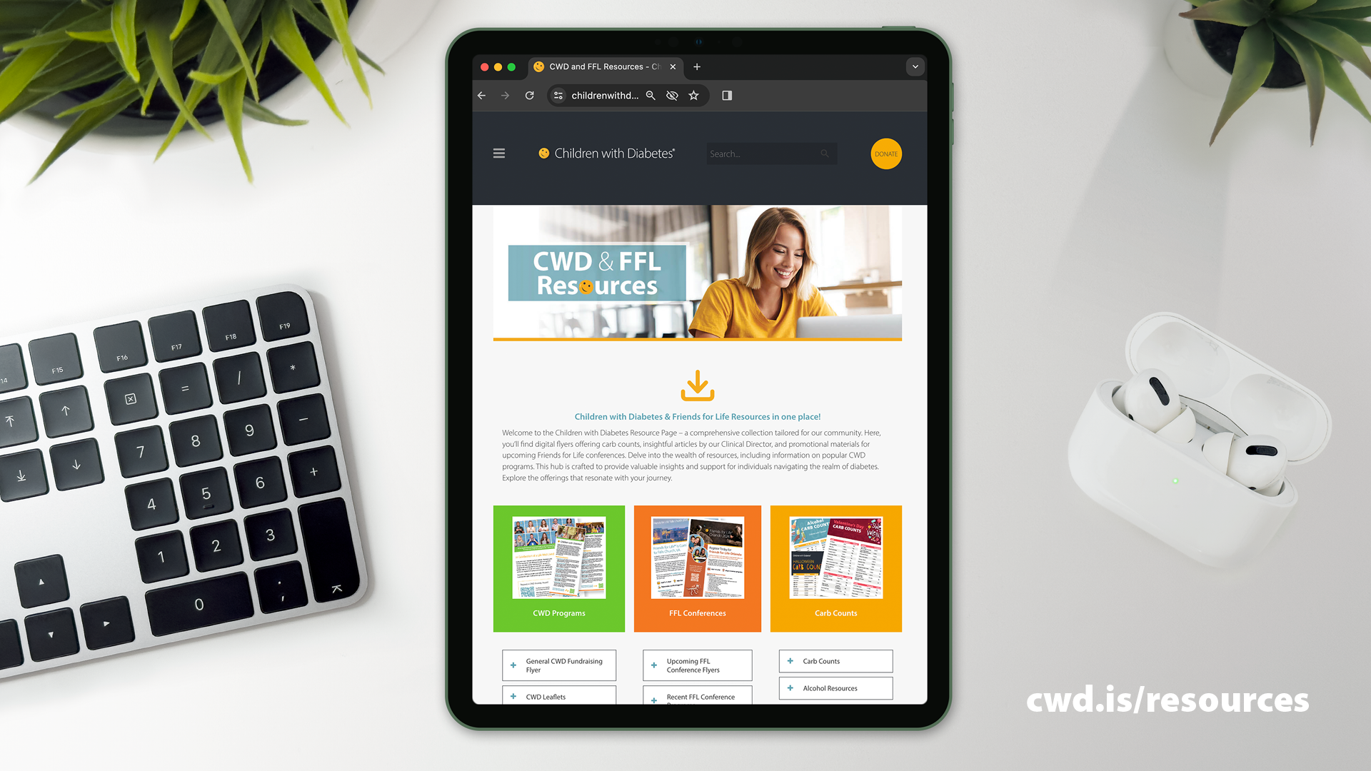

Slide 4
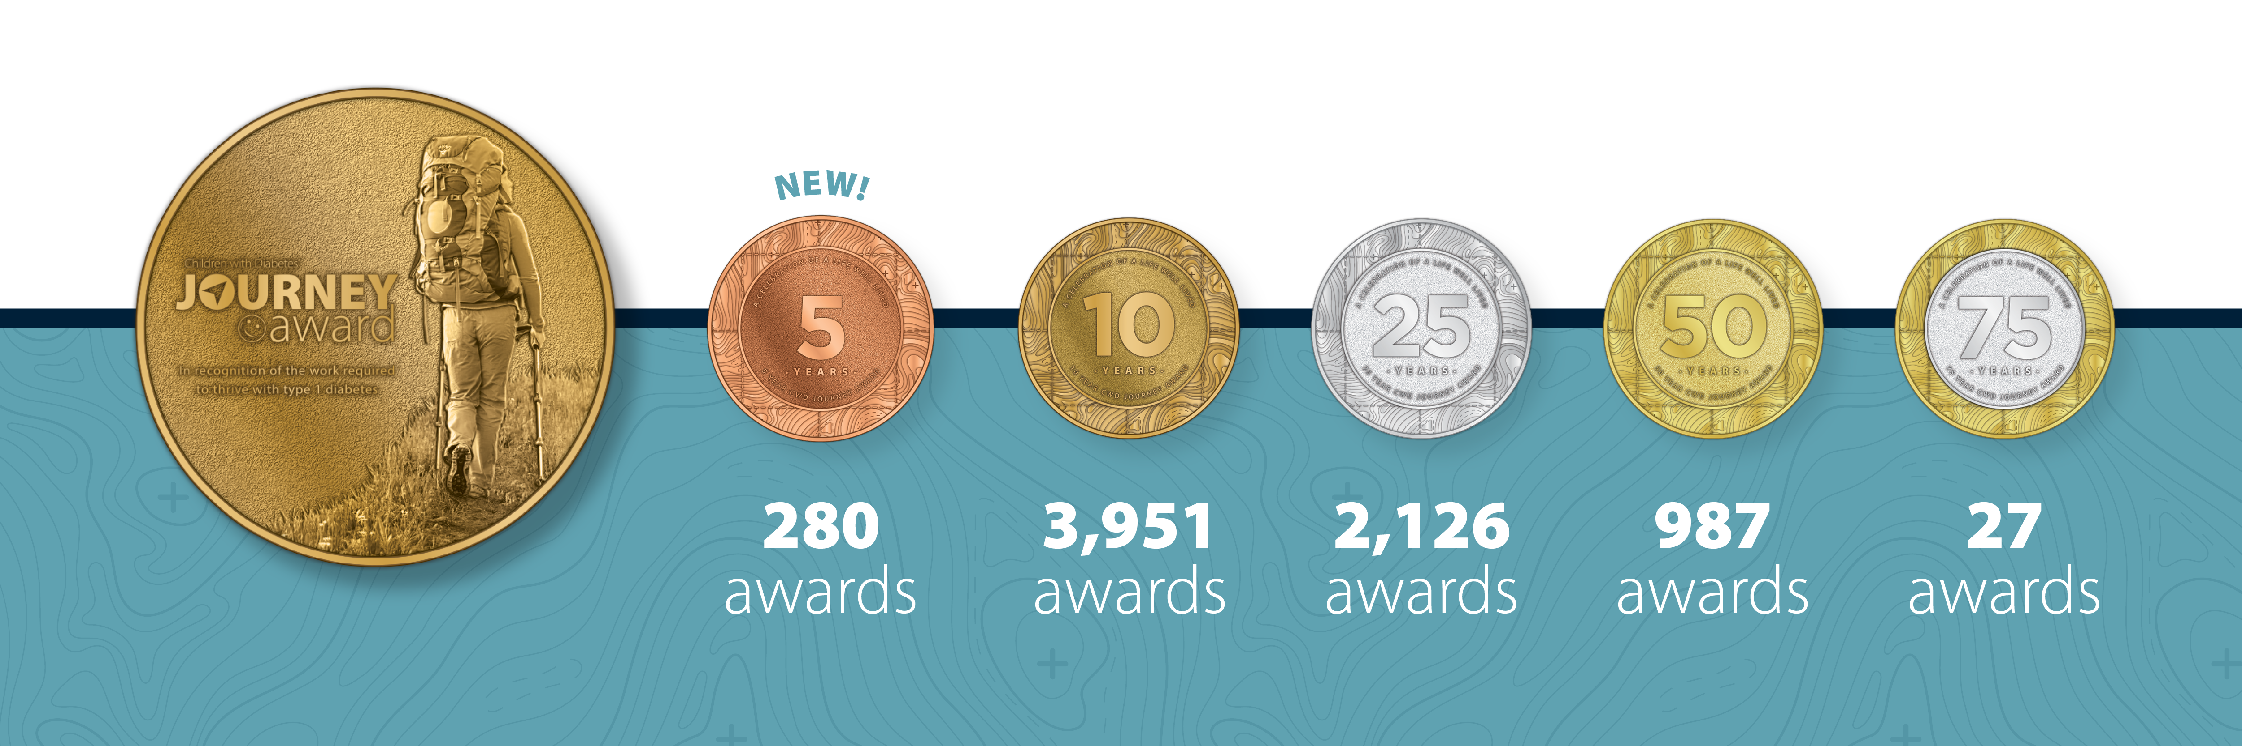

Slide 5
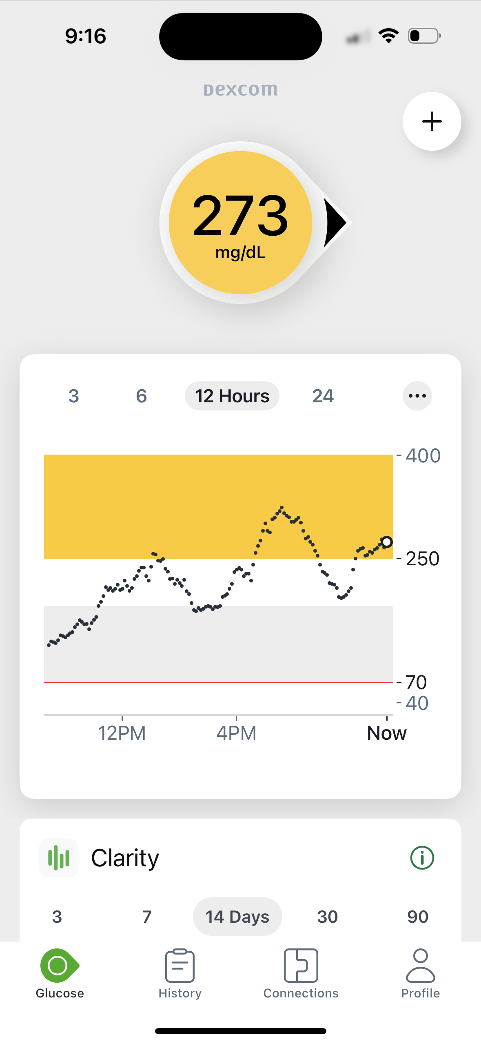
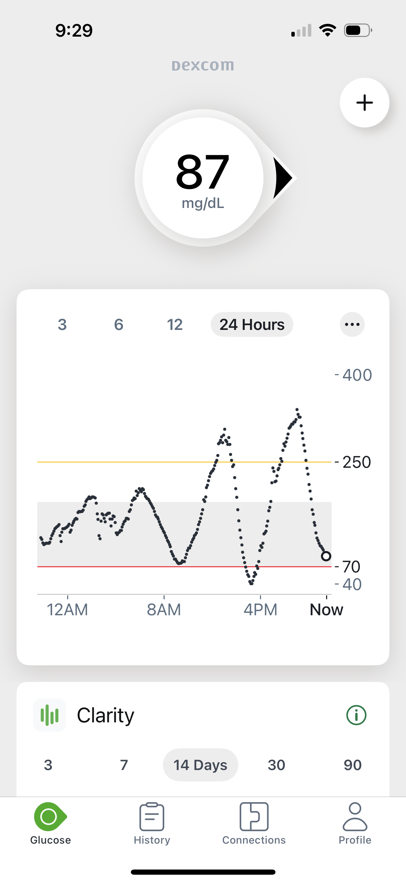
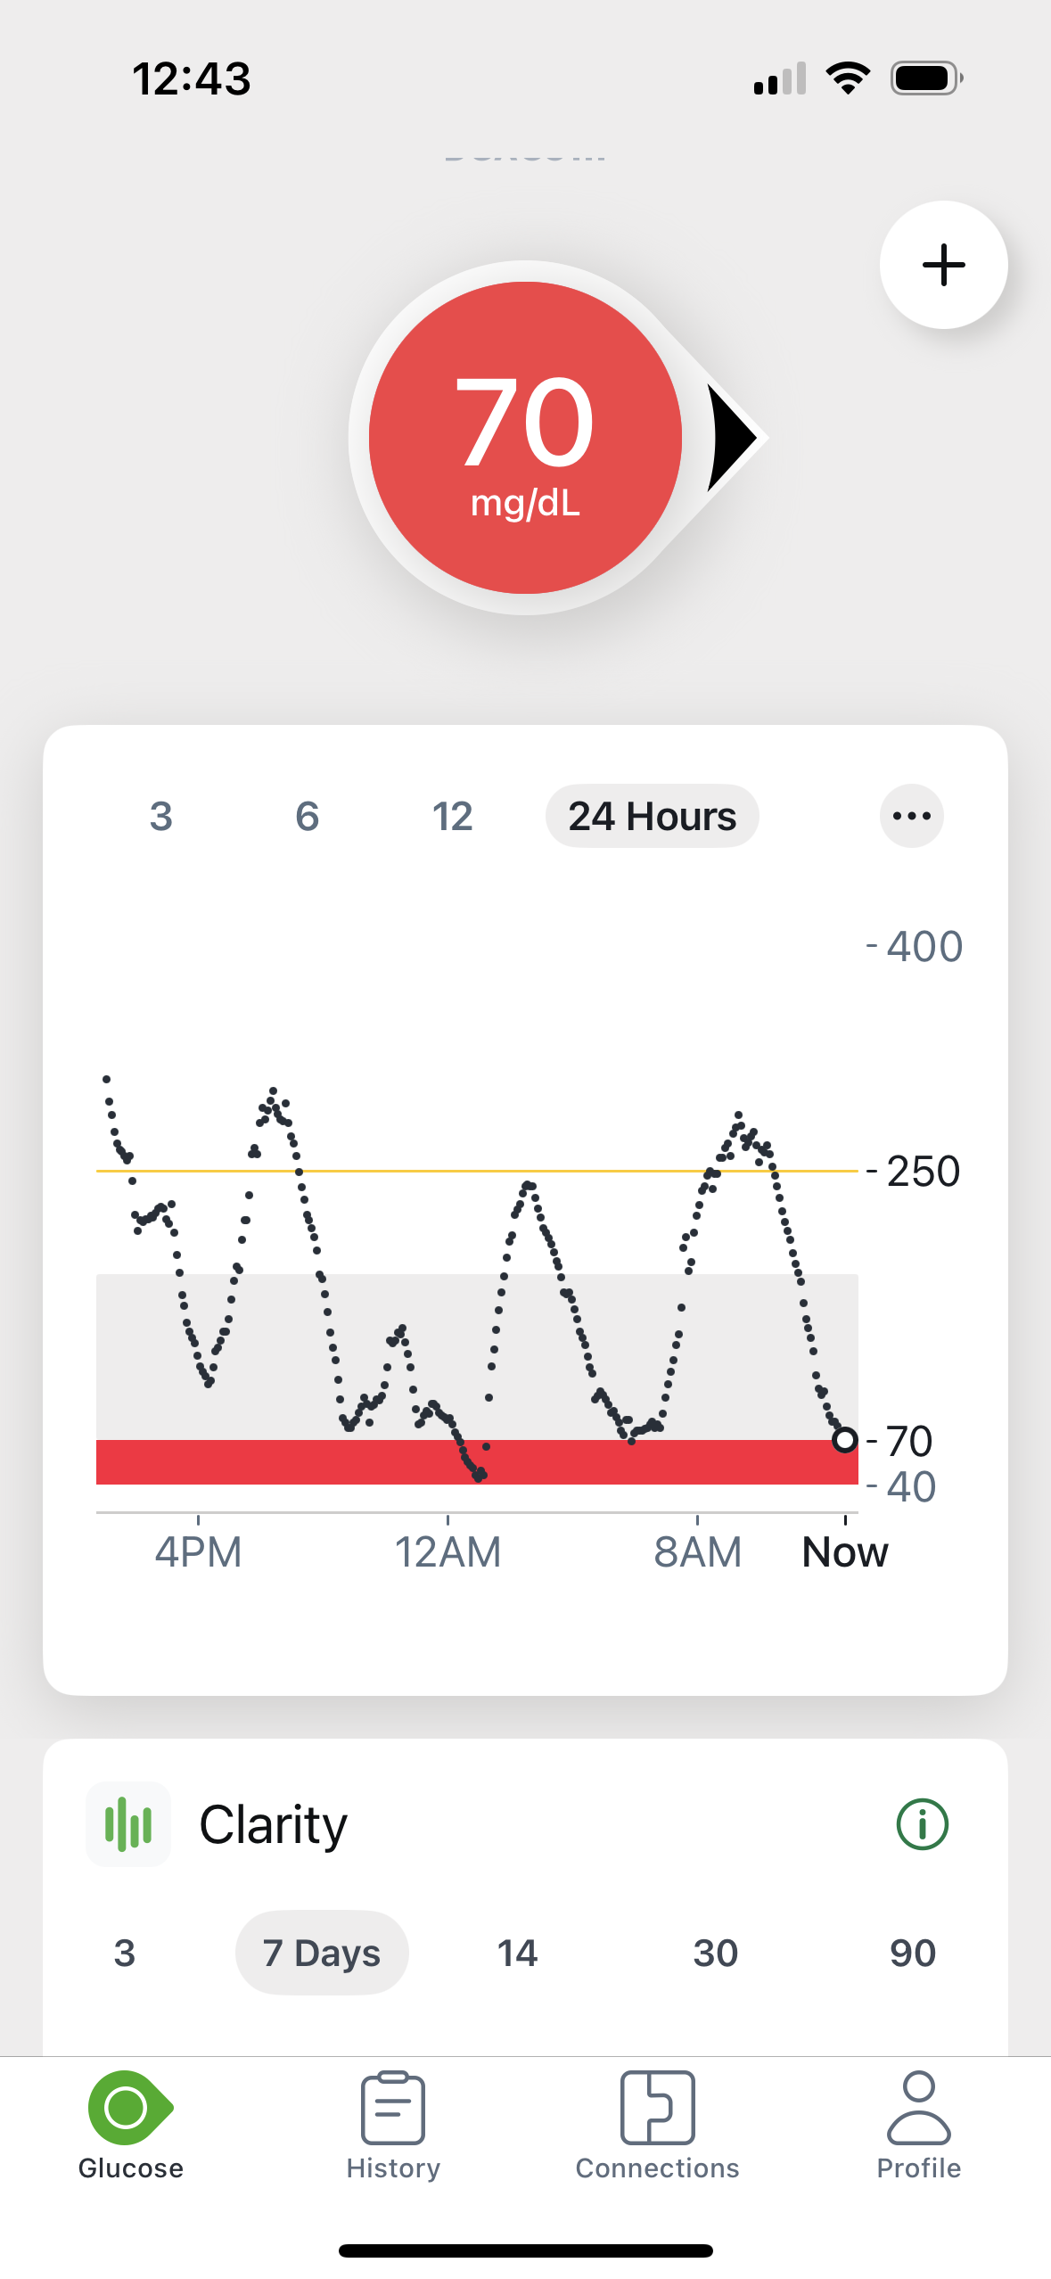
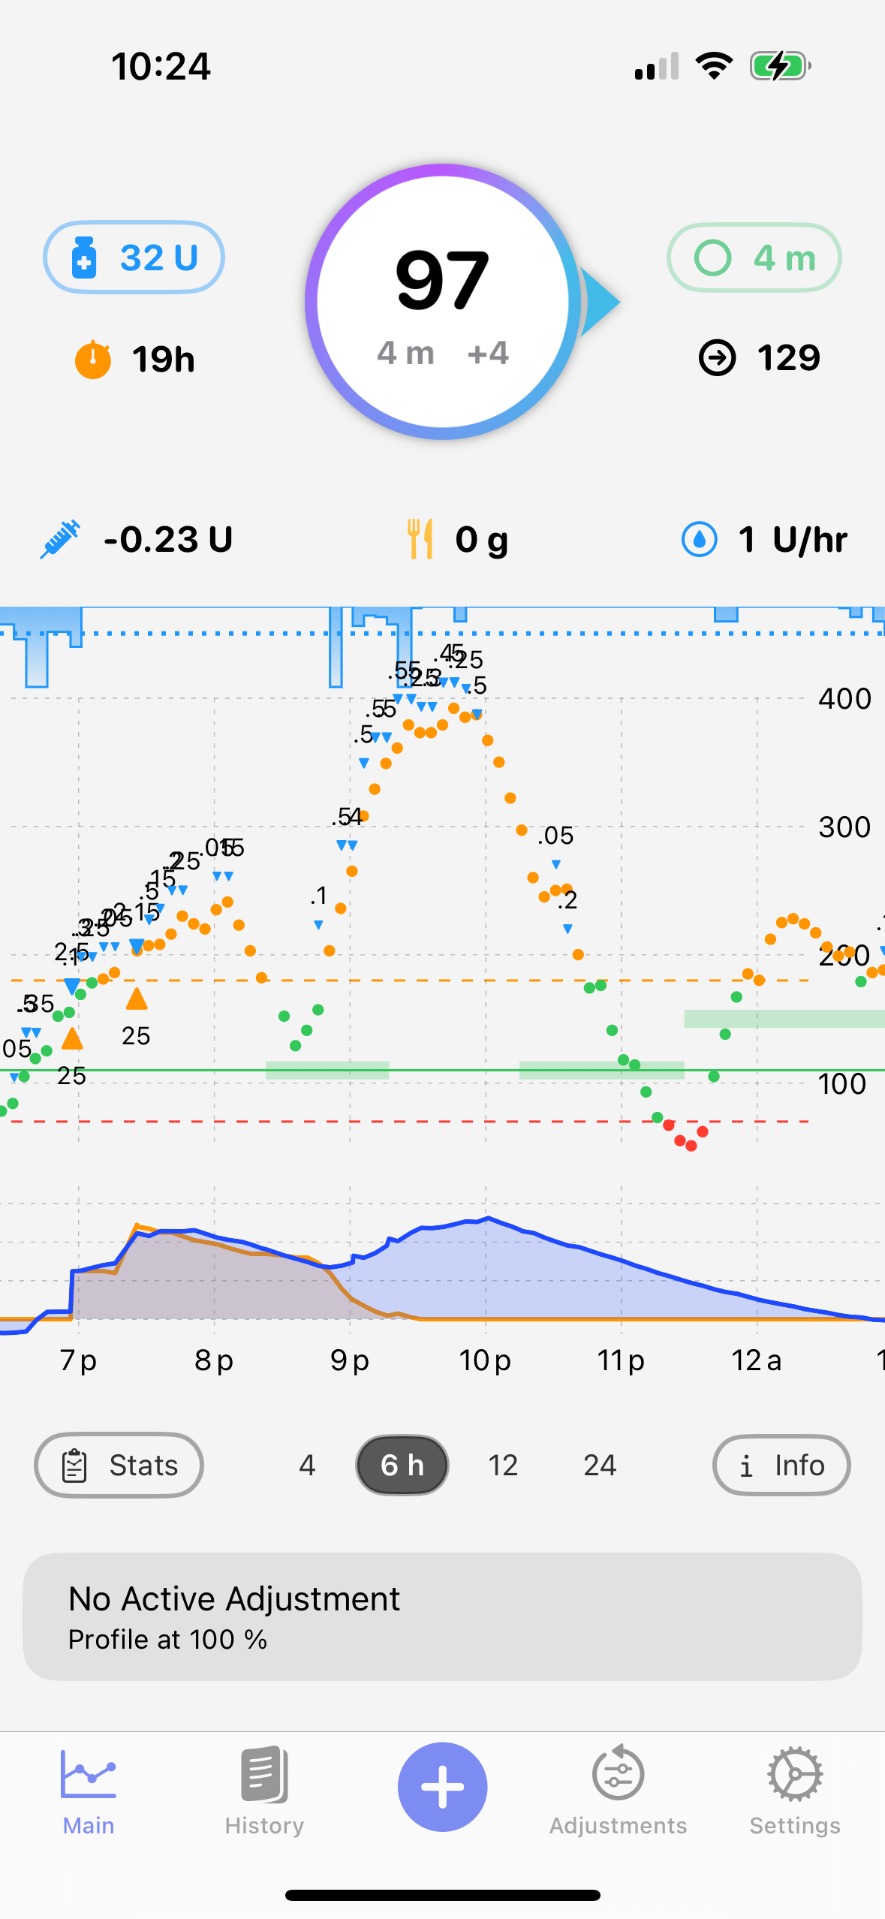
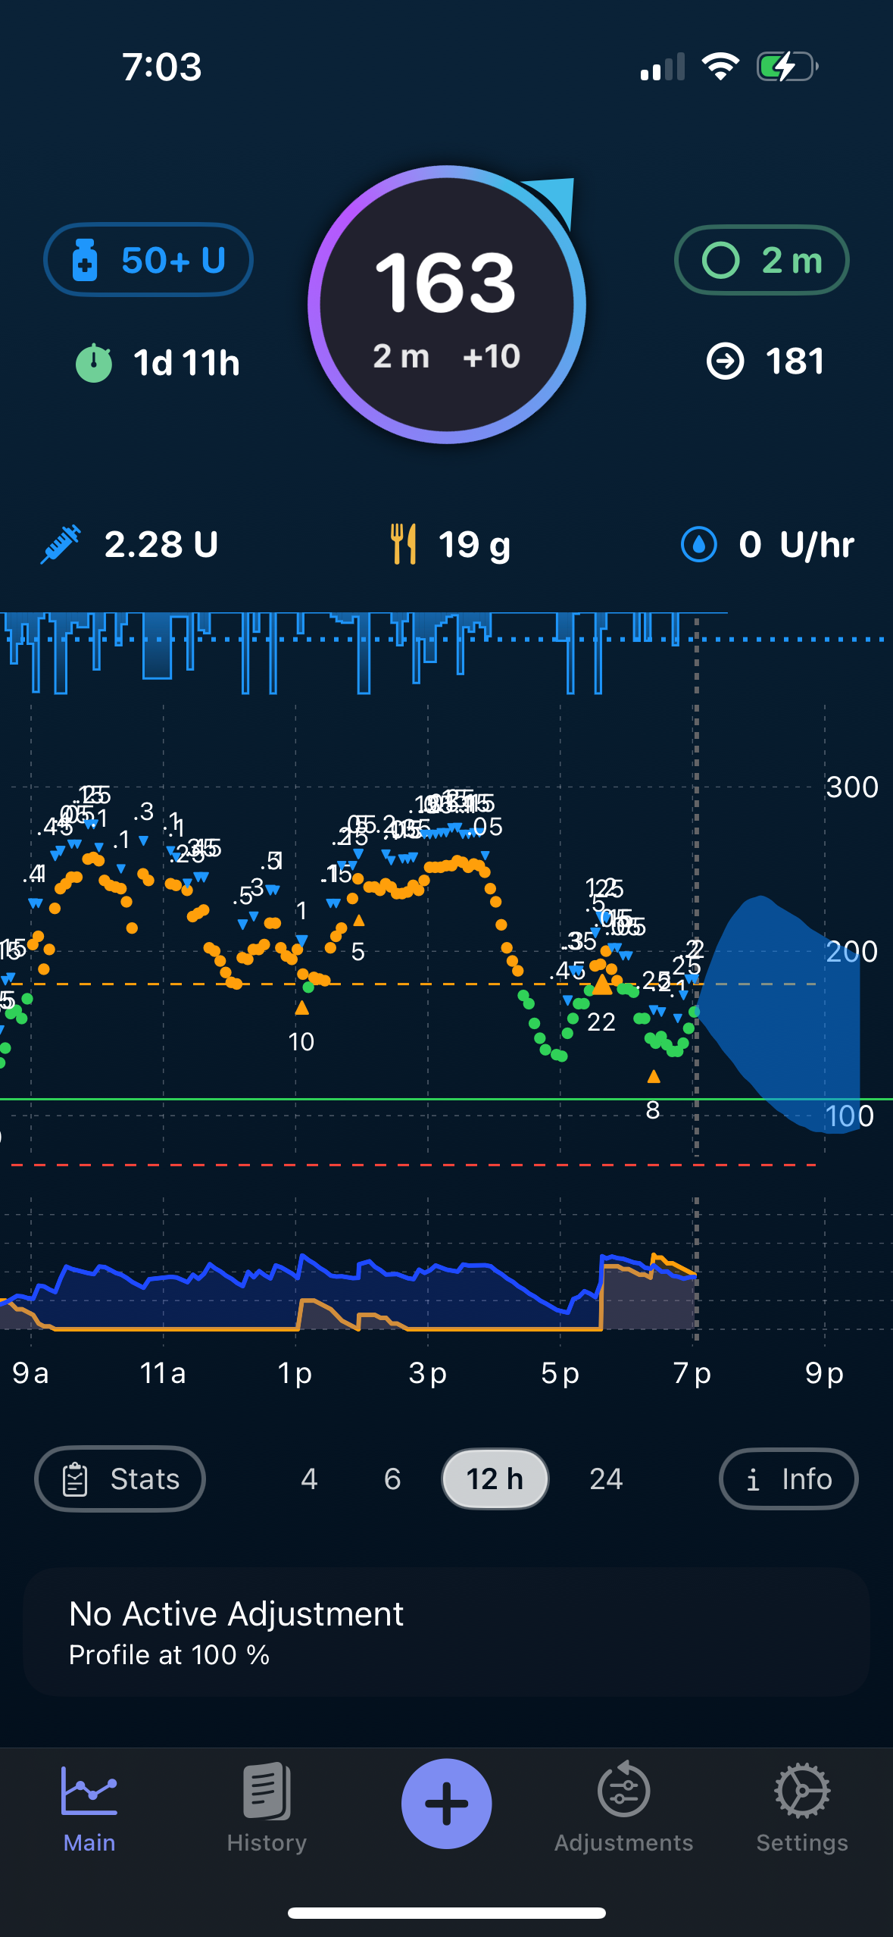
Reframing our Mindset
Choice versus Circumstance
Evolving understanding of things that contribute to glycemia
Perfection Does NOT Exist
Notes:
New diabetes subtype Compare to how we talk about and treat blood pressure or arthritis
Microbiome
New hormones - GLP

Slide 6
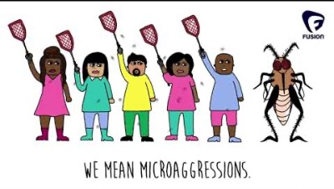
Stigma

Slide 7
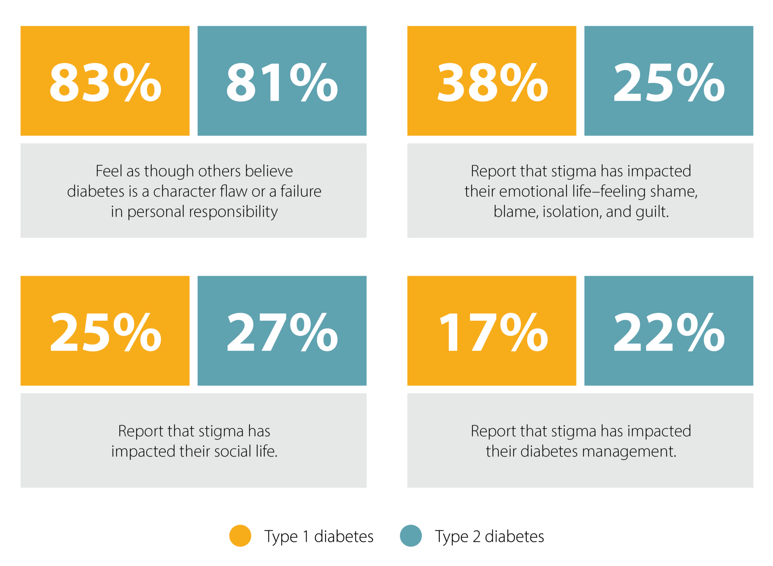
Stigma
Dstigmatize.org

Slide 8
Effects of Bias + Stigma
“Yeah. I just got offered that recently when I went to my doctor on Wednesday. Never before, and I've had it for a year and a half. I didn't know the technology existed.”
“I didn't really have a choice as to why I didn't get it [CGM and insulin pump]. I couldn't have it because my blood sugar was always high.”
“He [the doctor] just said if I was a bit more responsible, if I'm getting my numbers under control, then he would see if I should get the pump or not. But then in my mind I'm like, Wouldn't you want me to get the pump anyway so I can control my diabetes and so my numbers can get better?”
“I Didn't Really Have a Choice”: Qualitative Analysis of Racial-Ethnic Disparities in Diabetes Technology Use Among Young Adults with Type 1 Diabetes, Diabetes Technology & Therapeutics, September 2021
Notes:
Story about Kat + Access to Insulin Pump @ Stanford

Slide 9
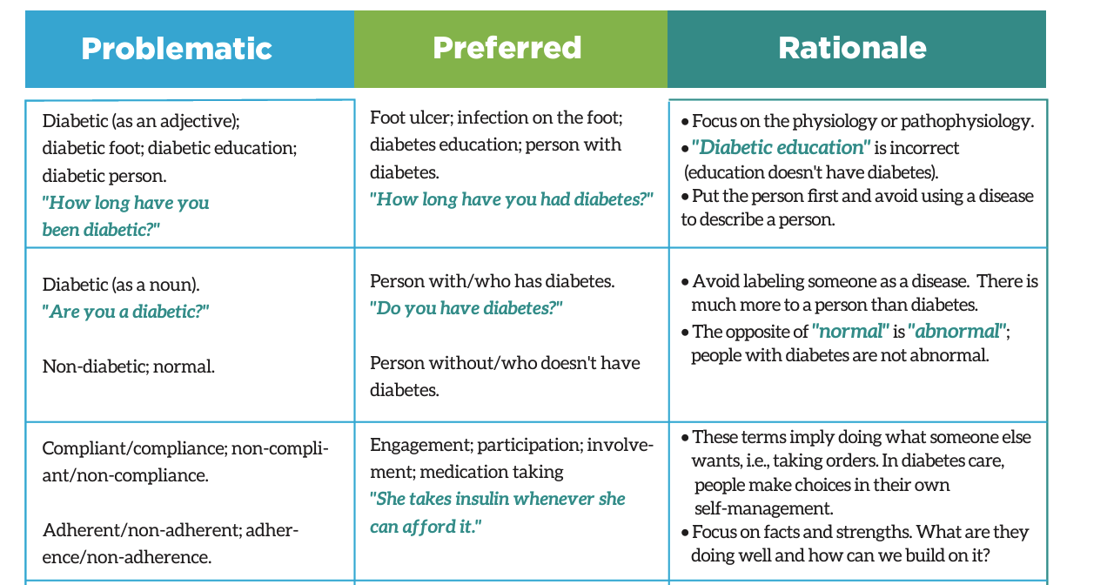

Slide 10
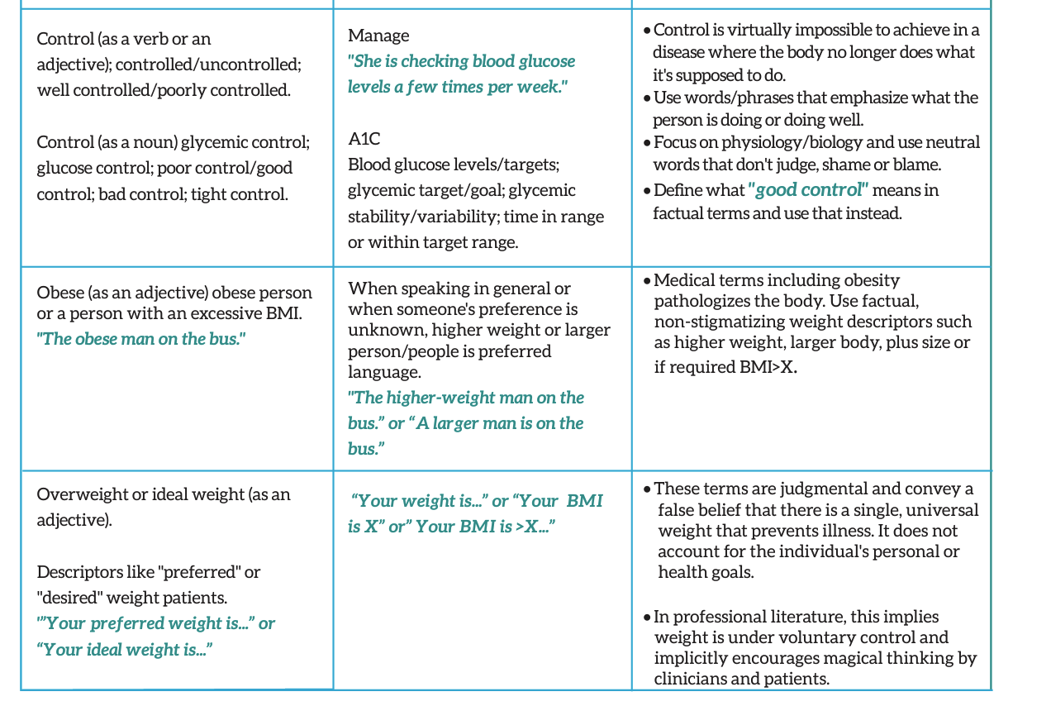

Slide 11
More than words
“People will forget what you said, people will forget what you did, but people will never forget how you made them feel” – Maya Angelou
“Stigma is communicated and perpetuated through our words and messages” – Jane K. Dickinson

Slide 12
Assigning morality
Non-modifiable circumstances
Implicit bias and socialization/upbringing
Intent versus impact
Harvard Implicit Association Test
We ALL have implicit biases
This is NORMAL and HUMAN

Slide 13
Human Connection
Knowledge is knowing that a tomato is a fruit; wisdom is not putting tomatoes into a fruit salad.
“Sit down, be humble” – Kendrick Lamar
We all desire respect and autonomy
In the healthcare provider-patient relationship, respect and trust are vital
Notes:
Just because you think you know something, doesn’t mean you fully understand it

Slide 14
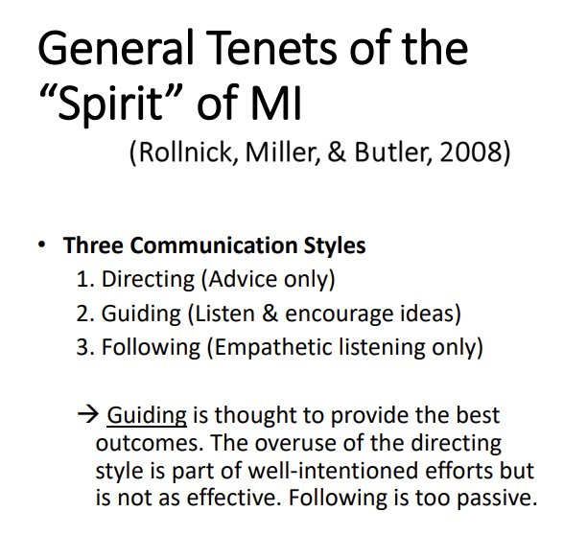
Motivational Interviewing – Jessica Kichler, PhD
Notes:
Why does this all matter

Slide 15
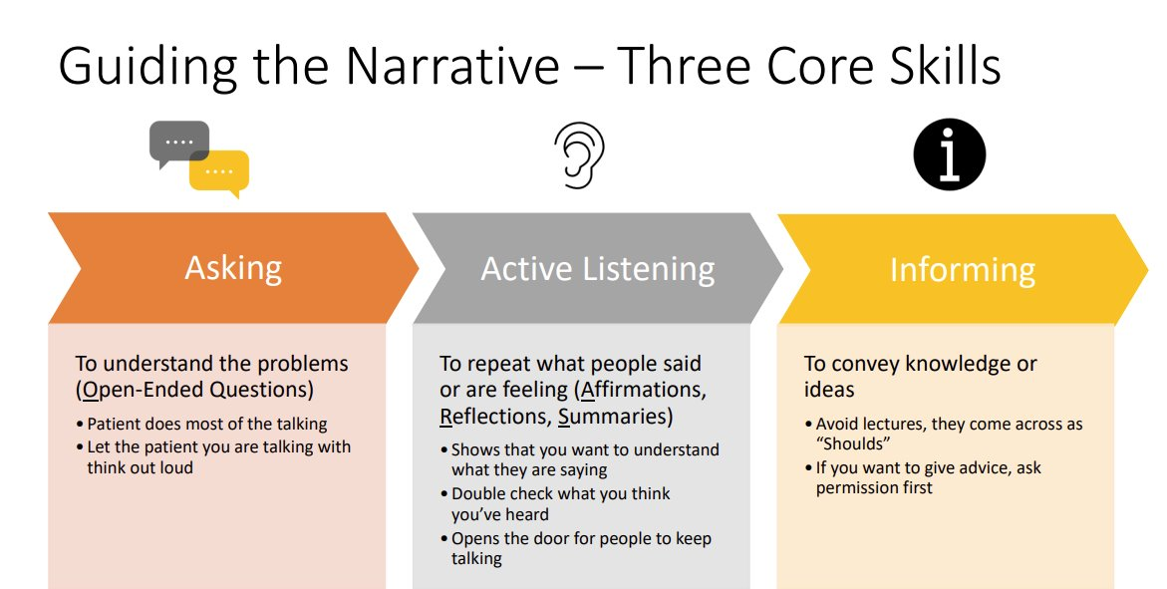
Motivational Interviewing – Jessica Kichler, PhD
Notes:
Why does this all matter

Slide 16
It’s a Full-Time Job with No Vacation
99.98% of the time PWD are managing their diabetes on
their own
Credit to Manny Hernandez

Slide 17
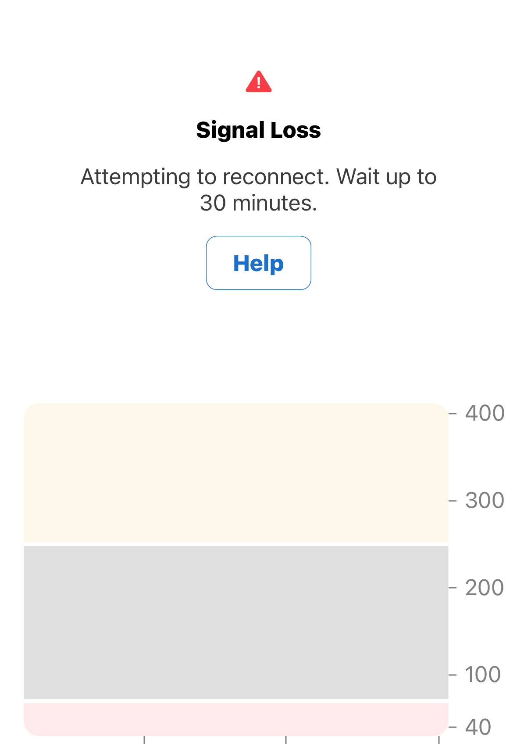
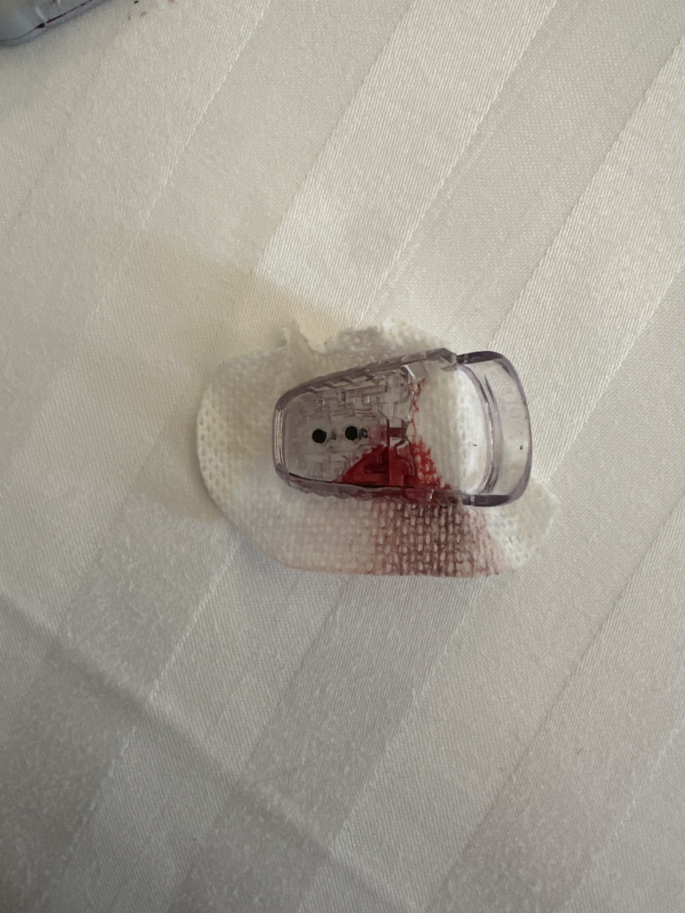
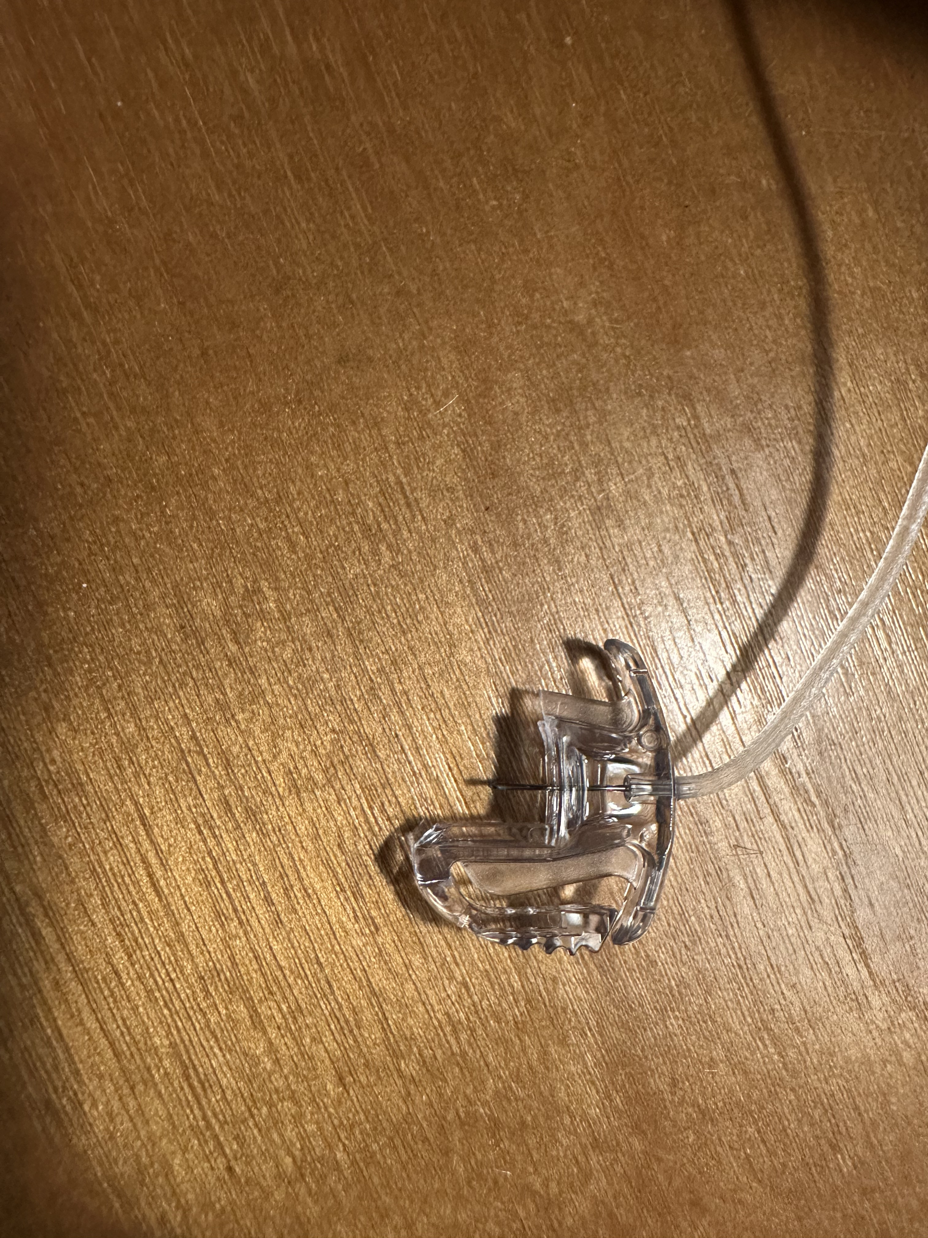
Insurmountable Variables
“Your A1C is pretty good for a type 1 diabetic”
“Why are you always alarming?”
”OMG your blood sugar is so high!”
“Can you eat that?”
Notes:
Many times values do not align with implicit biases

Slide 18
Hazel’s College Submission
They said it like a promise, something sure and solid. I was eight, and I believed them. I held onto those words like reins in a storm. Five years came and went. The cure never showed up. So I stopped waiting, and I started living.
The day I was diagnosed with Type One Diabetes, I was wearing my favorite pair of scuffed-up boots. I didn’t understand exactly what was happening, but I knew life was changing. One minute I was a kid, running barefoot through the fields, and the next I was learning how to count carbs and give myself shots. There were no breaks after that. No days off. Just constant monitoring and planning and hoping I’d stay steady. I wasn’t just the girl with diabetes. I was the girl who loved horses.
Even before I could walk, I’d press my face to the screen whenever a horse galloped across it. I watched Racing Stripes so many times I wore out the DVD. “Horse! Horse! Horse!” was basically my first sentence. When I get to be around them in life, something clicks. Horses didn’t ask me about my blood sugar. They didn’t flinch at my insulin pump. They just looked me in the eye and waited to see if I’d show up with calm, with confidence, with presence. When I’m with them, I’m not broken. I’m whole.

Slide 19
Hazel’s College Submission
Living with Type One isn’t just a medical condition – it’s a full-time job. You manage numbers like a math teacher, prep like a survivalist, and stay cool under pressure like a firefighter. You do it while trying to be a normal kid. I learned fast that most people don’t get it. Some were kind. Some weren’t. I was bullied, left out, even blamed for things I couldn’t’ control.
I didn’t let that break me.
I kept showing up at school, at the barn, in life. Boots on, shoulders back. I smiled when it was hard. I kept going when it hurt. Slowly, I learned that resilience isn’t always loud. Sometimes it’s quiet and steady, like the rhythm of hooves on dirt. When I was thirteen, I went to the Friends for Life conference. For the first time, I wasn’t the “weird diabetic girl.” I was just another kid who got it – and was gotten. That week changed everything. I realized that my story could help someone else feel less alone.

Slide 20
Hazel’s College Submission
So I started BG Waves, a lifestyle brand for people with Type One. I built the website, designed the clothes, and wrote out my stories. It’s about comfort and strength, about community and courage. Where the designs empower you to wear your journey with confidence. About turning our hardest moments into something beautiful and bold.
Even now, there are days when my blood sugar crashes out of nowhere, or I feel tired of being so “on.” I’ve learned though: strength isn’t about being fearless. It’s about standing tall even when you’re scared. And I do that every day. I’ve met others like me, people who live with this disease and still chase big dreams. We’re not broken, we’re built different. We rise, again and again.
So no, I don’t know when the cure will come. But I do know this: I’ve got boots on my feet, horses in my heart, and a fire in my soul. And I’m not going anywhere.

Slide 21

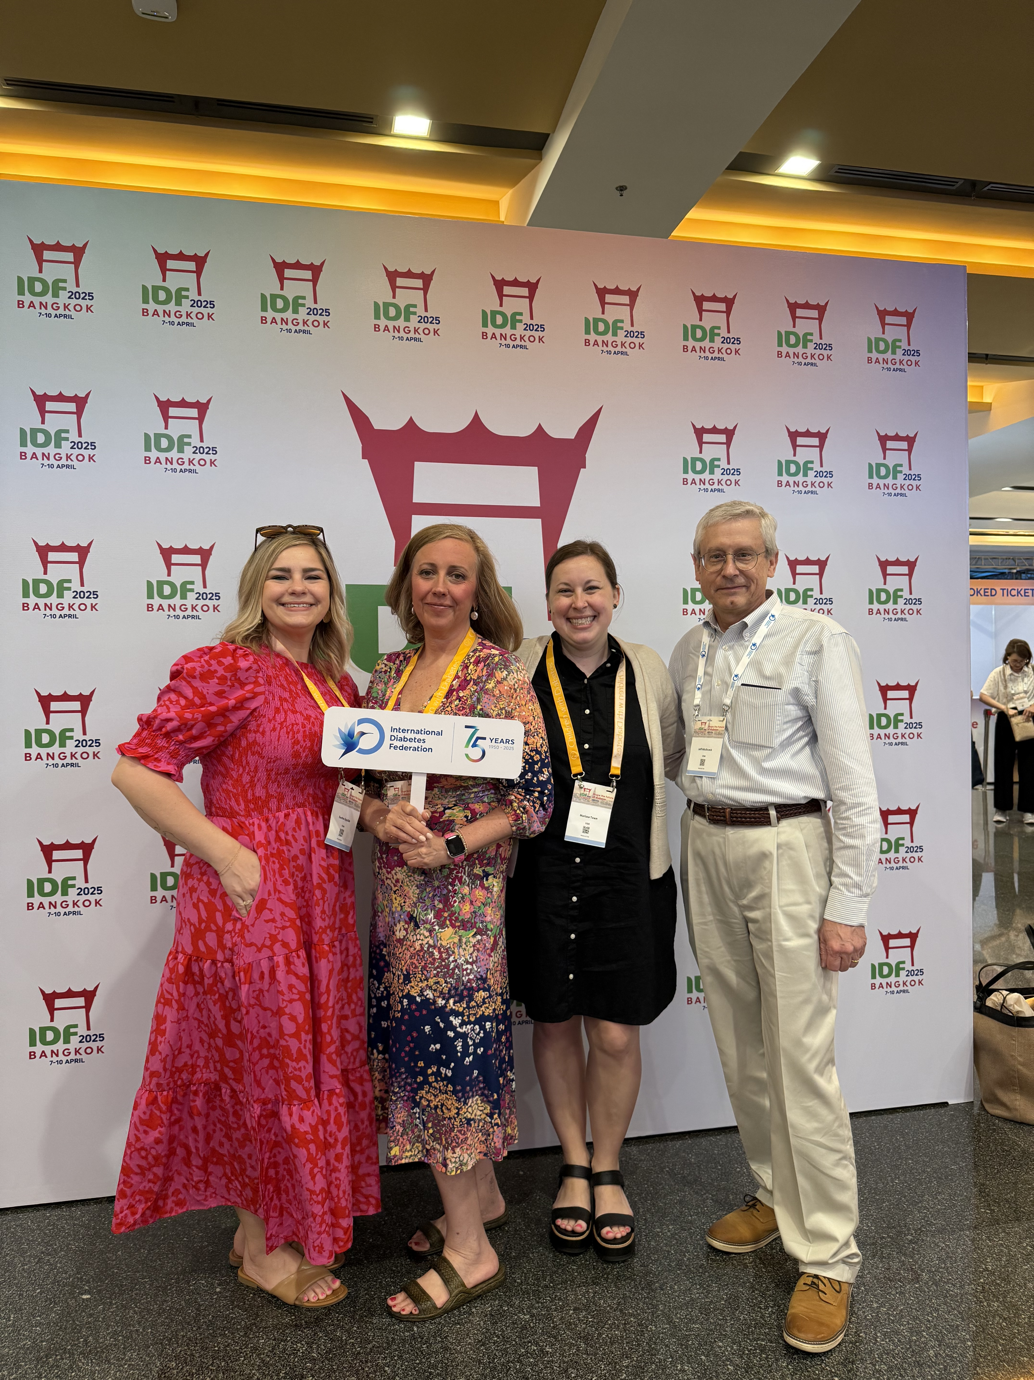
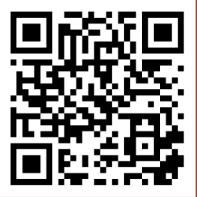
Thank you for Listening
Check Out My Glucose Data
Marissa Hitchcock, PWD, BSN, RN, CDCES | Clinical Director
marissa@childrenwithdiabetes.com

