Slide 1
Children’s Healthcare of Atlanta

Slide 2
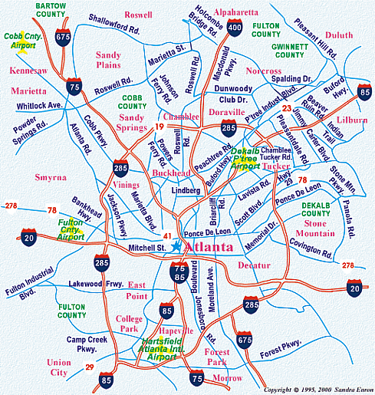
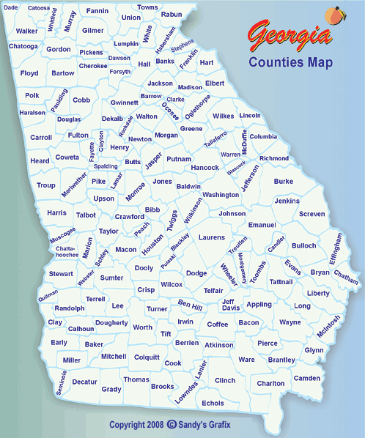
Atlanta

Slide 3
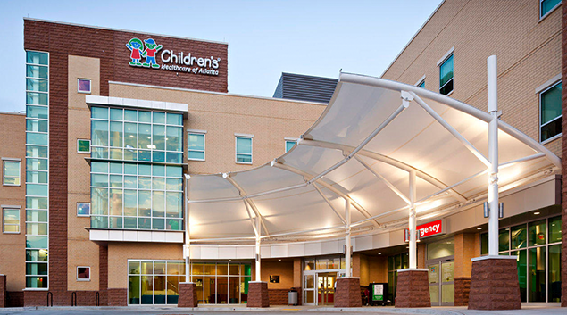
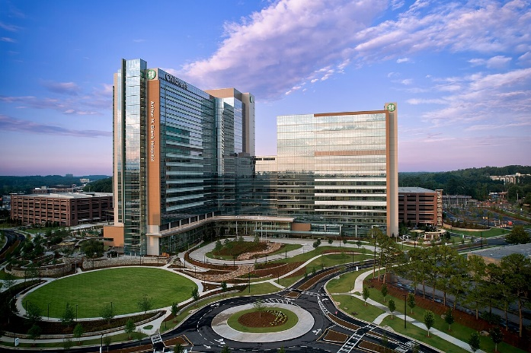
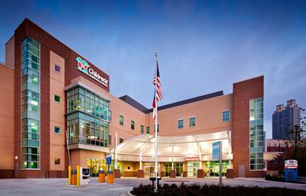
Children’s Healthcare of Atlanta
Scottish Rite Hospital
319 inpatient
ER
Arthur M Blank Hospital
446 inpatient
Hospital based clinics
69 ER
Hughes Spaulding Hospital
24 inpatient
Outpatient clinics
Emergency room
Grady/Children’s collaboration

Slide 4

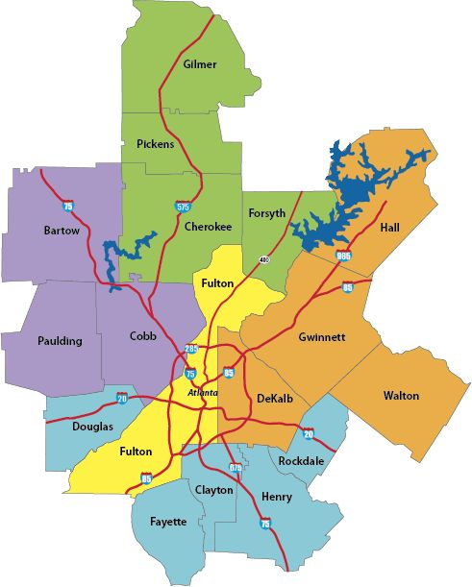
Children’s Healthcare of Atlanta - providers
Are team includes:
22 MDs
1 PAs
7 NPs
8 inpatient diabetes educators
13 outpatient diabetes educators
2 endocrine psychologists
11 nurses
3 Social workers
1 nutritionist
1 T2D physical trainer
We have 7 clinic locations around Atlanta

Slide 5


Children’s Healthcare of Atlanta - patients
In 2024, we saw
3394 kids with T1D
334 new onset
45% public insurance
963 kids with T2D
155 new onset
68% public insurance
Additional Specialty clinics
T1D predisposition
Bone
Thyroid cancer
Brain Tumor
Cancer survivor
Differences of sex development
Strong 4 Life
DiGeorge
Lipids
Turners
CFRD

Slide 6
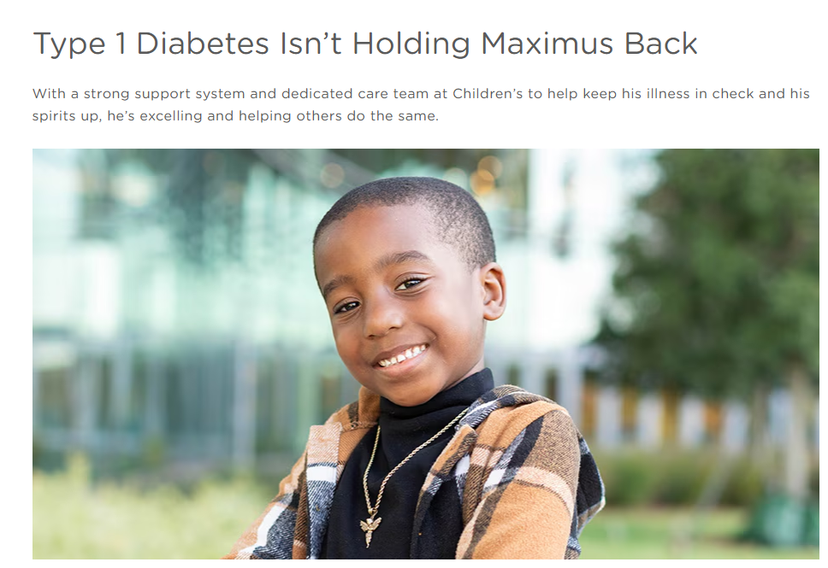
Thank you

Slide 7
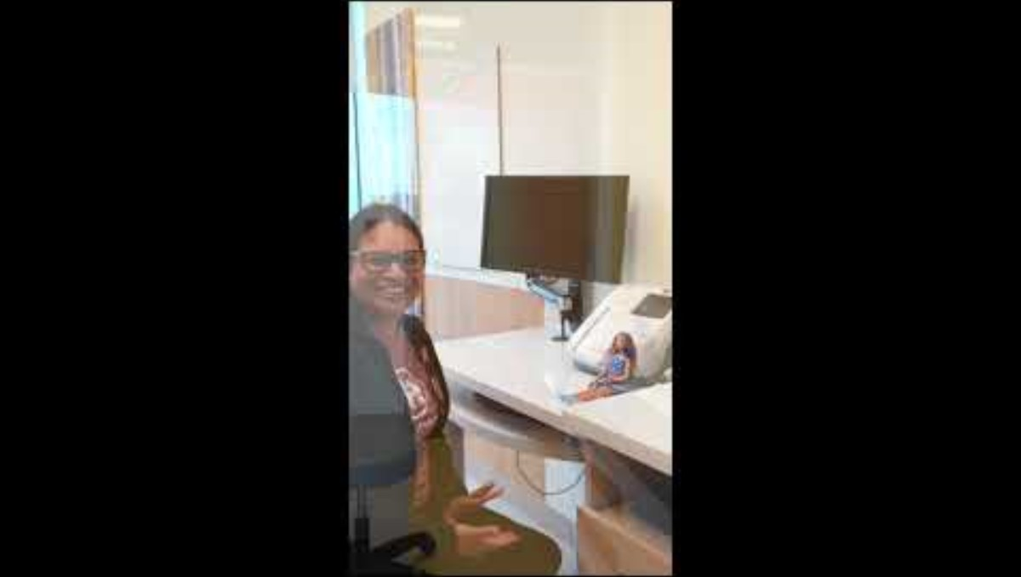
Barbie Video

Slide 8




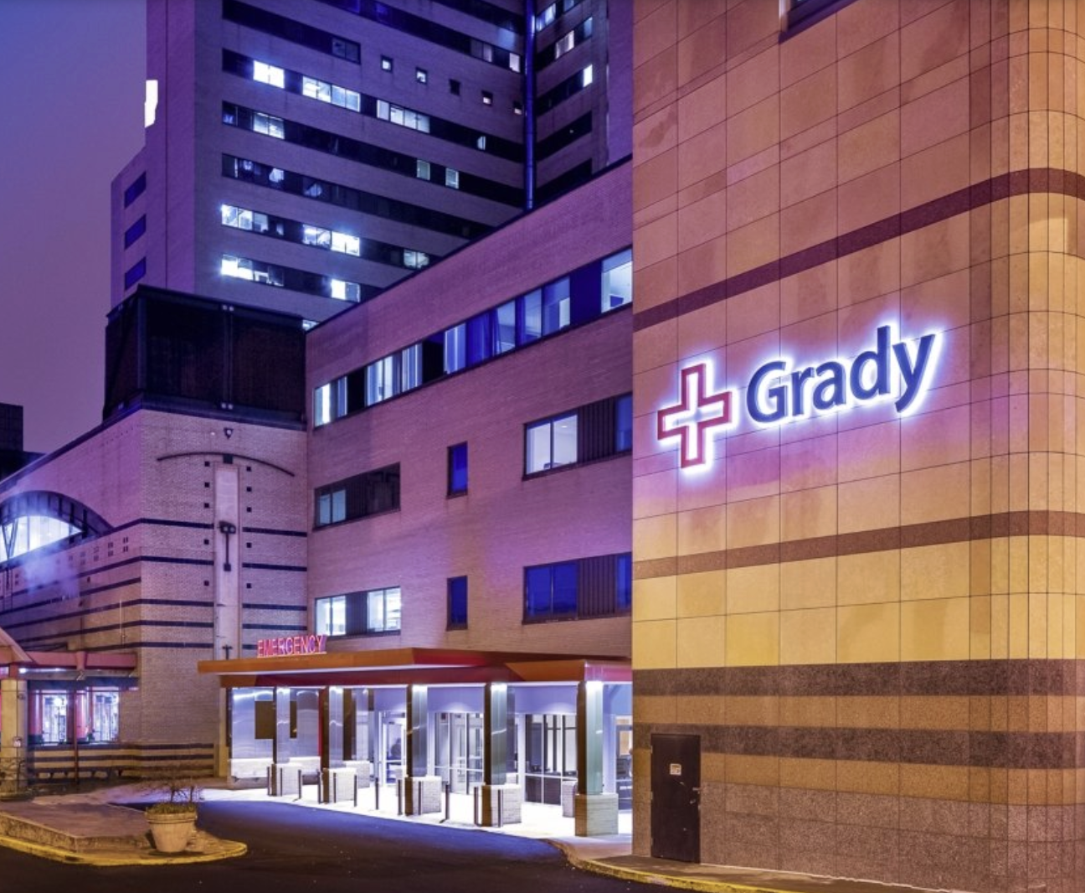
Grady Health
System

Slide 9
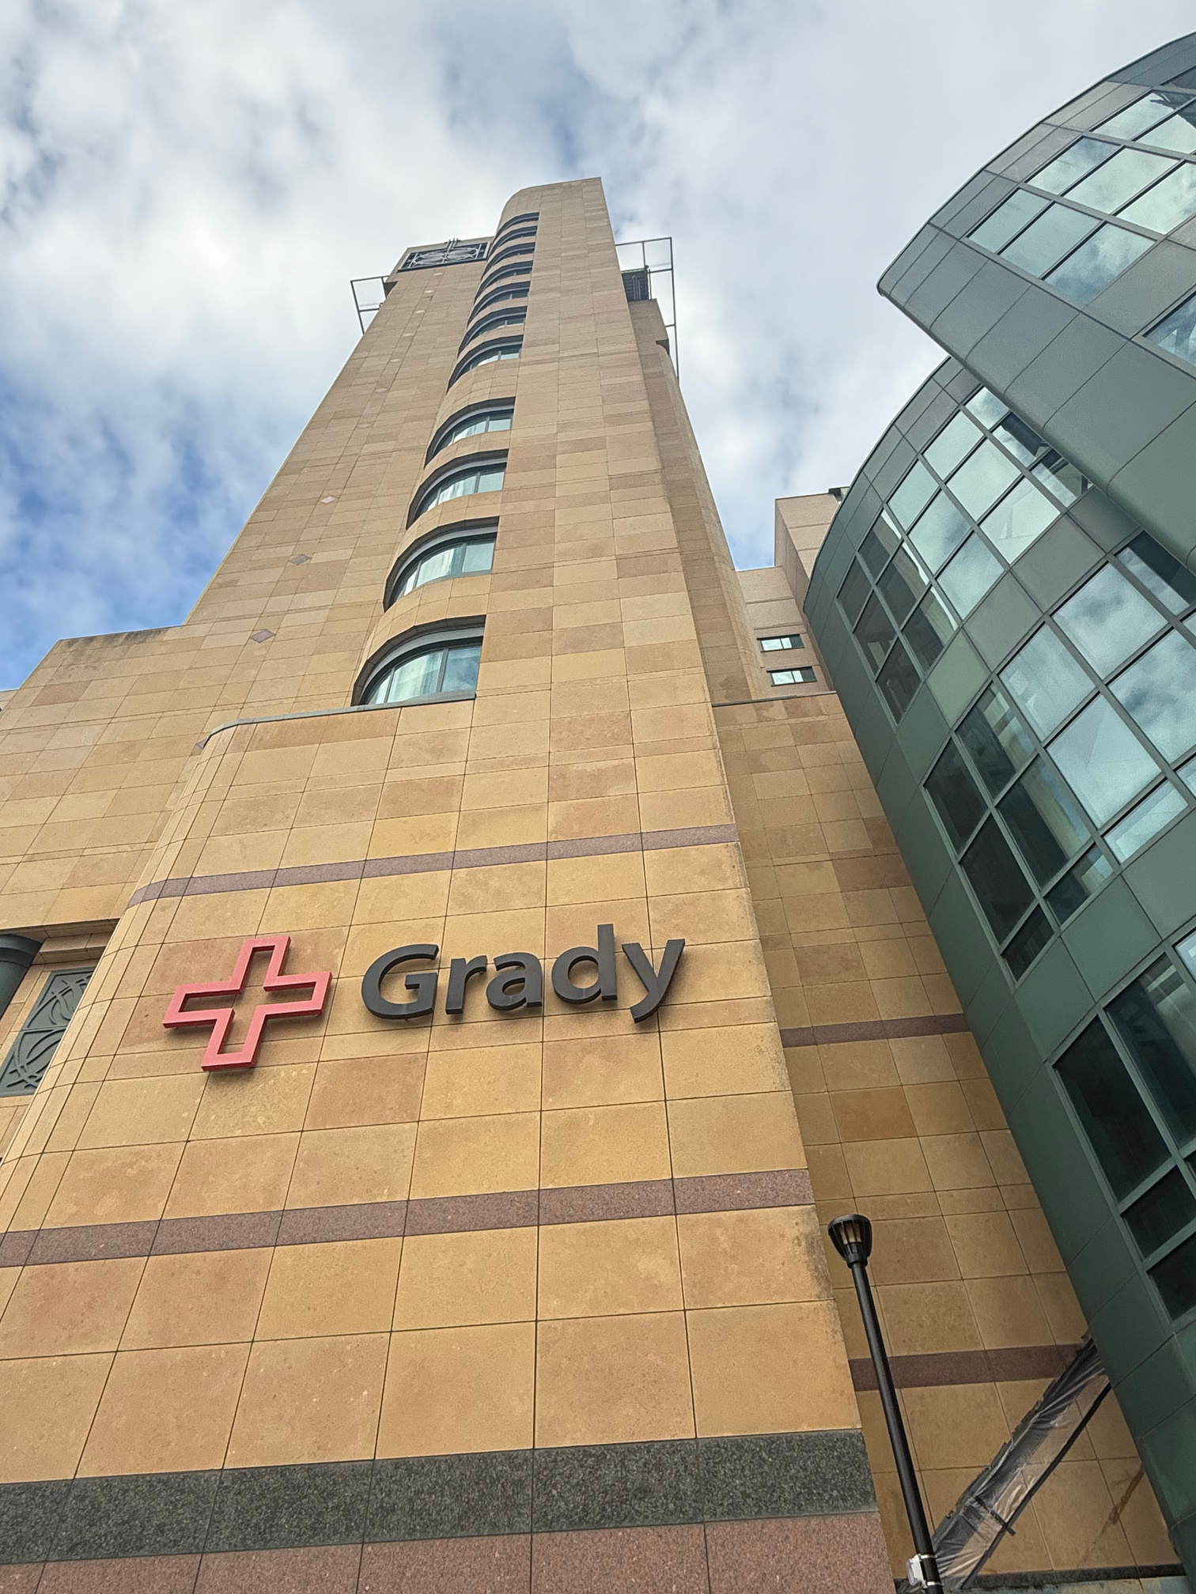

Introduction to
Grady Memorial Hospital
Established in 1892 as a 110-bed facility.
A 953-bed acute care teaching hospital located in downtown Atlanta.
Serving as the cornerstone of care for Atlanta.
Known as the premier trauma center in the State of Georgia and is the only Level I trauma center in the greater Atlanta area.

Slide 10
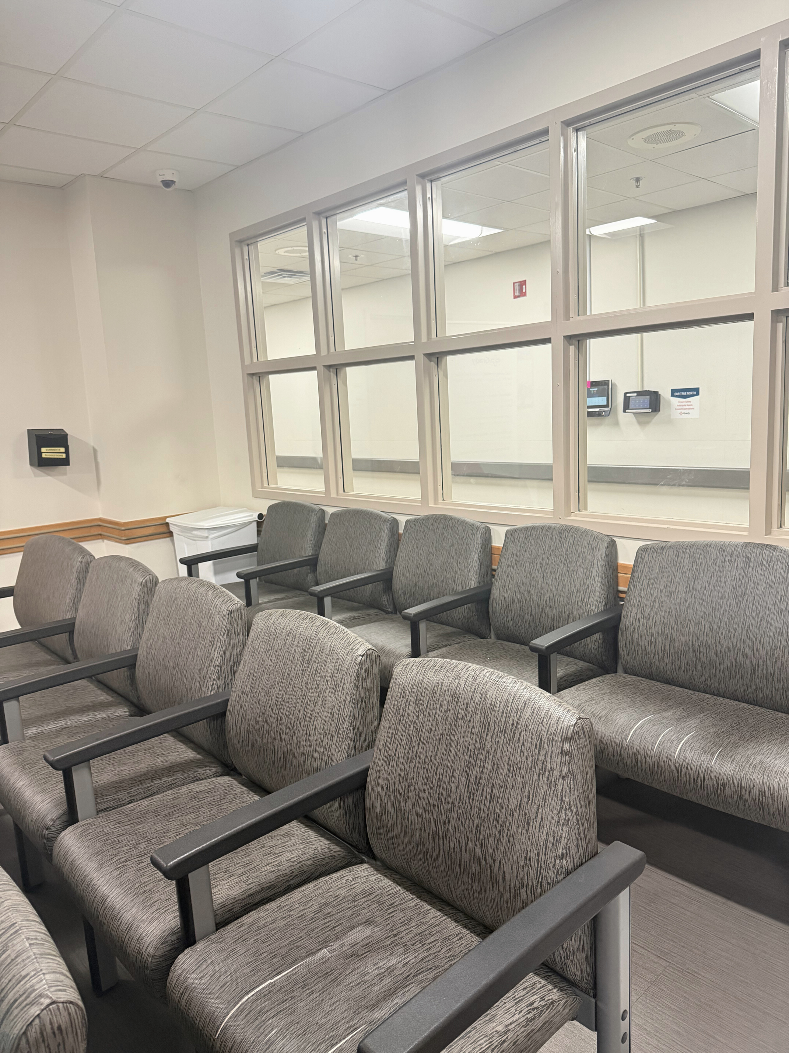
Main campus and major centers
Grady Memorial Hospital: 953-bed acute care teaching hospital.
Marcus Trauma Center: Level 1 Trauma Center, providing comprehensive emergency and trauma care.
Burn Center: Comprehensive burn center for adults and children.
Marcus Stroke and Neuroscience Center: Designated Advanced Comprehensive Stroke Center.
Georgia Comprehensive Sickle Cell Center: 24-hour comprehensive primary care clinic for adult sickle cell patients.
Georgia Poison Center: Certified and accredited poison control center.
Satellite and outpatient facilities
Primary Care Satellite Clinics: 5 free-standing clinics providing primary care services in family medicine, internal medicine, and pediatrics.
Correll Pavilion: A new outpatient facility that houses a variety of clinics, pharmacy, imaging, and more.
Cancer Center: Outpatient clinics for cancer treatments, genetic counseling, and support services.
Specialty Clinics: Outpatient specialty clinics are available on the main campus and at other locations, including those for HIV/AIDS, heart and vascular care, orthopedics, women's health, and more.
Infectious Disease Center: Comprehensive center for infectious disease care.
....

Slide 11
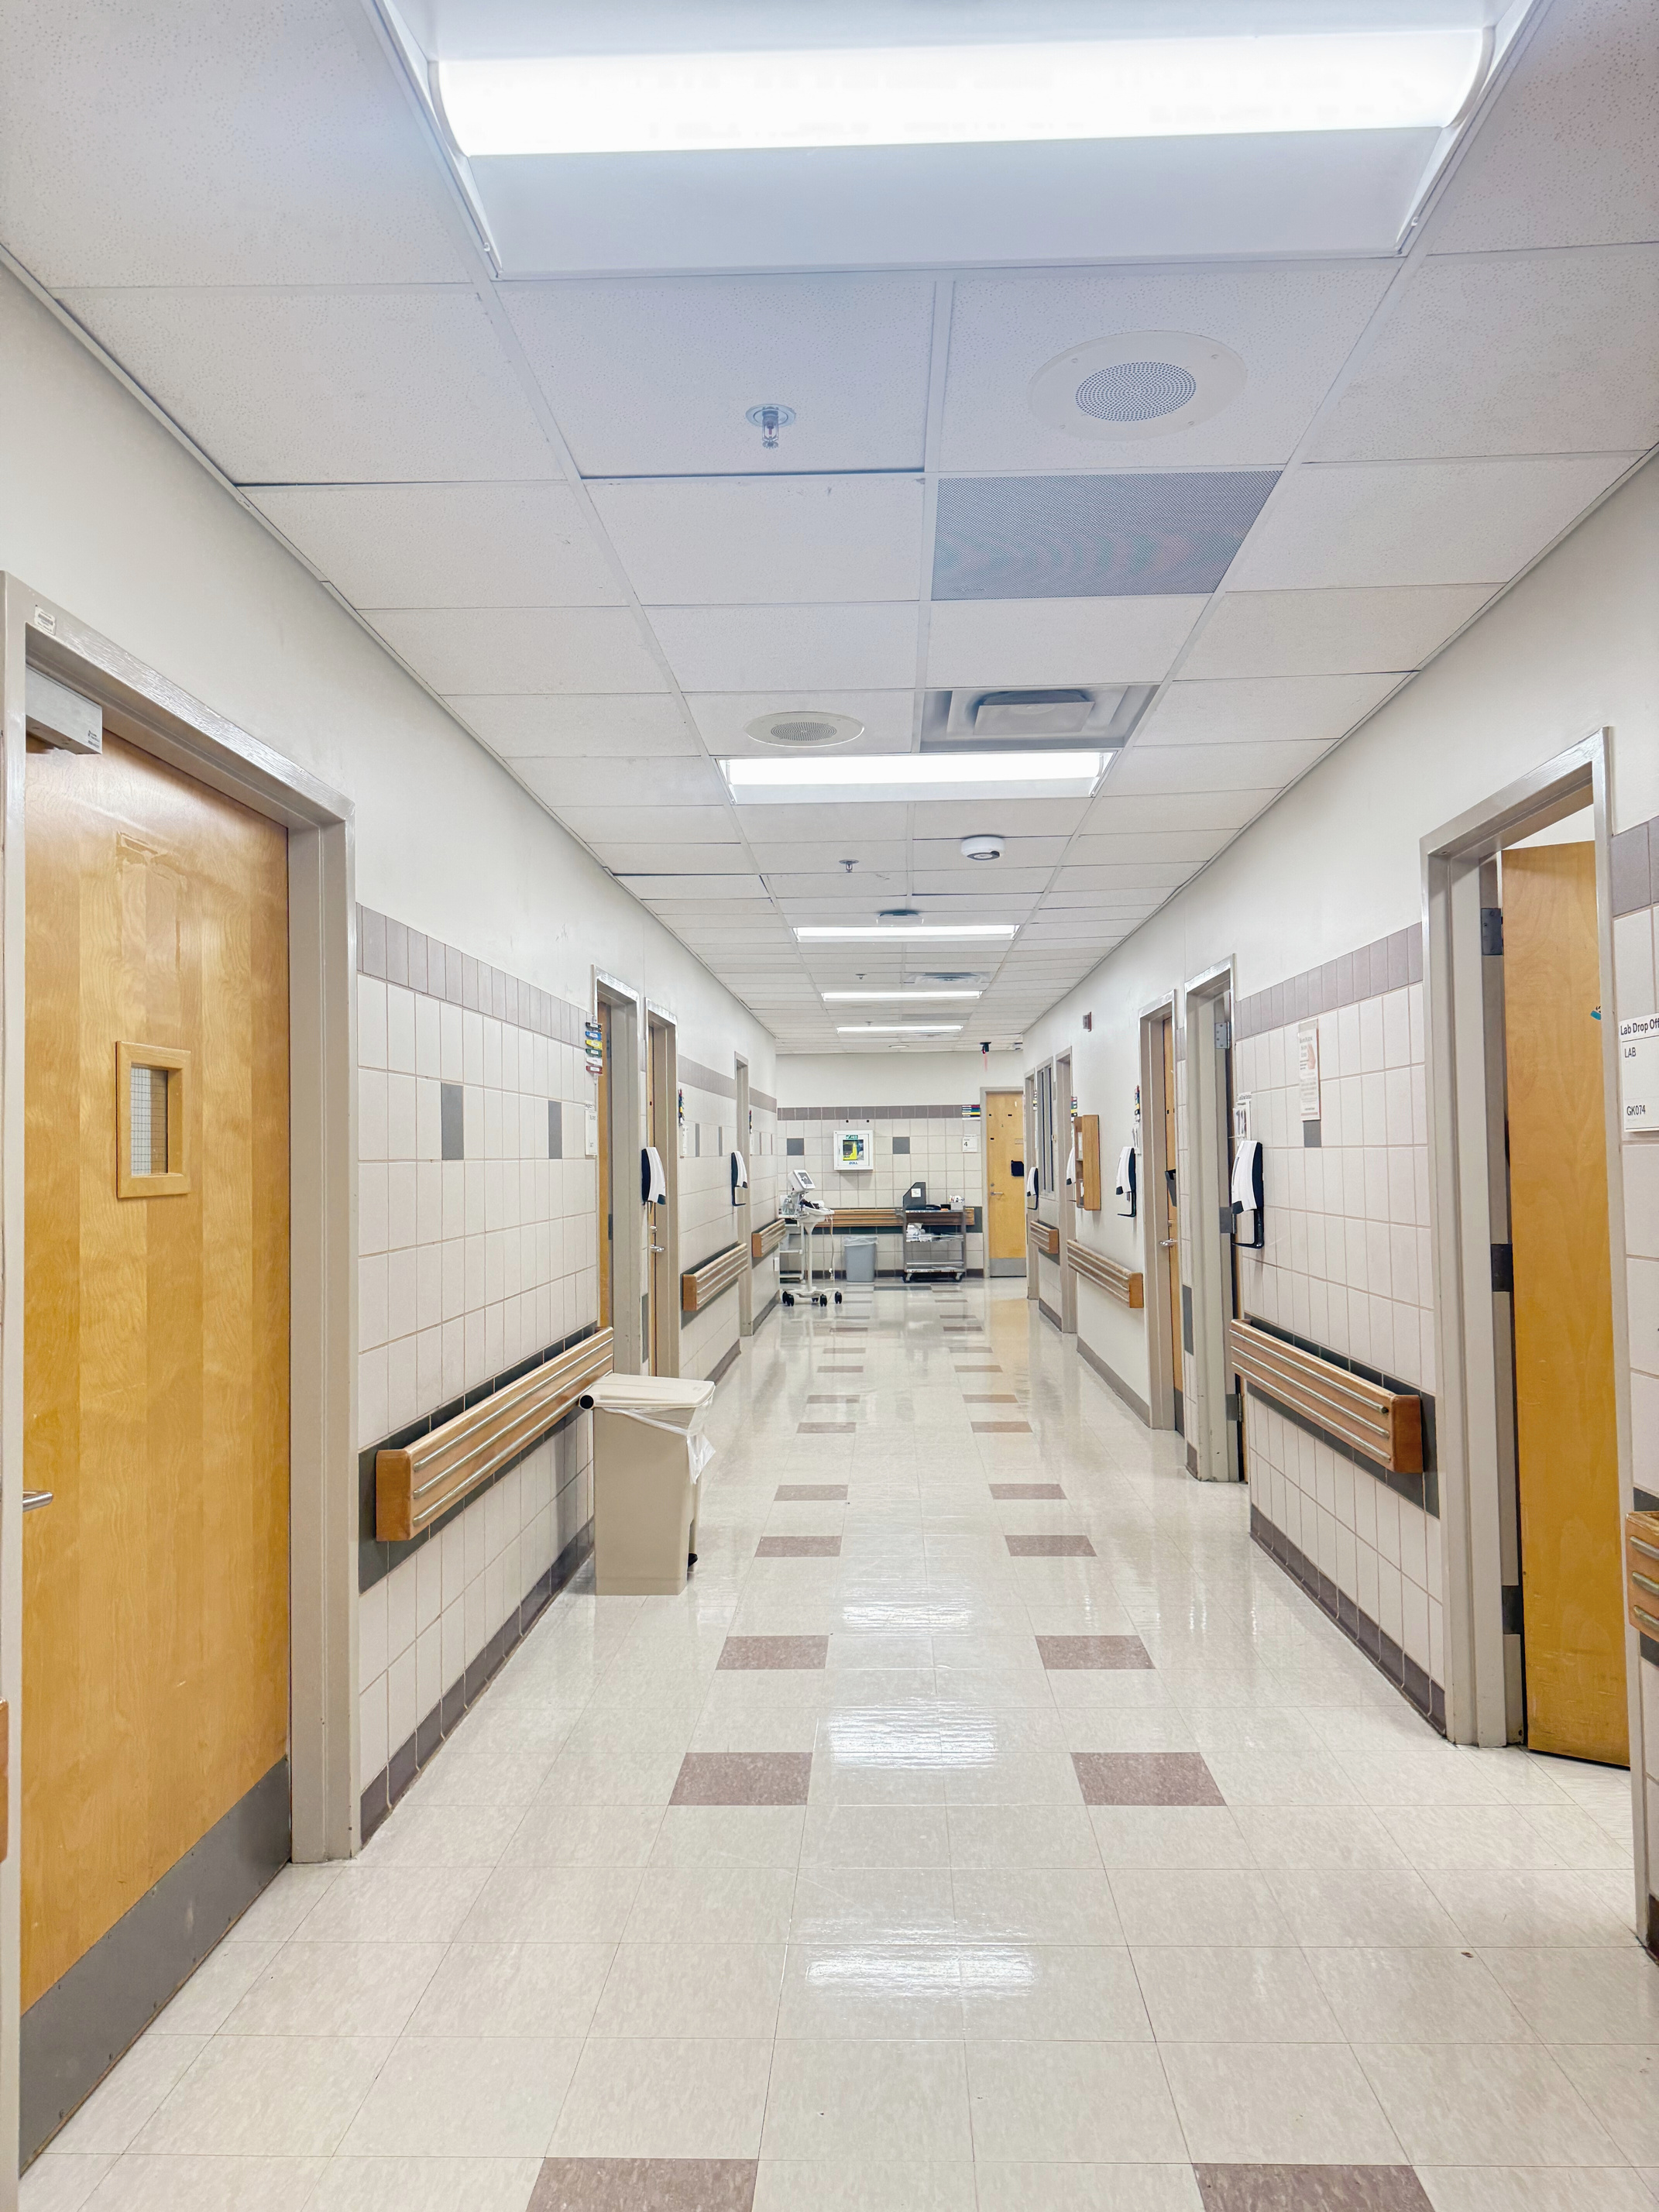
Grady Diabetes Center
Diabetes Specialty Care
Type 1 Diabetes Clinic
9 Endocrinologists
2 Clinical Pharmacists
1 Nurse Practitioner
2 RD/CDCES
3 Registered Nurses
5 Medical Assistants
2 Inpatient CDCES
Retinal imaging capability
2 Endocrinologists
1 Clinical Pharmacist/CDCES
1 RD/CDCES
1 Registered Nurse
1 Patient Navigator
Podiatry Clinic
4 Podiatrists
1 Wound Care Nurse
1 Podiatry LPN

Slide 12
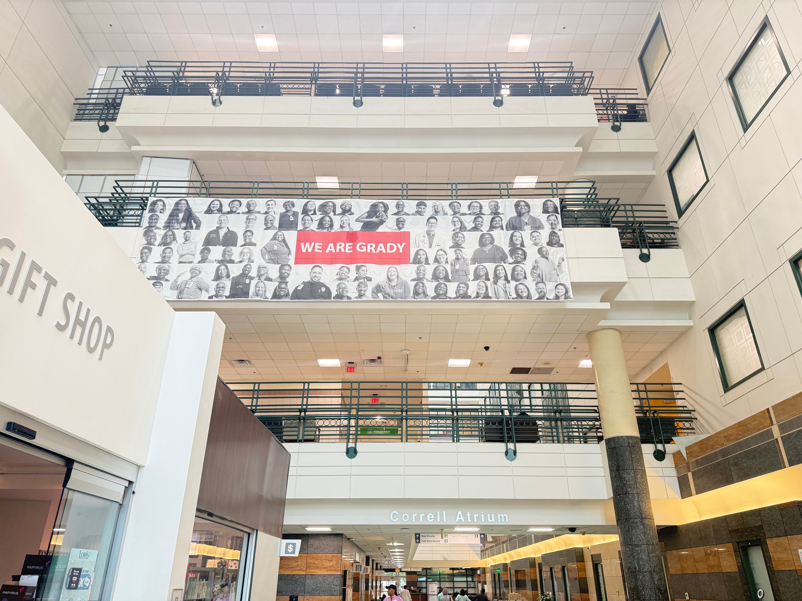
Clinic Statistics
Total Patient Volume
7,002 (2024)
6,558 (2025)
​T1D Clinic Patient Volume
190 visits (2024)
388 visits (2025)

Slide 13
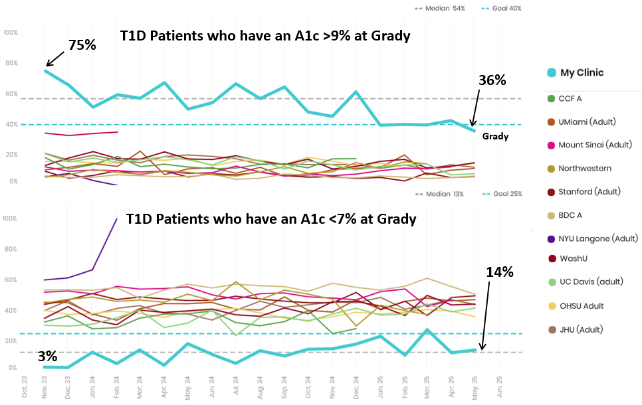
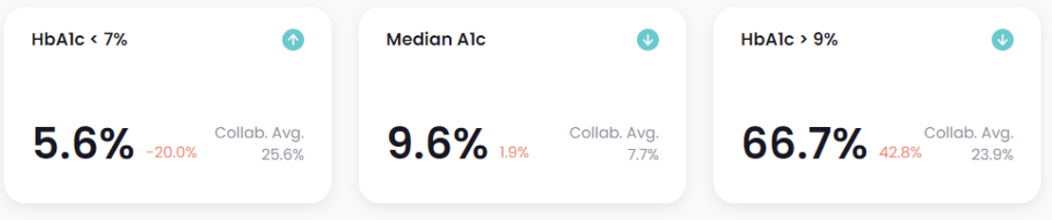
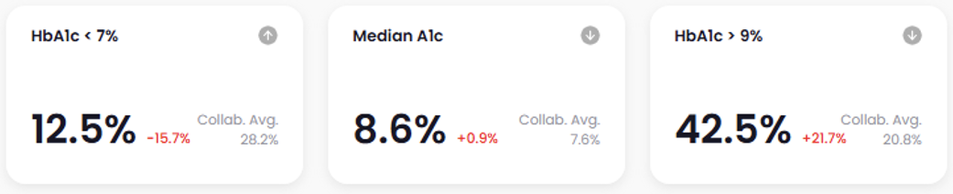
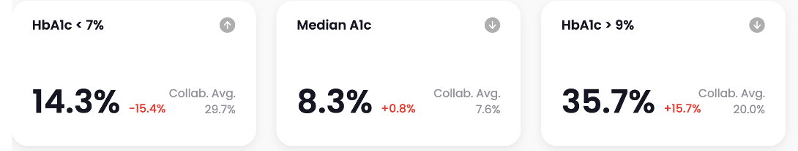
T1DX-QI Data Trends
June 2024
April 2025
May 2025

Slide 14

Research Endeavors in Diabetes Care
T1D Infrastructure and Care Models
T1D Program Navigator Grant (EMCF, PI: Davis)
Patient Registry
Integrated T1D and Mental Health support (MQ Mental Health Research, Breakthrough T1D, PI: Johnson)
T1DX-QI
Interdisciplinary Podiatric and Diabetic Foot Wound Care
Comprehensive Assistance and Resources for Effective Diabetic Foot Navigation (NIH/NIDDK, PI: Fayfman, Schechter)
Inpatient Diabetes Management
- Automated Insulin Delivery for Inpatients with Dysglycemia (NIH/NIDDK, PI: Pasquel)

Slide 15
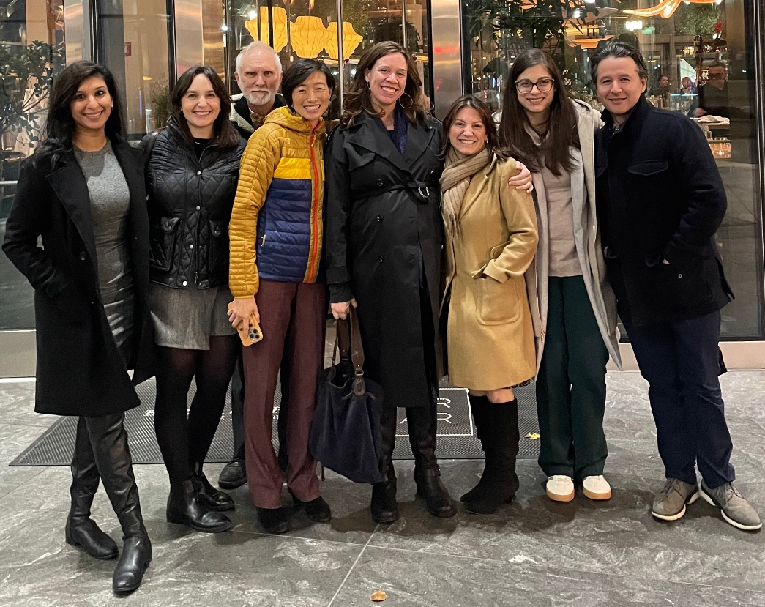
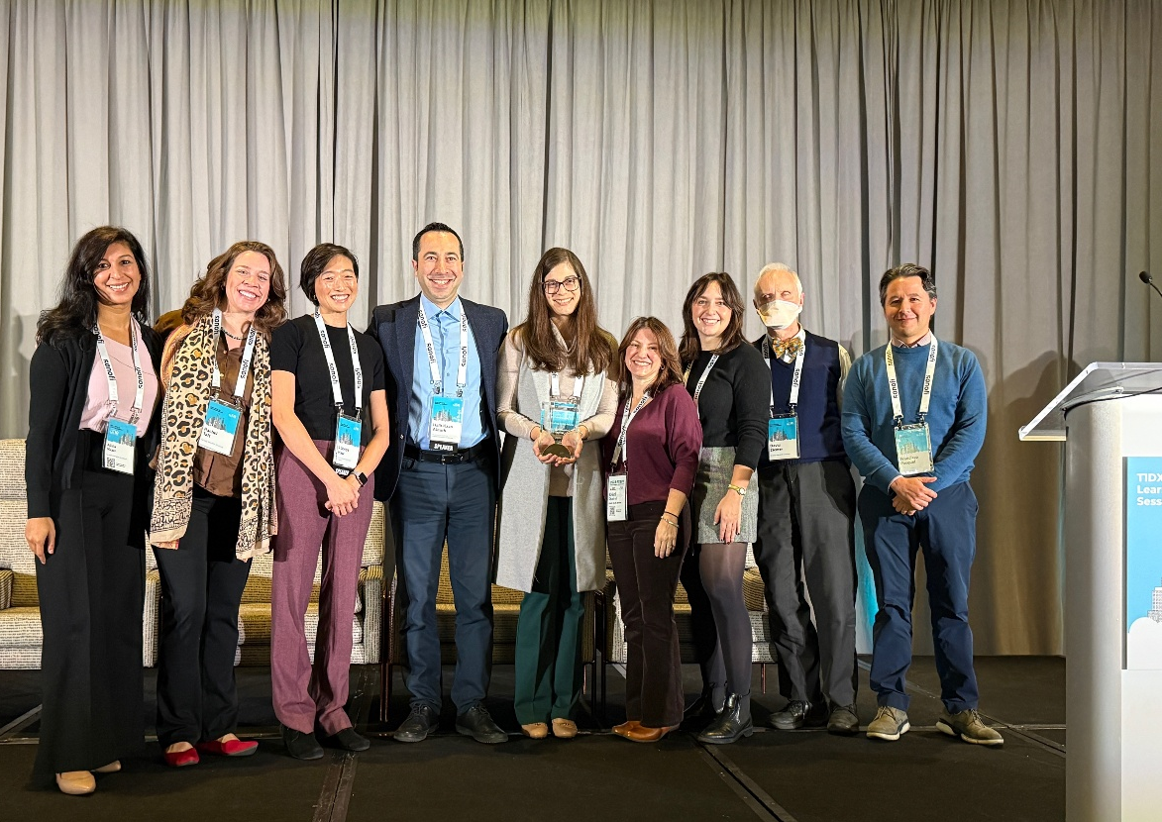
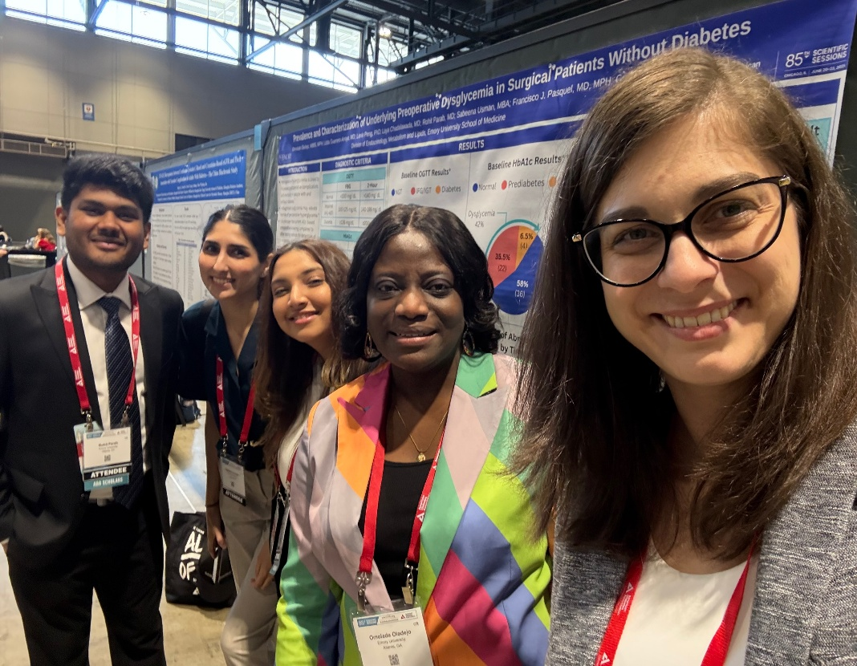
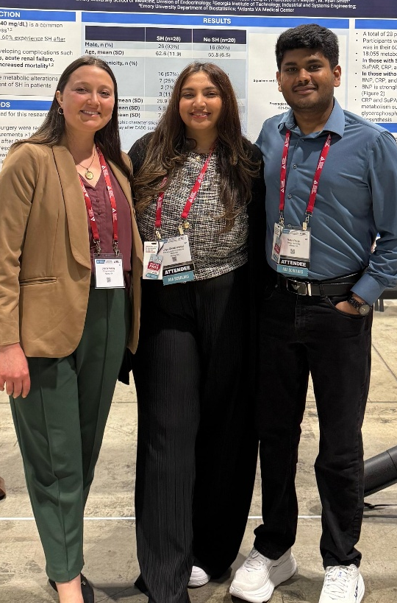
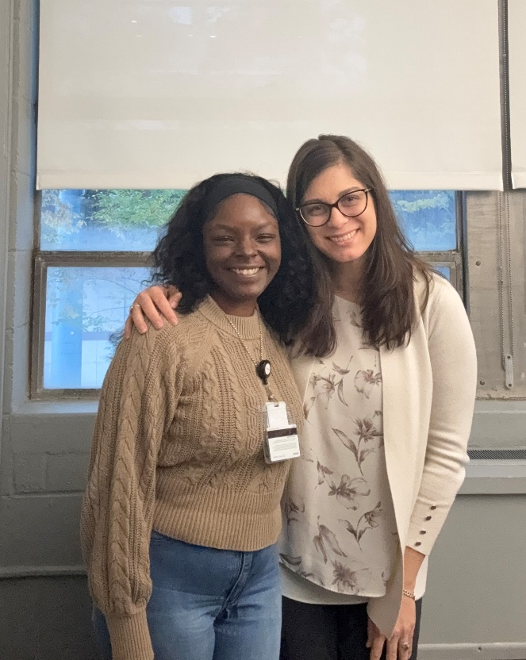

Welcome to ATL

