Slide 1



Slide 2

Welcome to the 9th Annual T1DX-QI Learning Session

Slide 3

Welcome, Logistics, + Agenda, Day 2

Slide 4
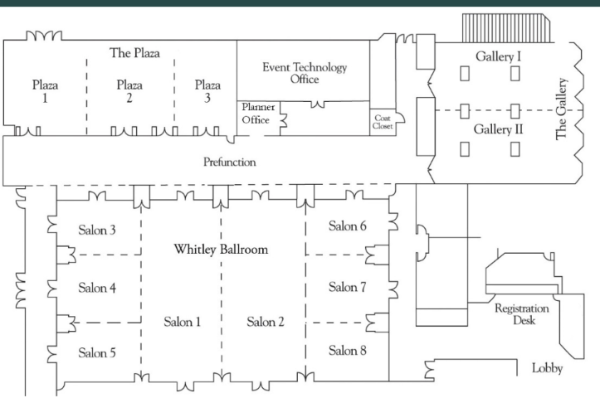

Section Header Here
Subtitle Here
Conference Rooms
Plenary sessions | Whitley Ballroom, Salon 1-2
Breakout sessions | Plaza 1-3 Salon 3-5 Salon 7-8
Sponsors & research partners | Prefunction area
Posters | Gallery I-II

Slide 5

Section Header Here
Subtitle Here
Logistics
Scan the QR code on your name badge for agenda.
If you have any food allergies or restrictions that you have not communicated yet, please contact a T1DX staff member.
T1D Exchange staff are here to help your get the most out of our time together. If you have any questions, please ask a member of the team.

Slide 6
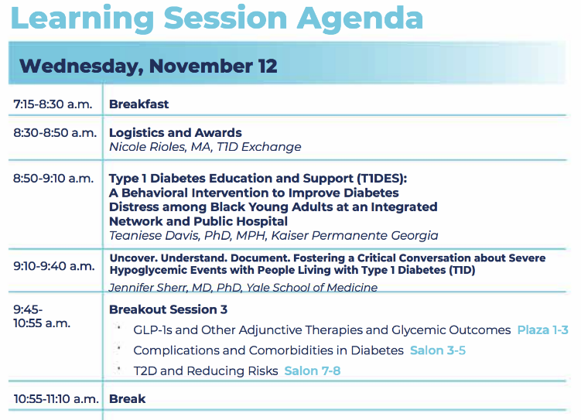
Section Header Here
Subtitle Here
Morning

Slide 7
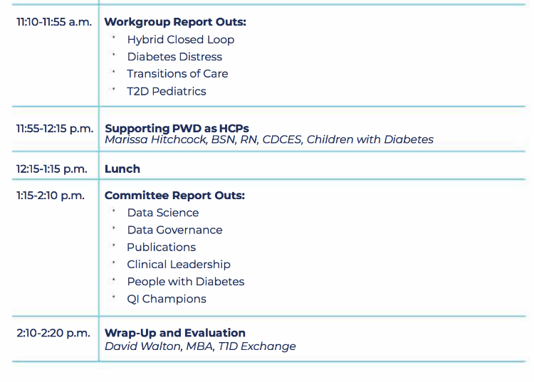
Section Header Here
Subtitle Here
Afternoon

Slide 8
Section Header Here
Subtitle Here
2025 Collaborative Awards

Slide 9
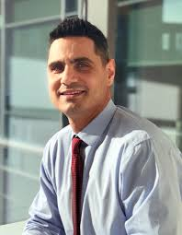

Section Header Here
Subtitle Here
Outstanding Adult PI
Dr. Nestoras Mathioudakis

Slide 10
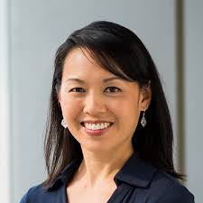

Section Header Here
Subtitle Here
Outstanding Pediatrics PI
Dr. Jenise Wong

Slide 11
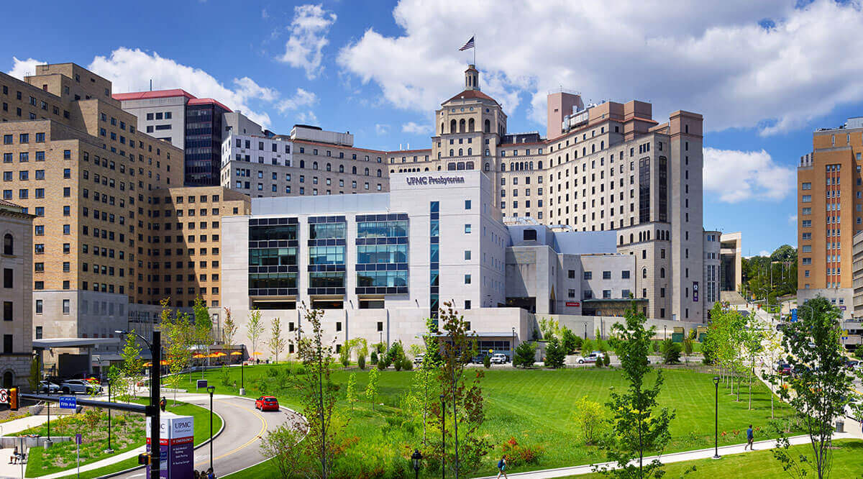

Section Header Here
Subtitle Here
Outstanding Adult Team
University of Pittsburgh Medical Center

Slide 12
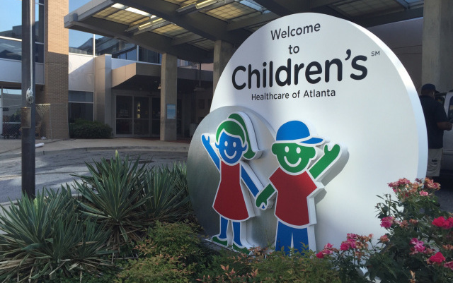

Section Header Here
Subtitle Here
Outstanding Pediatric Team
Children's Healthcare of Atlanta

Slide 13
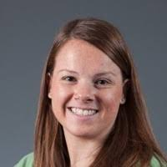

Section Header Here
Subtitle Here
Outstanding PWD Advocacy Award
Jeniece Ilkowitz

Slide 14
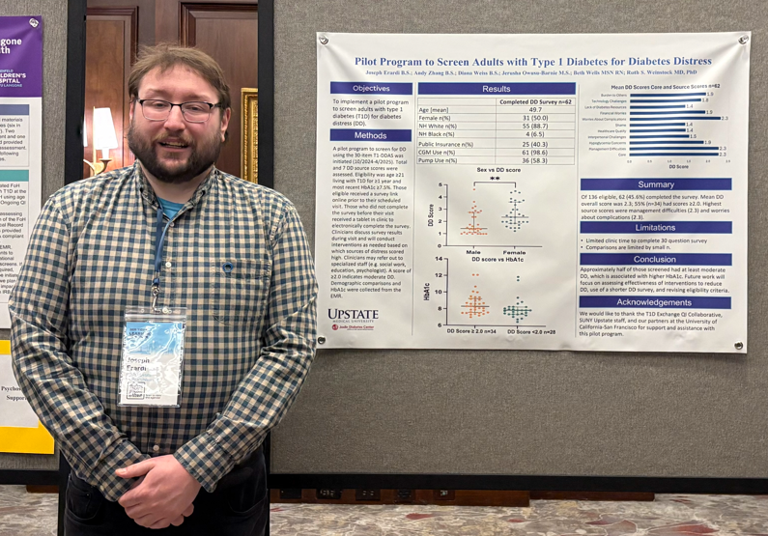

Section Header Here
Subtitle Here
v
Outstanding Coordinator Award
Joseph Erardi

