Slide 1



Slide 2

Section Header Here
Subtitle Here
Breakfast
Whitley Ballroom
7:15 – 8:30 am

Slide 3


Slide 4

Welcome to the 9th Annual T1DX-QI Learning Session

Slide 5

Logistics + Agenda Overview

Slide 6
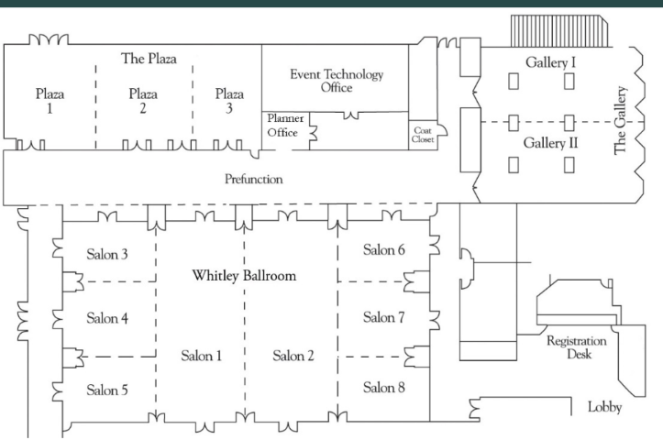
Section Header Here
Subtitle Here
Conference Rooms
Plenary sessions | Whitley Ballroom, Salon 1-2
Breakout sessions | Plaza 1-3 Salon 3-5 Salon 7-8
Sponsors & research partners | Prefunction area
Posters | Gallery I-II

Slide 7
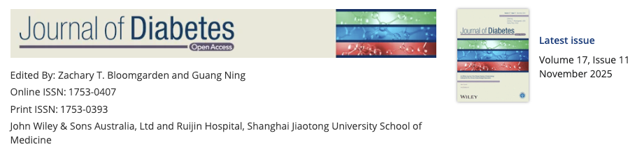
Section Header Here
Subtitle Here
Publishing the Work of the T1DX-QI 2025 Learning Session
Learning Session Commentary and 63 abstracts will be published in the Journal of Diabetes in the v. 17 Suppl.

Slide 8

Section Header Here
Subtitle Here
Logistics
Scan the QR code on your name badge for agenda.
If you have any food allergies or restrictions that you have not communicated yet, please contact a T1DX staff member.
Join us at the hotel staircase at 5:00 pm for a group photo!
Dinner tonight at St Cecelia’s for RSVPed attendees, starts at 6:30 pm.
T1D Exchange staff are here to help your get the most out of our time together. If you have any questions, please ask a member of the team.

Slide 9
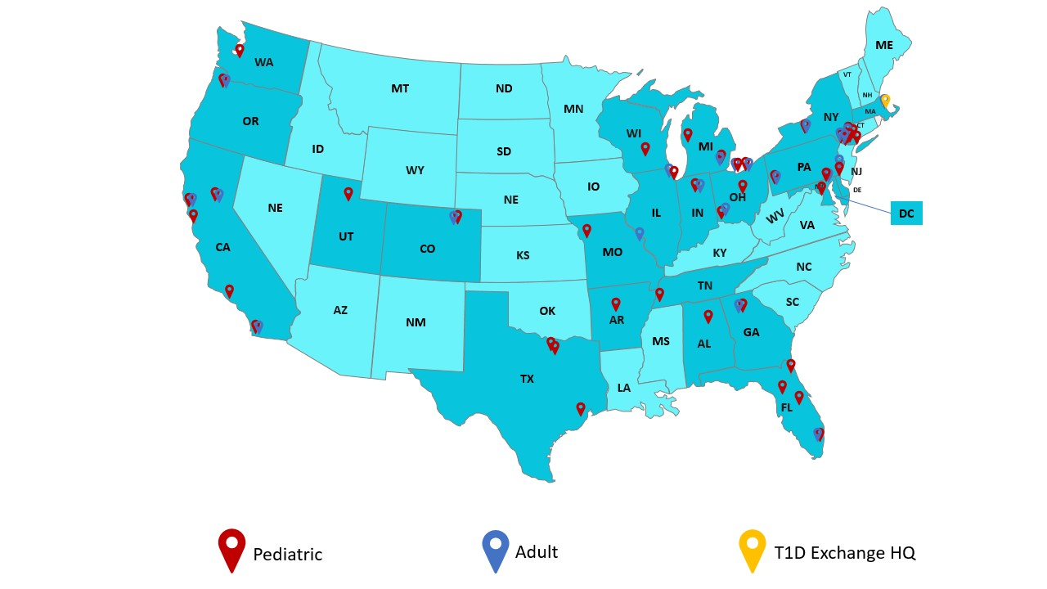
Section Header Here
Subtitle Here
T1DX-QI network of 63 centers cares for 150,000+ PWD
across 23 states and Washington D.C.

Slide 10





















Adult centers care for 30,000 PwT1D
Notes:
Include Trello link to the updated contact list for 41 Centers

Slide 11





























Pediatric centers care for 60,000 PwT1D
Notes:
Include Trello link to the updated contact list for 41 Centers

Slide 12
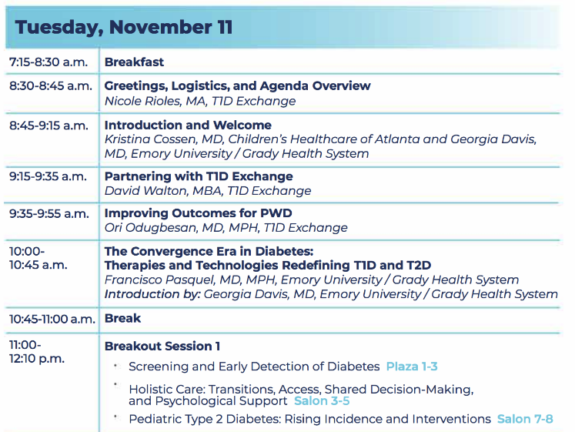
Section Header Here
Subtitle Here
Agenda, AM

Slide 13
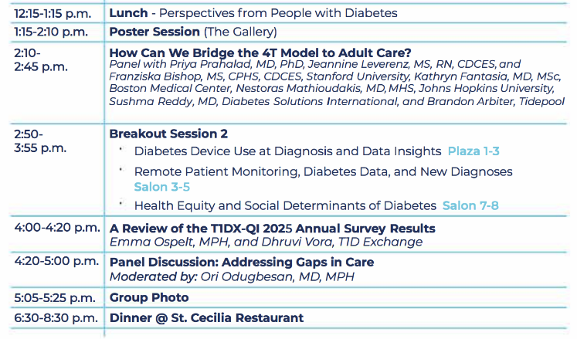
Section Header Here
Subtitle Here
Agenda, PM

Slide 14
Section Header Here
Subtitle Here
Educational Objectives
At the conclusion of this activity, learners should be able to:
Describe the future of novel therapies, interventions, quality improvements, and solutions to today’s diabetes care challenges.
Identify gaps in population health needs and state 3 ways that you can provide more equitable care over the next 2 years.
Apply the strategies of the T1DX-QI Equity Framework which can help to improve diabetes health outcomes and increase diabetes device access for PwT1D and PwT2D.
Discuss expectations for PWD care/engagement and describe ways to co-design care with PWD and family members.

