Slide 1


Organizational Update
Learning Sessions - Atlanta
Nov 11th-12th, 2025
Notes:
52CAE0

Slide 2

Overview
Introduction
Helmsley Grant
Medical Director Update
Partnering with T1D Exchange

Slide 3
Why Am I in A Great Mood?
Exciting updates on Helmsley grant and Medical Director discussions
Attended NCQQ Innovation Summit, Diabetes Technology Meeting, ISPAD and now this meeting (and my flight didn’t get cancelled)
Discussed innovation from a number of perspectives (on a panel, in meetings with possible funders, with clinicians and researchers sharing ideas including a number in the QIC)
Personally benefitted from the combination of great innovation (AID + GLP-1) and associated educational resources (including experts in the field)

Slide 4
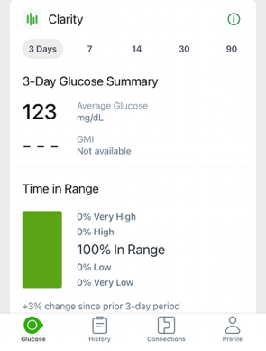
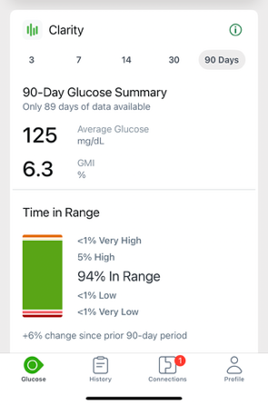
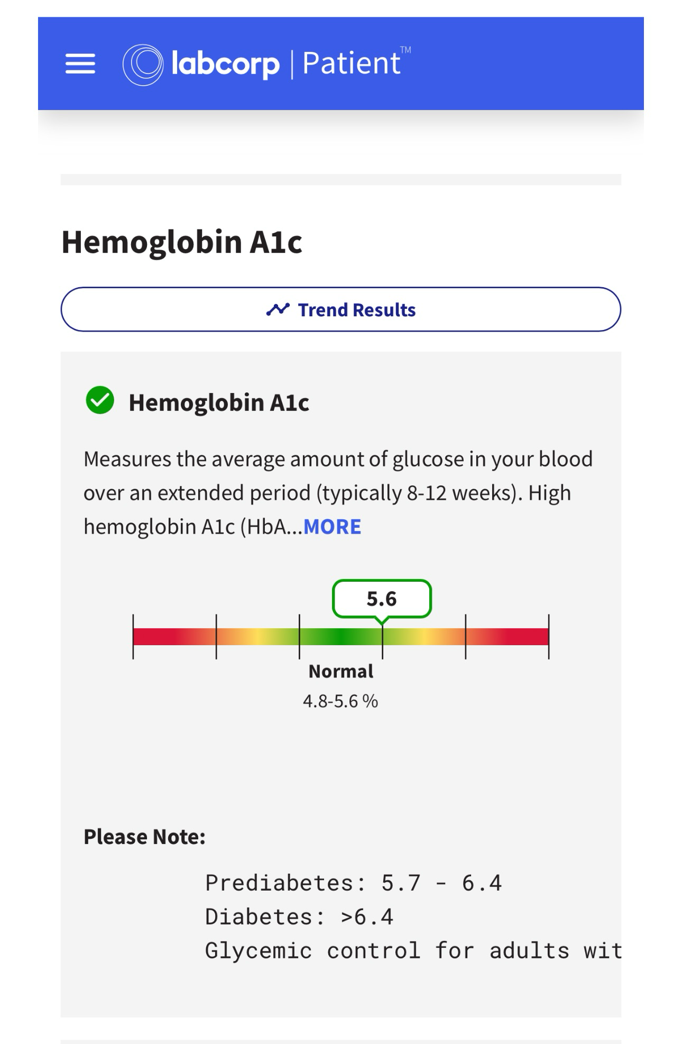
Past 6 Months of T1D Unprecedented For Me
3-Day 100% TIR
90-Day 94% TIR
A1c: 5.6%
First A1C in 30 years of T1D that began with a “5”
Labcorp says I’m “Normal”….

Slide 5
Helmsley Grant: 2025-2028
Received new grant from Helmsley Charitable Trust starting Oct 1st 2025
Quality Improvement Collaborative and related initiatives are the major focus of grant
Key priorities
  Continue trend of population level improvement in A1C
  Target modest growth of QIC with Adult centers and certain unrepresented geographies in US
  Extend impact of QIC to other health systems and sites of care via collaboration and knowledge sharing
  Grow EMR data and CGM data integration with EMR and Registry data
  Increase utilization of our Real World Data in supporting advocacy efforts with partners

Slide 6
Medical Director Update
Held meetings with endocrinologists inside and outside of QIC for feedback and interest
  Very positive feedback on utility and collegiality of QIC and its members as well as T1D Exchange staff
  Population level data and publication productivity highlighted by most
  Few suggestions for opportunities to do things differently in targeted areas
Explored two approaches to provide medical/research leadership and guidance
  Full-time hire
  Combination of part-time “advisors” with complementary backgrounds
Agreements being reviewed or are completed with four advisors
  Varying level of focus on QI-related work and other T1D Exchange Research opportunities
  Collective expertise in a wide range of areas
  Will enhance our capabilities in executing our work and competitiveness in pursuing new grant applications and meaningful industry-sponsored project work

Slide 7
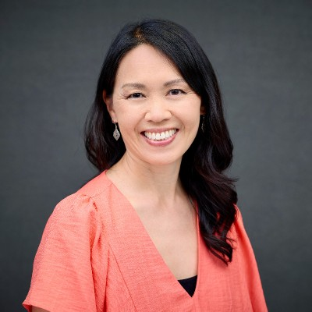
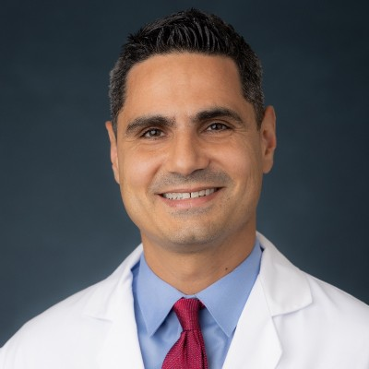
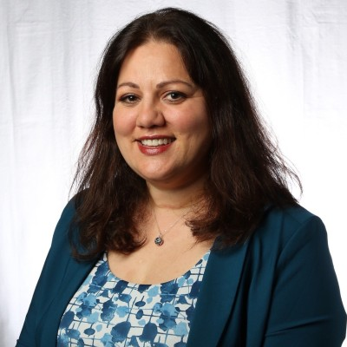
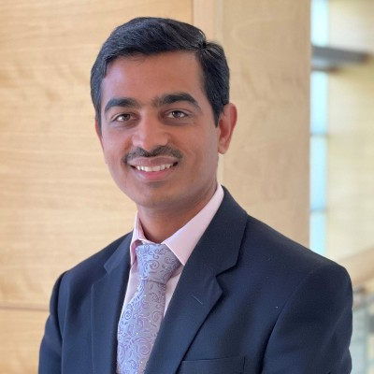
Medical Director Advisors
Greater QI Focus
Greater Research Focus
Jenise Wong
MD/PhD
Pediatric Endocrinology
UCSF
Nestoras Mathioudakis
MD/MHS
Adult Endocrinology
Johns Hopkins University
Jennifer Sherr
MD/PhD
Pediatric Endocrinology
Yale University
Viral Shah
MD
Adult Endocrinology
Indiana University

Slide 8
Partnering with T1D Exchange

Slide 9

Custom Research Capabilities
* Optional
We work with industry, academia, and advocacy organizations, to design, deploy, analyze, report and publish* on custom research projects.
We gather and analyze data to design and execute custom research projects.
Outcomes research
Market research
We have in-house diabetes expertise:
Research scientists
Data scientists
Subject matter experts
Quality improvement leaders
Health equity pioneers
*Publishing work optional depending on client interest

Slide 10
Custom Research Areas of Activity
Interviews
Focus groups
Cross-sectional surveys
Longitudinal surveys
Mixed method design
Patient reported outcomes
CGM analysis linked to survey responses
Quantitative and qualitative data analyses
EMR data analysis
Abstract/publication development & presentations

Slide 11
Examples of Sponsored Research
Vertex:
  Survey and CGM analysis of severe hypoglycemia and impaired hypoglycemia awareness
  Survey on severe hypoglycemia and extensive patient-reported outcomes (quantitative and qualitative)
  EMR analysis of total daily insulin dose by age and gender
Dexcom: Assessment of CGM adhesives with custom survey & adhesive site photo uploads
Mannkind: Survey of patient use, experience and satisfaction with inhaled insulin in adult T1Ds
Lexicon: EMR analysis of T1Ds living with Chronic Kidney Disease (e.g., DKA rates, SH rates, etc.)
Sequel Medtech: Survey of patient experiences with insulin delivery disruptions, such as occlusions
Abbott: Survey of T1Ds and T2Ds on experience/attitude with Diabetic Ketoacidosis (DKA) and ketone monitoring
Breakthrough T1D: Analysis of linked survey, lab, claims, device data to measure health outcomes

Slide 12
Example Ideas for Leveraging Our Research and RWD Capabilities
Machine Learning Prediction Models (DKA, SH, A1C rise, retinopathy, etc.)
Relationship of CGM Metrics (e.g., GMI, TIR) and A1C
Optimizing Pump/AID Settings
Adjunct Therapies in T1D and Relationship to BMI, A1C and Kidney Function
Projecting US T1D Population Statistics and Comparisons to Other Countries
Targeted Population Segment Analysis (e.g., teenagers, older adults and CGM/AID use)
Cardiovascular Health and Management
Hormonal Transition Time Periods and Glycemic Variability
Psychosocial Responses to Glycemic Outcomes, Device engagement and Complications

Slide 13







T1D Exchange Online Registry Overview
Direct-to-participant annual surveys since 2019
Supports custom survey research projects
~4,500 participants share CGM data
Self-reported demographics, SES, disease management, health outcomes
~24,000 participants including adults and caregivers
Registry team expertise: T1D research & lived experience
CONFIDENTIAL – do not distribute

Slide 14
T1D Exchange Registry: Annual Questionnaire* Variables
Demographics
Medications & devices
HbA1c, DKA, Hypoglycemia
Health Conditions
Mental Health
Age
Gender
Race/ethnicity
Health insurance
Education, employment status, income
Pump & CGM type
Use of AID features
Bolus & basal insulin for a typical day
Insulin brand
Non-insulin therapies
Key CGM metrics**
GMI
CV
Mean glucose
% TIR
% TAR
% TBR
HbA1c values and dates
History of DKA
Severe hypoglycemia events
Treatments for severe hypoglycemia events
Hypoglycemia unawareness
Fear of hypoglycemia
Complications
Retinopathy
Neuropathy (types)
Kidney disease
Cardiovascular disease
Diabetes-related amputation
Gastroparesis
Transplants
Autoimmune
Celiac Disease
Addison’s disease
Autoimmune thyroid conditions
ADHD
Alcohol and substance abuse
Anxiety
Depression
Diabetes distress
Eating disorders
OCD
*Not an exhaustive list of variables
**Sub-set of all CGM metrics that are available
CONFIDENTIAL – do not distribute

Slide 15
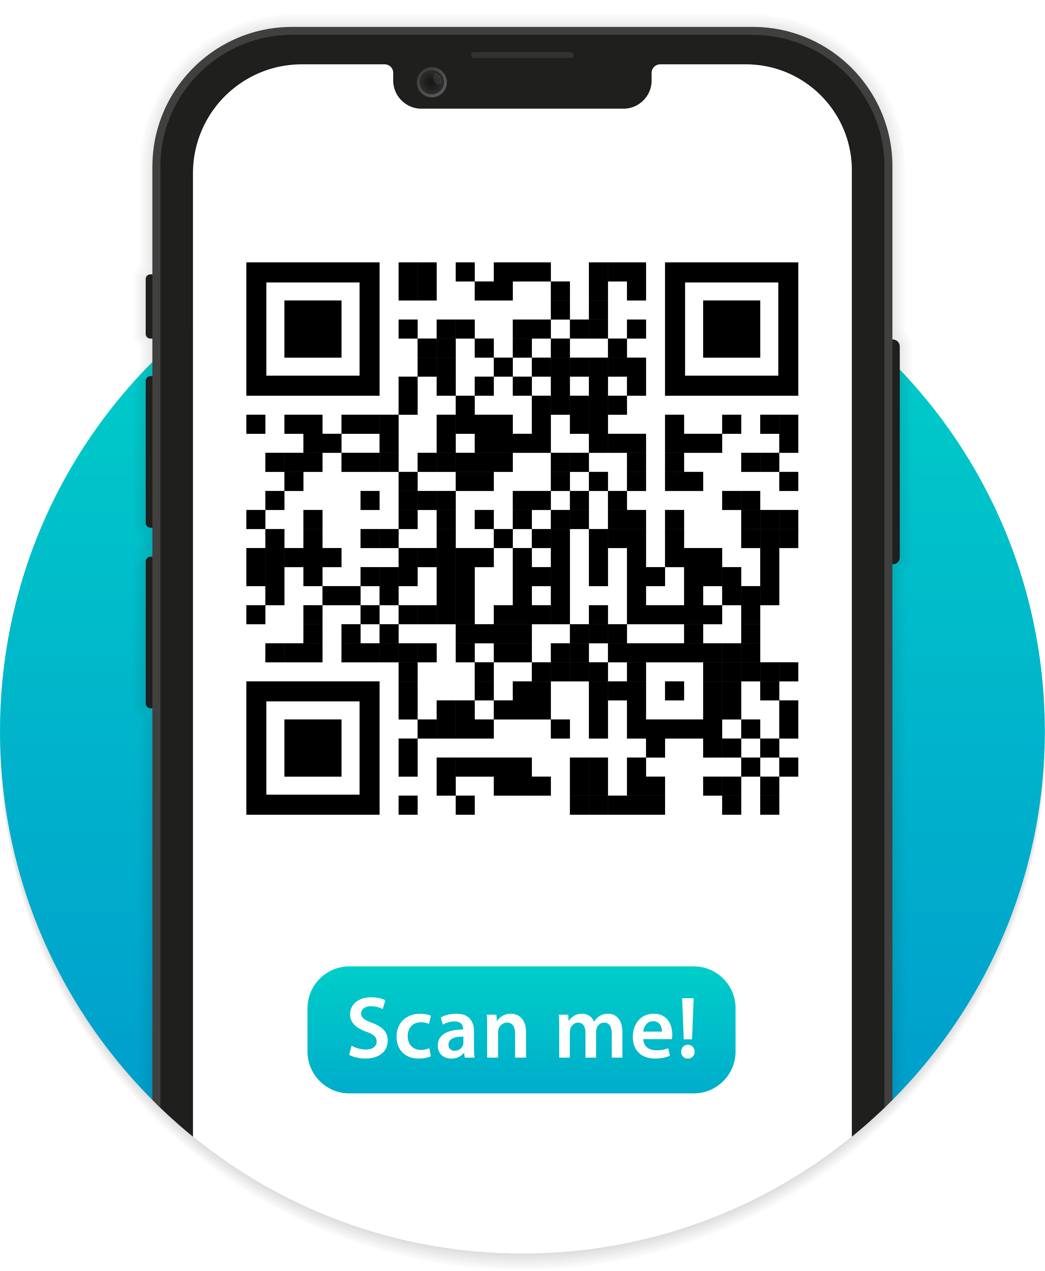
Build Connections with
the T1D Exchange Online Community
With 50,000+ community members, the T1D Exchange Online Community captures the diverse experiences and challenges faced by those living with T1D.
Members can:
Answer a “Question of the Day” about life with T1D (200+ responses/day)
Read the latest news on T1D treatments and devices
Participate in research studies
Connect with and learn from others impacted by T1D

Slide 16

Study Recruitment Services
Through our study recruitment capabilities, we accelerate research studies of all types:
Online surveys
Interviews and focus groups
Virtual or in-home studies
In-person clinical trials
Our expansive connection to the T1D community:
Characterized cohort of 24,000+ people with T1D in our online registry
Online community of 50,000+ people affected by T1D
Notes:
s

Slide 17












Study Recruitment: Partnering with Universities
Artificial Intelligence in Healthcare & Diabetes Survey
Swimming and Impact on Diabetes Survey
Microvascular Dysfunction with GLP-1 RA and Exercise Clinical Trial
NIDDK Covid Assessment Study
CGM Pilot Study
Financial Impact of T1D
Challenges of Birthing Individuals Managing T1D
Cognitive Behavioral Therapy and Diabetes Distress
Diabulimia
Impact of Diabetes Camp
Expenses in T1D on Behavior in Youth and Caregivers

Slide 18










Study Recruitment: Partnering with Industry Sponsors
Clinical Study of VX-880 Islet Cell Infusion in T1D
Clinical Study of CT-868 GLP-1/GIP RA in T1D
Clinical study of ZT-01 to prevent nocturnal hypoglycemia in T1D
Clinical study of HDV-Lispro, liver-targeted insulin to reduce hypoglycemia risk
Clinical study of Finerenone in Chronic Kidney Disease(CKD) and T1D
Clinical study of Diamyd Medical T1D vaccine
Clinical study of TTP-399 to reduce A1C and hypoglycemia risk
Gathering saliva samples for genetic risk score to discern T1D vs T2D in newly diagnosed
Survey on Experiences with insulin infusion disruption / occlusions
Interviews and Surveys on experience with DKA and ketone monitoring

Slide 19

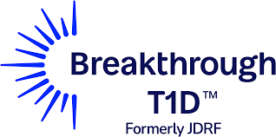


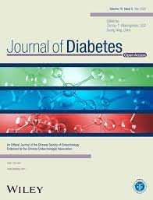






Select T1D Exchange Partners: Non-Industry

Slide 20













Recent T1D Exchange Partners: Industry

Slide 21
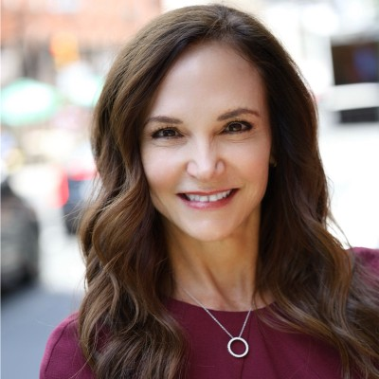

Contact our Business Development Team for more information
Debbie Taylor
dtaylor@t1dexchange.org
Any research, and study recruitment services
Courtney Holubiak
cholubiak@t1dexchange.org
Study recruitment services

Slide 22
Thank You

