Slide 1

T2D and Reducing Risks
Moderated by James Dawson

Slide 2
Raising the Bar Increasing Urine Microalbumin Screening Compliance in a Pediatric Type 2 Diabetes Program
Leena Mamilly, MD

Slide 3
The NCH type 2 diabetes experience
Established in 2014, expanded in 2021
Multidisciplinary clinic
Twice monthly, total of 24 patients
Alternating visit types
General diabetes clinics
Visit A
Provider
Diabetes LPN
Registered dietician
Social worker
Visit B
Provider
Diabetes LPN
Diabetes Educator
Therapeutic Recreation specialist
Psychologist
Nephrologist
Clinical pharmacist

Slide 4
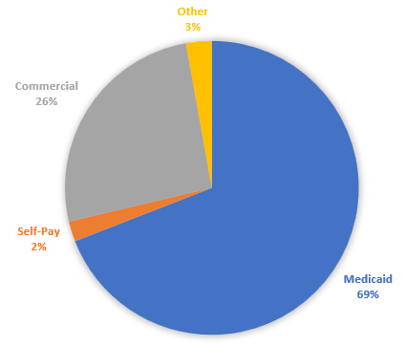
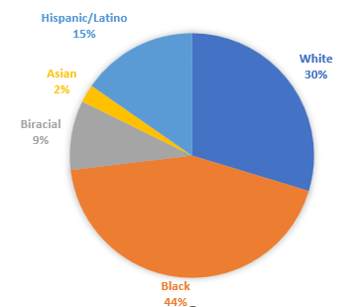
T2D Patient population
505 T2D visits
171 unique patients
60% females
Age 15.1±1.7 years

Slide 5





T2D Team
Manmohan Kamboj, MD
Division chief
Malak Abdelhadi, MBOE, LSSBB
Quality consultant
Teri Zortman
T2D program coordinator
Administrative assistant
Alyssa Kramer,
Data analyst

Slide 6
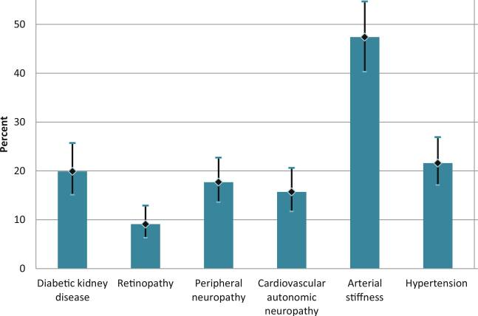
LM
Project Metric: Diabetic Kidney disease
Diabetic kidney disease (DKD) is one of the most common complications of T2D
Affects 20% of youth with T2D by the age of 21 years
Closely linked to CV complications and death
Urine microalbumin/creatinine ratio screening at diagnosis and annually
Jensen ET, Dabelea D. Curr Diab Rep. 2018
Notes:
19.9% of participants with T2DM had diabetic kidney disease, compared to 5.8% with T1DM, despite a similar disease duration

Slide 7
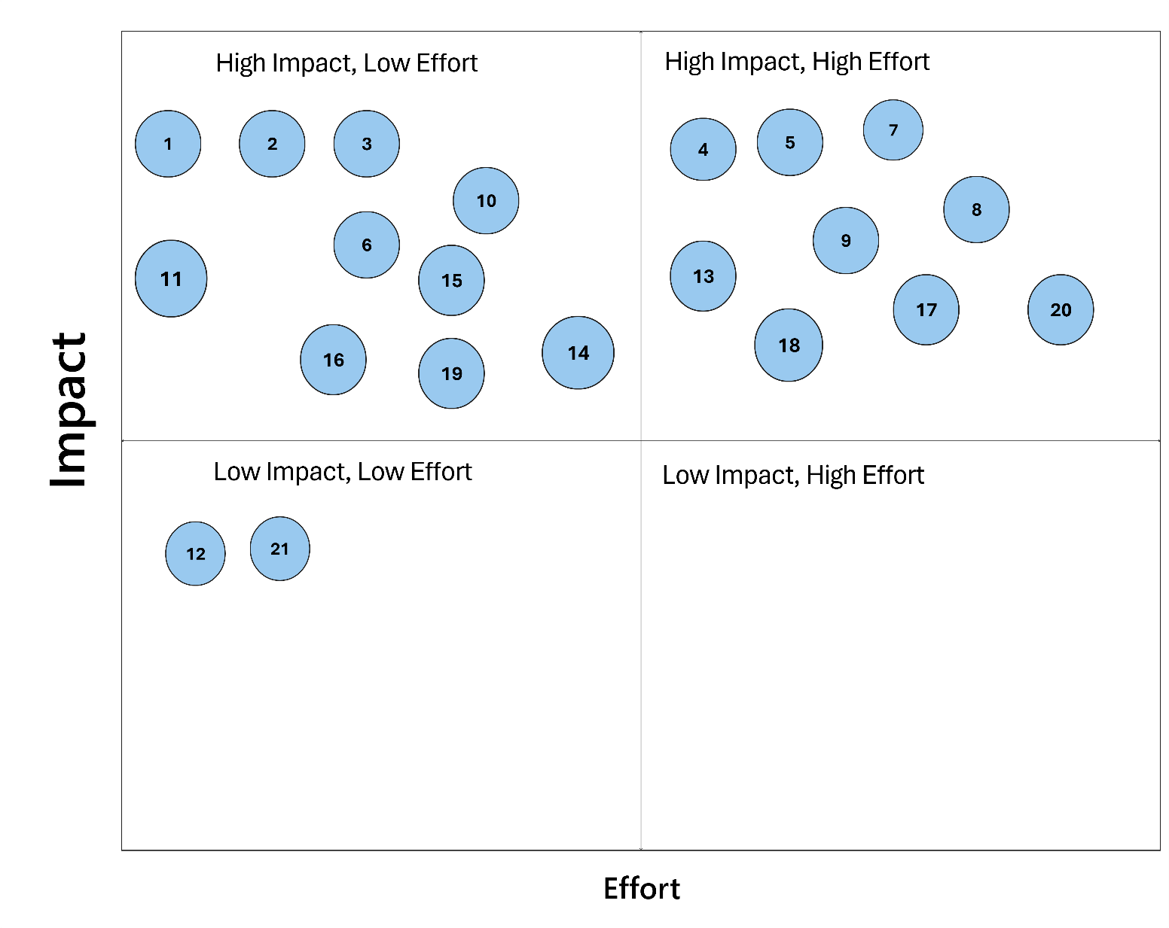
Remind patient at check in and provide water bottle and cup at rooming
Nurse/PCA to use secure chat to send testing reminder
Front desk to remind patient at check in
Provide education using universal scripting with purposeful language on importance of collection
Adding a note to the automated appt reminder
Utilizing PFK resources
Endo team to address barriers
Send out survey to patients to understand barriers
Coordination with other clinics
Discussing FMLA with legal guardians
Reminder signage in multiple clinics
Utilizing care gap and then reporting errors
Epic flag for microalbumin
Additional chart review for nursing/providers/ PCA
Update problem list
Missed screening tracker (care gap missing column)
Transportation
Health information and technology access
Appointment coordination and resource utilization
Lab coordination and streamlining workflow

Slide 8
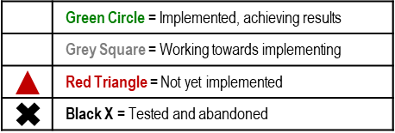
Improvement of urine microalbuminuria screening rate in youth with T2D
Interventions
Aim
Key Drivers
Remind patient at check in and provide water bottle and cup at rooming
Increase the % of Microalbuminuria screening among children/adolescents <19 years with T2D from 74% to 82% by 12/31/2025 and sustain for one year.
Nurse/PCA to leave a note in the secure chat as a reminder for Microalbumin testing
Patient Participation
Reminder signage in multiple clinics
Patient Appt Adherence
Appointment coordination and resource utilization
Utilizing PFK Resources to help with barriers
Staff Practice
Discussing FMLA with legal guardians – a one-page hand out (social work- reach out to Ming)
Global Goal:
Deliver high standard care to children
with T2D based on national guidelines.
Microalbumin/Cr testing added to LPIP list
Care Access
Epic flag for Microalbumin
Adding a note to the automated reminder that goes out. Action reminders
Notes:
The KDD is a living, breathing document and you can use a key to indicate status of intervention implementation for others to easily know the status of your project.

Slide 9
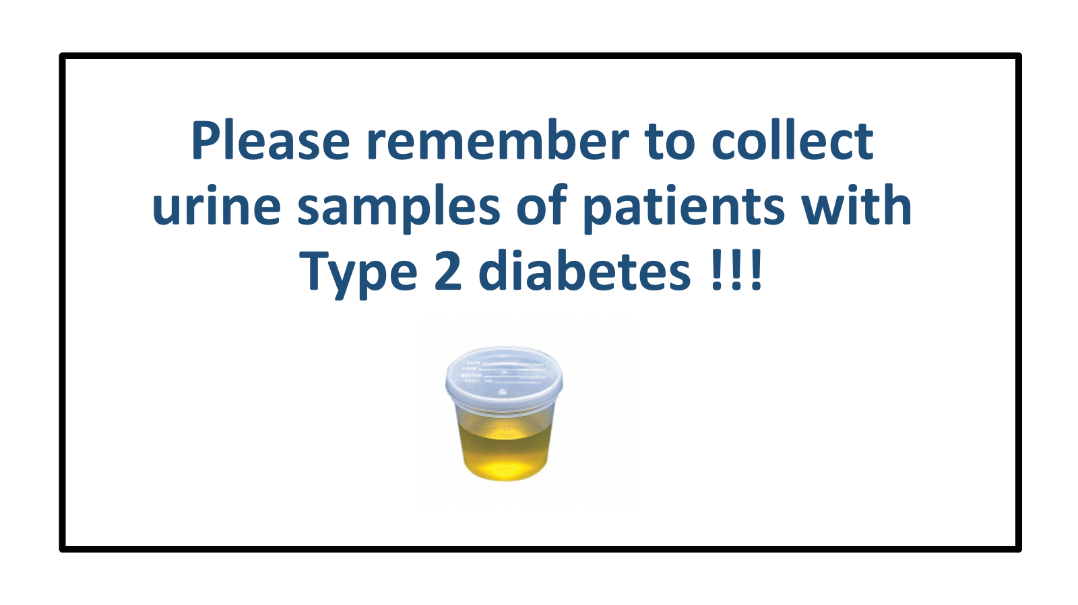
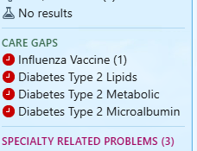

Keys to Success
Staff Practices
Reminder signage in multiple clinics
Pre-identify patients with T2D due for microalbumin screening
Epic flag for Microalbumin
Enable urine microalbumin order via LPIP

Slide 10

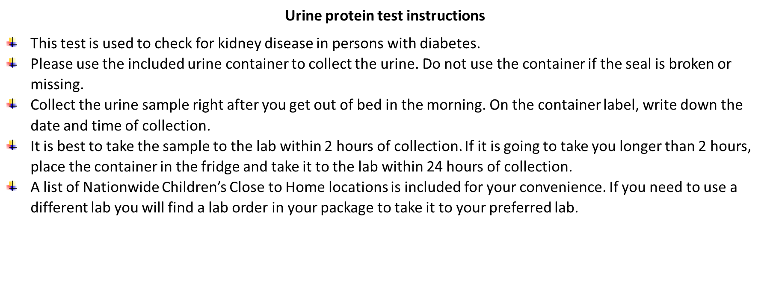

Keys to Success
Patient participation
Remind patient at check in and provide water bottle and cup at rooming
Add screening education or templated T2D AVS
Mail lab orders to patient homes

Slide 11


Keys to Success
Care Access
Appointment coordination and resource utilization
Utilizing Partners For Kids Resources to help with barriers
Discussing FMLA with legal guardians

Slide 12
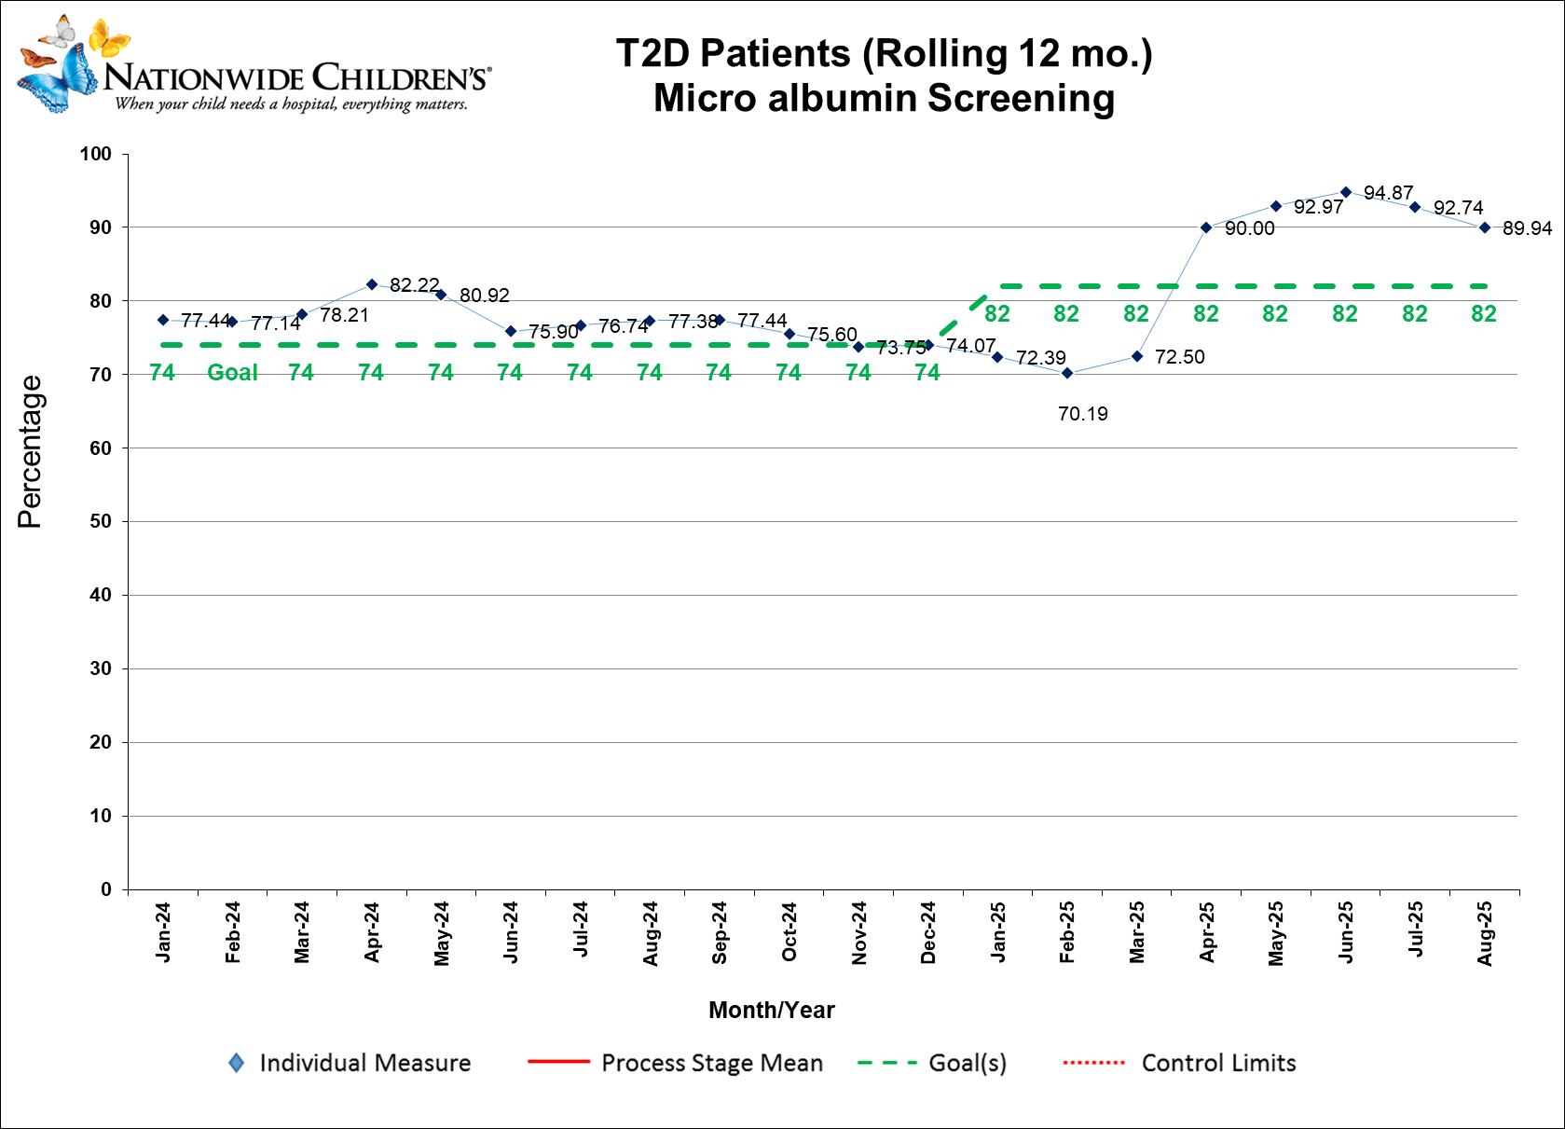

Slide 13
Next steps
Expand project metrics for comprehensive screening in youth with T2D
Standardize institutional management algorithms for positive screens
Expand dedicated T2D care

Slide 14
Thank you Questions/discussion

Slide 16
Improving Adherence to Screening Guidelines for Eye Examination in Youth with Diabetes
Allison Smego, MD
Dalhila Solorzano, MD
Jessika Weber, DO
Janet Sirstins, RN, BSN, CDCES
Zoey Chery, CMA
Vandana Raman, MD
Division of Pediatric Endocrinology, University of Utah
Primary Children’s Hospital, Pediatric Diabetes Program

Slide 17
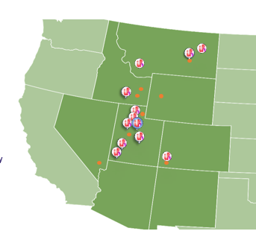

Primary Children’s Hospital Diabetes Clinic
Salt Lake City, UT
~2500 type 1 diabetes patients
~300 type 2 diabetes patients (rising)
Second location: Lehi, UT
Outreach Clinics: Logan, Layton, St. George
Large catchment area from surrounding states
Insurance: 77% private, 23% public
Contacts
Allison Smego, MD Vana Raman, MD
Allison.smego@hsc.utah.edu Vana.raman@hsc.utah.edu

Slide 18
Background
Diabetic retinopathy is leading cause of blindness in adults
Regular screening enables timely detection and intervention, reducing the risk of vision loss
Historically, our clinic struggled to obtain and document retinal exams in patients with diabetes

Slide 19
SMART Aim
Increase retinal examinations among patients with diabetes in alignment with the ADA screening recommendations by Dec 2024
Type 1 diabetes from 75% to 82%
Type 2 diabetes from 50% to 55%
Pilot: main clinic location
Notes:
We really wanted to start by making sure the transition was happening to ensure patients were not being lost during this process

Slide 20
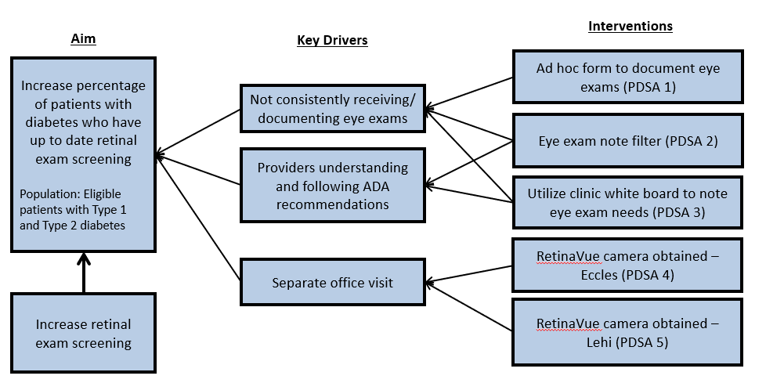
Key Driver Diagram

Slide 21
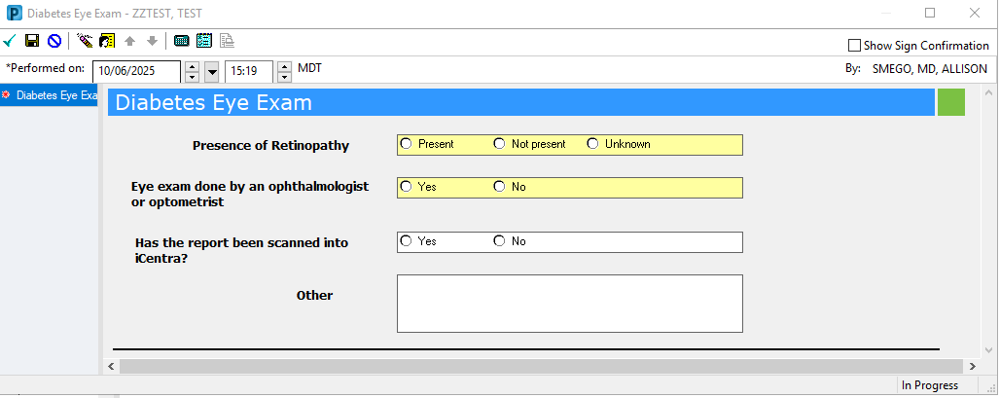
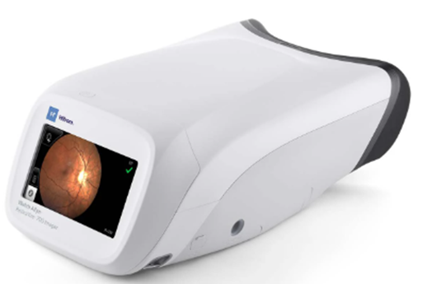
PDSA 1-3: Documenting retinal exam
Standardized documentation of retinal exams
Patients asked about eye most recent eye exam by MA at every visit
Filter to easily identify most recent retinal exam
PDSA 4: RetinaVue camera
Enabled in-clinic retinal screening during routine appointments

Slide 22
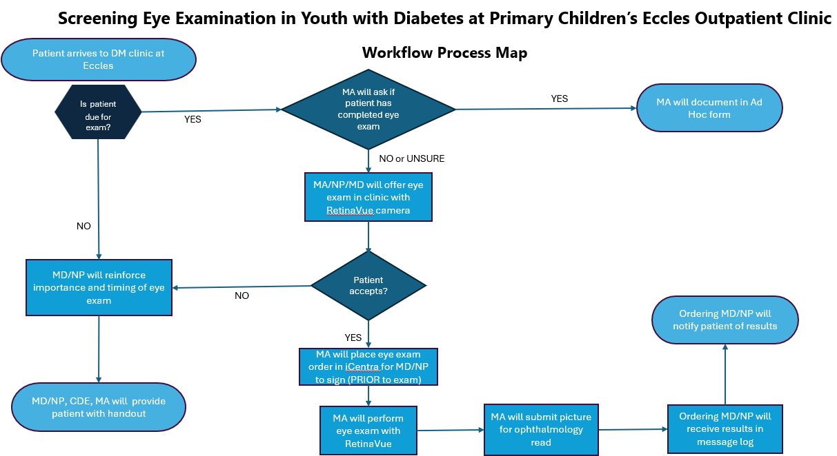

Slide 23
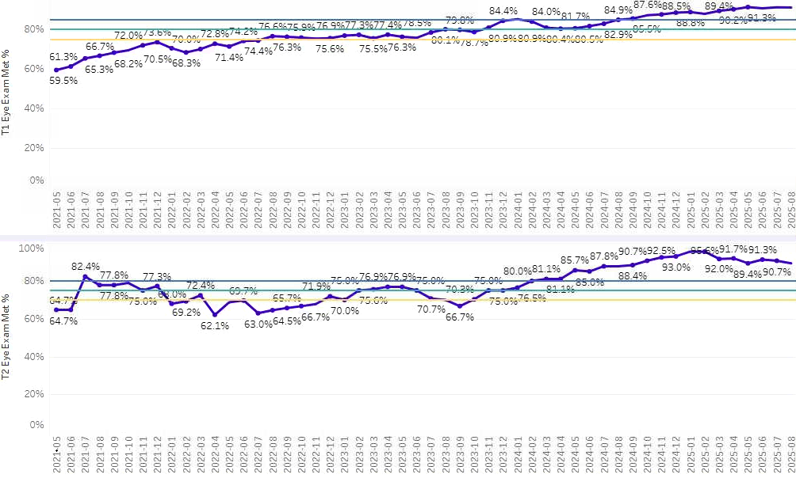
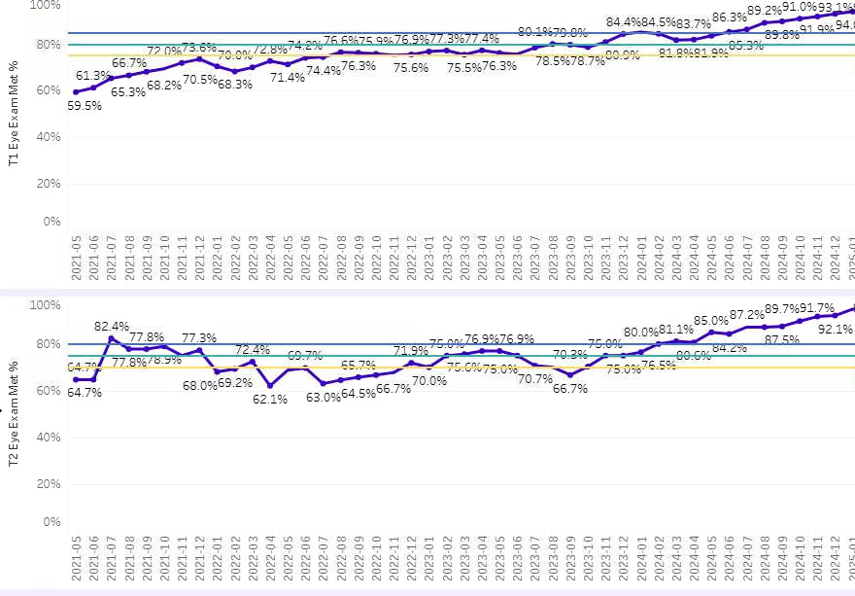
Progress
Pilot: main clinic location – got RetinaVue spring 2024
Including our second campus - got RetinaVue early 2025

Slide 24
Conclusions, Opportunities, Challenges
Standardized documentation and work-flow allowed for easier identification of eligible patients
Involving the entire care team allowed for multiple opportunities to offer patient reminders
In-clinic eye exam with RetinaVue Camera well received by patients and families
No billing complaints
Fast turn around on reports
One less office visit for patients and families
RetinaVue success at main location made it possible to petition for camera for second clinic location (implemented March 2025)
New EMR system as of September 2025 – new challenges ☺

Slide 25

Questions/Comments

Slide 27
Improving Diabetic Nephropathy Screening Practices for Type 1 and Type 2 Diabetes
Laurel Gordon, MD; Victoria Goldman, MD; Kelli Kaneta, MD; Wendy Bravo, MD, MSCE; Tara Sardesai, MD; Brian Miyazaki, MD; Lily C. Chao, MD, MS ​
2025 T1DX-QI November Learning Session
November 12, 2025
No disclosures

Slide 28
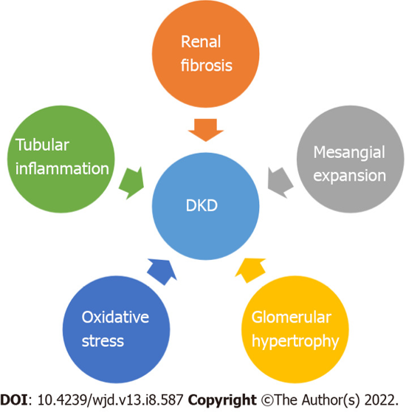
Diabetic Kidney Disease & Importance of Screening
Significant increase in diabetic kidney disease (DKD) with increasing T1D and T2D incidence 1.1 → 3.4% (2002-2013) (Li et al., 2016)
DKD findings:​
Persistent albuminuria (gold standard)
Arterial hypertension
Progressive decline in eGFR
Diabetic nephropathy → increased risk of:
Chronic kidney disease and end stage renal disease
Cardiovascular disease
Premature mortality

Slide 29
Current DKD Screening Recommendations
Type 1 Diabetes
Annual screening once dx 5 years:
Puberty OR age > 10 years (whichever is earlier)
Type 2 Diabetes
Annual screening starting at diagnosis
Screen with random spot urine
First morning void preferred
Goal: Alb:Cr < 30mg/g
Confirm with 2/3 urine samples over a 6-month period
Optimize glucose and BP Add ACE inhibitor
Notes:
Microalbuminuria, defined as a urine albumin excretion of 30–299 mg/day (or an albumin to creatinine ratio of 30–299 mg/g creatinine in random samples) in at least 2 of 3 measurements, is the earliest sign of DKD and occurs in 26% of children and adolescents after 10 years and in 51% after 19 years of diabetes.[9] In the classic DKD presentation, once microalbuminuria develops, urine albumin excretion continues to rise, particularly in presence of uncontrolled risk factors. Macroalbuminuria, defined as a urine albumin excretion ≥300 mg/day (or albumin to creatinine ratio ≥300 mg/g creatinine), heralds the onset of overt DKD and is thought to inexorably lead to impaired GFR (defined as an estimated GFR <60ml/min/1.73m²) and eventually ESRD

Slide 30
Provider Survey: Knowledge & Current Practices
Chart Review: Adherence to Current Screening Guidelines
20 diabetes providers surveyed (physicians, nurse practitioners)
70% correctly identified T1DM screening guidelines
100% correctly identified T2DM screening guidelines
40% selected correct criteria for time frame and number of samples collected for youth to meet criteria for DKD
70% selected correct criteria for repeat sampling needed to confirm diagnosis of DKD
Referrals to nephrology and initiation of ACE inhibitors varied widely

Slide 31
Fishbone Diagram
People
5
Environment
3
Patient Factors
1
Limited provider awareness on screening guidelines /remembering to order
Patient transportation barriers to clinics and labs
Patient reluctance to complete labs or forgetting to collect urine at home
Patient knowledge gaps/inability to complete labs
Difficulty collecting urine samples in clinical setting
High no-show rates preventing urine collection
Inconsistencies and Variable Adherence to DKD Screening Guidelines
Lack of clear guidelines on collection of urine and initiation of treatment
Lack of in-clinic ability to obtain measurements
No prompting in EMR when patient due for screening
Urine cups not regularly given to patients to collect at home
Appointments at various times so not able to collect first AM void in clinic
Wide variation in provider practice currently
Equipment
6
Methods/Workflow
4
Policies/Guidelines
2

Slide 32


Specific Aims:
Improve percentage of providers who select correct time frame for initiation of screening in T1D, time frame for urine sample collection, and number of repeat samples needed for diagnosis within 3 months:
Correct time frame for screening in T1D: 90%
Correct time frame for sample collection and repeat samples needed: 75%
Improve the percentage of patients with elevated urine albumin to creatinine ratios (UACR) who have repeat sample obtained within 6 months to goals of:
50% for T1D
80% for T2D

Slide 33
Key Driver Diagram
Key Drivers
Secondary Driver/Change Ideas
SMART Aims:
To improve percentage of providers who select correct time frame for initiation of screening in T1D, time frame for urine sample collection, and number of repeat samples needed for diagnosis within 3 months.
To improve the percentage of patients with elevated urine albumin to creatinine ratio (UACR) who have repeat sample obtained within 6 months.
Development of a clear, standardized protocol for UACR testing
Develop flowsheet for DKD screening aligned with national screening guidelines
Integrate flowsheet into clinical settings for easy reference
Provider education on repeat screening and timing of samples
Review guidelines and flowsheet in departmental educational conferences
Review options for collecting repeat urine samples from patients
Patients under-standing importance of timing of urine collection
Have clinicians educate patients on repeat urine collection in clinic
Provide urine collection instructions and extra urine cups for patient during clinic visit
Training and supporting providers in use of clinical flowsheet
Hold sessions to review clinician questions and feedback regarding flowsheet
Make changes to flowsheet based on feedback

Slide 34
PDSA Cycles:
 | Cycle 1 (completed) | Cycle 2 (pending)
Intervention | Developed new DKD screening flowsheet for provider use Conducted educational session with providers reviewing current screening guidelines and flowsheet | Place clinical flowsheets in provider rooms Provide urine collection instruction handout and urine collection cups regularly to patients
Assessment | Reassessed knowledge via same provider survey 3 months later | Perform repeat chart review to assess percentage of patients with abnormal sample who have repeat sample obtained within 6 months

Slide 35
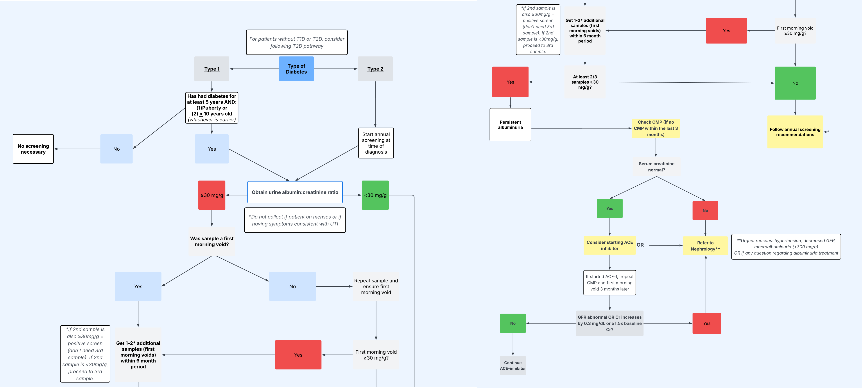
Provider Flowsheet Development

Slide 36
Post Cycle 1 Results:
Question 1: How often do you screen for diabetic nephropathy in patients with T1D?
Question 2: What is the time frame for collection of positive urine samples for which a patient would meet criteria for diabetic nephropathy?
Question 3: If the initial sample demonstrates elevated microalbumin, when would you obtain the next sample ideally (assuming all samples are done correctly)?

Slide 37
References
Afkarian M. (2015). Diabetic kidney disease in children and adolescents. Pediatric nephrology (Berlin, Germany), 30(1), 65–71. https://doi.org/10.1007/s00467-014-2796-5
Children and adolescents: Standards of Care in Diabetes—2025." Diabetes Care 48, no. Supplement_1 (2025): S283-S305
Dabelea, D., Stafford, J. M., Mayer-Davis, E. J., D’Agostino, R., Dolan, L., Imperatore, G., ... & SEARCH for Diabetes in Youth Research Group. (2017). Association of type 1 diabetes vs type 2 diabetes diagnosed during childhood and adolescence with complications during teenage years and young adulthood. Jama, 317(8), 825-835.
Dart, A. B., Sellers, E. A., Martens, P. J., Rigatto, C., Brownell, M. D., & Dean, H. J. (2012). High burden of kidney disease in youth-onset type 2 diabetes. Diabetes care, 35(6), 1265–1271. https://doi.org/10.2337/dc11-2312
Li, L., Jick, S., Breitenstein, S., & Michel, A. (2016). Prevalence of diabetes and diabetic nephropathy in a large US commercially insured pediatric population, 2002–2013. Diabetes care, 39(2), 278-284
Lopez, L. N., Wang, W., Loomba, L., Afkarian, M., & Butani, L. (2022). Diabetic kidney disease in children and adolescents: an update. Pediatric Nephrology, 37(11), 2583-2597.
Muntean, C., Starcea, I. M., & Banescu, C. (2022). Diabetic kidney disease in pediatric patients: A current review. World journal of diabetes, 13(8), 587–599. https://doi.org/10.4239/wjd.v13.i8.587

Slide 39
Advancing Equity and Outcomes: A QI Initiative to Increase CGM Use in Children with T2D
Matthew Canonico, BS; Loretta Smith, PNP; Blake Adams, RN; Grace Nelson, MD
University of Tennessee Health Science Center

Slide 40
Background & Objective
Continuous glucose monitoring (CGM) is an important tool for glycemic control.
Uptake is high in T1D, but significantly lower in T2D.
Objective: Identify barriers in CGM use and increase overall percentage CGM use for Type 2 Diabetes from 40% to 50%.
Smart AIM: Identify barriers in CGM use and increase overall % CGM use for Type 2 Diabetes patients from 40 to 50%

Slide 41
Methods
Initial and follow-up questionnaires administered at Le Bonheur Diabetes & Endocrinology Clinic in single NP DM clinic.
Data collected: insulin use, A1c, CGM awareness and usage, attitudes, and barriers from patients prescribed insulin.
This project reflects preliminary, initial and follow-up data. Data collection and analysis are ongoing.

Slide 42
KDD for CGM Use
Key Driver Diagram Secondary Drivers
SMART Aim Primary Drivers
**Survey families at clinic appointments and then survey again at follow up to assess barriers. Update survey to have better data.
Malfunctioning CGM
Provide families educational handouts on troubleshooting CGM on My Chart or during clinic appointment after CGM initiation
Identify barriers in CGM use and increase overall % CGM use for Type 2 Diabetes patients from 40% to 50%
Access to Care
Health Equity when discussing CGM
Review check in form with staff to assure consistent CGM discussion at each Diabetes appointment
Global Aim: Improve CGM use within the clinic for Type 2 Diabetes and improve continued use once CGM initiated.
Awareness of CGM
Authorization specialist to help with CGM starts and insurance coverage.
Patient Access at multiple locations
Survey patient at both downtown and East location

Slide 43
Fishbone Diagram for CGM use
Product:
-CGM not covered by all insurance plans .
-Type 2 DM is not always a covered diagnosis for CGM
-No in person training for CGM, so some hesitancy to apply device for new users
-Difficulty trouble shooting CGM
-Difficulty obtaining supplies
Global Aim: Improve CGM use within the clnic for Tyoe 2 Diabetes and improve continued use once initiated
Policies and Procedures:
-CGM introduced at Day 2 Education-different in T2DM
- Staff unsure of coverage for T2DM and CGM
Smart AIM: Identify barriers in CGM use and increase overall % CGM use for Type 2 Diabetes patients from 40 to 50%.
Place:
-Check in form used at both Humphreys and Downtown clinic with every Diabetes appointment
-Day 2 Education only offered downtown clinic location
-Survey only used at Downtown location
Process:
-Not consistently discussing CGM with all patients
-Staff not asking CGM info consistently during Diabetes check in.
-Utilizing educational handouts to assist with troubleshooting
People:
-Provider/staff forget to offer
-Patients unable to troubleshoot issues with CGM
-Patient unable to consistently get supplies
-Difficulty getting CGM PA’s done in a timely manner to prevent lack of supplies

Slide 44
Results: CGM Use by Diabetes Type CGM Knowledge
18
142
Patients surveyed thus far: 160 T1D, 52 T2D, 10 other
16
12
3

Slide 45
Results: Barriers Reported
One-third of all patients reported barriers to CGM.
Representative examples:
“It's uncomfortable and easy to come out.”
“Not interested in CGM. Readings are off by 100 or so.”
“Need to change sensors frequently with issues. Apple loses signal every night and has to be reopened frequently.”
“No insurance” or “Insurance wouldn't cover the cost.”
Main themes: (a) adhesion/wear, (b) access/insurance, (c) failure/inaccuracy/malfunction, (d) burnout/hesitancy/no interest

Slide 46
Results: Reported Barriers to CGM

Slide 47
Results: Follow-up Surveys (Preliminary)
Of 69 patients with T1D who have followed up and provided survey responses, 56 of them (81%) report using CGM most of the time.
Of 23 patients with T2D, only 7 (30%) report the same.
16% of T1D patients and 17% of T2D patients report continued concerns/barriers to CGM, matching those from the first round of data collection, e.g.:
“Falls off”
“Does not have insurance”
“Inaccurate”

Slide 48
Conclusions and Future Plans
Awareness of and access to CGM vary significantly between T1D and T2D pediatric patients.
Barriers include access/insurance, adhesion/wear, device failure, and hesitancy.
Targeted interventions may improve CGM uptake and outcomes in T2D.
Continue to survey patients, and potentially extend surveys to multiple locations
Provide education resources to families for every CGM start to help with troubleshooting and adherence.
Consistently ask CGM questions during intake at Diabetes appointments.

Slide 50

Section Header Here Subtitle Here
Break
Please return to Whitley Ballroom by 11:10 am

