Slide 1

GLP-1s/Other Adjunctive Therapies and Glycemic Outcomes
Moderated by Viral Shah, MD

Slide 2


Diabetes Resources Education and Management Support (DREAMS): Updates to 2024 and 2025 Cohorts
David W. Hansen, MD, MPH

Slide 3
Purpose
The program is intended to provide further support, via additional education visits with RN DCES, to individuals with diabetes who have been admitted to the hospital with diabetic ketoacidosis (DKA) or who have an HbA1c that is above 9.0% and at risk for DKA.
AIM: Decrease DKA admissions, improve HbA1c and increase quality of life for program participants.

Slide 4
Participants
Guidelines/
Education
Multifaceted barriers (socioeconomic, parental support, behavioral health needs)
Need for more guidance/education on diabetes management
Lack of transportation to program visits
Getting participants to commit to additional visits and follow through
Establishing routines and adherence to treatment plan
No required training for School Nurses, SW, guidance counselors (support at schools)
A need for more education required for support systems
Patients with high risk of DKA and high HbA1c
No education telemedicine visits
Depends on each patient needs
Resistance to wearing devices
A need for more flexible schedules
No set follow – up after program
Technology
Process/Procedure

Slide 5
Curriculum (2019-2023)
Pre-Visit
Weekly Calls
Visit 1
Weekly Calls
Visit 2
Weekly Calls
Visit 3
Weekly Calls
Visit 4
RN DCES
Confirm First Appt Date/Time
Review of Program & Expectations
Licensed Master SW and Child Life Specialist meet with patient in person
Notify QI Team
MyChart setup & usage
MD/APP + CDCES
LMSW/CCLS (as necessary)
Keep BG Log and/or Downloading of Devices
Setting SMART goals
Nutrition Education
Introduce Tech if indicated
Obtain A1c (preferably at admission)
CDCES + LMSW (as necessary)
Ketone Testing/Sick Day Guideline
Low Blood Sugar Management
Nutrition Education
Review Blood Glucose
CDCES + LMSW (as necessary)
Sport and Exercise Management
Technology
Achieving a greater independence at school
Nutrition Education
Establishing Routines
Review Blood Glucose
MD/APP + CDCES LMSW
How to identify blood sugar patterns and make changes
After Hours Game
Review the preview topics as needed
Review Blood Glucose

Slide 6
DREAMS changes for 2024 and 2025 cohorts
Added two visits to curriculum (6 total); determined by education staff what topics are to be discussed.
Added psychologist to program. Can meet with participants in short term therapy model.
Involved social worker with parents/guardians of those in program.
Eliminated return to usual care protocol. Return to usual care will be discussed with group on case-by-case basis.
Notes:
(participant needs).
(Can refer out to long term therapy as needed.)
(Parental Goals)
Flexibility of timeline for visits that best fits participants needs and to maximize chances of completing program.

Slide 7
2024 Cohort | Completed Program | Returned to Usual Care (Did not complete program)
n | 7 | 4
Age, mean | 16 | 15.5
Female % (n) | 85.7 (6) | 75.0 (3)
Male % (n) | 14.3 (1) | 25.0 (1)
Race
White % (n) | 57.1 (4) | 75.0 (3)
Black/African American % (n) | 14.3 (1) | 25.0 (1)
Other % (n) | 28.6 (2) | 0(0)
Insurance
Public % (n) | 71.4 (5) | 75.0 (3)
Private % (n) | 28.6 (2) | 25.0 (1)
HbA1c (%) [mean] at start of program + SD | 12.1 + 1.27 | 11.0 + 2.0
HbA1c (%) [mean] at last visit or when returned to usual care + SD | 10.8 + 2.11 | 11.1 + 0.79
Notes:
1 patient still to complete program from this cohort currently on visit #5
2024 cohort- started program in 2024 may not have completed until 2025

Slide 8
Notes:
6-month mean A1c is 9.1%
One participant who does not have 6 month follow-up because has completed program within last 6 months

Slide 9
2025 Cohort | Enrolled
n | 9
Age, mean | 15.5
Female % (n) | 33.3 (3)
Male % (n) | 66.6 (6)
Race
White % (n) | 33.3 (3)
Black/African American % (n) | 33.3 (3)
Other % (n) | 33.3 (3)
Insurance
Public % (n) | 77.8 (7)
Private % (n) | 22.2 (2)
HbA1c (%) [mean] at start of program + SD | 12.6 + 3.51
Average number of visits completed | 2.67
Notes:
2 returned to usual care. 3 have completed at least 4 visits.

Slide 10
DKA Events
2024 Cohort
21 events recorded prior to enrollment
During program and post completion/return-to-usual care: 9
6 from those who returned to usual care vs 3 from completed program
2025 Cohort
35 events prior to enrollment - 24 were from one participant
During program: 3 events (2 from participant noted above)

Slide 11
Next Steps
Finish visits/complete program for those enrolled in 2025 cohort
Analyze outcome measures of full cohort
Determine participant satisfaction of program and get feedback from those that completed program
Continue to try new interventions to address barriers
New goals to increase completion rate of program

Slide 12
Acknowledgements
PIs: Dr. David Hansen, Dr. Roberto Izquierdo
Diabetes Care and Education Specialists:
Ann-Marie Hudy, Janine Robbins, Eden Dodd, Cortney Parry
Psychologist: Dr. Ashely McDuffee
Social Worker: Elizabeth Delaney
Child Life Specialist: Margaret Nellis
Registered Dietician: Kathryn Lewis
QI Team: Jerusha Owusu-Barnie, Joe Erardi
Management: Beth Wells, Jess Reis, Melissa Stacy

Slide 14
Blossoming Outcomes:
A Multidisciplinary Model for Youth with Type 1 Diabetes and Sub-optimal Glycemic Control
Jody Beth Grundman, MD, MPH; Mai Tran, PharmD, BCACP, BCGP, CDCES; Lauren Clary, PhD; Lauren DeAnna, LICSW; Amanda Perkins, CPNP, CDCES, MPH
T1DX-QI November Learning Session
Atlanta, GA ,
November 12, 2025
Notes:
Thank organizers for opportunity to speak and collaborators

Slide 15
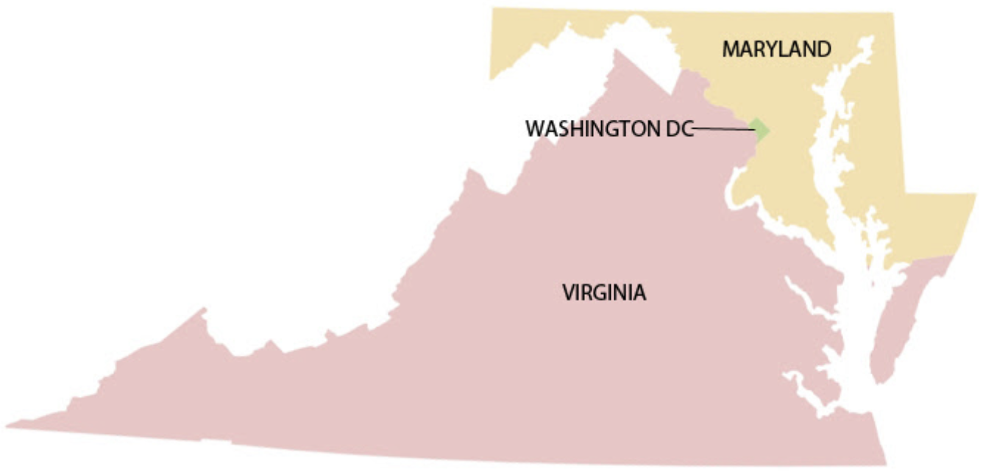
Children’s National Hospital, Washington DC, USA
~1600 youth with type 1 diabetes
Median HbA1c: 7.9%

Slide 16

Background
Youth with T1D and sub-optimal glycemic control often face barriers that are inadequately addressed in standard outpatient care
Global Aim:
Improve Glycemic Control and Diabetes Technology Use for Youth with Sub optimally Controlled T1D
Specific Aim:
Increase CGM and AID initiation to >80% and reduce mean HbA1c >1% among Blossom Clinic Participants within 3 years
Notes:
Youth with T1D and sub-optimal control often face:
Recurrent DKA and high HbA1c
Barriers inadequately addressed in standard outpatient care
Need for intensive, team-based intervention to improve engagement and outcomes

Slide 17
Blossom Clinic
Target Population: youth 6-18yrs with
>2 HbA1c >10% or >2 DKA in prior 12 months
12-month program, 4 structured visits + in between support
Interdisciplinary team
CDCES
Psychologist
Social Worker
MD/NP
Pharmacist
Health Coach
patient
Notes:
Eligibility:
T1D ≥1 year
≥2 HbA1c >10% OR ≥2 DKA admissions in prior year
Program:
12 months, 4 structured visits
Intensive team: provider, psychologist, social worker, CDCES, pharmacist, health coach
Between-visit support
Focus: Technology use, behavior change, psychosocial health
Funding for transportation
Touchpoints between visits
Tech focus: extra CGM supplies and support for tech education/initiation
Tools: SDOH, PHQ9 (child), PHQ2 (parent), GAD7, DNT5, DM knowledge assessment
Goal setting

Slide 18
Blossom Clinic
Interdisciplinary Care
Pre-clinic huddles
Extended visits
Decision point at 1 year
Patient/Family Centered
Patient goal setting
Between visit touchpoints
Comprehensive assessment tools
Equity-Focused Supports
Transportation
Food Pharmacy
Diabetes Supplies
Technology Support
CGM initiation/re-initiation
AID education, initiation, and sustained use
Extra Supplies
Notes:
transportation: Uber, gas cards, transportation through insurance
Pharmacy: consistent refills, active insurance, switch to specialty pharmacy with home deliveries
supplies: ketone sticks, CGM adhesive kits, smartphones
Assessments: depression, anxiety, diabetes numeracy test, problem areas in diabetes, knowledge assessments
Decision point at 1 year: shared decision-making with families on whether to continue Blossom or transition back to routine care.
*add in animation for each bulleted point to come in individually

Slide 19
Participant Baseline Characteristics (n=12)
Characteristic | Median, IQR
Age, years | 12.8 (11.9,15.1)
T1D Duration, years | 4.9 (3.5, 7.6)
HbA1c | 11.9 (9.9, 13.3)
Notes:
Data collected:
Demographics (age, sex, insurance, race/ethnicity)
Clinical (HbA1c, DKA/ER visits, CGM use, AID uptake)
Engagement (team members seen per visit)
Analysis: First 6 completers
Table (2-column):
N = 11 completers
Mean age: 13.0 years
Sex: 64% male
Race: 100% NHB
Insurance: 73% public
Baseline HbA1c: 11.7% (compared to median 7.9%)
CGM use baseline: 55% (compared to 92%)
AID use baseline: 27% (compared to 65%)

Slide 20
Clinical Outcomes
1.7%
58%
58%
*2 initiated AID after V4 (+28%)
Notes:
Text (bullets above/beside graph):
Mean HbA1c ↓ from 11.6% → 9.9%
DKA/ER events: 1 patient had 2 ER visits between V1-V2, seems to be an outlier
CGM use increased initially, at visits 3 and 4 2 patients had discontinued and restarted CGM at both V3 and V4
2 initiated AID, 2 planned initiation

Slide 21



Engagement
63% received AID education
(5/8 AID naïve youth)
3.1 + 0.5 Avg. team members seen per visit
100% Retention (attended all 4 visits)
Notes:
Avg. 3.2 ± 0.5 team members seen per visit
100% retention (all 11 completed full program)
Participants received consistent AID education: 3 were already on AID, 1 was using manual mode due to not having cell phone

Slide 22
Conclusions
Multidisciplinary, equity-focused design seems feasible and acceptable and supported families with complex needs
Strong engagement with multi-disciplinary team
Early data suggest improved HbA1c and greater readiness for AID use
Notes:
High feasibility and acceptability: 100% retention across 4 visits
Strong engagement: average 3+ team members per visit
Technology uptake: >60% received education, 2 initiated AID systems
Acute event reduction: DKA/ER events per patient decreased from 4.19 → 0.05 (~4 fewer events per patient)
Early data suggest improved HbA1c and greater readiness for technology use
Multidisciplinary, equity-focused design (transport, food pharmacy, extended visits) supported families with complex needs

Slide 23
Next Steps
Expanding Enrollment
Refine Workflows
Enhance Technology Support
Collect Longitudinal Outcomes
Scale and Spread
Notes:
Expand enrollment to reach more eligible youth (beyond initial 36 capacity)
Refine workflows (optimize pre-clinic huddles, between-visit touchpoints)
Enhance technology support with structured CGM/pump initiation pathways
Collect longitudinal outcomes on HbA1c, CGM wear time, diabetes distress
Scale and spread:
Explore replication at satellite sites
Share lessons learned across T1DX-QI collaborative
Evaluate sustainability and funding mechanisms

Slide 24
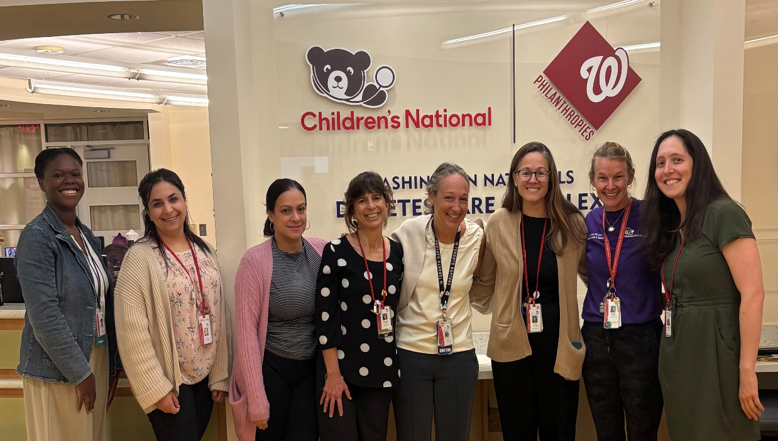
Special Thanks To…
Amanda Perkins, CPNP, CDCES, MPH
Mai Tran, PharmD, BCACP, BCGP, CDCES
Lauren Clary, PhD
Lauren DeAnna, LICSW
Roxanna Velasquez
Our CDCES and RDs!

Slide 26
Remote Patient Monitoring for PwT1D Experiencing Elevated Glycemic Measures
Stephanie Crossen, Mia Silva, Ava Warfel, Kelli May, Sushma Reddy, Brandon Arbiter
Notes:
Use ”New Slide” or “Layout” to view and customize the slide templates.

Slide 27
Background
Although CGM data is often remotely accessible, diabetes centers lack protocols for reviewing data and reaching out to people with type 1 diabetes (PwT1D) between appointments.
Diabetes data platforms like Tidepool now provide population health tools to risk-stratify patients based on their recent CGM metrics.
PwT1D experiencing elevated glycemic measures may particularly benefit from between-visit outreach.

Slide 28
Methods
Enrolled 20 PwT1D with >1 yr duration of T1D, >3 months CGM use, and HbA1c or GMI >8%.
Agreed to 4-month clinical RPM with associated outreach and billing.
Weekly reports via Tidepool+ TIDE dashboard to identify patients for outreach:
time-in-range (TIR) <30%
decrease in TIR of >15% from the prior week
Hypoglycemia (<70 mg/dl) >5%, or
CGM wear time <70%
Contacted via text, phone, and/or EHR messaging and offered assistance.
Notes:
Add billing data?

Slide 29
RPM Cohort
Cohort was majority adolescent and using AID systems; 50% publicly insured; 25% Latinx

Slide 30
RPM Outreach Data
PwT1D received outreach a median of 6.5 times (range 0-15) over 16 weeks.
Most frequent reasons for outreach were TIR <30% (48% of outreach) and CGM wear time <70% (27% of outreach).
Median time per outreach event was 10 minutes (range 5-60).
Low response rate to text messages → 65% of outreach involved phone.
41% of outreach events got no response (even with repeated attempts).
Notes:
5 participants received >10 outreach; 6 received <5 outreach; 9 received 5-10.
53% of encounters involved MD (not just navigator).

Slide 31
Changes in CGM Metrics
Significant improvement in TIR over 4 months, correlating with decreased hyperglycemia
Notes:
7 of 20 participants had TIR improvement of 10% or more

Slide 32
Survey Data
All respondents rated the program as “very helpful” (44%) or “a little helpful” (56%), and 83% of respondents thought it should continue.
Most frequently cited benefits were :
“Reminded me to stay focused on diabetes between visits” (61%)
“Made it easier to get help managing diabetes between visits” (50%)
Preferences for future RPM:
Weekly (56%) or monthly (28%) outreach
Text (72%) as preferred modality, followed by phone (22%)
Help with keeping glucose in target range (72%), getting diabetes supplies (39%)
Notes:
Other 17% thought “maybe” it should continue.
1 person reported privacy/security concern.
Burdens? 1 person reported time consuming; 1 reported difficult to receive/respond to messages.
Benefits: some cited helpful coordinating changes in management between two households

Slide 33
Reimbursement for RPM Codes
Overall RPM charges totaled ~$26,600 and reimbursements were ~$8300 (about $100 per patient per month for this cohort and payor mix).
Among charges that were paid, reimbursement rates varied
99453 (setup)
Public: $18-25
Private: $62-73
99454 (monthly facility charge for reviewing 16+ days of data)
Public: $34-63
Private: $250-380
99457/99458 (20+ minutes of care provided, must include some synchronous)
Public: $45-75
Private: $110-190
One participant with high deductible plan charged full amount. No other co-pays reported. Managed care charges and reimbursement hard to assess (contracts).
Notes:
Reimbursement for 99453+99457/8 was only about $3800 (remainder $4500 was 99454 which is facility charge).

Slide 34
Conclusions
Weekly RPM for PwT1D is feasible using pop health dashboards that risk-stratify CGM data (like Tidepool+ TIDE), and is potentially beneficial for PwT1D experiencing elevated glycemic measures.
Barriers to widespread implementation include staffing limitations, variable responsiveness by PwT1D and their families, and variability in reimbursement.

Slide 35
Thank you! Questions?
Notes:
Use ”New Slide” or “Layout” to view and customize the slide templates.

Slide 37
GLP-1 RA Choice and Change Patterns in Pediatric Type 2 Diabetes: A Single Institution Study
Department of Pediatric Endocrinology
Noha El Yaman, MD; Kathryn Haberlin-Pittz, MPH, CHES®, CHWC; Brett M. McKinney, BS; Luz A. Machuca, BSPH, CHES®; Tamara S. Hannon MD, MS

Slide 38
Background
The prevalence of type 2 diabetes in youth is rising.
GLP-1 RAs are increasingly used to improve glycemic control and weight outcomes.
Despite growing use, real-world pediatric data on GLP-1 RA choice, switching, and discontinuation remain limited.
Objective: To characterize GLP-1 RA prescribing patterns and identify reasons for switches or discontinuations in pediatric patients with type 2 diabetes.

Slide 39
Methods
Study Design:
Retrospective chart review at a tertiary pediatric endocrinology clinic (2019–2024).
Patients aged 7–18 years with type 2 diabetes
Visit-level demographic data and GLP-1 RA prescriptions
Analysis: Descriptive statistics

Slide 40
Cohort Characteristics
846 patients (3,431 visits)
59% females
Insurance: Government 76%, Private 23%, Self-pay 1%
x

Slide 41
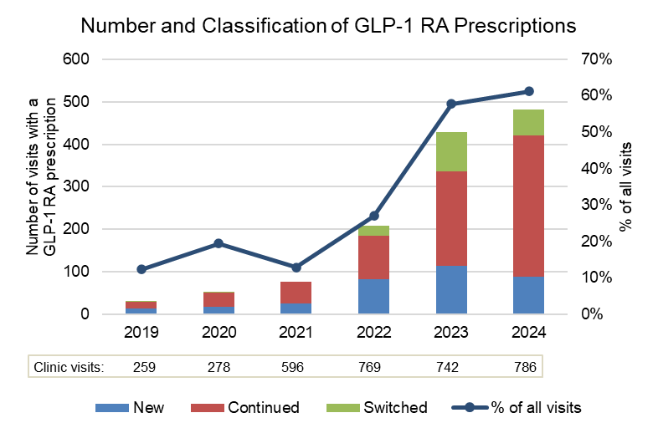
Prescribing Patterns
1,280 (37%) visits ended with a GLP-1 RA prescription.

Slide 42
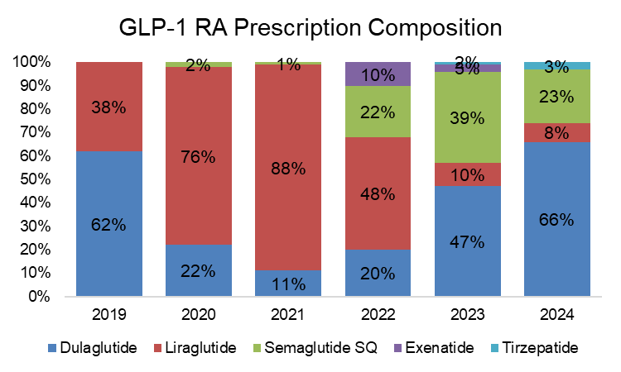
GLP-1 RA Choice
Notes:
Highlight preferences more than numbers..

Slide 43
GLP-1 RA: New

Slide 44
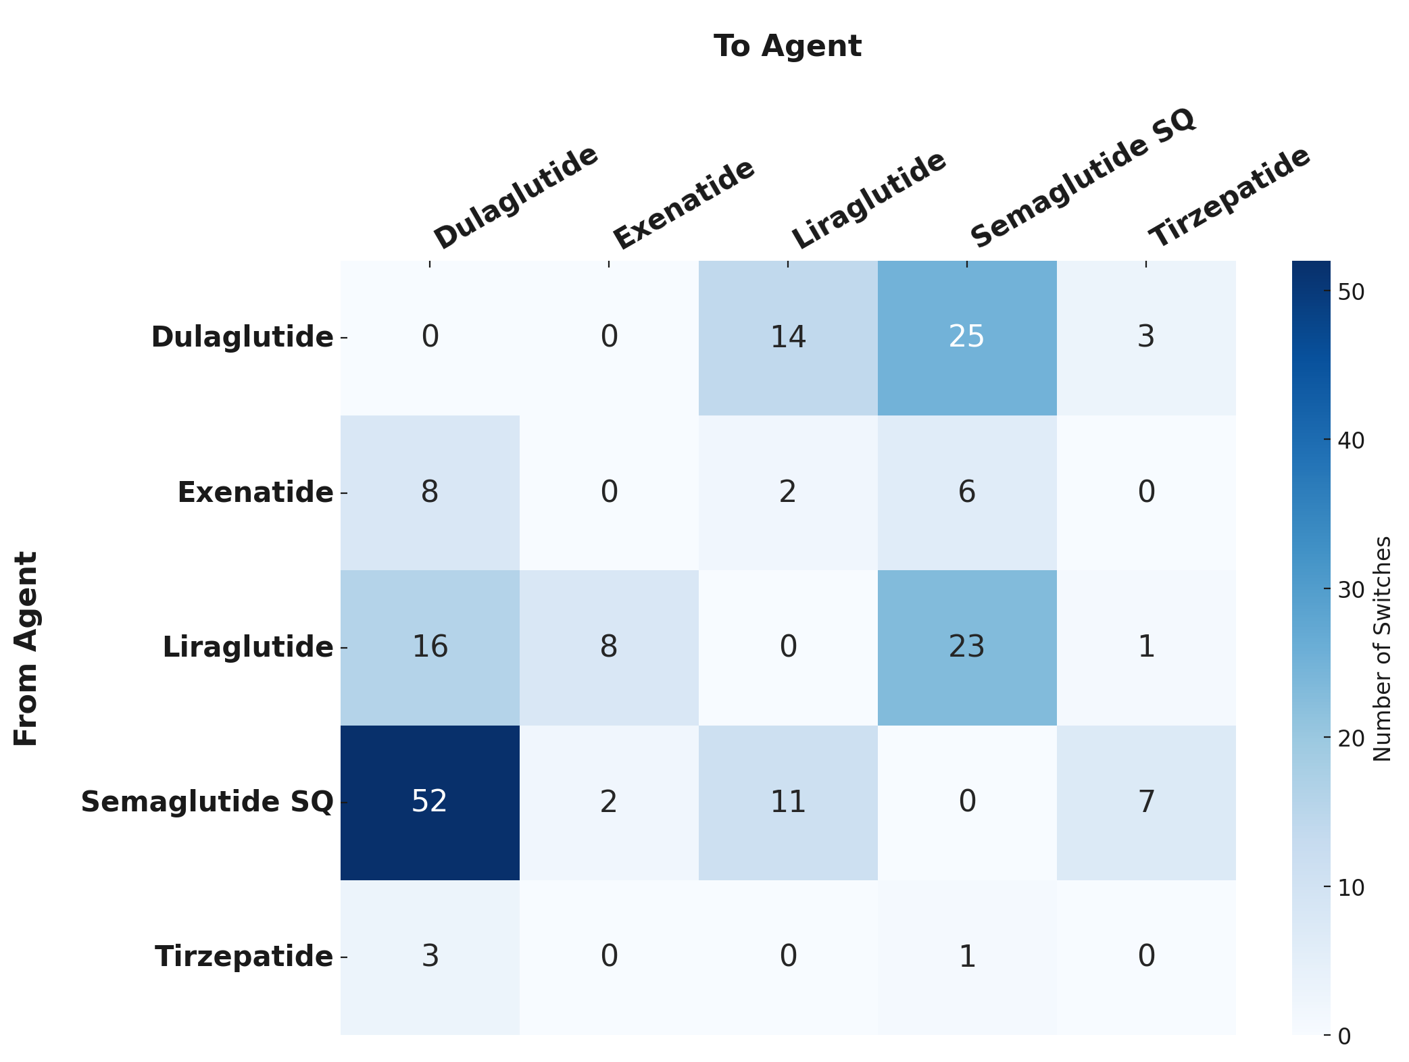
GLP-1 RA: Switches
Weight loss benefit (35%)
Insurance 49%
Weight loss benefit 13%
Unclear 10%
Availability Issues 6%
Side effects 6%
Adherence 5%
Treatment failure 3%
Patient preference 3%
Insurance (35%)
Adherence (19%)
Weight loss benefit (36%)
Insurance (88%)

Slide 45
GLP-1 RA: Discontinuation
GLP-1 RAs were discontinued at 58 visits.
Reasons:
Patient preference 26%
Insurance 24%
Side effects: 24%

Slide 46
Conclusion
Key Findings
Dulaglutide emerged as the most prescribed and most frequent switch target among pediatric T2D patients.
Insurance coverage was the leading factor guiding medication choice and switches, often overriding clinical preference.
Perceived efficacy (particularly for weight loss) and tolerability also contributed but to a lesser extent.

Slide 47
Lee Jia Jia, I., Zampetti, S., Pozzilli, P., & Buzzetti, R. (2024). Type 2 diabetes in children and adolescents: Challenges for treatment and potential solutions. Diabetes research and clinical practice, 217, 111879. https://doi.org/10.1016/j.diabres.2024.111879
Yugar, L.B.T., Sedenho-Prado, L.G., da Silva Ferreira, I.M.C. et al. The efficacy and safety of GLP-1 receptor agonists in youth with type 2 diabetes: a meta-analysis. Diabetol Metab Syndr 16, 92 (2024). https://doi.org/10.1186/s13098-024-01337-5
https://www.accessdata.fda.gov/drugsatfda_docs/label/2022/125469s051lbl.pdf?utm_source=chatgpt.com
Miller MG, Terebuh P, Kaelber DC, Xu R, Davis PB. Characterizing GLP-1 Receptor Agonist Use in Preadolescent and Adolescent Populations. JAMA Netw Open. 2024;7(10):e2439887. doi:10.1001/jamanetworkopen.2024.39887
x

Slide 48

Section Header Here Subtitle Here
Break
Please return to Whitley Ballroom by 11:10 am

