Slide 1

Complications and Comorbidities in Diabetes
Moderated by Marina Basina, MD

Slide 2
Sick Day Management Protocols for Patients on AIDs (Automated Insulin Delivery Systems) to Reduce Messages Sent to Providers
Kaveri Bhargava, Former T1D Exchange QI Coordinator
Arati Nagarkar, T1D Exchange QI Coordinator
Dr. Tamaryn Fox, Endocrinology Fellow
Dr. Marina Basina, Primary Investigator

Slide 3
Current Problem
An increasing number of patients with diabetes utilizing AID insulin pumps
During times of illness, pump settings need to be adjusted.
There is an increased risk of both hypoglycemia and hyperglycemia during times of illness .
No existing protocols to help manage AID during illness
Messages are sent to physicians with questions about insulin dose modification and are waiting for the response.
This can result in delays in response time and ultimately delays in patient care.

Slide 4
Aim Statement
Aim: To improve the efficiency of communication between patients and diabetes care teams by :
Shortening the turnaround time for provider responses to patient messages regarding insulin pump adjustments during illness.
Reducing the number of messages escalated from triage nurses to physicians.

Slide 5
Process Map
Patient sends a message (phone or via MyHealth)
Phone call goes to RN, MyHealth message goes to PCC/RN to triage
RN receives message and calls patient to gather information
RN sends message to doctor, doctor responds to RN (back and forth)
RN relays information to patient
Providers are usually in the clinic and may not be available until the end of the workday

Slide 6
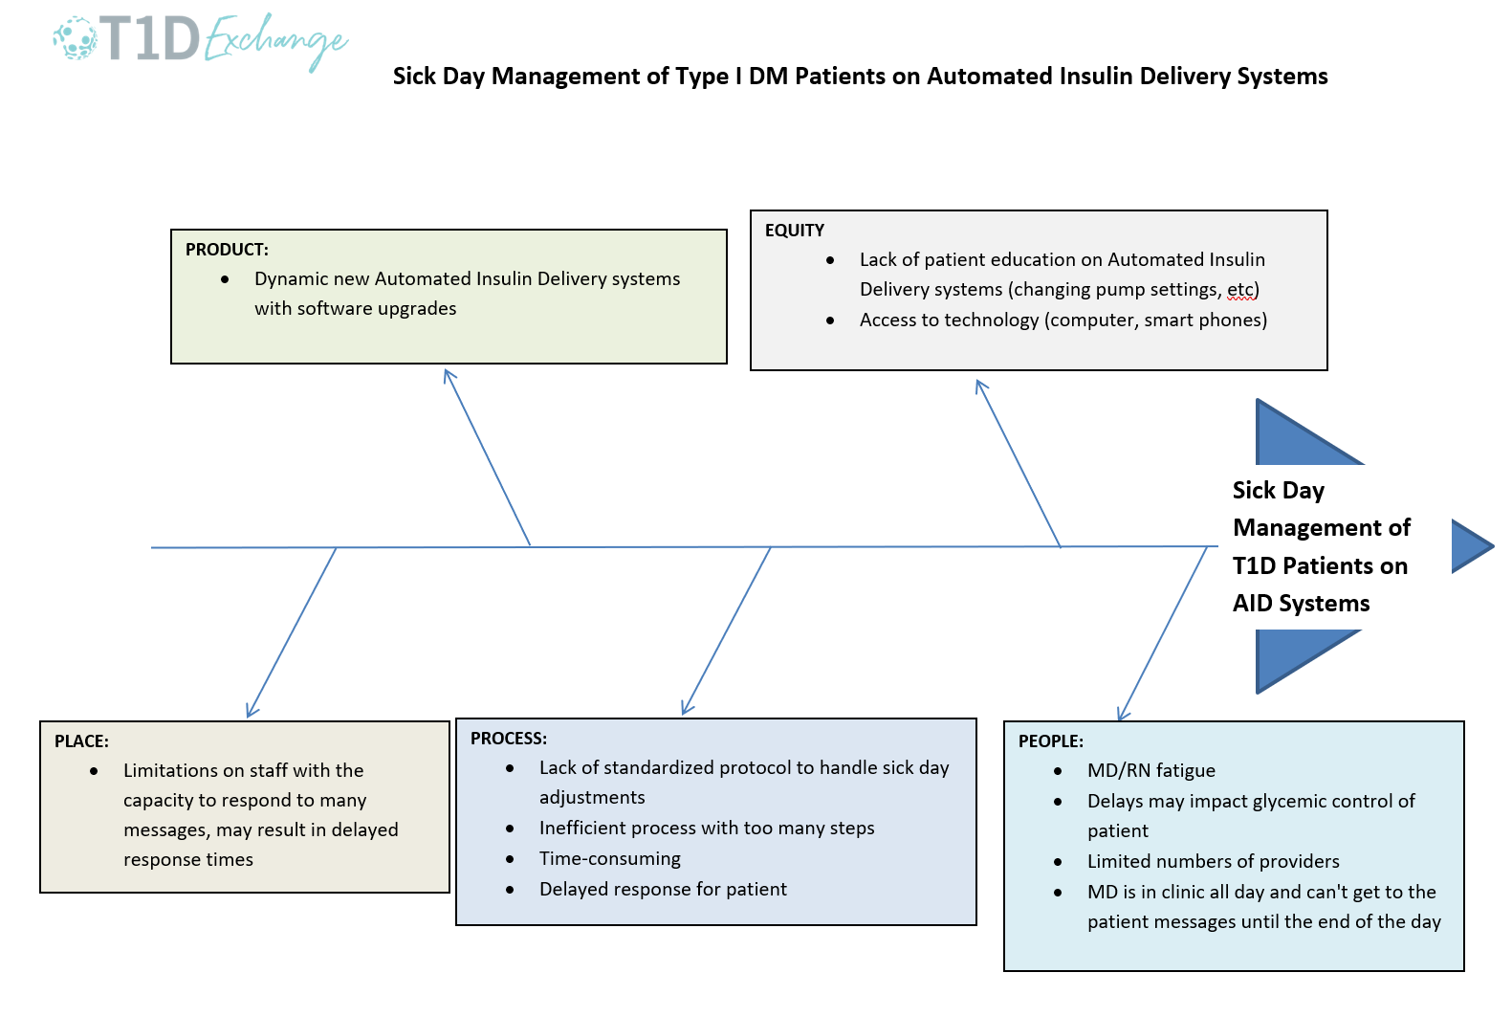
Fishbone Diagram

Slide 7

Survey Distribution
Internally via Survey Monkey Platform
  We sent out an email to adult endocrinology providers who regularly see diabetes patients .
Externally via Type I Diabetes Exchange
  Sent out email to T1D Exchange collaborative
  Used flyer with QR code at the November Learning Sessions

Slide 8
Survey
Sick Day Management PI Questionnaire
Sick patient Case :
35-year-old female presents with history of Type 1 DM x20 years. Calls clinic for advice on pump management ; developed sore throat , nasal congestion, fever x2 days, tested positive for COVOD today. Blood sugars have been in the 200-250 range despite frequent corrections.
Case Scenario 1: Tandem t:slim X2 with Control IQ
Patient is on Tandem t:slim X2 with Control IQ. Target 110, CHO 7, ISF 30, TDD 40 units. Has backup Lantus at home.
What would you advise ?
Switch to manual mode, increase basal rates by 20%.
Switch to SC injections for the next 2-3 days.
Continue auto mode, take 10 units of Lantus in addition to the pump.
Continue auto mode, change carb ratio to 5 and ISF to 20.
Other

Slide 9
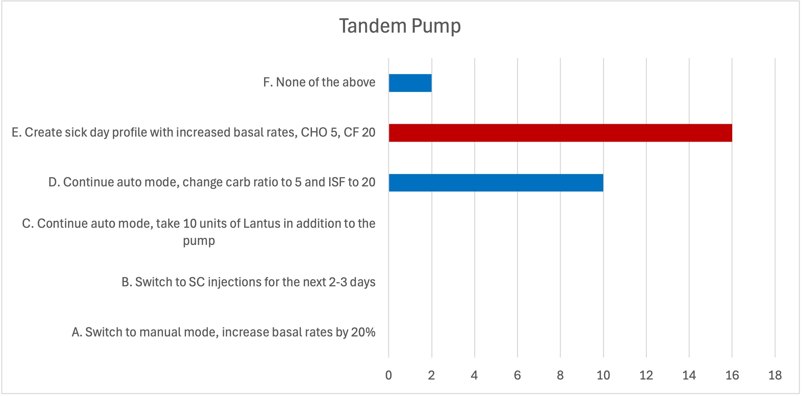
Data Analysis – Tandem
Patient is on Tandem t:slim X2 with Control IQ. Target 110, CHO 7, ISF 30, TDD 40 units. Has backup Lantus at home. What would you advise ?
The number of survey responses n = 28

Slide 10
Survey Cont’d
Case Scenario 2: Omnipod 5
Patient is on Omnipod 5 pump on Auto Mode. Target 110, CHO 7, ISF 30, TDD 40 units. Has backup Lantus at home.
What would you advise ?
Switch to manual mode, increase basal rates by 20%.
Switch to SC injections for the next 2-3 days.
Continue auto mode, take 10 units of Lantus in addition to the pump.
Continue auto mode, change carb ratio to 5 and ISF to 20.
Other

Slide 11
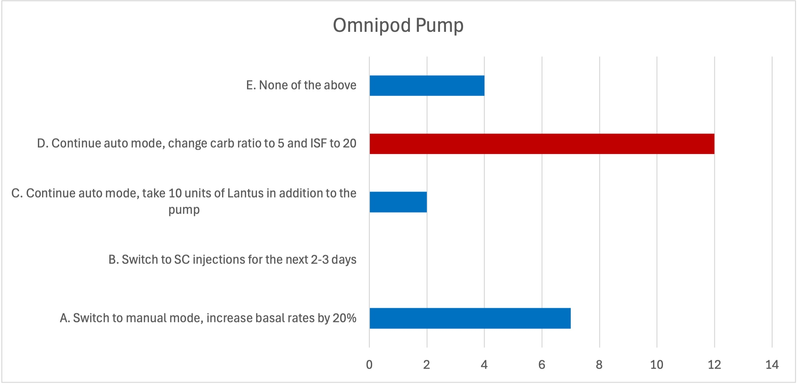
Data Analysis – Omnipod 5
Patient is on Omnipod 5 pump on Auto Mode. Target 110, CHO 7, ISF 30, TDD 40 units. Has backup Lantus at home. What would you advise ?
The number of survey responses n = 25

Slide 12
Survey Cont’d
Case Scenario 3: Medtronic 780G
Patient is on Medtronic 780G pump with Target 110, CHO 7, ISF 30, TDD 40 units. Has backup Lantus at home.
What would you advise ?
Switch to manual mode, increase basal rates by 20%.
Switch to SC injections for the next 2-3 days.
Continue auto mode, take 10 units of Lantus in addition to the pump.
Continue auto mode, change carb ratio to 5 and ISF to 20.
Other

Slide 13
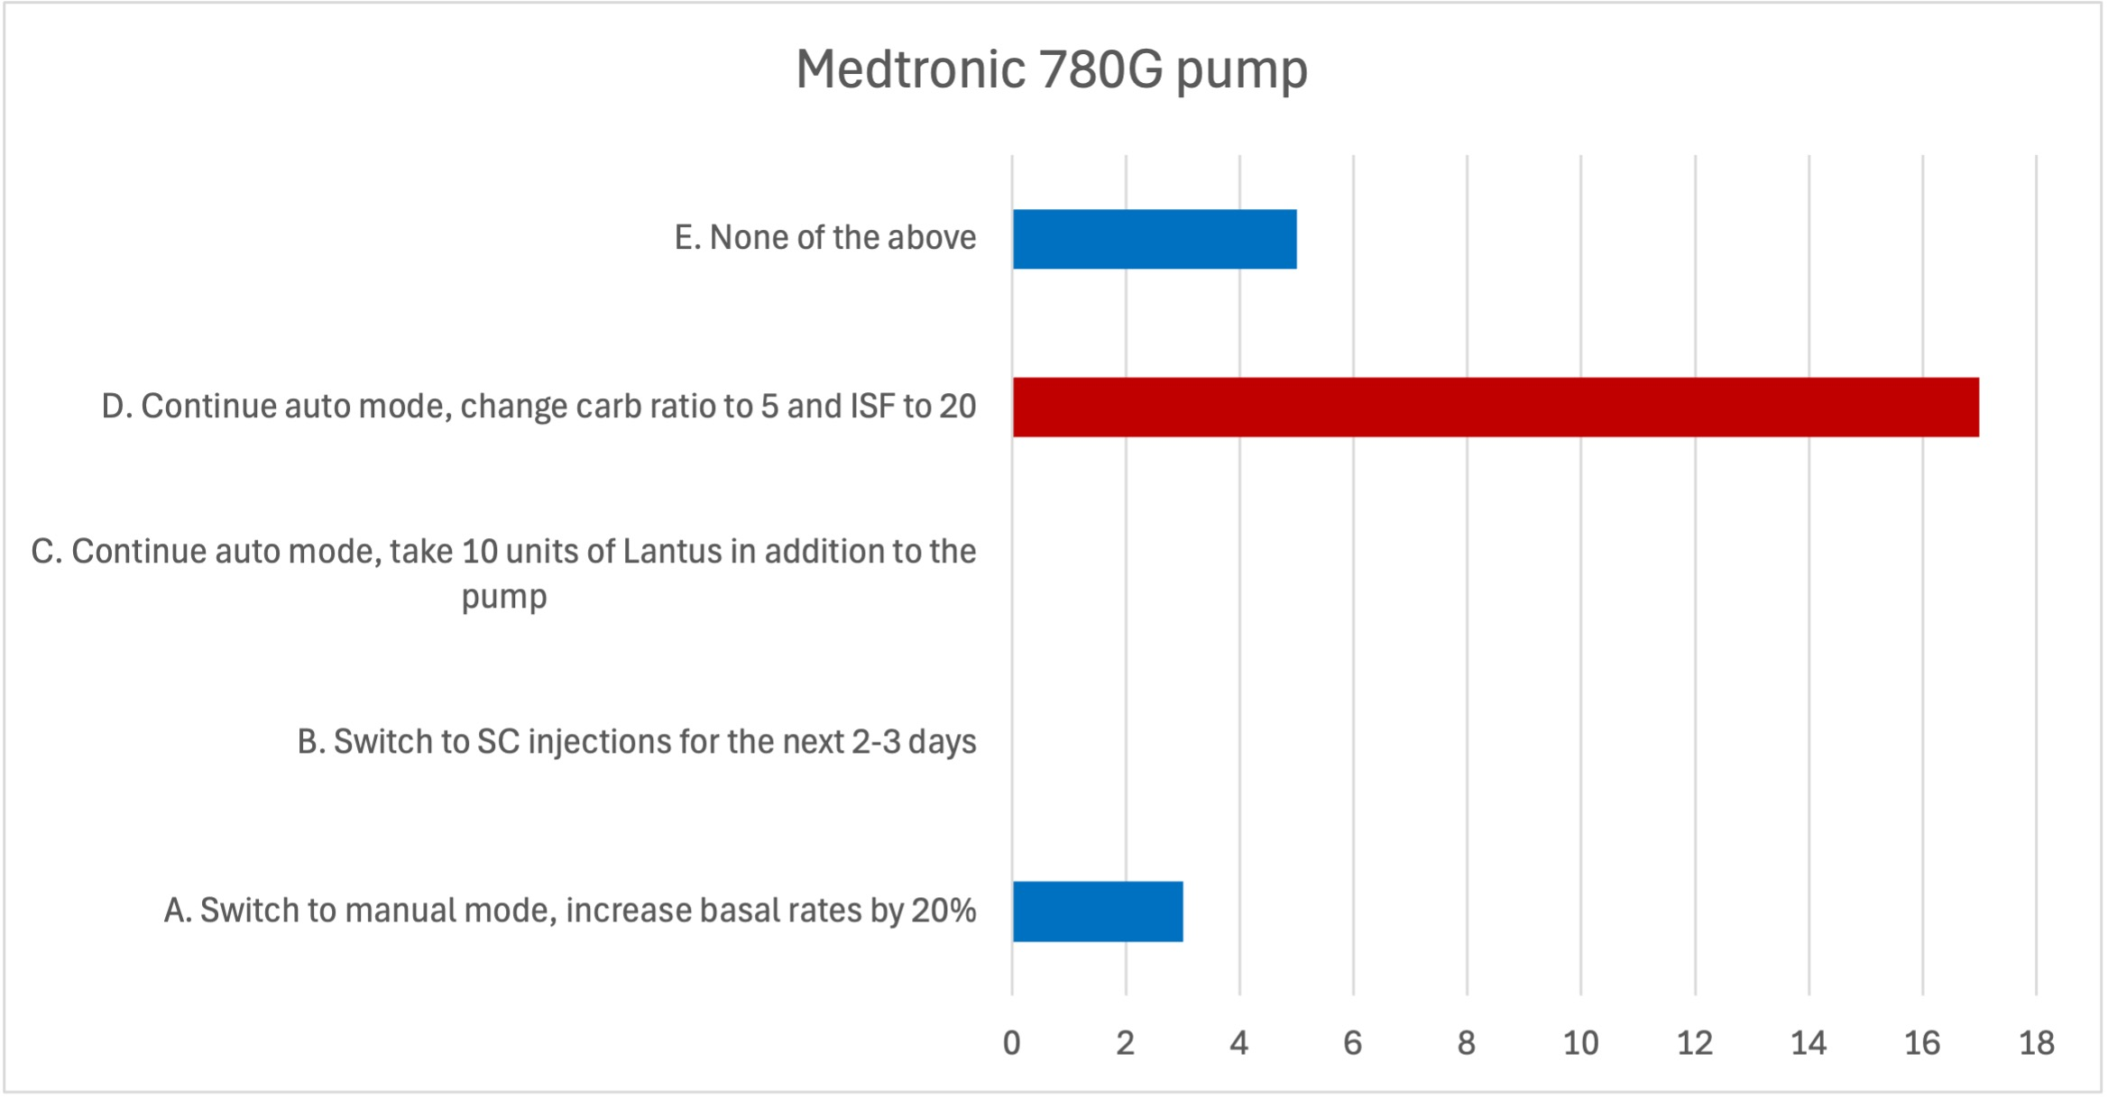
Data Analysis – Medtronic
Patient is on Medtronic 780G pump with Target 110, CHO 7, ISF 30, TDD 40 units. Has backup Lantus at home. What would you advise ?
The number of survey responses n = 25

Slide 14
Survey Cont’d
Case Scenario 4: iLet
Patient is on iLet pump with Target 110, CHO 7, ISF 30, TDD 40 units. Has backup Lantus at home.
What would you advise ?
Switch to SC injections for the next 2-3 days.
Enter all meals as larger than usual.
Other.

Slide 15
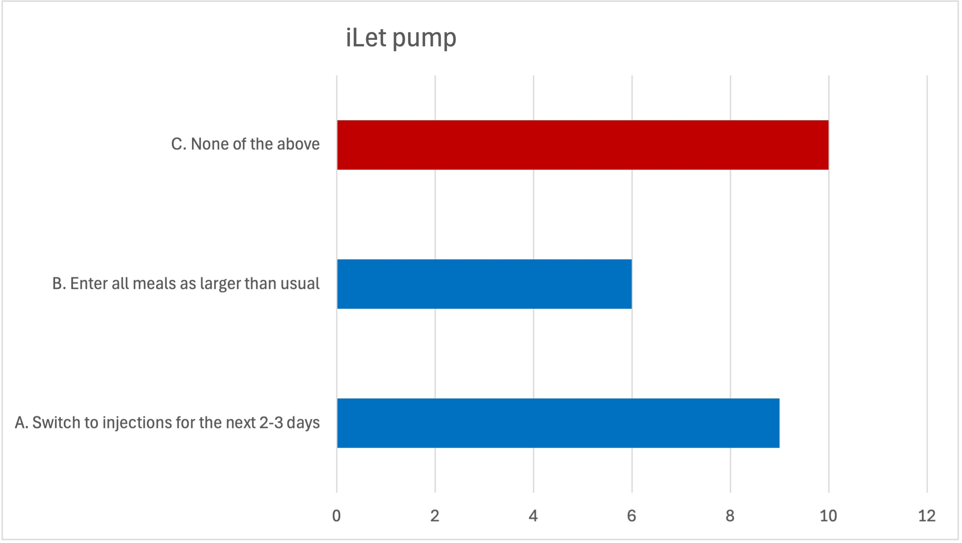
Data Analysis – iLet
Patient is on iLet pump with Target 110, CHO 7, ISF 30, TDD 40 units. Has backup Lantus at home. What would you advise ?
The number of survey responses n = 25

Slide 16
Limitations and Future Directions
Limitations:
Tracking patient messages being sent between RNs and providers (solution could be retrospective review)
Tracking response times from first message to final reply (solution could be doing retrospective review of time stamps)
Varying practices among providers sometimes resulted in no clear consensus in the survey answers so when a protocol is written and implemented this may limit buy in.
Future Directions:
Creating a protocol using the data from our survey
Testing the protocol in the clinic with 1-2 RNs
Implementing the protocol in the clinic as the standard protocol for sick day management for patients on AID systems
A future expert opinion publication on sick day management, created by convening field experts to develop actionable and practical recommendations

Slide 17
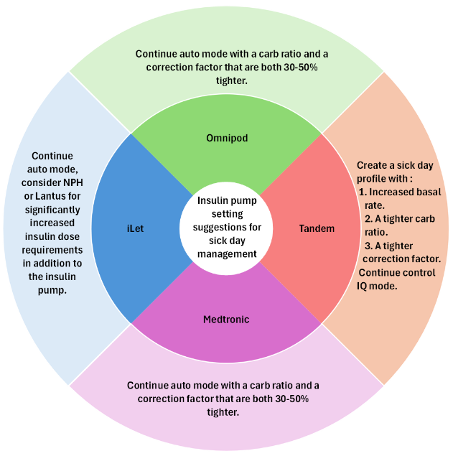
The draft pump specific sick day management protocol
TWIIST will be added to this configuration set once it becomes more widely available.

Slide 18
A record of the patient’s most recent sick-day insulin pump settings and management recommendations provided during the previous illness episode.
RNs and Providers can track the last illness that the patient suffered and record the pump settings as a reference guide to any future sick day pump changes while also considering the default pump specific sick day settings. A smart phrase will be created to capture these recommendations and send to the patient.
The data would comprise of the following entries :
Type of illness
Auto mode on/off
basal rate
carb ratio
correction factor

Slide 19
Thank you!

Slide 21
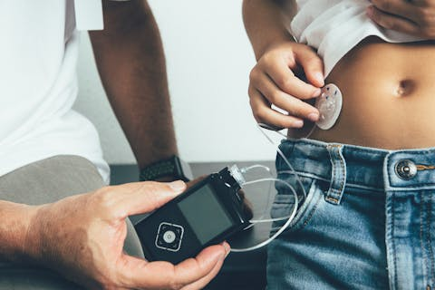

Having Your Back(up): Implementing Safety Nets for Insulin Pump Failures
Division of Endocrinology, Diabetes and Metabolism
Vivian Lee, Medical Student
Berit Bagley RN, CDCES
Deborah Plante, MD
Julie Durette RD, CDCES
Connor Reilly MS, PMP, CPHQ

Slide 22



Background
60% of adults with T1D are on insulin pump therapy
Pump site failure accounts for 57% of DKA events among pump users
Professional societies recommend patients have a pump backup plan (BUP) to mitigate risk

Slide 23


Insulin Pump Safety
Problem:
Complete BUP documentation (active basal insulin rx + instructions in After-Visit Summary/AVS) often absent or inconsistently placed in EPIC
Aim:
By August 2025, increase complete BUP documentation by 15% and standardize it with EPIC's Insulin Instructions (EII)

Slide 24
Retrospective Chart Review
 | No | Yes
Pump Implant Flag | (18%) | (82%)
Pump Settings Documented | (11%) | (89%)
Backup Plan Documented Chart note/AVS | (81%) | (19%)
Active Basal Insulin prescription | (58.6%) | (41.4%)
All components of successful backup plan | (88.5%) | (11.5%)
N = 157 patients
Assessed frequency of patients having the necessary components of a complete BUP

Slide 25
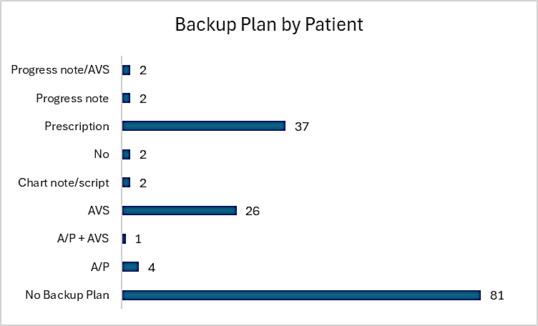
Chart Audit Results
Majority have no backup plan
EMR documentation location varies by provider

Slide 26
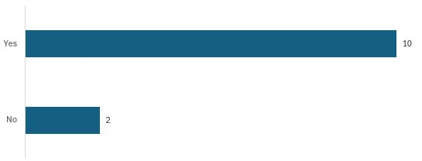
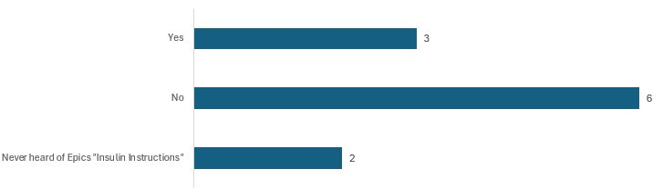
Survey to Adult Endocrinology Providers
Method of Providing BUP Instructions (Verbal, AVS, Prescription, Free text): Multiple methods often used together
Use of EMR to document Insulin Pump/CGM
Knowledge of EPIC's "Insulin Instructions" Feature:

Slide 27
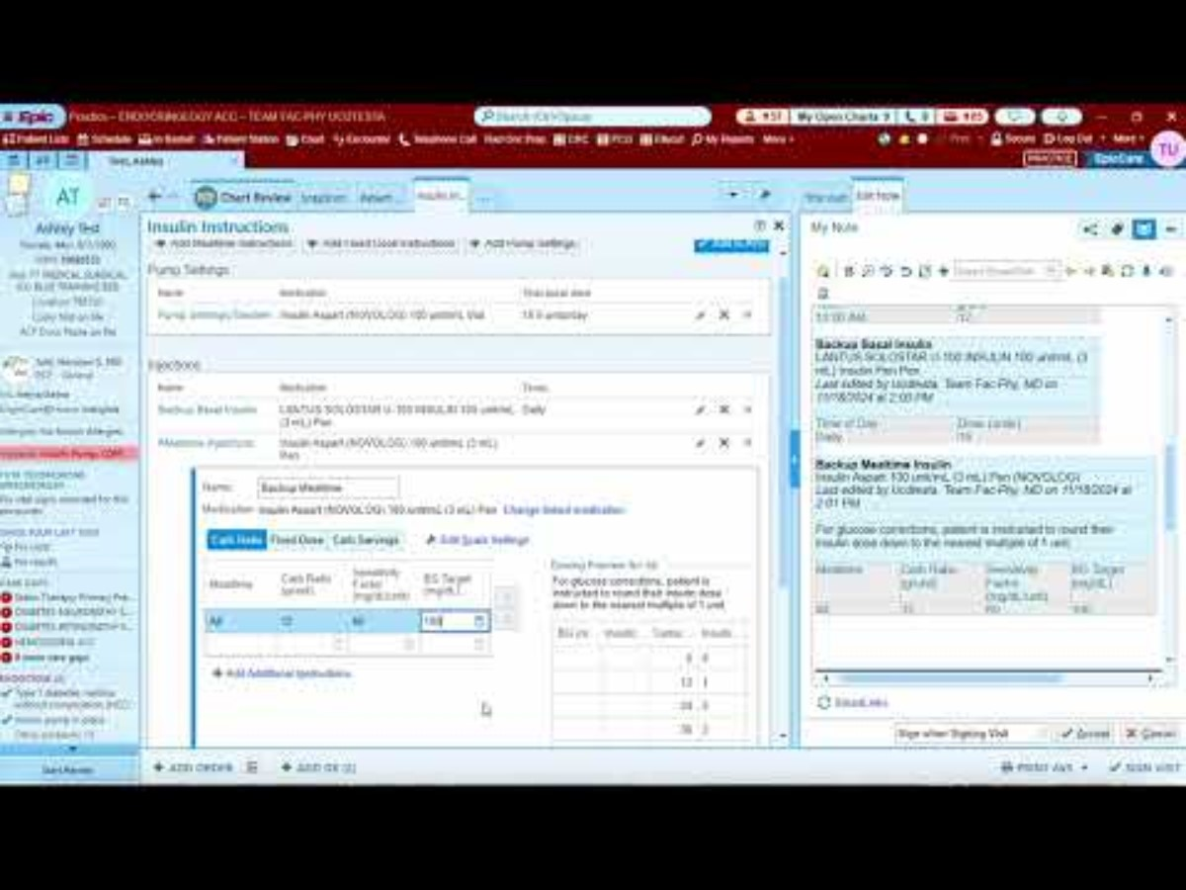

Intervention: EII for Pump Settings & BUP
Link: https://www.youtube.com/watch?v=96auw2v9sc4

Slide 28
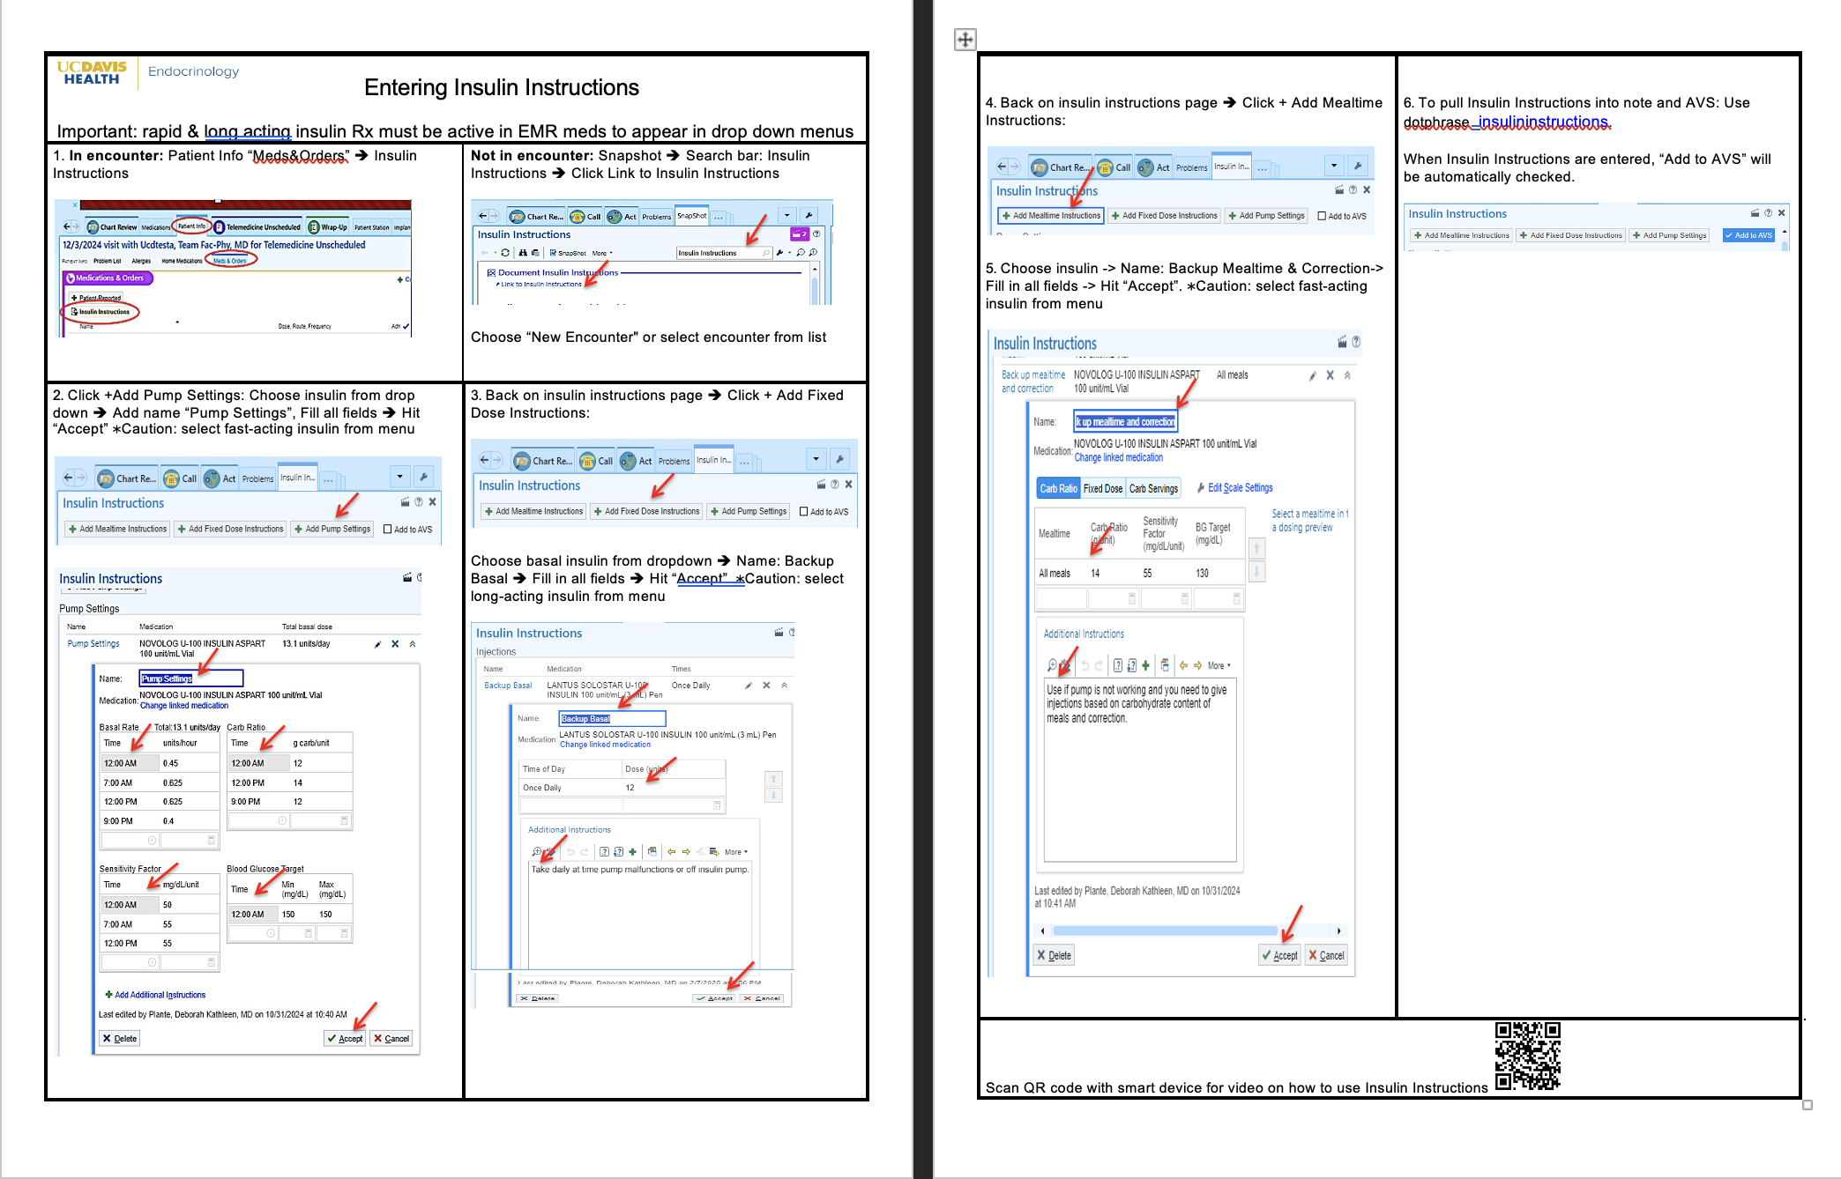
Intervention: Step-By-Step Guides in Provider Workspaces

Slide 29
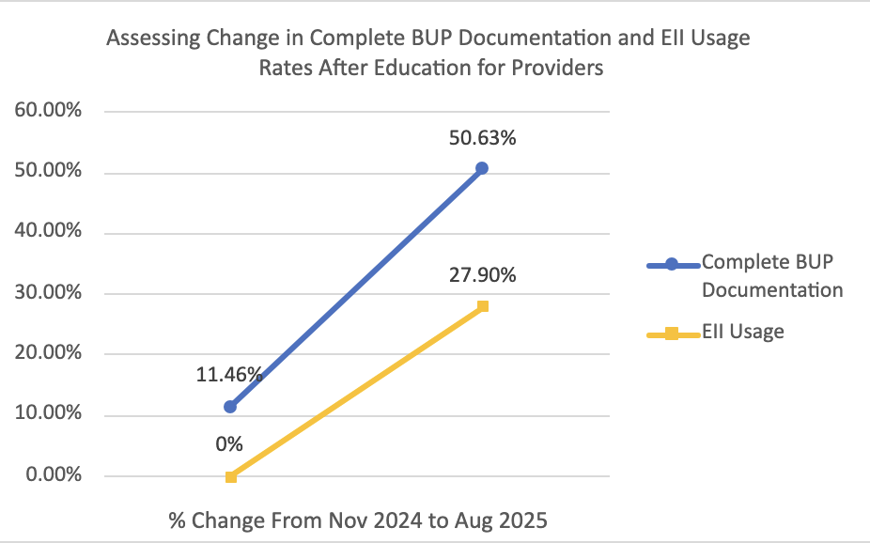
Change in BUP Documentation and EII Use Post-Intervention

Slide 30




Next Steps
Re-survey providers
Continued education on accessing & implementing EII
Annual technology update clinic
Standardized BUP Smartphrase or note template

Slide 31


Takeaways
Significantly improved BUP documentation overall & increased EII utilization; limited by variable provider engagement with EII
QR code to EII video:
All insulin pump patients should have BUP documented in a standardized location; inconsistency jeopardizes safety
EII recommended for standardization & accessibility to outpatient & inpatient providers
Notes:
Used inpatient and outpatient by our pediatric colleagues. Standard location helps RN/RD CDCES and inpatient team know pump setting.

Slide 33
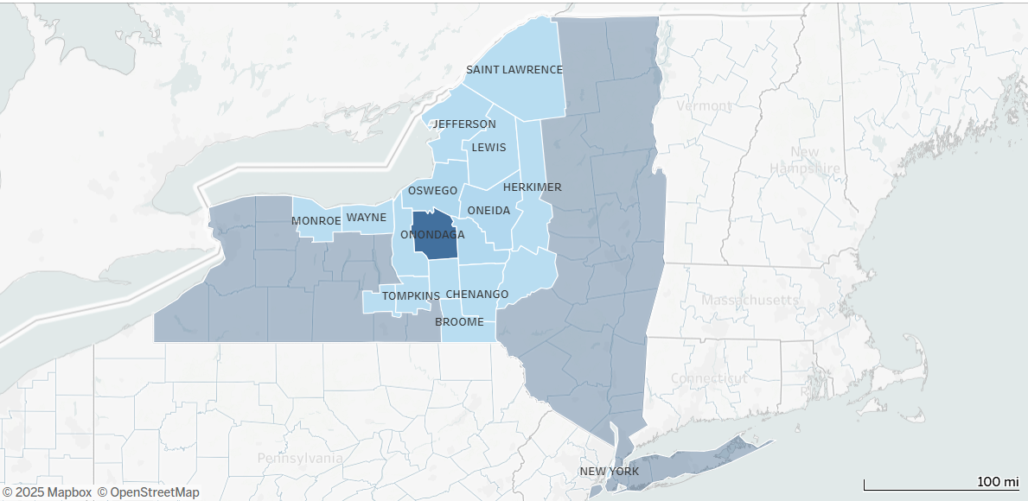


Screening for Peripheral Arterial Disease (PAD) in Diabetes Using the Ankle Brachial Index (ABI)
Jerusha Owusu-Barnie M.S.
Data Coordinator
Adults ≥50yrs. seen Oct-2024 to Jun-2025

Slide 34
Objective
The Society for Vascular Surgery and the American Podiatric Medical Association guideline recommend all people with diabetes ≥50 years of age be screened for PAD.
Interpretation of ABI results
  Normal: 1.0 to 1.3
  Borderline: 0.9 to 1.0
  Mild PAD: 0.7 to 0.9
  Moderate PAD: 0.4 to 0.7
  Severe PAD: Lower than 0.4
Risk factors of PAD: cardiovascular, metabolic, demographic
Complications: cardiovascular events, foot ulcers, amputation

Slide 35
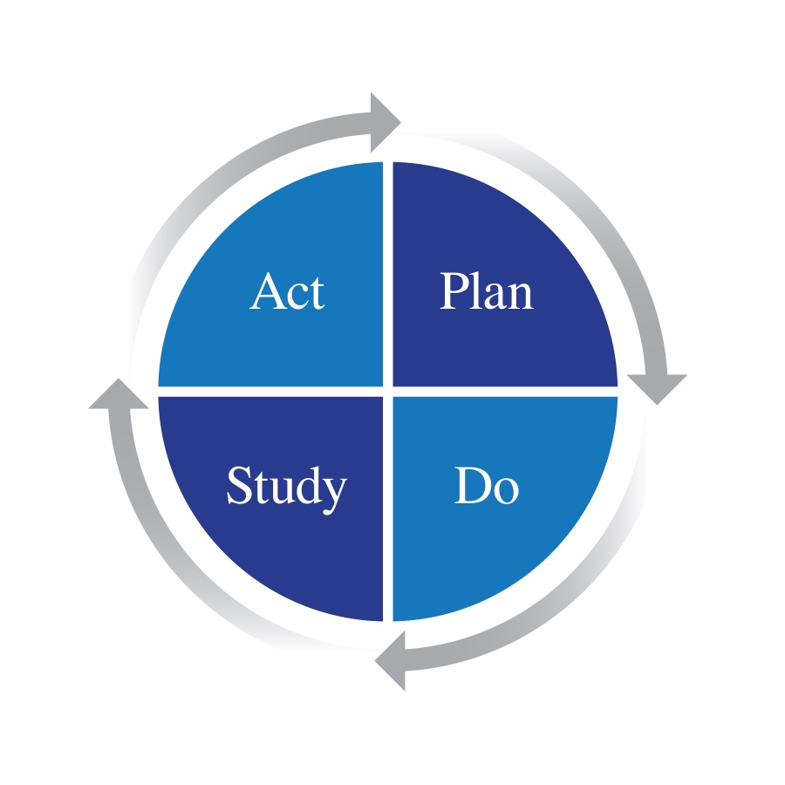
PDSA Cycle 1.
Act:
Smart Phrase in EPIC
Screen and improve documentation
Provide training and resources to staff
Aim:
Screen 50% of patients ≥50yrs. in 6 to 12 months (Start on 10/18/2024)
Study: up to 11/15/2024
Screened: 61 out of 165 patients seen
Referred: 17 patients out of 61 patients
Declined: 10 patients
Already seeing Vascular: 1 patient
LPNs:
Documenting by exception/declined
Need to train staff on troubleshooting device
Need a Flow Sheet built into Epic for easy documentation
Do:
Start screening Dr. Lundi’s (Podiatrist) patients who are 50yrs and over.

Slide 36
Fishbone Diagram (Ankle-Brachial Index)
Policies & Procedures
Patient
Already seeing Vascular/exclusion criteria
No standardized process for workflow
Declining scan(offer in future in 6 mo)
Screen 50 percent of patients ≥50yrs. in 6 to 12 months.
Inefficient documentation of scanned images into EPIC
.
Equipment limitation
No standardized process for referral to vascular
Adjustments to using device causing delays in screening
Lack of easy and efficient documentation
Device troubleshooting issues
Time constraints (20mins/patient)
Provider/Staff
Process

Slide 37
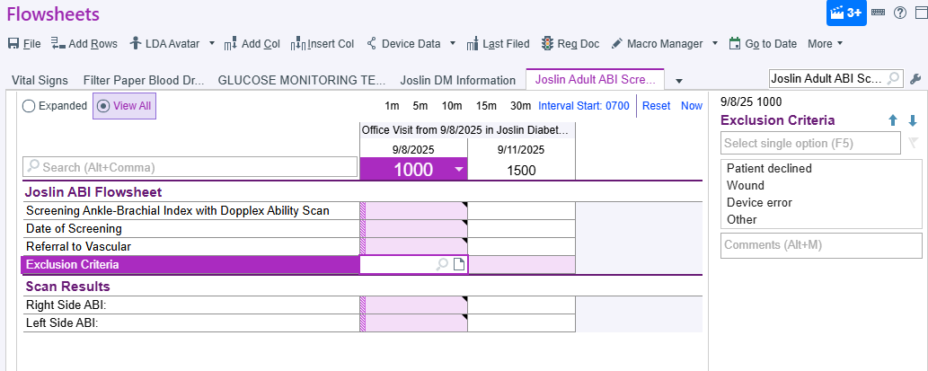

Slide 38

(Oct 2024 - June 2025) | Total, n (%) | ABI not screened, n (%) | ABI screened, n (%)
Number of patients seen | 768 | 523 | 245
Age (years), mean + SD | 67 + 9.3 | 67 + 9.5 | 66 + 8.7
Age ≥65 (years), mean + SD | 73 + 6.5 | 74 + 6.8 | 73 + 5.8
Sex
Male | 399 (51.9) | 264 (50.5) | 135 (55.1)
Female | 369 (48.1) | 259 (49.5) | 110 (44.9)
Race
Non-Hispanic White | 420 (54.7) | 298 (57.0) | 122 (49.8)
Non-Hispanic Black | 249 (32.4) | 165 (31.6) | 84 (34.3)
Hispanic | 41 (5.3) | 25 (4.8) | 16 (6.5)
Type 1 diabetes | 96 (12.5)** | 64 (12.2)** | 32 (13.1)
Type 2 diabetes | 647 (84.2) | 439 (83.9) | 208 (84.9)
Prediabetes | 3 (0.4) | 2 (0.4) | 1 (0.4)
HbA1c, median + SD | 7.7% + 1.7, 729 (94.9) | 7.7% + 1.8, 490 (93.7) | 7.7% + 1.6, 239 (97.6)
Diabetes duration (years), mean + SD | 22 + 13.1, 623 (81.1) | 22 + 13.2, 419 (80.1) | 22 + 12.9, 204 (83.3)
BMI kg/m2 | 32.8 + 8.0, 738 (96.1) | 33.7 + 8.6, 499 (95.4) | 30.9 + 5.9, 239 (97.6)
Obesity (BMI ≥ 30) | 37.5 + 6.7, 444 (57.8) | 38.4 + 7.2, 316 (60.4) | 35.0 + 4.5, 128 (52.2)
Smoking history
Former | 309 (40.2) | 206 (39.4) | 103 (42.0)
Current | 130 (16.9) | 83 (15.9) | 47 (19.2)
Non-smoker | 325 (42.3) | 232 (44.4) | 93 (38.0)
Insurance
Private | 130 (16.9) | 82 (15.7) | 48 (19.6)
Medicaid/Medicare | 632 (82.3) | 438 (83.8) | 194 (78.2)
Insulin use | 500 (65.1) | 343 (65.6) | 157 (64.1)
CGM Use | 379 (75.8) | 258 (75.2) | 121 (77.1)
Pump Use | 55 (11.0) | 36 (10.5) | 19 (12.1)
Exclusion |  | 113 (14.7)
* t-test and Chi-squared test used for p-value comparing PAD confirmed vs. no PAD present
**2 patients had pancreatic diabetes, were on insulin pump therapy and were combined with the T1D group for these analyses

Slide 39

(Oct 2024 - June 2025) | Referred to Vascular, n (%) | Completed Vascular appt, n (%)
Number of patients seen | 88 | 52
Age (years), mean + SD | 67 + 8.9 | 66 + 9.0
Age ≥65 (years), mean + SD | 72 + 6.3 | 72 + 6.9
Sex
Male | 53 (60.2) | 33 (63.5)
Female | 35 (39.8) | 19 (36.5)
Race
Non-Hispanic White | 52 (59.1) | 31 (59.6)
Non-Hispanic Black | 25 (28.4) | 15 (28.8)
Hispanic | 6 (6.8) | 4 (7.7)
Type 1 diabetes | 16 (18.2) | 8 (15.4)
Type 2 diabetes | 70 (79.6) | 43 (82.7)
Prediabetes | 1 (1.1) | 1 (1.9)
HbA1c, median + SD | 7.6% + 1.4, 86 (97.7) | 7.5% + 1.6, 51 (98.1)
Diabetes duration (years), mean + SD | 26 + 13.9, 75 (85.2) | 25 + 14.4, 44 (84.6)
BMI kg/m2 | 31.3 + 5.8, 86 (97.7) | 31.9 + 5.9, 51 (98.1)
Obesity (BMI ≥ 30) | 35.2 + 4.3, 49 (55.7) | 35.7 + 4.5, 30 (57.7)
Smoking history
Former | 37 (42.1) | 20 (38.5)
Current | 16 (18.2) | 8 (15.4)
Non-smoker | 35 (39.8) | 24 (46.2)
Insurance
Private | 11 (12.5) | 6 (11.5)
Medicaid/Medicare | 77 (87.5) | 46 (88.5)
Insulin use | 64 (72.7) | 39 (75.0)
CGM Use | 53 (82.8) | 30 (76.9)
Pump Use | 13 (2.0) | 6 (15.4)
Joslin ABI results
Evidence of PAD | 40 (45.5) | 25 (48.1)
PAD indeterminate | 48 (54.6) | 27 (51.9)

Slide 40

(Oct 2024 - June 2025) | No PAD present, n (%) | PAD confirmed, n (%) | P-value
Number of patients seen | 34 | 18
Age (years), mean + SD | 67 + 8.7 | 65 + 9.8 | 0.49
Age ≥65 (years), mean + SD | 72 + 7.2 | 74 + 6.0 | 0.33
Sex
Male | 22 (64.7) | 11 (61.1) | 0.80
Female | 12 (35.3) | 7 (38.9)
Race
Non-Hispanic White | 23 (66.7) | 8 (44.4) | 0.09
Non-Hispanic Black | 8 (23.5) | 7 (38.9)
Hispanic | 1 (2.9) | 3 (16.7)
Type 1 diabetes | 4 (11.8) | 4 (22.2) | 0.49
Type 2 diabetes | 29 (85.3) | 14 (77.8)
Prediabetes | 1 (2.9) | 0 (0)
HbA1c, median + SD | 7.3% + 1.6, 33 (97.1) | 7.9% + 1.7, 18 (100.0) | 0.23
Diabetes duration (years), mean + SD | 21 + 12.1, 28 (82.4) | 31 + 16.3, 16 (88.9) | 0.04
BMI kg/m2 | 32.7 + 5.3, 33 (97.1) | 30.3 + 6.8, 18 (100.0) | 0.20
Obesity (BMI ≥ 30) | 36.1 + 3.9, 20 (58.8) | 34.7 + 5.5, 10 (55.6) | 0.46
Smoking history
Former | 12 (35.3) | 8 (44.4) | 0.35
Current | 4 (11.8) | 4 (22.2)
Non-smoker | 18 (52.9) | 6 (33.3)
Insurance
Private | 4 (11.8) | 2 (11.1) | 0.94
Medicaid/Medicare | 30 (88.2) | 16 (88.9)
Insulin use | 24 (70.6) | 15 (83.3)
CGM Use | 18 (75.0) | 12 (80.0) | 0.65
Pump Use | 3 (12.5) | 3 (20.0)
Joslin ABI results
Evidence of PAD | 14 (41.2) | 11 (61.1) | 0.17
PAD indeterminate | 20 (58.8) | 7 (38.9)
* t-test and Chi-squared test used for p-value comparing PAD confirmed vs. no PAD present

Slide 41


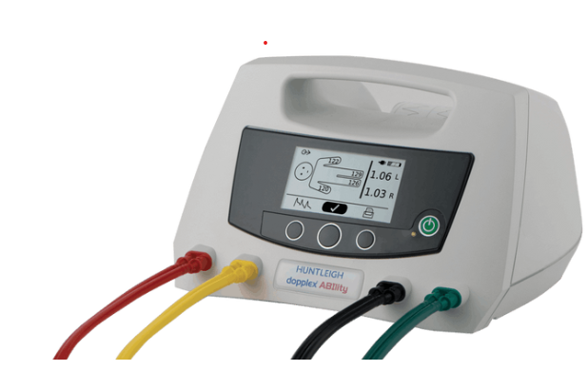
Lessons Learned:
Limited vascular cuff size
Importance of proper education and technique to ensure accurate results and staff confidence
Integrating efficiently into clinical workflow
  EPIC integration for flowsheets
  Template build for scheduling
Challenges:
Exclusion criteria
High referral rate – cost effectiveness
Conditions such as diabetes and advanced kidney disease, which are often comorbid with PAD, make ABI measurements more difficult and less accurate due to arterial stiffness.
Next Steps:
Continue to investigate result inaccuracy
Further investigate disparities in healthcare access for implementing ABI testing, particularly in communities with high rates of comorbidities like diabetes.
Arjo Huntleigh Doppler Ability Device

Slide 42
Acknowledgements
  Ruth S. Weinstock MD PhD
  Ricardo Lundi DPM
  Frances Logan LPN
  Joseph Erardi BS, Quality Assurance Coordinator
  Beth Wells MSN, RN, Associate Nursing Director
  Jessica Reis MSN, RN, Diabetes Center Nurse Manager
  SUNY Upstate IT Team
T1D Exchange QI Collaborative

Slide 44
Quality Improvement Analysis of Sick Day Rule Updates on DKA Admissions in Children With Type 1 Diabetes Using Hybrid Closed-Loop Insulin Pumps
Shelby Lindsey, BA; Candice Walker, MD; Grace Nelson, MD; Blake Adams, RN; Alyssa Dye, MD
University of Tennessee Health Science Center
Memphis, Tennessee, USA

Slide 45
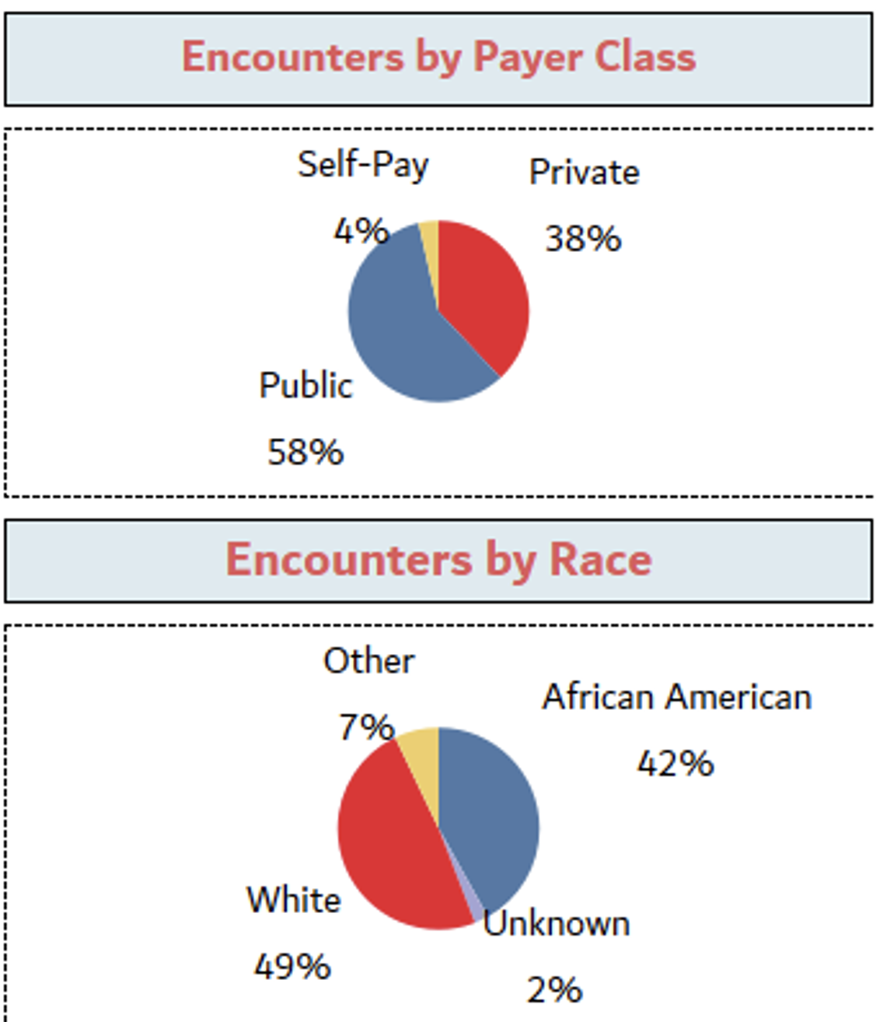
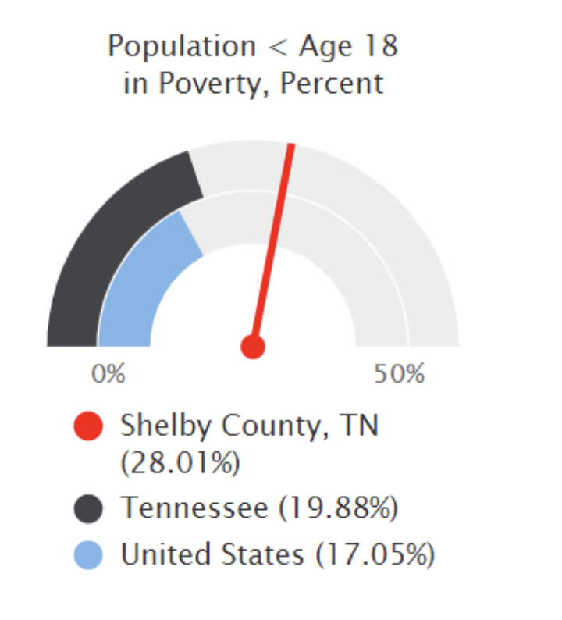
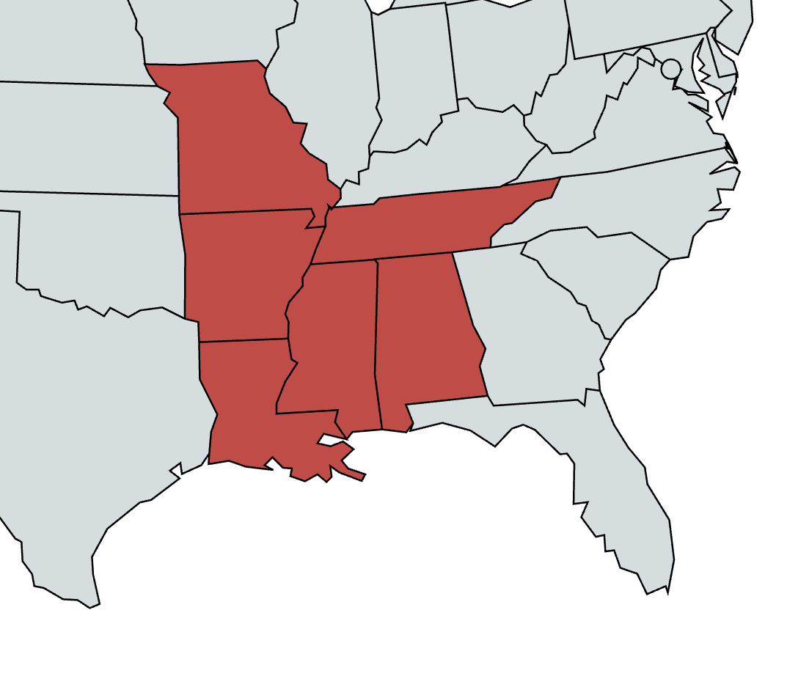

Population Demographics
Community Health Needs Assessment. Le Bonheur Children’s Hospital. 2024

Slide 46
Initial QI Analysis
Product:
-Not being able to acquire supplies for insulin pump
-Connectivity issues with CGM and therefore pump not working
-Insertion site failure
-Pump malfunctioning
Policies and Procedures:
-Sick day rules were complicated, and families had a hard time following
-Insurance requiring lengthy PA process for Pump and CGM supplies
Smart AIM: Decrease DKA hospital admissions by 5% for Type 1 Diabetics utilizing Hybrid Closed Loop pump by August 2025.
Process:
-Families being educated by pump company, but not grasping troubleshooting techniques
- Two week follow up post pump start sometimes not happening in a timely manner
People:
-Unable to follow sick day rules
-Unable to adhere medical regimen
-Families having difficulty troubleshooting technology
-Not wearing device consistently

Slide 47
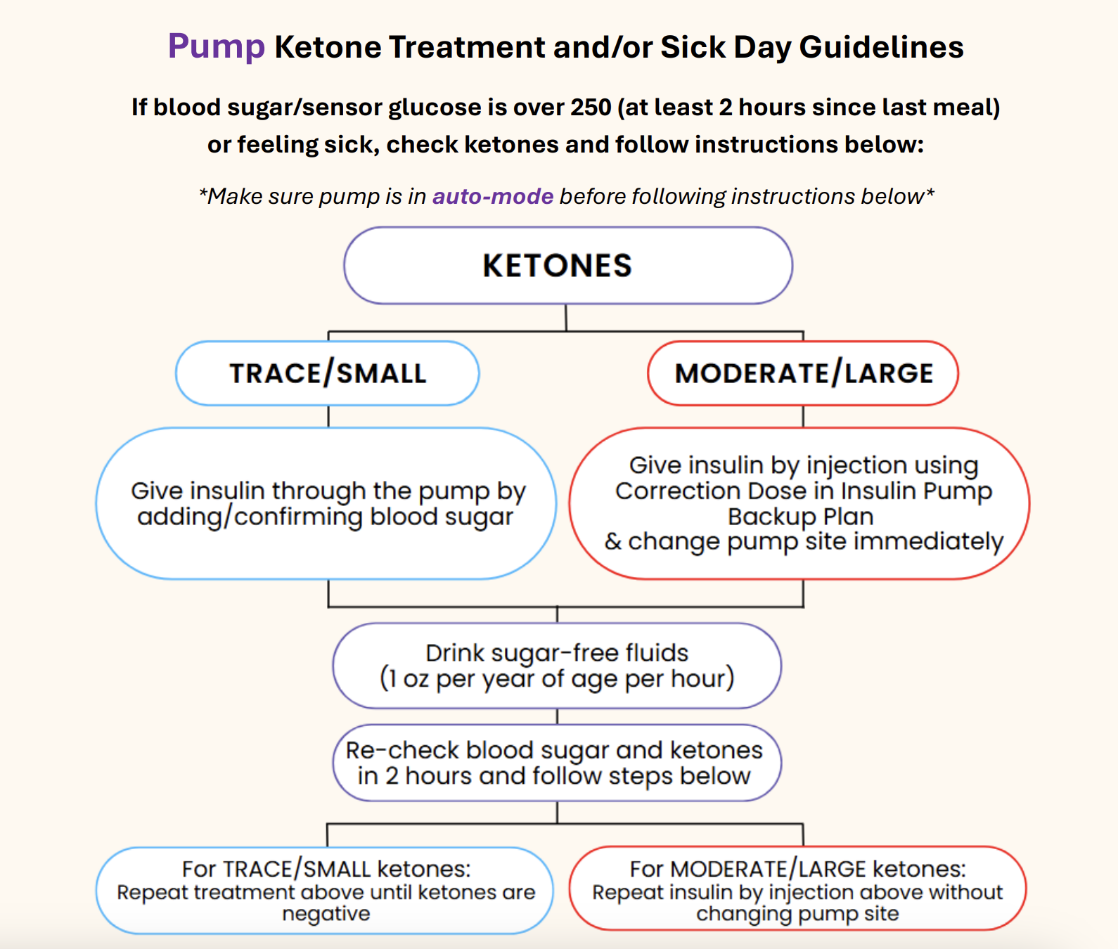
Changes made to rules emphasizing insertion site troubleshooting and timely site changes

Slide 48
Design
Quality Improvement Analysis
Patient data collected via chart review from January 2024-July 2025
New sick day rules initiated February 2025

Slide 49
PDSA Cycle 1
Noted increased number of DKAs due to insertion site failures
Update insulin pump sick day rules to emphasis earlier insertion site change.
Decrease the number of DKAs on insulin pumps
Roll out new sick day rules in February 2025 at office visits and inpatient admissions
Encourage physicians to document cause of DKA in EMR
Plan
Do
PDSA
Act
Study

Slide 50
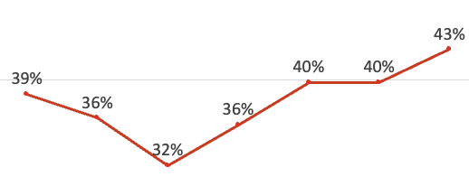
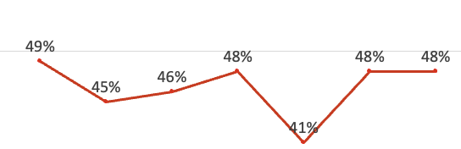

Results

Slide 51
Results
N=11
N=18
“pump malfunction,” CGM/pump communication, pod failure
GI, Respiratory, Soft Tissue
Lack of supplies, recent pump malfunction > 7d, personal choice
Bolus for carbs, charging pump, changing empty cartridge
Tubing leak, insertion site failure/kink, disconnected

Slide 52
Results

Slide 53
Discussion
Revised sick day rules effectively reduced insertion site–related DKA
HCL-related DKA of all cases increased after revised sick day rules
  Likely due to increased number of patients on insulin pumps
HCL-related DKA persists, driven by pump malfunctions, lack of supplies, and inability to comply with medical regimen.
These areas may benefit from further quality improvement interventions.

Slide 54
PDSA Cycle 1
Noted increased number of DKAs due to insertion site failures
Update insulin pump sick day rules to emphasis earlier insertion site change.
Decrease the number of DKAs on insulin pumps
Roll out new sick day rules in February 2025 at office visits and inpatient admissions
Encourage physicians to document cause of DKA in EMR
Plan
Do
PDSA
Continue to educate patients on new sick day rules
Increase accessibility of sick day rules
Address causes of not wearing, including supply issues
Act
Study
While overall DKA admission rates did not decrease, DKA due to insertion site failures or pump malfunctions decreased

Slide 55
Final QI Analysis; Possible future directions
Product:
-Not being able to acquire supplies for insulin pump
-Connectivity issues with CGM and therefore pump not working
-Insertion site failure
-Pump malfunctioning
Policies and Procedures:
-Sick day rules were complicated, and families had a hard time following
-Insurance requiring lengthy PA process for Pump and CGM supplies
Smart AIM: Decrease DKA hospital admissions by 5% for Type 1 Diabetics utilizing Hybrid Closed Loop pump by August 2025.
Increase accessibility of sick day rules
Delay starting pump until 2 months of supplies
Process:
-Families being educated by pump company, but not grasping troubleshooting techniques
- Two week follow up post pump start sometimes not happening in a timely manner
People:
-Unable to follow sick day rules
- Unable to adhere to medical regimen
-Families having difficulty troubleshooting technology
-Not wearing device consistently
Improve insulin pump backup plan and pump education

Slide 56

Questions?

Slide 63

Section Header Here
Subtitle Here
Break
Please return to Whitley Ballroom by 11:10 am

