Slide 1

Remote Patient Monitoring, Diabetes Data, and New Diagnoses
Moderated by Patrick Hanley, MD, MSHQS, FAAP

Slide 2
Improving Follow-up for Newly Diagnosed T2DM Patients
Casey Rust, RD, CDCES
Kristina Cossen, MD
Alison Higgins, RD, CDCES

Slide 3

Children’s Healthcare of Atlanta
Caring for 3394 T1D and 963 T2D patients <21 years old in Georgia.
T1D: 45% Medicaid, 51% Private
T2D: 68% Medicaid, 24% Private
T1D: 43% non-white
T2D: 72% non-white
Providers: 17.7
APP: 5.8
Social Workers: 3.0
Psychologist: 2.0
RN: 13.1
Registered Dietitian: 8.6 (w/ CDE)
Registered Nurses: 7.6 (w/ CDE)
Notes:
Children’s Healthcare of Atlanta Arthur M. Blank Hospital – ESa

Slide 4
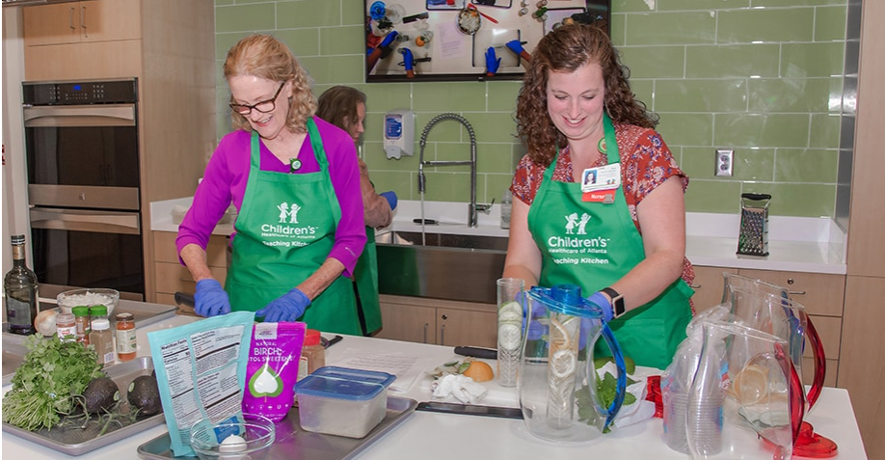
New Onset Type 2 Path
Teaching Kitchen with RD Chef
PCP referral to Endocrinology
New T2DM Clinic: Provider, Psychologist, CDCES, and SW
Established T2DM Visits: Provider, CDCES, Psych, Trainer, and SW
T2DM Class with CDCES
Introduction to Fitness with Trainer
Notes:
Photo from Diabetes Resources and Management | Children's Healthcare of Atlanta
Total number of T2DM (2024)
Seen in clinic every year: 1,131
Newly diagnosed every year: 157

Slide 5
Baseline
Concern: T2DM lost to follow-up after initial diagnosis appointment
Goal: Improve support for T2DM patients to promote follow-up visit attendance
AIM: Increase clinic follow-up within 3-months of New Onset Type 2 Diabetes clinic for adolescents age 10-18 from 75% from August 2023 to 90% by December 2025.
Goal
Median
Notes:
If we included last minute cancelations we were at about 58%

Slide 6
Fishbone
Policies & Procedures:
Difficulty getting type 2 meds covered by insurance
GLP shortage makes adherence difficult
Lack of CGM coverage if not on MDI
Equity:
Largely Medicaid patients - transportation challenges
Time off work – first appointment and class duration 4-5 hours
Reluctancy to disclose housing and food insecurity with SW
Cost of visit (parking and transportation)
Issue:
No show or last-minute cancelation rate for established type 2 patients is high
Difficulty getting some medications either through insurance denials and/or access with shortages.
Place and Process:
Type 2 appointments only at 2 of our locations (CAP and SB)
People / Staffing:
Limited availability for established type 2 clinics with providers
Limited CDCES staffing- elimination of one-to-one staffing for provider clinics
Auto call appointment reminders – did not allow for assessment of barriers

Slide 7
Global AIM
Drivers
Interventions
Key Driver Analysis
Improve glycemic control & minimize risk of complications in patients with T2DM
Patient/Parent Availability
Focused Teaching Kitchen education and demonstration
Appointment Efficiency
One on one CDE follow up
Smart AIM
Increased and shifted access for multiple providers
Increase follow-up within 3-months of New Onset Type 2 Diabetes in clinic diagnosis for adolescents ages 10-18 from 75% from August 2023 to 90% by December 2025
Clinic Slot Availability
RN call to verify access to medications
Clinic Appointment Notification
Administrative Assistant call 1 week prior to assess barriers
Patient Education/ Investment in Care
CDE calls to discuss SMART goals and adherence
Population
Virtual appointments
Patients newly diagnosed with type 2 diabetes in New Type 2 clinic and followed up by Children’s Healthcare of Atlanta
Parent Transportation
Produce boxes at clinic
Financial Barriers
Social Worker assessment
Satellite clinic appointments
Previous
Current
Fitbits at first appointment to increase fitness
Notes:
We’ve tried evening virtual teaching kitchen appointments, and no teaching kitchen, looked it to Fitbit

Slide 8
PDSA
PDSA (telephone calls)
Nursing call 2 weeks after initial visit to verify access to medications. (2 RN)
CDCES call 6 weeks after initial visit to assess SMART goal, evaluate self care behavior changes, and review BG trends. (1 CDE)
Administrative assistant to call 1 week before F/U appointment for reminder and assess barriers. (2 Admin)
SW support available if needed.
Previous
Separate teaching kitchen classes
Shifting and opening access with more providers
CDE follow-up in clinic
Notes:
Table with 1, 2 , and 3

Slide 9
3-Month Run Chart
CDE pooling in
clinic for f/u
Goal
Median
Follow-up calls

Slide 10
Conclusion
Significant barriers with this population
While additional calls did not improve 3-month follow-up, they did slightly improve 6-month follow-up
Next Steps:
Improve access
Virtual appointments
Produce boxes
Fitbits

Slide 11
Questions?

Slide 12
6 Month Run Chart
Follow up calls
Teaching kitchen f/u
classes, Open up slots
for type 2 f/u
CDE Pooling in
clinic for f/u

Slide 14
Validation and implementation of an EHR based DKA risk score
Elizabeth A. Brown, MPH; Bala Kulandaivel, MS, RN; Risa M Wolf, MD
Presented by: Elizabeth Brown

Slide 15

Background: JH Pediatric DKA Risk Score Development
Previously, diabetes nurse educators kept manual “TLC” lists of those needing extra support
A quick, comprehensive, and data driven approach to identify those at high risk of DKA was desired
Manual lists omit patients and require constant updates
DKA is a life-threatening yet avoidable complication of diabetes

Slide 16
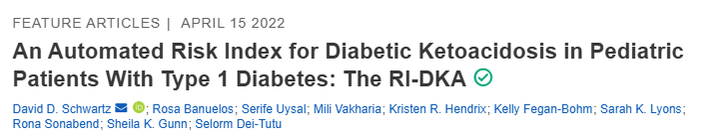

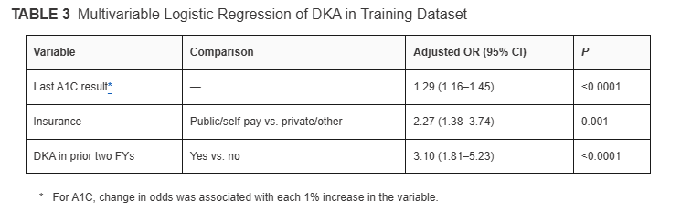
Epic based DKA risk score: the Texas Children's RI-DKA
RI-DKA score ranged from –3.5 to 14
TCH continues to iterate and current calculations may have changed
Notes:
-3 to 2 Low, 2.5 to 6.5 medium; 7 to 10 high; 10.5 to 14, very high
Public=4; DKA=5; A1c_8=-2; 8 to 9=0; 9+, linear increase of 0.5 for every 0.5

Slide 17
Rescaled score
Clinicians felt a score ranging from –10 to 100 would be intuitive
Same factors associated with DKA as TCH
Only factors that were readily available in the EMR were considered
New weights for JH Pediatric DKA score
Public/no insurance
25 points
DKA in prior 2 years
Excludes new onset
35 points
Most recent HbA1c
(HbA1c – 8)*5
Minimum: -10 points; maximum: 40 points
0 points for private/commercial

Slide 18
JH Pediatric DKA score ranges from -10 to 100
Score Range | Risk Level | Risk factors
-10 to 10 | Low (~55-60% of patients) | A1c <=10 and no other risk factors (private insurance, no DKA in last 2 years, other than new onset)
10.5 to 40 | Medium (~33% of patients) | A1c>10 and no other risk factors, or public insurance with A1c<=11 or DKA in prior 2 years with A1c<=9.
40.5 to 65 | High (~6-8% of patients) | Either public insurance with A1c>11, or DKA in prior 2 years with A1c>9 and <=14. Or, both with an A1c<=9.
65.5 to 100 | Very high (~2-4% of patients) | DKA in prior 2 year and HbA1c>14, or prior DKA and public insurance and A1c>9

Slide 19
Validation
Validated with JHU pediatric clinic data:
822 Patients seen between 2/2022-1/2024
Follow up care from 2/2024-1/2025
Percentage in validation dataset entering DKA by risk category
Very high: 26%
High:
9%
Medium:
4%
Low:
1%

Slide 20
Epic Build
Process
4/23/2025 Approved by Epic design team
4/17 Texas Children’s shared turbocharger package to ease build
5/7 1st iteration
6/4 2nd iteration
6/18 3rd iteration
7/2 4th iteration
7/18 5th iteration
9/2 Available in production
10/14 High risk banners added
A few challenges:
Not all diabetes patients were initially assigned a risk score
Difficulty assigning public/no insurance category accurately
New onset DKA admissions needed to be excluded
Outside hospital DKAs needed to be included

Slide 21
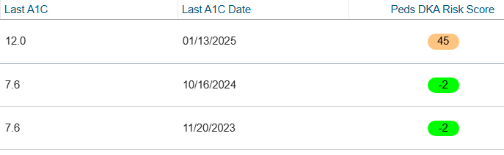
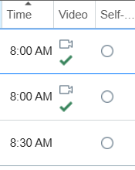
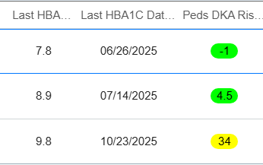
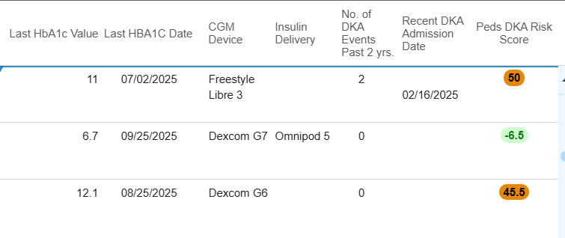
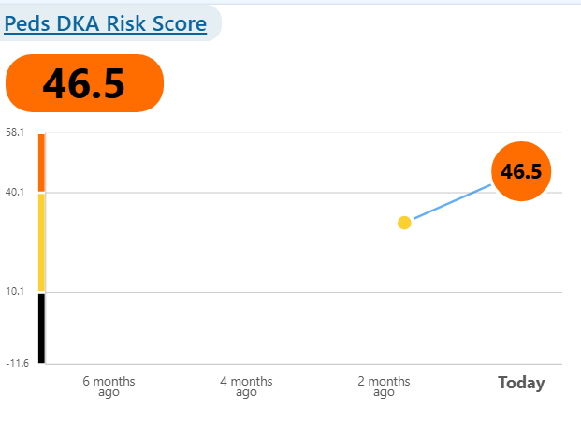
Available in Epic Hyperspace as of 9/2/2025
DKA risk score column can be added to:
Patient lists:
Schedules:
Reports:
2 other columns have also been added to Epic reports
Number of DKA events in the past 2 years (includes Care Everywhere hospitals)
Most recent DKA date (includes Care Everywhere hospitals)

Slide 22
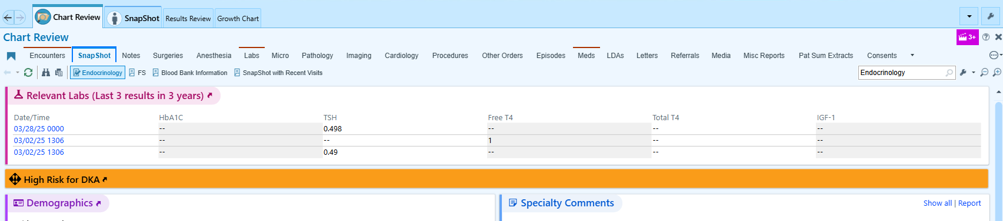
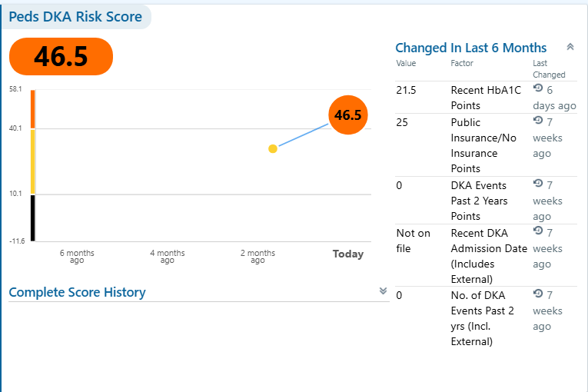
High Risk Banners in Patient Snapshot (Outpatient) and Summary (Inpatient)
Clicking on orange bar opens the Peds DKA Risk Score report

Slide 23
Future Directions
Clinical team can utilize JH Pediatric DKA risk score to identify high risk patients and increase outreach
Inpatient teams may consider additional supports when they see a patient with a high-risk score
Future QI projects to provide a support program to very-high risk group
Score calculation will be regularly monitored for opportunities to improve accuracy in determining highest risk cohort

Slide 25
Machine Learning Prediction of Diabetic Ketoacidosis in People with Type 1 Diabetes
Analysis of T1DX-QI Collaborative Data Using Random Forest

Slide 26
Overview
Diabetic ketoacidosis (DKA) is a major cause of preventable morbidity and mortality in people with Type 1 Diabetes (T1D)
EHR and device data offer opportunities for machine learning–based risk prediction
Early identification of individuals at high risk can enable timely, targeted interventions
Objective
To develop and validate predictive models to identify PwT1D at an increased risk for DKA
Demographic
Clinical
CGM-derived data

Slide 27
Method
Dataset
T1DX-QI Registry (2017–2023)
Sample
38,009 individuals
≥1-year T1D duration
Notes:
≥1 HbA1c measurement in the 1 year period prior to DKA

Slide 28
Method
Predictors
Measurement timeline
Outcome
DKA events – binary
Age
T1D duration
Cumulative prior DKA
Time since last DKA
Rate of A1c change
Medication
Device use
Latest A1c
1 year period prior to DKA for cases
Most recent measures for non-DKA
Inpatient
Ambulatory

Slide 29
Method
Performance Metrics
AUC
Modeling Framework
Train/test split: 70/30
Models
Random Forest
XGBoost
Accuracy
Sensitivity
Specificity
Logistic Regression

Slide 30
Results – Descriptive (Model without TIR)
 | Total | With DKA | Without DKA
N | 38,009 | 6,419 | 31,590
Median Age | 16 (8) | 15 (5) | 17 (7)
Median T1D duration | 5 (6) | 5 (5) | 6 (7)
Median A1c | 7.8 (2.2) | 9.6 (3.4) | 7.6 (1.8)
Mean Rate of A1c change | -0.0005 (0.012) | 0.0001 (0.017) | -0.0006 (0.011)
Mean Cumulative prior DKA |  | 3.2 (7.4)

Slide 31
Results – Descriptive (Model with TIR)
 | Total | With DKA | Without DKA
N | 8,342 | 759 | 7,583
Median Age | 16 (7) | 14 (6) | 16 (7)
Median T1D duration | 6 (8) | 5 (6) | 6 (8)
Median A1c | 7.3 (1.5) | 8.2 (2.1) | 7.3 (1.5)
Mean Rate of A1c change | -0.0005 (0.008) | -0.0004 (0.013) | -0.0006 (0.007)
Mean Cumulative prior DKA |  | 2.8 (5.7) | -

Slide 32
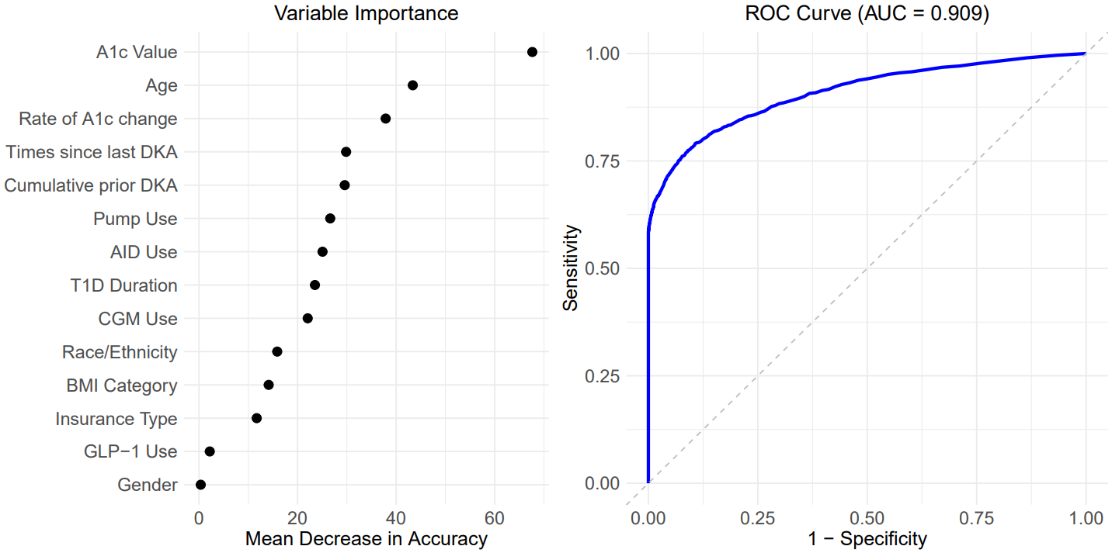
Results
Model without TIR
Importance of features in predicting DKA risk
Evaluation of the DKA risk prediction Model
Model | AUC | Accuracy | Sensitivity | Specificity
Random Forest | 0.909 | 0.932 | 0.998 | 0.606
XGBoost | 0.914 | 0.934 | 0.996 | 0.626
Logistic | 0.901 | 0.931 | 0.996 | 0.610

Slide 33
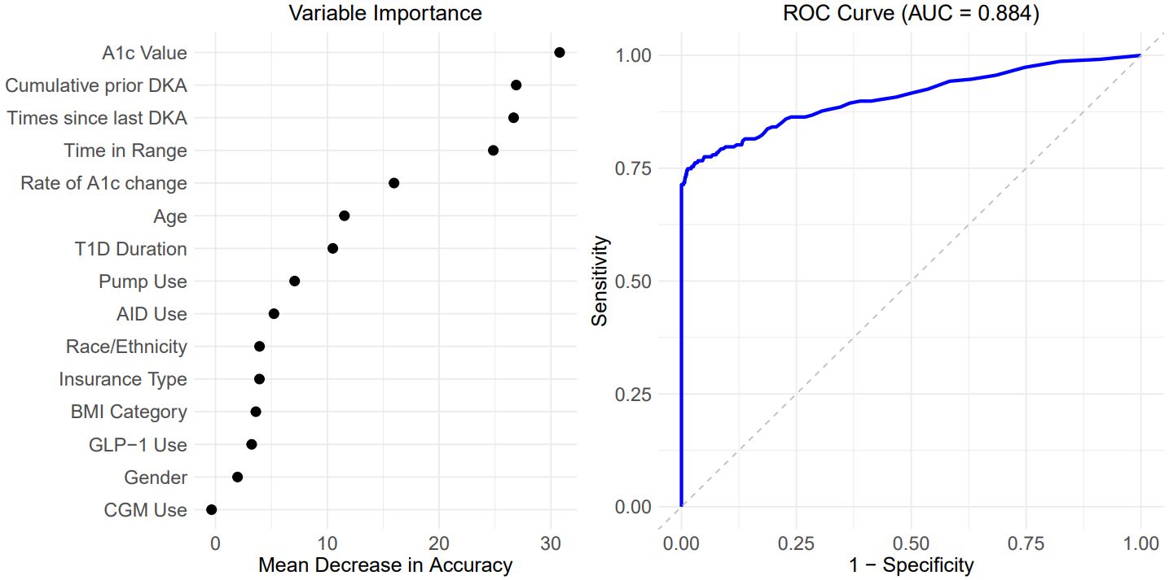
Results
Model with TIR
Importance of features in predicting DKA risk
Evaluation of the DKA risk prediction Model
Model | AUC | Accuracy | Sensitivity | Specificity
Random Forest | 0.884 | 0.964 | 1 | 0.626
XGBoost | 0.872 | 0.964 | 0.999 | 0.626
Logistic | 0.889 | 0.964 | 1 | 0.626

Slide 35
Utilizing Telemedicine in a New-Onset Diabetes Education Program for Pediatric Patients with Type 1 Diabetes
Meenal Gupta, MD
T1DX Learning Session
November 11, 2025
Contact: Meenal.Gupta@seattlechildrens.org

Slide 36
Background
Use of telemedicine in diabetes ambulatory care is well-established but studies on utilization of telemedicine for new-onset type 1 diabetes education (NODM) are lacking
Seattle Children’s has a 5-state referral base (WWAMI); largest in the country
Our outpatient NODM program launched in Oct 2019 at the main diabetes clinic
Rapid adoption of telemedicine in 2020; including NODM education program
Our NODM education program consists of
Part 1A: survival skills → 4-5 hours in clinic. Involves provider, RN, RD, SW
Part 1B: advanced skills → 7-10 days later, usually via telemedicine with an RN ± provider/RD/SW
Notes:
Diabetes clinic:
Main clinic (Sand Point): 52%
7 regional clinics- 3 sites: 44%
NODM numbers
2021: 351
2022: 301
2023: 251
2024: 236

Slide 37
Project Aim and Methods
Aims:
Compare glycemic outcomes (HbA1c) and healthcare utilization (clinic visits, diabetes related-admissions and ED visits) in the 1 year following NODM education delivered via in-person only vs. hybrid format (any part via telemedicine)
Assess probability of utilizing telemedicine for ongoing care based on modality of initial education
Inclusion criteria:
Patients <18y with NODM who received education: 1/1/2020-9/30/2022
Analysis:
Generalized linear models, adjusted for distance from the nearest diabetes clinic or main hospital

Slide 38
Results: Patient Characteristics
Characteristic | In Person N = 296¹ | Hybrid N = 246¹
Age (years) | 9.8 (6.9, 12.5) | 10.5 (6.6, 13.3)
Sex at birth
Female | 124 (42%) | 107 (43%)
Male | 172 (58%) | 139 (57%)
Race & Ethnicity
2 or more races | 21 (7.1%) | 8 (3.3%)
Asian | 8 (2.7%) | 5 (2.0%)
Black or African American | 26 (8.8%) | 13 (5.3%)
Hispanic | 41 (14%) | 41 (17%)
Non-Hispanic White | 178 (60%) | 152 (62%)
Other | 13 (4.4%) | 13 (5.3%)
Pacific Islander | 1 (0.3%) | 1 (0.4%)
Unknown/Refused | 8 (2.7%) | 13 (5.3%)
Characteristic | In Person N = 296¹ | Hybrid N = 246¹
Language Group
English | 274 (93%) | 233 (95%)
Language other than English | 22 (7.4%) | 13 (5.3%)
Insurance Group
Commercial | 168 (57%) | 135 (55%)
Medicaid | 90 (30%) | 74 (30%)
Self-pay/Charity/Other | 38 (13%) | 37 (15%)
Distance to Closest Clinic (straight-line miles) | 10 (6, 17) | 10 (5, 28)
Unknown | 13 | 3
Clinic visits (per patient) | 4 (3,4) | 3 (3,4)
¹ Median (Q1,Q3); n(%)
Notes:
296 patients in the in-person group and 246 in the hybrid group were included in the analyses. The groups were similar in all demographic characteristics with minor differences noted in distribution by race/ethnicity , had similar number of clinic visits per patient and interestingly had similar distance from nearest diabetes clinic

Slide 39
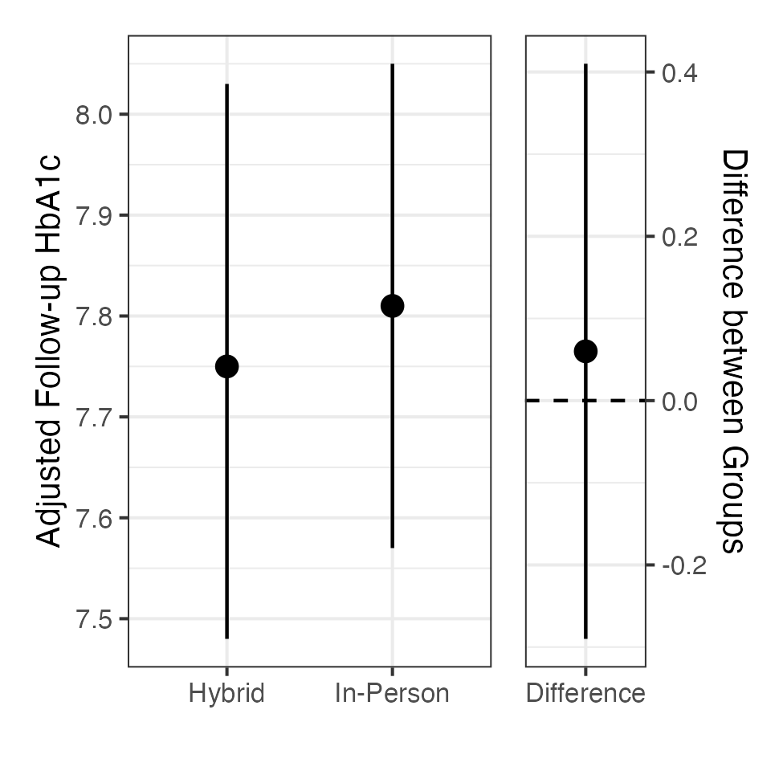
Results: Changes in HbA1c level
Unadjusted A1c levels
Distance-adjusted A1c levels
Characteristic | In Person N = 185 | Hybrid N = 134
First_A1c
Mean (SD) | 11.7 (2.1) | 11.8 (1.8)
Last_A1c
Mean (SD) | 7.8 (1.7) | 7.8 (1.3)
Notes:
Patients who had a baseline and 1 year +/-3 months post diagnosis HbA1c level were included in the analysis, and this resulted in 185 and 134 patients in the in-person and hybrid groups respectively. A1c level change was adjusted for baseline A1c and distance from the nearest diabetes clinic. The baseline and unadjusted 1-year post A1c levels were similar across both groups. As shown on the right, using Tobit regression to account for the censoring at 14, there was no statistically discernible difference (0.06, 95%CI: -0.29, 0.34; p = 0.74) between one-year HbA1c for the two education modalities.

Slide 40
Results: Admissions and ED visits
Admissions in the first year
ED visits in the first year
Characteristic | OR | 95% CI | p-value
grouping
In Person (n=11) | — | —
Hybrid (n=4) | 0.58 | 0.19, 1.8 | 0.35
Characteristic | OR | 95% CI | p-value
grouping
In Person (n=19) | — | —
Hybrid (n=12) | 0.67 | 0.3, 1.51 | 0.33
Models adjusted for distance from the main hospital
Groups (n): In-person (296), Hybrid (246)
Notes:
Logistic regression with Firth’s bias correction was used to examine ED visits, admission rates and no significant differences were found between the two groups in terms of diabetes-related admissions or ED visits in the first year following diagnosis. Models were adjusted for distance from the main hospital to account for any differences related to proximity to the Seattle Children's ED.

Slide 41
Results: Clinic visits
Characteristic | In Person N = 1,056¹ | Hybrid N = 854¹
Encounter type
Office Visit | 741 (70%) | 475 (56%)
Telemedicine | 315 (30%) | 379 (44%)
Clinic visits (per patient) | 4 (3,4)² | 3 (3,4)²
¹ n (%) ² Median (Q1, Q3)
Characteristic | IRR | 95% CI | p-value
grouping
In Person | — | —
Hybrid | 0.97 | 0.88, 1.06 | 0.46
Groups (n): In-person (296), Hybrid (246)
Notes:
Patients in the in-person group had 1056 and those in the hybrid group had 854 visits in the 1 year following diagnosis. There was no difference in the number of clinic visits between the groups in this time period.

Slide 42
Results: Probability of Telemedicine visits
The hybrid group had 89% higher odds of completing a clinic visit via telemedicine compared to the in-person group
Characteristic | OR | 95% CI | p-value
grouping
In Person | — | —
Hybrid | 1.89 | 1.56, 2.29 | <0.001

Slide 43
Conclusion
Telemedicine can serve as an effective and convenient mode of NODM education without compromising metabolic outcomes
Ongoing utilization of telemedicine for diabetes care suggests this modality may be preferred by patients/families for a variety of reasons
Future studies should assess patient and family satisfaction and perceived benefits of telemedicine in NODM education

Slide 44


Thank you
Faisal Malik, MD
Alissa Roberts, MD
Kelsey Eitel, MD
Yasi Mohsenian, MPH
Statistician:
Dwight Barry, PhD
Nursing lead:
Joy Briggs, MBA, MSN, CDCES
Sunny & Lily
Meher

Slide 46

Section Header Here Subtitle Here
A Review of the T1DX-QI 2025 Annual Survey Results
Whitley Ballroom
4:00 – 4:20pm

