Slide 1

Health Equity and Social Determinants of Diabetes
Moderated by Shideh Majidi, MD, MSCS

Slide 2
REACH-AID:
Reducing Equity and Access Challenges to Harness Automated Insulin Delivery
Britni Schipper BSN, RN, CDCES
Brooke Turner MPH, RD, CDCES
Kelsey Kasbaum MS, RD
November 11-12, 2025
Notes:
We are joining you all here today from West Michigan’s Corewell Health Helen DeVos Children’s Hospital.
We are the largest children's hospital system on the west side of Michigan.

Slide 3
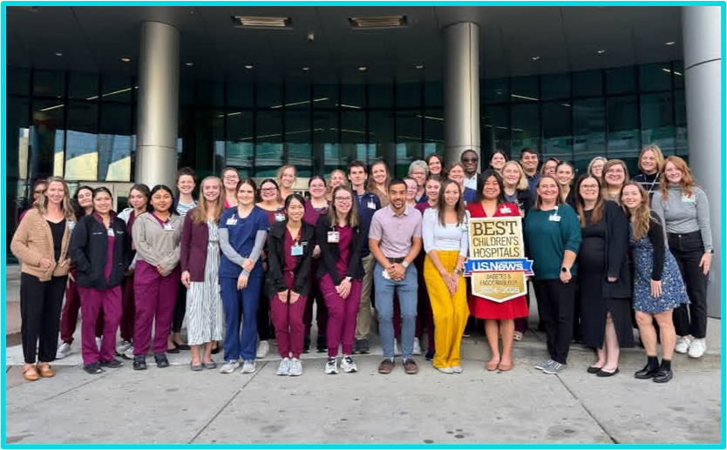
Our Clinic
Corewell Health is a not-for-profit, integrated, managed care health care organization based in West Michigan.
HDVCH is the largest children’s hospital in the west side of Michigan
Our clinic FTE:
6.9 Endocrinologists
2.7 APPs
7.9 CDEs
2.0 Dietitians
3.0 Social Workers
0.4 Psychologists
12.0 MA/NT staff
2.0 PA Specialists
Notes:
BROOKE - We are joining you all here today from West Michigan’s Corewell Health Helen DeVos Children’s Hospital.
We are the largest children's hospital system on the west side of Michigan.
Our clinic’s make-up is as you see here. More importantly to note we have a 1:1 ratio of endocrinologists and CDEs.

Slide 4

Demographics of HDVCH Peds Endocrinology
T1D population: 1700 patients
Number of new onsets: 285
Public insurance (CMS): 30%
Ethnicity
77% White
10% African American
10% Hispanic
1% Asian
1% Native American
1% Other
Notes:
BROOKE - Our patient population of specifically T1D patients is 1700, we saw new 285 patient’s last year (2024) and 30% of our population is publicly insured.

Slide 5
HCL Pump Use Improvement Fishbone Model
Workflows
Initiation of closed loop pump order
- New to pump vs current pumper
- Verifying all components needed to use system are in place
- How to order pump (pharmacy vs DME)
- Provider bias for initiating HCL pump starts
Initial education of system
- Time consuming for families
- Missing school/work
Follow up process
- When to follow up and how
- Varying needs depending on family
Documentation
- Dot phrases/variability
Equity/Access
Insurance Coverage
- Not all insurances cover closed loop pump
- Tedious PA approval process for some insurances
- DME vs pharmacy coverage
Costs
- Cost of cell phone to use Omnipod 5 / Mobi system
- Up front cost of pump along with ongoing supplies costs
Social/Psychological
Readiness
- Learning a new device
- Delay in start waiting for patient to be “ready”
Stress/Fear
- Fear of change in management
- Loss of control of insulin delivery
Family dynamics
Improve use of HCL among pediatric patients to 75% by June 2025
Education
Knowledge gaps
- Variability in family abilities and learning styles
- Algorithm pumps function differently than traditional pumps/MDI
- Education about HCL pumps was limited to those who requested it/advocated for information, leading to bias.
Time consuming
- Need to be able to complete required pump training in person as well as initial classes prior to pump
Initial vs Ongoing
- Requires continuous education and communication as they learn the system
Technology
Lack of Trust
- Putting trust into technology to make dosing decisions
- Concern for accuracy of CGM leading to poor outcomes
Lack of Confidence
- Do not feel savvy enough for technology troubleshooting
- Technology failure/troubleshooting can be intimidating
Equipment Gaps
- Unable to access technology needed to use system (cell phone)
Notes:
BROOKE - Our goal was to increase HCL pump use in our patient population from 52% to 75%.
We started with a Fishbone Model to highlight different areas where barriers existed to HCL utilization.
The bolded areas were areas of focus during this project

Slide 6
Key Drivers
AIM:
HDVCH Peds Endo will improve use of hybrid closed loop pump to 75%
by June 2025
Technology
Social/ Psychological
Equity/ Access
Office Workflows
Education/ Procedures
Provide advanced level education for closed loop
pump use
Partner with vendors/payers/donors to support smart device access
Improve access for patients whose insurance requires DME vs pharmacy and PAs
Create process for ongoing support after pump initiation
Standardize process for initiating CGM, pump therapy, Opt-Out focus
Unable to access technology needed to use system (cell phone)
Global AIM:
Among people with T1D; increase proportion of patients achieving glycemic targets
At least 25% with A1c <7%, OR
Increase proportion of patients with A1c <7% by 5%, OR
Increase TIR among CGM users by 5% from baseline in 2 years.
Notes:
BROOKE - Here is our key driver's diagram – The bolded areas are interventions that we have created PDSA cycles for so far.
See again our AIM statement and the Global AIM statement. Something to note is, while our aim statement is more generalized for our entire population, we found that a lot of barriers were more specific to those with public insurance and we decided to focus on those interventions first.

Slide 7
PDSA 1 – Insurance Coverage Advocacy (Oct 2022-Ongoing)
Problem: Limited coverage in Medicaid plans reduced access to HCL pumps.
Created a standardized letter outlining the medical necessity of a hybrid closed loop pumps
  Utilized PA specialists and PA letters to secure successful PA approvals (Commercial and Medicaid).
Worked with Managed Medicaid Plans to advocate for coverage of the Omnipod 5 system at pharmacy level:
  Priority Health Medicaid: (Jan 2023) Worked with Omnipod/Insulet, Adapt Health (DME) and Priority Health Medicaid to establish dual billing with Adapt Health (DME with Pharmacy capability).
  Meridian Health Medicaid: (May 2023) Insurance was denying pharmacy coverage which led to many patient’s coverage being halted. Met with Meridian to resolve issues with billing, coverage restored at pharmacy and DME.
Additional interventions:
  Hired pharmacy technician
  Flow charts for helping with Pharmacy billing issues (Secondary Medicaid/ CSHCS)
  Created a clinic-wide insurance coverage guide
Notes:
BROOKE - Our first PDSA cycle involved advocacy of coverage for HCL pump usage for both private and public insurers.
However, a bulk of this work we did was focused on patients with public insurance.
- Our clinic is blessed to have a PA specialist who assisted with a lot of this work.
Custom letters were created per plan once coverage approved and were shared with Omnipod Representatives to distribute to other clinics.
Priority Health and Meridian Medicaid's were two particular insurance plans that were denying pharmacy coverage of OP5 this led to gaps in coverage as well as issues getting initial Intro-kits to start HCL.
Delays in coverage persist and are ever changing. Since the start of this PDSA, we have made a case for hiring 1.0 FTE Pharmacy Tech position, we have created insurance guides, and flow charts to help with troubleshooting billing for our patients.

Slide 8
PDSA 2 – Standardize Education for Pump Therapy (April 2023)
Problem: Diabetes education program was time consuming for families.
Pump trainings were previously 2-part classes: Day 1: saline start, Day 2: insulin start.
  Missing work/income
  Changes made to workflow:
Standardized pump training to one class with insulin start (April 2023)
Standardized communication regarding Education to reduce gaps in understanding/attendance.
Offered pre-recorded virtual education classes (Feb 2025)
Notes:
BRIT- Our second PDSA involves education – in our clinic each patient completes Pump Training at our clinic with a Pump trainer.
We initially had patients completing 2 days of Pump Training (a saline start then an insulin start), but this was time consuming and did not greatly benefit outcomes. In April 2023, we decided to switch to a One-day Insulin starts only and have had great success and less lash-back from families about timing/scheduling concerns.
Prior to Pump trainings patients must complete a series of 4 classes before they are able to get their HCL pump and schedule pump training.
The classes are ~2.5 hours long each, and not all parents were able to attend during office hours due to its time commitment.
Attendance to all 4 classes was a barrier for patients being able to start pump therapy.
We recorded all 4 classes to assist parent who were not able to attend our required classes, and they were available at the end of Feb 2025.
We standardized communication with all families regarding this to avoid any confusion about what classes are expected.

Slide 9
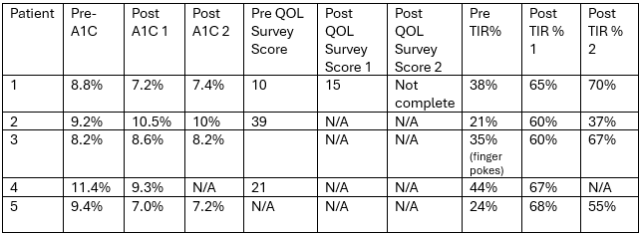
PDSA 3 – Device Donation for HCL Pump (Jan 2023- Oct 2024)
Problem: Unable to access smart devices needed for HCL pump usage.
Obtained 5 mobile devices
Donation Criteria:
  Medicaid patients
  Currently using a CGM
  Unable to purchase device
  Category 1 for CSHCS Income Guidelines
Patients completed QOL surveys upon receiving device. Planned quarterly check in.
  No consistent patterns in quality of life (QOL) changes.
  Difficult to dispense survey to patients
Most patients saw improvement in HbA1c and % TIR.
Fig. 3 – Pre/Post data from Device Drive patients.
In Jan 2025, OP5 integrated with Libre2+.
  Smart Device no longer necessary, improving access for patients.
Inconsistent phone donations.
Notes:
BRIT- 1. Average cost of smart phones in US is $790.00. Unfortunately, cheaper options for non-smart devices do not integrate with most pumps or CGMs.
2. Corewell was able to purchase 2 phones with foundation money and 3 additional phone were donated for use.
- Phones were wiped of data and provided to families that met criteria for the device drive.
- See criteria
3. A quality of life survey was created by our team (combination of two existing surveys) to monitor for changes in … ?
Quality of life survey questions?

Slide 10
PDSA 4 – Opt-Out Approach to Pump Education (Nov 2024)
Problem: Provider bias and limited patient education led to reductions in initiating HCL systems
Opt-In Approach
New: Opt-Out Approach
Not proactively scheduling Introduction to Pump class, only those that asked for it were scheduled.
Waiting until the 1st or 2nd face to face follow up to discuss pump options and sign up for class.
Intro to Pump class required for patient to be able to order pump.
Inconsistent criteria for starting pump therapy.
Patients going months to years without discussing pump therapy.
Added Introduction to Pump classes to initial class series scheduled at New Onset Office Visit.
  Every patient started in CGM therapy at initial diagnosis
  All providers to discuss pump therapy at first follow up visit.
Criteria for starting pump:
  Patient is consistently wearing CGM at first follow up
  Completed Diabetes Education Classes 1, 2, and 3
  Attend first follow up appointment (4-6 weeks post diagnosis)
  Complete Class 4 (Intro to Pump) and notify clinic of pump preference
Notes:
BRIT- Before sending link for class 4 (Intro to Pump) CDE’s check to see if first follow up has occurred.

Slide 11
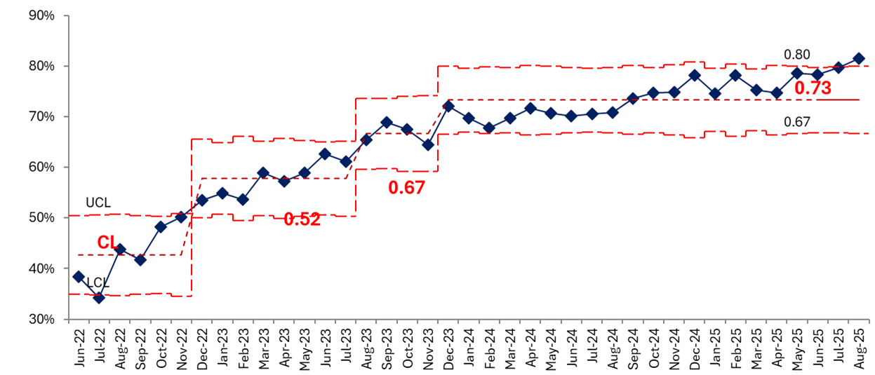
Results of REACH-AID Study
Total HCL pump Utilization in T 1D Patient Population
Omnipod 5 Launched/ Started Prescribing
PDSA 3 - Device Drive
PDSA 4 – Opt-Out System
PDSA 1 – Insurance Coverage Advocacy
PDSA 2 – Standardize Pump Education
New Shift in Trend
Percentage
By July 2025, our goal of 75% overall HCL pump use was met.
Fig. 4 –Percent Hybrid Closed Loop Utilization among total T1D population with percent shift from centerline data (June 2022 to August 2025), PDSA cycles listed along timeline (y-axis).
Notes:
KELS- Data shows % of total HCL use among all T1D patients at HDVCH. Along with interventions and occurrences that we believe influenced this increase in utilization.
- By May 2025 we started seeing a new shift in our data, by June 2025 74% of patients were utilizing HCL pumps.
- We actually hit our goal of 75% HCL pump use by July 2025. and are seeing another shift in trends at this time – we expect to see this % utilization increase further.

Slide 12
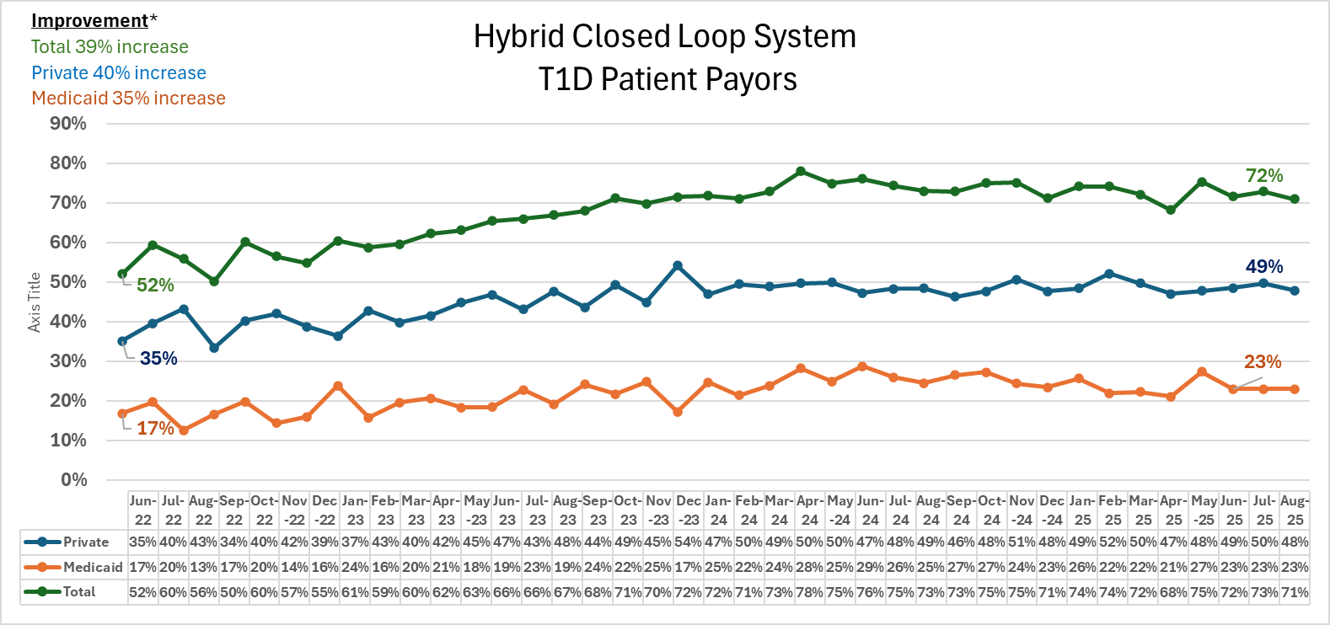
Analysis of Data
From June 2022 to June 2025, total payer population (public + private) saw a 39% relative improvement from baseline (r² value is 0.9078), with similar gains by payer:
40% improvement among privately insured patients.
35% improvement among Medicaid (publicly) insured patients.
  Medicaid patient probability correlation not significant.
Fig. 5 – Percent Change of HCL Pump Utilization by payer and total population over time (June 2022-Aug 2025).
Notes:
KELS- This graph shows us % change (or improvement) by payer and (in green) total of the two payer populations.
Total Population = (Medicaid + Private payors combined) improved by 39% - from 52% to 72%. A regression analysis of both payer populations suggests our data was not random but very much so a result of our interventions.
Looking separately per payer –
Private: payers HCL use improved by 40% with our interventions (R² =?)
Medicaid: payers HCL use improved by 35% - (R² = ?)
Interestingly, not included in this data is a large group of “unknown” payers (30% of patients utilizing HCL Pump is not shown here). Our speculation is that this Unknown data possibly skewed our improvement values.
- Thoughts are that this unknown data could be a Specialized income-specific Secondary Michigan Medicaid (CSHCS) which a sizable portion of our patients rely on.

Slide 13
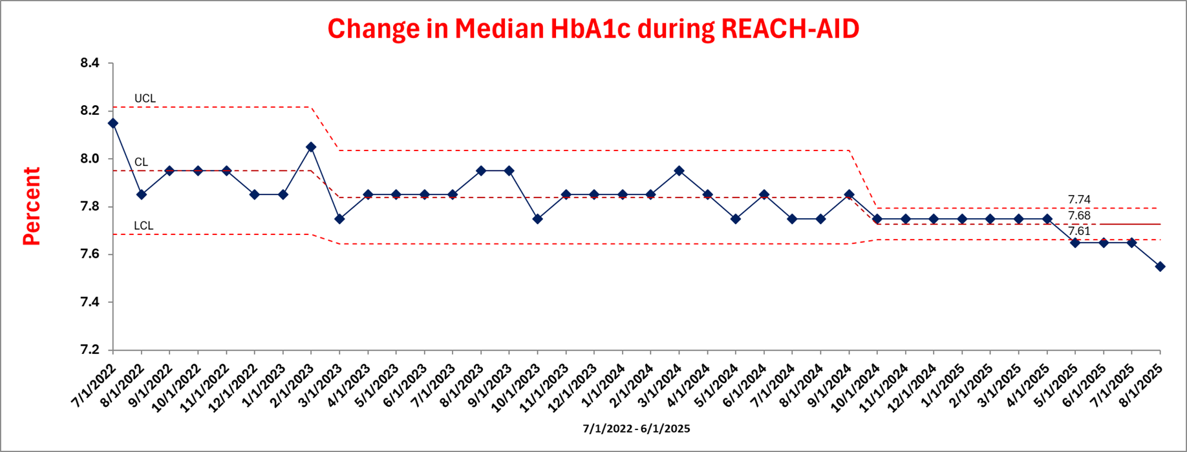
Median HbA1c Improvements
The median HbA1c in patients from the same data set decreased by 0.5% over the study period.
Data shows a narrowing variability in HbA1c indicated by reduction in Upper Centerline.
Fig. 6 - Change in Median HbA1c during REACH AID Reports.
Notes:
KELS- Data reviewed in qualified patient populations (same inclusion criteria for REACH-AID: had diabetes for more than 1 year, one A1c in <1 year, completed encounter within reported month).

Slide 14
Limitations and Considerations for the Future
Limitations of our data:
  Improvement in Medicaid payer HCL pump use was not statistically significant
    “Unknown payer” population skewing data in our analysis
  Data does not differentiate pump initiation vs. ongoing pump use
  QOL survey incomplete
  Device Drive not as successful as anticipated
Considerations for the future:
Investigate barriers to ongoing HCL pump therapy
  Supply issues/attending quarterly appointments
  Continue to advocate for pharmacy coverage
Further Education
  Standardize follow up process post pump start
  Advanced skills for using HCL pumps
  Avoiding gaps in HCL pump therapy
  Tech troubleshooting
Notes:
KELS- Our data includes staying on a pump, barriers to keeping patients on a pump. Pas, coming to appointments for coverage of supplies, education, troubleshooting
We don’t have data on pump initiation vs. ongoing pump use.

Slide 15

REACH-AID QI Project
Thank you – Questions?
HDVCHdiabeteseducators@corewellhealth.org – Britni Schipper, Brooke Turner, Kelsey Kasbaum (Diabetes Educators)
Donna.Eng@helendevoschildrens.org – Dr. Donna Eng MD

Slide 17
Improving Food Insecurity Screening and Access to Nutrition Support for Youth with Type 1 Diabetes
Naomi R. Fogel, MD
Ann and Robert H. Lurie Children’s Hospital of Chicago
Northwestern University Feinberg School of Medicine
Chicago, Illinois
November 11, 2025

Slide 18
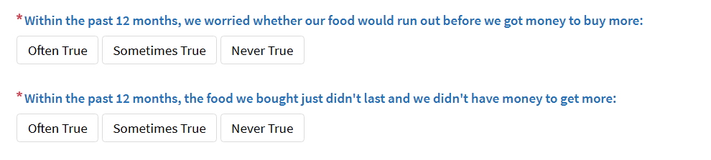
Food insecurity (FI) in Type 1 Diabetes
Disproportionately high rates of FI in T1D youth (Malik 2023)
FI is associated with
  poorer glycemic control, higher risk for DKA (Malik, 2024)
  increased ED visits (Mendoza)
  lesser adherence to fiber and sodium guidelines (Bercaw)
  difficulty obtaining insulin, technology, diabetes education (El Kalach)
Pediatric T1D patients are not consistently screened for FI (Malik 2023)
Hunger Vital Sign
Notes:
Malik FS, Liese AD, Reboussin BA, Sauder KA, Frongillo EA, Lawrence JM, Bellatorre A, Pihoker C, Loots B, Dabelea D, Mayer-Davis E, Jensen E, Turley C, Mendoza JA. Prevalence and Predictors of Household Food Insecurity and Supplemental Nutrition Assistance Program Use in Youth and Young Adults With Diabetes: The SEARCH for Diabetes in Youth Study. Diabetes Care. 2023 Feb 1;46(2):278-285. doi: 10.2337/dc21-0790. PMID: 34799431; PMCID: PMC9887610.
Malik FS, Liese AD, Ellyson A, Reid LA, Reboussin BA, Sauder KA, Frongillo EA, Pihoker C, Dabelea D, Reynolds K, Jensen ET, Marcovina S, Bowlby DA, Mendoza JA; SEARCH for Diabetes in Youth Study Group. Household food insecurity and associations with hemoglobin A_{1c} and acute diabetes-related complications in youth and young adults with type 1 diabetes: The SEARCH for Diabetes in Youth study. Diabetes Res Clin Pract. 2024 Jun;212:111608. doi: 10.1016/j.diabres.2024.111608. Epub 2024 Apr 3. PMID: 38574894; PMCID: PMC11290462.
Mendoza JA, Haaland W, D'Agostino RB, Martini L, Pihoker C, Frongillo EA, Mayer-Davis EJ, Liu LL, Dabelea D, Lawrence JM, Liese AD. Food insecurity is associated with high risk glycemic control and higher health care utilization among youth and young adults with type 1 diabetes. Diabetes Res Clin Pract. 2018 Apr;138:128-137. doi: 10.1016/j.diabres.2018.01.035. Epub 2018 Feb 8. PMID: 29427695; PMCID: PMC5910177.
Bercaw H, Reid LA, Mendoza JA, Frongillo EA, Sauder KA, Reboussin BA, Mayer-Davis EJ, Dabelea D, Marcovina SM, Mercado C, Liese AD. Food Insecurity and Adequacy of Dietary Intake in Youth and Young Adults With Youth-Onset Type 1 and Type 2 Diabetes. J Acad Nutr Diet. 2023 Aug;123(8):1162-1172.e1. doi: 10.1016/j.jand.2023.03.013. Epub 2023 Mar 27. PMID: 36990427; PMCID: PMC10522799.
El Kalach N, Julceus EF, Rudisill AC, Malik FS, Flory K, Frongillo EA, Sauder KA, Mendoza JA, Liese AD. Association Between Food Insecurity and Inability to Obtain Provider-Recommended Medications, Multidisciplinary Services, and Technology in Youth and Young Adults With Diabetes: A Cross-Sectional Study. Endocr Pract. 2025 Mar;31(3):298-305. doi: 10.1016/j.eprac.2024.11.014. Epub 2024 Dec 4. PMID: 39643004; PMCID: PMC11885030.

Slide 19
Baseline Screening Data
5% positive (n=121)
4% positive
(n=45)
Only 15% of positively screened patients received any FI intervention
73% of diabetes visits had a screener completed
95% of diabetes patients had a screener completed in the 6 months prior to most recent visit

Slide 20
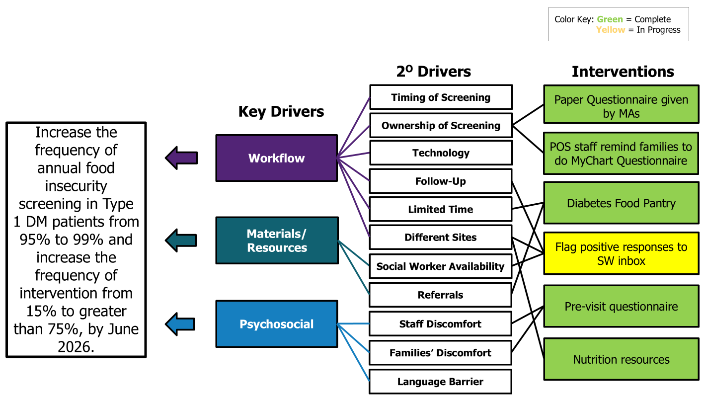
Key Driver Diagram

Slide 21
Process Map

Slide 22
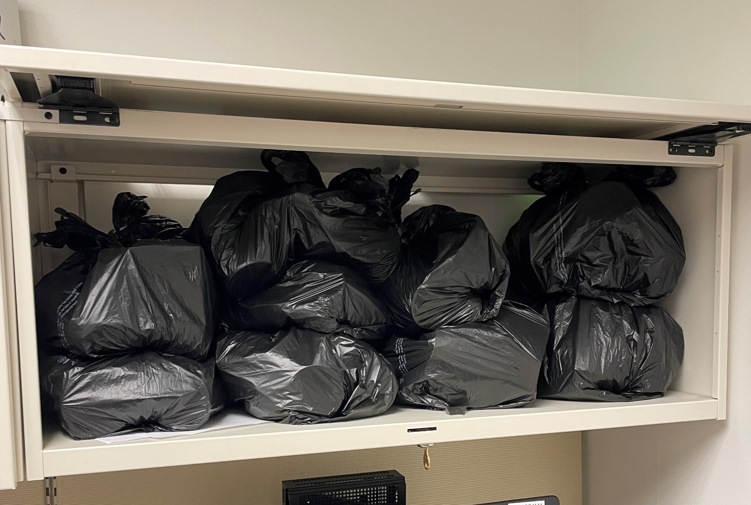
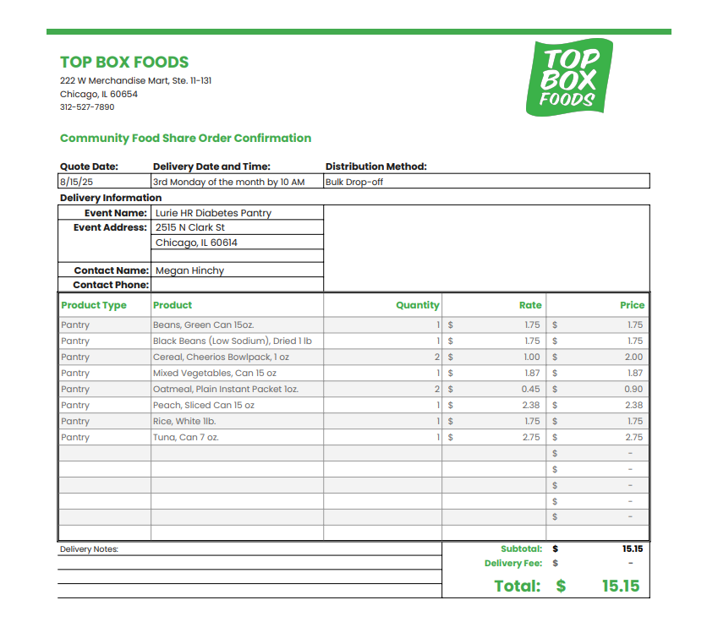
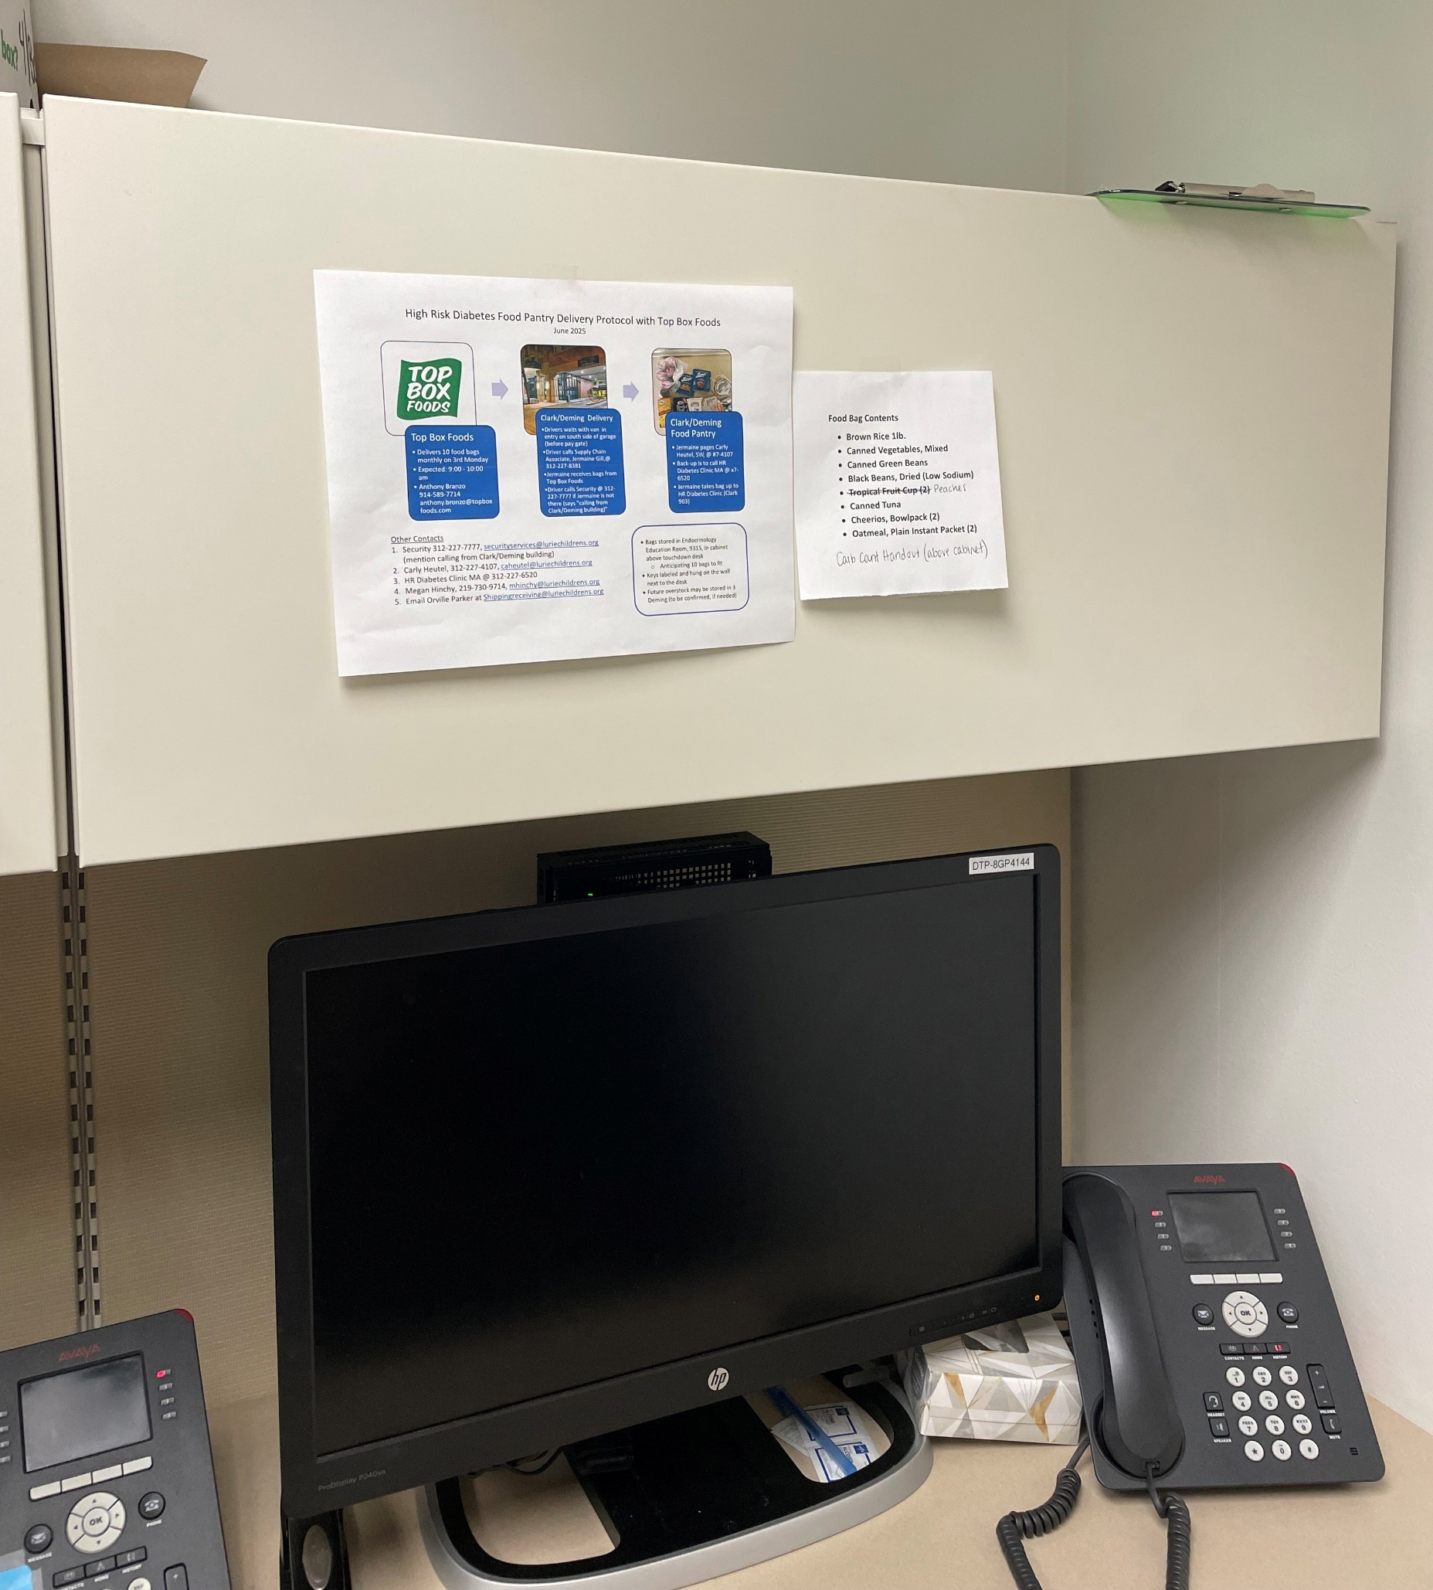
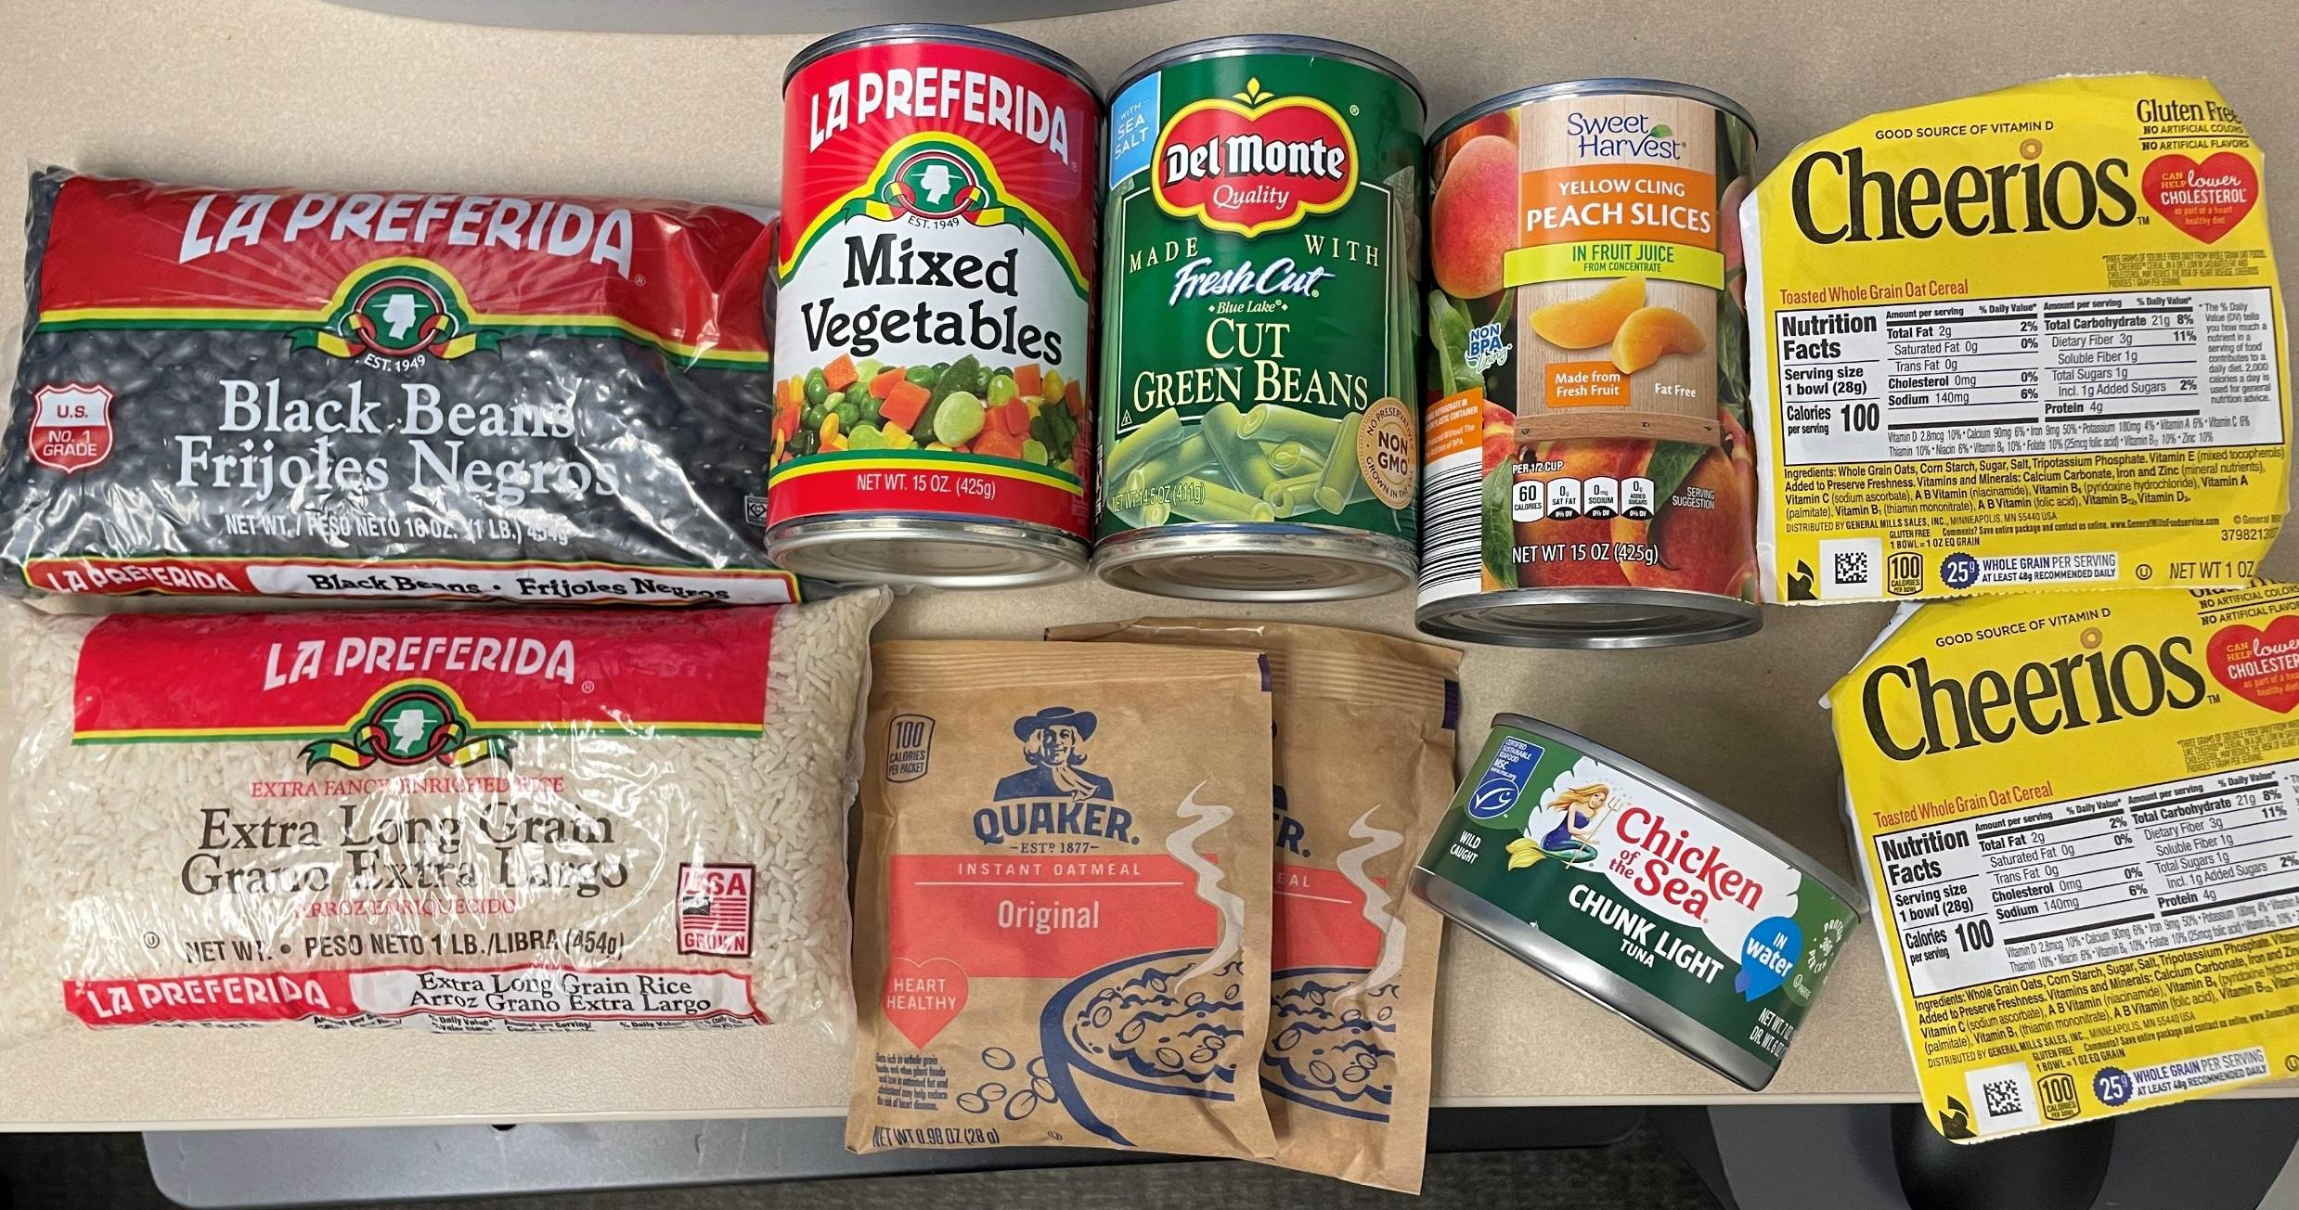
Diabetes Food Pantry

Slide 23
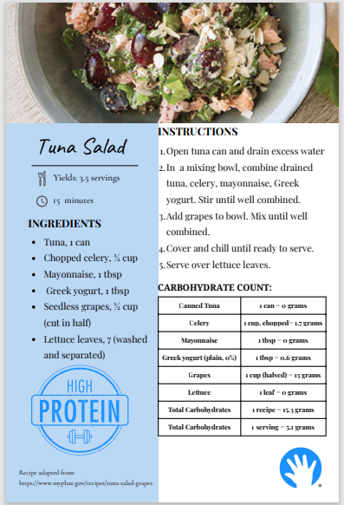
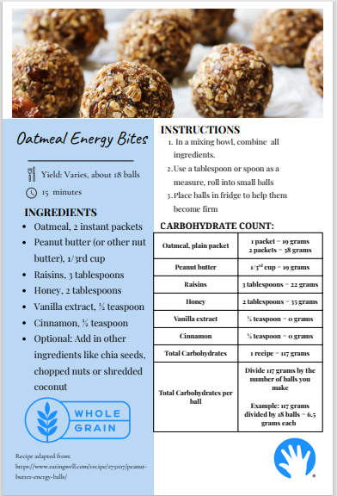
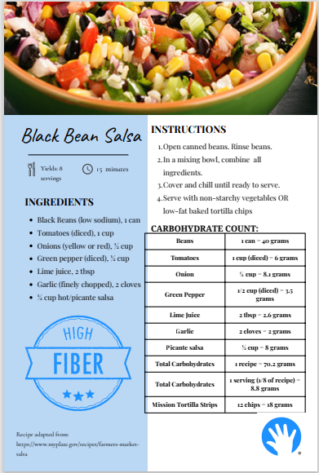
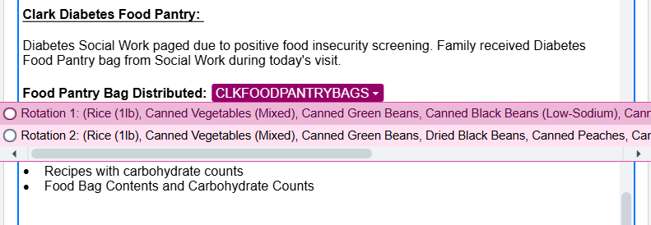
Food pantry resources
Carbohydrate counts
Recipes
Dot phrases
Food Bag Contents and Carbohydrate Counts:
Contenido de la Bolsa y Carbohidratos:
Rice 1 lb | 1 cup (cooked) = 45 g
Canned Vegetables, Mixed | 1 cup = 14 g
Canned Green Beans (Drained) | 1 cup = 6 g
Black Beans, Canned (low sodium) | 1 cup = 42 g
Canned Pears | 1 cup = 30 g
Canned Tuna | 1 can = 0 g
Cheerios, Bowl Pack (2) | 1 bowl = 21 g
Oatmeal, Plain Instant Packet (2) | 1 packet = 19 g
Arroz (1 libra) | 1 taza (cocido) = 45 g
Vegetales mixtos enlatados | 1 taza = 14 g
Ejotes enlatados (escurridas) | 1 taza = 6 g
Frijoles negros (enlatados) | 1 taza = 42 g
Peras (enlatadas) | 1 taza = 30 g
Atún enlatado | 1 lata = 0 g
Cheerios (2 tazones) | 1 tazon = 21 g
Avena instantánea simple (2 paquetes) | 1 paquete= 19 g

Slide 24
Results

Slide 25
Results

Slide 26
Results

Slide 27
Lessons Learned and Next Steps
Multiple approaches to screening
Importance of in-clinic food availability to reduce barriers
Value of dietitian involvement in addition to social work for education and support
Still need to solve notification issue – automated inbox message to SW for positive screener
Expand to other clinic sites (barriers include distance/transportation, availability of storage, SW)

Slide 28
References
Malik FS, Liese AD, Reboussin BA, Sauder KA, Frongillo EA, Lawrence JM, Bellatorre A, Pihoker C, Loots B, Dabelea D, Mayer-Davis E, Jensen E, Turley C, Mendoza JA. Prevalence and Predictors of Household Food Insecurity and Supplemental Nutrition Assistance Program Use in Youth and Young Adults With Diabetes: The SEARCH for Diabetes in Youth Study. Diabetes Care. 2023 Feb 1;46(2):278-285. doi: 10.2337/dc21-0790. PMID: 34799431; PMCID: PMC9887610.
Malik FS, Liese AD, Ellyson A, Reid LA, Reboussin BA, Sauder KA, Frongillo EA, Pihoker C, Dabelea D, Reynolds K, Jensen ET, Marcovina S, Bowlby DA, Mendoza JA; SEARCH for Diabetes in Youth Study Group. Household food insecurity and associations with hemoglobin A_{1c} and acute diabetes-related complications in youth and young adults with type 1 diabetes: The SEARCH for Diabetes in Youth study. Diabetes Res Clin Pract. 2024 Jun;212:111608. doi: 10.1016/j.diabres.2024.111608. Epub 2024 Apr 3. PMID: 38574894; PMCID: PMC11290462.
Mendoza JA, Haaland W, D'Agostino RB, Martini L, Pihoker C, Frongillo EA, Mayer-Davis EJ, Liu LL, Dabelea D, Lawrence JM, Liese AD. Food insecurity is associated with high risk glycemic control and higher health care utilization among youth and young adults with type 1 diabetes. Diabetes Res Clin Pract. 2018 Apr;138:128-137. doi: 10.1016/j.diabres.2018.01.035. Epub 2018 Feb 8. PMID: 29427695; PMCID: PMC5910177.
Bercaw H, Reid LA, Mendoza JA, Frongillo EA, Sauder KA, Reboussin BA, Mayer-Davis EJ, Dabelea D, Marcovina SM, Mercado C, Liese AD. Food Insecurity and Adequacy of Dietary Intake in Youth and Young Adults With Youth-Onset Type 1 and Type 2 Diabetes. J Acad Nutr Diet. 2023 Aug;123(8):1162-1172.e1. doi: 10.1016/j.jand.2023.03.013. Epub 2023 Mar 27. PMID: 36990427; PMCID: PMC10522799.
El Kalach N, Julceus EF, Rudisill AC, Malik FS, Flory K, Frongillo EA, Sauder KA, Mendoza JA, Liese AD. Association Between Food Insecurity and Inability to Obtain Provider-Recommended Medications, Multidisciplinary Services, and Technology in Youth and Young Adults With Diabetes: A Cross-Sectional Study. Endocr Pract. 2025 Mar;31(3):298-305. doi: 10.1016/j.eprac.2024.11.014. Epub 2024 Dec 4. PMID: 39643004; PMCID: PMC11885030.

Slide 29


High Risk Diabetes Food Pantry Team
Carly Heutel, MSW, LSW
Anna Jenkins, MPH, BSN, RN
Suzanne (Maggie) McKay, MPH, RD, LDN, CDCES
Katherine Ortega, RD, LDN
Sean Delacey, MD
Laura Levin, DO
Wendy Izzo, MHA

Slide 31
Bridging the Gap in CGM Disparities: Standardizing Early CGM Initiation in New Onset Type 1 Diabetes
Cook Children’s Type 1 Exchange Team
Principal Investigator: Susan Hsieh, MD
Stephanie Ogburn, BSN, CDCES, LSSGB
Candice Williams, MSN, APRN, CPNP-PC, LSSYB
Mouhammad Alwazeer, MD
Luke Cielonko, MD
Kelli Goree MSN RN
Jasmine Jones, LVN
Our Journey Through Quality Improvement (QI)

Slide 32
Disclosures
No disclosures to report.
Notes:
No disclosures to report.

Slide 33


Objectives
        To evaluate trends of device use before and after QI interventions
        Identify areas of success within our workflow
        Identify areas of growth to expand device use in patients with T1D
Notes:
To evaluate trends of device use before and after QI interventions
Identify areas of success within our workflow
Identify areas of growth to expand device use in patients with T1D

Slide 34
Clinic Profile
Multidisciplinary Team Members | Volume and Demographics
Pediatric Endo MDs: 13 APP: 7 (outpatient) 2 (inpatient) Diabetes Educators: 11 (2 w/CDCES) Registered Dieticians: 5 (2 part time) Medical Assistants: 4 Social Worker: 1 Clinical Therapists: 4 (2 part time) Data Coordinator: 1 (part time) | Approx. 1600 patients with T1D seen in the last 1 year Newly diagnosed patients with T1D per year: 290 Insurance: Private 64% Public 35% Other 1% Race: Non-Hispanic White (NHW)) 63% Non-Hispanic Black (NHB) 14% Asian 3% American Indian / Alaska Native <1% Native Hawaiian/Pacific Islander <1% Other <1% Ethnicity: Hispanic 19% Non-Hispanic 79% Other / Not Reported 2%

Slide 35
Define the problem
What we know…
The use of diabetes devices such as insulin pumps and continuous glucose monitors (CGMs) in the management of type 1 diabetes (T1D):
      Improves glycemic control
      Improves long-term outcomes
      Improves quality of life
      Reduces diabetes distress
      Results in high patient satisfaction
Source: Ori Odugbesan MD MPH, et al. T1D Exchange. Diabetes device equity change package. Boston, MA; December 2022.
Notes:
The use of diabetes devices such as insulin pumps and continuous glucose monitors (CGMs) in the management of type 1 diabetes (T1D):
Improves glycemic control
Improves long-term outcomes
Improves quality of life
Reduces diabetes distress
Results in high patient satisfaction

Slide 36
Define the problem
What is actually happening…
Despite its documented benefits, there are inequities in diabetes technology.
When compared to non Hispanic white patients (NHW), non-Hispanic Black (NHB) and Hispanic patients use diabetes technology less frequently.
Individuals from high SES and non-Hispanic white groups were more likely to be started on insulin pumps within the first year of diagnosis when compared to those who were Non-Hispanic Black, Hispanic, or of lower SES.
Source: Ori Odugbesan MD MPH, et al. T1D Exchange. Diabetes device equity change package. Boston, MA; December 2022.
Notes:
Despite its documented benefits, there are inequities in diabetes technology.
When compared to non Hispanic white patients (NHW), non-Hispanic Black (NHB) and Hispanic patients use diabetes technology less frequently.
Individuals from high SES and non-Hispanic white groups were more likely to be started on insulin pumps within the first year of diagnosis when compared to those who were Non-Hispanic Black, Hispanic, or of lower SES.

Slide 37
Define the problem
What is actually happening…
The attitudes, assumptions, and behaviors of providers are contributing factors
Studies have demonstrated a disconnect between providers’ perceived barriers to diabetes technology use and those experienced by persons with T1D.
Perceived discrimination, cultural congruence, and limited English proficiency likely exacerbate this disconnect between providers and patients.
Source: Ori Odugbesan MD MPH, et al. T1D Exchange. Diabetes device equity change package. Boston, MA; December 2022.
Notes:
The attitudes, assumptions, and behaviors of providers are contributing factors
Studies have demonstrated a disconnect between providers’ perceived barriers to diabetes technology use and those experienced by persons with T1D.
Perceived discrimination, cultural congruence, and limited English proficiency likely exacerbate this disconnect between providers and patients.

Slide 38
Define the problem
At Cook Children’s 34% gap in CGM use existed between non Hispanic white (NHW) patients and non Hispanic Black (NHB), Hispanic, and Asian patients.
Notes:
At Cook Children’s 34% gap in CGM use existed between non Hispanic white (NHW) patients and non Hispanic Black (NHB), Hispanic, and Asian patients.

Slide 39
Barriers to Diabetes Care
Health Literacy
Access
Lack of Social Support
Cost
Stigma
Language / Cultural Barriers
Source: American Diabetes Association. 2022. Health Equity and Diabetes. https://diabetesjournals.org/spectrum/article/35/3/264/147399/Health-Equity-in-Diabetes

Slide 40
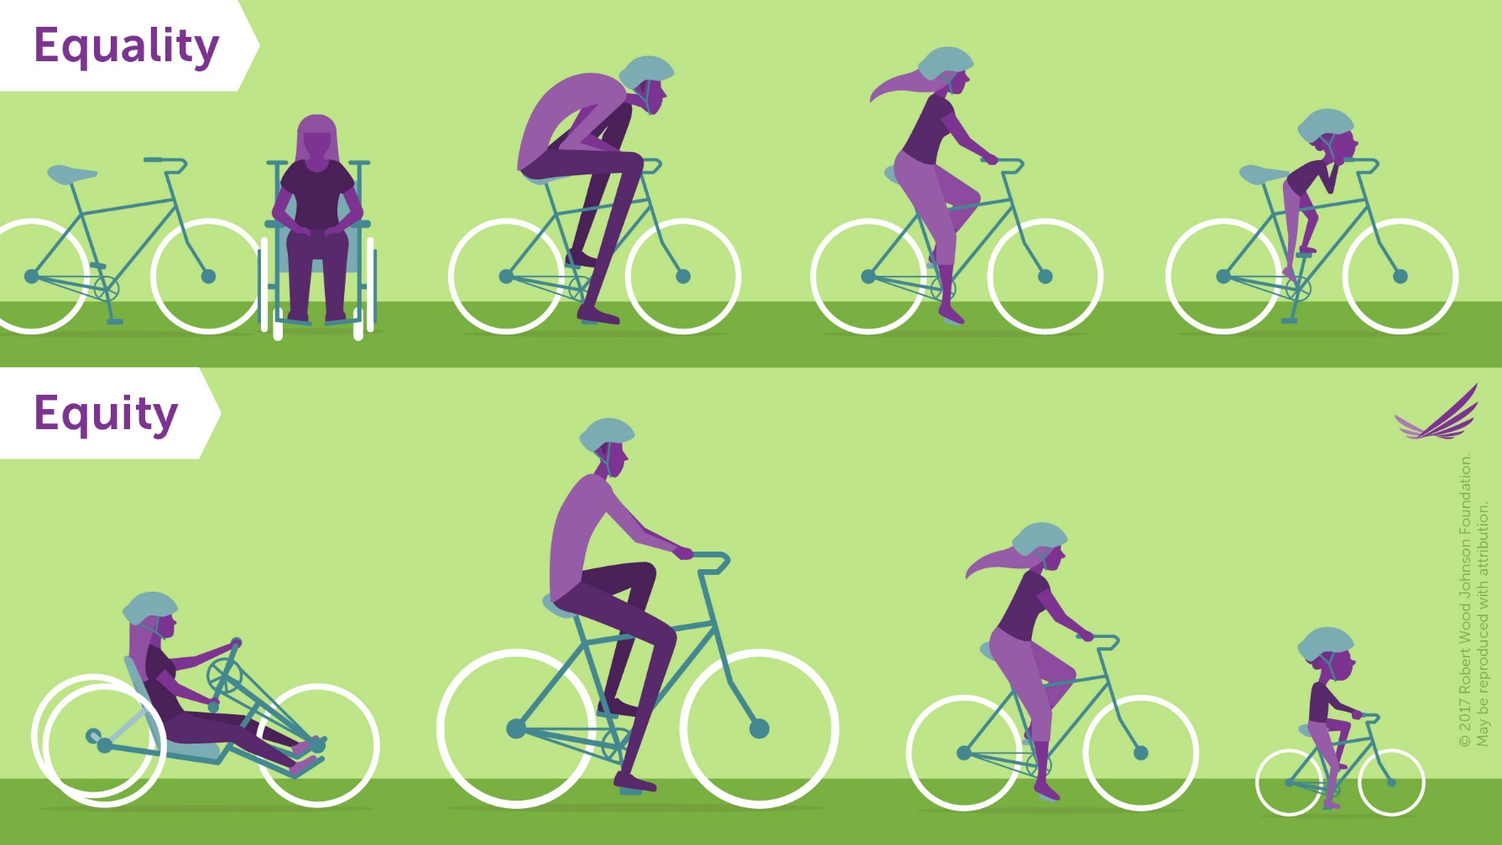
Equality vs. Equity
HbA1c <8%
Hx of DKA
Discuss with all patients with guidance for success
Source: Robert Wood Johnson Foundation, Visualizing Health Equity (https://www.rwjf.org/en/insights/our-research/infographics/visualizing-health-equity.html)

Slide 41
Cook Children’s CGM Equity
Key Driver Diagram
Change Ideas
Primary Drivers
Patient Barrier Assessment Survey
Provider bias survey / Educator Bias Survey
Establish Parent Partnership Group
Ensure support and education available for
non-English speakers
Aim
Address Inequities
Increase the utilization of CGM use by 10% for people with T1D by 12/31/24.
Demonstrate reduction in CGM disparities
by 3%
CGM
Interest & Access
Early education – Initiate discussion at diagnosis
Equitable delivery – “Right tool for all patients”
Education in multiple languages
Financial support and education
Patient Education
Education at Diagnosis, Follow-Up
Documentation of “Lack of Interest”
Follow up re “Lack of Interest” esp in Diabetes Distress
Provider Education
Review of data
Continuing education
Notes:
-Increase the utilization of CGM use by 10% for people with T1D by 12/31/24. -Demonstrate reduction in CGM disparities by 3%
Through a specific, targeted intervention, the Cook Children’s Endocrine and Diabetes Clinic sought to achieve a preliminary goal of a 3% reduction in this gap.

Slide 42
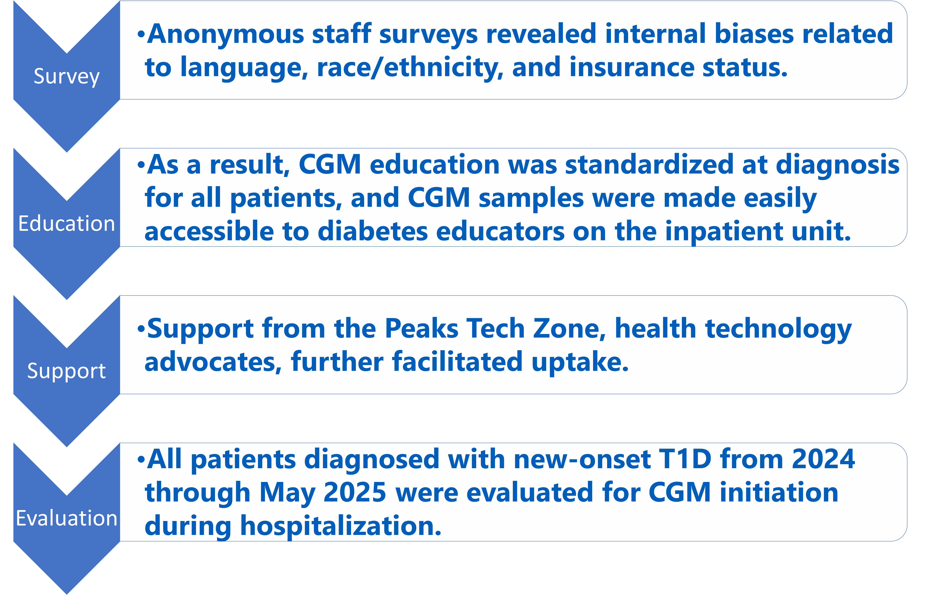

Interventions
Notes:
April 2024 - Educator bias survey
May 2024 – Educator Conversation at T1D Diagnosis
May 2024 – Use of Vendor Material in English and Spanish

Slide 43
Educator Assessment
Find the pain points and success areas
(Key Driver Analysis)
Related to CGM Discussion at diagnosis:
“Family is already overwhelmed or they are uninsured, OR if patient expresses refusal to wear a continuous monitor”
“Patient's solely rely on CGM if they do not get practice using a manual glucometer.
“Initially I did, and I still usually do; but if family seems overwhelmed I don't mention it unless the pt is a small child <6”
Notes:
Related to CGM Discussion at diagnosis:
“Family is already overwhelmed or they are uninsured, OR if patient expresses refusal to wear a continuous monitor”
“Patient's solely rely on CGM if they do not get practice using a manual glucometer.
“Initially I did, and I still usually do; but if family seems overwhelmed I don't mention it unless the pt is a small child <6”

Slide 44
Data Analysis

Slide 45
Percent of Patients with T1D Using CGM
Baseline and Intervention Period, By Race/Ethnicity

Slide 46
Analyze data to determine a change
CGM Equity – Our Aim
Increase the utilization of CGM use by 10% for people with T1D by 12/31/24.
Demonstrate reduction in CGM disparities
by 3%
CGM use for all patients did improve by 6%, but did not reach 10% improvement
86% (pre) vs 92% (post) (90% Sept. 2025)
Reduction in disparities based on race and ethnicity improved by 3%
NHW-NHB 7% reduction (15% reduction Sept. 2025)
NHW-Hispanic 14% reduction (18% reduction Sept. 2025)
Notes:
Post-intervention, overall CGM use in the clinic increased by 6%. CGM use gap narrowed by 7% between NHW and NHB patients and by 14% between NHW and Hispanic patients.
Furthermore, as of September 2025 CGM use gap narrowed by 15% between NHW and NHB patients and by 18% between NHW and Hispanic patients.

Slide 47
Conclusions
CGM use for all patients with diabetes can improve quality of life and improve glycemic management.
Early, standardized CGM Education at the time of diagnosis improved access and reduced disparities in CGM use among underserved populations. Addressing provider bias, improving workflow, and ensuring device accessibility were key to closing the gap. Embedding CGM initiation into early diabetes education may serve as a model for promoting health equity in diabetes care.
Notes:
CGM use for all patients with diabetes can improve quality of life and improve glycemic management.
Early, standardized CGM Education at the time of diagnosis improved access and reduced disparities in CGM use among underserved populations. Addressing provider bias, improving workflow, and ensuring device accessibility were key to closing the gap. Embedding CGM initiation into early diabetes education may serve as a model for promoting health equity in diabetes care.

Slide 48
Future Considerations
Sustain & Spread
Advocate for improved access (pharmacy coverage) to CGM for public insurance
The Cook Children’s Endocrine and Diabetes Clinic will initiate CGM use for people with Type 2 Diabetes that have been started on insulin.
Notes:
Advocate for improved access (pharmacy coverage) to CGM for public insurance
The Cook Children’s Endocrine and Diabetes Clinic will initiate CGM use for people with Type 2 Diabetes that have been started on insulin.

Slide 49



Questions & Comments

Slide 51
BPA-TECH: Johns Hopkins Diabetes Centers Best Practice Advisory (BPA) Project to Improve Equity in Diabetes Technology Use
Risa Wolf, MD (Pediatric diabetes)
Nestoras Mathioudakis, MD, MPH (Adult diabetes)
11/12/2025

Slide 52
Purpose
Encourage prescribing AID systems, the standard of care for people with type 1 diabetes (T1D)
Reduce disparities in access to and usage of diabetes technology.
Grady Memorial Hassenfeld Children's
Nationwide Children's Seattle Children's
SUNY Adult UT Southwestern Pediatrics Johns Hopkins Adult Johns Hopkins Pediatric

Slide 53
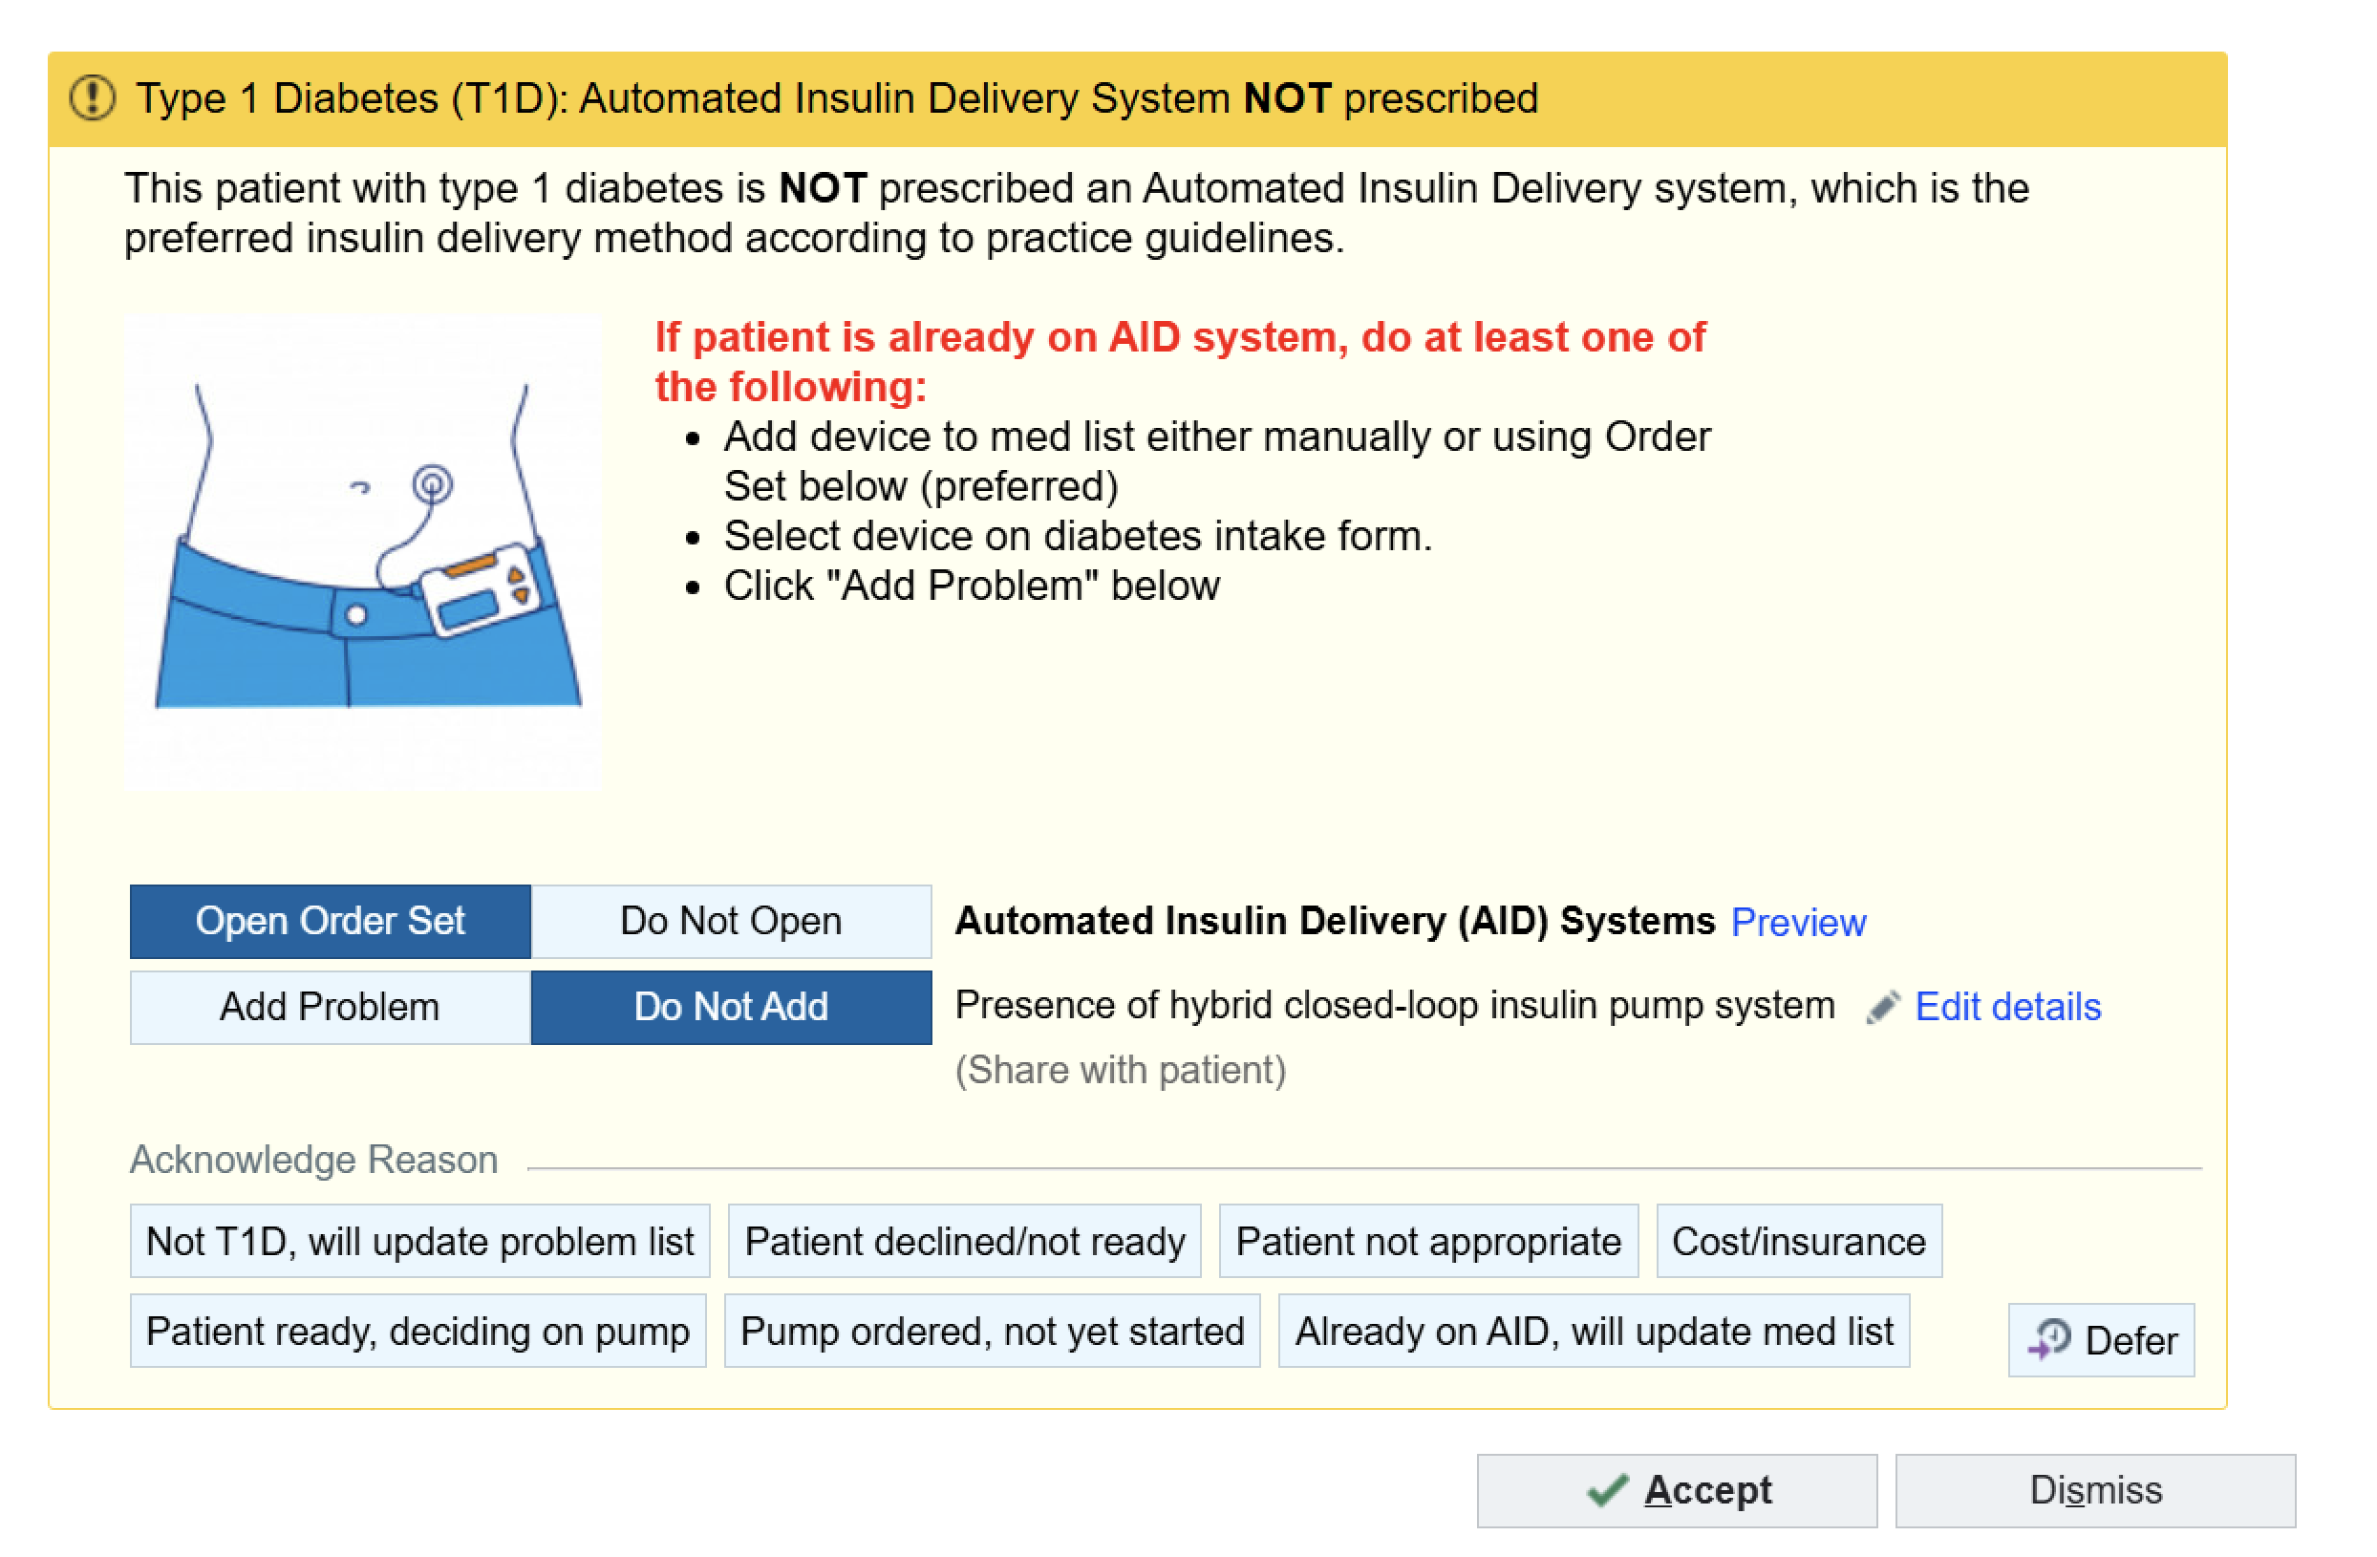
BPA Design
Best Practice Advisory (BPA) (also known now as an Our Practice Advisory (OPA)) is intended to remind providers that automated insulin delivery systems are the gold standard for T1D and should be considered for patients.
Interruptive OPA that triggers based on the following conditions:
  An encounter is opened for an Office Visit or Telemedicine Visit in the Adult or Pediatric diabetes centers
  Restricted to provider visits (MD, DO, NP) with prescribing privileges; includes residents/fellows, Excludes RN/CDCES
  Patient is over 2 years of age with T1D and no evidence of AID use in the medical record (flowsheets, problem list or medication list)

Slide 54
BPA Actions
Possible Actions:
Accept Advisory
Select Acknowledge Reason
Add Problem to Problem List
Open Orderset
Cancel Advisory (Dismiss)
Defer
Acknowledgement Reasons:
Not T1D – will update problem list
Patient declined/not ready – requires free text comments.
Patient not appropriate – requires free text comments.
Cost/insurance
Patient ready, deciding on pump
Pump ordered, not yet started
Already on AID – will update med list

Slide 55
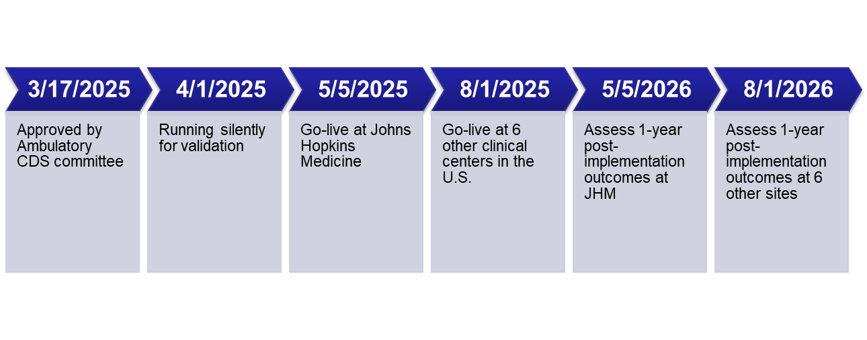
BPA Deployment and Preliminary Outcomes
Training completed in both pediatric and adult departments, training guide provided.
BPA deployment date 5/5/2025
Following data from the first 3 months of data: 5/5/2025 through 8/1/2025
  Utilization is per unique patient
  Age range 2-88 years old
  4 Encounter types: Video visit, office visit, appointment, erroneous visit
  3 trigger points: 35.8% storyboard notifications, 34.9% open patient encounters, 29.3% general navigator section
Notes:
Utilization is per unique patient
Age range: 2 – 88 years old
4 Encounter Types
Video visit, office visit, erroneous visit, appointment
3 trigger points
35.8% storyboard notifications
34.9% open patient encounters
29.3% general navigator section

Slide 56
OPA Responses by Patient Count
(Adults and Peds)
Action Taken | Patient Count | Percentage
Accept Advisory (No Action Taken) | 1 | 0.16%
Acknowledge/Override Warning | 239 | 39.24%
Add Problem | 5 | 0.82%
Cancel Advisory | 217 | 35.63%
Deferred | 116 | 19.05%
Open Smart Set | 31 | 5.09%

Slide 57
Acknowledgement Reasons: Peds and Adults

Slide 58
Acknowledgement Reasons
(Adults and Peds)
Acknowledgment Reason | Pediatric Patient Count | Percentage | Adult Patient Count | Percentage
Already on AID, will update med list | 58 | 24.17% | 38 | 33.93%
Cost/insurance | 4 | 1.67% | 37 | 33.04%
Not T1D, will update problem list | 19 | 7.92% | 13 | 11.61%
Patient declined/not ready | 88 | 36.67% | 11 | 9.82%
Patient not appropriate | 34 | 14.17% | 10 | 8.93%
Patient ready, deciding on pump | 26 | 10.83% | 2 | 1.79%
Pump ordered, not yet started | 11 | 4.58% | 1 | 0.89%

Slide 59
Examples of Provider Comments
Honeymoon phase
Incarcerated
Previous negative AID experiences
Sub-par patient compliance
Patient not on CGM
New onset T1D
The patient will consider
Safety concerns
New patient
Not interested/declined
AID discussed
Insurance issues

Slide 60
Reviewing OPA Configuration
Right information
No issues reported
Right person
No issues reported
Right time in the workflow
Feedback about pre-charting vs. during encounter
Consider longer lock-out period for patient decline or not appropriate (6 months vs. 3 months)
Right format
No issues reported about OPA format
Right channel
No issues reported about Storyboard, OPA navigator, etc.
Notes:
Could remove this slide for space

Slide 61
Iteration(s) of OPA
Potential sources of alert fatigue:
  Not T1D, will update problem list
    Many providers select this, but do not update problem list
  Already on AID, will update med list
    Many providers select this, but do not update med list
Add hyperlinks to existing tools for AID documentation
Remove pre-charting trigger
Consider a “snooze” option (pop-up again after X min)
Add smartlinks to pull OPA inputs into clinic note

Slide 62
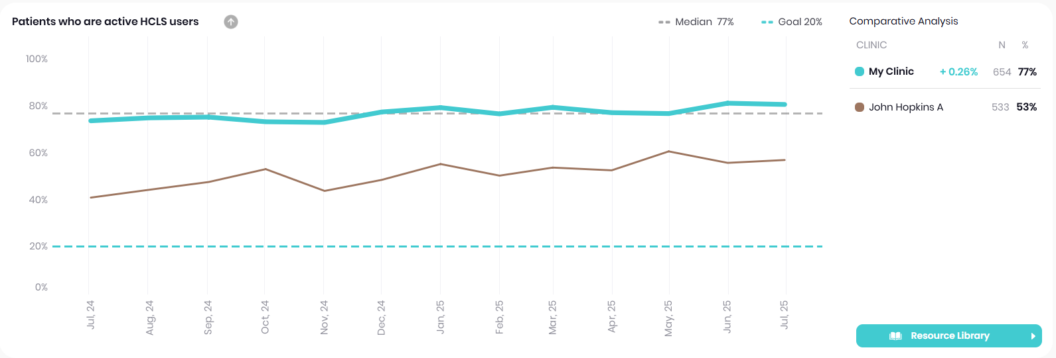
Patient outcomes
Notes:
Update with August data before the meeting

Slide 63

THANK YOU!
Funding from Breakthrough T1D
T1Dx Team: Nicole Rioles, Trevon Wright, Emma Ospelt, Susan Thapa
Hopkins team: Daniel Alizadeh, Elizabeth Brown, EPIC team

Slide 65

Section Header Here
Subtitle Here
A Review of the T1DX-QI 2025 Annual Survey Results
Whitley Ballroom
4:00 – 4:20pm

