Slide 1

Diabetes Device Use at Diagnosis and Data Insights
Moderated by Brian Miyazaki, MD

Slide 2
A Standardized, Interdisciplinary Approach to Accelerate Automated Insulin Delivery System (AID) Initiation in Adults with Diabetes
T1Dx QI Collaborative
Penn Rodebaugh Diabetes Center, Hospital of the University of Pennsylvania, Philadelphia, Pennsylvania, USA

Slide 3
Standardizing the Pump Start Process to Reduce
Time to AID Initiation
Background: AID is now standard of care
Problem Statement: Patients and providers expressed frustration and confusion about the steps necessary to start AID therapy, leading to delays in initiation. These delays cause suboptimal glycemic control and dissatisfied patients.
Aim of QI initiative: By December 2024, the median time-to-AID initiation will decrease from baseline time ~59d to 45d or less.
Observation period: Jan 2022 – Dec 2024
Population: Adults with diabetes (T1D, T2D, MODY, other) starting AID systems
  First time starting AID
  Switching from one AID to another
Target outcome: median time-to-AID initiation (in days), measured in cohorts every 6 months
Covariates collected:
  Age
  Sex
  Race & Ethnicity
  Diabetes type
  Insurance type
Notes:
Automated insulin delivery systems (AID) are now standard of care due to their efficacy in improving glycemic control.
The problem statement was informed by monthly diabetes provider meetings in which providers informally aired grievances about issues with new pump starts. Further, interactions with patients during visits confirmed that they were experiencing longer times to get onto their pumps than they (or we) would like – which led to the development of this program.
At the same time, we also have fellows at our institution who I was able to educate/walk through how I decide starting pump settings and there was a desire for incorporating more education around this too. So standardizing the process made it so that there was a clear point – after a provider sent a telephone encounter to me – that I would pause, often contact the fellow, walk them through how I was completing the form, and then send it off to the pump representatives. So while reducing the time to start on a pump was one aim of the project, we were really addressing multiple things at once by standardizing our procedures.
While we initially did not have a specific equity focus, we knew that there would likely be disparities identified and so we also collected covariate data to explore our own prescribing practices regarding AID systems

Slide 4
Development and Description of the Intervention
Made list of necessary steps for pump starts, then involved key stakeholders:
  Providers
  RD/CDCES who teaches/reviews carb counting
  RN/CDCES/CRNP who provides education on pump options/”Pump 101”
  Industry partners
Our Standardized Protocol included:
Templated electronic medical record documentation
Visit with RD to review carbohydrate counting
Assignment of one CRNP to complete pump orders & communicate with industry partners
Follow up appointment within 4 weeks of AID initiation
Visit with RN/CDCES for AID education and options
1
2
3
4
5
Notes:
We decided as providers that all patients starting on pumps should have formal carb counting education/nutrition education for "carb awareness", and at least have a “carb counting refresher” even if they had been counting carbs for a while, before starting on a pump.
We also wanted patients to be aware of the basics of how insulin pumps work, and what their options are in terms of brands of pump and the different features that distinguish the types of pumps.
Our awesome RN Taylor had already been doing education sessions about pump basics and pump types, so we decided to formally call this “Pump 101” and make it part of the new pump start process. She had transitioned her role to more formal CDCES role to provide these specific sessions
Our awesome RD Carolyn was also completely on board for doing a “carb counting refresher” with everyone and would let us know when each of those had been completed so orders could be placed.
We decided it would make sense to have one person as the “point person” for communications with our industry partners – that’s me – and I was able to negotiate for a small amount of protected time for this role.
Our protocol included:
Templated electronic medical record documentation
Visits with a registered dietitian to review carbohydrate counting and a nurse/certified diabetes educator for AID education/options
Assignment of a nurse practitioner to complete pump orders and communicate with industry partners
A follow up appointment within four weeks of AID initiation
To note: we did not have formal “PDSA Cycles” – this project occurred at at time when we were experiencing turnover/transition in our QI leadership, so we developed this protocol and tracked our data in an ongoing excel document, but we did not refine and re-test different interventions over the nearly 3 year period.

Slide 5
Statistical Analyses / Generation of Run Charts
Mann Whitley U-test used to compare medians from each 6-month time period, also used t-tests for comparison of means as a sensitivity analysis
One way ANOVA used to look at time-to-AID initiation between groups, by:
  Race/Ethnicity
  Sex
  Insurance Type
  Diabetes Type
  Age category
There were no covariates available from baseline data to perform subgroup analyses, so we used first 6-month observation period as our “baseline” in order to perform subgroup analyses and run charts
Notes:
We used nonparametric Mann Whitley U-tests (aka Wilcoxon Rank Sum tests) to compare median time to AID due to the rightward skew of our data – when we looked at a histogram of all our patients’ time to pump initiation, we had a long right-ward skewed tail of folks who took a really long time to get on their pump, but did eventually start on the pump so we did include them
Also checked t-tests given our sample size was large enough to compare means despite skew - though neither of these were statistically significant
We used analysis of variance (ANOVA) to see if there were differences in mean time to pump by groups - race, insurance type, diabetes type, sex, age

Slide 6
Results
 | New AID System Start 61.7%, (n=216) | Changing AID System Type 38.3%, (n=134) | Total (n=350) | Missing
Female, % (n) | 52.7% (107) | 55.5% (71) | 53.7% (178) | 5% (19)
Race, % (n)
Asian | 1.4% (3) | 2.2% (3) | 1.7% (6) | 0
Black | 28.2% (61) | 15.7% (21) | 23.4% (82) | 0
Other | 6.5% (14) | 3% (4) | 5.1% (18) | 0
Unknown | 6.5% (14) | 3.7% (5) | 5.4% (19) | 0
White | 57.4% (124) | 75.4% (101) | 64.3% (225) | 0
Ethnicity, % (n)
Hispanic/Latino | 6% (13) | 2.2% (3) | 4.6% (16) | 0
Non-Hispanic/Latino | 93.5% (202) | 96.3% (129) | 94.6% (331) | 0
Unknown | 0.5% (1) | 1.5% (2) | 0.9% (3) | 0
Insurance Type, % (n) |  |  |  | 6.3% (22)
Medicaid | 23.4% (47) | 8.6% (11) | 17.7% (58)
Medicare | 12.4% (25) | 15.8% (20) | 13.7% (45)
Private/Other | 59.7% (129) | 71.6% (96) | 68.5% (225)
Type of Diabetes, % (n) |  |  |  | 0.3% (1)
Type 1 Diabetes | 83.7% (180) | 97% (130) | 88.8% (310)
Type 2 Diabetes | 9.8% (21) | 3% (4) | 7.2% (25)
Other | 6.5% (14) | 0% (0) | 4.01% (14)
N = 350 patients initiated AID
Most were female, white, privately insured, and living with T1D
Median time-to-AID decreased from 59d at baseline to 36d in the last 6-month observation period, a ~40% reduction overall
Subgroups of interest:
  White: 49d → 38d (22% reduction)
  Other race: 36d → 19.5d (46% reduction)
  Black: 46d → 50.5d (10% increase)
  Medicaid: 42d → 38.5d (8.3% reduction)
  Medicare: 41d → 29d (29.3% reduction)
  Private/Other: 44d → 35.5d (19.3% reduction)
Notes:
majority were female (53.7%), non-Hispanic/Latino (94.6%), White (64.3%), privately insured (61%), and living with type 1 diabetes (88.8%). Median time-to-AID decreased from 59 days at baseline to 36 days, a 39.8% reduction. Improvements varied by race/ethnicity, with reduced time-to-AID for White (22.4%) and Other (45.8%) race patients, but not for Black (9.7% increase) patients. Time-to-AID was reduced for all insurance types (Medicaid, 8.3%; Medicare 29.3%; Private 19.3%).
For subgroups, we used the first 6-month observation period (Jan 2022-June 2022) as their “baseline” with the new protocol in place (we did not have previous comparison data of subgroups before new pump process), and then compared to the last 6-month observation period (July 2024-Dec 2024)

Slide 7
Results – Median Time-to-AID Initiation Overall
Notes:
None of the changes were statistically significant – likely due to skewness and limitations in data set
Given QI focus, included all and emphasized run charts instead of statistical tests to demonstrate findings
Results of t-tests become significant when outliers dropped
There were 14 outliers (>1.5x IQR + Q3) who took between 121-629 days to start pumps (reasons could include insurance, general follow up, training delays, communication, etc.)
If we drop these folks, the mean time-to-AID becomes statistically significant (mean time to pump – 47 days; p=0.000)

Slide 8
Subgroups of Interest – New to Pump, Switching Brands
Notes:
You can see the slope of the line is not as steep for new pump starts – we think this is likely because it takes time to make a decision about the pump and feel more comfortable going from no pump to new pump than switching from one brand to another once you’re already familiar with AID systems-also pump pathway and visits involved (pump 101, RD visit) vs switching brand

Slide 9
Cumulative new AID Systems
Notes:
You can see we had more new starts from no pump than brand switches (raises the question: is this due to 4-5 year warranty periods or satisfied with their pump?)
Not everyone
Cumulatively uptrend In AID use

Slide 10
Conclusions from New Pump Start Program
Standardizing the process reduced time-to-AID initiation for patients overall
  Largest improvement seen in white, privately insured, female patients with T1D
However, disparities exist:
  Black patients with no improvement in time-to-AID
  Medicaid patients with less improvement in time-to-AID compared to privately or Medicare-insured
Need for strategies that promote equitable access to AID systems
Notes:
Now that we have the baseline data, this will actively assist us to begin planning and focusing on equitable access to AID/diabetes technology. We are planning on utilizing the T1D's "Equity Change" packet to guide our practice – this is going to be an ongoing group discussion at our provider meetings to develop strategies on equity and inclusion.

Slide 11
Acknowledgements:
Laura Emmons, MSN, CRNP; Wendy Yang, BA; Taylor Lee, BSN, RN, CDCES; Patricia Y. Chu, MD, MHSc, MSCE; Austin Matus, PhD, RN; Emma Edmondson, MD, MSHP.
Special Thanks:
Rodebaugh Diabetes Center: Michael Rickels, MD, MS; Ilona Lorincz, MD, MSHP; Mark Schutta, MD; Carrie Burns, MD.
Also, special thanks to all of our wonderful patients!
Questions/Feedback?
Thank you!

Slide 13


The Role of the CDCES in Promoting the Use of AID in the Teamwork, Targets, Technology, and Tight Control (4T) Program
Jeannine Leverenz, Barry Conrad, Annette Chmielewski, Ian Chan, Rachel Bell, Mindy Lee, Franziska Bishop, Priya Prahalad, David Maahs

Slide 14
Disclosures
I have no disclosures
Funding:
NIDDK - R18DK122422
Helmsley Charitable Trust (G-2002-04251- 2)
ISPAD-JDRF Research Fellowship
SDRC (1P30DK 11607401)
LPCH Auxiliaries
National Science Foundation (2205084)
Stanford HAI
Stanford Maternal & Child Health Research Institute
Stanford REDCap Platform (UL1 TR003142)
Dexcom provided the first month of CGM supplies

Slide 15
Background
Diabetes technology, including CGM and Automated Insulin Delivery (AID), is the standard of care, with ISPAD guidelines recommending early initiation.
The 4T program is a CDCES-driven program that initiates CGM in the first month of diabetes diagnosis and performs remote patient monitoring (RPM).
Despite early CGM initiation, we found persistent delays in starting insulin pumps/AID.
Aim of this QI effort: To develop a protocol for the CDCES team to support and promote the use of Automated Insulin Delivery (AID)

Slide 16
Methods
Youth with newly diagnosed T1D received routine new onset education with a Certified Diabetes Care and Education Specialist (CDCES)
Offered opportunity to start on Dexcom in the 1st month of diagnosis with a CDCES
Youth who start CGM have a 1-week telehealth follow-up with a Nurse Practitioner (NP) or CDCES
All youth received a 1-month follow-up with a provider
Weekly to monthly remote patient monitoring by the CDCES team (following SMCH policy)
Families Encouraged pre-pump class with the CDCES team within 3 months of diagnosis

Slide 17





4T Study Timeline
CGM Follow-up
CGM Start
Baseline Research Visit
Telehealth or in-person
Diabetes
Diagnosis
*
*
*
*
*
*
*
*
*
*
*
*
*
Month
Month
Month
Month
Month
Month
Month
Month
Month
Month
Month
Month
Month
1
2
3
4
5
6
7
8
9
10
11
12
13
Pre-Pump Class
= Continuous Glucose Monitoring (CGM)
= Hemoglobin A1c (HbA1c) test: In-clinic or at-home test
= Patient Reported Outcomes (PROs) Survey: ~15 minutes to complete
= Stanford Children’s Diabetes Clinic Visit: Historic/Standard of Care
*
= Remote Monitoring: Regular CGM data review from diabetes educator
= Systematic pump exposure in months 1-3 – addition for Study 2

Slide 18
Methods Continued
CDCES team developed the following materials for new-onset patients and families:
  New onset teaching notebook for families
  Handout for the CGM start
  Handout for the CGM telehealth follow-up visit
  Pre-pump/AID class handouts and update them as new technology is approved
  Pump/AID initiation handout
  Policy for CDCES to make dose adjustments
Once the family meets with the pump manufacturer representative, the CDCES team scheduled visits with the family to start insulin via the pump/AID
The CDCES team answered questions and set up CDCES telehealth visits for those who need more education

Slide 19
Table 1. Characteristics of the Historical, Pilot 4T, 4T Study 1, and 4T Study 2 Cohorts
Characteristic | Historical | Pilot 4T | 4T Study 1 | 4T Study 2
N | 272 | 135 | 133 | 183
Baseline characteristics
Age (years) at T1D diagnosis, median (Q1, Q3) | 10 (7, 13) | 10 (7, 13) | 11 (6, 14) | 11 (7, 13)
Sex, n (%)
Male | 137 (50.4) | 71 (52.6) | 74 (55.6) | 85 (46.4)
Female | 135 (49.6) | 64 (47.4) | 59 (44.4) | 98 (53.6)
Race/ethnicity, n (%)
Non-Hispanic White | 120 (44.1) | 53 (39.3) | 52 (39.1) | 64 (35.0)
Non-Hispanic Black | 5 (1.8) | 0 (0) | 1 (0.8) | 1 (0.5)
Hispanic | 69 (25.4) | 29 (21.5) | 49 (36.8) | 70 (38.3)
Asian or Pacific Islander | 25 (9.2) | 19 (14.1) | 11 (8.3) | 22 (12.0)
American Indian or Alaska Native | 1 (0.4) | 0 (0) | 0 (0) | 2 (1.1)
Other | 21 (7.7) | 19 (14.1) | 17 (12.8) | 23 (12.6)
Unknown / Declined to state | 31 (11.4) | 15 (11.1) | 3 (2.3) | 1 (0.5)

Slide 20
Table 1. Characteristics of the Historical, Pilot 4T, 4T Study 1, and 4T Study 2 Cohorts – Continued
Characteristic | Historical | Pilot 4T | 4T Study 1 | 4T Study 2
N | 272 | 135 | 133 | 183
Baseline characteristics
DKA at diagnosis, n (%) | 94 (34.7) | 67 (49.6) | 72 (54.1) | 98 (53.6)
HbA1c (%) at diagnosis, mean (SD) | 10.9 (2.5) | 12.3 (2.1) | 12.2 (2.4) | 11.6 (2.6)
Insurance type, n (%)
Private | 197 (73.0) | 104 (77.0) | 83 (62.4) | 110 (60.1)
Public | 73 (27.0) | 31 (23.0) | 47 (35.3) | 73 (39.9)
Both | 0 (0) | 0 (0) | 2 (1.5) | 0 (0)
No Insurance | 0 (0) | 0 (0) | 1 (0.8) | 0 (0)
Primary language, n (%)
English | 245 (90.1) | 117 (86.7) | 112 (84.2) | 158 (86.3)
Non-English | 27 (9.9) | 18 (13.3) | 21 (15.8) | 25 (13.7)
Notes:
Language spoken – for non-English – 9.3% Spanish and 4.4% ‘other’ combined into ‘non-English’ for simplicity and space

Slide 21
Table 2
Follow-up Characteristics
 | Historical | Pilot 4T | 4T Study 1 | 4T Study 2
N | 272 | 135 | 133 | 183
Follow-up characteristics
CGM initiation within 1 year, n (%) | 102 (37.5) | 132 (97.8) | 133 (100) | 182 (99.5)
Initiated CGM <= 30 days, n (%) | 6 (2.2) | 124 (91.9) | 131 (98.5) | 182 (99.5)
Days to CGM initiation, median (Q1, Q3) | 100 (50, 172) | 7 (5, 11) | 10 (6, 18) | 6 (4, 13)
CGM wear time* (%), median (Q1, Q3) | N/A | 90.7 (55.8, 96.0) | 96.4 (89.3, 97.9) | 96.7 (90.8, 98.4)
Insulin pump use within 1 year, n (%) | 89 (32.7) | 48 (35.6) | 66 (49.6) | 119 (65.0)
Automated Insulin Delivery (AID) | 21 (7.7) | 17 (12.6) | 33 (24.8) | 118 (64.5)
Predictive Low-Glucose Suspend | 2 (0.7) | 2 (1.5) | 2 (1.5) | 0 (0)
Open loop | 66 (24.3) | 30 (22.2) | 34 (25.6) | 5 (2.7)
None | 183 (67.0) | 87 (64.4) | 67 (50.4) | 77 (42.1)
Days to pump initiation, median (Q1, Q3) | 178 (111, 250) | 142 (91, 256) | 162 (86, 255) | 91 (63, 187)
*Percentage of time CGM is worn out of eligible hours of device wear.
Notes:
]

Slide 22
Conclusions
Workflows developed by the CDCES team have increased the number of patients on diabetes technology and decreased the time to CGM and pump/AID initiation in the 4T Program
The 4T program requires a strong CDCES team to support the education necessary to meet the needs of families starting technology
The 4T program implemented a systematic protocolized program to provide the education necessary to meet the needs of families starting technology
Notes:
A subset of patients in this study received weekly data review by a CDE. Please see poster 1281-P for additional information on this arm of the study.

Slide 23
Next Steps – Standard of Care Cohort
Insulin Dosing Policy paper (JCTE) – pending
Focus on ‘Stanford New Onset’ Program
  Continue weekly review for first 3 months after T1D diagnosis then monthly RPM
  Continue monthly RPM for patients in Pilot, Study 1, Study 2 and new onset program
  Continue RPM billing
  Train new CDCES team members
Notes:
A subset of patients in this study received weekly data review by a CDE. Please see poster 1281-P for additional information on this arm of the study.

Slide 24


Next Steps - 4T T1DX-QI Work
4T T1DX Workshop in January 2025, and 15 T1DX-QI centers attended
Submitted an NIDDK U34 planning grant to a U01 multicenter funding opportunity to disseminate and implement the 4T program nationally
Updates
Onwards!

Slide 25












Acknowledgements: Teamwork, Targets, Technology and Tight Control in Newly Diagnosed Pediatric T1D: 4T Study
Investigators:
David Maahs , MD, PhD
Priya Prahalad, MD, PhD
David Scheinker, PhD
Manisha Desai, PhD
Korey Hood, PhD
Ananta Addala, DO
Ramesh Johari, PhD
Dessi Zaharieva, PhD, CDCES
  PI of exercise study
Diana Naranjo, PhD
Emily Fox, PhD
Carlos Guestrin, PhD
Molly Tanenbaum, PhD
Staff Scientist:
Franziska Bishop, MS, CDCES
Coordinators:
Ana Cortes, BS
Erica Pang, BS
Rachel Tam, BA
Ilenia Balistreri, BS
Alondra Loyola, BS
Noor Alramahi, BA
Eliana Frank, BS (CRM)
Clinical Staff:
Jeannine Leverenz, RN, CDCES
Piper Sagan, RN, CDCES
Anjoli Martinez-Singh, RD, CDCES
Annette Chmielewski, RD, CDCES
Shannon Lin, RD, CDCES
Barry Conrad, RD, CDCES
Kim Clash, NP
Julie Senaldi, RN, CDCES
Mindy Lee, MD, PhD
Kylie Seeley MD, MPH
Lauren Horton, CDNP, DNP
Systems Utilization Research for Stanford Medicine (SURF):
Gloria Keoung Kim, MS
Paul Dupenloup, PhD
Jamie Kurtzig, BS
Ransalu Senanayake, PhD
Mateo Petel, BS
Pierre-Amaury Laforcade, BS
Quantitative Sciences Unit (QSU):
Victoria Ding, MS
Victor Ritter, PhD
Blake Shaw, MS
Bryan Bunning, MS (PhD candidate)
T1D Working Group (Statistics):
Johannes Ferstad, MS
Bob Junyi Zou, PhD
Alex Wang, MS
Yujin Jeong, BS
Informatics:
Natalie Pageler, MD
Simrat Ghuman, PhD
Connor Brown, BS
Brendan Watkins, MBA
Glenn Loving, MS
Collaborators:
York University:
Michael Riddell, PhD
Children’s Mercy:
Mark Clements, MD, PhD
Funding:
NIDDK - R18DK122422
Helmsley Charitable Trust (G-2002-04251- 2)
ISPAD-JDRF Research Fellowship
SDRC (1P30DK 11607401)
LPCH Auxiliaries
National Science Foundation (2205084)
Stanford HAI
Stanford Maternal & Child Health Research Institute
Stanford REDCap Platform (UL1 TR003142)
Dexcom provided the first month of CGM supplies
Notes:
I’ll add pictures

Slide 27

CGM INITIATION PROJECT
2024
BARBARA DAVIS CENTER
PEDIATRIC DIVISION

Slide 28
BACKGROUND
  Poor glycemic control, measured by hemoglobin A1C (HbA1C), puts patients at high risk for microvascular and macrovascular long-term complications.
  CGMs are recommended for all pediatric patients with T1D promptly after diagnosis.
  CGM devices have been shown to decrease HbA1c .
  Barriers for CGM use include:
    painful insertion, skin irritation, adhesive issues, information overload, and limited technology or health literacy, cost, insurance coverage, and body image concerns.
    Racial and ethnic disparities also occur with CGM initiation.
  At the Barbara Davis Center (BDC), variable knowledge and practices resulted in inconsistent CGM initiation and poor provider documentation.
  Visual and hands-on multi-lingual patient education regarding CGM improves initiation and use.
  Providers should be educated regarding the importance of prescribing CGMs

Slide 29
PROJECT GOALS
  Primary AIM: Improve the use of CGM within 45 days of diagnosis for patients ages 2-21 diagnosed with T1D from 45% to 78% from April 1, 2024 to October 1, 2024
  Secondary AIM: Improve use of CGM within 90 days of diagnosis for patients ages 2-21 diagnosed with T1D from 65% to 90% from April 1, 2024 to October 1, 2024

Slide 30
METHODS
Multidisciplinary team meetings consisting of:
  Project Lead
  Quality Improvement (QI) Coordinator
  Physicians
  Medical Director
  Certified Diabetes Care and Education Staff (CDCES)
  Registered Dietitians (RD) and Registered Nurses (RN)
  Nurse Practitioners (NP)
  CGM Company Representatives
  Epic EHR Analyst
  Patients and Families with T1D
Population:
  Patients 2-21 years old newly diagnosed with T1D
Process measures:
  Use of CGM “yes/no” documented in EHR
  If CGM “No,” reason is documented,
  CGM class attendance from patient/families,
  Patients starting to use a CGM within 90 days of diagnosis will continue using a CGM
Balancing Measures:
  CGM class time
  Staff satisfaction survey

Slide 31


PLAN DO STUDY ACT
  Educated interprofessional team about 2024 ADA Standards of Care for CGM initiation and language shift
  Revised the CGM class for newly diagnosed patients/families, making it mandatory
  Created education materials addressing CGM use
  Partnered with CGM company representatives to attend class and assist with CGM placement
  EHR template updated with “hard stop” CGM use documentation and “non-use” reasons
  Collaborated with Children’s Diabetes Foundation (CDF) to create a bilingual video de-stigmatizing CGMs
English video:
Spanish video:

Slide 32
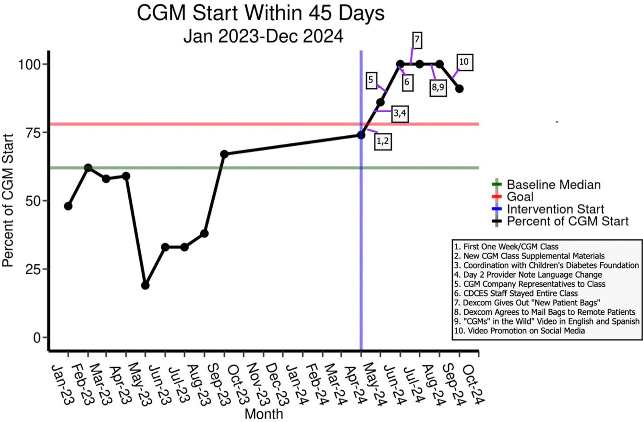
RESULTS
Primary AIM:
Improve the use of CGM within 45 days of diagnosis for patients ages 2-21 diagnosed with T1D from 45% to 78% from April 1, 2024 to October 1, 2024
Goal: 78%
Results: 91% (p<0.001)
Category | Baseline Mean | Implementation Mean | Risk Ratio (95%)
CGM Yes | 91 (45.05%) | 99 (90.83%) | 2.02 (1.71, 2.37)
CGM No | 111 (54.95%) | 10 (9.17%) | .17 (.09, .31)

Slide 33
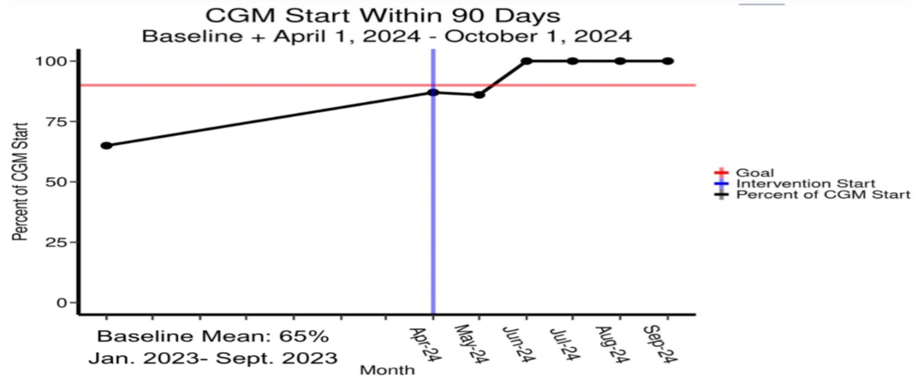
RESULTS CONT’D
Secondary AIM:
Improve use of CGM within 90 days of diagnosis for patients ages 2-21 diagnosed with T1D from 65% to 90% from April 1, 2024 to October 1, 2024
Goal: 90%
Results: 95% (p<0.001)
Category | Baseline Mean | Implementation Mean | Risk Ratio (95%)
CGM Yes | 132 (65.35%) | 103 (94.5%) | 1.45 (1.3, 1.61)
CGM No | 70 (34.65%) | 6 (5.5%) | .16 (.07, .35)

Slide 34
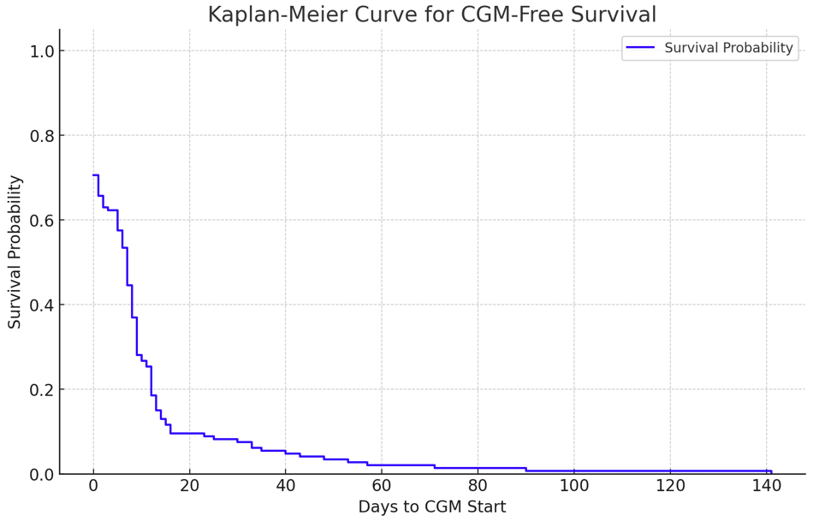
KAPLAN-MEIER CURVE

Slide 35
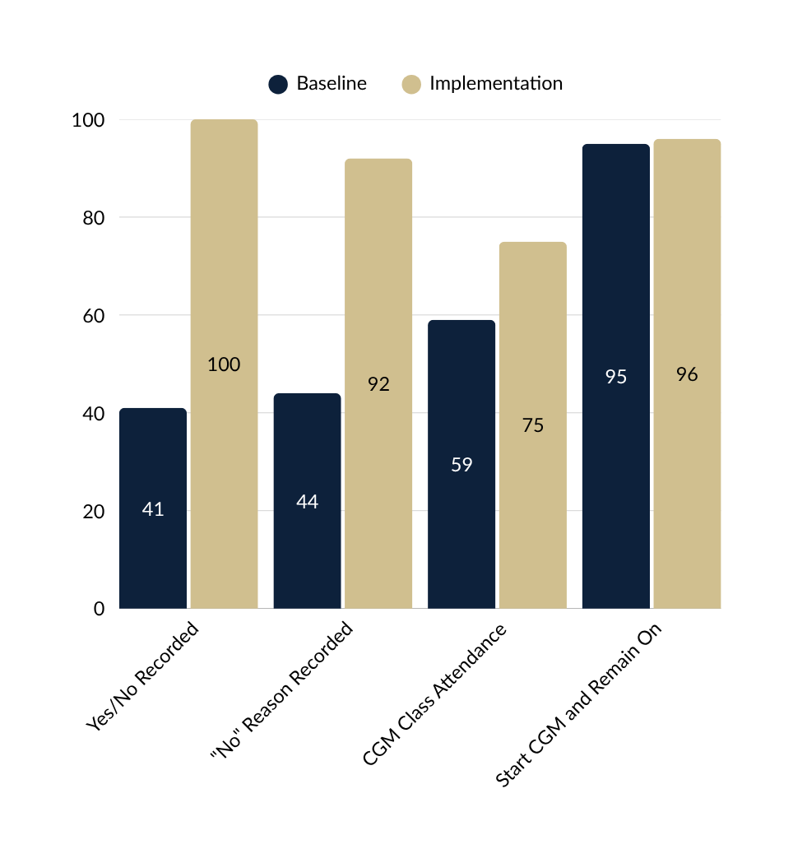
PROCESS MEASURES
Indicates Goal
  Improved recording of CGM use in EHR
  Added drop down to encourage providers to report reason for non-use
  More patients attended CGM class
  Patients who started CGM generally remained on it at subsequent visits
100%
100%
98%
90%
%
%
%
%
%
%
%
%

Slide 36
RESULTS CONT’D
CGM Class Length
Balancing Measure
No pre-data, only CDCES insight; thus, no analysis
Class pre-implementation: 30-45 minutes long
Goal: 75% of classes will not exceed 45 minutes
Result: Did not meet goal; 49% of classes exceeded 45 min
Staff Satisfaction Survey Results
Likert Scale 1-5 | PRE-TEST Previous Protocols on Workload | PRE-TEST Previous Protocols on Best Practice | POST-TEST New Protocols on Workload | POST-TEST New Protocols on Best Practice
1: Very Dissastisfied | 0 | 0 | 0 | 0
2: Dissatisfied | 3 | 5 | 0 | 1
3: Neutral | 4 | 7 | 3 | 0
4: Satisfied | 7 | 8 | 7 | 7
5: Very Satisfied | 5 | 0 | 9 | 11
Staff Satisfaction Survey
Balancing Measure
Goal: 80% “4” or higher
Met: 84%
Best practice satisfaction: 95%

Slide 37
CONCLUSIONS
Implementation of a protocol at a pediatric T1D diabetes clinic resulted in increased rate of CGM Initiation
Primary AIM: CGM initiation within 45 days of diagnosis
Goal: 78%
Results: 91% (p<0.001)
Secondary AIM: CGM initiation within 90 days of diagnosis
Goal: 90%
Results: 95% (p<0.001)
Process Measures: Improved
Balancing Measures: Improved
  CGM “yes/no”, reason for “no” consistently documented
  Class time slightly longer than goal
  Staff satisfaction improved
Challenges
  Cost remains a barrier for some patients
  Additional personnel assisting with CGM class
Future Directions
  Improve AID adoption

Slide 39

The Next Chapter: Evolving Our T1D Exchange Quality Improvement Portal
November 2025

Slide 40








Our Data Benchmarking Journey
V1.0 of the portal and basic run charts available
Additional features added to the library tab
Health equity filters added to reports
T1DX-QI Collaborative formed
V2.0 launches with a dashboard, comparison and reports tab
Continuous efforts to de-bug and improve data quality
Improve Tab launched with the ability to display PDSAs
Data sharing began via SmartSheet
2016
2017
2018-2019
2020-2021
2022
2023
2024
2025

Slide 41
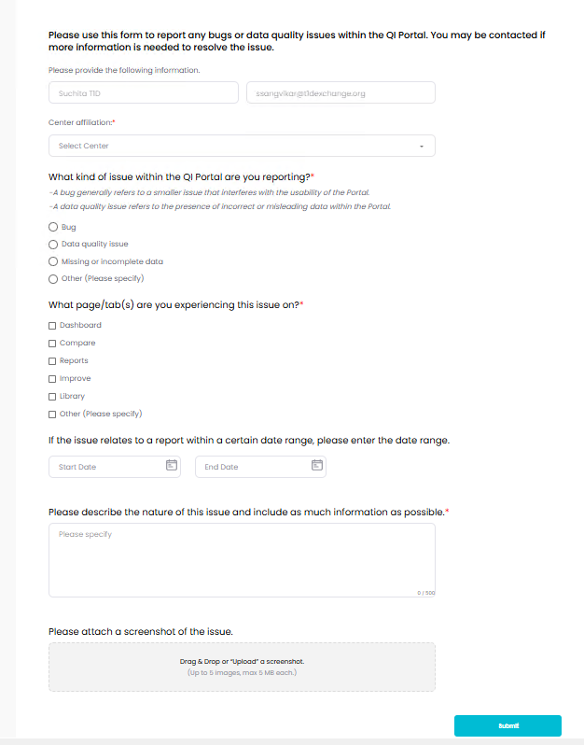
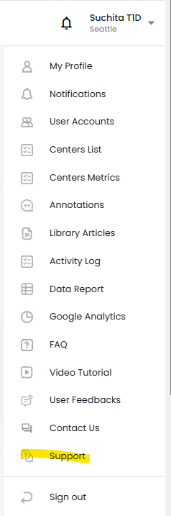
Recent QI Portal Updates
“Support” button provides an opportunity for users to report any bugs or data quality concerns

Slide 42
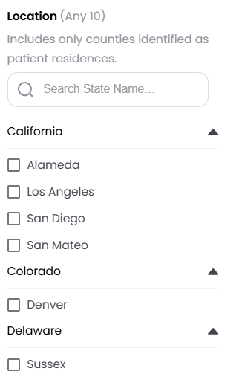
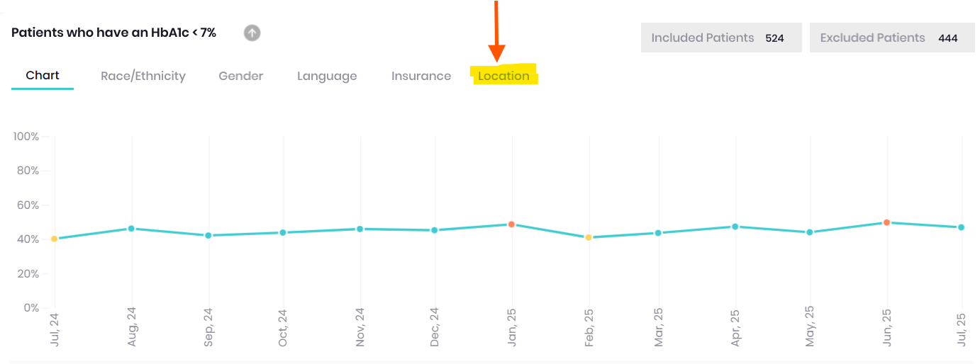
New Feature: Location Filter
Click “Location” on the reports tab where other health equity filters are located. You can select up to ten counties to compare at a time

Slide 43

Other Changes in progress (we heard you!)
Median HbA1c to be added to the dashboard
Changes on how centers will be compared
  Peds only compared against other peds centers
  Adults only compared against other adult centers
Insights Tab to show high-level aggregated measures
T2D dashboard

Slide 44
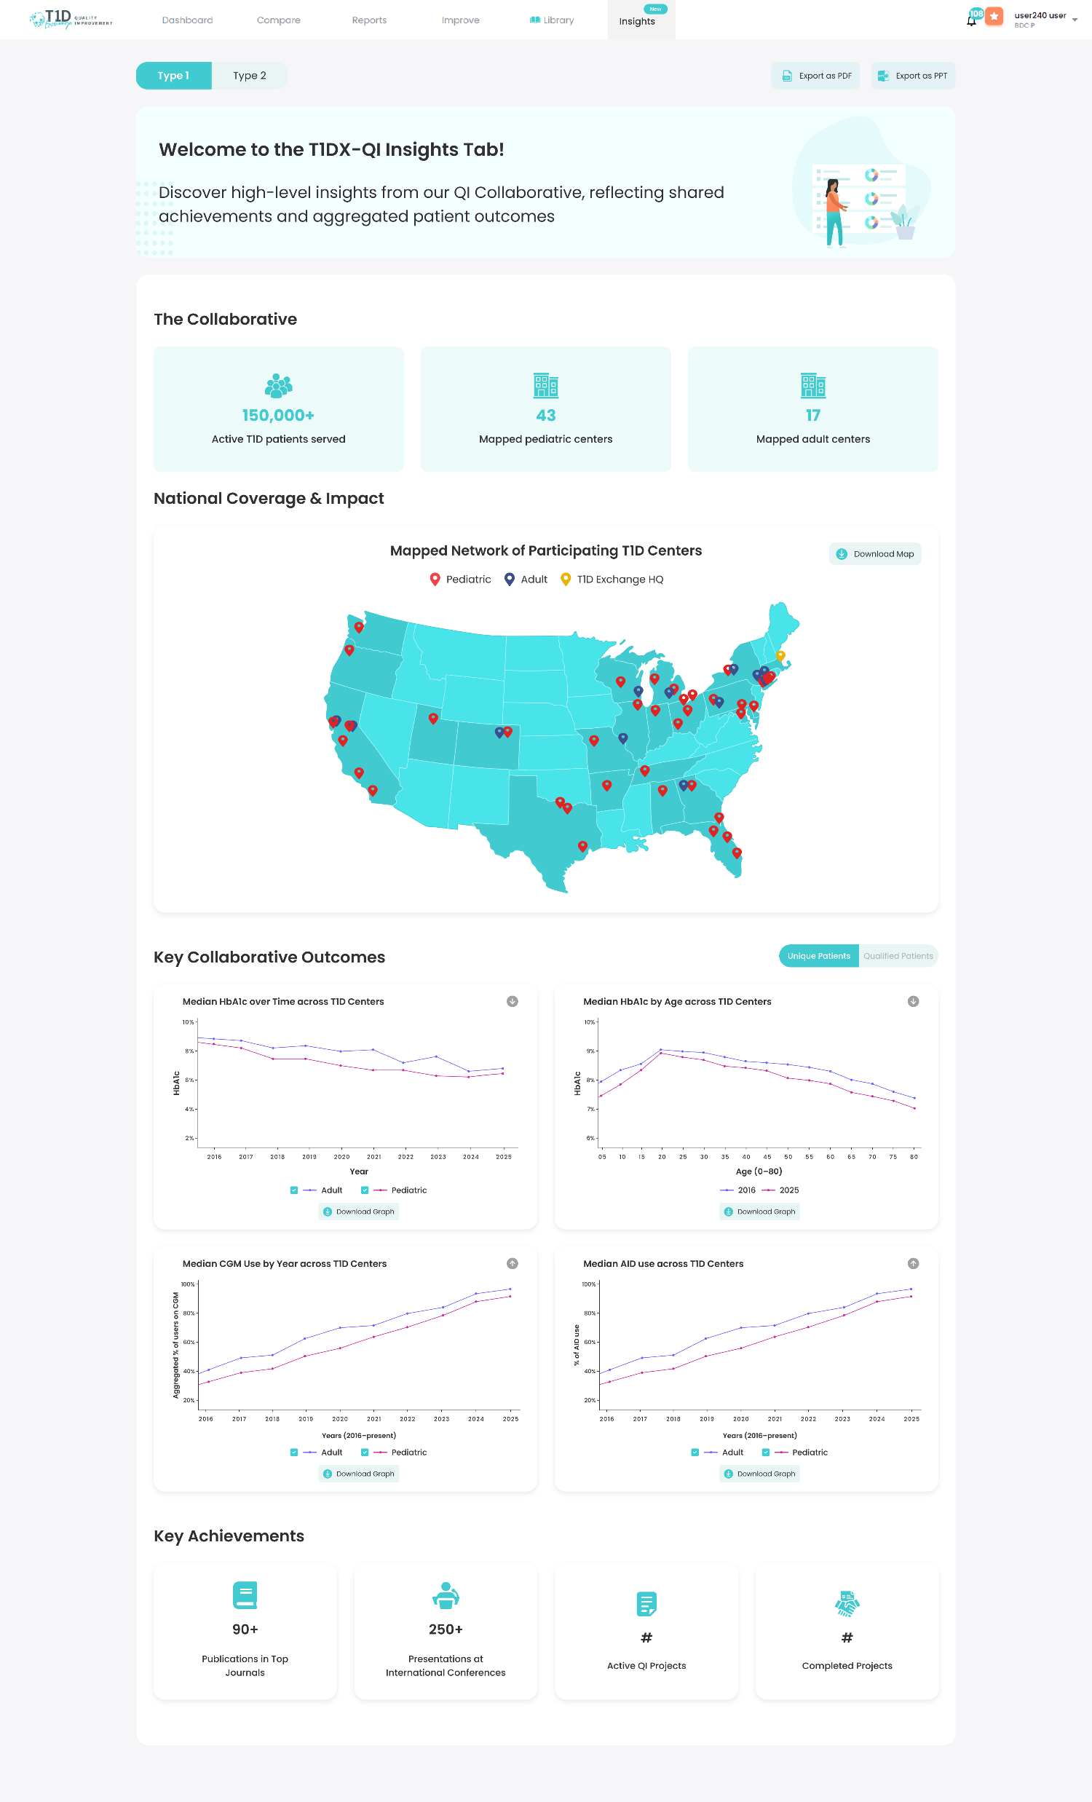

Insights Tab

Slide 45
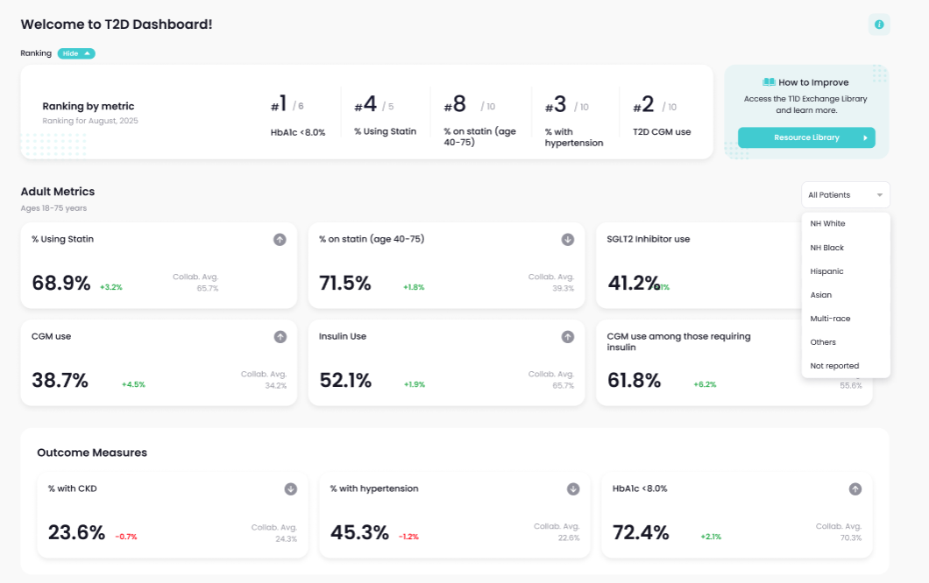
T2D Dashboard: Coming in 2026

Slide 46

Feedback via the QI Newsletter
Suggestion | Implemented | In Progress
Zip code filters, access to food, etc.
Customizable report, ready to print
PDSA cycles directly in the portal
More SDOH data
Glycemic metrics beyond A1c (more CGM metrics) (+)
Pediatric and adult T2D data (+)
More information about excluded patients
Better exports to PPT
Transition metric data, screening for presymptomatic T1Ds
Statin use and GLP-1s (+)
Accurate DKA metric data
7
suggestions implemented
4 suggestions currently being developed

Slide 47
Additional suggestions under consideration
Suggestion | May consider in the future | Not feasible currently
Customization of graphs with ability to edit axes
Description of how each center is collecting each metric (patient-reported, provider-reported, prescription data)
A “whole T1D Population Report” over a year
New onset T1D data (esp if they were in DKA)
Pull data from the EMR more broadly
Overlay PDSAs with data graphs/reports
Staffing ratio data in the portal
Expanded patient section in the portal library (with resources vetted by PWDs) (+)
Editable versions of the handouts, flyers, forms, tip sheets (+)
Pull in data from other hospitals to identify high-risk DKA patients
“Highlight reel” curating data from the past year and showing growth (+)
Notifications of significant pop health changes
Aggregate measures broken down by race/ethnicity

Slide 48


Help us prioritize for 2026
Join at menti.com

Slide 49
acabrera@t1dexchange.org

Slide 50

Section Header Here
Subtitle Here
A Review of the T1DX-QI 2025 Annual Survey Results
Whitley Ballroom
4:00 – 4:20pm

