Slide 1

Screening and Early Detection of Diabetes
Moderated by Alex Tuttle, MD, MEd

Slide 2


Single-Center Experience: Implementation of Screening and Staging of Type 1 Diabetes
Abha Choudhary MD, Christina Aref, PA-C, Katie Hamilton RN, BSN, Preethy Varghese MSN, APRN, CPNP-PC, CDCES, Don Buckingham Sr. MBOE, CPHQ, Leah Nguyen, MSN, APRN, CPNP-AC

Slide 3


UTSW/Children’s Medical Center(Pediatrics)
Faculty: 16.65 FTE
Fellows: 3
APP: 8.1 FTE
CDCES: 17.5 FTE
RD: 1.96 FTE
SW: 5 FTE
Psychology: 2 FTE
Total number of T1D : 1957
Non- commercially insured : 43%
CGM users: 82%
Pump users: 59%
New onset admissions/year: ~ 250

Slide 4
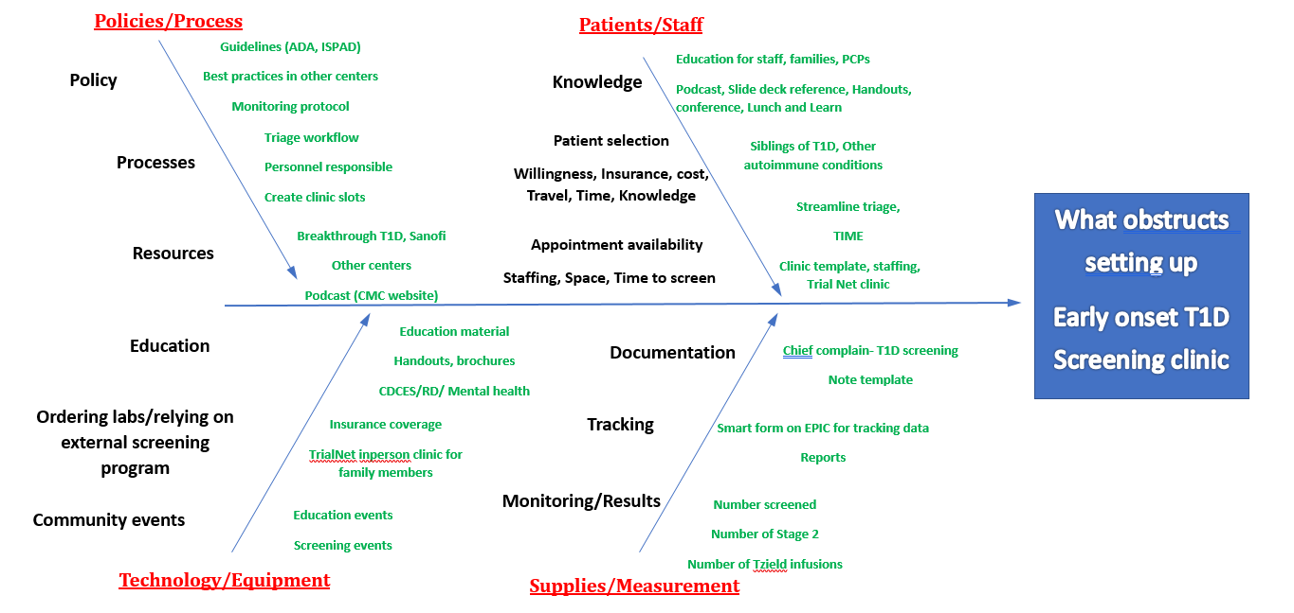
Fishbone Diagram

Slide 5
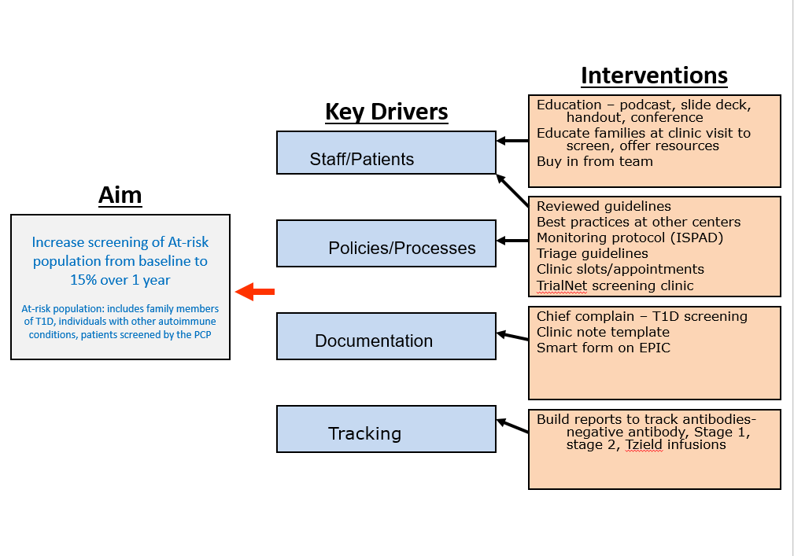
Key Driver Diagram

Slide 7
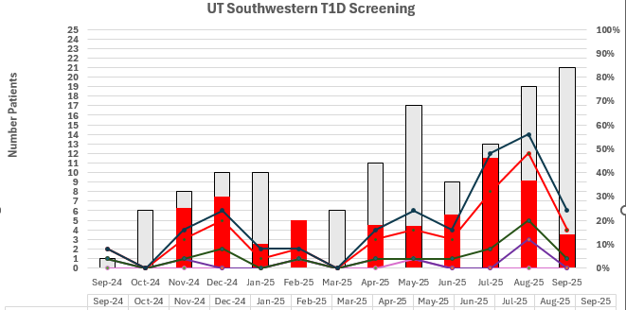
FUTURE
Breakthrough T1D event 11/14/2025
Grand rounds 1/2026
Screening summit 3/2026 (Dallas)
Educate PCPs- targeted education to screen AA
Education curriculum for stage 1 &2 (RD, CDCES)
Psychology for presymptomatic T1D (screening tools)
Increase Infusion capacity at Plano/Revenue
Oct 2025
Trial Net
in-person screening -research coordinators
4th Tue AM
Plano
Trial Net flyer-
weekly newsletter
Education of Primary care at Children’s
GI to screen Celiac patient
ADA/ISPAD
guidelines reviewed
Education slides created and shared with team
Started screening clinic in Dallas
2 sessions per month (8 slots)- PA (CA)
Formed a team of MD, PA, APP, CDCES, ASR
Separate Triage process
Visit note template developed
EPIC smartform revision started so data/
metrics can be tracked
Screening flyers for PCP (Preethy)
Education for CHMG PCP's (Preethy)
Trial Net
in-person screening -research coordinator
4th Tue PM
Dallas
Trial Net screening Flyer approved
Screening Podcast for PCPs LIVE
Screening clinic start at Plano (Leah Nguyen)
Trial Net Flyer- clinic, binder
EPIC smart form revision LIVE
One page screening Fact sheet for PCPs

Slide 8
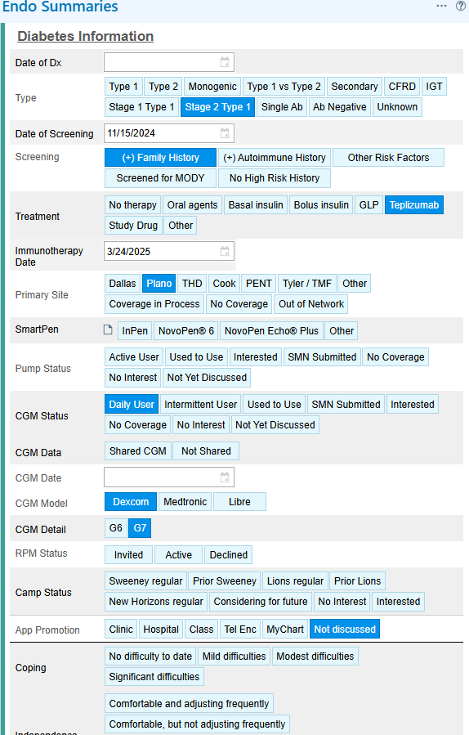
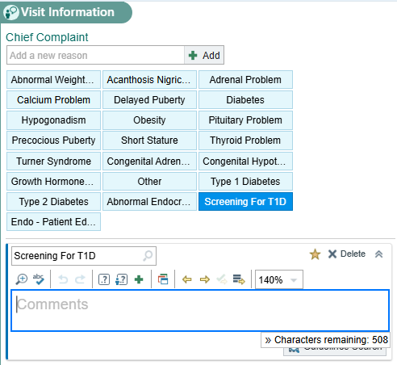

Slide 9
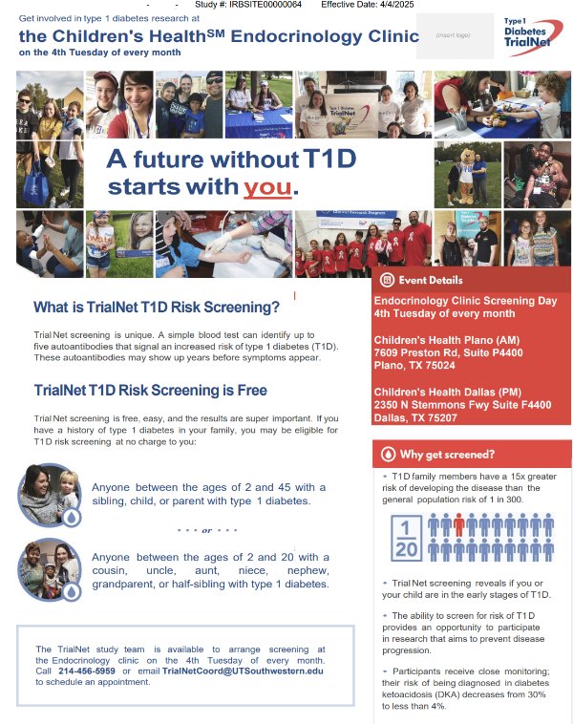
Trial Net in person screening clinic Flyer

Slide 10
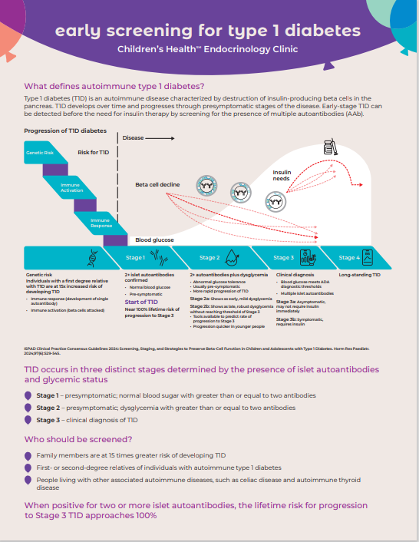
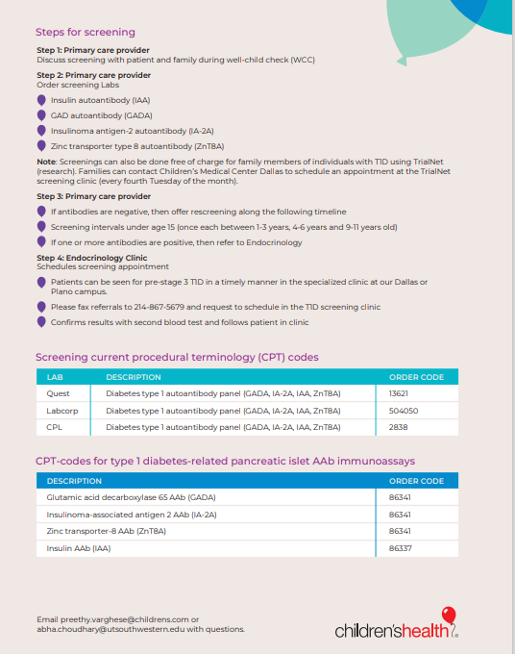
Fact sheet for the PCPs

Slide 11
Tzield experience
Demographics | Baseline labs | Date of Infusion | Side effects | Follow up
11 y M (2/24/2012) NHW;CIGNA +Family history Trial Net | A1C:4.9% OGTT: 2H: 145 mg/dl | 9/25/2023- 10/8/2023 (Midline) | Fatigue Rash(day#5) Low ALC (#5)-0.43 Improved day # 8 | 2/5/2024- A1C 5.4% 2/2025: A1C: OGTT/CGM Sees Endo in Austin
15 y M (6/13/2010) Asian; Medicaid +Family history Trial Net | A1C 6% OGTT: FBG: 107 mg/dl 2H: 125 mg/dl | 2/1/2024-2/14/2024 (Midline) | Fatigue Rash (day#5) Low ALC (#5)- 0.56 Improved day # 5 | 12/6/2024: A1C 6.7% (Stage 3) 3/25/2025: A1C: 6.3 %
16 y F (10/25/2008) NHW; CIGNA Teddy Study | A1C: 5.8% OGTT: FBG: 118 mg/dl CGM: TA140: 17% | 3/24/2025-4/6/2025 (Midline) | Rash (Day#9) Low ALC (day#8)- 0.58 Improved day # 14 Hyperglycemia #day 11 | 7/2025: A1C 5%, TIR: 96%
16 y M (11/21/2008) NHW; BCBS Screened by PCP (No family history) | A1C 6%; OGTT(5/9) FBG:105 mg/dl 2H: 267 mg/dl–stage3 CGM started 5/21: 81 (F); 2H(160) | 6/9/2025- 6/22/2025 (Midline) | Low ALC: (day#5)- 0.5 Improved day#8 Rash (day#5)->worsened and then improved by #12 | 8/28/2025: A1C 5.4% CGM TIR: 95% PHQ9= 2 CGM- intermittently OGTT in 6 months
17 y M(1/21/2008) NHW, UHC Screened by PCP(no family history) | A1C 6.5% OGTT: FBG: 110 mg/dl 2H: 122mg/dl CGM: | 10/7/2025- 10/20/2025 | Low ALC: (day#5): 0.64 Improved day 14 Hyperglycemia day #6 Rash day#8

Slide 13
Improving Screening Rates of Patients at Risk for Type 1 Diabetes in an Academic Institution with Multiple Providers and Clinic Sites
Laura Levin DO
Ann & Robert H. Lurie Children’s Hospital of Chicago

Slide 14
Background
T1D is often first diagnosed in patients presenting with life-threatening DKA.
Individuals with a family history of type 1 diabetes or a personal history of autoimmune disease are known to have an increased risk of developing T1D compared to the general population.
Islet autoantibodies can be detected before abnormal blood sugars or symptoms appear, allowing for earlier monitoring and reduced risk of DKA.
Teplizumab can delay the onset of clinical disease by a mean of 24 months in patients with 2+ autoantibodies and dysglycemia.
Broadening screening for T1D can reduce the number of patients presenting with DKA and identify candidates for treatment.
This project aims to increase the rate of patients screened for T1D by 15% from baseline over 18 months (06/2024 – 12/2025).

Slide 15
Fishbone Diagram
Cause
Effect
Education
Workflow
Smart phrase
Do 20-minute education to providers
Provider knowledge of early stages of T1D
1X/month
Dedicated clinic
Chart office visit
Ownership? Providers vs. Staff
Dedicated point person
Family knowledge of screening
Give info in AVS
Family knowledge of Teplizumab
Telemedicine
Double booking
Provide handout
In-person
Delay in diagnosis for Stage 3 T1D
Who registers pt?
Pt registration in Epic
Patient list in epic
Tracking pts overtime
Discuss with every family
Arranging OGTT
Referrals
ASK vs. Enable
Screening kits availability
Diagnosis codes
Insurance coverage for screening
CGM
Insurance coverage for monitoring
Equipment
Equity

Slide 16
Driver Diagram
2^{O} Drivers
Dedicated clinic
Interventions
Dedicated point person
Dedicated Resources (clinic, point person, etc.)
Double booking
(telemedicine and in-person)
Key Drivers
Create Registry
Increase by at least 15% (from baseline) the proportion of people screened for T1D in 18 months (June 2024-December 2025)
Pt registration in Epic
Workflow
Tracking pts overtime
Dedicated Screening Appt Slots (telemedicine and in-person)
Equity
Referrals
Education for PCPs
Insurance coverage for screening
Equipment
Insurance coverage for monitoring
ASK, TrialNet, Enable and Lurie Lab
Arranging OGTT
Education
Education for Families
Screening kits availability
Provider knowledge of early stages of T1D
Education and Protocol for Endocrine Division
Provider knowledge of screening
Family knowledge of Teplizumab

Slide 17
Methods
July 2024 - July 2025
13 Diabetes Providers
(out of 28 Providers)
8 Clinic Sites
Interventions included:
  Education given to providers regarding the rationale and process for screening during our monthly division meeting
  Prompts created within our diabetes clinic flowsheet in the EMR
  Multiple screening options offered, including lab draw and enable kits
  Dedicated screening clinic appointments offered to families to pair with their current child with type 1 diabetes
  Informational posters displayed in clinic rooms to raise patient awareness
Notes:
Multiple interventions were implemented between July 2024-July 2025 within our large academic medical center with 13 providers working at 7 clinic sites
Education was given to providers regarding the rationale and process for screening during our monthly division meeting
Prompts were created within our diabetes clinic flowsheet in the EMR
Multiple screening options were offered, including lab draw and enable kits
Dedicated screening clinic appointments were offered to families to pair with their current child with type 1 diabetes
Informational posters were displayed in clinic rooms to raise patient awareness

Slide 18
Barriers
Provider Barriers
Provider buy-in and education about screening
  Several providers are not diabetes providers and not familiar with the screening recommendations
  Comfort level of providers to offer screening
  Provider concerns about time taken away from the visit
Patient Barriers
Families are often weary of screening their other children and may prefer not to know the results.
Additional appointments for siblings, including lab draws and/or Tzield infusions, can create significant financial burden.
Many families are not familiar with Tzield, its function, or how it can help prevent the onset of disease.
Families with children under 8 years old may opt not to screen due to Tzield not being covered and the lack of alternative medications available on the market at this time.

Slide 19
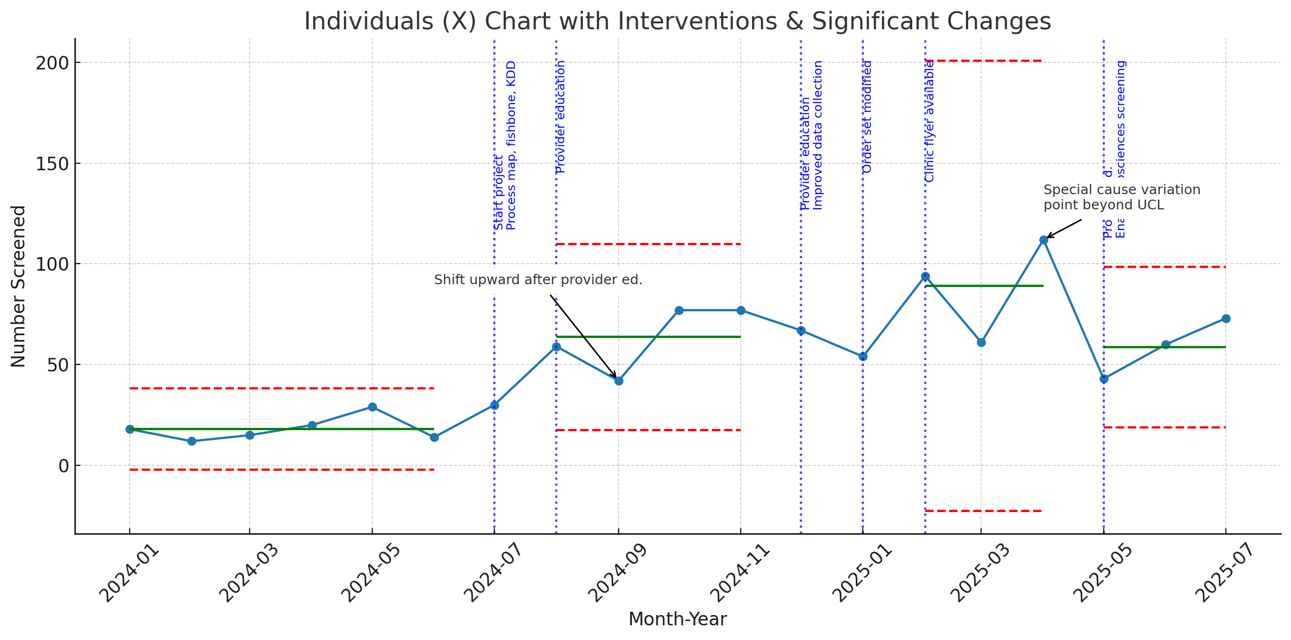
Results
A control chart with screening data from January 2024-July 2025 showed an upward shift in mean screening rates after initial intervention with sustained higher rates over time

Slide 20
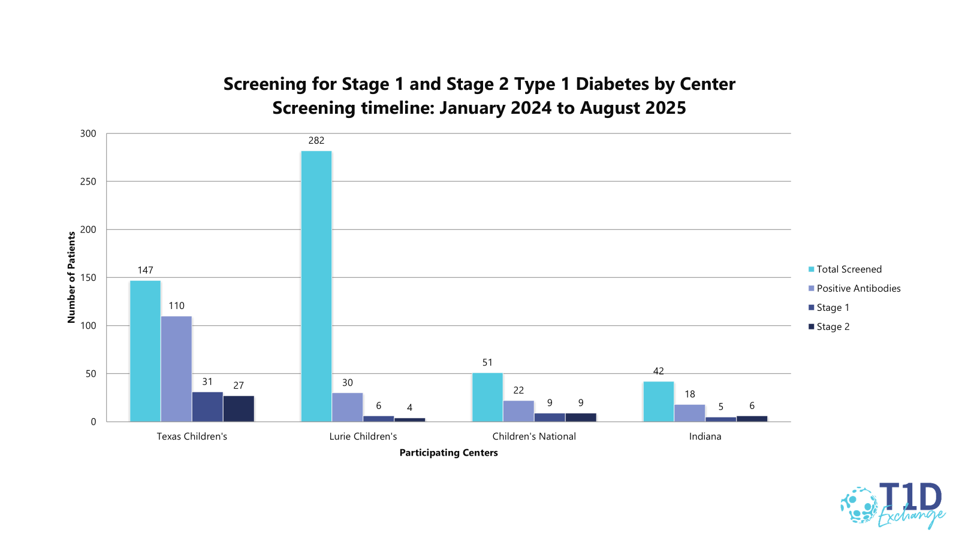

Slide 21
Key Takeaways
Efforts to streamline screening processes for providers through order sets, provider education and integrating it in the flowsheet increased screening rates.
Standardized order sets can be shared with community providers and other specialty clinics. These can serve as low effort high impact interventions to quickly increase screening rates at other clinic sites.
Variability in monthly screening rates is likely secondary to varying provider familiarity with screening guidelines and processes.
The impact of expanded screening on the rates of patients who receive early treatment for T1D is difficult to assess due to the low rates of autoantibody positivity in the screening population.
Increased screening rates are necessary to better assess the impact of expanded screening on treatment outcomes.
A multifaceted quality improvement approach targeting team engagement, workflow integration, patient education and accessible testing significantly improved T1D screening rates

Slide 22
Next Steps
Sharing teaching materials with community providers and other specialty clinics
Establishing visit type for screening and having a dedicated screening clinic with Nurse Practitioner
Sending a letter to eligible families regarding screenings and educational materials
Continued efforts to standardize screening, educate providers, and expand family outreach are essential to sustain and further enhance early detection of T1D

Slide 23
Acknowledgements:
  Lurie Children’s Endocrinology Department
    Guido Mora MD
    Mary McCauley MD
    Naomi Fogel MD
  Wendy Izzo MHA
  Type 1 diabetes families
  T1D Exchange

Slide 24
Thank You!
Questions?

Slide 26


Operationalizing Stage 1 and Stage 2 Type 1 Diabetes Screening: A Multicenter Quality Improvement Initiative
Author: Trevon Wright MHA1; Daniel Desalvo MD2; Alex Tuttle, MD, MEd3; Laura Levin, DO4; Shideh Majidi MD, MSCS5; Carla Demeterco-Berggren MD, PhD6; Laura Jacobsen, MD7; Emma Ospelt, MPH8; Nicole Rioles, MA1,9
Affiliations: 1)T1D Exchange; 2) Texas Children’s Hospital 3) Children’s National Hospital; 4)Ann & Robert H. Lurie Children’s Hospital of Chicago

Slide 27
Disclosure
None

Slide 28
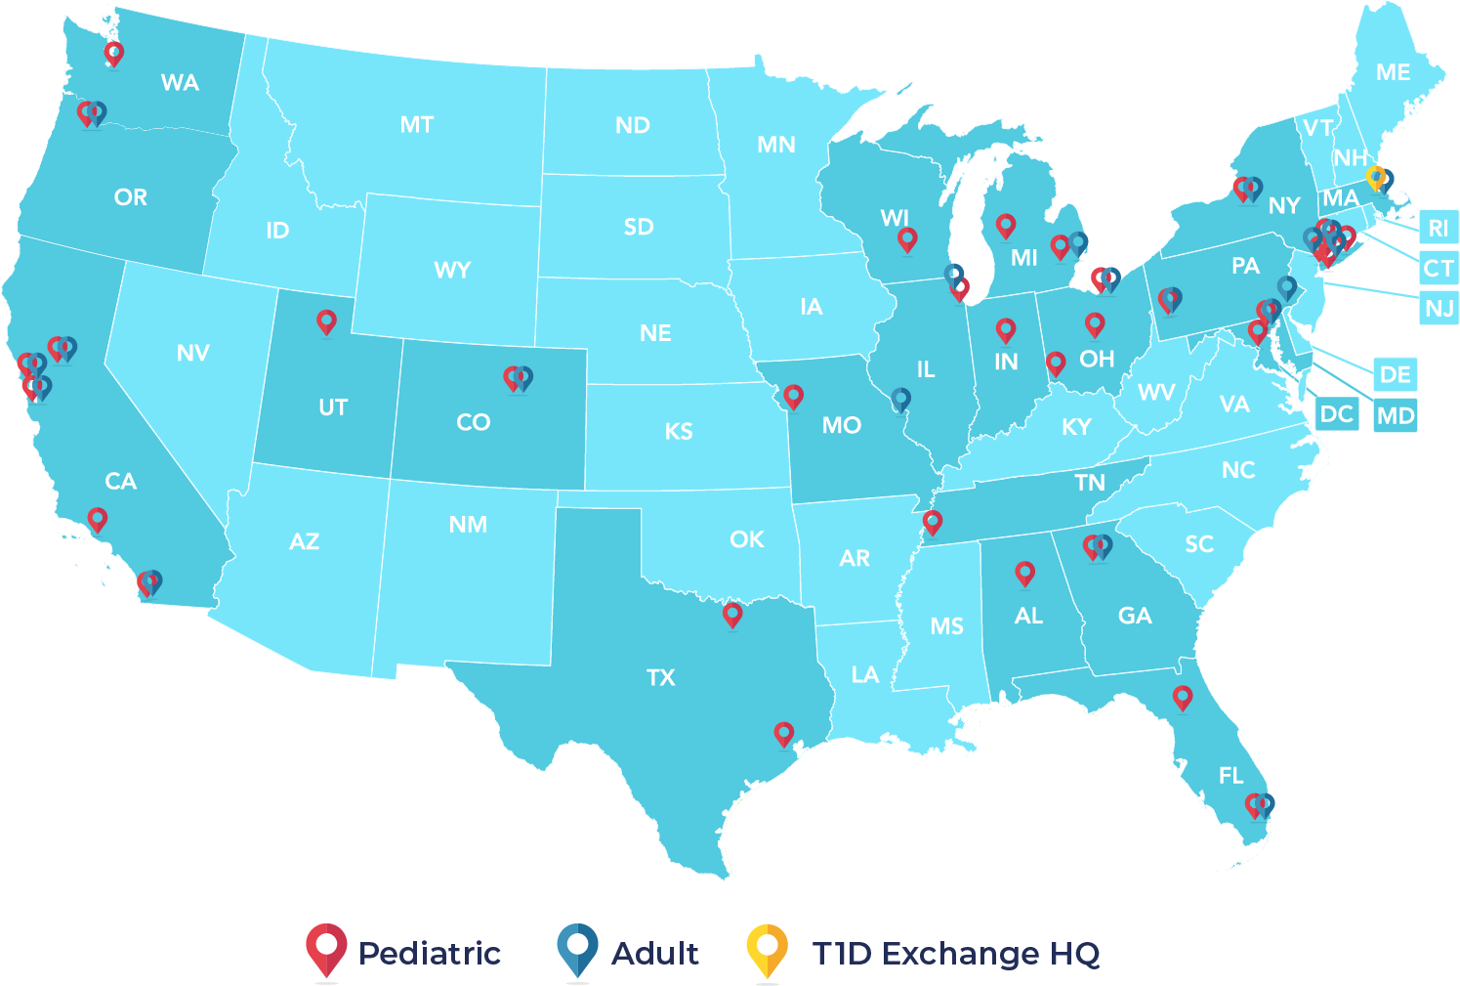
T1D Exchange Quality Improvement Collaborative (T1DX-QI)
The T1DThe T1D Exchange Quality Improvement Collaborative (T1DX-QI) brings together 63 centers across the United States that care for over 150,000 individuals with type 1 diabetes (1).
T1DX-QI members share data via the T1D Quality Improvement platform to track baselines and outcomes and measurably improve the lives of individuals with type 1 diabetes.

Slide 29
Background
Type 1 Diabetes (T1D) progresses through identifiable preclinical stages.
This initiative aimed to improve early detection of stage 1 and stage 2 T1D by increasing screening efforts and enhancing monitoring through educational coaching across endocrinology centers.
The primary goal was to operationalize early-stage T1D screening using a quality improvement framework. For monitoring, individuals were eligible because they had confirmed Stage 1 or Stage 2 T1D, while screening eligibility was based on risk factors (e.g., family history, program-specific criteria).

Slide 30
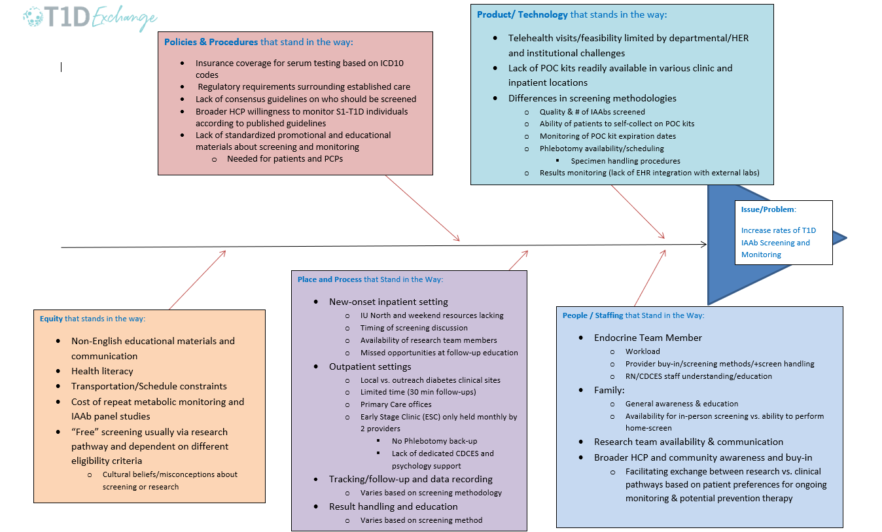
Fishbone Diagram- Autoantibody Screening
Contributing Factors

Slide 31
Methodology
Participating centers developed at least three strategies for screening implementation best practice strategies for incorporating T1D screening into the clinical center including:
    Patient engagement approaches
    Workflow changes
    Overcoming systemic barriers and processes
    Documentation of screening and stage 1 and stage 2 diagnosis in the EMR
Specific aims included a 15% increase in screening and a 30% increase in monitoring individuals for progression to stage 3. A secondary objective was to collect feedback from healthcare providers and support staff.
Four multidisciplinary focus groups (45–60 minutes) were conducted with participating endocrinology centers, Discussing implementation experiences, workflow changes, and barriers. Centers ranged from new program developers to those with existing infrastructures.

Slide 32
Overview of High-Level Findings
Some centers were building a completely new screening program from the ground up, while others had a pre-existing program to build off of.
Administrative and scheduling support varies by center and is crucial to the continued success of screening and increasing capacity.
Having dedicated clinic time for screening is a facilitator for success.
Increasing provider awareness and ensuring that screening discussions are happening outside of the project team is necessary.
The majority of centers are documenting early stages 1 and 2 of diabetes. For the center that is not yet, they are documenting if the provider discussed screening with the family or patient, as are others.
Barriers included inconsistent provider involvement, documentation practices, EMR limitations, and Teplizumab access challenges.

Slide 33
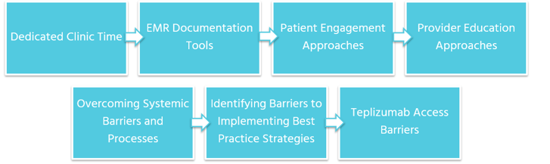
Results
Centers reported that dedicated clinic time, expanded staffing (e.g., phlebotomists, CDCES), EMR documentation tools, and patient/provider education significantly supported screening implementation. Patient engagement materials, provider-facing dot phrases, and new visit types were also developed.

Slide 34
Conclusion
QI Integrating early-stage T1D screening into routine care is achievable through structured QI support.
Clinical teams identified several best practice strategies and systemic obstacles, offering a foundation for broader implementation.
Centers developed clear guidelines to determine who exactly will be screened including specific criteria, who they will see in the clinic, a referral system, and tracking tools
Additional staff added including a dedicated phlebotomist and more CDCES and psychology support

Slide 35
References
Alonso, T, Corathers, S, Shah, A, Clements, M, Kamboj, M, Sonabend, R, DeSalvo, D, Mehta, S, Cabrera, A, Rioles, N, Ohmer, A, Mehta, R, Lee, J. Establishment of the T1D Exchange Quality Improvement Collaborative (T1DX-QI) https://doi.org/10.2337/cd19-0032.
Ospelt E, Hardison H, Rioles N, Noor N, Weinstock RS, Cossen K, Mathias P, Smego A, Mathioudakis N, Ebekozien O; T1D Exchange Quality Improvement Collaborative. Understanding Providers' Readiness and Attitudes Toward Autoantibody Screening: A Mixed-Methods Study. Clin Diabetes. 2024 Winter;42(1):17-26. doi: 10.2337/cd23-0057. Epub 2023 Oct 12. PMID: 38230325; PMCID: PMC10788649.
CAITLIN S. KELLY, KATHERINE S.M. CHAPMAN, JESSICA L. DUNNE, EMILEE M. CORNELIUS, MEGAN PETER, ELLEN PAGAN INDOE, WENDY WOLF; 634-P: Autoantibody Screening Attitudes and Experiences in People Affected by Type 1 Diabetes. Diabetes 20 June 2023; 72 (Supplement_1): 634–P. https://doi.org/10.2337/db23-634-P

Slide 37
Implementing an Early Screening Workflow for Stage 1 and Stage 2 Type 1 Diabetes in a Pediatric Endocrinology Clinic
November 11, 2025|Lydia Holly, BSN, RN, Clinical Care Coordinator
Fran Cogen, MD; Jody Grundman, MD; Letitia Gallant, DNP; Shideh Majidi, MD

Slide 38
Objectives
Review the importance of early screening and staging for type 1 diabetes
Outline the implementation of a two-pronged approach centered on education and workflow coordination
Review key outcomes from the first year of screening and early treatment discussions
Identify next steps to strengthen and sustain early screening efforts within clinical practice

Slide 39

Why Early Screening Matters

Slide 40
Problem & Baseline State
Before June 2024:
No standardized process for identifying eligible patients
Education and ordering varied by provider
Families were unaware screening existed
Result: Eligible patients were missed, and follow-up was inconsistent

Slide 41
Project Aim
Establish a systematic antibody screening process to identify and monitor patients at risk for Type 1 diabetes.

Slide 42
SMART AIM
KEY DRIVERS
INTERVENTIONS
Patient & Family Awareness
Host cross-disciplinary education sessions and share regular updates
Establish a systematic antibody screening process to identify and monitor patients at risk for Type 1 diabetes.
Develop and embed patient education resources
Provider & Staff Knowledge & Engagement
Expand outreach: specialty clinics and community settings
Streamlined Workflows & Policies
Build coordinated screening workflows: leverage EMR tools, standardized follow-up steps
Integrative EMR Systems & Data Infrastructure
Create policy outlining eligibility, follow-up steps, and team roles
In Progress
Finished
Paused
Not Started

Slide 43
SMART AIM
KEY DRIVERS
INTERVENTIONS
Patient & Family Awareness
Host cross-disciplinary education sessions and share regular updates
Establish a systematic antibody screening process to identify and monitor patients at risk for Type 1 diabetes.
Develop and embed patient education resources
Provider & Staff Knowledge & Engagement
Expand outreach: specialty clinics and community settings
Streamlined Workflows & Policies
Build coordinated screening workflows: leverage EMR tools, standardized follow-up steps
Integrative EMR Systems & Data Infrastructure
Create policy outlining eligibility, follow-up steps, and team roles
In Progress
Finished
Paused
Not Started

Slide 44
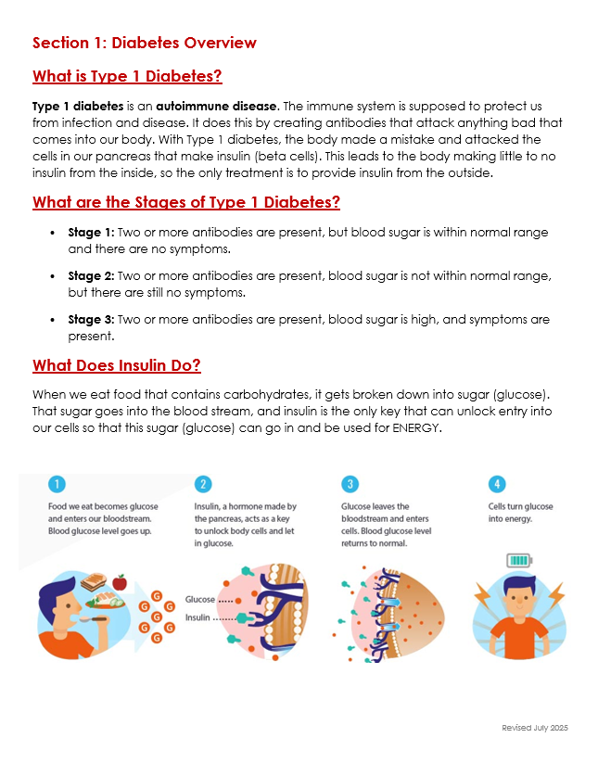
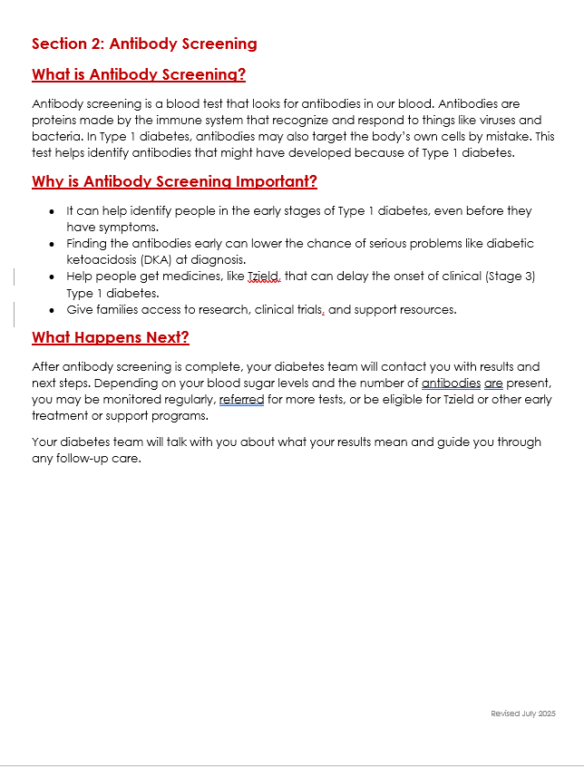
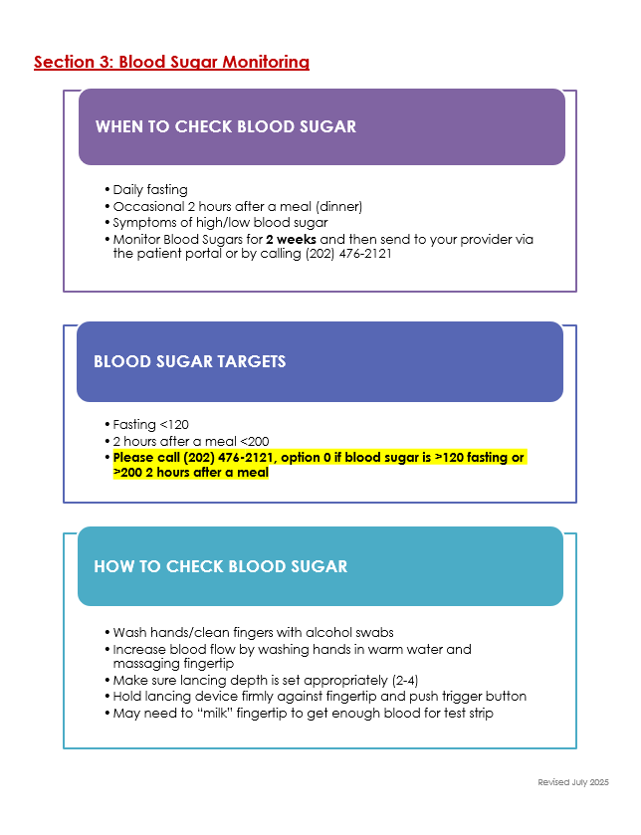
Education & Workflow Coordination
Education
Developed clear, accessible materials explaining early-stage T1D and the purpose of antibody screening
Translated into Spanish & Amharic
Embedded resources into clinical touchpoints: new onset binder, triage area
Reinforced through CDCES and provider conversations

Slide 45


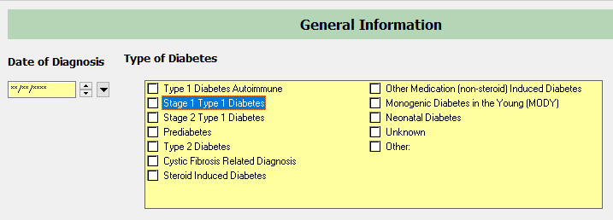
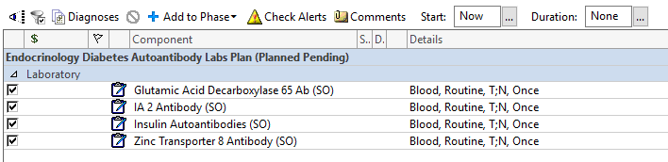
Education & Workflow Coordination
Workflow Coordination
Created structured process for ordering and tracking antibody screens
Built EMR-based order sets and tracking tools
Defined a clear pathway to follow-up on positive screens: staging, monitoring, and discussion of Tzield for eligible Stage 2 patients

Slide 46
Results
61 patients screened
33 patients antibody neg
28 patients
antibody pos
6 patients
at-risk, 1 ab+
10 patients Stage 1
11 patients Stage 2
1 patient Stage 3
9 patients Tzield eligible
5 patients received Tzield

Slide 47
Lessons Learned
Champions drive change
Patient-centered care is essential
Education is foundational
Equity requires intention
Small operational changes can drive a big impact
EMR-based workflows prevent missed opportunities
Notes:
Champions drive change. Identifying dedicated leads helped sustain momentum and accountability.
Patient-centered care is essential. Each family’s experience and readiness for screening is unique.
Education is foundational. Consistent, accessible information empowers both families and staff.
Equity requires intention. Tailoring education and communication helps reduce barriers to access.
Small changes create big impact. Streamlined processes improved efficiency and consistency.
EMR-based workflows reduce missed opportunities. Embedding steps into clinical documentation promotes follow-through.

Slide 48
Next Steps
Formalize the T1Delay clinic structure and referral process to ensure consistent scheduling and clear triage criteria.
Expand the multidisciplinary team by incorporating psychology and dietician (RD) support into T1Delay clinic visits
Continue expanding outreach to additional specialty clinics and community settings
Integrate data dashboards for automatic tracking

Slide 49
Thank You!

Slide 51

Section Header Here
Subtitle Here
Lunch
Perspectives from People with Diabetes
Whitley Ballroom
12:15 – 1:15pm

