Slide 1

Pediatric Type 2 Diabetes: Rising Incidence and Interventions
Moderated by Monica Bianco, MD

Slide 2
Reducing Wait Time in Pediatric Diabetes Clinic by Optimizing Access to Diabetes Device Data
Elizabeth A. Mann, MD
Rachel Fenske, PhD, RDN, CD, LDN, CDCES
Whitney Beaton, MSN, RN, ACCNS-P, CDCES
Courtney Schultz, BSN, RN

Slide 3
Diabetes clinic visits are complex with multidisciplinary care teams, comprehensive care, and complex data sources
Patient Reported Intake Form (PRIF)
New baseline average visit duration of 63 minutes
Notes:
We all provide pediatric diabetes services in a complex environment with many care team members, a highly coordinated approach to care helping patients and families navigate the many psychosocial and other complexities of daily chronic disease self-manmagement
At UW, our average visit duration was 74 minutes in 2022. you can see that there’s some variation between MD’s and NP’s. there was also some variation with longer visits when a learned (resident or student) was present and if the patient had a nutrition appointment at the same time.
Initial efforts focused on streamlining patient report outcome data capture, developing a patient intake form
Scheduled visits varied by provider – 30 or 45 min

Slide 4
Our patient experience comments highlighted dissatisfaction with visit length, highlighting downtime as a specific problem
”The appointments always take a solid 90 minutes and I feel like I have to repeat the info to 3 different people.”
“I wish (visits) didn’t take so long.”
“Sitting in the exam room while waiting for 30 minutes is uncomfortable.”
“Would like some improvement on making appt faster.”
“2 hour for a visit is a long time.”
“Very long wait times. 2 hours plus appointment.”
- Press Ganey Survey Comments that addressed efficiency or visit duration from 2024

Slide 5
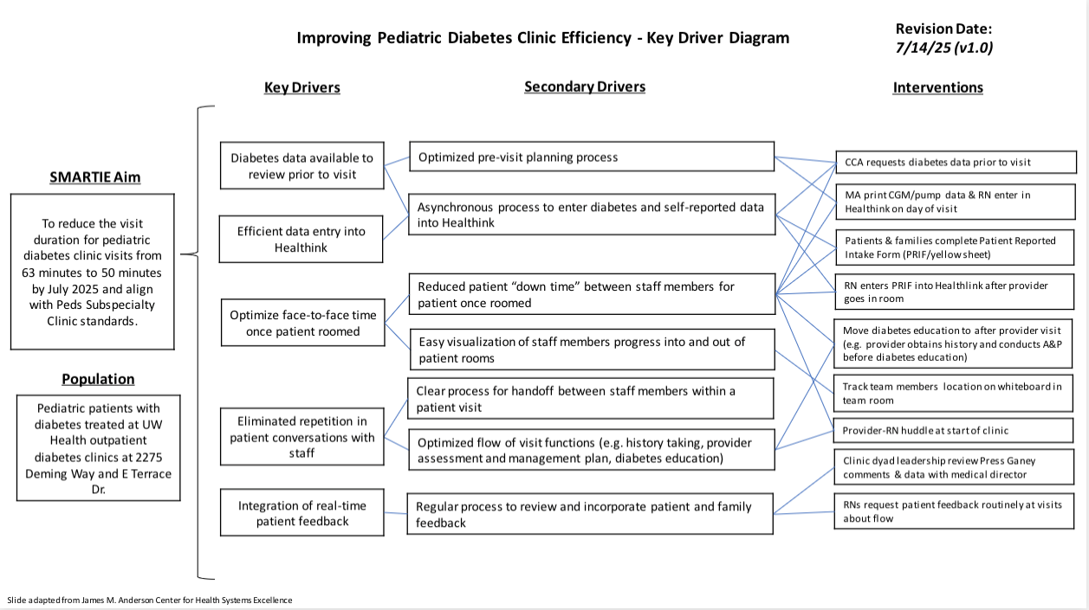
Key Driver Diagram: Improving Pediatric Diabetes Clinic Efficiency
PDSA 1
PDSA 2
PDSA 3
PDSA 4
Notes:
From ”Key Driver Diagram – Clinic Efficiency”

Slide 6

PDSA Cycle 1 & 2: Download cloud-based device data & enter in EHR 1-2 days prior to visit
Change concept
Methods
Lessons learned:
Removing bottleneck for diabetes device data entry at the beginning of clinic reduced wait time from “roomed and ready” to provider in room.
Seemingly obvious workflow was hard to gain support for initially because of team’s muscle memory
Automated device uploads to the Cloud allow this workflow to be so effective
Reduced MA “steps” moving around to print reports after patient roomed
Improve Work-flow
Find and remove bottlenecks
Do tasks in parallel
Move steps in the process close together
Scan for link to IHI’s Worksheet with Change Concepts from The Improvement Guide
Notes:
PDSA cycles were really built off Langley’s Improvement Guide and the Change concepts within. The IHI created a worksheet with these change concepts, and if you’re considering any improvement project, I’d encourage you to reference this and explore whether you can pull in some change ideas from different aspects

Slide 7
PDSA Cycle 3: Modify clinic flow
Old flow
New flow
Change concept
Methods
Lessons learned:
Changing provider behavior requires supportive leadership, open communication, transparency and constant feedback
Sometimes the simple solutions are the best
Focus on the service
Change the order of steps
Minimize handoffs
Reduce redundancy
MA rooms patient
RN obtains history, provides education
RD provides education, if due/scheduled
Provider develops plan
MA rooms patient
RN provides targeted diabetes education only if needs identified
RD provides education, if due/scheduled
Provider obtains history, & develops plan
Scan for link to IHI’s Worksheet with Change Concepts from The Improvement Guide
Notes:
Providers were often repeating same questions or education. Handoff of information from RN to provider always had to happen but handoff now from provider back to educator can be targeted and not comprehensive.

Slide 8
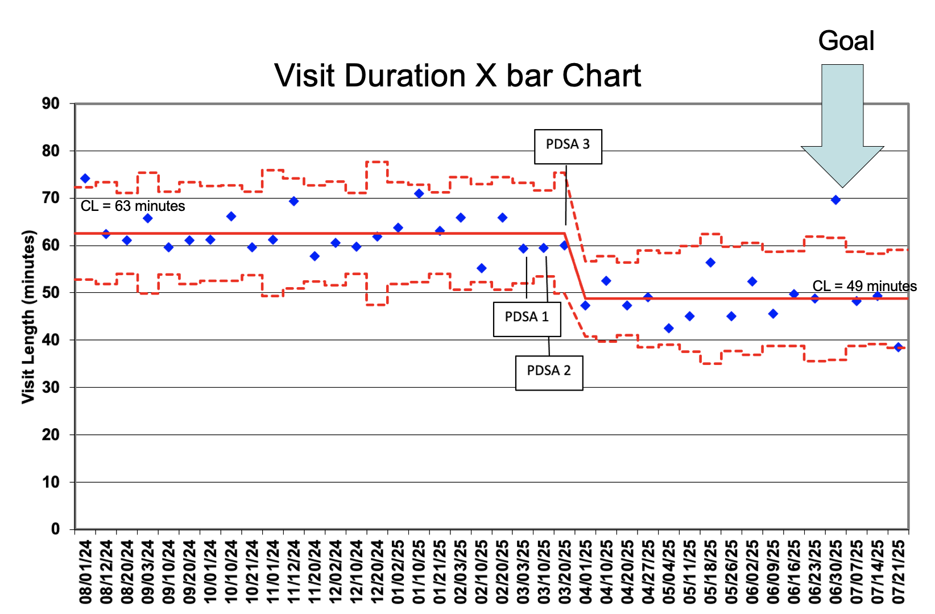
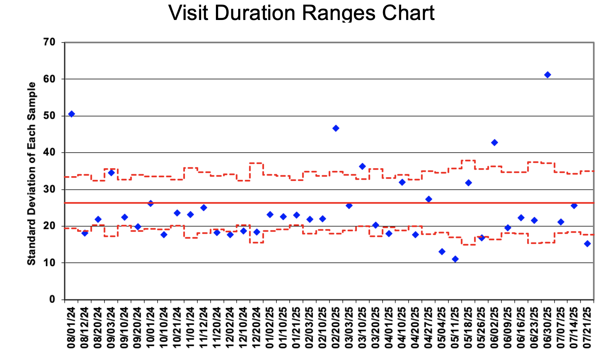
X bar S Chart of average visit duration per 2-week period for all pediatric diabetes clinic visits

Slide 9
PDSA 4: Incorporate patient and family feedback in workflow changes
Change concept
Methods
Lessons learned:
Patient experience comments are only a small sample, but collectively over time can tell a powerful story
Conversations with patients and families about clinic processes can strengthen provider-patient relationships
Enhance the customer relationship
Listen to the customer
Scan for link to IHI’s Worksheet with Change Concepts from The Improvement Guide
Notes:
PDSA cycles were really built off Langley’s Improvement Guide and the Change concepts within. The IHI created a worksheet with these change concepts, and if you’re considering any improvement project, I’d encourage you to reference this and explore whether you can pull in some change ideas from different aspects

Slide 10
Process measure demonstrates reduced down time in patient visits
Process Measures
Balancing Measures
Wait time between staff members decreased on average from 10 to 5 minutes
In 2025, no negative patient experience comments about visit duration or wait times
One comment indicated unintended consequence of missing a refill order – PDSA cycles incorporated patient feedback to correct

Slide 11
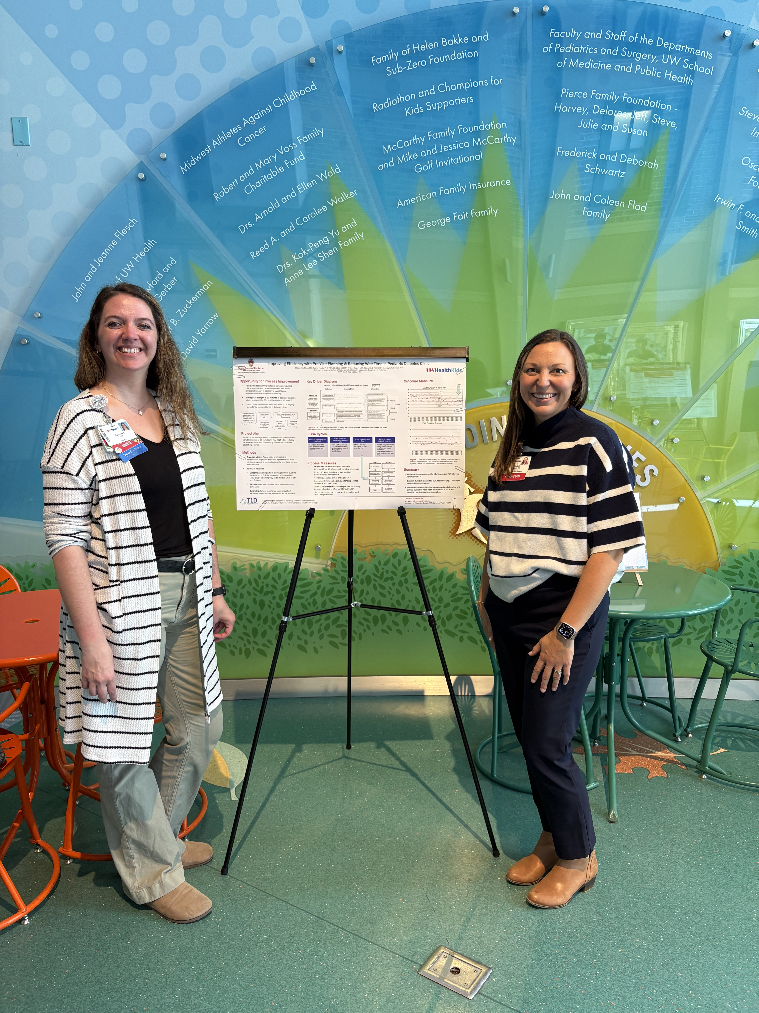
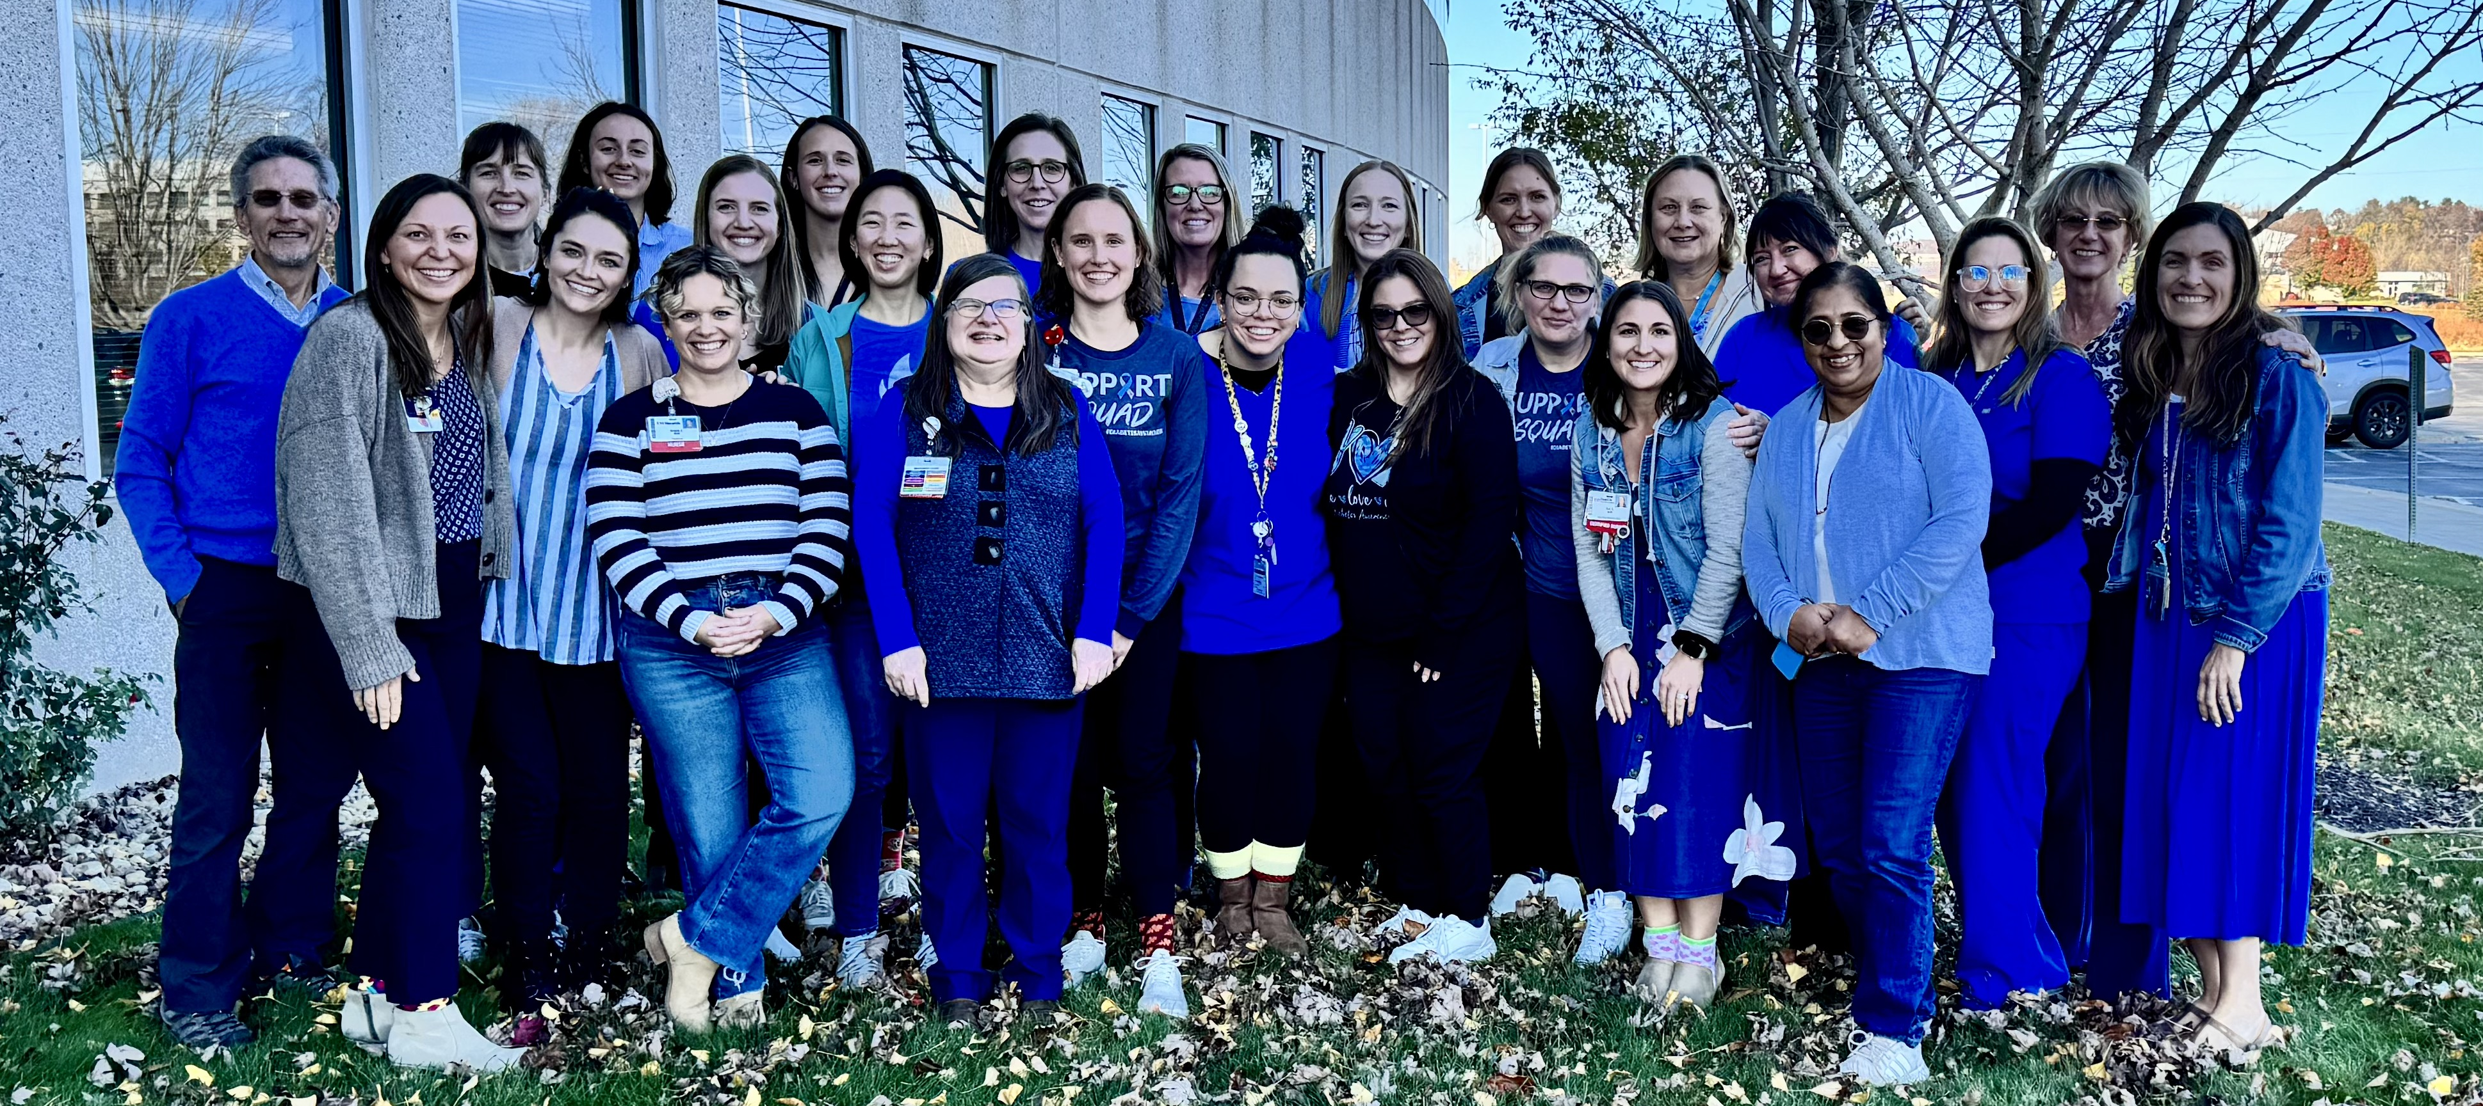
Thank you to the Clinical Team at UW Health Kids Pediatric Diabetes Clinic
Peds Diabetes Clinical Team, fall 2024 during team retreat
Presenting this work at our local QI fair with our clinic manager Courtney Schultz, BSN, RN

Slide 13
Low Continuous Glucose Monitoring Use in Youth with Type 2 Diabetes: Baseline Data from the T1D Exchange Pediatric T2D Registry
Ori Odugbesan MD MPH

Slide 14
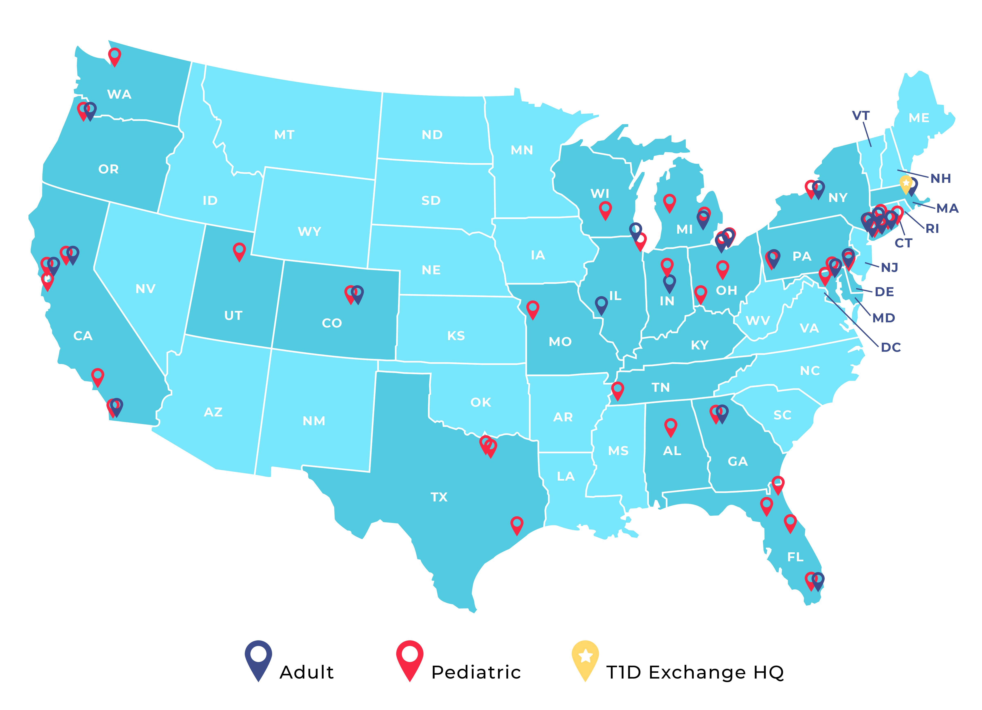
T1D Exchange
The T1D Exchange is a Boston-based nonprofit with a mission to improve the outcomes of people with diabetes.
The T1D Exchange Quality Improvement Collaborative (T1DX-QI) has 62 pediatric and adult endocrinology centers across the US currently caring for approximately 90,000 People with T1D diabetes and 60,000+ people with T2D across 22 US States.

Slide 15
Background
The incidence of type 2 diabetes (T2D) in adolescents and young adults (YA) is increasing.
Compared with people with type 1 diabetes (PwT1D) or adults with T2D, this group experiences more rapid disease progression and a higher rate of developing complications.
Despite these risks, adolescents and YA with T2D have limited access to advanced diabetes management tools, such as continuous glucose monitoring (CGM), which are widely used in T1D care.
CGM is beneficial to glycemic control in youth with type 1 diabetes (T1D) and adults with type 2 diabetes (T2D); however, studies in youth with T2D are limited.
The American Diabetes Association (ADA) recommend that CGM be offered to all youth with type 2 diabetes on insulin therapy

Slide 16
Methods
The T1D Exchange engaged twenty-five pediatric centers to establish the Pediatric T2D Registry.
T1DX-QI faculty and participating centers identified core outcome measures, including CGM use, for benchmarking.
Fifteen centers provided baseline CGM use to T1DX-QI for 2024 (Demographic table).
Six centers shared monthly aggregate CGM data via Smartsheet from September 2023 to July 2025. Data was analyzed and displayed using a control chart.

Slide 17
Demographic Table
Clinic Name | Site 1 | Site 2 | Site 3 | Site 4 | Site 5 | Site 6 | Site7 | Site 8
Denominator | 444 | 350 | 260 | 750 | 275 | 137 | 215 | 61
Public Insurance | 307 (69%) | 280 (80%) | 169 (65%) | 693 (92%) | 92 (33%) | 88 (64%) | 170 (79%) | 54 (89%)
White pop | 74 (17%) | 53 (15%) | 105 (40%) | 58 (7%) | 20 (7%) | 51 (37%) | 35 (16%) | 18 (30%)
NHB | 296 (67%) |  |  |  |  |  |  | 17 (28%)
Hispanic pop | 60 (14%) | 210 (60%) | 20 (8%) | 548 (73%) | 200 (78%) | 30 (22%) | 25 (12%) | 21 (34%)
CGM use | 23 (5%) | 32 (9%) | 20 (8%) | 47 (6%) | 25 (9%) | 11 (8%) | 49 (23%) | 20 (33%)
A1c lab completed | 307 (100%) | 320 (91%) | 250 (96%) | 649 (87%) | 275 (100%) | 135 (99%) | 212 (99%) | 61 (100%)
Mean A1c | 7.71% | 7.6 | 8.0 | 7.9 | 7.8 | 7.5 | 7.9 | 7.4
A1c below 8% | 312 (70%) | 211 (66%) | 75 (29%) | 397 (61%) | 130 (47%) | 85 (63%) | 132 (62%) | 45 (74%)
Clinic Name | Site 9 |  | Site 10 | Site 11 | Site 12 | Site 13 | Site 14 | Site 15
Denominator | 70 |  | 164 | 352 | 315 | 817 | 321 | 86
Public Insurance | 59 (84%) |  | 118 (72%) | 314 (89%) | 259 (81%) | 554(66%) | 298 (93%) | 54 (63%)
White pop | 12 (16%) |  | 37 (23%) | 144 (41%) | 67 (21%) | 77 (9%) | 9 (3%) | 28 (33%)
NHB | 15 (21%) |  | 76 (46%) |  |  | 225 (28%) |  | 30 (35%)
Hispanic pop | 10 (14%) |  | 42 (26%) | 148 (42%) | 154 (49%) | 778 (56%) | 180 (56%) | 24 (28%)
CGM use | 27 (39%) |  | 82 (50%) | 3 (<1%) | 51 (16%) | 165 (20%) | 40 (12%) | 11 (13%)
A1c lab completed | 69 (99%) |  | 119 (100%) | 340 (97%) | 252 (80%) |  | 319 (99%) | 86 (100%)
Mean A1c | 8.0 |  | 7.2 | 8.3 | 8.1 | 7.95 | 8.4 | 7.3
A1c below 8% | 42 (61%) |  | 114 (70%) | 208 (61%) | 169 (67%) | 858 (61%) | 175 (55%) | 64 (74%)

Slide 18
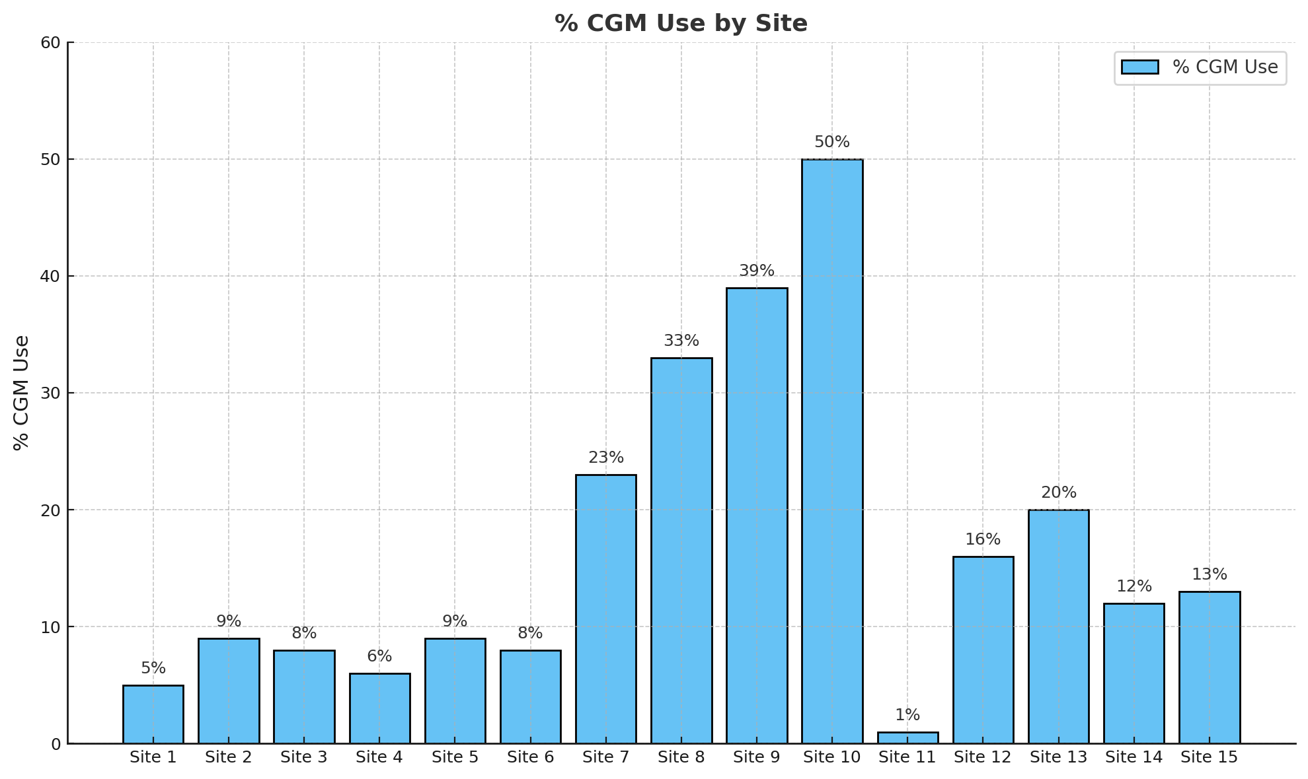
Result (Baseline CGM Use Across Centers)
Marked variation across clinics among 15 centers that shared baseline CGM data with T1DX-QI
Indicates differences in prescribing and access.
CGM use varied widely, from 1% CGM use in center #12 to 50% in center #11
Demonstrates low baseline CGM use across centers

Slide 19
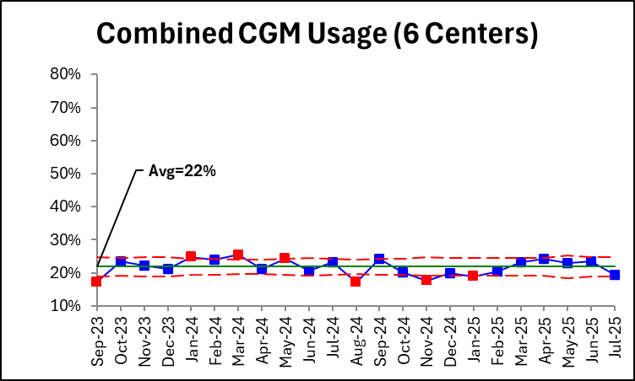
Monthly Trend Among Six Centers)
Among six centers reporting monthly CGM use, median CGM use is 22%
Demonstrates low baseline CGM adoption in this population.

Slide 20
Limitation
Our analysis was based on baseline and aggregate data reported by participating centers adolescents, and young adults with type 2 diabetes.
This study did not assess CGM use among insulin users.

Slide 21
Conclusion
Baseline data from participating centers demonstrates low CGM use among adolescents and youth with T2D among participating centers.
Given the rising prevalence of T2D in this population, there is a need to increase CGM use in this population to improve glucose monitoring and reduce comorbidities

Slide 22
Acknowledgement
Co-Chairs of the Pediatric T2D committee
All faculty at the 25 centers that are part of the T2D Registry
Helmsley Charitable Trust for funding the QI collaborative

Slide 24
Assessing Health Literacy in Pediatric Type 2 Diabetes
Alissa Guarneri, MD MBOE
UPMC Children’s Hospital of Pittsburgh
UPMC Pediatric Team: Ingrid Libman, MD PhD; Brittaney Moore, DNP;
Brooke Myers, QIC; Kathryn Williams, CRNP

Slide 25
Background
Pediatric type 2 diabetes is a complex disease
Despite advancements, the overall quality of care remains suboptimal
Health literacy (HL) is the ability to obtain, process, and understand health information, follow directions for treatment, and ask pertinent questions
Directly influences self-management behaviors, treatment adherence, and glycemic control¹
Low HL in both patients and caregivers linked to low technology adoption and increased risk of complications¹
Up to 8% of caregivers of pediatric diabetes patients have low HL²
The American Diabetes Association recommends using validated, age-appropriate health literacy tools in pediatric diabetes patients,³ though no diabetes-specific instrument exists
Schillinger D, Grumbach K, Piette J, et al. Association of Health Literacy With Diabetes Outcomes. JAMA. 2002;288(4):475–482. doi:10.1001/jama.288.4.475
Jean Potter et al, Association between caregiver health literacy and patient characteristics in pediatric new onset diabetes mellitus, Public Health, Volume 247, 2025, 105892, ISSN 0033-3506, https://doi.org/10.1016/j.puhe.2025.105892.
Improving Care and Promoting Health in Populations: Standards of Care in Diabetes—2025. Diabetes Care 1 January 2025; 48 (Supplement_1): S14–S26. https://doi.org/10.2337/dc25-S001

Slide 26
Current State
UPMC Children’s Hospital of Pittsburgh
140 patients with Type 2 Diabetes Mellitus
20 new diagnoses per year
Average age at diagnosis: 12.7 years (SD 2.2)
Average BMI at diagnosis: 36.2 kg/m² (SD 7.4)
Average HbA1c at diagnosis: 9.1% (SD 2.8%)
27.5% no-show or cancel rate
44% of patients identify as non-White/Caucasian race/ethnicity
65% of patients publicly insured
6% uninsured
100% Insulin Start

Slide 27
Baseline
A multidisciplinary team created a brief (<10 question) survey for patients aged 12–18 years with type 2 diabetes for ≥2 years and their caregivers
Assessed understanding of diagnosis, treatment, complication monitoring, and factors that impact blood glucose
Goal: ≥ 15% of total population
PDSA 1 targeted patients seen within main hospital clinic
Received 17 patient/14 caregiver surveys (12.4% of population)
PDSA 2 expanded to satellite clinics
Received additional 3 patient/3 caregiver surveys (15% of population)

Slide 28

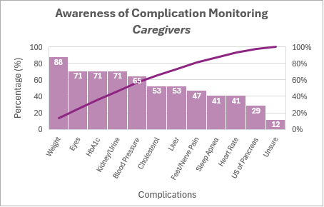
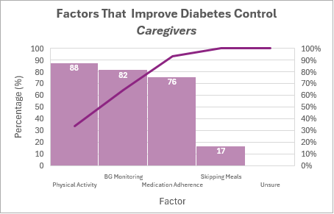
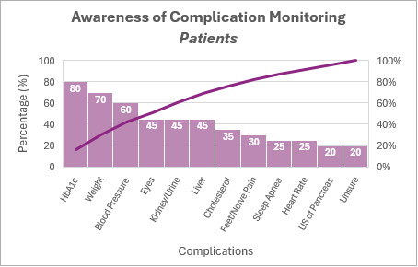
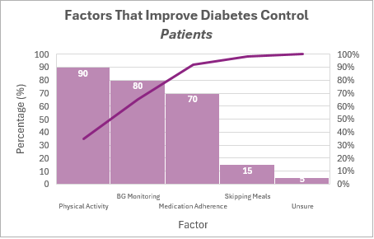

Slide 29
PROBLEM: Despite self-reports of generally good understanding of pediatric type 2 diabetes, discrepancies exist between patient and caregiver perception of knowledge and actual knowledge.
AIM: Identify gaps in health literacy among patients aged 12-18 years with type 2 diabetes and their caregivers within UPMC Children’s Hospital of Pittsburgh diabetes clinic and improve factors that impact health literacy by 10% from baseline by June 30, 2026 and sustain for 1 year.

Slide 30
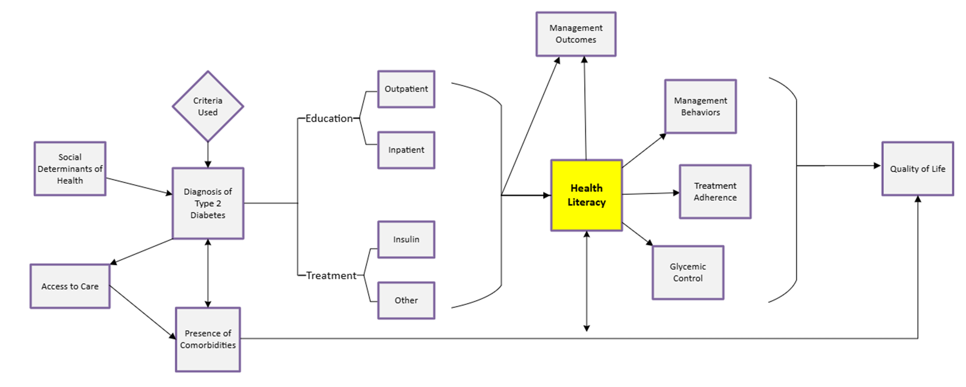
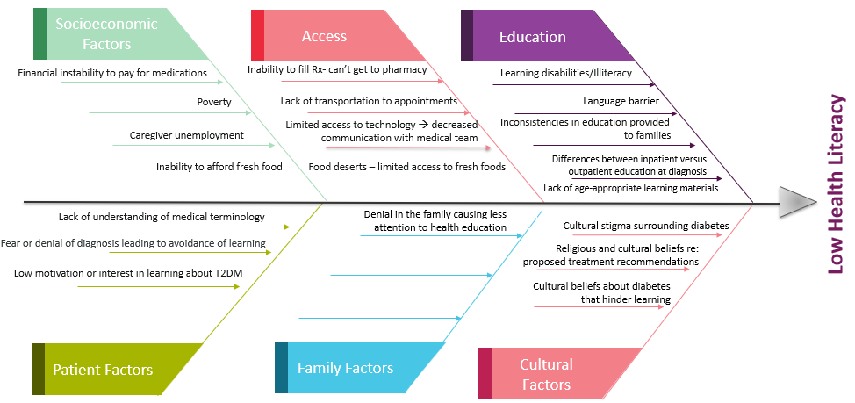
The Central Role of Health Literacy in
Type 2 Diabetes Management Among Youth
Factors Contributing to Low Health Literacy

Slide 31
Green = Completed/Current
Yellow = In Progress/Partial
Red = Not Started/Out of Scope
Key Driver Diagram
Interventions
SMART Aim
Key Drivers
- Create questionnaire with input from multidisciplinary team
- Establish workflow for baseline and follow-up HL assessments - Use paper → electronic health literacy screenings - Train staff on consistent administration of survey
Identify gaps in health literacy among patients aged 12-18 years with type 2 diabetes and their caregivers within UPMC Children’s Hospital of Pittsburgh diabetes clinic and improve factors that impact health literacy by 10% from baseline by June 30, 2026 and sustain for 1 year.
Assessment of Health Literacy
Redesign educational materials at 4th grade reading level
Create bilingual handouts (English/Spanish)
Standardize education provided to families (IP & OP)
Implement teach-back method to confirm understanding at
diagnosis and during office visits
Ensure materials are age-appropriate and culturally relevant
Provide consistent counseling to patients on comorbidity risks
Education
Efficient Use of Technology
Patient and Caregiver Engagement
Prescribe CGM to all new-onset patients
- Dexcom/Freestyle Libre if started on insulin
- Stello for all others
Promote use of glucometer app for blood sugar logging
Global Aim
Staff Training
- Develop a brief “family education toolkit”
- Track no-show & cancel rates and assess barriers to access - Create brief videos addressing key DM management concepts
Improve quality of life in
pediatric patients with
Type 2 Diabetes
Conduct in-service sessions on plain language principles
Share updates quarterly via email
Auto text for providers to remind them of topics to counsel
patients/caregivers at office visits

Slide 32
Education
Outpatient Education
New-onset
TBD
Wellness Clinic
PDSA 3 – Shadow education sessions
Wellness Clinic (Pre-Diabetes, OGTT)
General information packet provided to each patient (key topics covered)
No script
Delivery and depth are tailored to each individual patient/family
Diet recall at every encounter
Language kept simple; avoidance of medical jargon
Focus on setting simple, achievable modifications
Outpatient vs Inpatient New-onset Education
TBD
Inpatient Education
New-onset
TBD

Slide 33
Key Learnings
Health Literacy plays a key role in successful management of pediatric type 2 diabetes
Gaps in health literacy persist, particularly regarding key monitoring metrics and nutrition
Age-appropriate, targeted education for both patients and caregivers is warranted to optimize disease management and quality of life
There is a need for a validated health literacy survey for pediatric patients with type 2 diabetes
Thank You!

Slide 35

Step by Step: Increasing Physical Activity in Youth with Diabetes
Division of Diabetes & Endocrinology
Lauren Culbreth, Paola Rondon, Brittany Jones, Emily Smith, Mili Vakharia, Grace Kim
November 11, 2025

Slide 36
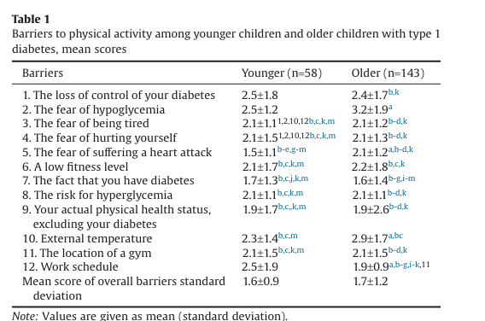
Barriers to Exercising in Pediatric T1D
<12 y/o:
Loss of control of diabetes
Fear of hypoglycemia
Work schedule
External temperature
≥12 y/o:
Fear of hypoglycemia
External temperature
Loss of control of diabetes
Low fitness levels
Greater parental support
=
lower overall perceived barriers
Ref: J Am Med Dir Assoc. 2016;17(1):85.e1–85.e7. doi:10.1016/j.jamda.2015.10.005
Notes:
J Am Med Dir Assoc. 2016;17(1):85.e1–85.e7. doi:10.1016/j.jamda.2015.10.005
Study done in Quebec, 201 patients at least 3 mos diabetes duration;
This questionnaire examines 12 barriers to physical activity on a scale from 1 to 7 (1), (1 being extremely unlikely, to 7, being extremely likely
Parents also answered by responding 1 (never), 2 (sometimes) or 3 (very often) if they encouraged their children to engage in PA or to be present with them when they themselves were being physically active.
External temperature- increased risk of dehydration with hyperglycemia; become dehydrated more quickly in high heat – impaired performance, muscle cramps
Striking was the fact that 88% of younger participants and 91% of older participants reported that their parents discouraged PA -→ shows need for education regarding how we can safely encourage our kiddos to exercise
?Loss of control – going into exercise with higher blood sugars → worsening A1c
Physical activity notably improves glycemic control, cardiovascular health, and overall well-being in children with diabetes.
However, most do not meet the physical activity targets established by the ADA.
Barriers such as fear of hypoglycemia and limited parental/community support contribute to low adherence.
Fewer than one in five youth with diabetes meet the American Diabetes Association (ADA) guidelines for exercise, which recommend at least 60 minutes of moderate-to-vigorous physical activity daily, including muscle- and bone-strengthening activities at least 3 days per week.
While the ADA guidelines are clear and consistent across recent statements—youth with type 1 or type 2 diabetes should engage in at least 60 minutes of moderate-to-vigorous aerobic activity daily and limit sedentary time—the actual proportion of youth meeting these recommendations is low.^{[1-3]} The ADA Standards of Care 2025 note that "most youth with diabetes do not meet these recommendations," and published data from national surveys and cohort studies consistently estimate that only about 15–20% of youth with diabetes achieve the recommended levels of physical activity.^{[1]} This is similar to the general pediatric population, where national data show that less than 25% of U.S. adolescents meet the 60-minutes-per-day guideline.
Barriers include fear of hypoglycemia, lack of structured opportunities, and competing demands. The ADA emphasizes the need for individualized counseling and family-based interventions to improve adherence.
In summary, the majority of youth with diabetes do not meet ADA exercise guidelines, with estimates in the range of 15–20% meeting the recommended activity levels.
References:
1.
5. Facilitating Positive Health Behaviors and Well-Being to Improve Health Outcomes: Standards of Care in Diabetes-2025.
Diabetes Care. 2025;48(Supplement_1):S86-S127. doi:10.2337/dc25-S005.
2.
14. Children and Adolescents: Standards of Care in Diabetes-2025.
Diabetes Care. 2025;48(Supplement_1):S283-S305. doi:10.2337/dc25-S014.
Leading Journal
Physical Activity/­Exercise and Diabetes: A Position Statement of the American Diabetes Association.
Colberg SR, Sigal RJ, Yardley JE, et al.
Diabetes Care. 2016;39(11):2065-2079. doi:10.2337/dc16-1728.

Slide 37






SMART AIM: Increase percentage of youth with T1D and T2D, ages 6-18 years, being assessed and meeting goal of at least 10-30 minutes of moderate intensity physical exercise at least 3 days per week by 5% by end of FY2025.
Lauren Culbreth, MPAS, PA-C, ACSM-EP, CDCES
Paola Rondon, MS, RD, LD, CDCES
Brittany Jones, MPH, RD, LD, CDCES
Emily Smith, MS, RD, LD
Mili Vakharia APRN, FNP-C, CDCES
Grace Kim, MD

Slide 38
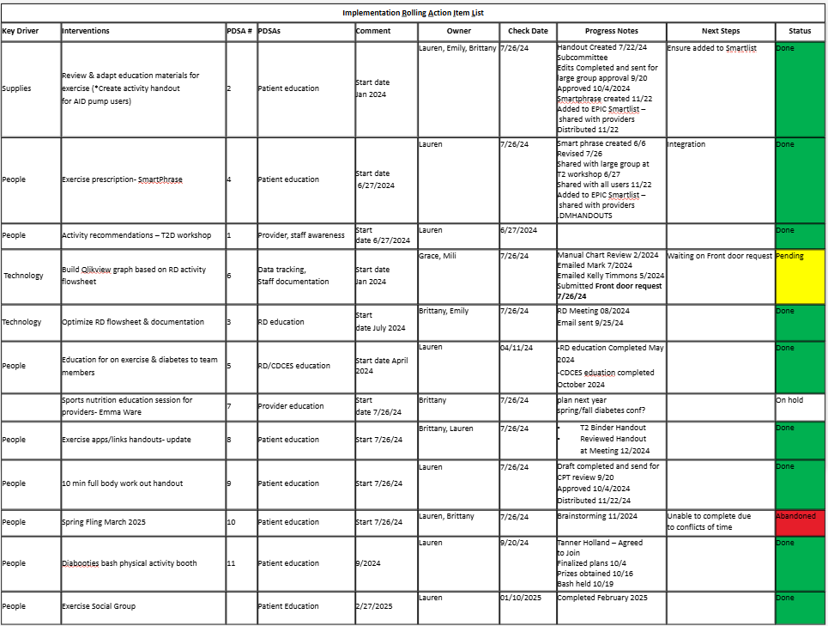
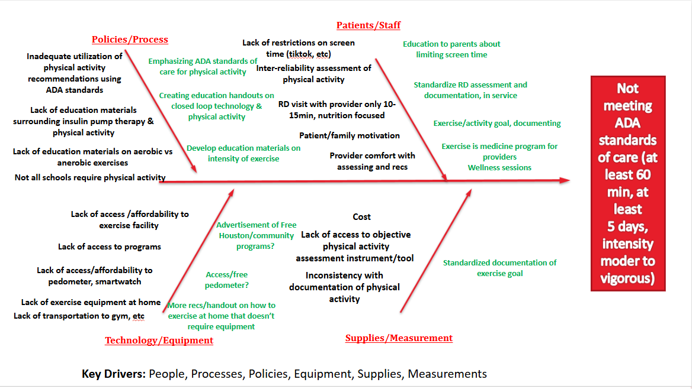
QI Tools

Slide 39
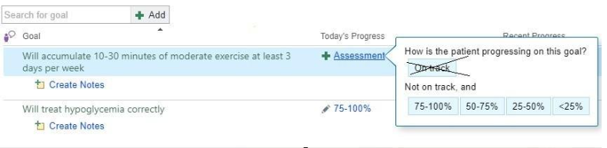
PDSA Cycles
1. Created an EPIC workflow leveraging dietitian flowsheet and diabetes educator goal documentation for physical activity (January 2024)
2. Educated dietitians on physiology of exercise in diabetes (May 2024)
Notes:
If blurry may need to replace

Slide 40

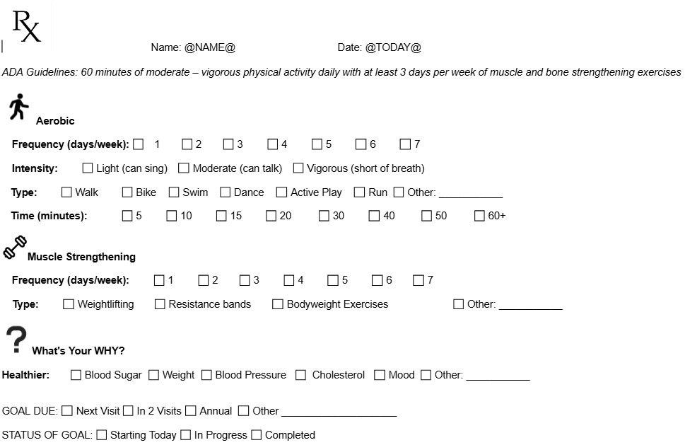
PDSA Cycles
3. Integrated exercise prescriptions into clinic (June 2024)

Slide 41
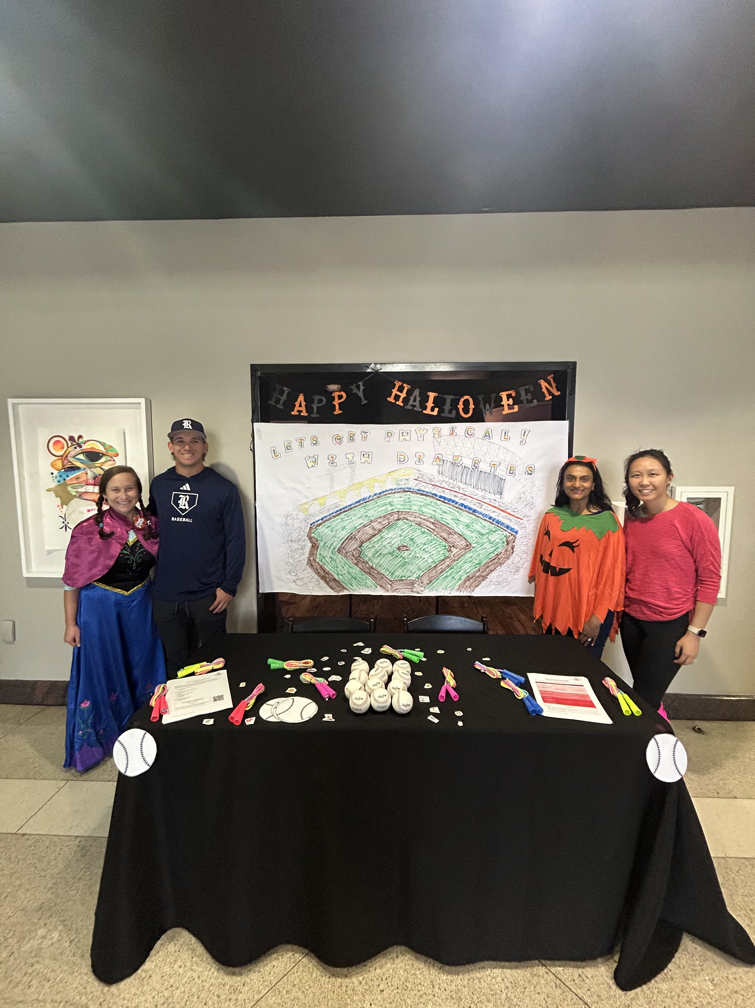

PDSA Cycles
4. Conducted community outreach to patients and their families, raising awareness of physical activity benefits (September 2024)
5. Trained diabetes educators on exercise management strategies (October 2024)

Slide 42
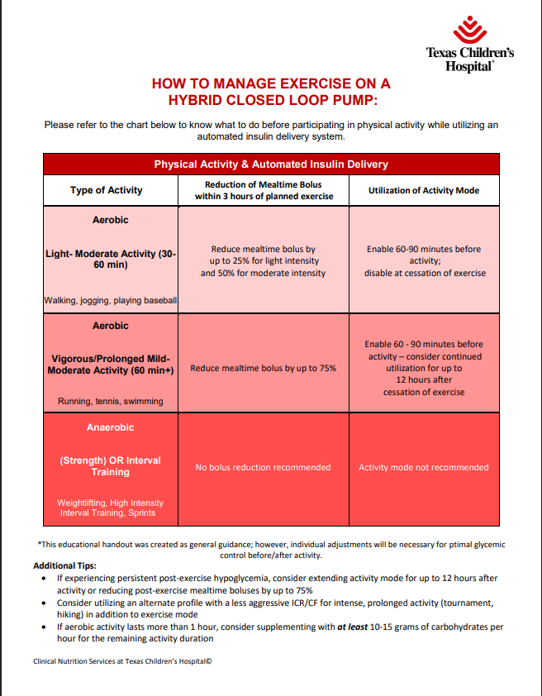
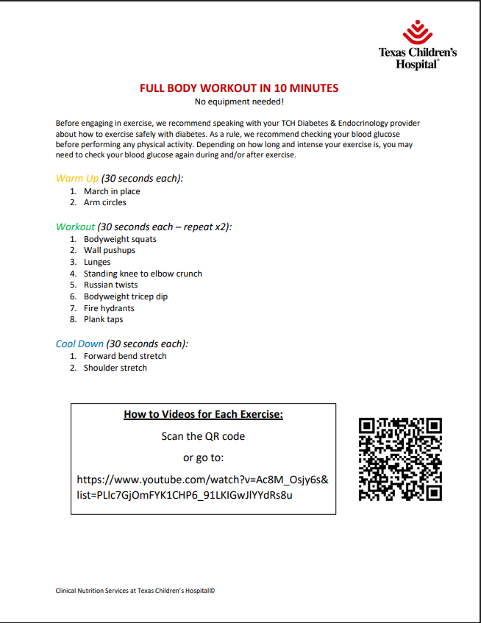
PDSA Cycles
6. Implemented patient-facing educational materials (November 2024)
7. Held a virtual webinar for families on managing diabetes and physical activity (February 2025)
Notes:
Heavily based on consensus guidance
Exercise management in type 1 diabetes: a consensus statement Riddell et Al

Slide 43
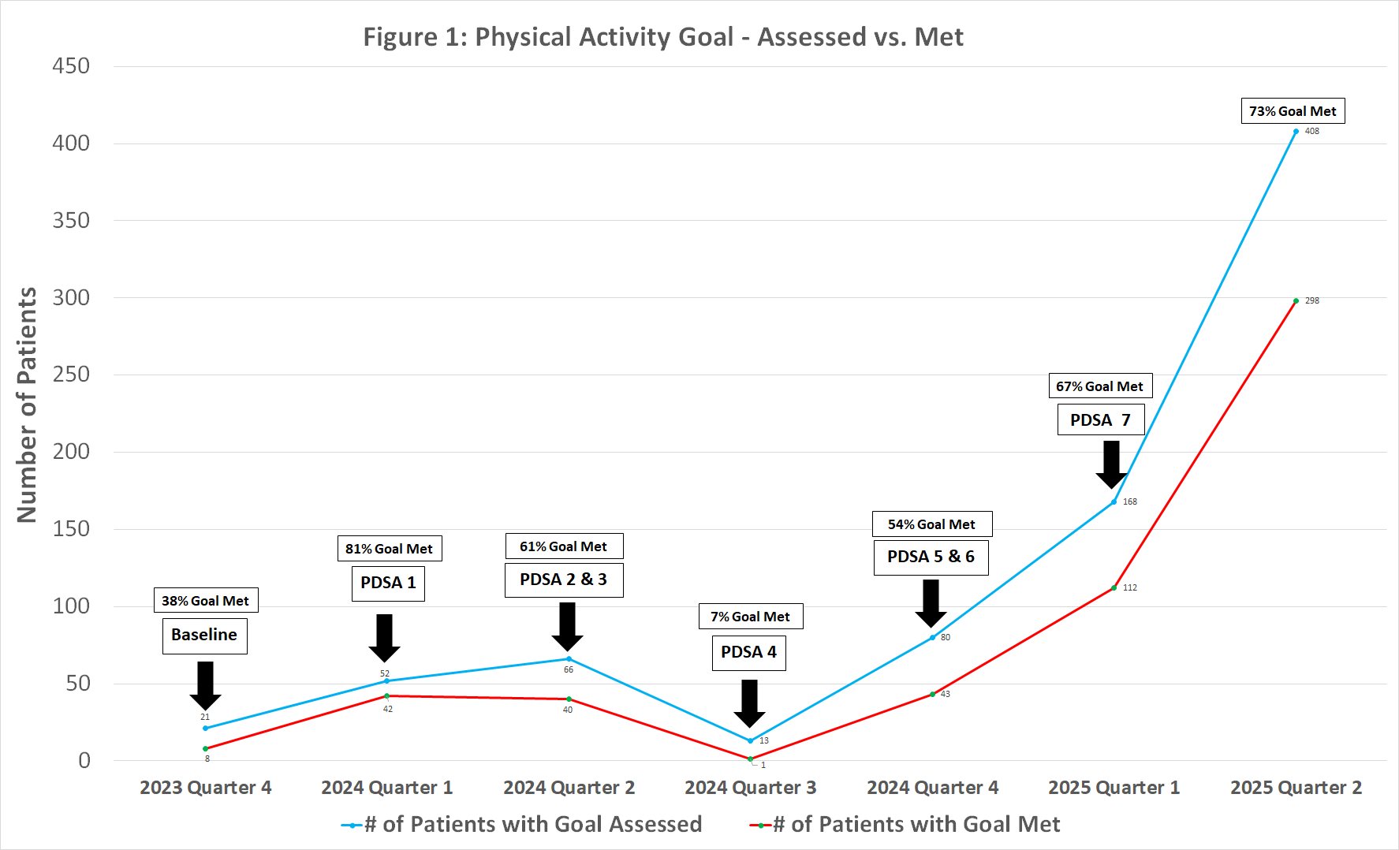
Results
Through this multidisciplinary-led QI initiative, the percentage and number of patients assessed and meeting physical activity goal increased from a baseline of 38% of 21 patients, to 73% of 408 patients from December 2023 to June 2024.
Notes:
Explain graph, blue red, x/y axis
Results:
The percentage and number of patients assessed and meeting physical activity goal increased from a baseline of 38% of 21 patients, to 73% of 408 patients from December 2023 to June 2024 (Figure 1).
Conclusions:
This multidisciplinary-led QI initiative improved both assessment and frequency of youth performing at least 10-30 minutes of moderate intensity exercise at least 3 days per week.

Slide 44
Thank You
Email: leculbre@texaschildrens.org
Notes:
Performed patient survey at community diabetes event in October 2025
Analyze results for next PDSA cycle idea generation

Slide 46

Section Header Here Subtitle Here
Lunch
Perspectives from People with Diabetes
Whitley Ballroom
12:15 – 1:15pm

