Slide 1

Holistic Care: Transitions, Access, Shared decisions, and Psychological Support
Moderated by Siham Accacha, MD, CDCES

Slide 2
Implementation of an Electronic Medical Record Pediatric to Adult Healthcare Transition Planning Tool for Youth with Diabetes Mellitus
Mary Katherine Douthit, MD¹
Kristina Cossen, MD^{1,2}
¹Children’s Healthcare of Atlanta, Division of Pediatric Endocrinology and Diabetes
²Emory University School of Medicine, Department of Pediatrics, Division of Pediatric Endocrinology and Diabetes

Slide 3
Introduction
Problem: Adolescents and young adults (AYAs) with diabetes mellitus (DM) experience worse outcomes during pediatric to adult healthcare transition (HCT)¹​
Gap: Guideline-recommended HCT planning is inconsistently performed by providers^{2,3​}
Opportunity: Electronic medical record (EMR) tools can improve adherence to clinical guidelines⁴​
Objective: Use a Plan-Do-Study-Act (PDSA) approach to increase provider use of a new EMR HCT tool from 0% to 50% in 12 months​

Slide 4
Methods
Setting
Data Collection & Analysis
Single outpatient pediatric DM clinic at a large healthcare system
AYAs (≥ 17y) and providers with ≥20% clinical time in DM clinic
Baseline: Nov 1-30, 2023
Intervention: Jan 11-Dec 2, 2024
Primary outcome: % of established DM visits for AYAs (≥ 17y) with any HCT tool use​
EMR query for tool use, demographics, and clinical data​
Run charts tracked progress
Surveys assessed provider satisfaction & barriers to use
ORs (95% CI) and chi-square tests for statistical analysis

Slide 5
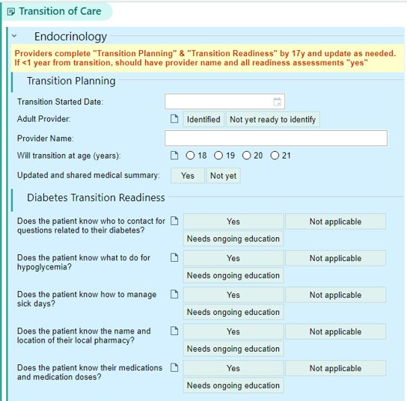
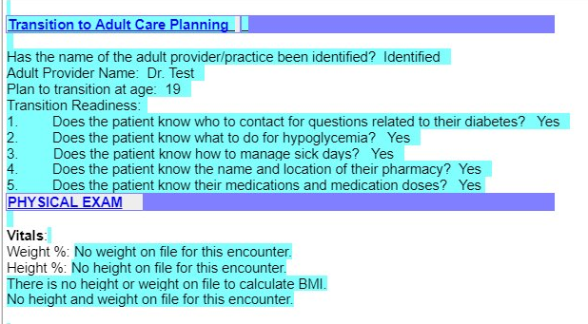
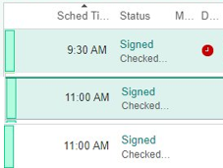
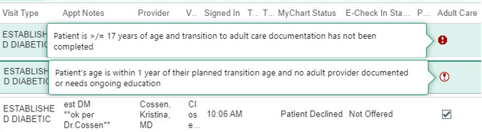
Fig. 1: EMR-based HCT tool and provider reminders

Slide 6
Results
Baseline: HCT planning documented in only 19% of provider notes
30 providers participated (22 physicians and 8 APPs), and 2196 encounters were reviewed for 1102 unique patients
Providers identified time constraints as the main barrier to use
n=7

Slide 7
Fig. 2: Run chart of proportion of well-visits with any HCT tool use for patients ≥17y at DM Clinic in 2024
Cycle 1
Jan. 11th
Cycle 2
Feb. 19th
Cycle 3
May 2nd
Cycle 4
Aug. 18th
Cycle 5
Nov. 7th
Cycles
HCT tool training & release
Provider reminders & satisfaction survey
Tool revision & training
Provider reminders & feedback on barriers to use
Tool revision, EMR-integrated reminders & training

Slide 8
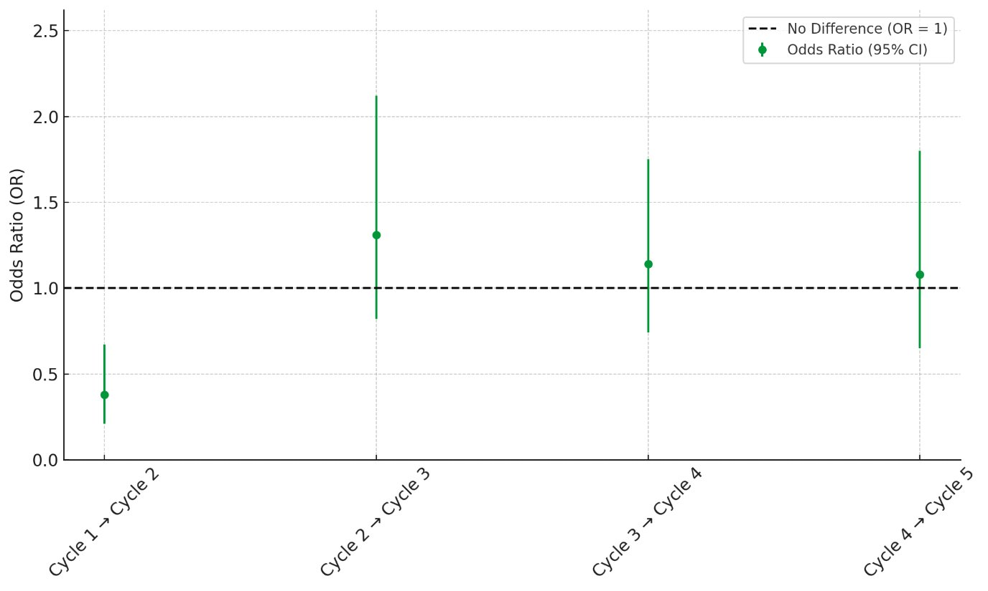
Fig. 3: Comparisons of HCT tool use by PDSA cycle

Slide 9
Table 1. Provider use of HCT EMR tool by patient characteristics for established DM visits Jan - Dec 2024 ​
​ | Total # of patients​ | Provider use of HCT tool​ n (%)​ | p-value​
Age (years)​ | 1102​ | ​ | <0.001​
17​ | 410​ | 48 (11.7%)​ | ​
18​ | 376​ | 60 (16.0%)​ | ​
19​ | 183​ | 27 (14.8%)​ | ​
≥20​ | 133​ | 37 (27.8%)​ | ​
College Plan ​ | 183​ | ​ | NS​
Yes​ | 60​ | 12 (20.0%)​ | ​
No​ | 123​ | 20 (16.3%)​ | ​
Race​ | 1102​ | ​ | NS​
White​ | 457​ | 83 (18.2%)​ | ​
Black​ | 490​ | 70 (14.3%)​ | ​
Asian​ | 29​ | 4 (13.8%)​ | ​
Declined​ | 49​ | 5 (10.2%)​ | ​
Other​ | 77​ | 10 (13.0%)​ | ​
Preferred spoken language​ | 1102 ​ | ​ | 0.14​
English​ | 983​ | 159 (16.2%)​ | ​
Non-English​ | 119​ | 13 (10.9%)​ | ​
Insurance​ | 1102​ | ​ | NS​
Private​ | 484​ | 85 (17.6%)​ | ​
Public​ | 558​ | 80 (14.3%)​ | ​
None​ | 60​ | 7 (11.7%)​ | ​
DM Type​ | 1102​ |  | 0.06​
Type 1​ | 742​ | 128 (17.3%)​ | ​
Type 2​ | 341​ | 43 (12.6%)​ | ​
Other*​ | 19​ | 1 (5.3%)​ | ​
HbA1c​ | 1101 ​ | ​ | NS​
<7%​ | 310​ | 48 (15.5%)​ | ​
7-9%​ | 377​ | 61 (16.2%)​ | ​
>9%​ | 414​ | 63 (15.2%)​ | ​
Number of clinic encounters​ | 1102​ | ​ | <0.001​
1​ | 434​ | 53 (12.2%)​ | ​
2​ | 344​ | 42 (12.2%)​ | ​
3+​ | 324​ | 77 (23.8%)​ | ​
*Other DM Types: Monogenic DM, Drug/chemical induced DM, cystic fibrosis related DM, status post pancreatic resection​

Slide 10
Discussion
Provider education, direct reminders, and EMR integrated reminders were not sufficient to improve HCT tool use​
Tool engagement was less likely if patients were younger or seen less often in clinic​
Tool use trended lower in non-English speakers and those with atypical diabetes
Future interventions targeting increased tool use with our younger population may improve HCT readiness and lead to safer transitions​
Additional interventions and longitudinal ​studies in this population are needed to ​improve the HCT process

Slide 11
References
Peters A, Laffel L; American Diabetes Association Transitions Working Group. Diabetes care for emerging adults: recommendations for transition from pediatric to adult diabetes care systems. Diabetes Care 2011;34:2477–2485​
American Diabetes Association Professional Practice Committee; 14. Children and Adolescents: Standards of Care in Diabetes—2025. Diabetes Care 1 January 2025; 48 (Supplement_1): S283–S305​
Got Transition/Center for Health Care Transition Improvement. Six core elements of health care transition. 2016. https://www.gottransition.org/resources/index.cfm. Accessed June 13, 2025.​
Staroselsky M, et al. Improving electronic health record (EHR) accuracy and increasing compliance with health maintenance clinical guidelines through patient access and input. International journal of medical informatics 75.10-11 (2006): 693-700.

Slide 13

Next Stop, Adult Care: Implementing A Transition Roadmap for Youth with Diabetes
Mili Vakharia, APRN, FNP-C, CDCES, Daniel DeSalvo, MD, Don Buckingham, MBOE, CPHQ, Cynthia G. Sanders, DNP, CPNP-PC, Elizabeth Kubota-Mishra, DO, Nelly Miranda, RN, CDCES, Sophia Ebenezer, MD, Meghan Craven, MD, Siripoom McKay, MD, Sarah Lyons, MD, and Grace Kim, MD
Vakharia@bcm.edu Houston, Texas
The 9th Annual 2025 T1D Exchange-QI Learning Session
Nothing to disclose
Photography is allowed
Date: November 11, 2025

Slide 14
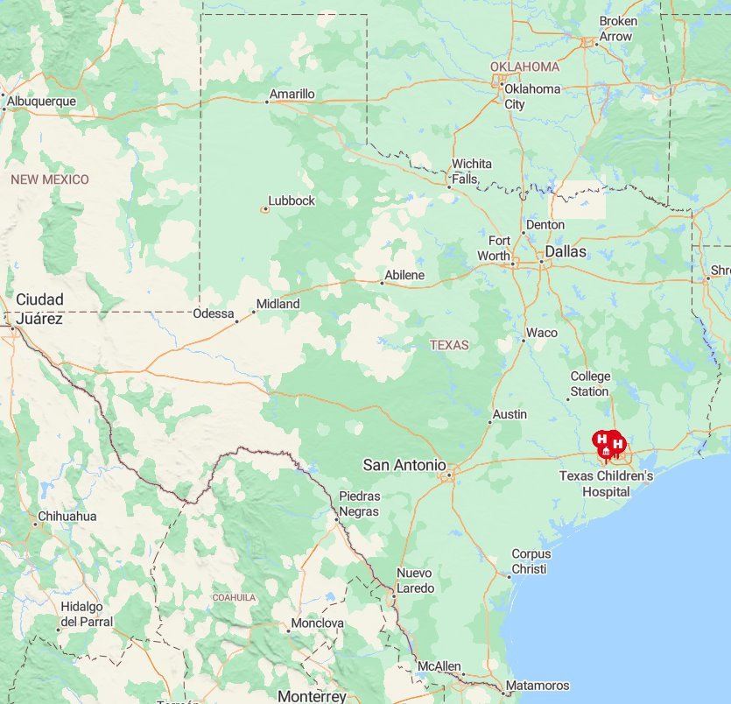
Texas Children's Hospital
Patients
Type 1
Providers
35 Pediatric Endocrinologists
9 APPs
Ambulatory staff & leadership
4 CDCES/RD leadership
Practice administrator
CDCES/RD: ~29
Diabetes clinics
4 major hospital campuses
2 Patient navigators
SW: ~6
2 psychologists
MAs & Nurses
6 satellite clinics
12 Pedi Endo Fellows
Type 2
Total: ~779 patients
Total: ~3300 patients
>16 yrs: ~1048
>16 yrs: ~442
~40% with public insurance
Insurance

Slide 15
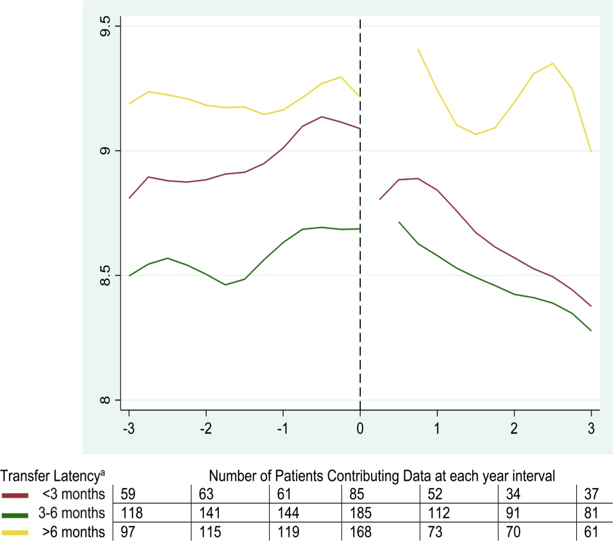
Background
Adolescents transitioning from pediatric to adult diabetes care
Experience increased self-management demands
Navigate a crucial and vulnerable stage of development
Lead to gaps in care, including decreased follow-up
Contributes to worsening glycemic control
Increased risk of complications, such as hospitalizations
Poorly coordinated transition
Guidelines (i.e., ADA and ISPAD) emphasize a planned transition process
Highlighting the need for structured education and preparation
Corathers et al., 2022). Prolonged lapses between pediatric and adult care are associated with rise in HbA1c and inpatient days among patients with type 1 diabetes. Diabetes Research and Clinical Practice, 192, 110113. https://doi.org/10.1016/j.diabres.2022.110113
ADA Standards of Care, Diabetes Care, 2024
ISPAD Clinical Practice Consensus Guidelines, Pediatric Diabetes, 2022
Bryant et al., Clinical Diabetes, 2024, doi:10.2337/cd23-0014

Slide 16
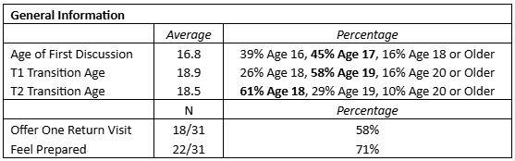
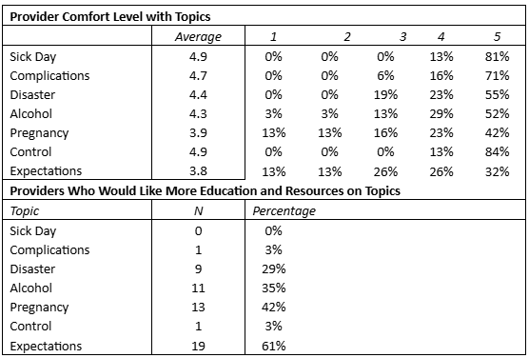
Provider Survey

Slide 17
Key Drivers: What obstructs transition planning?
Policies/Process
Patients/Staff
Patients not aware of transition plan
Transition policy, provider discussing transition topic
No standardized transition policy/process
Create transition policy document- Clinic CPT
Providers & CDCES not comfortable with certain topics
Transition workshop on safe and healthy healthcare transition
Providers/CDCES/SW unaware of transition roles
Create transition education curriculum with roles
What obstructs transition planning?
No standardized documentation in EPIC about education and assessments
EPIC build- need to be specific- flowsheet, provider flow sheet
No list of adult providers
Create adult endocrinologist provider list
No standardized documentation in epic about date of transition goal
No standardized transition education plan or materials
Create transition education curriculum based on age, readiness
Date of transition added to provider flowsheet- Clinic CPT
Technology/Equipment
Supplies/Measurement

Slide 18

SMART Aim
Develop a transition roadmap and increase the rate of older adolescents (age >16) with a documented transition plan by 30% over a 1.5-year period from a baseline of 20% in November 2023 to >50% by June 2025.

Slide 19
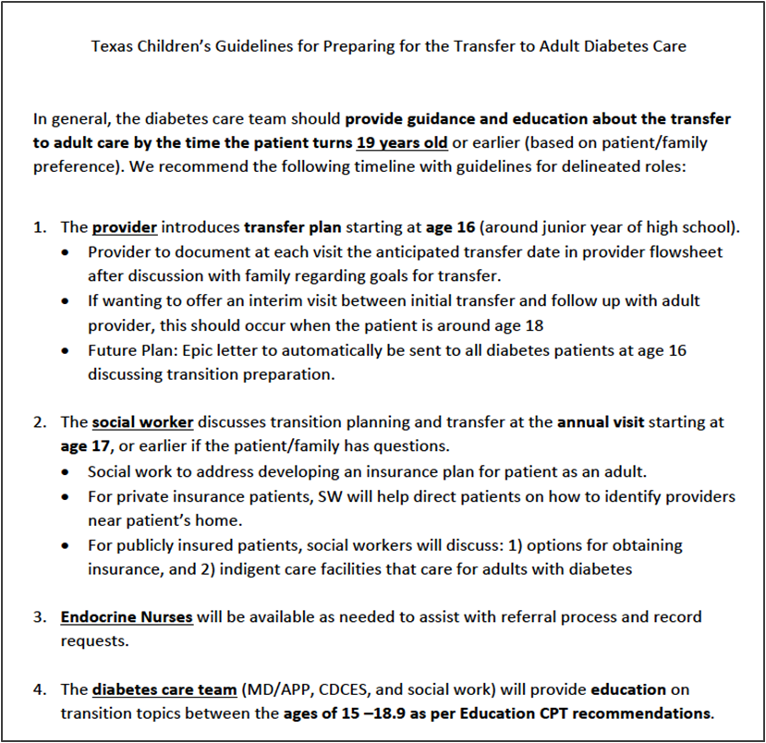
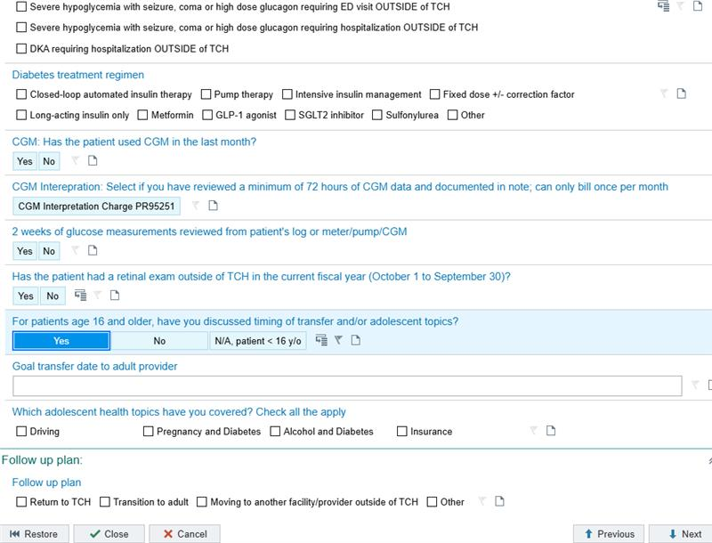
Nov 2023
Implemented a transitions policy with transition curriculum
Integrated EMR tools including provider flowsheet with anticipated transition date & education topics
Jan 2024
Defined transition tasks for each member of the diabetes care team (i.e., provider, CDCES, social worker)
PDSA Cycles

Slide 20
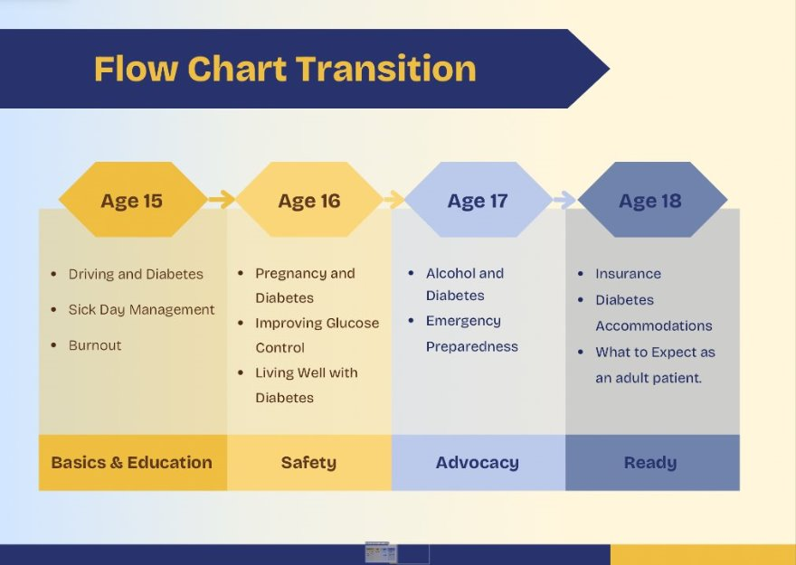
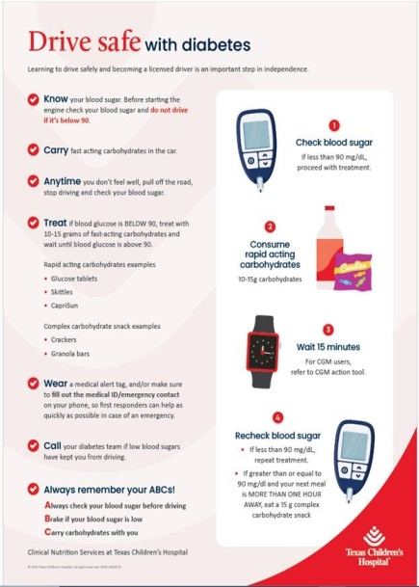
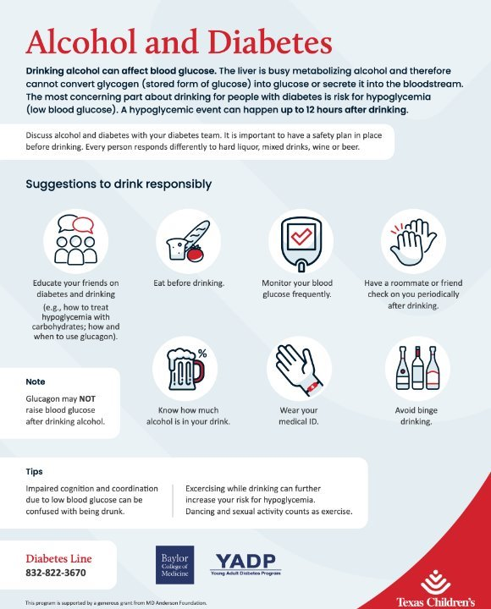
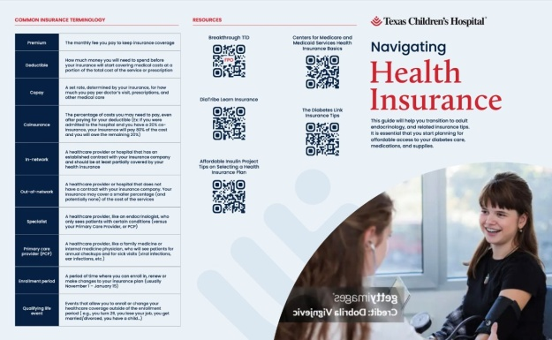
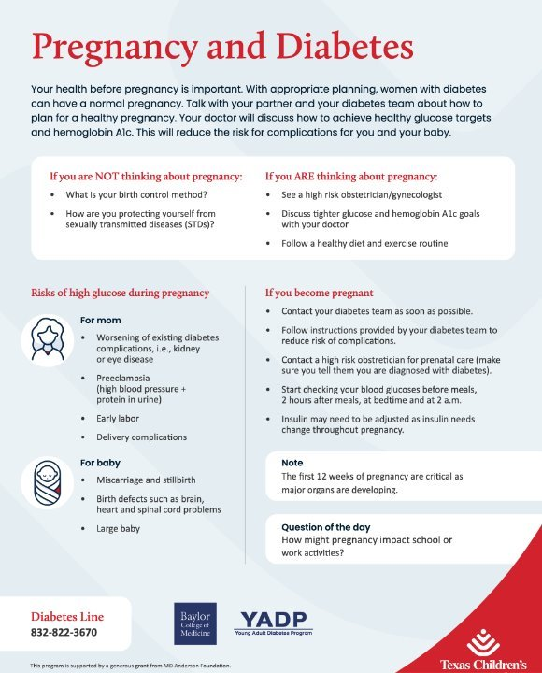
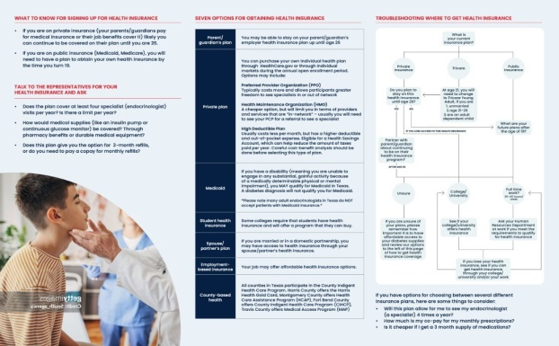
Nov 2023
Implemented a transitions policy with transition curriculum
Integrated EMR tools including provider flowsheet with anticipated transition date & education topics
Jan 2024
Defined transition tasks for each member of the diabetes care team (i.e., provider, CDCES, social worker)
Feb 2024
Conducted a transition seminar for staff/providers on key education topics to increase comfort & knowledge
May 2024
Updated & disseminated a geographical-based list of local adult endocrinologists
Jan 2025
Updated clinic passport to assign specific transition tasks to each care team member
Roadmap to Transition

Slide 21
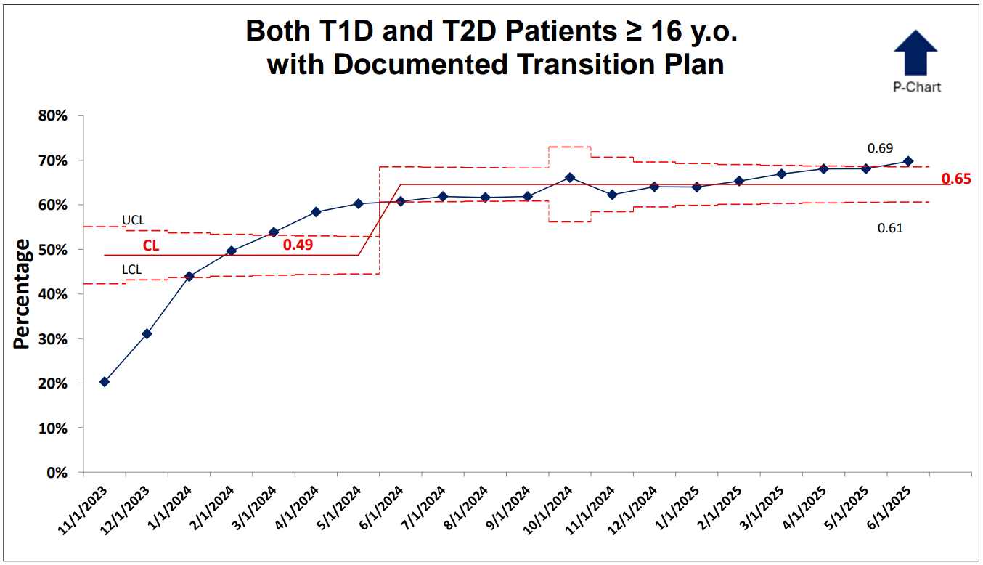
Results
Achieved SMART Aim of increasing documented Transition Plan from baseline of 20% to >50%
Statistically significant centerline shift from baseline of 49% to 65% by June 2025.

Slide 22
Summary
Lessons Learned
Team-based roadmap – a key to successful transition
Success driven by
Leveraging EMR integration
Multidisciplinary approach
Sustain improvements
Monitor patient-level outcomes post-transition
Clear task distribution for team members
Future directions
Address barriers for those with public health insurance

Slide 23

Thank you !!
TCH Diabetes Care Process Team
Division Chief: Rona Sonabend, MD
Daniel DeSalvo, MD
Sarah Lyons, MD
Siripoom McKay, MD
Melissa Marshall, RN
Curtis Yee, Practice administrator
Cynthia Sanders, DNP, CPNP-PC
Elizabeth Kubota-Mishra, MD
Sophia Ebenezer, MD
Meghan Craven, MD
Nelly Miranda, RN, CDCES
Grace Kim, MD
Mili Vakharia, FNP-C, CDCES
Don Buckingham, MBOE, CPHQ
Mark Rittenhouse, EPIC/IS Architect
T1D Exchange QI Collaborative
Patients & Families
Certified Diabetes Care & Education Specialists
Physicians/Advance Practice Providers
Medical Assistants
Social Workers
Psychologists
Ambulatory Service Representatives
Ambulatory Leaders
Mili Vakharia, FNP-C, CDCES
Vakharia@bcm.edu

Slide 25
Development of Transition Curriculum from Patient Identified Topics
Lauren Waterman, MD; Emily Boranian, RN, CDCES;
Erin Cobry, MD
University of Colorado Anschutz Medical Campus
Barbara Davis Center for Diabetes, Aurora, CO, USA
November 2025

Slide 26

Disclosures
LAW and EB have no conflicts of interest related to this project to disclose
EC does research with Dexcom, Abbott, Tandem, Insulet, Medtronic, Beta Bionics, Luna Health, Eli Lilly, and Sequel Med Tech.
26

Slide 27
Background
Emerging adults with type 1 diabetes (T1D) struggle with glycemic control and transition readiness
In addition to basic diabetes self-care, anticipatory guidance is required on:
Alcohol and substance use
Sex, contraception, and pregnancy
Insurance and health care navigation
Independent living/meal planning
Comprehensive transition education can be difficult to achieve in routine clinical visits due to time limits

Slide 28
Objective
Determine discussion rates of patient-identified transition topics in a pediatric clinic through electronic health record (EHR) note template notifications

Slide 29
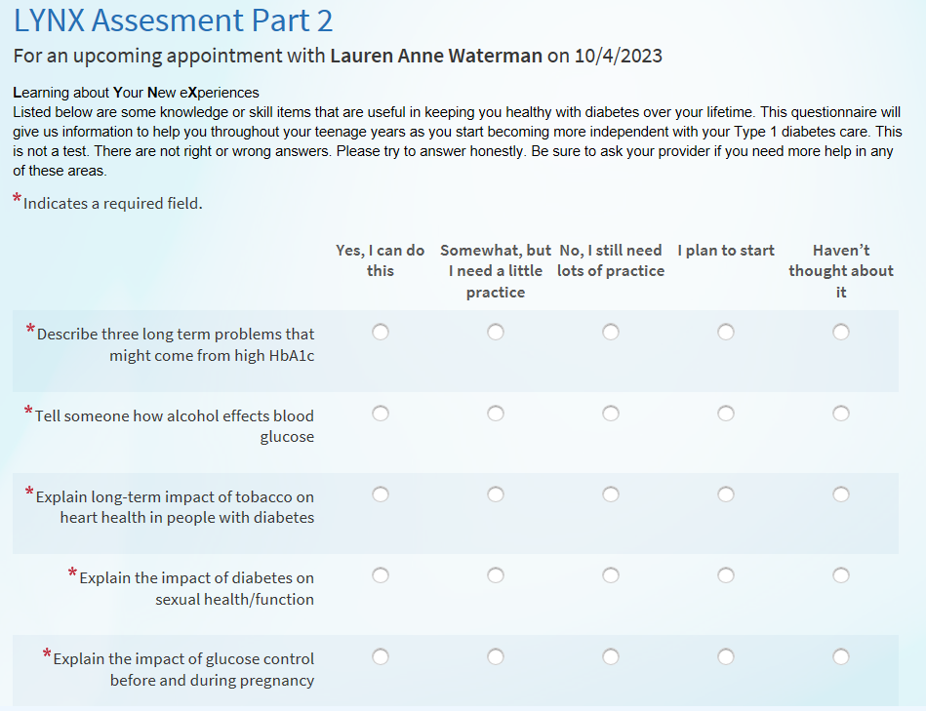
Methods: Patient-Identified Topics
LYNX: Learning about Your New eXperiences
Adapted from the 44-item READDY 1.0 (Readiness of Emerging Adults with Diabetes Diagnosed in Youth) survey
Assessing patient confidence in transition topics: Diabetes Knowledge, Health System Navigation, Insulin Self-Management, and Health Behaviors
Lynx survey was divided into two parts:
Part 1: basics of diabetes care
Part 2: higher level diabetes care
Each part administered at check-in for routine appointments on a yearly basis from age 16 years until transition to adult care

Slide 30
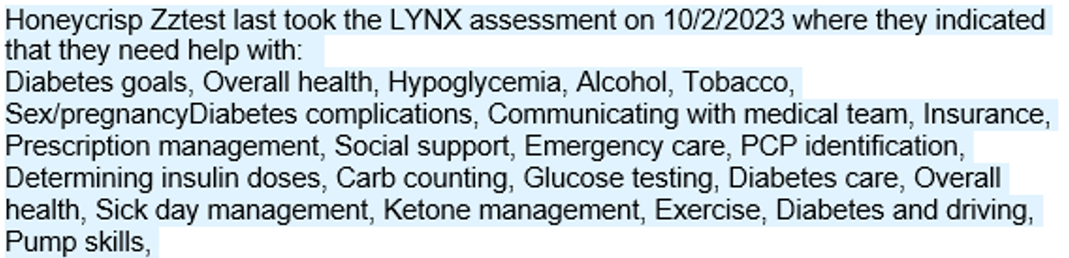
Methods: Patient-Identified Topics
Each question is assigned a key word/phrase
Topics not rated “Yes, I can do this” are included in the note template as a conversation prompt for providers
Patient responses from the last 12 months were pulled from the EHR
Complications
Alcohol
Tobacco
Sex/pregnancy

Slide 31
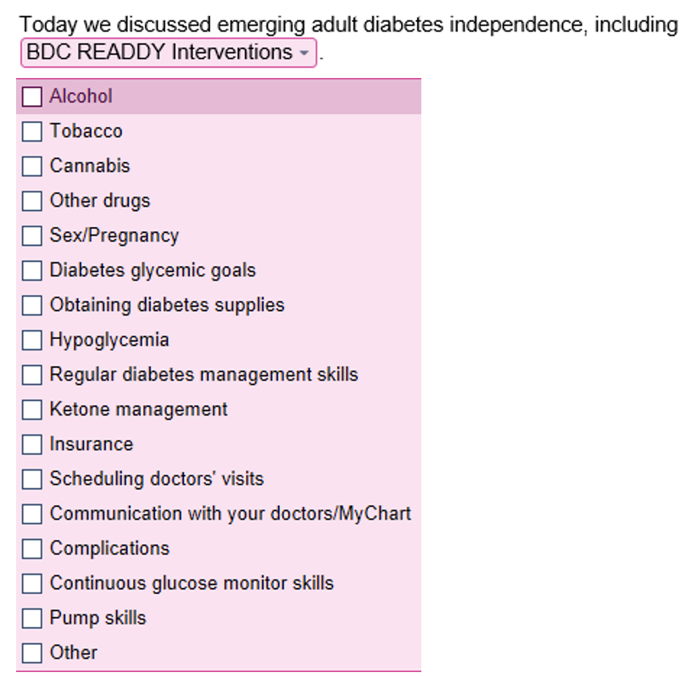
Methods: Transition Topics Discussed
Drop down list in the note template allows providers to document what transition topics were discussed during that visit
Discussed topics were pulled from notes from the last 12 months from the EHR

Slide 32
Results:
Part 1: 1087 patients with 789 (72.3%) identifying at least one topic of concern
Part 2: 387 patients with 320 (82.7%) identifying at least one topic of concern
Patients requested help across most transition topics
Provider discussions focused primarily on routine diabetes management
Largest gaps were seen in substance use, sex, and insurance

Slide 33
Conclusions
Despite EHR prompts, providers infrequently cover key components of emerging adult care, likely due to:
The need to cover many topics in a limited appointment time
Lack of familiarity with these topics by pediatric providers
Despite these concerns, it is imperative that these topics are covered regularly, given the frequent engagement in these higher risk behaviors

Slide 34
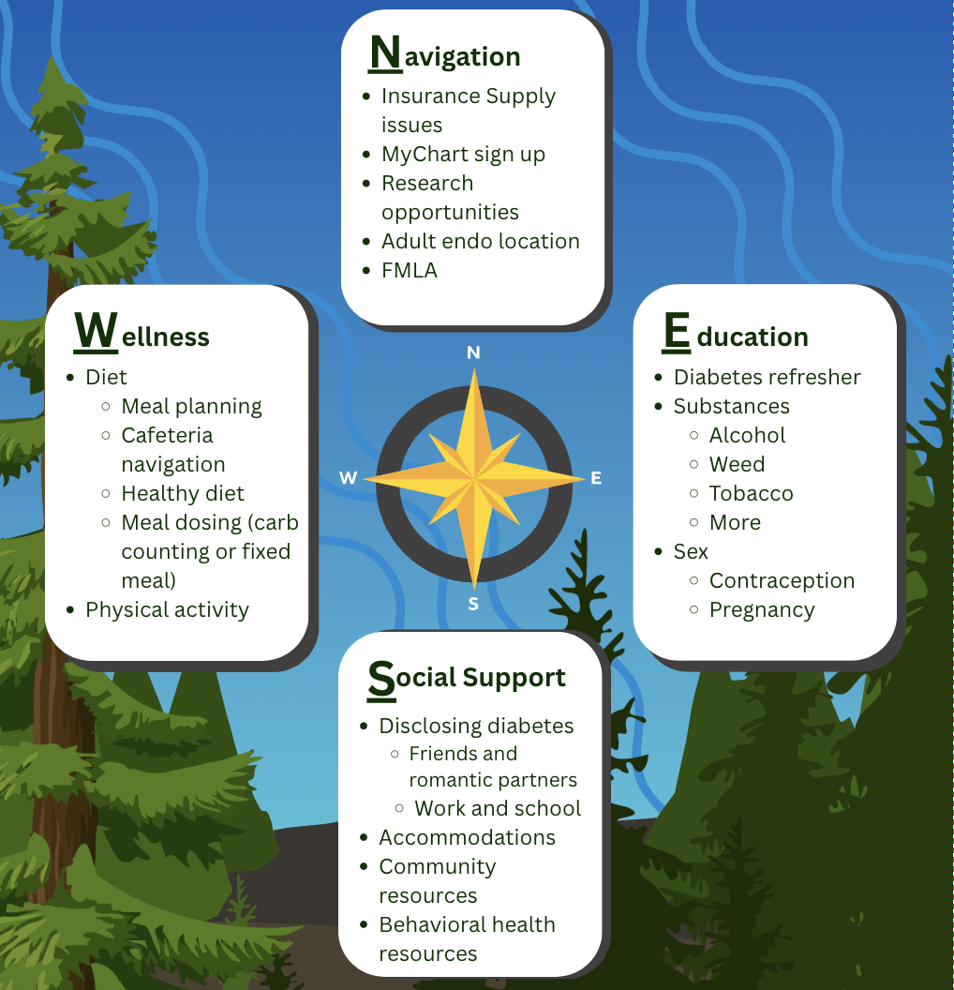
COMPASS Curriculum
Goal to improve discussion rates by involving a multidisciplinary team
Providers
Diabetes educators
Dietitians
Social workers
Patient navigators
Piloting the process within the monthly transition clinic before wide-spread adoption into routine clinical care

Slide 36

Exploring the Emotional Impact of Clinical Encounters Among People Living with T1D
Claire Rainey, BA; Alyssa Cabrera, MPH, CPHQ; Nicole Rioles, MA;
Notes:
Good morning!
My name is Claire Rainey, and I’m a Quality Improvement Analyst at T1D Exchange
I have been living with type for almost 5 years, and today I am going to talk about the Emotional Impact of Clinical Encounters Among People Living with T1D
Before I dive in, I want to take a moment to acknowledge my audience. I know I’m speaking to clinicians who already go above and beyond when it comes to empathy and connection. My goal today isn’t to criticize, but to bring awareness to some of the negative experiences people with type 1 face, and then build on the great work you’re already doing by thinking together about how we can make positive, supportive experiences the norm for everyone living with type 1

Slide 37
Background
T1D misconceptions contribute to judgement and stigma that affect people with T1D (PwT1D) across many aspects of their lives — including clinical care
The aim of this study is to explore how communication in the clinical setting can influence PwT1D behavior and the quality/frequency of care that PwT1D receive
This study explores:
The impact of judgmental or dismissive clinical interactions on PwT1D behavior and attitude regarding their care
How negative experiences can shape trust or mistrust in providers and future engagement with care
The importance of clear, respectful, bi-directional communication in fostering person-centered care
Notes:
- These misconceptions are not exclusive to interactions with family, friends, or things you might see in the media. They can occur in clinical settings too.

Slide 38
Methods
This study employed a qualitative approach, asking people from the T1D community, including people responding to the Question Of The Day from the T1D Exchange and T1DX staff members living with T1D, to share personal narratives and insights based on lived experience
We gave them the following prompt:
We're exploring how trust is built — or broken — between clinical staff and people with T1D, especially through communication. Often, trust erodes when staff speak or act from a place of judgment or assumption. We're gathering real experiences to better understand this dynamic.
Have you experienced judgment or assumptions from clinical staff?
How did you respond?
How did it affect your ability to stay open or engaged with them or that clinic?
Notes:
The clinical staff included non-diabetes specialist care, endocrine care, primary care, front-line staff, check-in staff, staff who answer the phone
- Those who play a role in your clinical experience from start to end

Slide 39
Methods
6 themes were identified across the stories shared:
Moral Judgement and Negative Framing
Dismissal of Lived Experience
Misinformed Care
Unprofessional Interactions
Emotional Guarding
Inadequate Support
Notes:
We used inductive coding to analyze the stories that were shared and identified 6 major themes.
Emotional guarding: Withholding and withdrawal, disengagement, loss of openness and trust
Inadequate support: refers to unmet needs - Patients are left feeling isolated or unseen, rather than empowered and understood.

Slide 40
Living with T1D for 5 years
"I had just made the switch from a pediatric endocrinologist to an adult endocrinologist, and it was my first appointment at the new clinic. I didn't know where I was supposed to go for the appointment, so I asked the front desk security person.
I asked him where I needed to go for my diabetes appointment. He said, 'diabetes? you have diabetes? you don't have diabetes you don't eat a lot of junk.' I was baffled by his response to my simple request of asking him for directions. I felt the need to tell him that T1D is not caused by eating too much junk food.
He gave me directions, and I walked to the waiting room feeling sad and uncomfortable. This particular diabetes clinic is known throughout the world for their commitment to care and empowerment of patients, however I felt belittled and judged in my first encounter there."
Unprofessional Interactions
Dismissal of Lived Experience
Emotional Guarding
Moral Judgement and Negative Framing
Notes:
I want to highlight a few of the stories that were shared.
Summarize story, pick out one quote, and at the end say the result of what happened Summary -- At her first adult diabetes clinic visit, the speaker was met with a dismissive, judgmental comment from a front desk staff member, leaving her feeling belittled and uncomfortable before even seeing her care team.
Read second and third paragraph Result This story is unique because the negative comment came from a security guard. It highlights that everyone in a clinical setting—no matter their role—plays a significant part in the patient experience, and what they say truly matters. Additionally, because this was the patient’s first visit at the adult clinic, the encounter set the tone for all future appointments.

Slide 41
Living with T1D for 28 years
“In a 20 min OB/GYN appt to discuss a gyn issue, the NP I saw spent the first half of the visit talking about my A1c. "Your level is 6.2% now. It was 5.8% in your last visit. It's not moving in the right direction." I looked at her blankly and said: "You know that the Standard of Care goal is 7% and it's adjusted to 6.5% only for people for when it is safe, and I am below both, right?"
She reiterated it was "moving" in the wrong direction and that this can be a dangerous over time. I felt the need to mention my TIR, but also felt panicked, knowing that there would not enough time to talk about the gyn topic that I was visiting for.
As a person who has been hospitalized 20 times for severe hypoglycemia, keeping A1c below 7% has never been a recommendation of my endocrinologist. Instead, he supports me in trying to keep time below 70mg/dL below 4%.
I felt angry and resentful that she was not giving space for the important topic for the visit and was instead focusing on something that she had no history with and no expertise with.”
Moral Judgement and Negative Framing
Misinformed Care
Inadequate Support
Unprofessional Interactions
Notes:
Summarize story, pick out one quote, and at the end say the result of what happened
Summary -- During a short OB/GYN visit, the nurse practitioner fixated on a small change in A1c rather than the reason for the appointment, disregarding both context and the patient’s endocrinologist’s guidance. This left the patient feeling dismissed, panicked, and resentful that her actual concerns were overlooked. – Her immediate needs were not addressed. – Not everyone is in a position—or has the knowledge—to challenge or correct misinformed comments. – Universal theme: there is often not enough time in healthcare for meaningful, patient-centered conversations.

Slide 42
Living with T1D for 12 years
"My provider at the time would pull up my pump and CGM reports and ask what I was doing at a specific time before a spike or before going low, etc. When I answered honestly, she would often clarify what I was saying with a furrowed brow, as if in disbelief. And to be fair, I was 22, so I was doing questionable things and was probably too honest about that with her, but I felt really judged. At one point, she had me schedule an appointment with their social worker, which meant I had to pay a copay and take a half-day off work, at a time in my life when I was living paycheck to paycheck. After a brief conversation with the social worker, she was like, "Yep, sounds like you're 22, I'm not worried.“
At my next appointment with the provider, I told her about the social worker visit. She seemed irritated. I was never honest with her again and answered all of her questions with as few words as possible.
Later, I participated in a clinical trial at a different institution for an SGLT-2 inhibitor, and during the trial, my A1C level was 5.4% at my regular endocrinology visit. After the trial was over, during my next visit with my provider, I had an A1C somewhere in the low 6s, which was still lower than my usual A1C. She furrowed her brow and said, "Are you sure you're not taking the SGLT-2 still?" and I said, "No, the trial is over" and she said, "But could you still be getting it?” I was so shocked that she was insinuating I was getting an SGLT-2 inhibitor under the table and lying about it. After that, I never went back or told them I was switching hospitals, just stopped responding to them.”
Dismissal of Lived Experience
Moral Judgement and Negative Framing
Emotional Guarding
Notes:
Summarize story, pick out one quote, and at the end say the result of what happened
Summary -- The speaker describes feeling repeatedly judged and disbelieved by their provider, whose skepticism and inappropriate referrals eroded trust to the point that the patient stopped being honest and eventually left the practice without notice.
This story demonstrates a complete loss of trust. There is nothing left
Think about privilege and socioeconomic status – patients can easily be completely lost in the system
This is her POV, but the doctor might have a different one
They might not know that she was deeply unhappy and abandoned the practice

Slide 43
Results
Frequency of Identified Themes Across Participant Responses
Themes | Theme Descriptions | n
1. Moral Judgement and Negative Framing | When clinicians frame diabetes outcomes as personal failings or moral shortcomings, rather than as part of a complex medical condition. | 10
2. Misinformed Care | Providers or staff operate from inaccurate assumptions about T1D, leading to misguided advice or misplaced focus. These knowledge gaps can harm both trust and quality of care. | 10
3. Dismissal of Lived Experience | Ignoring or minimizing a patient’s experience with T1D. | 9
4. Unprofessional Interactions | Tone, language, or behavior cross boundaries of respect or empathy. Even brief comments or nonverbal cues can damage a patient’s sense of safety and dignity. | 9
5. Emotional Guarding | Withholding and withdrawal; loss of openness and trust after negative experiences. | 8
6. Inadequate Support | When emotional, informational, or practical needs go unmet during care. Patients are left feeling isolated or unseen, rather than empowered and understood. | 7
n = Number of instances when the specific theme was discussed in shared stories
n = 53

Slide 44
Key Takeaways
Every interaction matters — even brief or subtle comments can leave lasting emotional impact
Clinicians and clinic staff hold immense power to shape how people feel about themselves and their care
These encounters are more common and more harmful than many realize — awareness is the first step toward change.
People with T1D face frustrations beyond the clinic (insurance, cost, stigma) — compassionate, empathetic care helps lighten that burden
Notes:
Even someone with zero healthcare training can set the tone for their clinical experience and can either make people feel supported or make them feel knocked down by the interaction → point to experience with the security guard being judgmental about behavior

Slide 45
How You Can Make a Difference
Regardless of specialty or role, basic human decency and respect builds trust
Your empathy and respect ripple outward — influencing staff, trainees, and other providers
Lead with active listening, empathy, and respect
Celebrate progress, validate emotions, and model compassion across your team
Aim for every person to leave your clinic feeling heard, safe, and respected
Be mindful of bias or stigma when interviewing candidates to help create a positive, welcoming work environment
Notes:
Even someone with zero healthcare training can set the tone for their clinical experience and can either make people feel supported or make them feel knocked down by the interaction → point to experience with the security guard being judgmental about behavior

Slide 46
Q&A
Contact: crainey@t1dexchange.org
Notes:
Do we know the background of these people?
The group largely reflects the QOTD population which skews slightly older, female, private insurance, device using, and more than 70% white
Insulin pump use: ~80-90%
CGM use: >95%
Insurance: About half have private, employer-provided insurance plans and about 1/3 have Medicare
Race: ~80-90% white
No specific gender questions, but anecdotally, skews female
Duration of T1D:
~5% diagnosed within the past 5 years
~78% have had T1D for more than 25 years
~31% have had T1D more than 50 years
Suggestions on how to train staff
Important to remember that every interaction sets the stage for the patient experience
Validate the role that everyone at the practice has
Don’t just include clinicians, but include all staff that is part of the patient experience
Hospital have ways of evaluating pt experience, there are large companies that do a practice survey (survey questions are extremely generic so do not show real experiences – imperfect system)
Opportunities for clinics to make space so that patients can be more honest - and clinics can learn more from honest feedback

Slide 48

Section Header Here Subtitle Here
Lunch
Perspectives from People with Diabetes
Whitley Ballroom
12:15 – 1:15pm

