Slide 1
2025 Annual Survey Results
Preliminary High-Level Findings from Annual Survey

Slide 2
Overview
Conducted August – October 2025 to collect 2024 data
Sent to 64 centers
42 Pediatric and 21 Adult centers responded
76 questions, 12 sections
Demographics
Center Staffing/FTE Summary
T1D Screening, Staging, and Monitoring
Teamwork, Targets, Technology, and Tight Glycemia (4T)
Dietician Support
Health Equity
Health Care Transition
GLP-1 Use in Children with T2D
Economic Impact
Ketone Monitoring

Slide 3
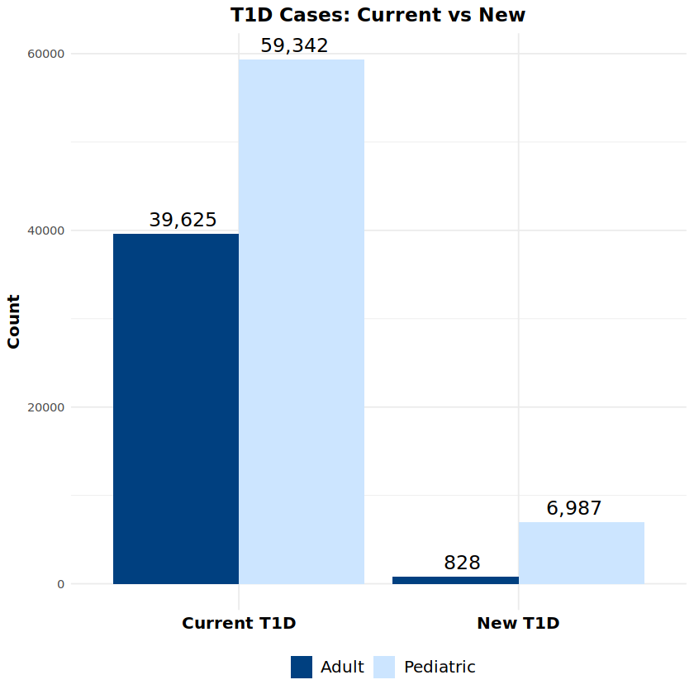
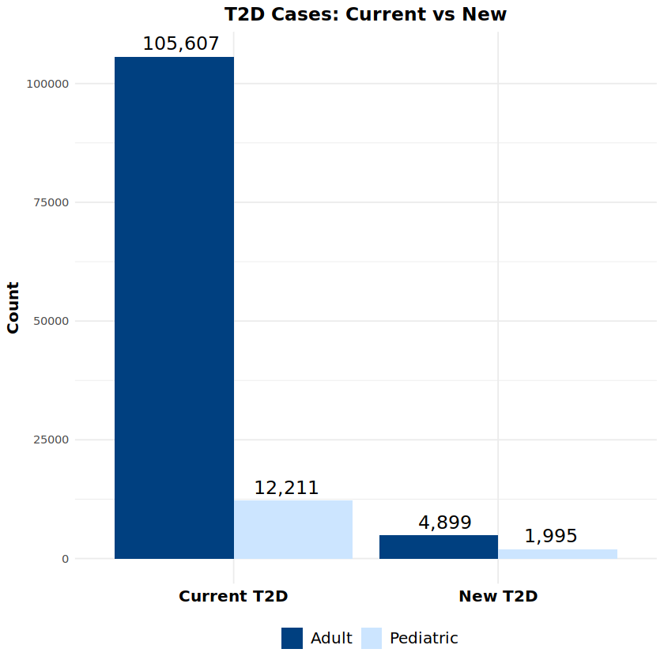
Demographics - Total PwT1D and PwT2D in 2024

Slide 4
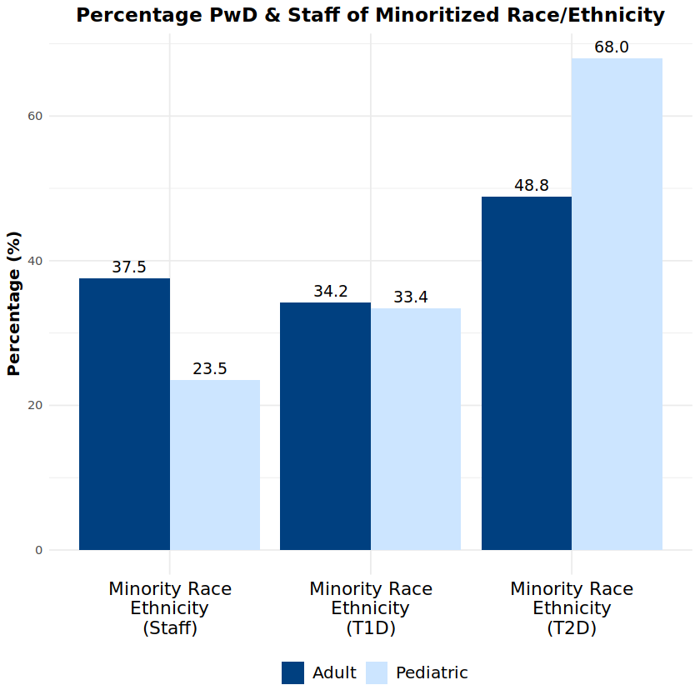
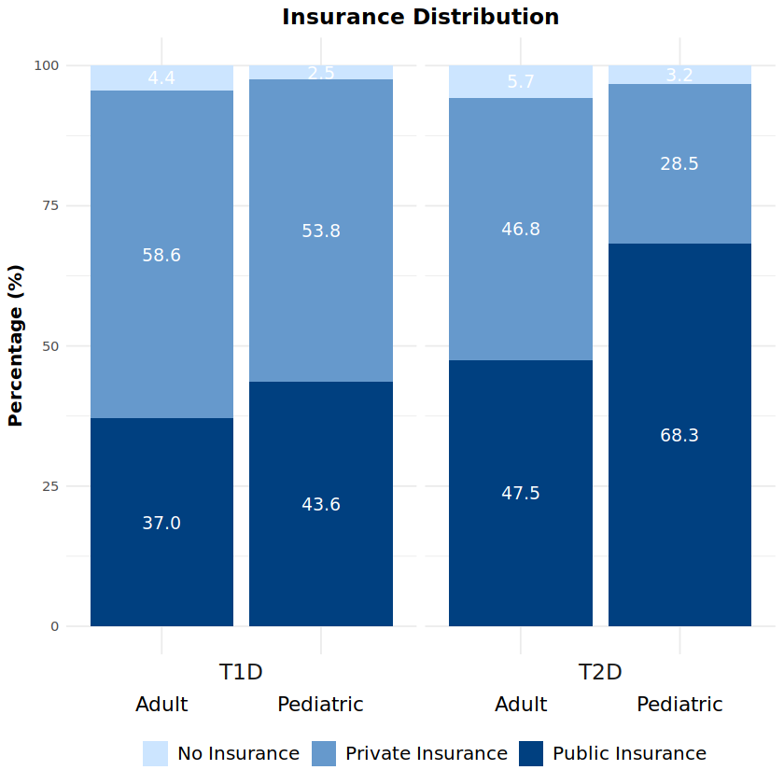
Demographics

Slide 5
Center Staffing/FTE Summary

Slide 6
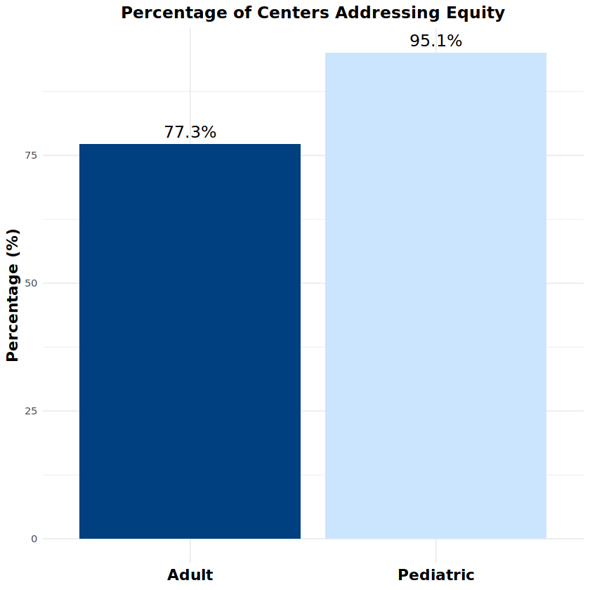
Health Equity

Slide 7
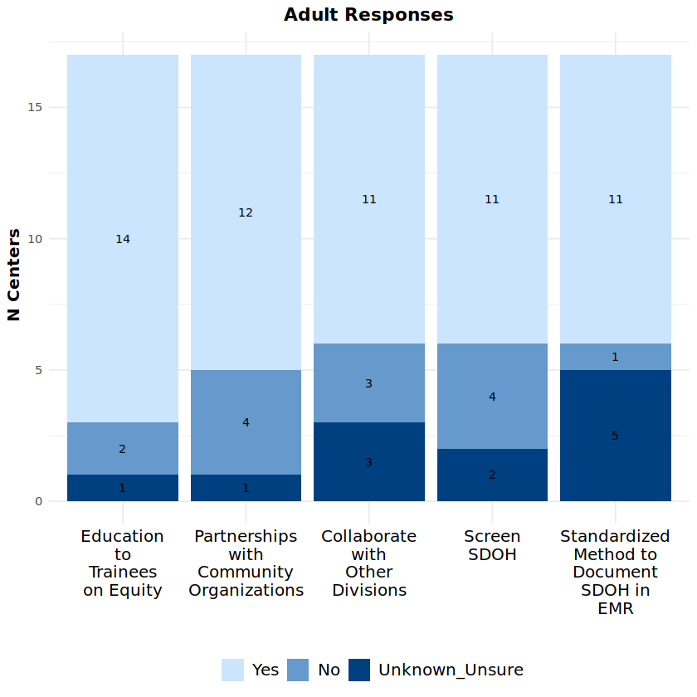
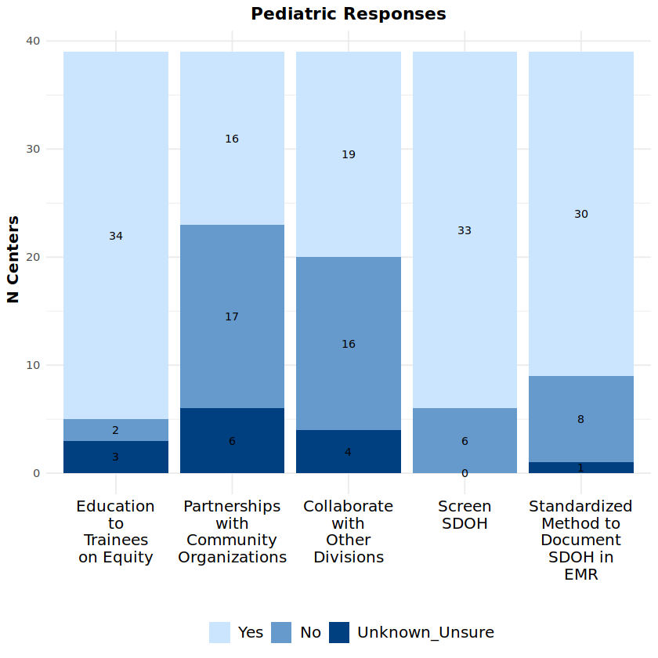
Health Equity – Measure/Programs Addressing Equity

Slide 8
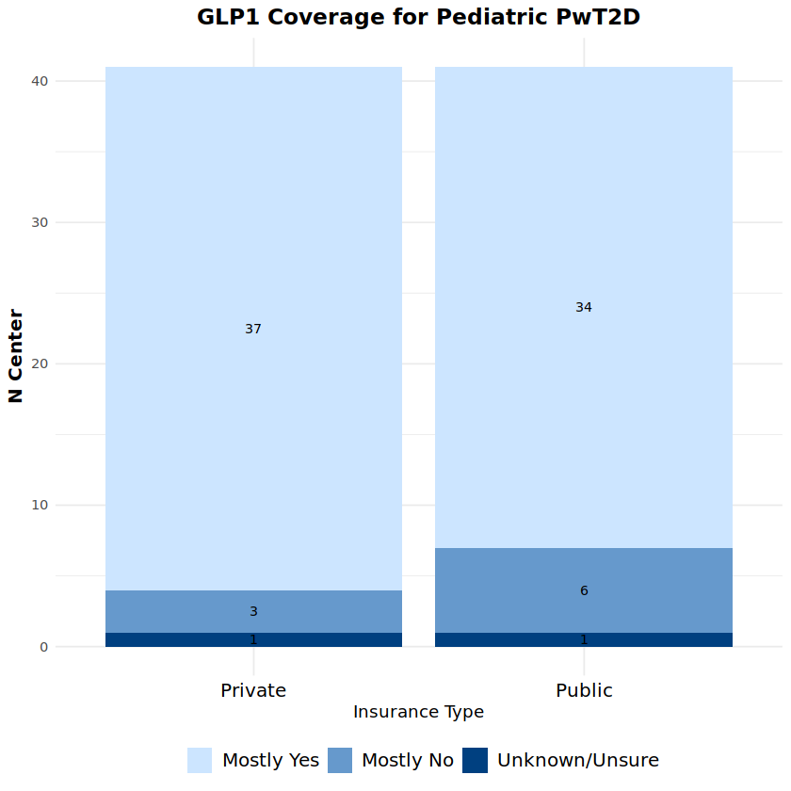
GLP-1 Use in Children with Type 2 Diabetes
Collaborative wide pediatric PwT2D being treated with GLP-1
46%

Slide 9
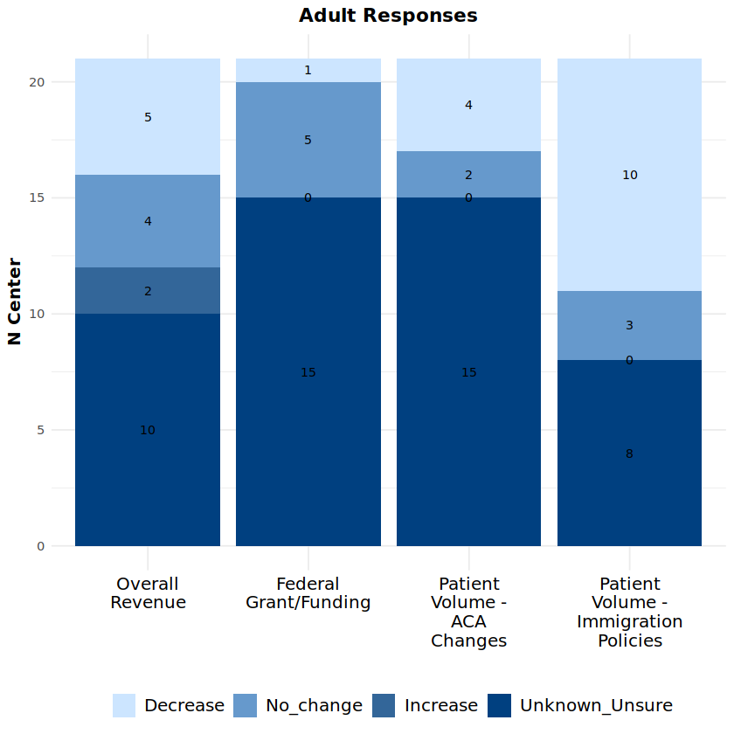
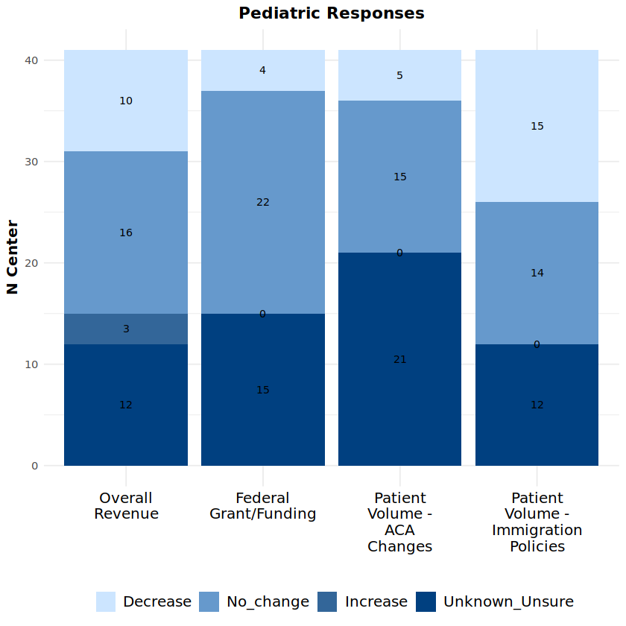
Economic Impact – Jan 2025 to Present

Slide 10
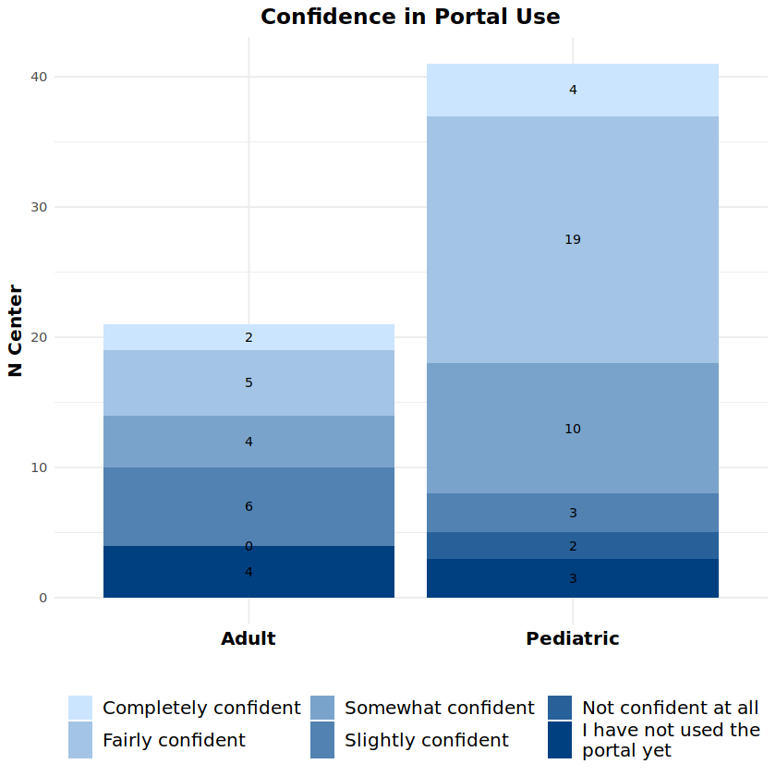
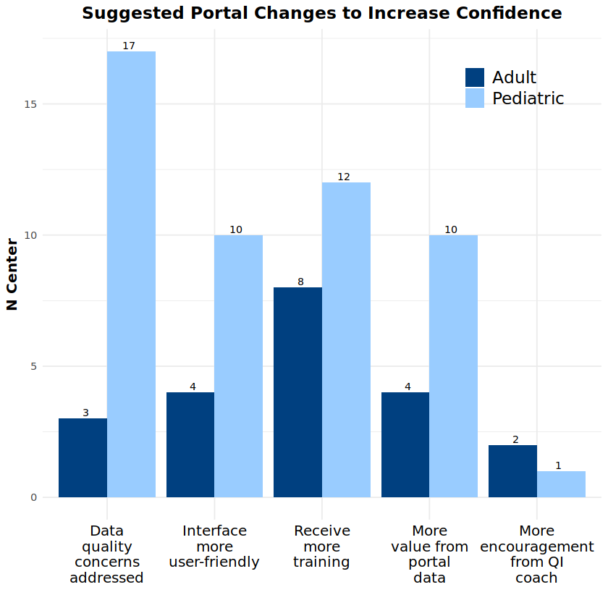
T1DX-QI Experience – QI Portal

Slide 11
2025 Annual Scorecard Overview
Data Availability Report

Slide 12
Overview
Annual data scorecards were completed for each data-mapped center
Scorecards assess data availability and completeness for key variables outlined in the T1D Data Specification
Data Timeframe: July 2024 – July 2025
Calculated data availability for each variable and compared collaborative-wide averages
10 adult centers and 23 pediatric centers

Slide 13
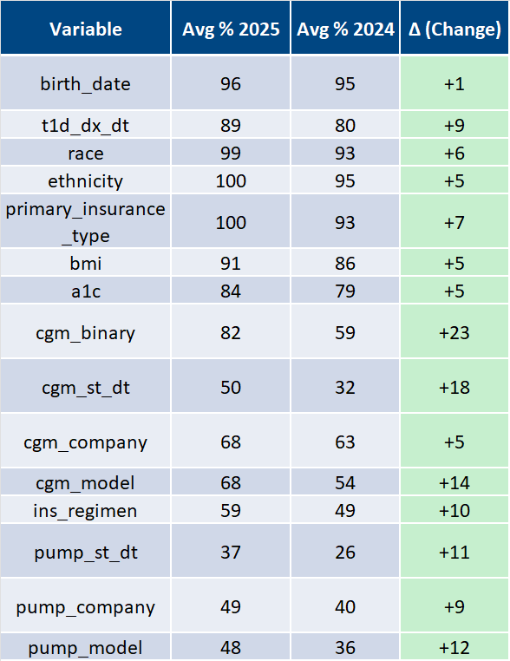
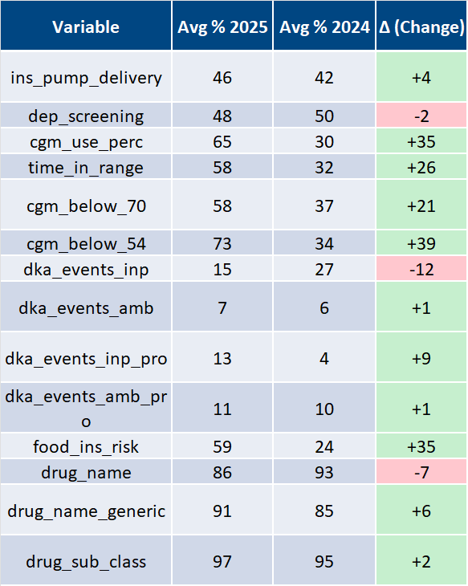
Collaborative-Wide Averages
Notes:
Centers that were not reporting a variable were excluded from average calculation

Slide 14
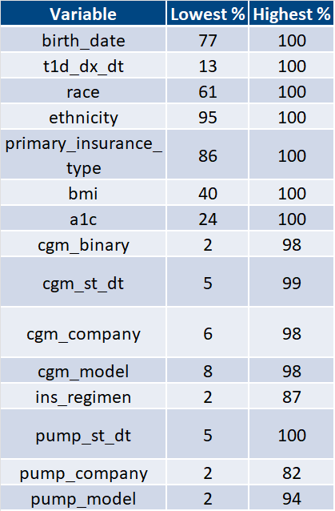
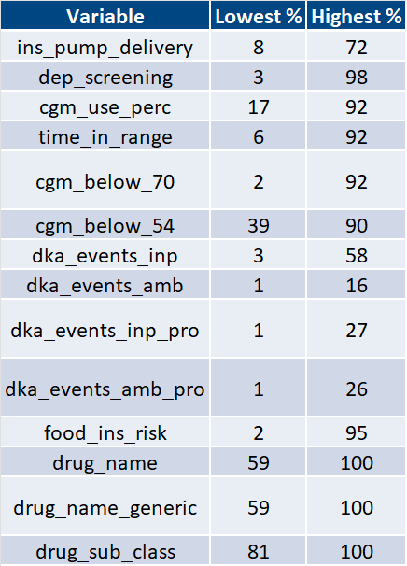
Collaborative-Wide Ranges

