Slide 1


The Silent Threat: CVD in Type 1 Diabetes and When to Start Statins.
Marina Basina MD
Notes:
Underestimated or underappreciated burden of CVD in type 1 DM: Navigating Uncertainty or controversies of statin initiation.

Slide 2
Patient cases
Patient A
Patient B
30-year-old male, T1D since 6 yo, no complications, no FH of CVD, + FH of HLD, avid athlete, on Tandem CIQ, A1C 6.2-6.6%
TC 222, TG 51, HDL 75, LDL 130
54 yo male with T1D since 21 yo, no complications, no FH of HLD or CVD, on Loop, A1C 5.7-6.1%, rare hypoglycemia, avid athlete
TC 198, TG 53, HDL 80m LDL 75
A. Start patient A on statin therapy
1
B. Start patient B on statin therapy
2
Start both patients on statin therapy
3
Obtain additional tests for patient A or B, or both
4

Slide 3


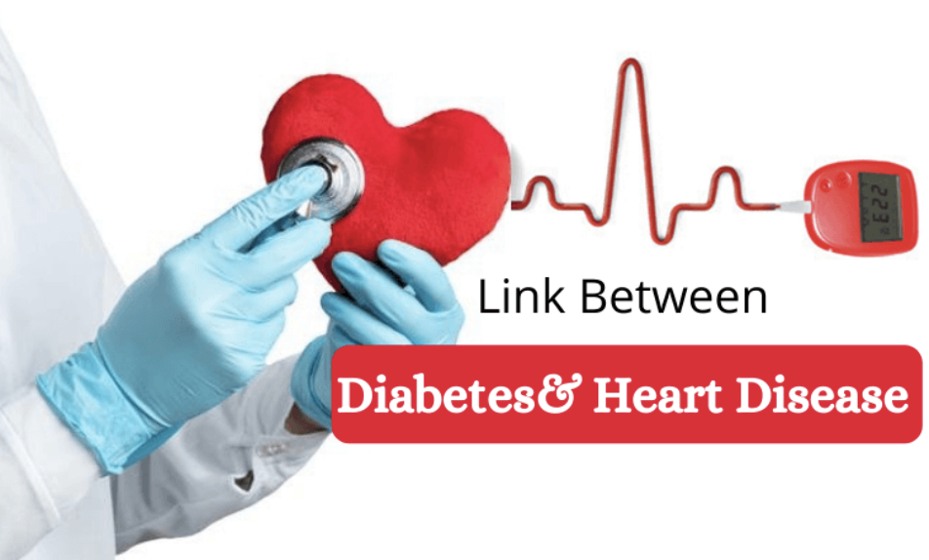
Type 1 DM and CVD
T1D – 1 in 300 people by the age of 18 yo and incidence is rising
Adolescents with T1D show subclinical atherosclerosis similar to FH
56% of T1D in T1DX registry are either overweight or obese
IR is common despite non-IR lipid profile
Developing T1D before age 10 years:
- results in a loss of 17.7 life-years for women and 14.2 life-years for men
- ~ 30-fold higher risk of MI compared with general population (Lancet 2018; 392)
Ds after 20 yo --> loss of 10 life-years

Slide 4
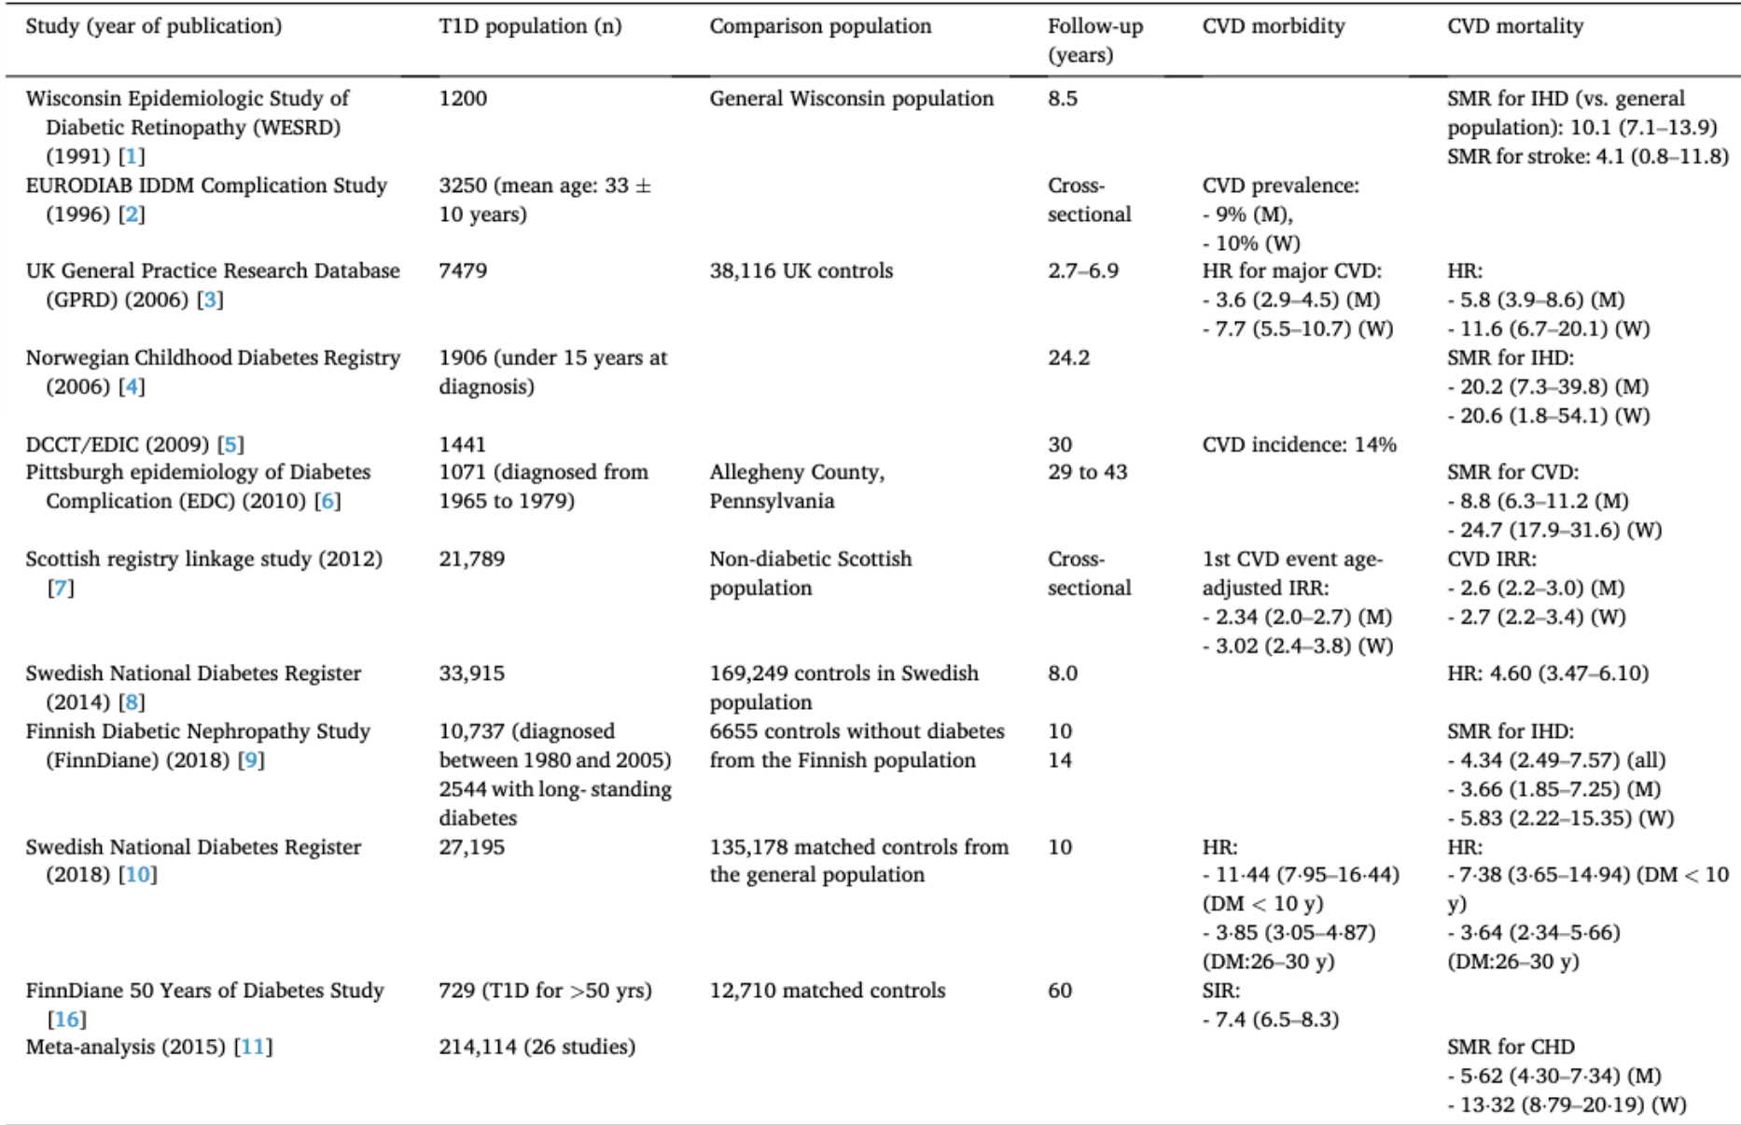
Age-matched population
Epidemiological Data on CVD in T1D
Verges, Atherosclerosis 394 (2024)
SMR standardized mortality rate, SIR standardized incidence rate, IRR – incidence rate ratio
Notes:
From CVD and underestimated danger paper
SMR standardized mortality rate, SIR standardized incidence rate, IRR – incidence rate ratio

Slide 5

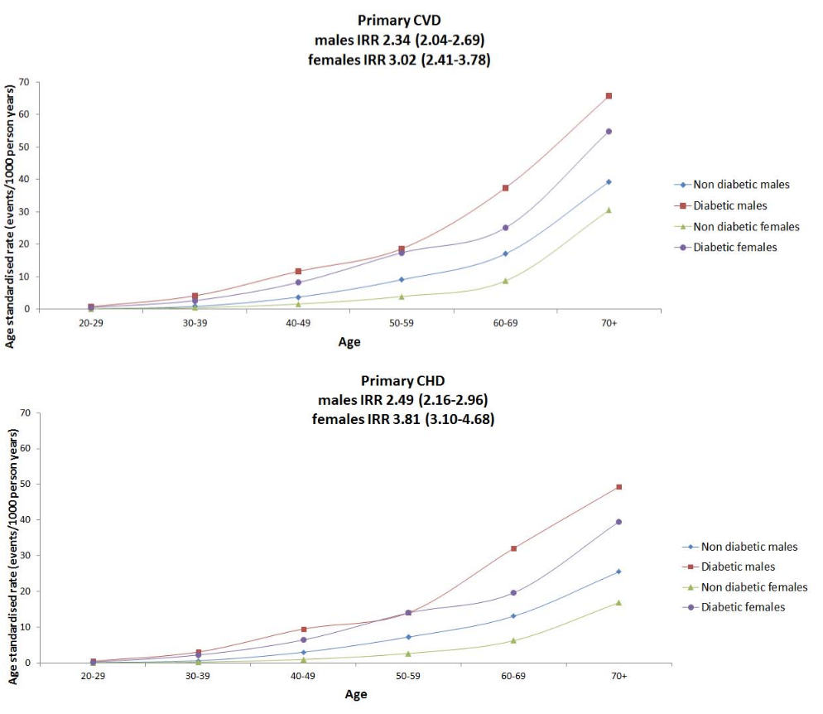

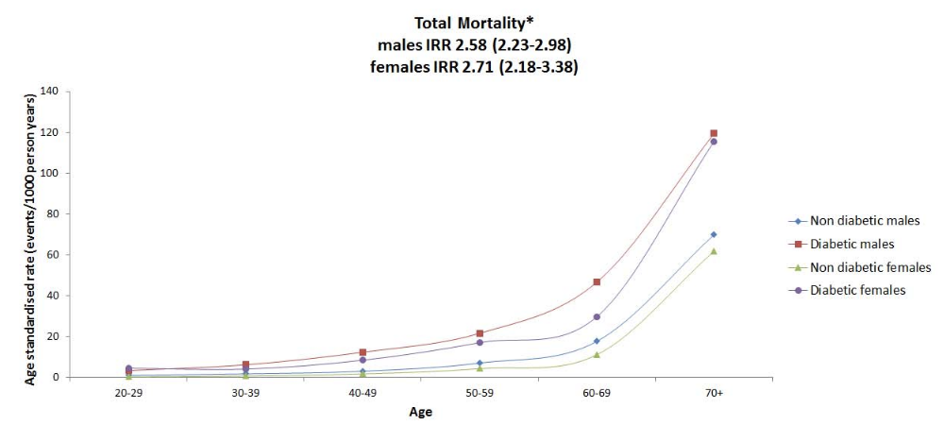
Epidemiology: Younger Age
Higher CVD 1st event in younger patients => earlier onset of CVD
Scottish Registry Linkage Study (PLOS Medicine, Oct 2012)
T1DM (n = 21,789) versus the non-diabetes population (3.96 million)
Notes:
We evaluated these risks in adults with T1DM compared with the non-diabetes population in a nationwide study
from Scotland and examined control of CVD risk factors in those with T1DM. the age-adjusted incidence rate ratio (IRR) for
CVD and mortality in T1DM (n = 21,789) versus the non-diabetic population (3.96 million) was estimated using regression analysis. The age-adjusted IRR for first CVD event associated with T1DM versus the non-diabetic population was higher in
women (3.0: 95% CI 2.4–3.8, p,0.001) than men (2.3: 2.0–2.7, p,0.001) while the IRR for all-cause mortality associated with
T1DM was comparable at 2.6 (2.2–3.0, p,0.001) in men and 2.7 (2.2–3.4, p,0.001) in women.

Slide 6
Epidemiological Data
Norway and Sweden Nationwide study in 59.331 patients with T1D and 484.241 with T2D: higher incidence of CV events in T1D, higher rates of MI and stroke (Kristofi et al, Diab Care 44(5), 2021)
UK General Practice Research Database HR for MACE was
2.3 in men 65-75 years vs 11.3 under 35;
4 in women > 75 yo compared to 15.4 women 35-45 yo (Diab Care 29 (4) 2006)
Higher risk with early DM onset: Nationwide Swedish Study DM onset < 10 yo → 4-fold higher CVD incidence compared to onset 26-30 yo (Lancet Lond Engl 392, 2018)

Slide 7

Gender Differences
Higher risk F>M in CHD, not in Cerebrovascular Ds
M>F in PVD
JCEM 2023 Dei Cas et al (Italy)
Sex Differences in CVD and CV Risk Estimation in Patients with T1D
Retrospective, multicenter, observational study in 11 Italian Diabetes Outpatient Clinics participating in Study Group on DM and Atherosclerosis of Italian Society of DM
Inclusion criteria: T1D > 18 years old
Exclusion: pregnancy and other than T1D diagnoses
Extracted data: age, sex, T1D duration, age at diagnosis, BMI, BP, A1C, TC, Tg, LDL, HDL, liver enzymes, creatinine, e-GFR, CKD stage > 3 (e-GFR<60)
Lancet Diab Endocr 3(3) 2015
Mean 3-year A1C calculated
Smoking –”yes” for current smokers
Exercise “yes” for > 3.5 hr/wk
The Journal of Clinical Endocrinology & Metabolism, 2023, Vol. 108, No. 9
Notes:
The reason for higher ischemic HD in women is unknown.
SMR standardized mortality rate
Chronic Kidney Disease Epidemiology Collaboration (CKD-EPI) study equation

Slide 8
Gender Differences (cont.)
Insulin TDD and modalities of insulin therapy (MDIs, CGM, insulin pump)
Data on Micro- and Macrovascular complications
Information on max carotid plaque lesion as max % stenosis on Uls
10-year CVD risk was estimated in primary prevention for CVD using the Steno type 1 risk engine
The Journal of Clinical Endocrinology & Metabolism, 2023, Vol. 108, No. 9

Slide 9
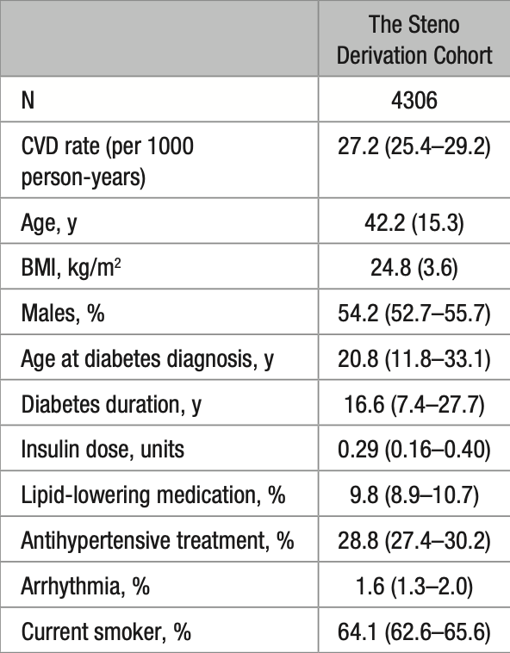
The STENO T1 Risk Engine
CVD prediction model by using 4306 adults with T1D attending Steno DM Center in Denmark
CVD defined as a composite fatal and non-fatal events of IHD, ischemic stroke, HF, and PAD
Median FUP 6.8 years: 793 (18.4%) patients developed CVD
2 stage approach for risk prediction model: non-parametric/data driven and poisson regression analysis
External validation was in T1D Funen DM database in Denmark
Included entire adult age range (18-90 yo), both newly diagnosed and long-standing DM
~ 1 out of 3 patients diagnosed with T1D after 30 yo
Circulation. 2016;133:1058-1066
Notes:
Included entire age range

Slide 10
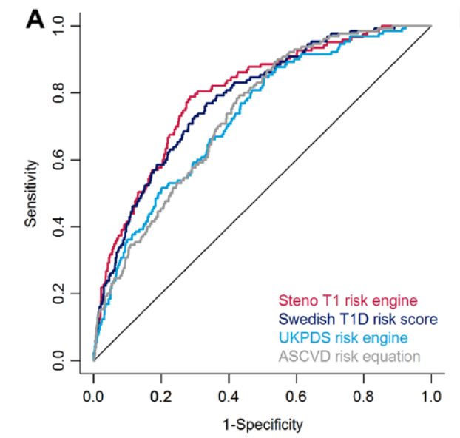
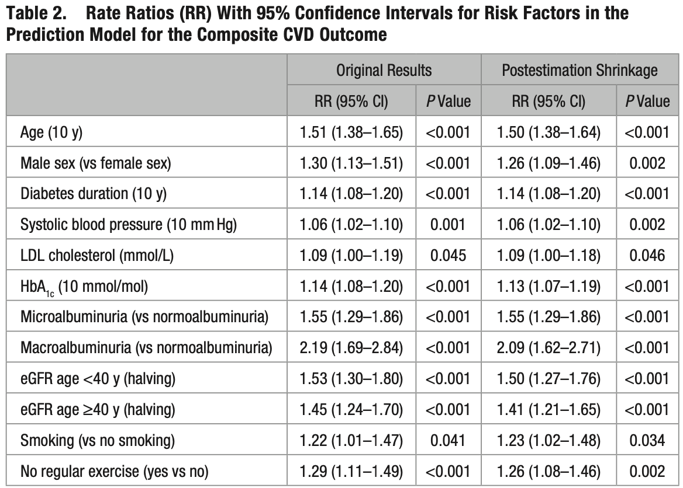
The STENO T1Risk Engine
The first CVD model to include both albuminuria and eGFR
Current risk models for general population and T2D underestimate the risk in T1D
An interactive Web-based calculator is available at www.steno.dk/T1RiskEngine.
Notes:
postestimation parameter-wise shrinkage of the regression coefficients (shrink package in R), based on calibrating the linear predictor using leave-one-out cross-validation (Jacknife).35
Using this approach, weak predictors less correlated with the CVD outcome are shrunken relatively more than the strong predictors in the model.

Slide 11
Comparison of risk calculators
Steno
Franingham
Age
Sex
DM duration
SBP
LDL
A1C
Micro/macro-albuminuria
eGFR
Smoking history
Regular exercise
Age
Gender
TC
HDL
SBP
Smoking status
Use of BP meds
DM status
FH in premature CVD in some versions
<10% low risk, 10-20% medium, >20% high risk

Slide 12
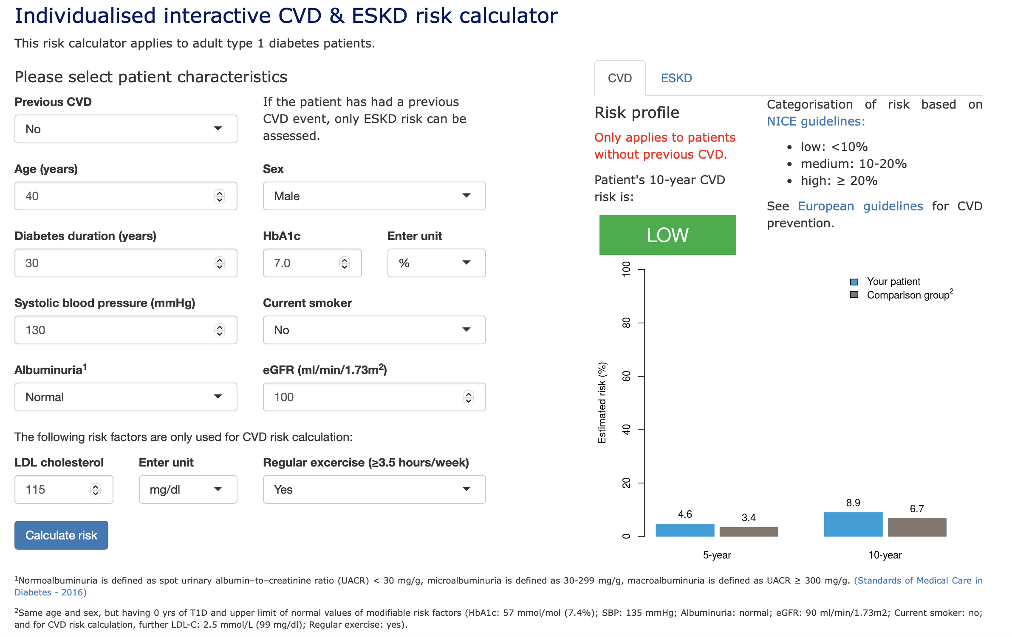
https://steno.shinyapps.io/T1RiskEngine/

Slide 13
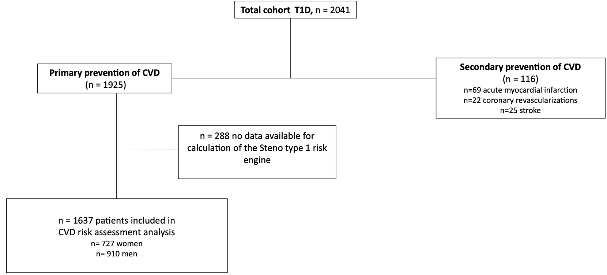
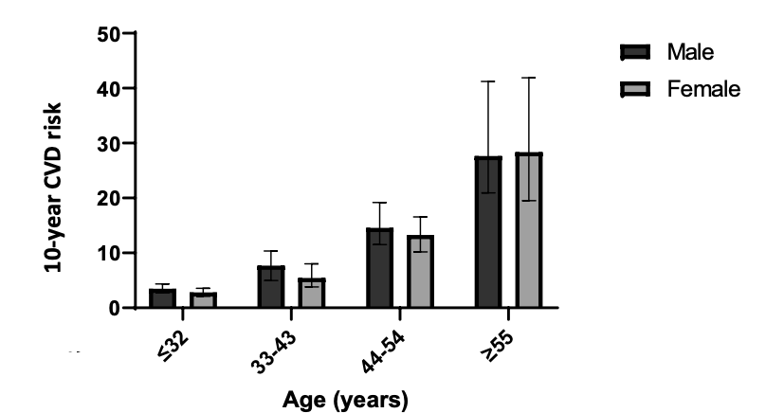
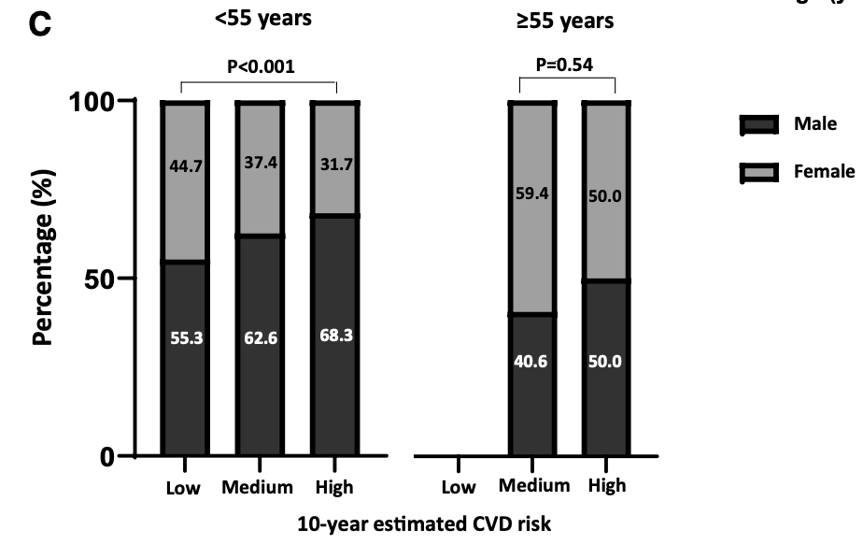
Gender Differences
Distribution of 10-year CVD risk using Steno T1 risk engine in primary prevention cohort
Sex and age quartiles
P<0.001
The Journal of Clinical Endocrinology & Metabolism, 2023, Vol. 108, No. 9
Notes:
Higher risk in male in the first 2 quartiles but no longer significant in the last two quartiles
C – risk category distribution under 55 and over 55 yo

Slide 14
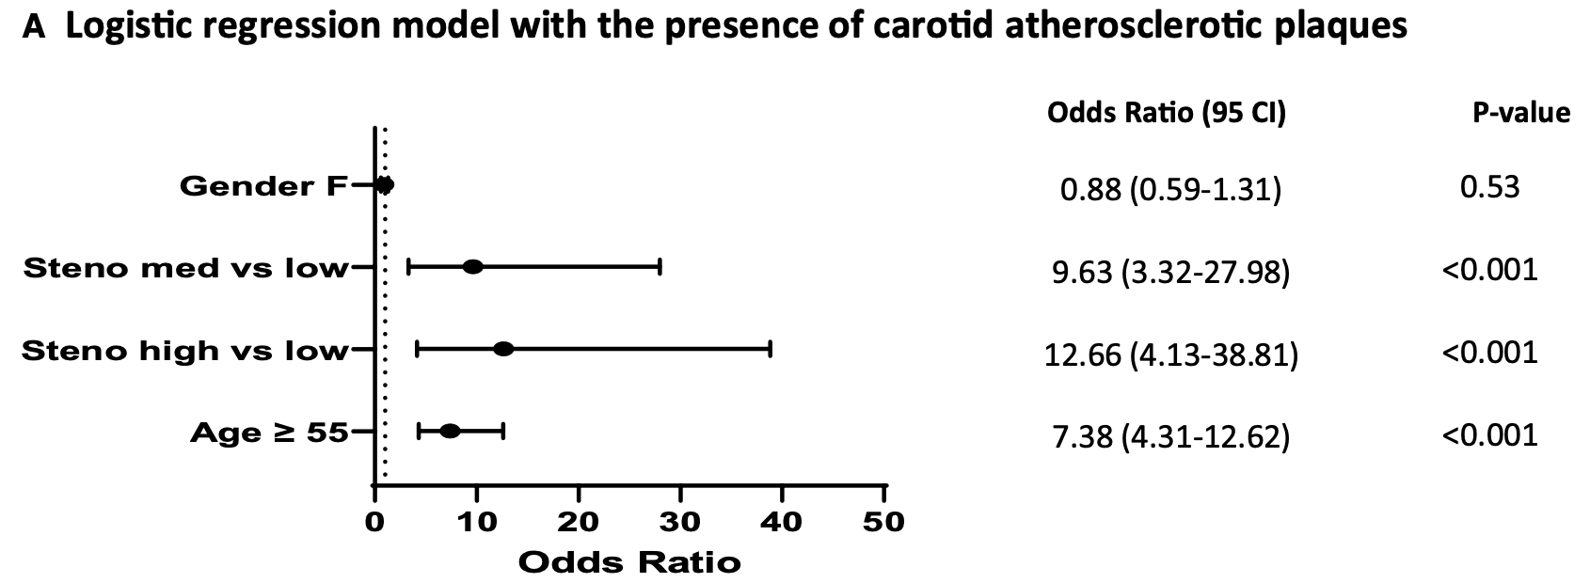
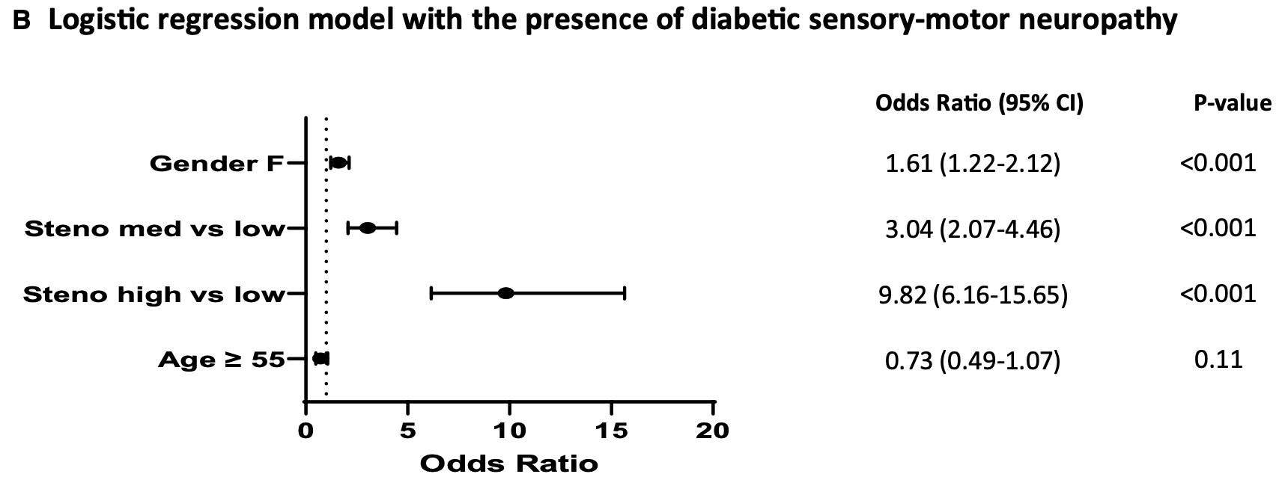
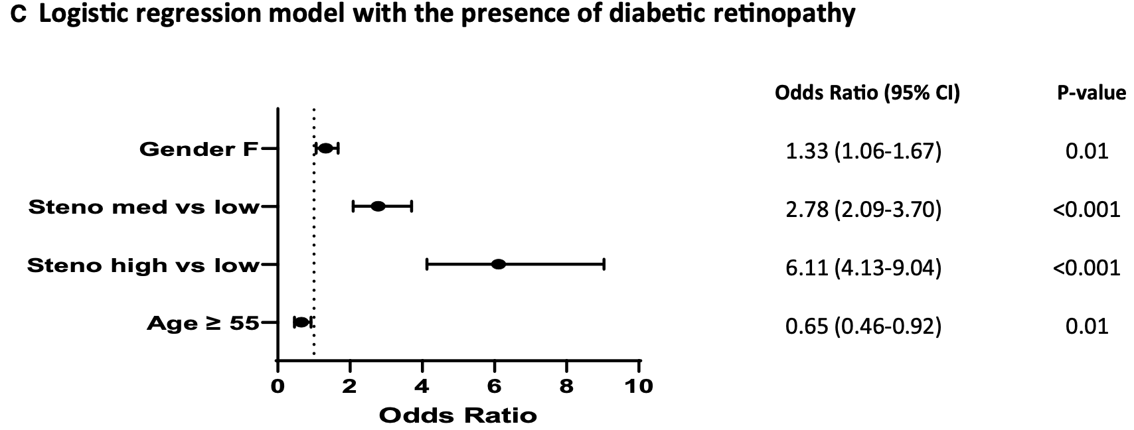
Sex differences in 10-year estimated risk prediction of carotid artery atherosclerosis plaque and microvascular complications
The Journal of Clinical Endocrinology & Metabolism, 2023, Vol. 108, No. 9
Notes:
the performance of 10-year estimated CVD risk score in identifying the presence of carotid atherosclerotic plaques was good in patients aged <55 years, irrespective of sex, but it was less accurate among women and among those with age ≥55 years.

Slide 15
Sex difference in CVD
Retrospective, multicenter, observational study in 11 Italian Diabetes Outpatient Clinics participating in Stud
Both men and women with T1D are at high CVD risk.
The 10-year estimated CVD risk was higher in men aged <55 years than in women of
similar age,
But these sex differences disappeared at age ≥55 years, suggesting the female sex was no longer protective.
The Journal of Clinical Endocrinology & Metabolism, 2023, Vol. 108, No. 9

Slide 16
Role of A1C

Slide 17
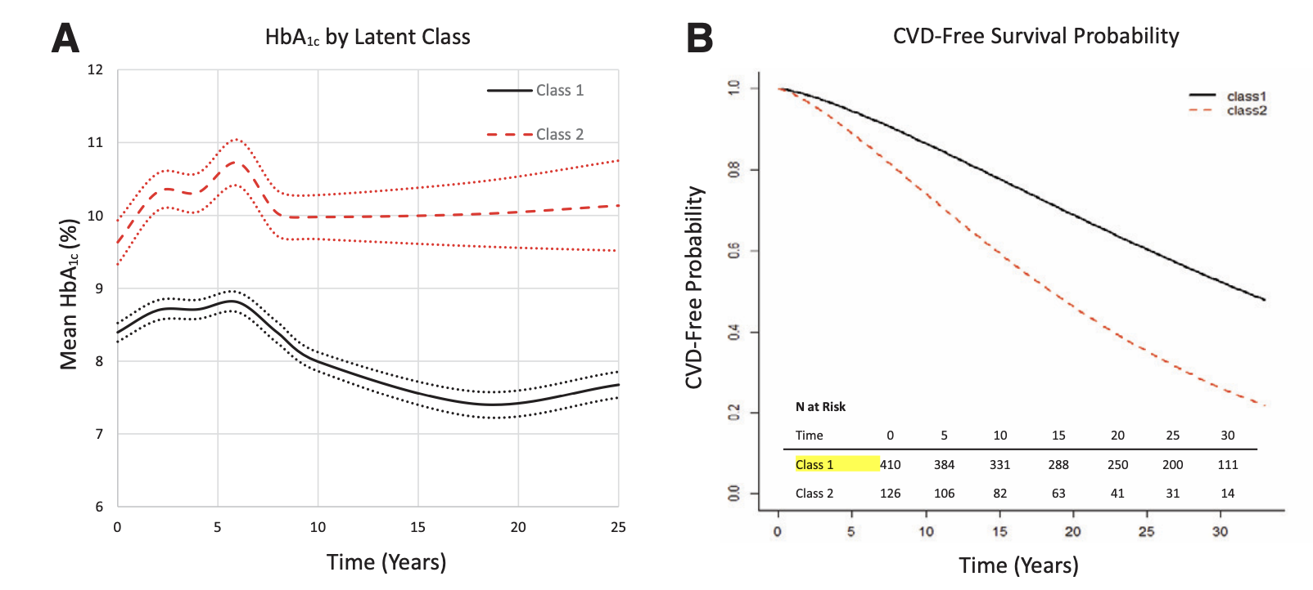
30-year CVD in T1D by long term patterns of glycemic control (Diab Care 2022;45)
Pittsburg Epidemiology of Diabetes Complications (EDC) T1D cohort
Longitudinal, continuous A1C and CVD risk
Prospective cohort study of DM onset < 17 yo in 658 participants
Followed from 1986-1988 till 2016-2018 for total CVD incidence
Each participant had up to 8 measurements of A1C
Over 30 years, 47.4% developed total CVD (n = 253 incident cases) and 31.0% developed MACE (n = 176).
3-point MACE: CVD death, non-fatal MI and stroke.
Class 1: low A1C group 8.4% → 7.7%
Class 2: high A1C group ~ 10% throughout FUP – HR 3.07 risk of total CVD compared to Class 1 and HR 5.1 for MACE, p< 0.0001
Notes:
Evaluated an association of longitudinal total CVD incidence, defined as the first instance of CVD death, nonfatal myocardial infarction (MI; including clinical events and subclinical MI on electrocardiogram [i.e., Minnesota code 1.1 or 1.2]), nonfatal stroke, coronary revascularization procedure, blockage >50%, ischemic electrocardiogram at a study visit (Minnesota codes 1.3, 4.1–4.3, 5.1–5.3, and 7.1), or EDC physician-diagnosed angina.
The secondary outcome was MACE was the first instance of CVD death, nonfatal MI, or nonfatal stroke.

Slide 18
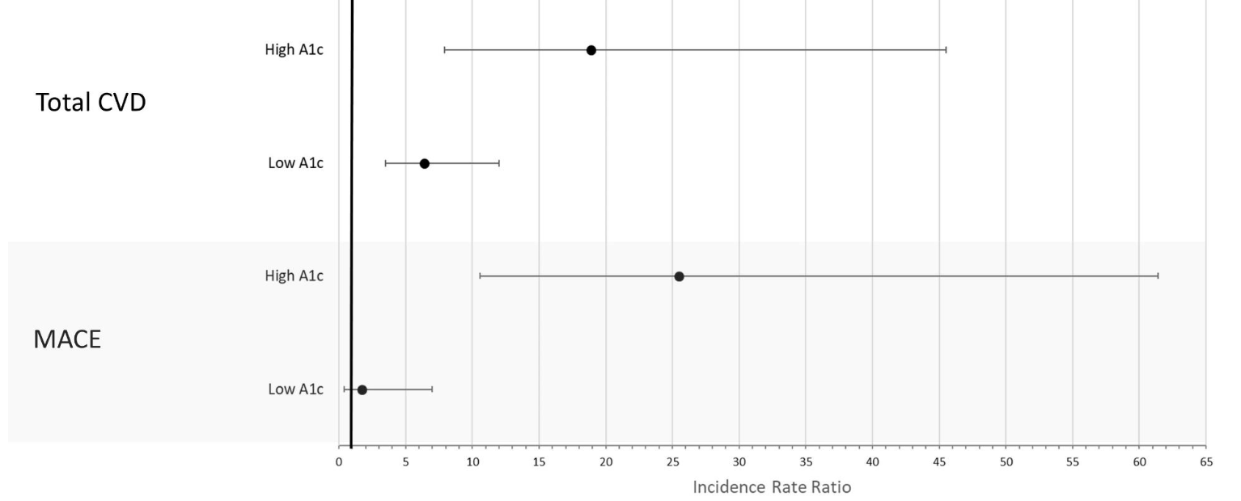
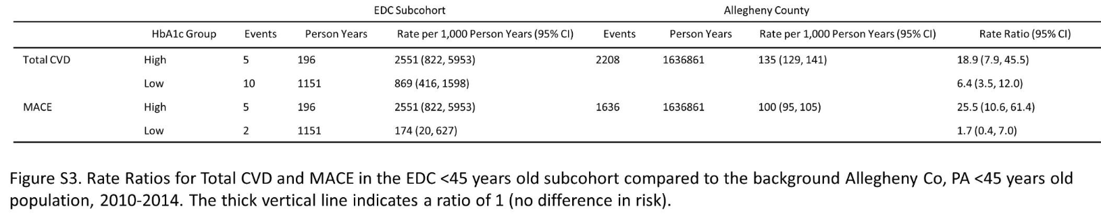
30-year CVD in T1D by long term patterns of glycemic control (Diab Care 2022;45)
Low A1C class:
non-HDLc, eGFR, smoking associated with total CVD
Non-HDLc, SBP, WBC - MACE
High A1C class:
BP meds use, AER – total CVD
AER, eGFR, smoking – MACE
Study doesn’t identify specific A1C cut off point
Notes:
Kidney in high A1c
80% of the incident CVD events observed in low HbA1c were coronary revascularization without prior MI, while the high HbA1c group had only MACE
CVD is more likely to be identified prior to MACE in those with better glycemic control and underscore the complexities associated
with including revascularizations in composite CVD definitions,

Slide 19
Clinical Conclusions
Traditional risk factors may be overshadowed by A1C
Chronically elevated A1C → direct vascular damage by hyperglycemia itself
AER and CVD risk – also result of hyperglycemia vascular damage
In Low A1C, traditional RFs are more apparent => treatment of HLD and BP are as important as glycemic control
Family history of MI – only in low A1C group

Slide 20

CGM Metrics and CV Outcomes

Slide 21
Virtual DCCT
Using DCCT data virtual CGM traces were created
Multistep machine-learning trained on archival SMBG data
Then sequentially added CGM traces
Virtual CGM profiles used to compute CGM metrics and prediction of micro- and macrovascular complications (original DCCT, not EDIC)
Horton et al, Diabetes Technology and Therapeutics 2025

Slide 22
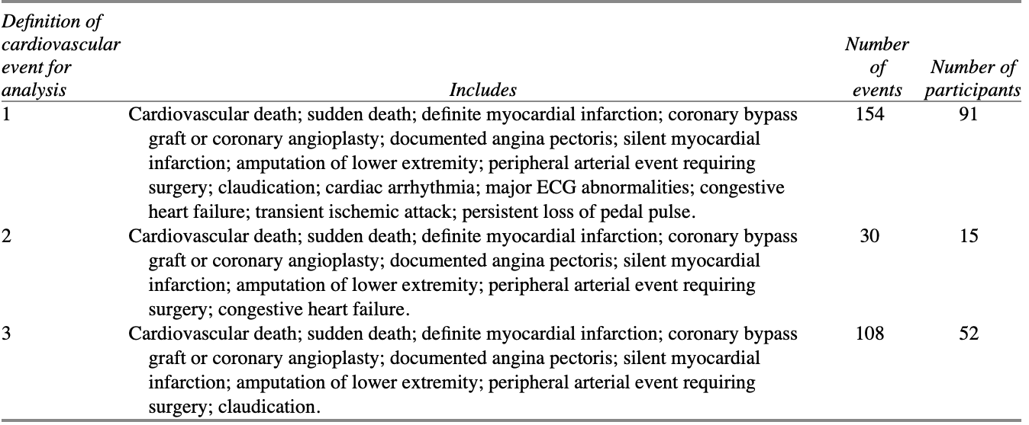
Virtual DCCT and CV Outcomes
Virtual CGM metrics are associated with CV outcomes in people with type 1 diabetes. These findings support the case for CGM metrics to be included as clinical trial primary endpoints for this population.
Horton et al, Diabetes Technology and Therapeutics 2025
Notes:
3 definitions were used

Slide 23
ACS in T1D
Diab Res and Clin Practice 2022;192

Slide 24

Understanding of health disparity in T1D and ACS
Higher short and long-term mortality after MI
Insufficient information of the RFs prevalence in T1D patients presenting with ACS
Aim: to address the gap in clinical characteristics, management, and outcomes in T1D presenting with ACS to tertiary center in Western Australia.
Retrospective analysis of T1D patients admitted with STEMI and NSTEMI
61 patients included in the analysis: youngest patient – 31 yo with STEMI
62% had microvascular complications, 44% with prior CAD
Diab Res and Clin Practice 2022;192
Notes:
Estimated glucose disposal rate

Slide 25
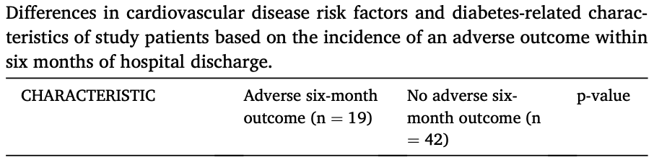
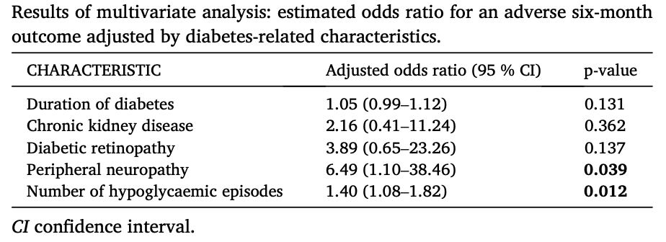
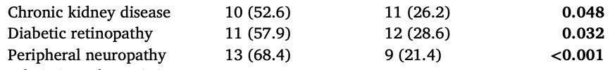
ACS in T1D (cont)
Adverse CVD events (ACS, unplanned revascularization, HF, stroke, or CVD death) or all cause mortality
within 6 months after discharge
Notes:
First table is univariate analysis
Second table: All variables which had a significant relationship with adverse six-month outcome were included in a multivariate logistic
regression analysis to determine independent predictors of this outcome.

Slide 26

Differential Impact of T1D vs T2D on Acute MI outcomes?

Slide 27
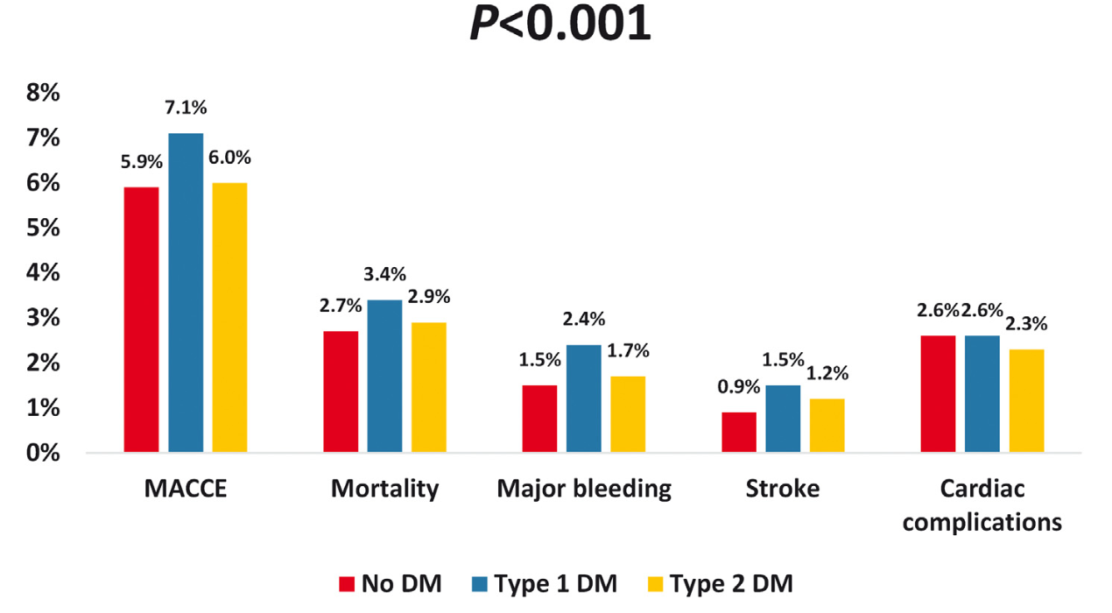
Differential Impact of T1D and T2D undergoing PCI
DM as a risk factor for adverse outcomes after an AMI
NIS (National Inpatient Sample) – data from > 7 million discharges each year in the US
1,363,800 individuals undergoing PCI, 12,640 (0.9%) had T1DM and 539,690 (39.6%) had T2DM
Cardiac complications included reinfarction, hemopericardium, cardiac tamponade, coronary dissection, and pericardiocentesis
Notes:
Cardiac complications included reinfarction, hemopericardium, cardiac tamponade, coronary dissection, and pericardiocentesis

Slide 28
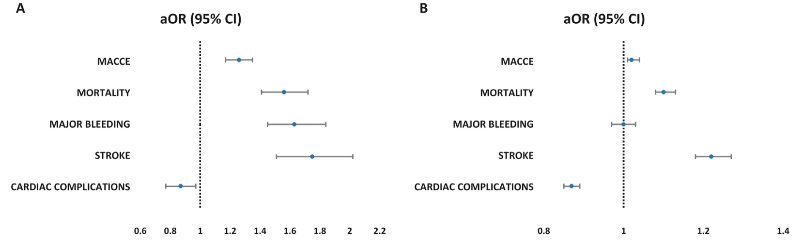
Differential Impact of T1D and T2D undergoing PCI
DM patients receiving PCI during hospitalization → worse outcomes
T1DM patients have a distinct clinical profile, with worse clinical outcomes compared to patients with T2DM and were more likely to experience higher MACCE and in-hospital mortality
Notes:
Cardiac complications included reinfarction, hemopericardium, cardiac tamponade, coronary dissection, and pericardiocentesis
MACCE– major adverse cardiovascular and cerebrovascular events (composite of mortality, cardiac complications and stroke)

Slide 29

CVD Underlying Mechanisms in T1D

Slide 30
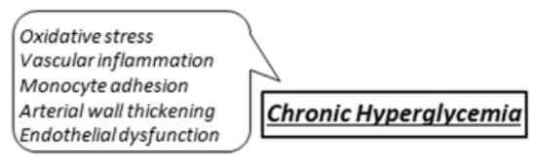
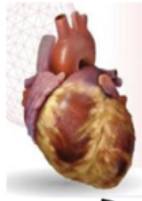

Chronic Hyperglycemia
DCCT/EDIC: increased risk by 42% for each 1% increase in A1C
Pittsburg EDC Study: A1C and DM duration → independent RFs for MACE
Wisconsin Epidemiologic Study of DM Retinopathy: 20-year average A1C → independent RF for CVD mortality
Mechanisms:
1) Increase in DAG → activation of PKC → augments production of collagen, fibronectin, TGF-beta, proinflammatory cytokines, VGEF, PAI-1, decrease in NO
2) Activation of polyol pathway → exacerbation of intracellular oxidative stress
3) Formation of AGEs
Notes:
Diacylglycerol DAG, protein kinase C,
Advanced glycation end products

Slide 31
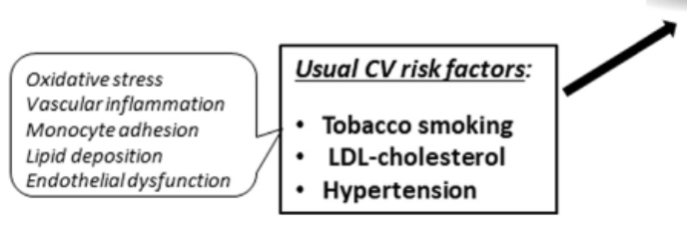
Usual Risk Factors
Smoking – same increased risk as in general population
LDL level: Yes in DCCT/EDIC, Pittsburg EDC,
No in EURODIAB (Diabetologia, 2014)
Prognostic factors were age, A1c, waist-hip ratio, albumin/creatinine ratio, and HDL
Cholesterol Treatment Trialist Collaboration Metanalysis (Lancet Lond Engl 2008): 38 mg/dl reduction in LDL → 21% MACE relative risk reduction in T1D
Hypertension – consistently as a RF in all the studies regardless of age and duration of DM
Notes:
EURODIAB predictive model for CVD (Maahs)

Slide 32
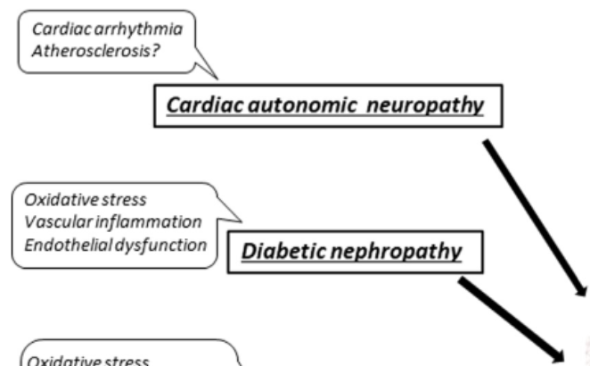
CAN and Nephropathy
Higher risk of arrhythmia, sudden cardiac death
Silent MI
Microalbuminuria linked to:

Slide 33
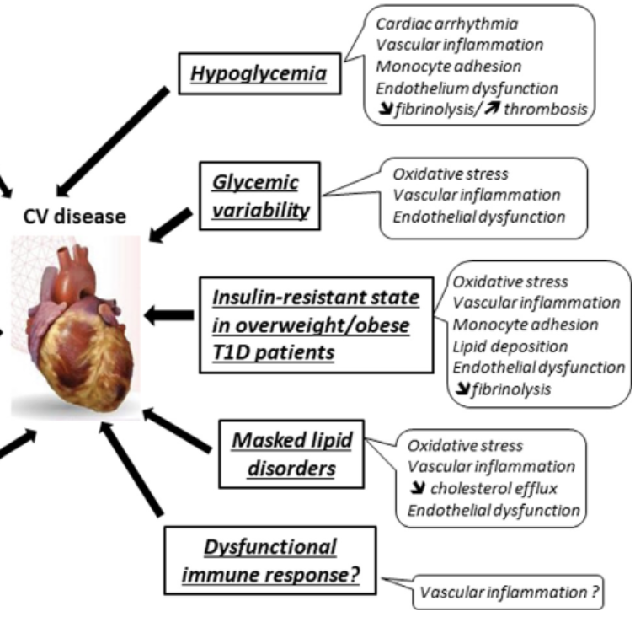
Other Potential Factors
Severe Hypoglycemia as independent RF for CVD HR 1.82 (Diab Res Clin Prac 2012)
Lengthens QT + endothelial dysfunction, platelet activation
Suggested but not confirmed
MetS features + T1D = higher risk of CVD
Quantitative and functional abnormalities in lipoproteins that are atherogenic (TG enrichment of LDL, increased level of oxidized LDL, reduced anti-oxidative properties of HDL etc.)
Cardiac myosin autoantibodies in patients with T1D post-MI
Notes:
Increased CEPT activity for cholesterol

Slide 34
Double Burden of T1D and HF

Slide 35
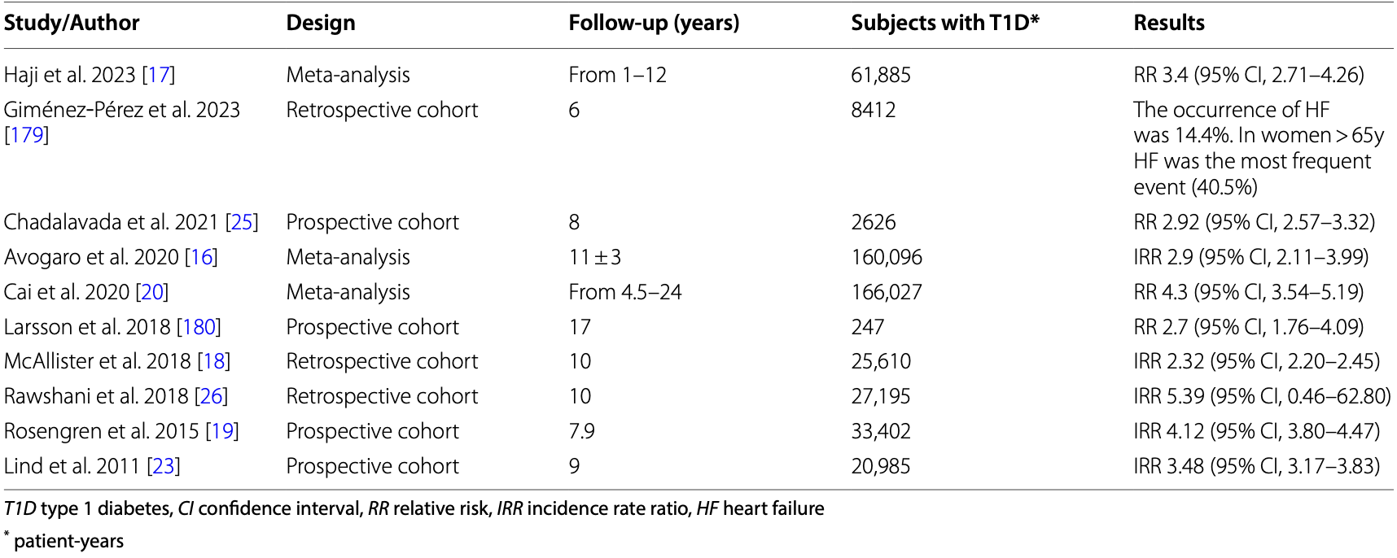
T1D increased risk of HF
Julián et al. Cardiovascular Diabetology (2024) 23:65

Slide 36

Metabolic Health in T1D

Slide 37
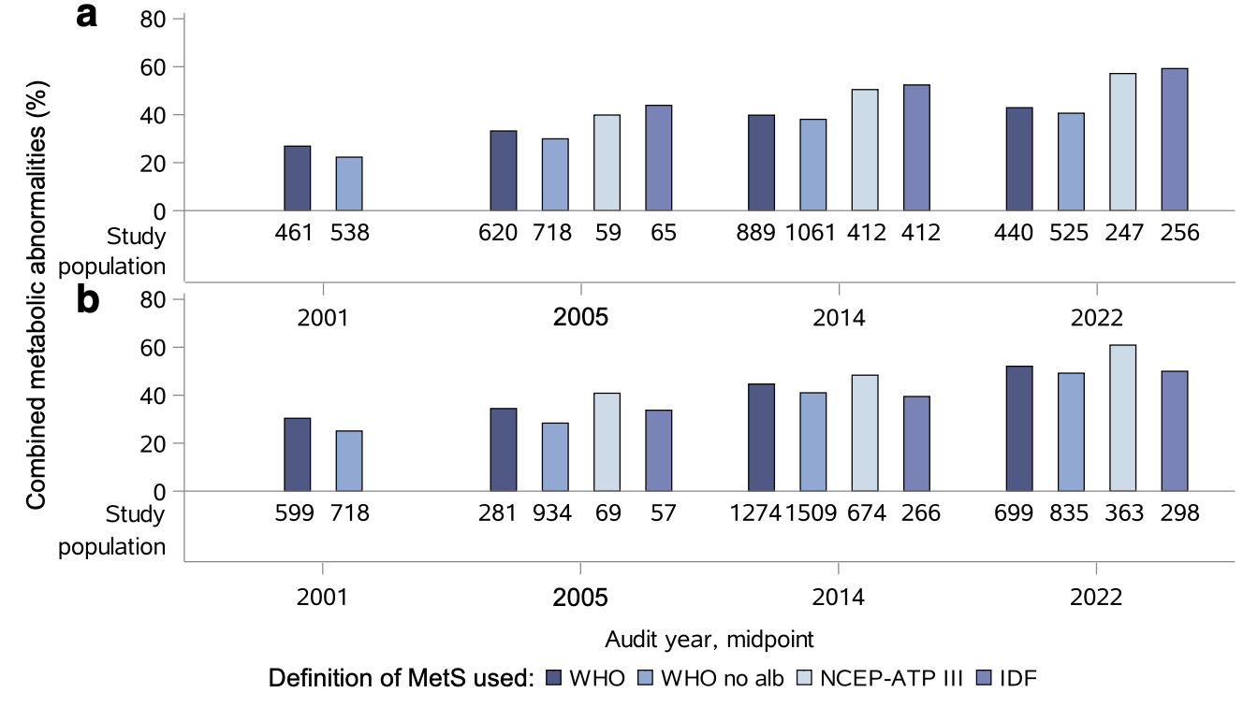
Increase in overweight, obesity, and metabolic abnormalities in T1D
Women
Men
Diabetologia (2024) 67:2678–2690
Notes:
WHO: presence of two or more of the following conditions: obesity (BMI >30 kg/m2), hypertension (BP ≥140/90 mmHg and/or treatment
with antihypertensive drugs), triglycerides ≥1.7 mmol/l (≥150 mg/dl), HDL-cholesterol <0.9 mmol/l (<35 mg/dl) in men or <1 mmol/l (<40 mg/dl) in women and/or treatment with lipid-lowering drugs, or albuminuria (albumin 0.3 g/l [>30 mg/dl]).
NCEP-ATPIII (national center for environmental protection) definition in people living with diabetes, the metabolic syndrome/combined metabolic abnormalities requires the presence of two or more of the following conditions: WC ≥102 cm in men (≥88 cm in women), hypertension (BP ≥130/85 mmHg and/
or treatment with antihypertensive drugs), TG ≥1.7 mmol/l (≥150 mg/dl), or HDL-cholesterol <1 mmol/l (<40 mg/dl)
in men/<1.3 mmol/l (<50 mg/dl) in women and/or treatment with lipid-lowering drugs.
IDF definition of the metabolic syndrome/combined metabolic abnormalities in people living with diabetes, requires the presence of one or more of the following conditions: hypertension (BP ≥130/85 mmHg and/or treatment with antihypertensive drugs), TG ≥1.7 mmol/l (≥150 mg/dl), or HDL-cholesterol <1 mmol/l (<40 mg/dl) in men/<1.3 mmol/l (<50 mg/dl) in women and/or treatment with lipid-
lowering drugs

Slide 38
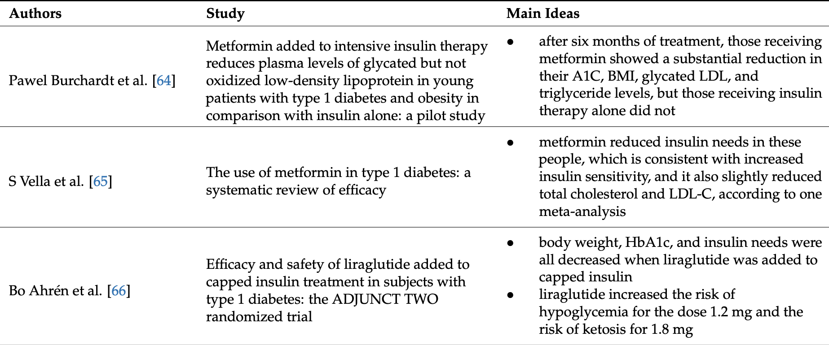
Targeting MetS in T1D
Medicina 2024, 60, 2067

Slide 39
Reducing cardiometabolic risk with semaglutide in type 1 diabetes (RESET1): Study protocol of a phase 2 double-­blinded randomised placebo-­ controlled trial
Evaluate whether Semaglutide reduces carotid femoral pulse wave velocity, a measure of large arterial stiffness, and a validated surrogate marker of cardiovascular risk in the T1D population
Investigate the underlying mechanisms of this potential cardiometabolic protection, by performing detailed physiological profiling before and after treatment.
60 patients with T1D, age 25-70 yo, duration of T1D >/= 2 years, BMI > 25, A1C > 7%
26 weeks of treatment compared to placebo
Diabetic Medicine. 2024;41:e15377

Slide 40
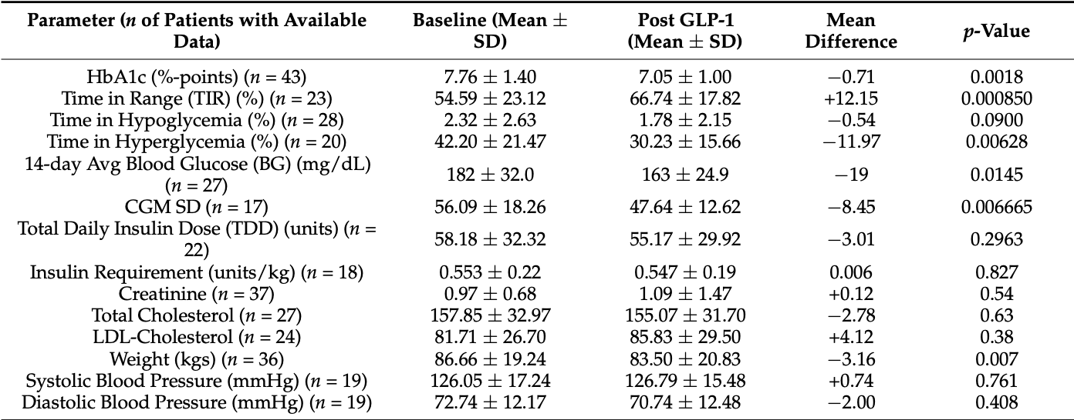
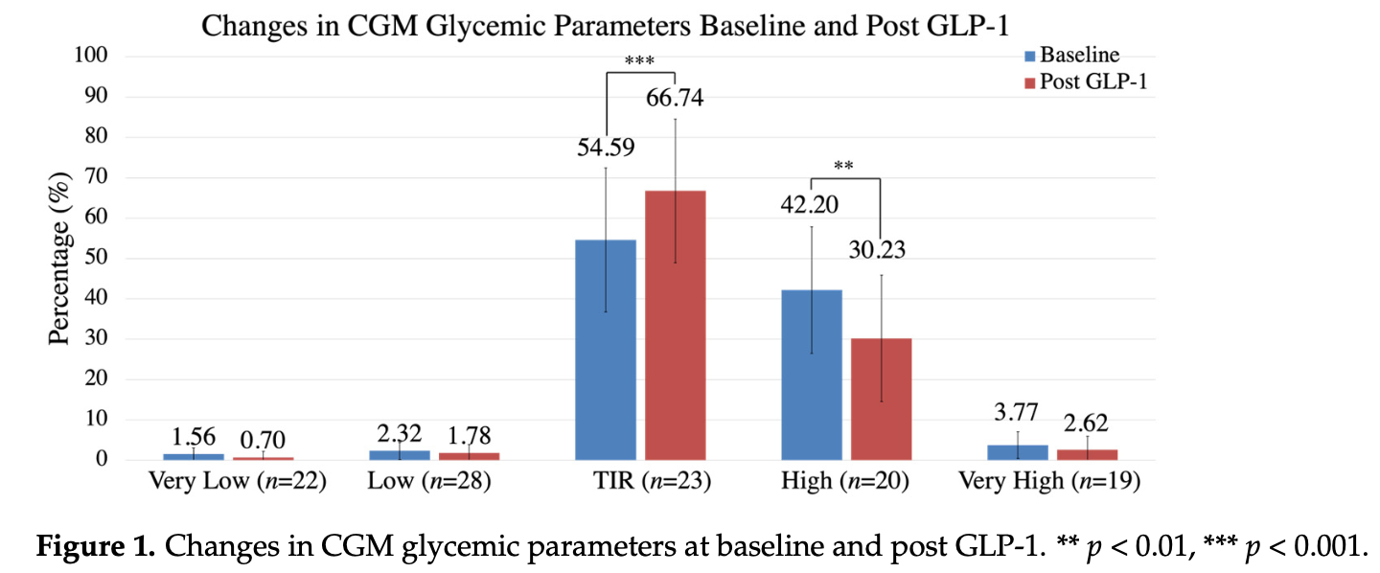
Long-Acting GLP-1 in T1D
Glycemic and metabolic benefits of long-acting GLP-1 in T1D
Mahandas, Basina et al. Endocrines 2023, 4, 93–101. https://doi.org/10.3390/endocrines4010008

Slide 41

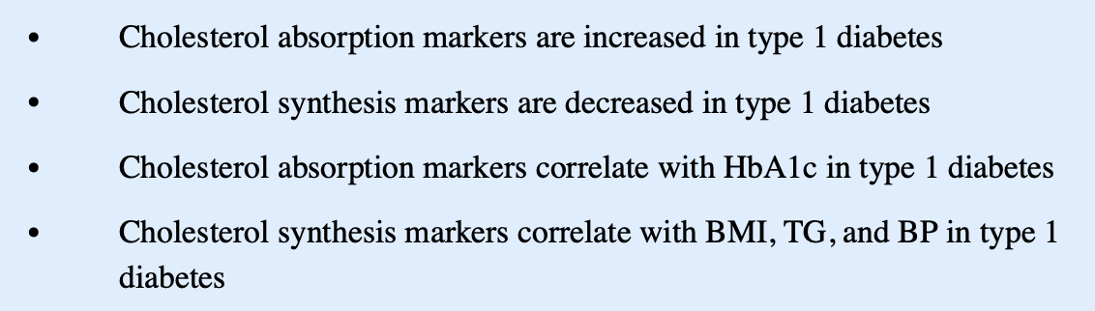
Statins in T1D
J Clin Lipidol . 2019 ; 13(6): 940–946
Notes:
Type 1 Diabetes is Associated with an Increase in Cholesterol Absorption Markers but a Decrease in Cholesterol Synthesis
Markers in a Young Adult Population

Slide 42
Challenges in T1D Research
>17 non-insulin therapies FDA approved for T2D in the past 10 years
FDA mandates: demonstration of CVD safety
New drugs to be tested against MACE (Major Adverse Cardiovascular Events) composite end point - death from CV causes, nonfatal MI, or nonfatal stroke
Unique atherosclerosis pathophysiology, different from T2D
Challenges with surrogate markers for CVD
No T1D-specific statin trials
Cholesterol Treatment Trialists’ Collaboration meta-analysis of RTCs in 18.686 individuals with DM – safely reduction in primary and secondary ASCVD (Lancet 2008; 371:117–125)
Only 1466 T1D individuals – similar reduction of events to T2D, but # of the events was small

Slide 43

Challenges in T1D Research: Underrepresentation in the Trials
IMPROVE-IT Ezetimibe trial – no report on T1D outcomes
FOURIER Evolocumab (Repatha) 27.564 participants/11.301 with DM (40%)/286 with DM1(2.5%/1.03%) (Lancet Diabetes Endocrinol 2017; 5:941–950)
ODYSSEY OUTCOMES Alirocumab (Praluent) 18.924 participants/5.444 with DM (28.8%)/37 with T1D (0.68%/0.2%)
No conclusions can be drawn

Slide 44
Benefits of Therapy
T1D age 40 years and older and/or with duration of diabetes > 20 years, and/or microvascular complications irrespective of the CV risk score
Hero C, Rawshani A, Svensson AM, et al. Association between use of lipid-lowering therapy and cardiovascular diseases and death in individuals with type 1 diabetes. Diabetes Care.2016;39(6):996–1003.
Swedish registry: effects of lipid-lowering therapy in 24 230 individuals with T1D without known CVD
5387 were treated with lipid-lowering medications (97% statins) and 18 843 were not treated
Mean follow up of 6 years
HR for CVD deaths 0.6; all-cause death, 0.56; fatal/nonfatal stroke, 0.56; fatal/nonfatal MI, 0.78; fatal/nonfatal CHD, 0.85; and fatal/nonfatal CVD, 0.77
HPS – 615 individuals with T1D – CVD reduction was not different from 5348 of T2D
Notes:
HR of treated versus non-treated

Slide 45

Risk Enhancing Factors

Slide 46
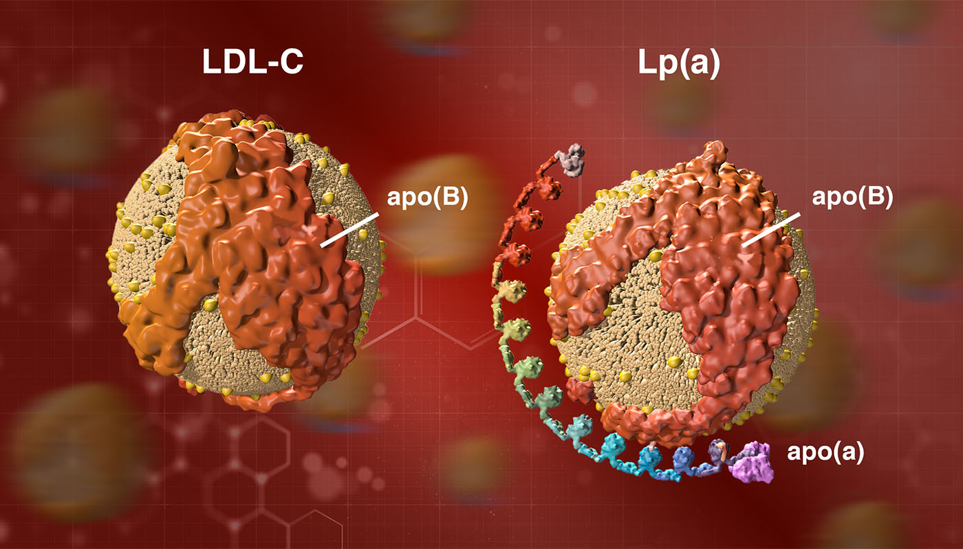
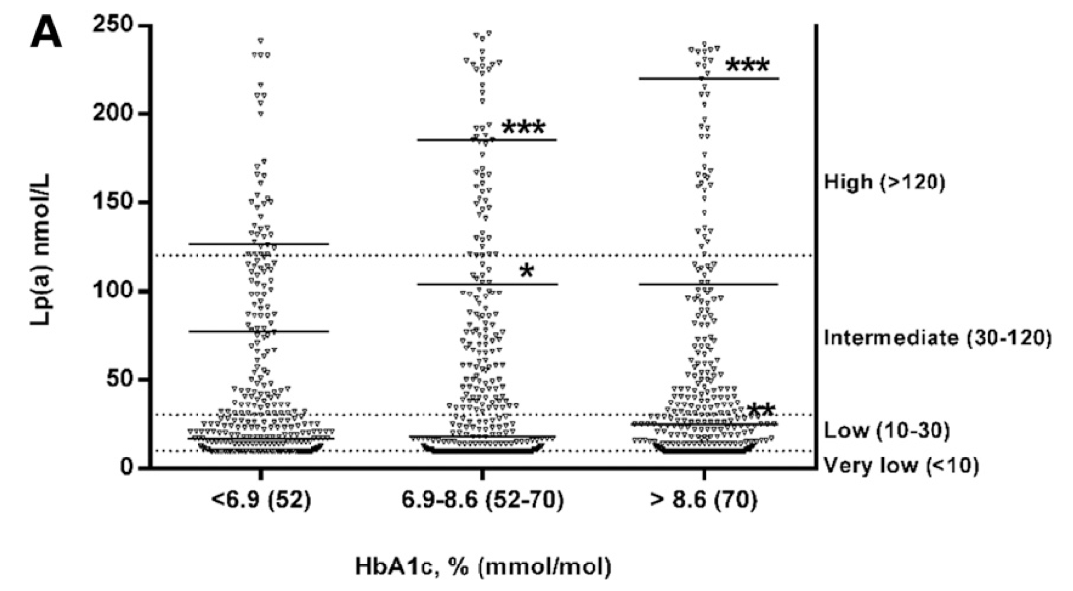
Lp(a) in T1D
- produced and released from the liver
- risk-enhancing factor
- functions as main lipoprotein transporter for oxidized phospholipids (OxP)
- Significantly associated with ASCVD if > 50 mg/dl and hsCRP > 2 mg/l (J Am Col Card 2021:78)
Diab Care 2020:43
Significant predictor of ASCVD in T1D
Associated with metabolic control => Can insulin therapy affect Lp(a) synthesis?
No Targeted Therapy
Diab Care 2020:43
Notes:
functions as main lipoprotein transporter for oxidized phospholipids (OxP)
- is an LDL particle with Lp(a)
Good glycemic control is associated with lower Lp(a) levels => insulin can lower the synthesis of it
is also associated with aortic valve calcification

Slide 47
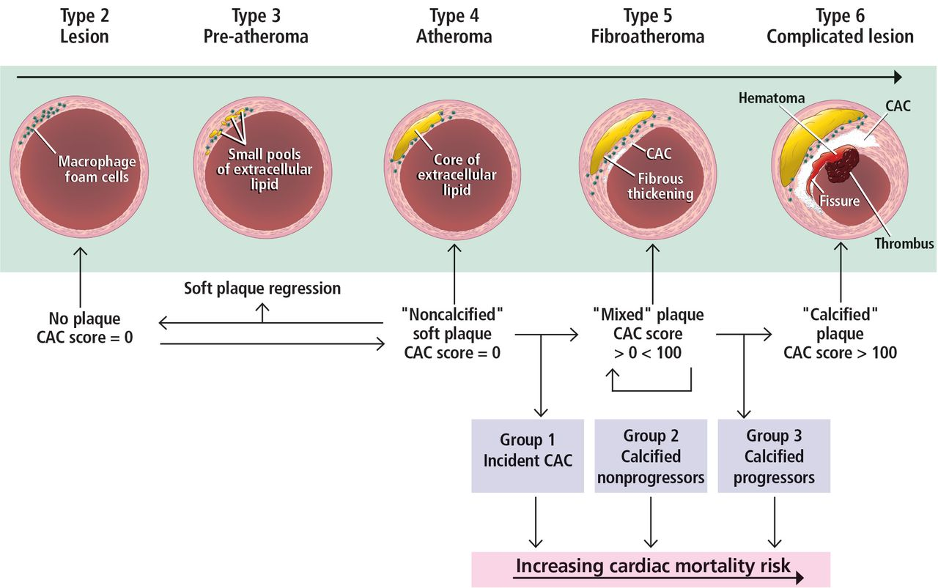
Coronary Artery Calcium (CAC) Score
Does not detect non-calcified plaques
Can help to decide the initiation or intensification of statin therapy
Radiation exposure: 1 mSv. In comparison, the usual radiation dose of a chest X-ray is 0.02–0.1 mSv and a chest CT about 7 mSv. The average environmental exposure yearly in the United States is on the order of 3–5 mSv
Notes:
Mili’sievert

Slide 48
CAC Score
National Lipid Association (NLA) Guidelines (J Clin Lipidology 2021):
CAC may be considered in T1D 40-75 yo to refine CVD risk assessment
Recommended in T1D 30-39 yo with DM duration of > 20 years
If Score is 0 Agatston Units (AU), repeat the test in 3 years

Slide 49
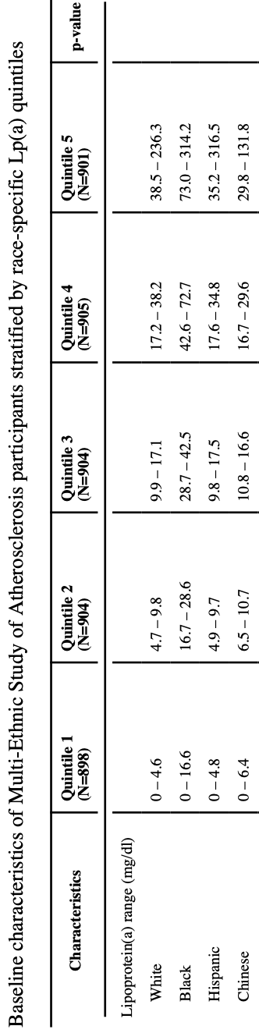
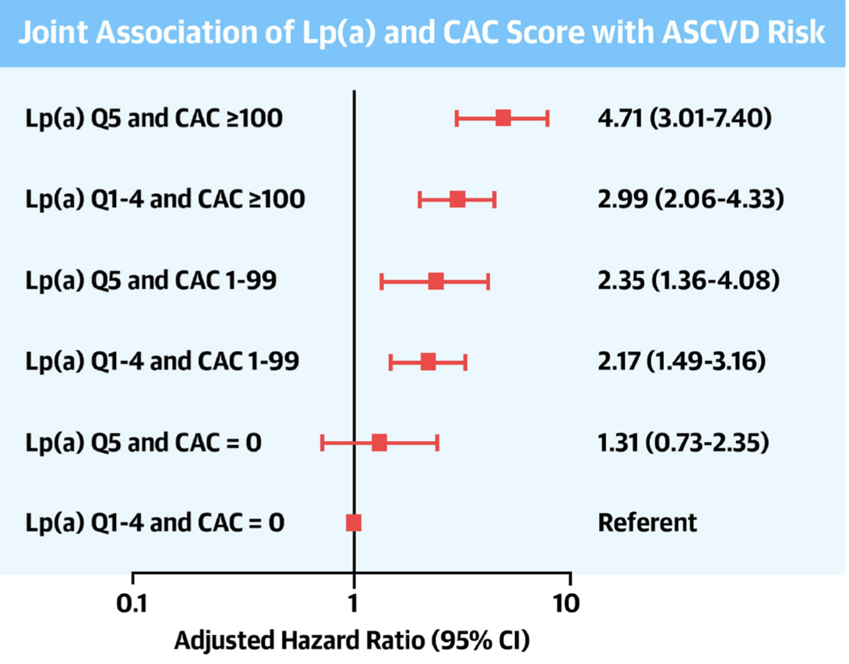
Risk Enhancing Factors in Risk Assessment (Lp(a) + CAC)
Individuals with elevated Lp(a) and CAC score are the highest ASCVD risk.
Elevated Lp(a) level does not stratify ASCVD risk further among those with low CAC score.
J Am Coll Cardiol . 2022 March 01; 79(8)

Slide 50
Carotid ULS For Assessment Of Pre-clinical Atherosclerosis
T1D + DKD regardless of the age
T1D >/= 40 yo
T1D < 40 yo + > 10 years DM duration + any of the following:
A) DM Retinopathy
B) Premature CVD in 1st degree relatives (< 55 yo in men and < 65 yo in women)
C) Active smoking
D) Hypertension
E) atherogenic dyslipidemia TG>150, HDL <45 in women and < 40 in men
Diabetes Ther (2024) 15:1831–1844
Notes:
Eligible patients

Slide 51
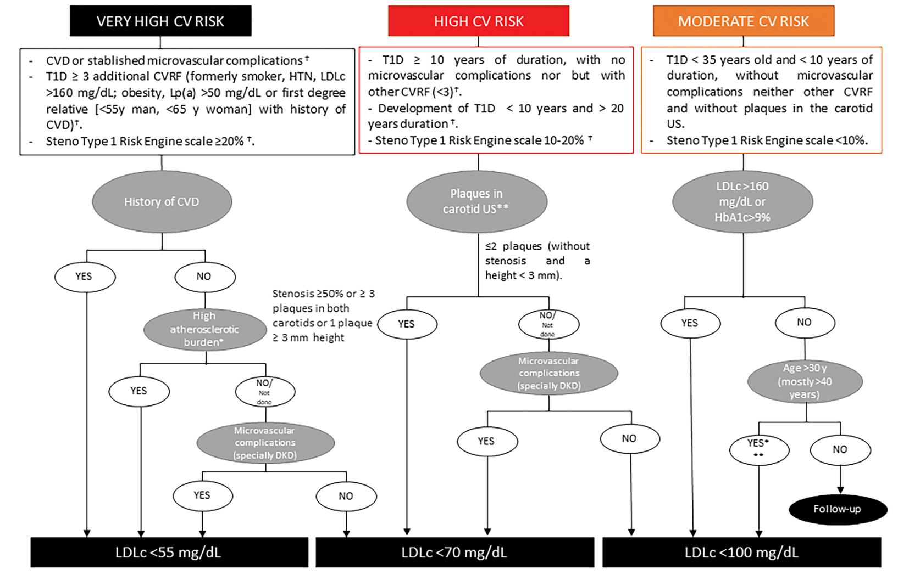
Diabetes Ther (2024) 15:1831–1844

Slide 52
Summary and Barriers To Care
Statin underutilization
Clinicians’ uncertainty for lipid-lowering therapy due to numerous guidelines with varying recommendations
Lack of T1D-specific trial evidence
Women receive fewer therapies than men - Concern about prescribing in childbearing age? (DCCT/EDIC JAMA Netw open 2022)
Notes:
Multifactorial

Slide 53

Summary and Barriers To Care
Time constrains and complexity of care:
- Intensive insulin therapy
- Diabetes technology
- Screening for microvascular complications
- Behavioral therapy and self-care
“Super-normal” lipid profile in well-controlled DM 1 → considered cardioprotective

Slide 54

Thank You
Questions

