Slide 1
Northwestern Endo Practice
Sometimes patients don’t want to attend, either because of they “know” what they want; documentation of class, useful for documentation of “diabetes education in CMN
1
Clinic receives CMN and MD signs after confirmation that patient has attended Cool Tools class
Patient seen in clinic and offered AID as therapy OR asks for AID therapy
Pt eligible for AID or interested?
Patient is referred to Diabetes Program “Cool Tools Technology Session” which is either in person OR virtual
Several times per month
Can be 1:1 or class
2
NO
YES
Patient may not be able to afford copayment, insurance may deny pump
Patient back to Endo Provider
Patient continues regimen and is asked at each visit (!) about AID
CDCES initiates necessary paperwork/RX for the selected device
Supply Confirmation
Vendors and CDCES and patient are in touch to confirm shipping of device
Appointment is scheduled for the following 2-4 weeks
3
Patient may self train!!
4-6 weeks Follow-up with CDCES OR Provider Based on patient experience
2WK Virtual or in Person Follow-up with CDCES
AID settings are adjusted as needed
IN-PERSON INITIAL PUMP TRAINING
iLet: NM-CDCES + Vendor Trainer
Omnipod: NM-CDCES
Medtronic: NM-CDCES + Vendor Trainer
Tandem: NM-CDCES

Slide 2
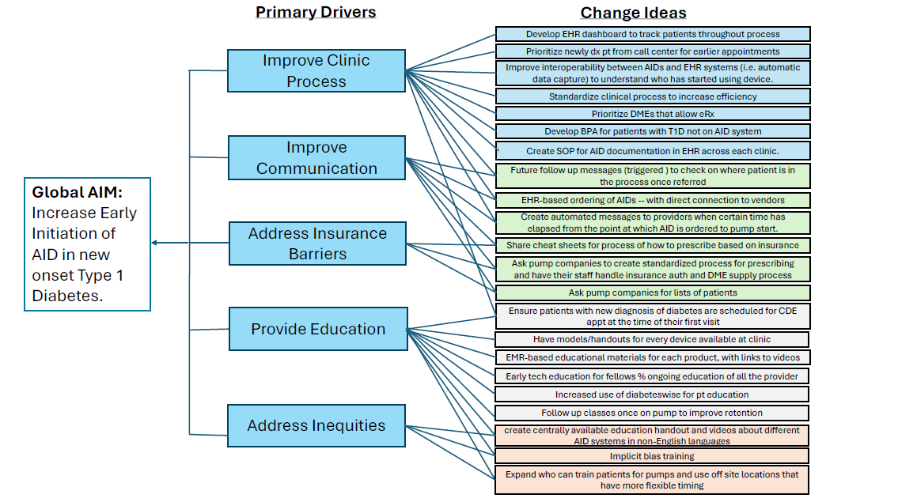

Slide 3
Plan: Enhance EARLY AID discussion
Patients are referred to Adult Endo
Misdiagnosed with T1D
Diagnosed in the hospital (honeymoon phase)
Diabetes Education is focused on survival skills more than AID
CGM initiated on first visit
Can we enhance early initiation of AID?
Automatically combine early education with our cool tools class for introduction to AID

