Slide 1
IMPROVAID- CHOA
Kristina Cossen
Casey Rust
June 2025

Slide 2
CHOA Population
Patients seen in the last six months <22 years old (3,012)
With pump: 1679 (56%)
Without pump 1342 (44%)
*difference remains with new onset DKA removed
 | With Pump | Without Pump
Current Age | 13.6y | 13.6y
Male | 51% | 53%
Time with diabetes | 74 months | 57 months
DKA events in 12 months* | 101 | 252
Medicaid | 38% | 57%
A1c | 8.1% | 9.6%

Slide 3
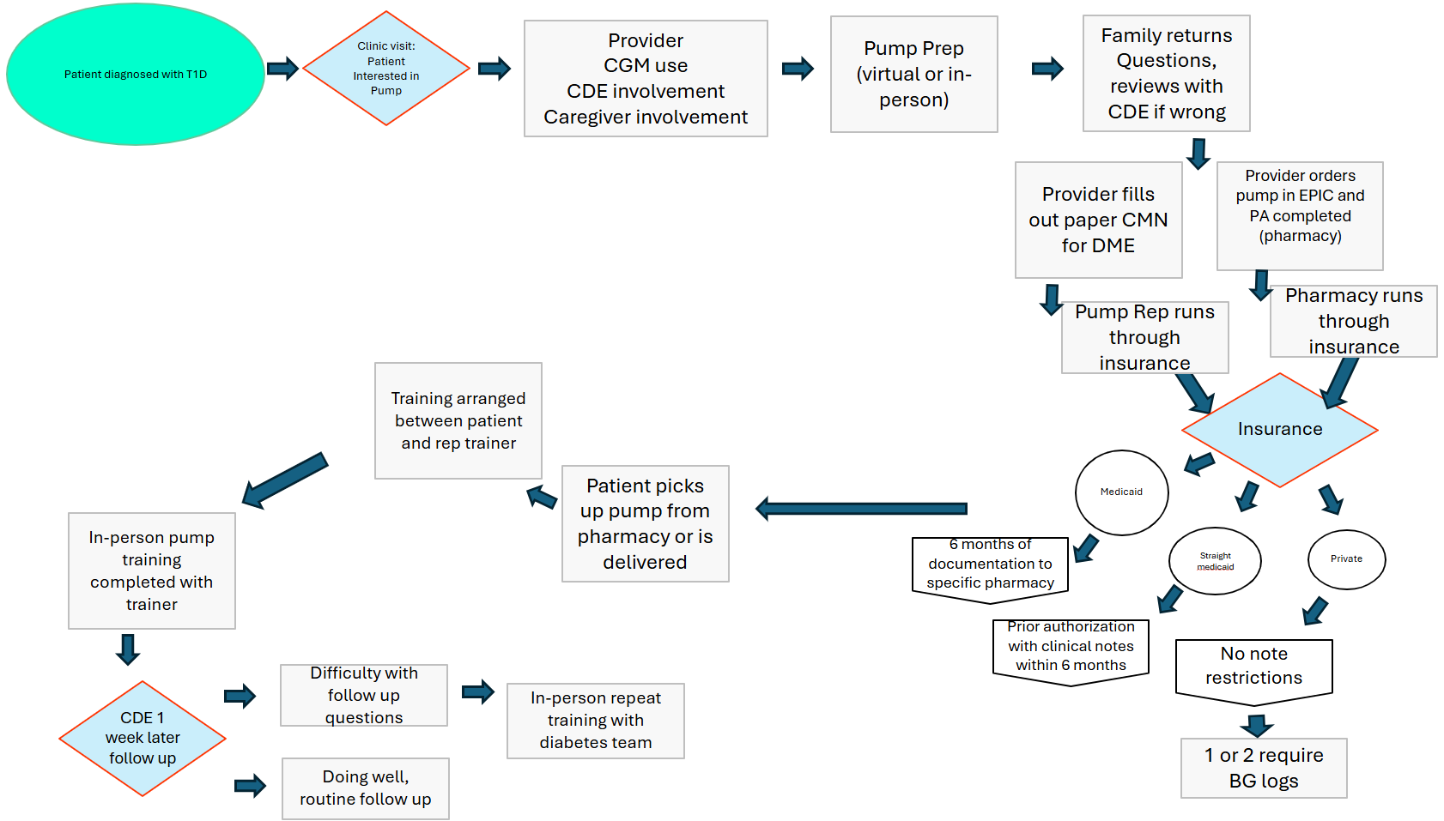
Process Map

Slide 4
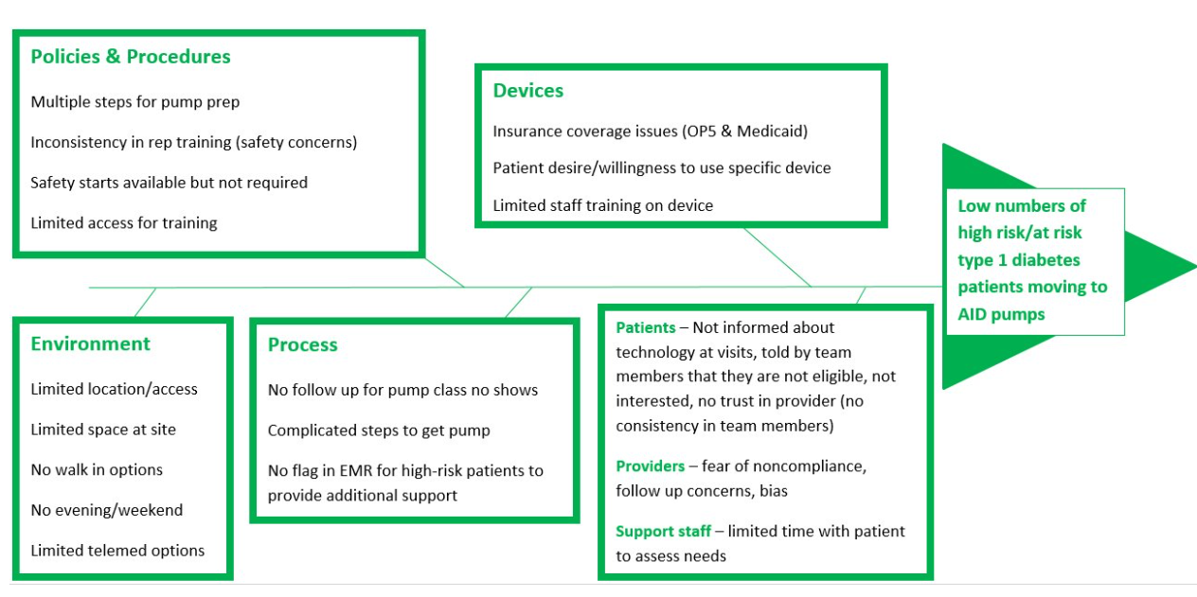
Previous Attempts (Project IMPACT)

Slide 5
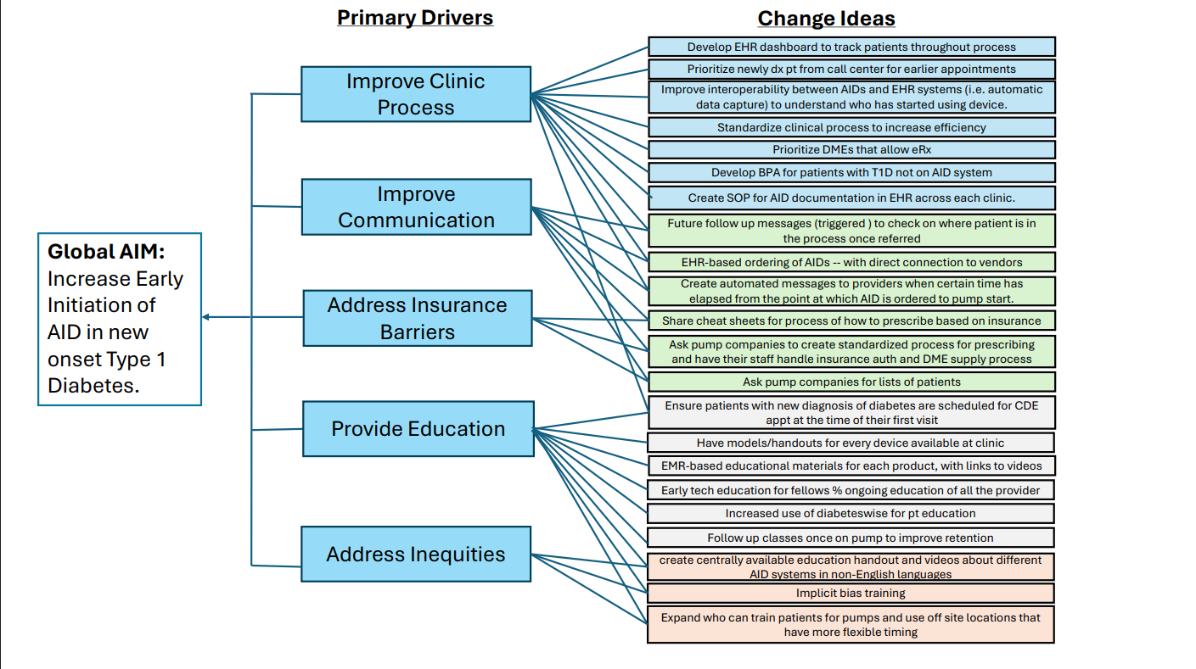
Key Driver Analysis
Things we do
What IMPACT did
What we plan to address

Slide 6
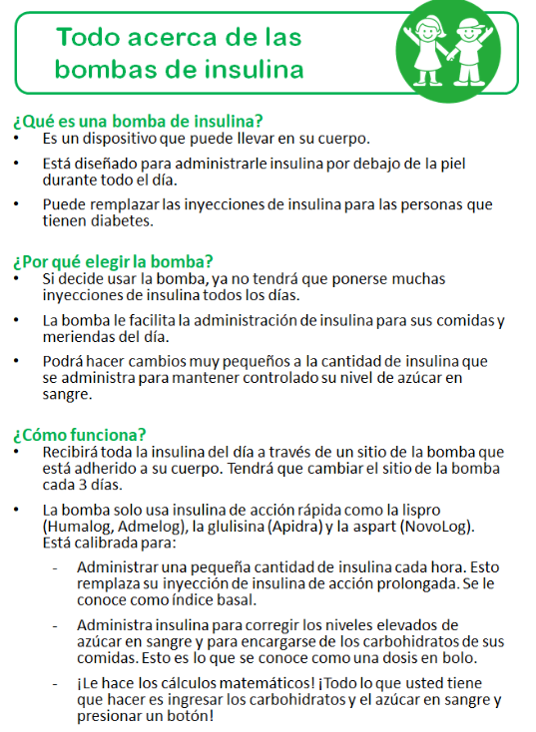
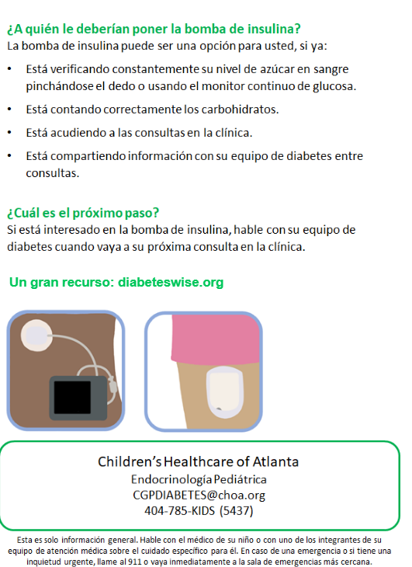
PDSA 1 (easy) - Diabeteswise
To improve education around Pump use and Devices
Already had an information sheet available, not widely used
6/6/2025: Emailed providers and educators about the dot phrase
Updated to include diabeteswise
We may switch to education created by CHOA
Difficulty: Hard to track use easily

Slide 7
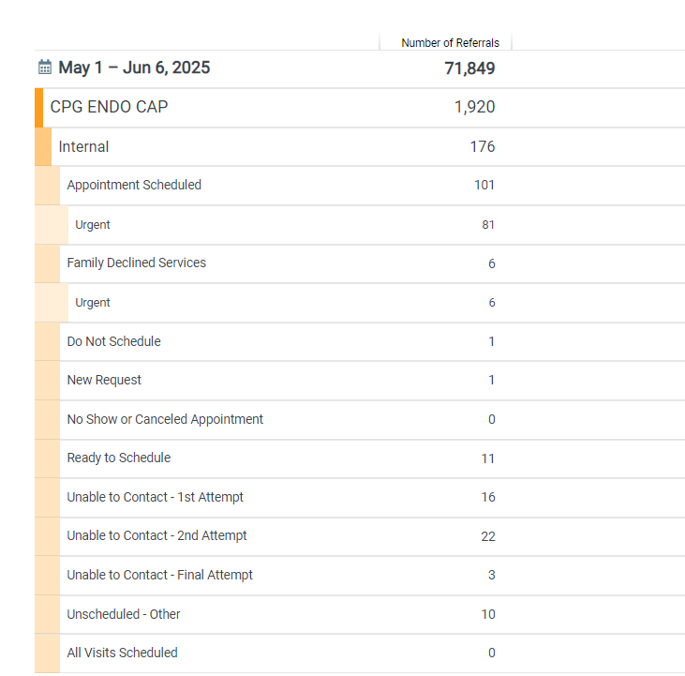
PDSA 2 (hard) – Pump work-queue
We currently have a work-queue system in placed for
Nutrition order
Psychology order
(both are only within department use)
Plan
Expand work-queue option for “pump start”
Only have administration schedule
Allows for tracking – can be used to create “time to pump” or where the patient is in pump process
Slicer Dicer Report (example)

Slide 8
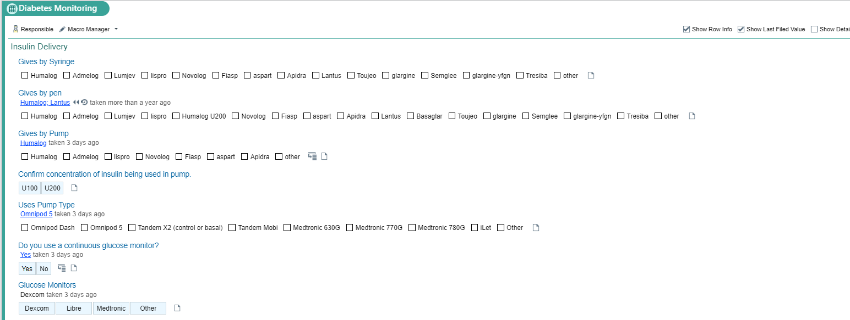
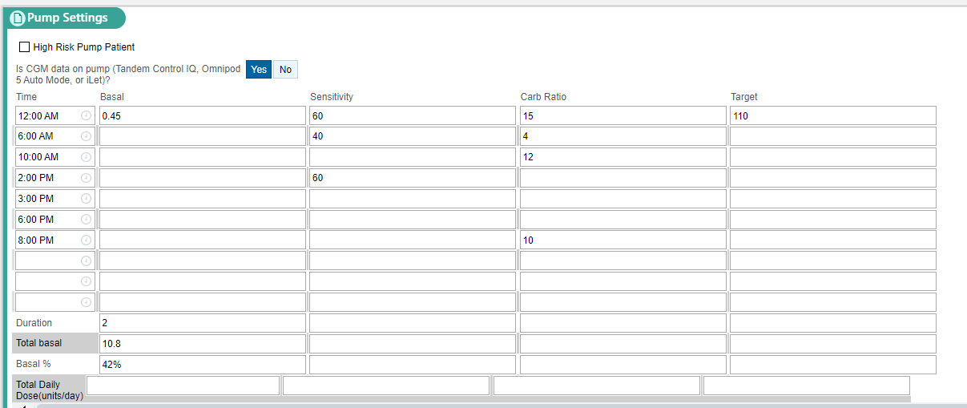
PDSA 3 (hardest) - BPA

Slide 9
PDSA 3 (hardest) - BPA
We can use OURPRACTICE ADVISORIES for a notice
Will not make it hard stop
Will provide options to “opt out” of providing a pump
“patient declined” “not enough insulin” “family not interested” “tried previously” “cost” etc.
This will allow additional information for next PDSA

