Slide 1
Diabetes Distress Screening Project Update Jennifer Iyengar Clinical Associate Professor Michigan Medicine

Slide 2
Screening Implementation
T1DDAS (8Q) assigned to all pts with T1D on problem list q9 months at e-check in
12/18/2023 Domino’s Farms
4/29/24 Brighton
6/19/24 West Ann Arbor
TBD Northville and EAA

Slide 3
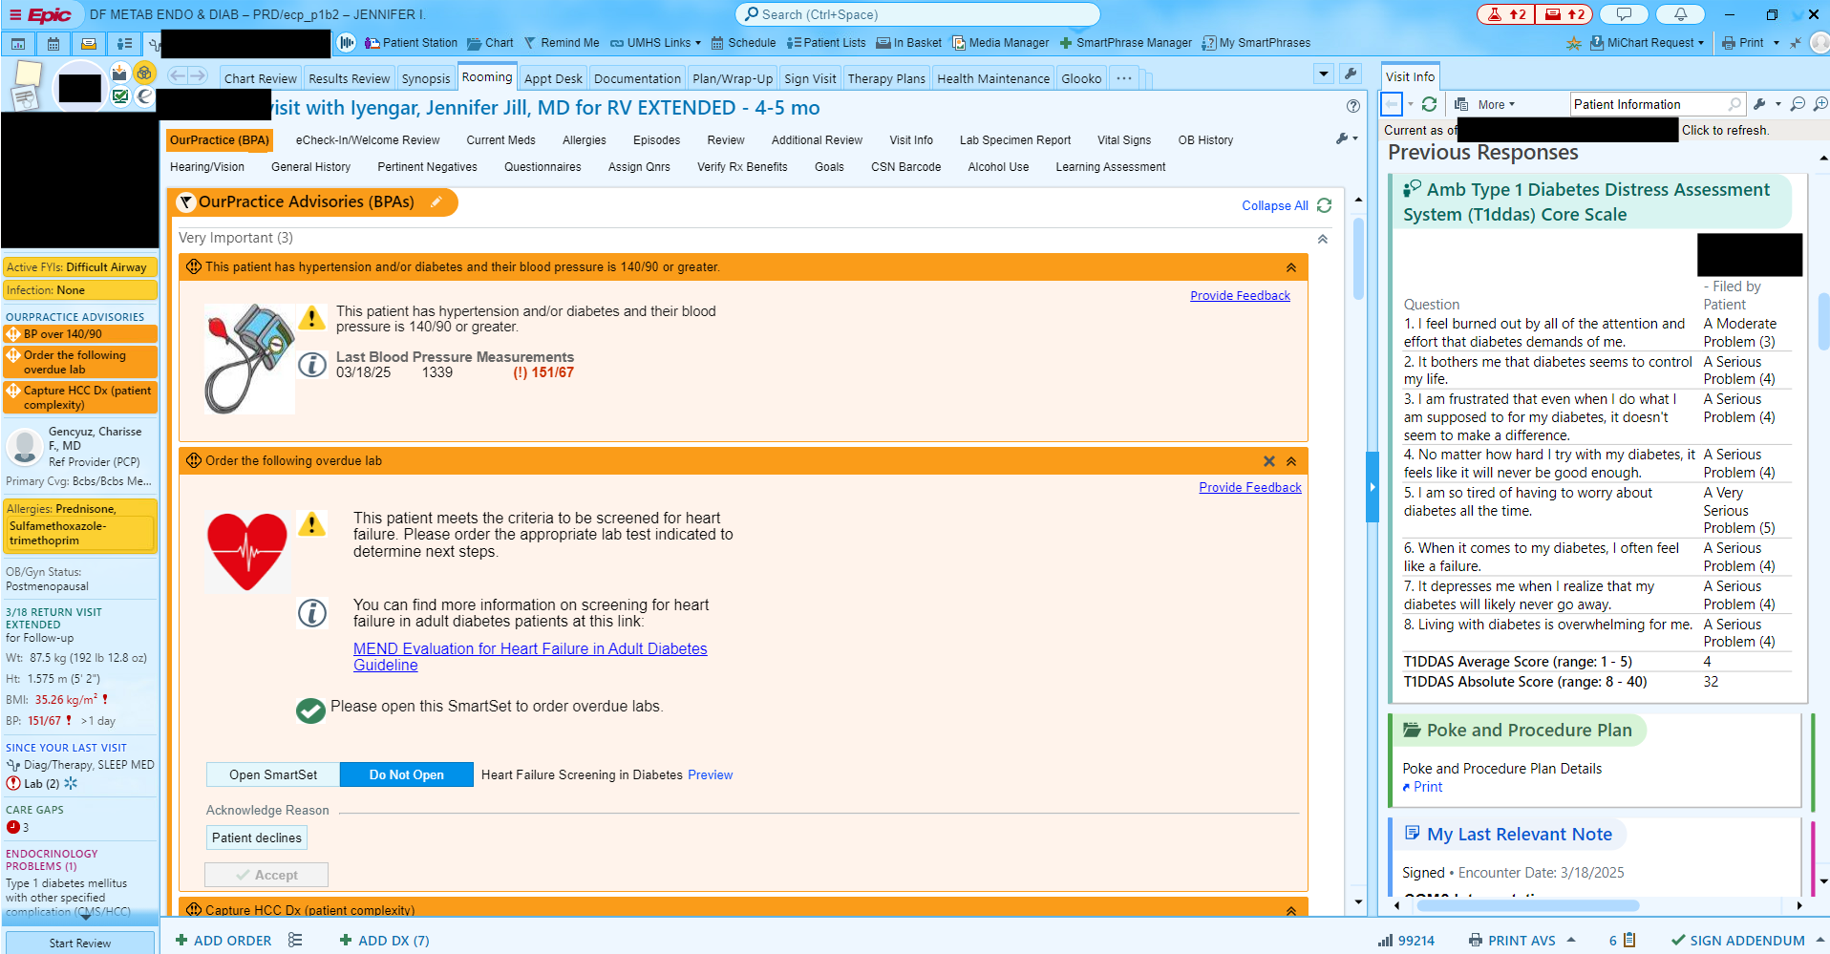

Slide 4
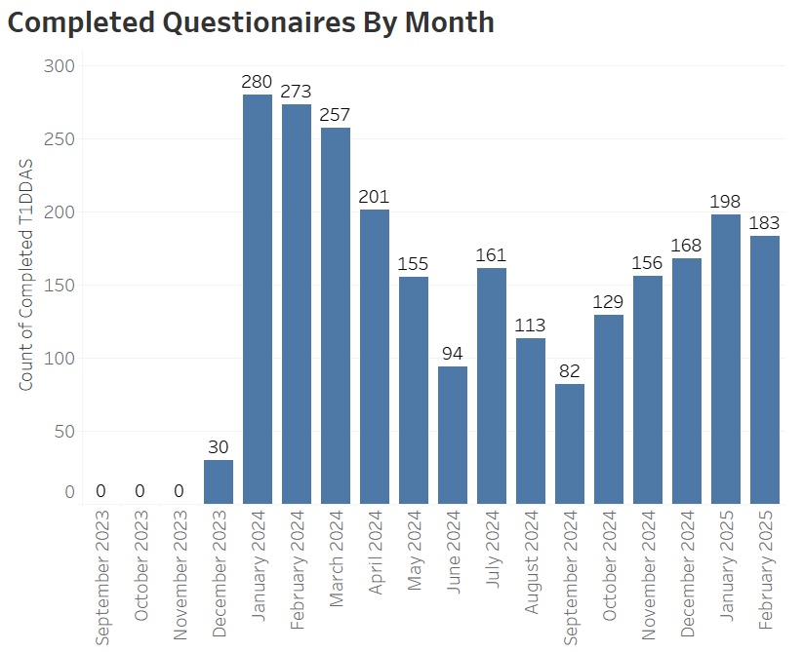
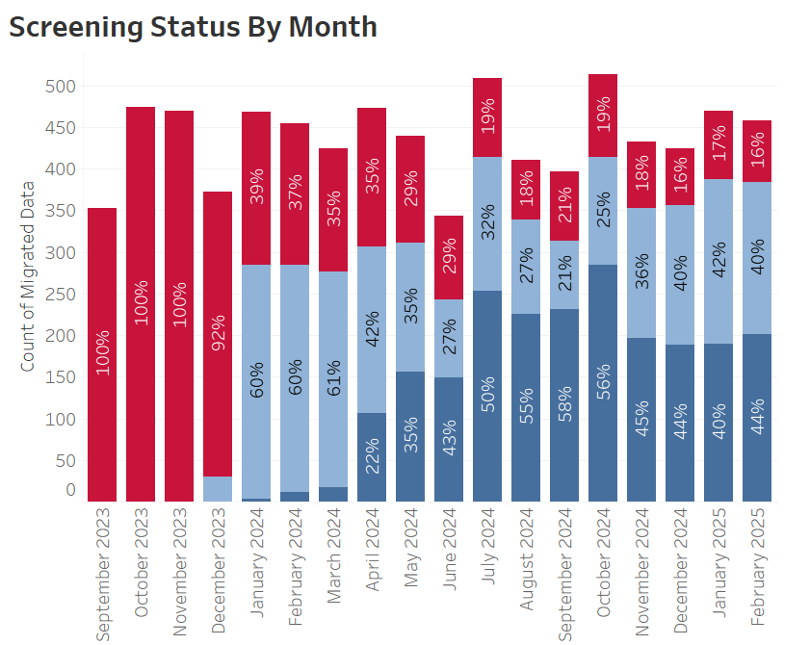
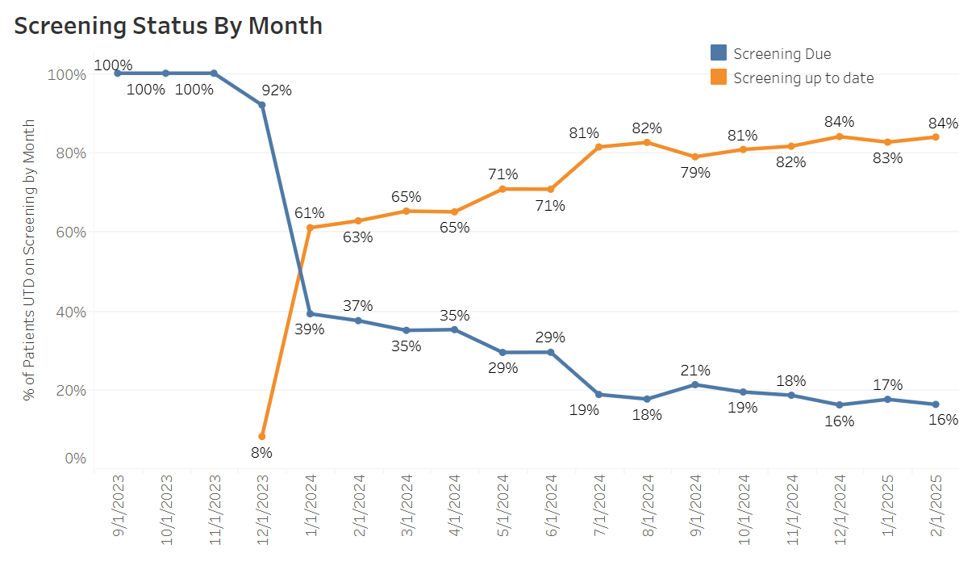

Slide 5
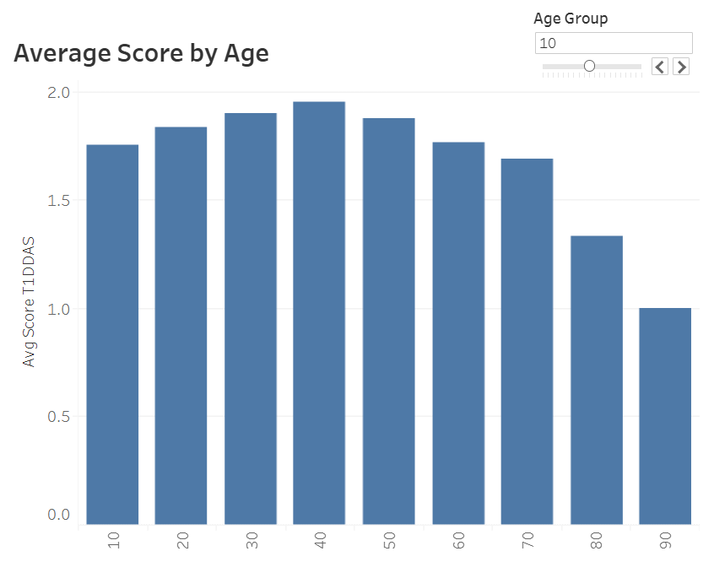
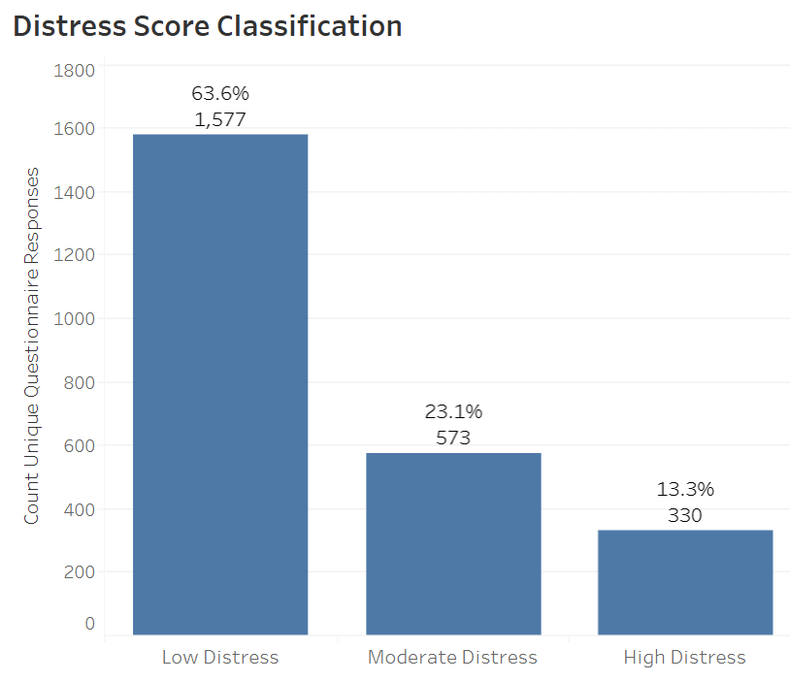

Slide 6
What do we do with a high score?

Slide 7
What do we do with a high score?
The answer may vary depending on whether we answer this question from a research perspective or a quality improvement perspective

Slide 8
Deliverables
Survey 15-20 Michigan Medicine endocrinologists to ascertain if DD screening results are being reviewed during their clinical encounter and what their current practice pattern is when encountering patients experiencing elevated distress
Survey approximately 250 adults with T1DM managed by Michigan Medicine Endocrinology who have completed the T1DDAS core scale during the e-check in process to understand which tools or interventions patients perceive as most beneficial in addressing diabetes distress
Using an impact/effort matrix, prioritize and develop a set of Clinical Decision Support (CDS) tools around these interventions. We will conduct multiple Plan-Do-Study-Act (PDSA) cycles, aiming to achieve a documented response to moderate or high levels of diabetes distress in 50% of patient encounters.

Slide 9
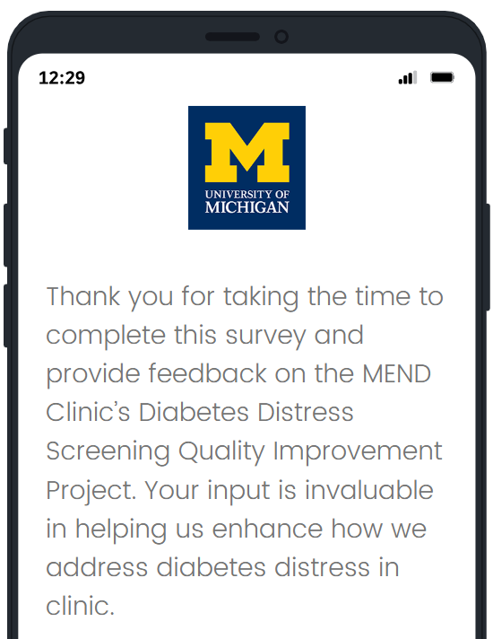
Physician Survey
Surveyed 40 physicians + 2 nurse practitioners
19 responses (45% response rate)
17 reported seeing PwT1DM at one of the 3 locations in last 6 months

Slide 10
Prior to screening how often during your clinical encounters did you discuss DD?
(n=16, 1 n/a)
<25% of encounters = 10
25-50% of encounters = 5
>50% of encounters = 1
Currently, how often during your clinical encounters do you discuss DD?
(n=17)
<25% of encounters = 9
25-50% of encounters = 6
>50% of encounters = 2

Slide 11
When a patient reports moderate or severe diabetes distress on their T1DDAS as evidenced by a mean score >/= 2.0 and >/= 3.0 respectively, how often does the result alter your treatment plan or result in other action steps?
(n=17)
Do not review or have not see high score=6
<25% of encounters = 4
25-50% of encounters = 3
>50% of encounters = 4
When a patient reports moderate or severe diabetes distress on their T1DDAS as evidenced by a mean score >/= 2.0 and >/= 3.0 respectively, how often do you discuss the results with the patient?
(n=17)
Do not review or have not see high score=5
<25% of encounters = 5
25-50% of encounters = 2
>50% of encounters = 5
Notes:
for example, a referral to social work or a recommendation that the patient see a mental health provider

Slide 12
Agreed that DD is an important to address
01
Felt confident in their ability to identify DD
03
Satisfied with the resources currently available to address DD
04
Agree it is the role of the endocrinology provider to address DD
02
95%
68%
58%
16%

Slide 13
Most Common Barriers
Limited clinic time
Inadequate resources
Insufficient training

Slide 14
Most Helpful Supports
Social work referrals
Embedded psychologist
Handouts with local mental health resources

Slide 15
Help us enhance our approach to diabetes and mental health!
Diabetes distress is the emotional burden of managing diabetes, which can lead to burnout—feeling overwhelmed, frustrated, or disengaged with daily self-care tasks.
Please choose up to five current or potential resources that you believe would best support individuals in our clinic who are experiencing diabetes distress and burnout:
[ ] Handout with tips on managing diabetes distress
[ ] List of local mental health resources
[ ] List of support groups, both local and national
[ ] Diabetes support group led by a diabetes educator
[ ] Social work referral for help with diabetes distress
[ ] Diabetes education referral for support with diabetes distress
[ ] Training for doctors to improve how they communicate with patients experiencing diabetes distress
[ ] Psychologist offering appointments in our clinic
[ ] Michigan Medicine peer mentor program for people with type 1 diabetes
[ ] Group program or workshop for patients that teaches strategies to reduce diabetes distress
[ ] New app or online tool for diabetes mental health support
[ ] Other (please specify)
[ ] I prefer not to answer

Slide 16
Next Steps
Patient 1-question survey – IT ticket placed
Adapt provider survey for pediatrics
Training scheduled – “Diabetes Turning Points” 10/31
Advocating for clinic psychologist
Develop patient education materials
Work with IT to build smartset

Slide 17
Thanks to the Team
Joyce Lee, MD, MPH
Hayley Centola, PhD
David T. Broome, MD
Kara Mizokami-Stout MD
Lynn Ang, MD
Jung Eun Lee MS
Jennifer Wyckoff, MD
Briana Mezuk PhD
Scott Soleimanpour, MD

