Slide 1
Diabetes Distress Screening at Seattle Children’s Hospital
T1Dexchange Working group update
May 2025

Slide 2
Background- previous state
>2000 youth with T1DM, seen in clinic every 3 months
  Seattle campus (main), Bellevue, Everett, Federal Way
Annual “team visit” recommendation with social work and nutrition, this was where DD assessment would occur, though not using validated tools
  22.4% of patients ages 13-21 did this in 2017

Slide 3
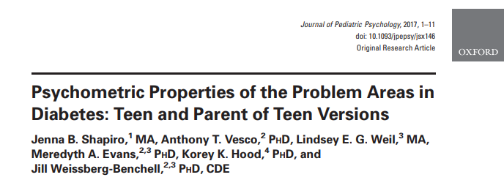
PAID-T
Not feeling motivated to keep up with my daily diabetes tasks.
Feeling that my friends or family act like “diabetes police” (e.g. nag about eating properly, checking blood sugars, not trying hard enough).
14 items, total score calculated
Validated ages 12-18 yo
Shapiro et. Al -> score >=44 indicated high DD
1 6
Not a problem A serious problem
Feeling that my friends or family don’t understand how difficult living with diabetes can be.
Worrying that diabetes gets in the way of having fun and being with my friends.

Slide 4
Clinical Protocol (Citrix)
Eligible patients for PAID-T: Ages 13+ with diabetes, at each visit
Screening tools filled out on electronic tablet (Tonic) given by MA with other intake forms when rooming.
Provider given printed report prior to visit- high scores flagged
+PAIDT: recommend SW follow up if not seen in past year and provider discussion

Slide 5
SCH Diabetes PRO Screening Timeline
Meetings with social work, Division leadership, MAs, to develop clinical protocol for psychosocial screening in diabetes clinics using TONIC electronic platform
February 2017
June 2018
Presented PRO screening protocol at staff meeting and facilitated an in-service on suicide safety assessments with review of available tools
January 2019
Initiated screening at every visit
SW expands availability
September 2020
Transition to EPIC
Piloted PRO screening using TONIC platform with three diabetes providers, solicit feedback, coach MAs in process, refine alert process for flags
March 2018
March 2020
COVID-19 pandemic
Started PRO screening at Main campus diabetes clinic (patients ages 13-21, English speaking)
June 2018

Slide 6
Previous SMART Aim (2017)
Aim: Increase annual mental health screening rates to 50% at Main Campus by Fall 2019 in English- and Spanish-speaking adolescents and young adults with diabetes, ages 13+.

Slide 7
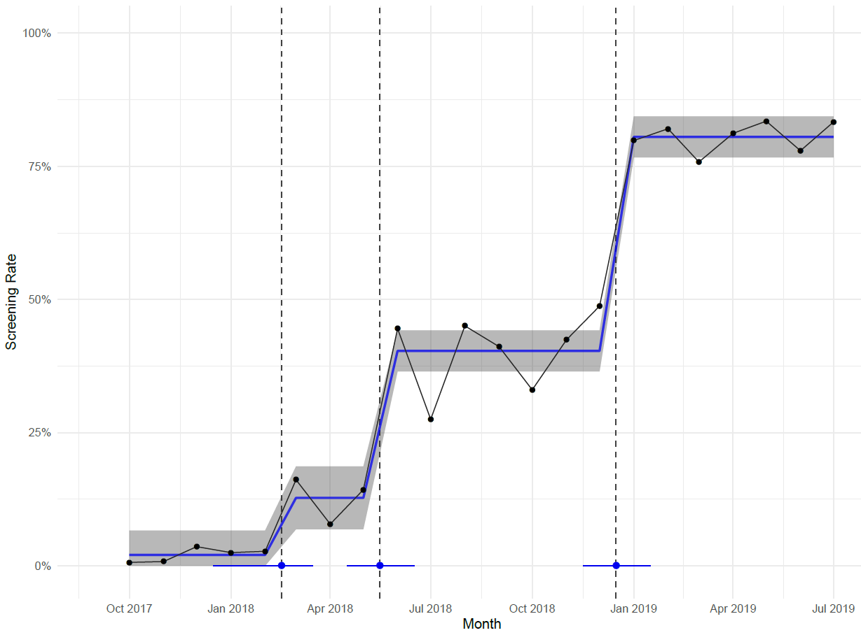
Results: Annual screening rates on Main Campus (13+ yo)
Annual screening went from 2% pre-implementation to 80% post-implementation
Changes to Protocol
Widespread screening
22% of patients endorsed high diabetes distress (PAID-T ≥ 44).
Pilot screening
Notes:
Measurable goals (what)
Timeframe (when)
Population (who)

Slide 8
Clinical Protocol (Epic)
Eligible patients for PAID-T: Ages 13+ with diabetes, at each visit- auto assigned based on visit type (12-13 manually assigned)
Screening tools sent to patients via Mychart 5-7 days before appointment if telemed or AHEAD clinic (MA manually sends)
If not completed prior to visit or if in person visit, patient completes PAID-T on tablet when rooming
+PAIDT flags in Epic (though no BPA): recommend SW follow up if not seen in past year and provider discussion

Slide 9
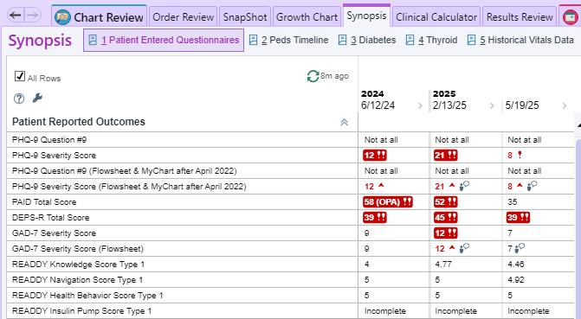
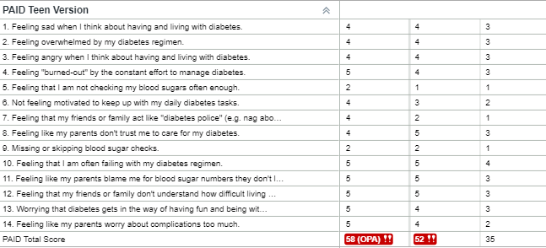

Slide 10
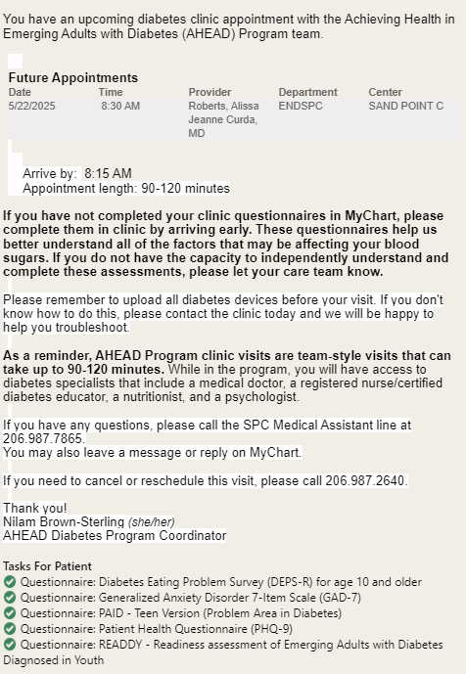

Slide 11
New SMART Aim
Increase annual Diabetes distress screening rates to 80% at all diabetes clinics by Spring 2025 in English- and Spanish-speaking adolescents and young adults with diabetes, ages 12+.

Slide 12
Key Drivers
Interventions
SMART Aim:
Increase annual Diabetes distress screening rates to 80% at all diabetes clinics by Spring 2025 in English- and Spanish-speaking adolescents and young adults with diabetes, ages 12+.
Adequate support and resources to respond to positive screens
Provider, Patient/family acceptance and comfort with screening
Use validated screening tools (PAID-T, PAID-PEDS)
Screening for eligible patients integrated into clinical practice
Use of electronic tool (Epic) to help identify eligible patients
Leadership and clinic staff involvement with screening protocol development
Educational sessions for providers on DD and screening tools
Sent screening tool via Mychart ahead of clinic
Consistent screening method and tool established
Formal interventions for those with elevated DD
Method for tracking of screening rates established
Monthly tracking of screening rates for DD sent with T1DX data pulls, incorporate as part of new data specs so data more visible on QI portal

Slide 13
SCH Diabetes PRO Screening Timeline
September 2020
Transition to EPIC
Screening via EPIC mychart, not TONIC
June 2023
MA leadership role eliminated by hospital
Sept 2023
DD data submitted to T1DX as part of monthly data
July 2022
Expand PAID-T screening to regional clinics
Hospital-wide depression screening protocol initiated
June 2023
SCH joins T1DX Diabetes distress workgroup
March 2024
Expanded visit types for auto assignment of PAID, including TM

Slide 14
Screening Rates at all sites/visits ages 12+

Slide 15
Next steps
-next PDSA cycle, work with MA team on focusing on completing screening prior to visit, even with in person visits
-Request build of PAID-Peds in EPIC for youth ages 8-12 (20 item, cutoff score >=41)

