Slide 1
CCHMC - IMPROVAID
PDSA Planning
Hailee Delsart, MD

Slide 2
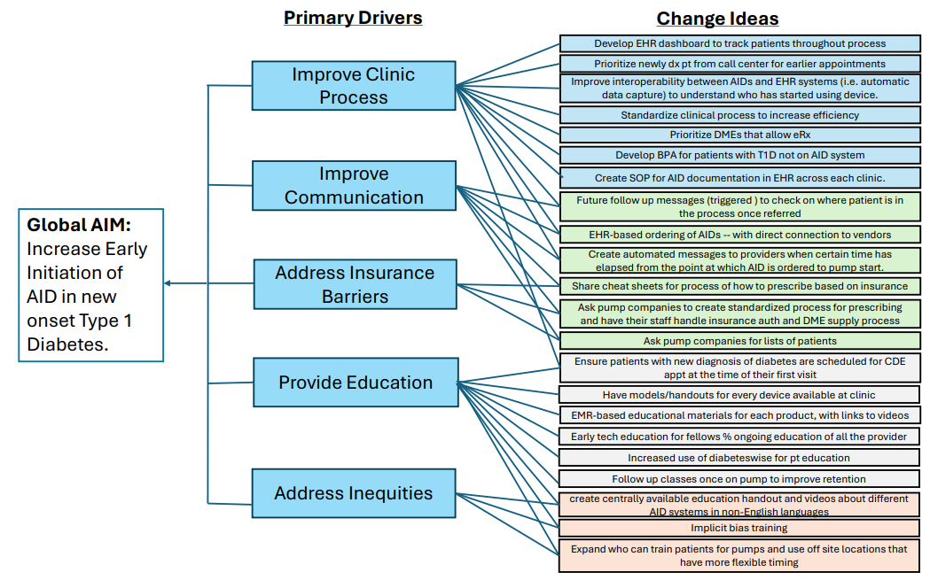

Slide 3
Flowsheet
1-month post-dx
Glooko One Click
Glooko Metrics
Flowsheet
Utilize RN CC
Utilize RN CC
Automatic
Orientation lectures
PANTHER
Post-pump FU
Notes:
I crossed out in red boxes that represent things we have already implemented at CCHMC OR Thankless Tasks that were advised to be eliminated based on the Effort/Impact Matrix Tool.

Slide 4

Decreasing Time from T1D Diagnosis to Insulin Pump (AID) Initiation Key Driver Diagram (KDD)
Project Leader(s): Hailee Delsart
Revision Date: 3/31/2025 (v5)
Global Aim
Key Drivers
Interventions (LOR #)
Increase the number of T1D patients with A1c <7% and/or glucose Time In Range (TIR) >70%
Utilize coordinator roles: financial counselor, insurance navigator, RN care coordinator (LOR 2)
Innovative healthcare delivery system
Provide education/training about and exposure to DM tech options (LOR 1)
Initiate access to DM technology at CCHMC pharmacy and DME (LOR 2)
SMART Aim
Increase the percentage of patients on insulin pump therapy within 3 months of diagnosis with T1D from 22% to 50% by June 30th, 2025.
Accurate understanding of DM tech for patients/families
Share patient experiences with other patients considering DM technology (LOR 2)
Proactive Outreach for Missed Appts (LOR 2)
Standardized and patient-centered process for DM tech initiation
Offer CGM at diagnosis (LOR 2)
Include Shared Decision-Making Tool as part of check-in process at Clinic Visits (LOR 1)
Alleviate patient concerns and address DM stigma
Roadmap from Diagnosis to Pump Start provided at Diagnosis (LOR 1)
Population
Scheduling of Pump Options at Dx (LOR 2)
Youth 0-18 yr diagnosed with Type 1 Diabetes (T1D) within the past year receiving care at CCHMC DM Center
Consistent and equitable provider offering of DM tech
Offer Modified Pump Options On Demand (LOR 2)
RN Care Coordinator Check-In after Pump Rx Completed (to Schedule Pump Start) (LOR 2 )
Legend
This work is licensed under the Creative Commons Attribution-NonCommercial-ShareAlike 4.0 International License. To view a copy of this license, visit http://creativecommons.org/licenses/by-nc-sa/4.0/ or send a letter to Creative Commons, PO Box 1866, Mountain View, CA 94042, USA. If you have any comments, questions or feedback regarding this tool, please email your feedback to AC4U@cchmc.org. Template created and maintained by The James M. Anderson Center for Health Systems Excellence at Cincinnati Children's Hospital Medical Center.
Potential intervention
Active intervention
Adopted intervention
Abandoned intervention
James M. Anderson Center for Health Systems Excellence
Note: LOR # = Level of Reliability Number, e.g., LOR 1
Notes:
Using our baseline data and in collaboration with members of the Diabetes Center including diabetes educators, diabetes technology educators, diabetes providers, family partners, and QI data specialists, we created this Key Driver Diagram. This project has a strong foundation that was built by previous work on increasing access to CGM, and almost all our patients diagnosed with type 1 diabetes have a CGM placed at diagnosis. Out-of-pocket costs associated with some private insurance plans in the US make diabetes technology cost-prohibitive, despite having insurance coverage.

Slide 5
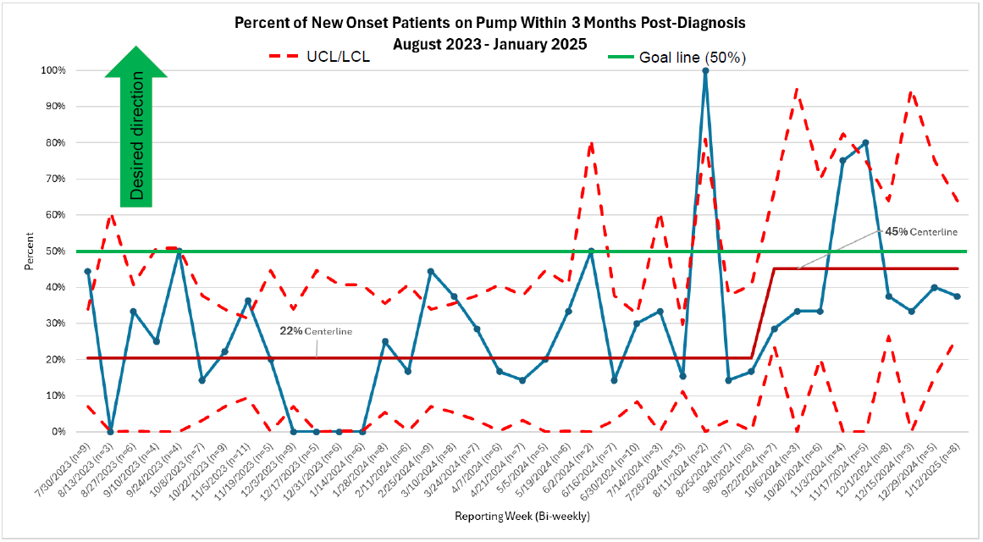

Slide 6

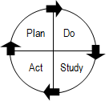
Ramp Plan
EHR-based ordering of AIDS with direct connection to vendors | Initial Test Cycle | Test Cycle 2 | Test Cycle 3 | Test Cycle 4
Date of Test | TBD | TBD | TBD | TBD
Test Cycle Description, including changes in scale/time: | Discuss use of Parachute with other institutions who have already adopted it Discuss current process with insurance navigator Contact Parachute to discuss cost and training of providers | Have a few dedicated providers (2 or 3) receive training on how to use Parachute | Test Rx process with Parachute versus SOP with insurance navigator and compare timelines for completion as well as ease of use | Expand use of Parachute to other prescribers of diabetes technology
Notes:
Epic orders exist for all insulin pump types but this method of prescribing is not commonly utilized for pumps that need to go through DME companies (Tandem, Medtronic, iLet). There are prescription forms that are filled out by the provider and then sent to either the pump company territory manager or DME company by the insurance navigator.
Parachute Health is a cloud-based order documentation and communications platform that allows healthcare providers to digitally prescribe DME and supplies.

Slide 7
Project Title: | IMPROVAID
Intervention Name: |  | EHR-based ordering of AIDS with direct connection to vendors
What key driver does this test impact? |  |  |  | Address Insurance Barriers
Test Cycle #: | 1 |  | Test Cycle Start Date: |  | Test Cycle Completion Date:
Use Parachute for DME ordering (including supplies) and determine feasibility
List the tasks necessary to complete this test (what) | Person Responsible (Who) | When | Where
Parachute needs to be an option for prescribers; purchase software | DM Center leadership | 1st | N/A
Training on Parachute needs to be completed for trial provider | Parachute rep and trial provider | 2nd | EHR
New onset T1D pt chooses pump that goes through DME and not pharmacy benefits | Pt/patient’s family and their primary provider | 3rd | EHR
Provider is able to successfully prescribe insulin pump and supplies via Parachute without any additional involvement of CDCES, insurance navigator, or insulin pump company rep
Qualitative: This is a new process, so it will likely take time to become accustomed to providers prescribing via Parachute instead of CDCES filling out form, sending to insurance navigator, who sends to prescriber, who sends back to insurancee navigator, who sends to insulin pump company, who sends to insurance company.
Quantitative: Should be able to track Rx via EHR as well as time between steps in prescribing and pump start process.

Slide 8
Ramp Summary
EHR-based ordering of AIDS with direct connection to vendors | <Enter Intervention> | Test Cycle 1 | Test Cycle 2 | Test Cycle 3 | Test Cycle 4
Date of Test | Date of Test
Plan | Describe the objective of the test cycle.
Do | What changed from the previous test cycle?
Study | Results: Data and Observations
Act | Action (Adapt, Adopt or Abandon):

Slide 9
Ramp Plan
Ask pump companies for lists of patients | Initial Test Cycle | Test Cycle 2 | Test Cycle 3 | Test Cycle 4
Date of Test | TBD | TBD | TBD | TBD
Test Cycle Description, including changes in scale/time: | Email Kelli Canup from Insulet/Omnipod Email Jess Higgins from Tandem for list of patients prescribed Tandem t:slim X2 or mobi Email Beth Dendler from Medtronic for list of patients prescribed Medtronic 780G Contact Kim Keppler or Dave Speiser from twiist to discuss WHEN prescriptions for twiist should be available in pharmacies and HOW to schedule pump education. | Allison receives monthly reports from insulin pump companies and determines which patients have NOT scheduled pump start. Allison then forwards information to pt’s provider’s RN CC (would want to do small tests of change at first, but each provider has a different RN CC).
Notes:
Insulet/Omnipod training is currently happening off-site
Mention Kristin Pryor as insurance navigator
CDCES Allison Deisinger in charge of iLet pump starts at CCHMC but Susan Sewell is also trained. Rachel Sheets?
Email local pump company contacts to inquire about notification of pump shipment from DMEs.
For Omnipod, could run a report if the Omnipod 5 Intro Kit was dispensed from the pharmacy; same would theoretically apply for twiist.

Slide 10
Project Title: | IMPROVAID
Intervention Name: |  | Ask pump companies for list of patients
What key driver does this test impact? |  |  |  | Address Insurance Barriers
Test Cycle #: | 1 |  | Test Cycle Start Date: |  | Test Cycle Completion Date:
To ensure email is the most effective means of obtaining information regarding insulin pump starts both within CCHMC and without (by pump company representative) – is this something they can provide?
To determine WHO should receive these reports and HOW to track the patients’ progress
To determine how often providers should be notified of insulin pump starts for their patients
List the tasks necessary to complete this test (what) | Person Responsible (Who) | When | Where
Email from pump company reps listing patients prescribed on a monthly basis | Pump company reps | Monthly
Lead CDCES performs chart review at the end of a month to determine if successful pump start completed | Allison Deisinger | Monthly
Patients NOT on insulin pump within a month are contacted by provider’s RN CC | Allison Deisinger RN CC | Monthly
List is received by CDCES Tech Team Lead, who is able to perform chart review (burden of workload) and then forward patient to provider’s RN CC for follow up if not scheduled for pump start within 1 month of Rx
RN CC able to successfully contact patient/caregiver and confirm receipt of insulin pump +/- supplies as well as schedule them for pump start appointments.
Qualitative: This is a new process which involves many different people (multiplee insulin pump companies, multiple RN CC, multiple providers), so I could envision people not knowing what to do or who to ask for help, however, we have identified leaders amongst the CDCES Tech Team and RN CC Team.
Quantitative: Can track how many patients are successfully starting insulin pump therapy WITHOUT the need for intervention from RN CC, as well as those who do need additional assistance scheduling training.

Slide 11
Ramp Summary
Ask pump companies for lists of patients | <Enter Intervention> | Test Cycle 1 | Test Cycle 2 | Test Cycle 3 | Test Cycle 4
Date of Test | Date of Test
Plan | Describe the objective of the test cycle.
Do | What changed from the previous test cycle?
Study | Results: Data and Observations
Act | Action (Adapt, Adopt or Abandon):

Slide 12
Ramp Plan
<Enter Intervention> | Initial Test Cycle | Test Cycle 2 | Test Cycle 3 | Test Cycle 4
Date of Test
Test Cycle Description, including changes in scale/time:

Slide 13
Project Title:
Intervention Name:
What key driver does this test impact?
Test Cycle #: |  |  | Test Cycle Start Date: |  | Test Cycle Completion Date:
List the tasks necessary to complete this test (what) | Person Responsible (Who) | When | Where
Qualitative:
Quantitative:

Slide 14
Ramp Summary
<Enter Intervention> | <Enter Intervention> | Test Cycle 1 | Test Cycle 2 | Test Cycle 3 | Test Cycle 4
Date of Test | Date of Test
Plan | Describe the objective of the test cycle.
Do | What changed from the previous test cycle?
Study | Results: Data and Observations
Act | Action (Adapt, Adopt or Abandon):

