Slide 1
IMPROVAID QI Project
PDSA
Presented by: Nestoras Mathioudakis, MD MHS; Daniel Alizadeh

Slide 3
Plan
Review baseline data on time to insulin pump start:
  Children w/ T1D
  Adults w/ T1D
BPA: Track % of patients with T1D who are not on an AID
  If deemed not appropriate by provider, quantify % where reason specified is newly diagnosed
  Leverage BPA to identify potentially existing AID users to remove from target population
Definition of newly diagnosed (<1 year?)
  Create a shared patient list of patients and review by team at standing interval

Slide 4
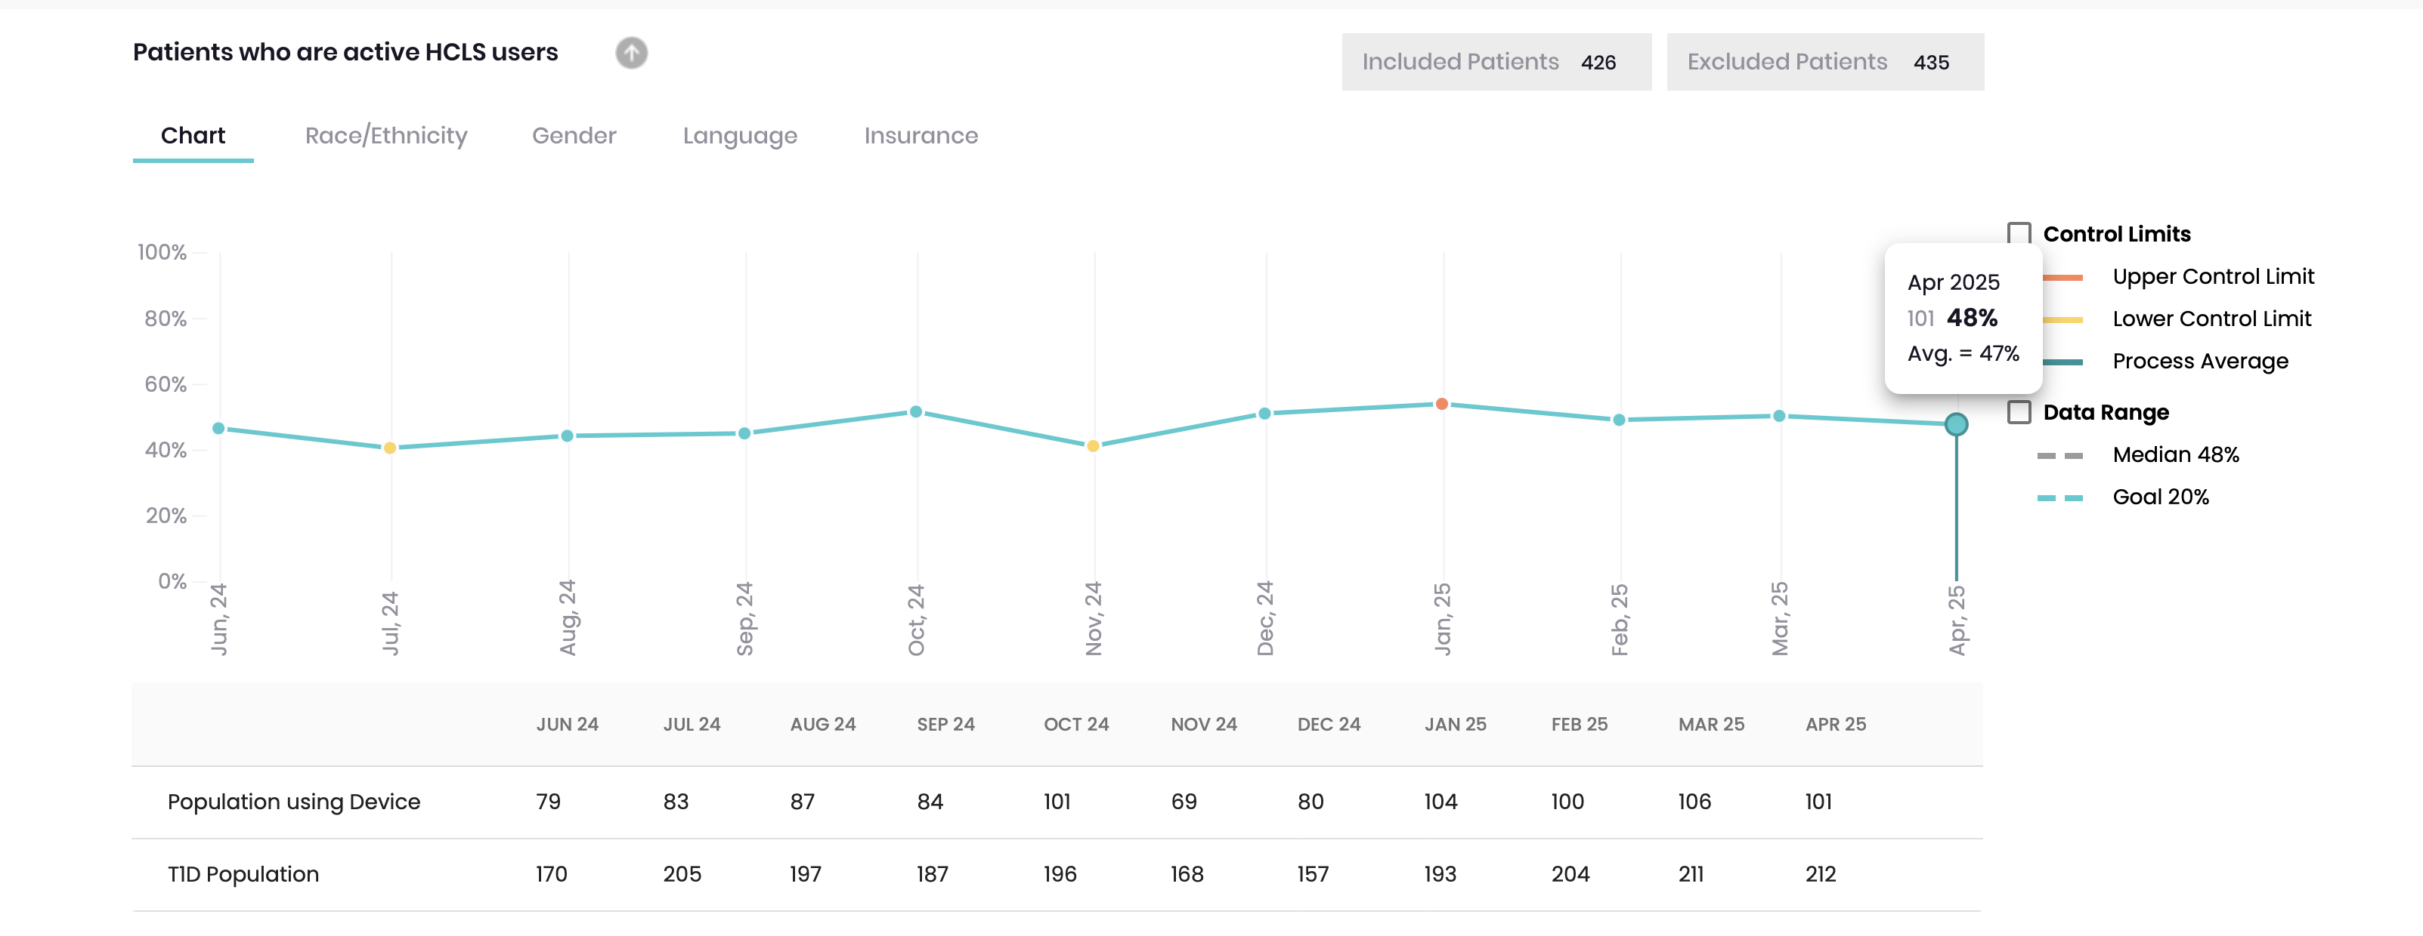
Baseline Data
May 25: Implemented BPA
re: AID use in T1D

Slide 5
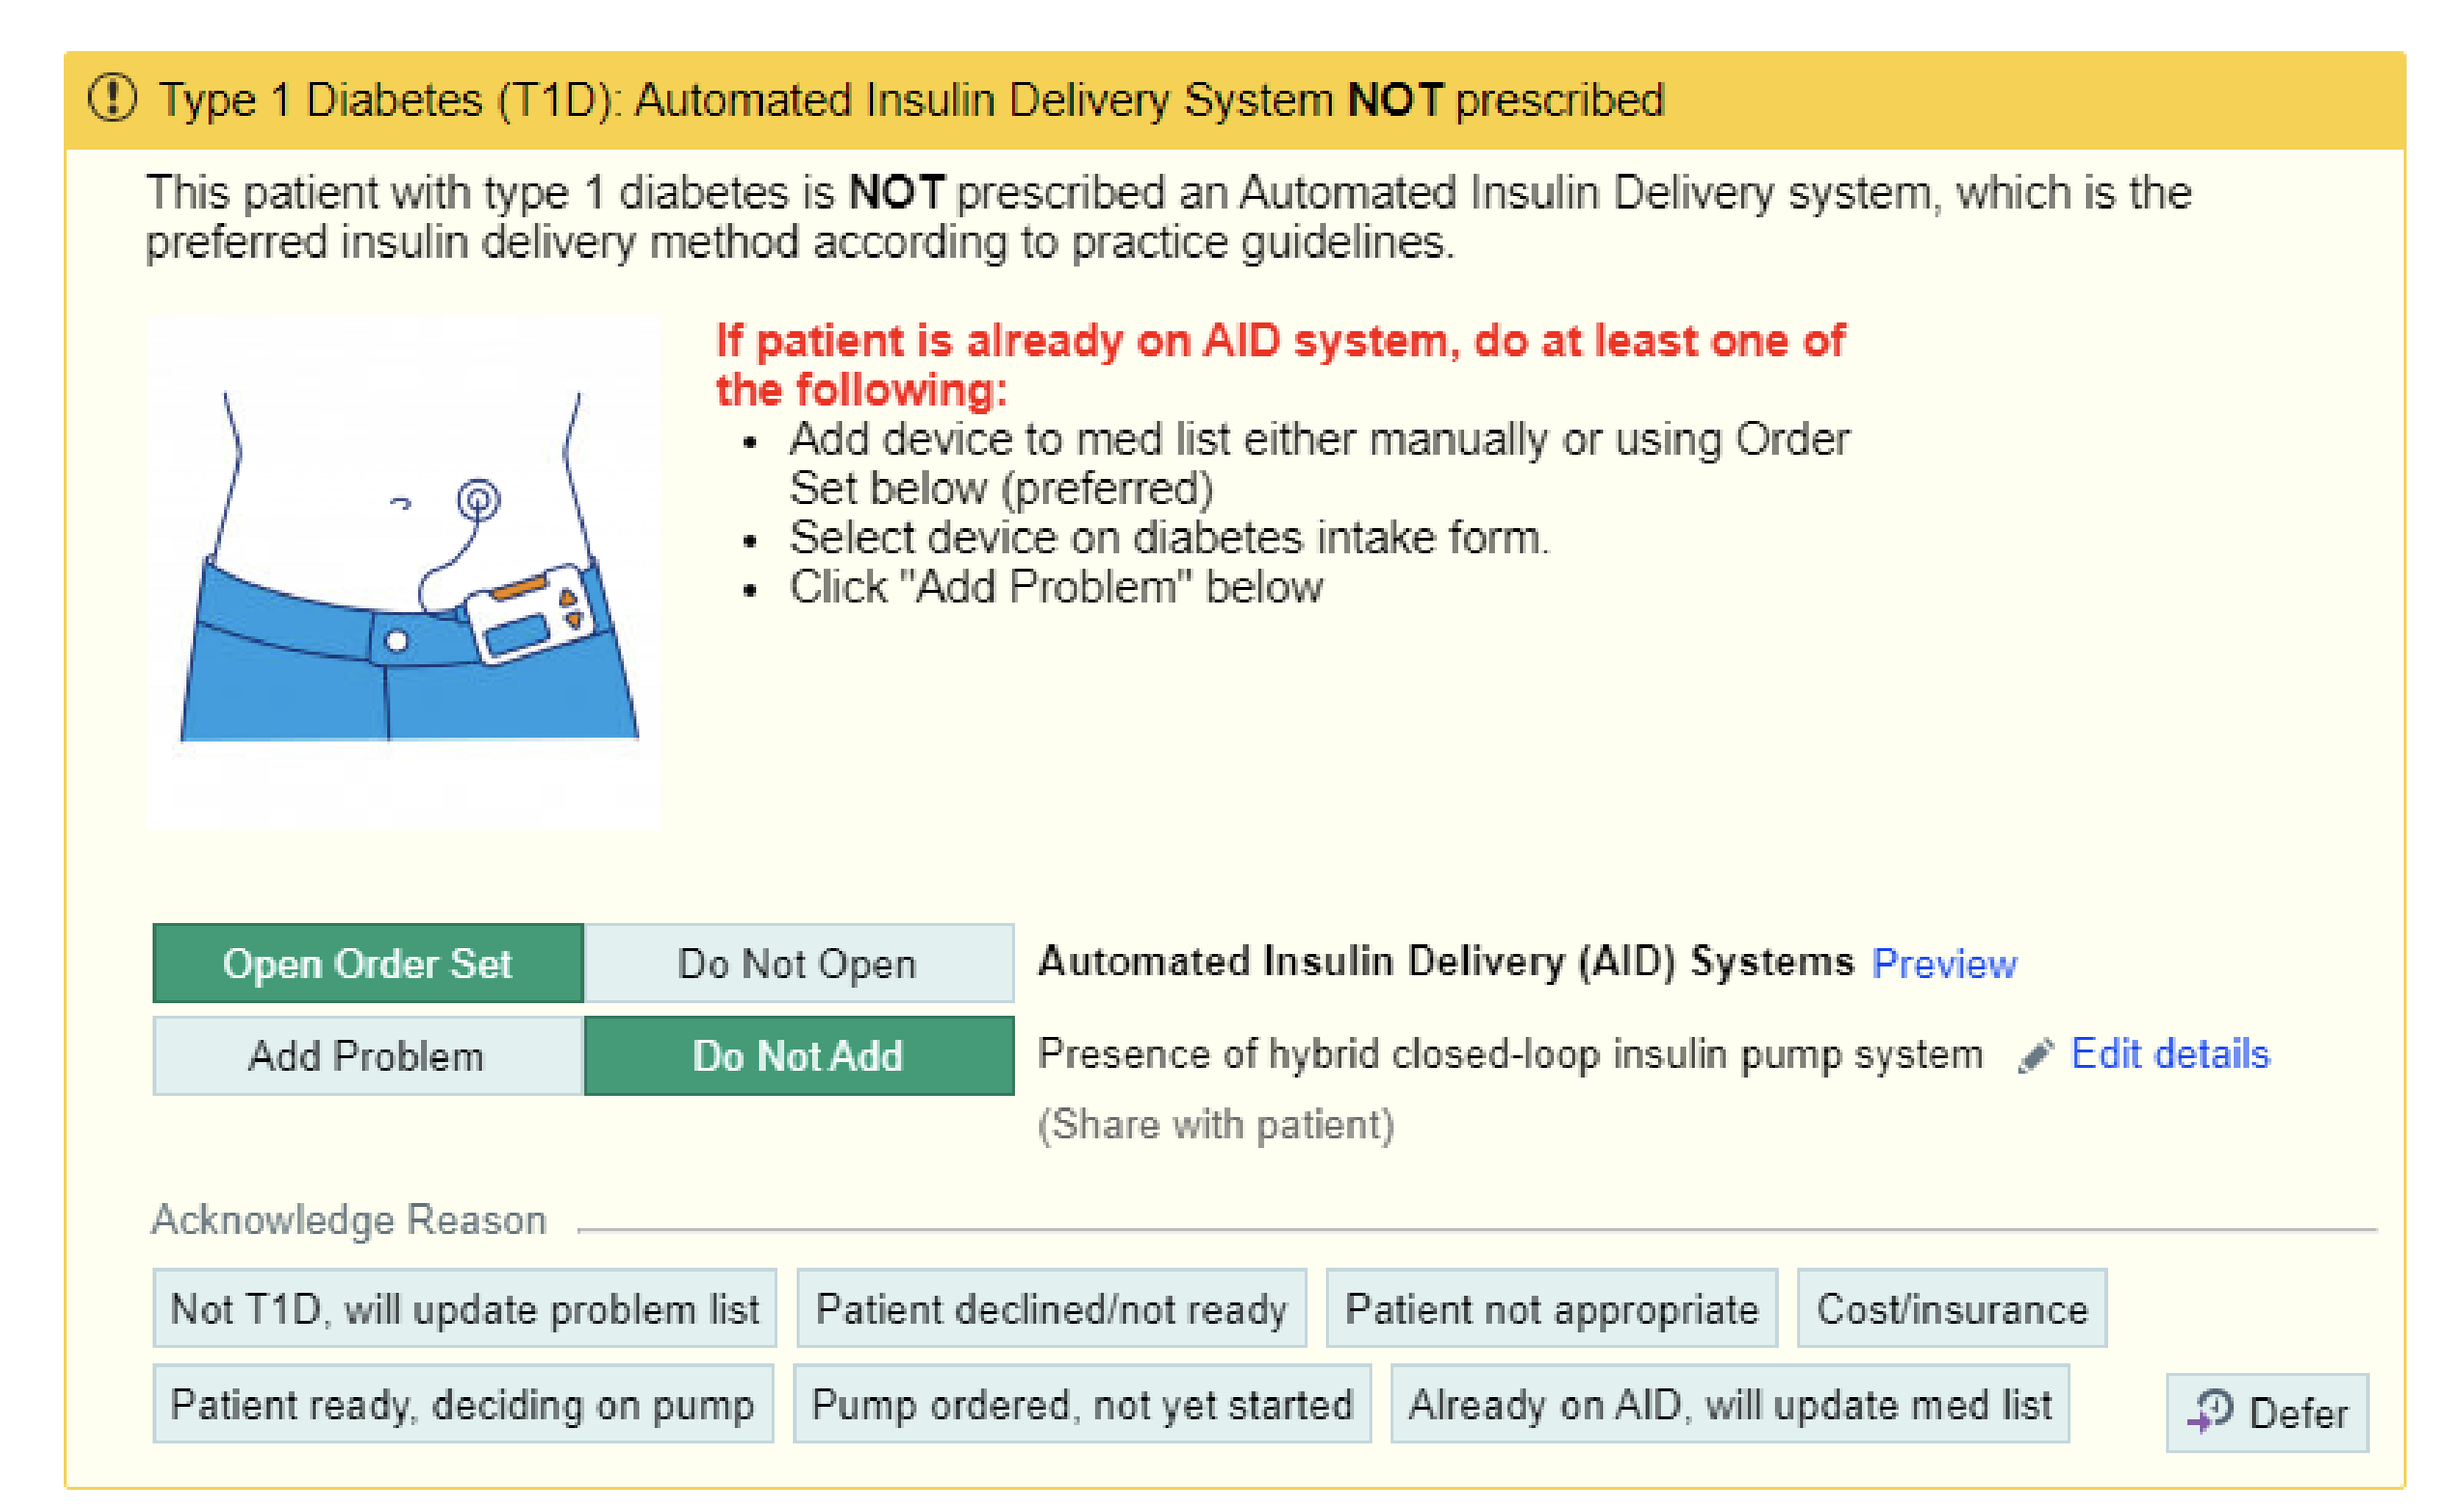
BPA

Slide 6
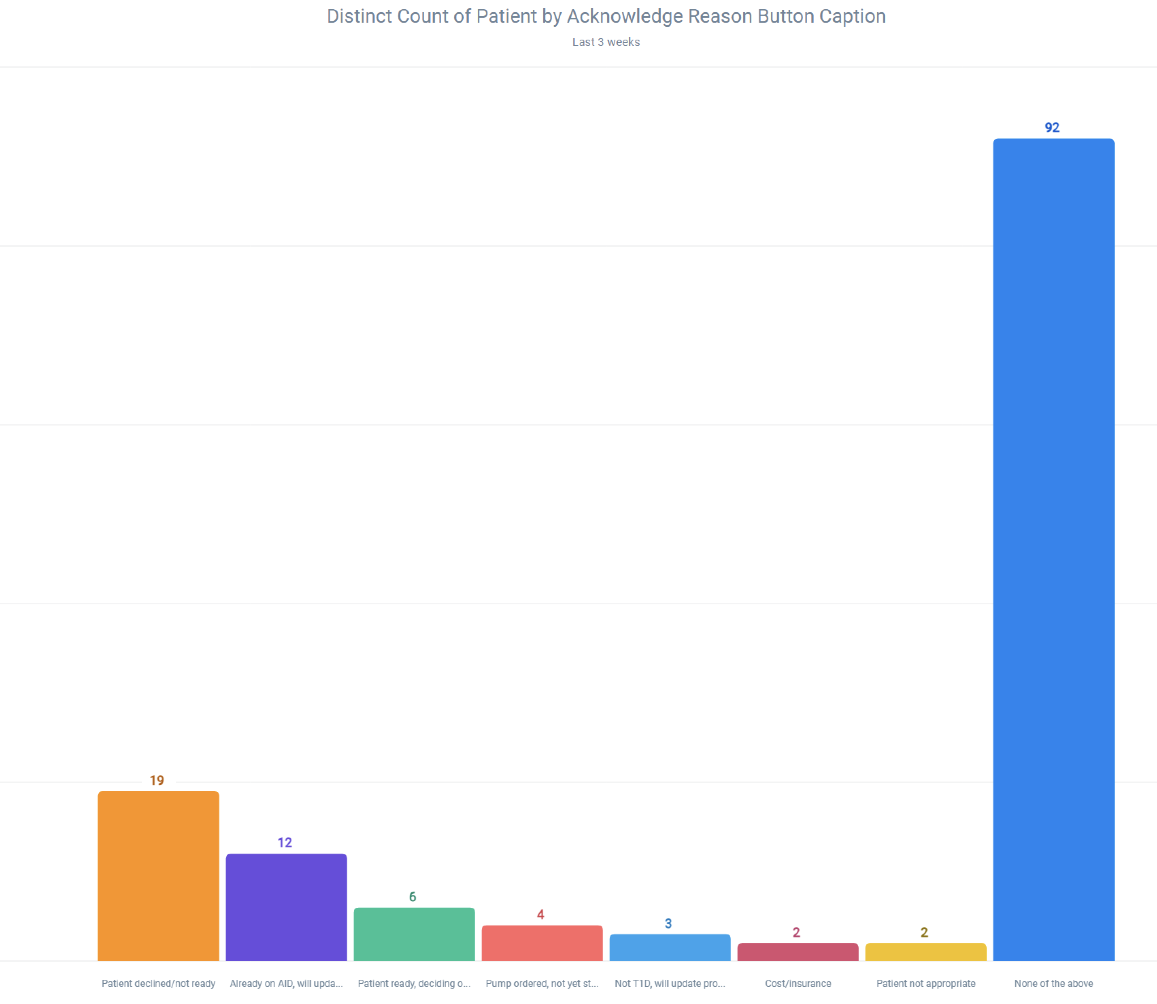
BPA Results (5 weeks)
How many already on AID?
Manual review- MA add device to med list
Track process

Slide 7
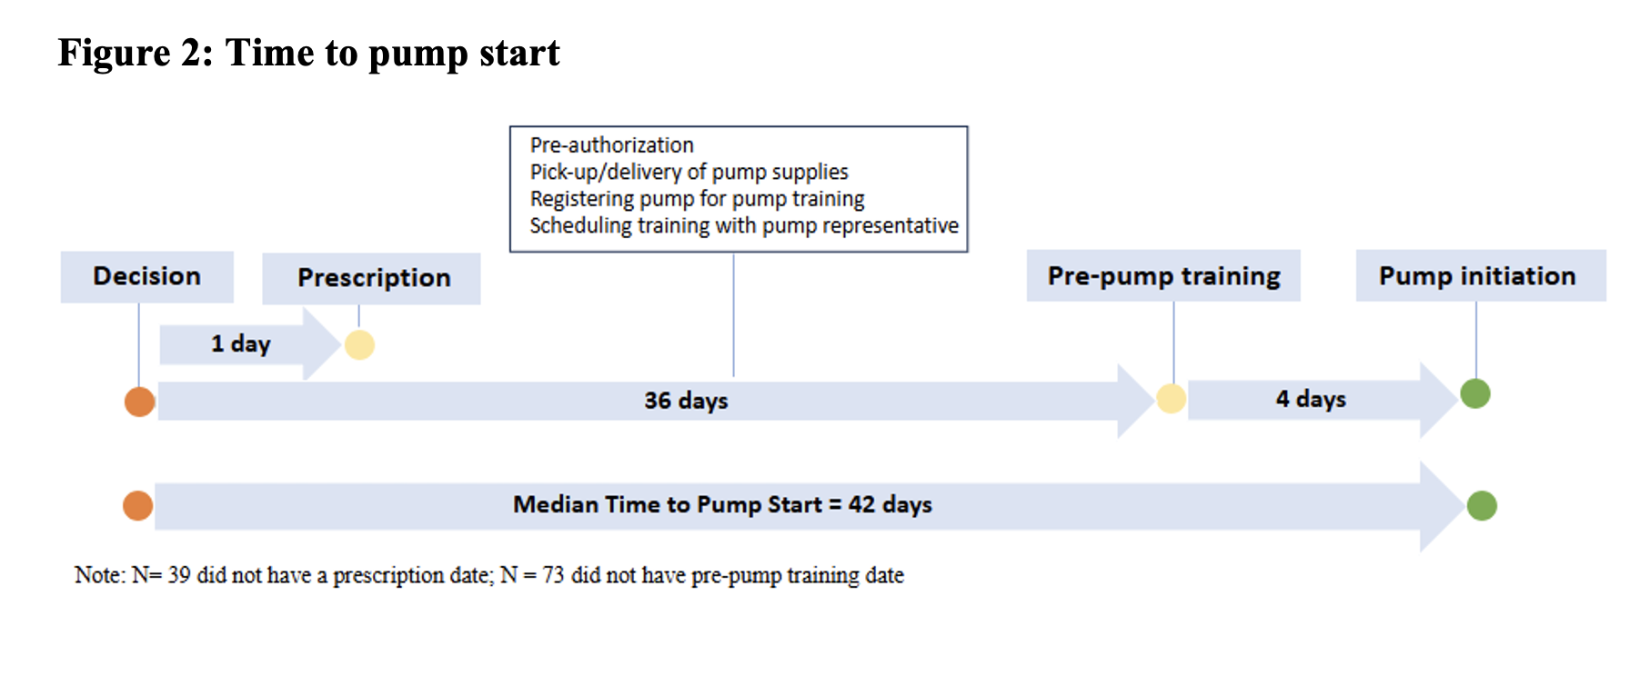
Time to pump start (children)

Slide 8
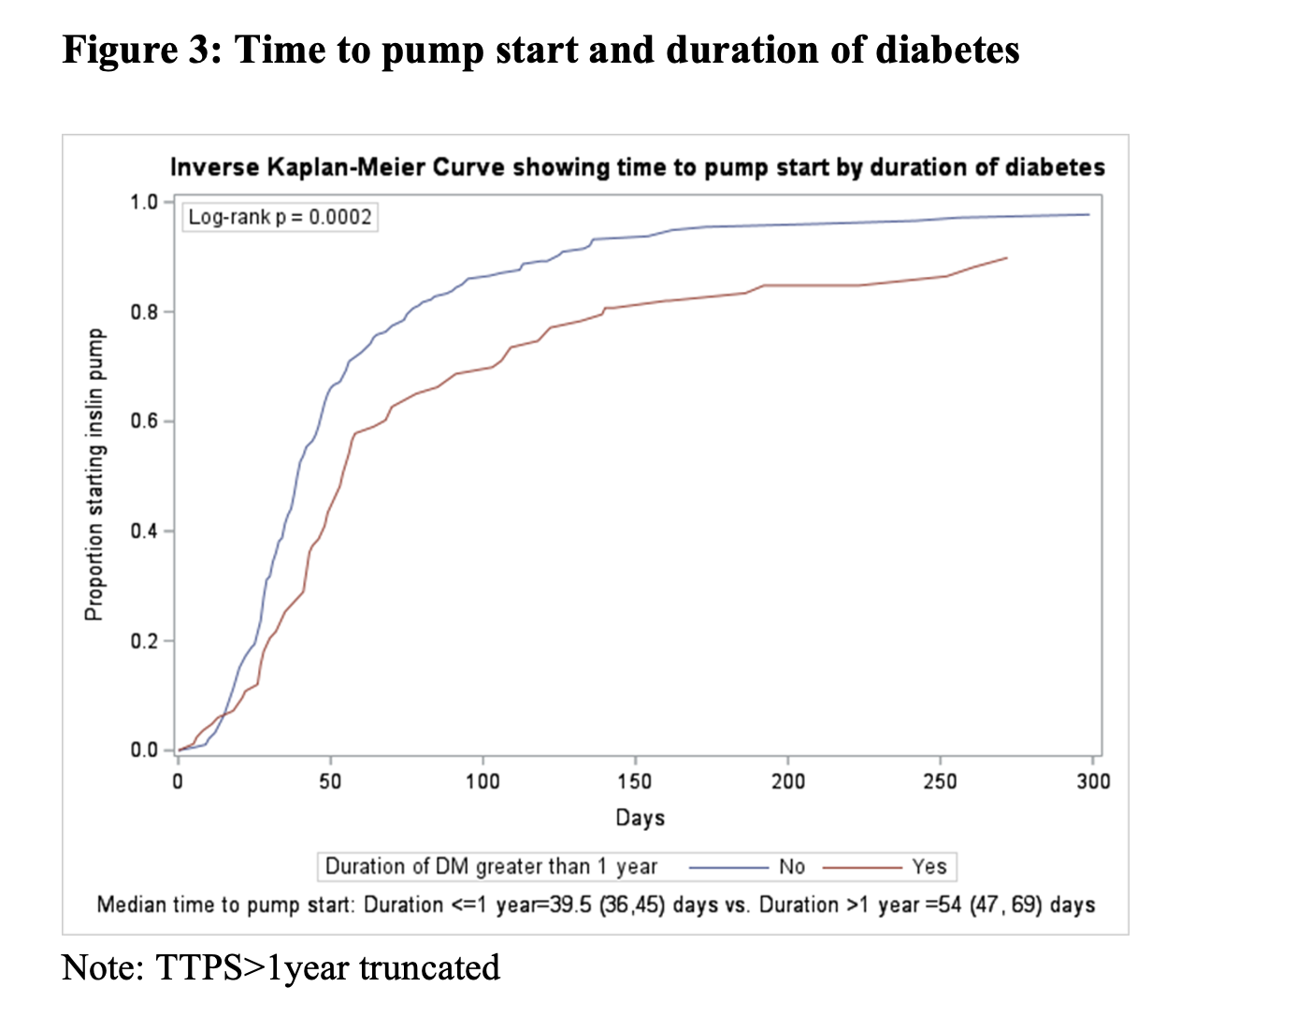
Time to pump start (children)

Slide 9
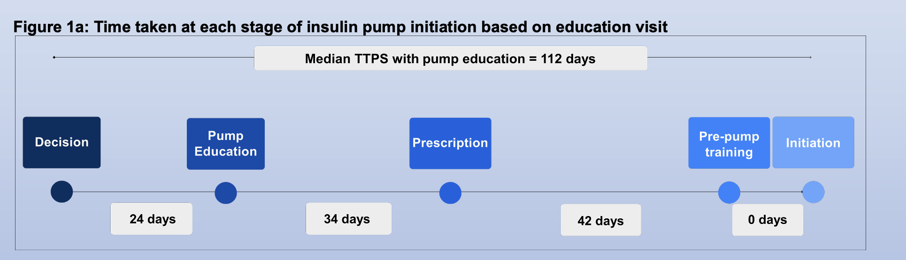
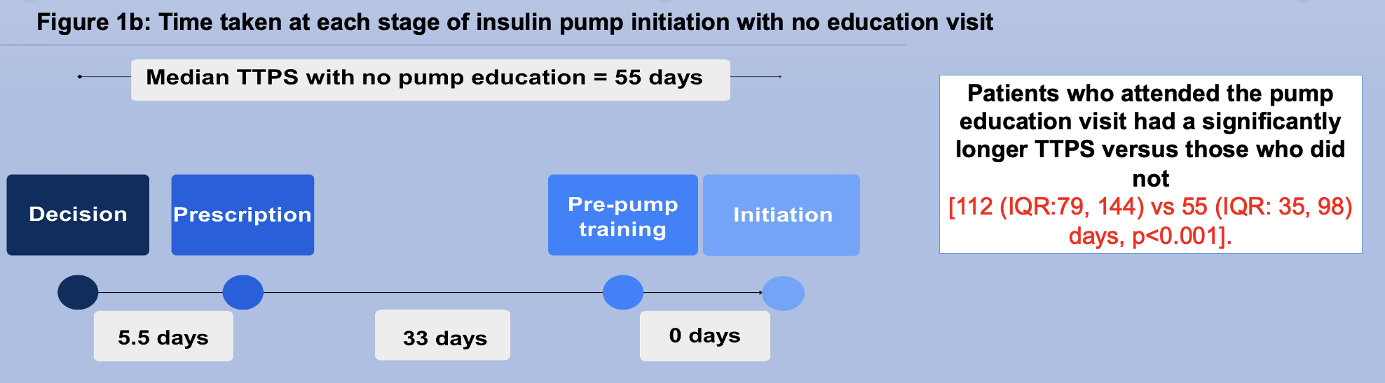
Time to pump start (adults)

Slide 10
PDSA Cycles
Cycle 1: Our Practice Advisory
Cycle 2: Electronic dashboard for tracking status
Cycle 3: Parachute/Epic EHR integration

Slide 11
Plan
Based on preliminary data, goals are to:
  Increase AID utilization by 15% from baseline among:
    All T1D patients
    Newly diagnosed T1D patients
  Reduce lag time between pump decision to initiation by 25%
    Children: 42 days → 30 days
    Adults: 112 days → 90 days

Slide 12
Do
Leverage existing BPA to identify T1D patients where AID status may be uncertain, reconcile med list, allowing team to focus on patients not on AID
Create Epic dashboard to track patients who have started the pump process
  Consider building automated reminders to care team
  Filter out by newly diagnosed status
Integrate Parachute with Epic (pilot testing) to track status of pump orders outside EMR

Slide 13
Study
Use T1D Exchange QI dashboard
  Track outcomes (AID use) by diabetes duration (<1 year; >1 year)
Create new dashboard to track time from pump decision to initiation

