Slide 1
Understanding HCLs and Unique Ways to Manage Patients on HCLs
Slides from 'Unique Ways in Managing Patients on HCLs: Case Presentation'
Elizabeth Gunckle
Emily Coppedge

Slide 2
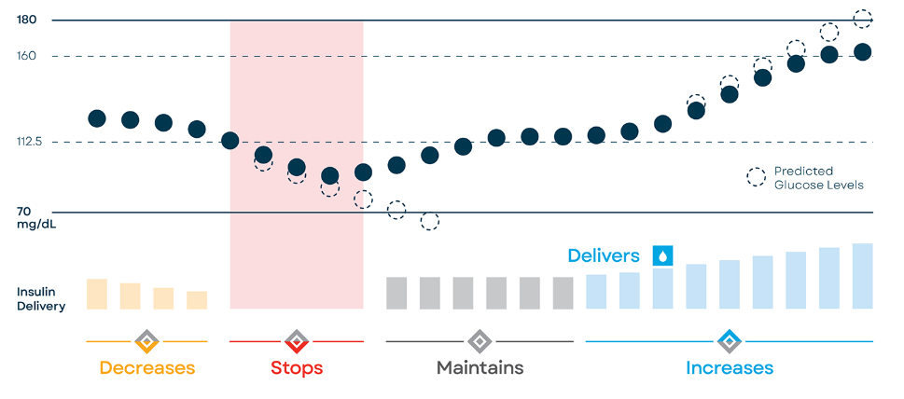
Understanding the Tandem Algorithm
Algorithm uses programmed basal rates and adjusts insulin delivery based on predictive CGM values 30 minutes in the future
Insulin delivery is adjusted every 5 minutes
Algorithm updates every 24 hours
HCL features currently available with Dexcom G6™ , Dexcom G7™ , and Freestyle Libre 2 Plus™
https://www.tandemdiabetes.com/docs/default-source/quick-reference/quick-reference-control-iq-mgdl-ml1004929.pdf?sfvrsn=d9dc04d7_62
Notes:
https://www.tandemdiabetes.com/docs/default-source/quick-reference/quick-reference-control-iq-mgdl-ml1004929.pdf?sfvrsn=d9dc04d7_62
If BG is predicted to drop below 112.5 in 30 min, will decrease basal rate
If BG is predicted to drop below 70 in 30 min, will suspend insulin
If BG is predicted to be between 112.5 and 160 in 30 min, will maintain basal rate
If BG is predicted to be above 160 in 30 min, basal rate will increase
If BG is predicted to be above 180 in 30 min, automatic correction will be delivered
Above graph is with 5 min increments

Slide 3
Understanding Control-IQ®
Target range 112.5 - 160 mg/dL
Algorithm increases or decreases insulin based on predicted CGM values 30 minutes into the future
Control-IQ® automatically gives 60% of correction bolus if blood glucose levels are predicted to be above 180 mg/dL
Automatic correction boluses can deliver once every 60 minutes or if it has been > 60 minutes since last manual/bolus calculator bolus
https://www.tandemdiabetes.com/docs/default-source/user-guide/user-guide-mobile-bolus-tslim-x2-control-iq-7-8-mgdl-aw-1011648.pdf

Slide 4
Sleep Activity Algorithm
Target range 112.5 - 120 mg/dL
Basal rates will increase if predictive CGM values are above 120 mg/dL
No autocorrections
Can preset sleep schedule or manually turn on/off
Start about 2 hours after final carb containing food/beverage for the day
End prior to first meal of day
https://www.tandemdiabetes.com/docs/default-source/user-guide/user-guide-mobile-bolus-tslim-x2-control-iq-7-8-mgdl-aw-1011648.pdf

Slide 5
Exercise Activity Algorithm
Target range 140 – 160 mg/dL
Suspends basal insulin if predictive value < 80 mg/dL
Automatic corrections are still delivered at 60% of correction bolus if predictive blood glucose is above 180 mg/dL
Tip: If autocorrections are not desired, can give/waste 0.01 U bolus to restart the 60-minute autocorrection clock
Must be set by patient
Start 1 hour prior to exercise
Can now set duration: 0.5 - 8 hr
https://www.tandemdiabetes.com/docs/default-source/user-guide/user-guide-mobile-bolus-tslim-x2-control-iq-7-8-mgdl-aw-1011648.pdf

Slide 6
Control IQ® + Long-Acting
Teen​ager with complex social situation
A1C 16%​
Pre-pump regimen:
40 units long-acting nightly
Sliding scale 8/10/12 units based on blood glucose level
Patient barrier: interest in pump therapy , but safety concern to be full basal/bolus on pump
Solution: keep long-acting insulin on board, while using pump for boluses and HCL benefits

Slide 7
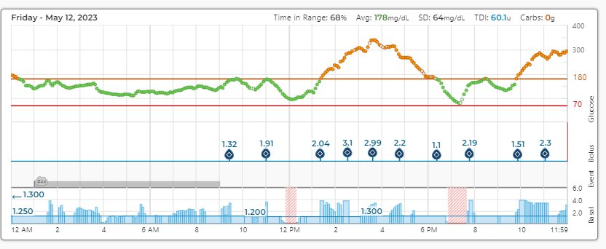
Control IQ® - Corrections Only
College student
Previously on MiniMed™ 670G, A1C at time of transition to t:slim X2™ 11.5% (July 2021)
Patient barrier: remembering to bolus
Solution: strengthen correction factor and basal rates
 | July 2021 | March 2022 | December 2022
A1C | 11.5% | 10.1% | 8.2%
Basal rates | 12a: 1.15 5:30a: 1.0 10a: 1.1 3p: 1.2 | 12a: 1.15 -> 1.25 5:30a: 1.0 -> 1.25 10a: 1.1 -> 1.2 3p: 1.2 -> 1.3 | 12a: 1.25 5:30a: 1.25 10a: 1.2 -> 1.3 6p: 1.2-> 1.4
Correction factor | 30 | 30 -> 25 | 25 -> 20
Carb ratio | 5 | 5 | 5

Slide 8
Omnipod 5 Automated Mode
SmartAdjust™ technology adjusts basal delivery every 5 minutes based on predictive CGM values 60 minutes in the future
Basal rates are determined by algorithm, does not utilize programmed basal rates after first 72 hours
Adjustable target glucose (110 - 150 mg/dL)
Adjustable "correct above" glucose levels (110 – 200 mg/dL)
No autocorrections
No sleep mode
Algorithm adjusts every pod change
https://www.omnipod.com/what-is-omnipod/omnipod-5

Slide 9
Automated: Limited
SmartAdjust™ compares adaptive basal rate for current pod versus programmed basal rates every 5 minutes and gives the lower of the two rates
System automatically enters this mode when any of the following occur:
Pod and CGM have lost communication for > 20 minutes
System has maxed out the basal rate for too long without improvement in glucose values
Insulin delivery was paused for too long

Slide 10
Long-Acting + Automated Mode
Adolescent patient
Complicated psychosocial history, including anxiety and depression
Older sister is the main caregiver and supervises insulin injections
Patient barrier: patient wants to reduce daily injections, but family reports patient is not reliable with independent diabetes management (ignores CGM alerts)
Solution: continue long-acting insulin and use pump for bolus only

Slide 11
Long-Acting + Automated Mode: Special Considerations
Transitioning off long-acting insulin:
Automated mode:
Gradually reduce long-acting insulin with each pod change so algorithm can adjust
Manual mode
Adjust basal rates to reflect true physiologic needs and keep pump in manual mode for at least 1 week until algorithm adjusts

Slide 12
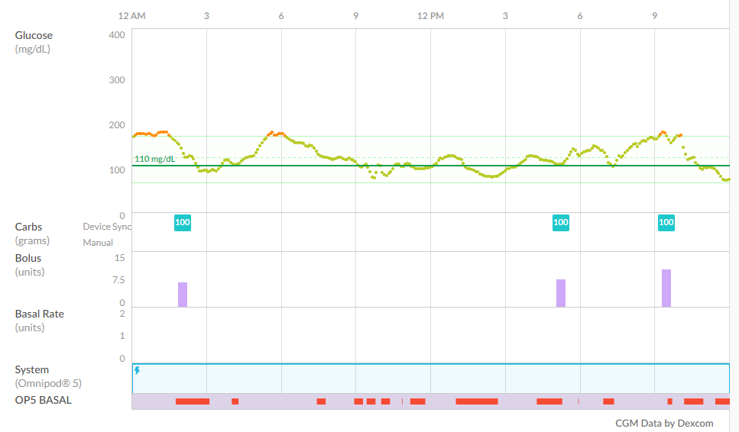
Set Mealtime Boluses
As this system has no autocorrections, meal boluses are of higher importance compared to other HCL pumps
If patient strongly wishes to be on Omnipod® 5 but finds carb counting burdensome, consider set carbs for meals
Take meal history and conservatively estimate average number of carbs at each meal
If carb amounts are similar at meals throughout the day, consider entering the same number of carbs for all meals
Stress importance of pre-meal boluses

