Slide 1
Agenda
Manuscript Outline
Finalize 2025 Annual Survey Questions
Current Equity Initiatives within the T1DX-QI Collaborative

Slide 2
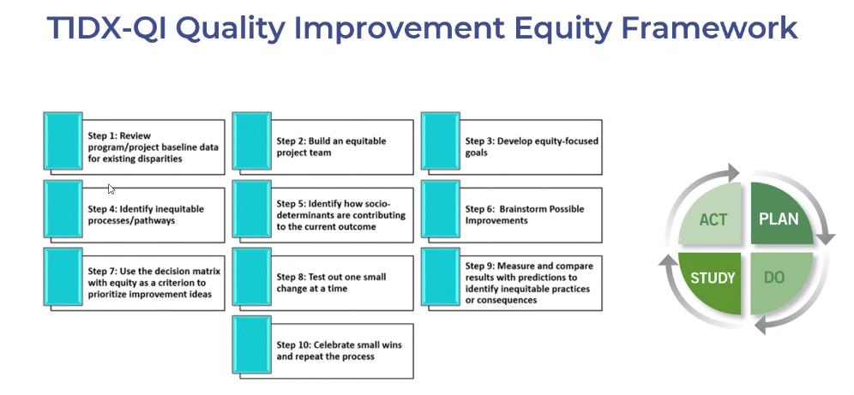
Manuscript Outline Overview: Type 1 Diabetes Workforce Considerations to Improve Health for All
Introduction
Population outcomes in T1D
Groups with poorer outcomes
Description of of T1DX-QI Quality Improvement Equity Framework
Focus on Step 2
Description of the workforce/ skills in existing interventions and ongoing trials in T1D
Aim: To describe the racial/ethnic makeup and job titles of the workforce of T1D Exchange clinics

Slide 3
2024 Survey Responses (HEAL)

Slide 4
Demographics
 | PwT1D | PwT2D
Adult Centers | 27,016 | 74,746
Pediatric Centers | 64,678 | 13,852
Total | 91,694 | 88,598
Notes:
*At least one visit in person/virtual in 2023
Centers reported a higher percentage of PwT2D than PwT1D identifying as a minoritized race/ethnicity, a trend more pronounced in pediatric centers where most reported over 50% of PwT2D identifying as minoritized race/ethnicity.
Over 80% of centers had less than half of their staff identify as a minoritized race/ethnicity
Findings demonstrate a mismatch between race/ethnicity of staff members and the PwT1D and PwT2D they serve, particularly among PwT2D and within the pediatric population. Future QI efforts at participating centers should explore the impact of this mismatch on PwT1D and PwT2D, and their diabetes outcomes.

Slide 5
FTE Summary
Adults | Physician without CDCES | Physician with CDCES | Nurse practitioner/physician assistant without CDCES | Nurse practitioner/physician assistant with CDCES | Social worker without CDCES | Social worker with CDCES | Registered nurse without CDCES | Registered nurse with CDCES
Mean Ratio of providers to patients | 1:342 | 1:164 | 1:516 | 1:723 | 1:2074 | 1:2137 | 1:728 | 1:1998
Median | 1:247 | 1:164 | 1:464 | 1:442 | 1:1779 | 1:1489 | 1:650 | 1:1500
Range (min, max) | (90, 989) | (0, 164) | (67, 4750) | (410, 1333) | (879, 8200) | (1489, 2785) | (231, 1867) | (200, 5400)
Pediatrics | Physician without CDCES | Physician with CDCES | Nurse practitioner/physician assistant without CDCES | Nurse practitioner/physician assistant with CDCES | Social worker without CDCES | Social worker with CDCES | Registered nurse without CDCES | Registered nurse with CDCES
Mean Ratio of providers to patients | 1:229 | 1:2070 | 1:820 | 1:1200 | 1:1148 | 1:3016 | 1:581 | 1:489
Median | 1:176 | 1:1153 | 1:546 | 1:1102 | 1:933 | 1:3478 | 1:313 | 1:498
Range (min, max) | (60, 1082) | (83,4975) | (143, 4000) | (121, 4777) | (111, 5250) | (1108, 4000) | (60, 6369) | (114, 1050)

Slide 6
FTE Summary
Physician
Nurse Practitioner/Physician Assistant
Social Worker
Registered nurse
Psychologist
Psychiatrist
Clinical pharmacist
Registered dietitian
QI coordinator/analyst/specialist
Patient/Parent partner
Data analyst/specialist
Technology coordinator/navigator

Slide 7
Language for Manuscripts and Grant Applications
 | Preferred language | Language we don’t prefer
Collaborative terms | T1D Exchange | “Type 1 Diabetes” Exchange is not our full name. We are incorporated as “T1D Exchange”
 | Centers | Clinics, Hospitals, Sites
Populations | People with Diabetes (PWD) | Patients, Diabetics
 | People with Type 1 Diabetes (PwT1D) | Patients, Diabetics
 | People with Type 2 Diabetes (PwT2D) | Patients, Diabetics
Diseases/events/dx | Diabetes-related Ketoacidosis (DKA) | Diabetic Ketoacidosis (DKA)
Glucose monitoring | Check | Test
 | Manage A1C Blood glucose levels Blood glucose goals (above or below) Glycemic goal Euglycemia Measure | Control, Glycemic control, Compliance, Adherence Test
Diabetes management | Engagement, involvement, participation | Compliant
Health equity | Minoritized Other examples? | Minority
EHR

Slide 8
2025 Draft Annual Survey Questions focused on Health Equity
Does your diabetes center have partnerships with community organizations to promote health equity?
a. Yes
b. No
If yes, list the name(s) of the community organization(s) (Open Ended)
Does your diabetes center have multi-disciplinary partnerships among center staff to promote health equity?
a. Yes
b. No
If so, please complete the following:
a. List the disciplines involved in the partnership (Open Ended)
b. Describe the heath equity focus area of the partnership (Open Ended)
c. Select among the following to indicate how the partnership is funded:
i. Internal Institutional Funding
II. Federal or State Grant(s)
iii. Foundation Grant(s)
iv. Industry Funding
v. Other, Please Indicate
Federal grants

Slide 9
Updates
Summary of next steps
Next meeting: Thursday July 17, 1-2pm EST

