Slide 1
Process Map
A process map is a QI tool that helps to visualize complex systems and support the adaptation of improvement interventions.
The processes are unique/different for all participating centers
There could be a few similarities in clinical workflows between centers
Pain points in clinical processes should be annotated
Pain points will help facilitate discussions about possible interventions.

Slide 2
When to use shapes
Use this shape to start and end your process
This shape represents a decision point
You must answer yes or No
Add this sign to process that are difficult or causing pain (Pain points)
This shape represents a process

Slide 3
1
this is a new process for us
Pain points:
No standardized process for providers to identify patients who may benefit from CGM and offer in a structured manner
If patients are unfamiliar, uncomfortable, or do not want CGM for other reason-it is often not revisited, and they do not have an opportunity to discuss again in future; can be barrier for non-English speaking patients; no standard resources to give patients to consider CGM after visit
Patient wants CGM and provider thinks would benefit, but not on MDI (soon less of an issue with basal-only covered by CMS)
No documentation that patient uses TID insulin (soon less of an issue with basal-only covered by CMS)
For patients with transportation or geographic barriers, this second visit to learn to apply and use CGM can be a problem; telehealth visits help with this somewhat; can also be barrier for non-English speaking patients
Inability to automatically share data for patients with incompatible smartphones limits use of CGM data between visits and with telehealth
Provider thinks patient would benefit from CGM
Patient eligible- MDI use
All provider routes chart to one diabetes tech prior auth nurse indicating which CGM
Diabetes tech nurse checks insurance coverage and documentation
4
one.
3
Is documentation sufficient and CGM is covered?
Patient interested?
NO
YES
NO
YES
Provider discusses available CGM with patient and elicits preference
Diabetes tech nurse sends note to provider req documentation/advising CGM not covered
Diabetes tech nurse pends prescription for covered CGM to appropriate pharmacy, sends to provider for signature
5
2
Prescription filled
Patient scheduled for DCES visit to learn to use CGM, link to clinic
No CGM
Prescription sent to appropriate pharmacy; documentation submitted to insurance by diabetes tech nurse
Is more info needed?
No
Patient begin CGM use
Site 1 Process and Pain Points for CGM
Yes
6
New information including updated information sent to pharmacy/insurance
If not using phone as reader-unable to access data unless patient brings reader to appointment

Slide 4
Clinician determines patient would benefit from personal CGM
Patient is interested in personal CGM
Patient does not receive personal CGM
No
Yes
Yes
Clinician Determines if patient can self- train
Clinician indicates need for CDCES visit for CGM education (staff message to ASR or check out paperwork)
CDCES visit scheduled and attended
Patient starts using personal CGM
No
Note/staff message routed to Pharmacy Liaison and Tech navigator to determine coverage and DME v pharmacy benefit
DME company contacts patient to review cost and shipping information
Patient receives personal CGM
Yes
Is CGM approved?
No
Is CGM covered?
No
Clinician signs CMN/ CGM Rx
Is more info needed?
Site 2 Process and Pain Points for CGM
Yes
Yes
Where is script sent?
DME
Technology Navigator determines DME supplier, sends notes
Additional information required by DME sent by tech navigator
Retail pharmacy
Is PA needed?
Script sent to preferred retail pharmacy
Pharmacy Liaison Completes PA
CGM approved, rx received by retail pharmacy and ready for pick up

Slide 5
Give info on GoodRx- Libre 2/3 sensors and out-of-pocket costs
CDE provides education
Consider CGM
= pain point
Would pt benefit from CGM?
Do they want CGM?
YES
NO
On insulin?
Does pt have insurance?
Patient seen by physician in diabetes clinic
YES
YES
NO
YES
NO
No CGM prescribed
Initiate application on Parachute
Give info on GoodRx- Libre 2/3 sensors and out-of-pocket costs
No CGM prescribed
CGM approved and delivered to pt’s home
Follow-up with parachute application, make changes as requested
CDE provides education
Request denied
Site 3 Process and Pain Points for CGM

Slide 6
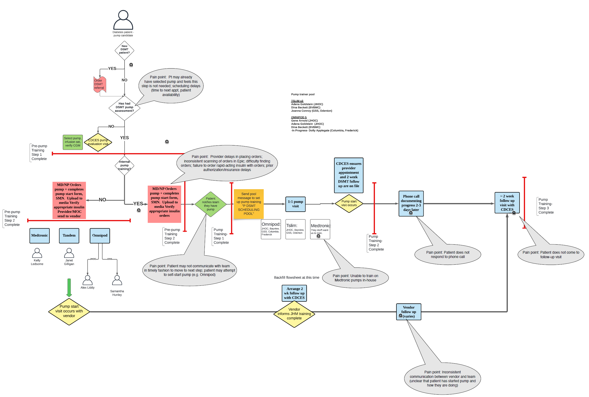
Site 4 Process and Pain Points for CGM

Slide 7
Patient interested in starting on AID?
Site 5 Process and Pain Points for CGM
Patient and provider discuss AID initiation in clinic
Company representative contacts patient and starts a Certificate of Medical Necessity (CMN) Form
NO
YES
No AID
Provider messages company representative
Patient prefers MDI’s
Insurance issues
PCC/DM education staff confirms patient has all pump supplies to move forward with registration and training
Company sends clinic CMN form for completion
Provider CC’s DM educator and staff messages that prescription has been placed
Patient receives pump!
Prior authorization may be issued

Slide 8
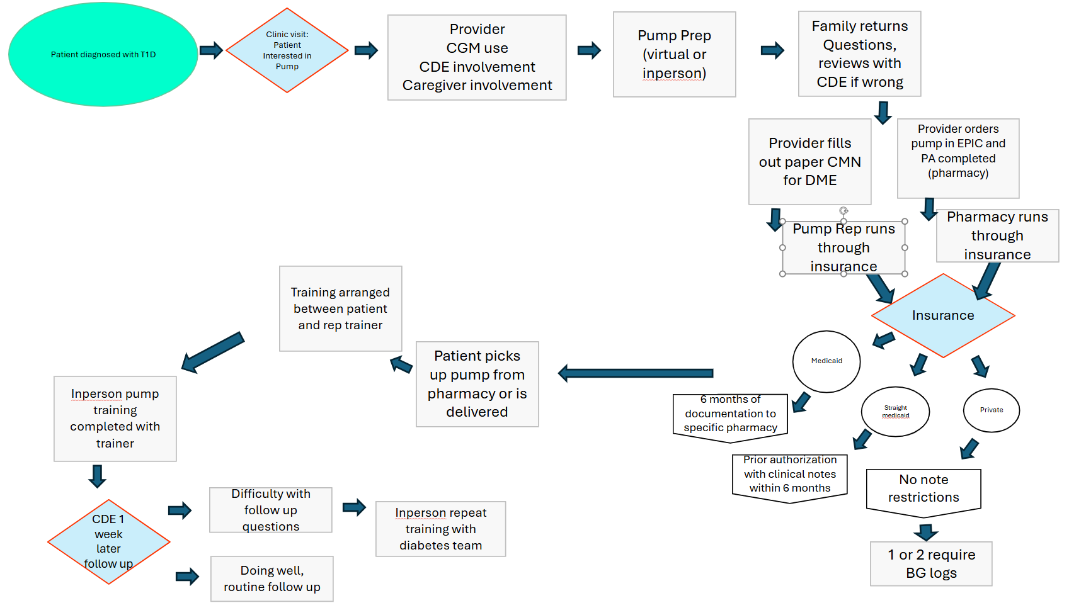
Site 6 Process and Pain Points for CGM

Slide 9
1
Patient with prolonged hospital stay (non-diabetes reasons)
Provider thinks patient on insulin would benefit from AID
no
yes
7
Patient/family interested?
Consider loaning clinic pump (Tandem) and providing CGM samples
Site 7 Process and Pain Points for CGM
yes
no
6
Provider assess reasons/barriers
On CGM?
no
CGM start with clinic sample while working on insurance
Consider referral to diabetes psychology, SW, CDCES as appropriate
yes
2
Pain points
Patient/family attends pump/AID education class
Variable timing for AID discussion, especially pre4T program (~2019). Now, this is mostly occurring <3 month from diagnosis. Delay due to lower health literacy or non-English speaking family due to already long visit/need to prioritize other discussions
Class is offered monthly in English via zoom during workday. Can’t physically touch the pump until next in person visit. Need 1:1 CDCES appointment for non-English speakers.
Some private insurances require 6 month of T1D diagnosis before approving pump
Delay because families do not respond to calls from insurance/pharmacy/device companies for required information
Delay when families don’t answer calls or MyChart messages to schedule appointments
Some patients (mostly adolescent girls) do not want to wear devices; some patients get used to MDI and hesitant to switch; some parents think the child is too young and want to wait
No insurance coverage, using off label. Hospital staff education/comfort with technology management. Limited choice of pump
Patient/family chooses pump
CDCES pends pump order and gets MD signature
CDCES submits order to pharmacy/DME
Pharmacy / DME / insurance need more info?
Gather new information/documentation for pharmacy/insurance
yes
3
4
5
Patient started on AID
no
Pump start with CDCES
Prescription filled and shipped to patient

Slide 10
Provider
offers tech
Patient
receives education?
Provider provides Rx
Clinician inertia/implicit bias
Lack of familiarity in tech
Short visits
No therapeutic relationships
No patient-driven focus
No standardized
education in clinic
Differences in support staff across sites
Provider familiarity
Communications not streamlined
Patient continues MDI
Insurance approved?
Site 8 Process and Pain Points for CGM
Issue with prior auths
Large patient cost
Insurance issues
Patient comfort with using tech
Difficulty with company training
No standard prescriber training
Patients lost to follow up
Unable to receive tech or supplies through pharmacy or supplier
Patient starts on tech
Patient receives training?
Patient receives Rx

