Slide 1
CGM & Pump Equity Project
January 2025 Update

Slide 2
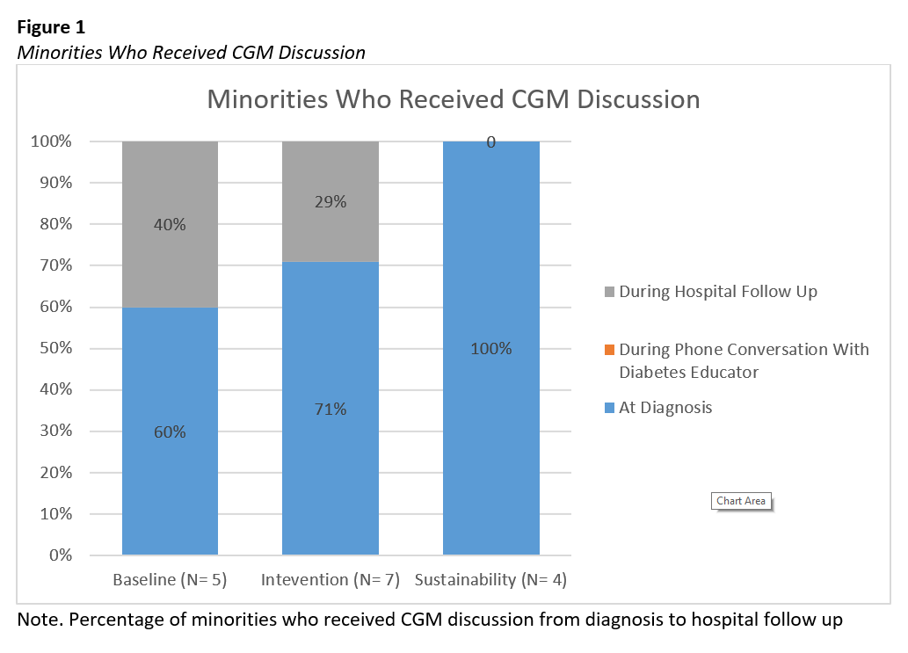
CGM Equity
Aim: Improve CGM use in all patients, regardless of race or payor
Next Steps: Equity Follow Up Presentation (Focus on Provider Bias)
- Scheduled for March 2025

Slide 3
April 2024
Educator Bias Survey

Slide 4
Pump Equity
Awaiting data access from Cook to have more specific data on race, language and SDOH – Approved this week

Slide 5
Nov 2023
Provider Bias Survey Review

Slide 6
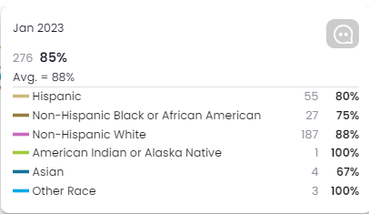
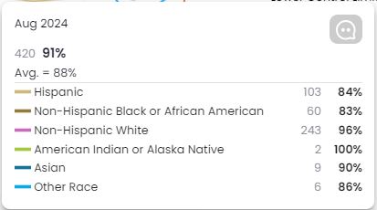
Dashboard Information Filtered By Race & Ethnicity

Slide 7
Cook Children’s CGM Equity Key Driver Diagram
Change Ideas
Primary Drivers
Patient Barrier Assessment Survey
Provider bias survey / Educator Bias Survey
Establish Parent Partnership Group
Ensure support and education available for non-English speakers
Aim
Address Inequities
Increase the utilization of CGM use by 10% for people with T1D by 12/31/24.
Demonstrate reduction in CGM disparities by 3%
CGM Interest & Access
Early education – Initiate discussion at diagnosis
Equitable delivery – “Right tool for all patients”
Education in multiple languages
Financial support and education
Patient Education
Education at Diagnosis, Follow-Up
Documentation of “Lack of Interest”
Follow up re “Lack of Interest” esp in Diabetes Distress
Provider Education
Review of data
Continuing education

Slide 8
Cook Children’s Pump Equity Key Driver Diagram
Change Ideas
Primary Drivers
Patient Barrier Assessment Survey
Provider bias survey / Pump Bias Survey
Establish Parent Partnership Group
Ensure support and education available for non-English speakers
Aim
Address Inequities
Increase the utilization of Insulin Pump use by 10% for people with T1D by 12/31/24.
Demonstrate reduction in Insulin Pump disparities by 3%
Improve access to pump data with 10% increase in patients added to HC portals
Early education
Equitable delivery
Pump Interest
Updated approved pump approval guidance
Streamlined approval notice
Pump Access
Virtual Pump Education
Group Vendor Education
1:1 Education for non-English speaking families
Patient Education
Regular review of data on our pump users
Provider to Provider Pump Education Refresher
Regular review of updated resource
Provider Education
Improve Pump
Data Analysis
Efficient access to integrated pump data
Safe storage of patient information (CCMC IT)

