Slide 1
Equity Expansion Project Close-out
February 2025

Slide 2
Agenda
Review Project Timeline
Project Overview
Project Dashboard
Next Steps for centers

Slide 3
Timeline | Expectations
June 2022 –January 2023 (7 months) | All participating sites will report project baseline data using the smart sheet. All participating sites will review their existing data. The baseline data review will be stratified by race/ethnicity
February 2023 | Hold Kick off meeting/Plan recurring monthly meeting Each site will identify champions for the QI project, including at least one patient/parent who identifies as Black or Hispanic
March/April 2023 | Hold Equity/unconscious bias training (5-10 participants per site) Baseline data analysis Each site will identify champions for the QI project, including at least one patient/parent who identifies as Black or Hispanic
April 2023 | Teams map out current process and annotate pain points in the process. Teams will share process map at meeting in April
May 2023 | Team will perform a fishbone activity/ create KDD and set SMART Aims
June- May 2023 | Use PDSA Cycle to test intervention starting with one provider and scaling across the clinic. Weekly/bi-weekly Plan-Do-Study-Act cycles; Each team will complete at least 15 PDSA cycles
June –Dec 2023 (Extended for data) | QI documentation: Each site will share PDSAs results with other team at monthly meetings and share updates using RAIL tool
Deliverables | QI success stories, manuscripts

Slide 4
Project Overview
T1DX-QI aimed to expand on learnings from the equity pilot to design new intervention ideas
T1DX-QI centers expanded on preliminary findings from the pilot
Expansion group to help validate successful interventions for long term sustainability.
Expanded the project to include connected pen

Slide 5
T1D Exchange Equity Framework:
Ebekozien OA, Ori Odugbesan et al Equitable Post COVID-19 Care: A Practical Framework to integrate Health Equity in Diabetes Management. Journal of Clinical Outcomes and Management Nov 2020 https://doi:10.12788/jcom.0025

Slide 6
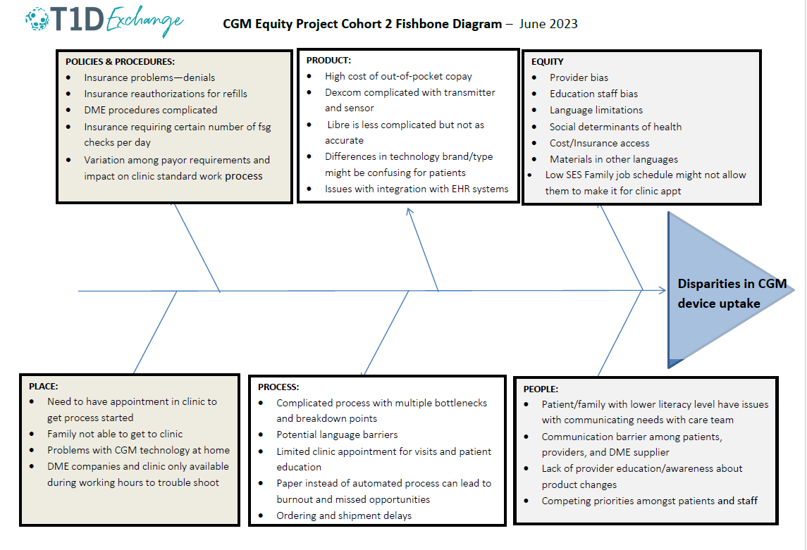

Slide 7
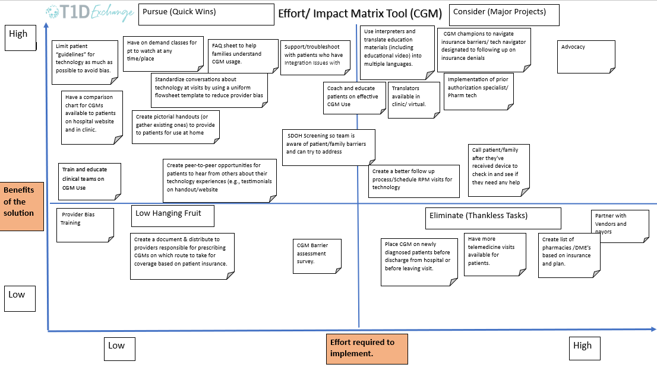

Slide 8
Interventions

Slide 9
Sample CGM & Pump Interventions
Chart Review
Retrospective chart review to know if all providers are asking all patients without technology if they want to/ are providing these patients education on tech options.
Identified which patients are not on CGM or Pump.
Barrier Assessment
The use of Device Disparities Questionnaire for patients to identify top barriers patients are facing when starting new devices.
Patient-led focus group completed a barrier assessment survey for pumps.
The team Identified patients who were not sharing data due to lack of resources or support (i.e. no cell phone, internet service to enable CMG use/data sharing) and connected patients with available resources

Slide 10
Sample CGM & Pump Interventions
Standardize CGM/Pump Process
The teams standardized the process for discussing devices regularly at appointments
Revised flowsheet to standardize discussions about CGM, capture CGM adoption and use at point-of-care
The Notified educator/physician of upcoming scheduled patients who do not have CGM/pump and remind them to discuss during clinic visit.
Improved Education
Implemented early education for new onset patients. Providers feel more comfortable prescribing CGMs.
Created modules for virtual pump and CGM class

Slide 11
Sample CGM & Pump Interventions
Reduced inequities
The team provided educational materials in multiple languages at diagnosis.
The team implemented in-person interpreters for insulin pump education. The Interpreter meets with patients 20 minutes prior to their appointment.
The team conducted provider bias training for pumps
Offered 1:1 pump class, either because of language barrier or if requested by family.
Created a resource for providers to determine pathway for prescriptions for public vs Private insurance (DME vs. Pharmacy).

Slide 12
Sample Interventions for SmartPen Use
Patient Education
Utilized a DME Rep to provide education to CDCES (recorded session for physicians to view later).
Provided smartpen education to both patients and their families.
Address Inequities
Covering the copay for smartpen.
Samples of smartpen available for patients to try
In house pharmacy handled process for smartpen cartridges for patients who need help.
Provider education

Slide 13
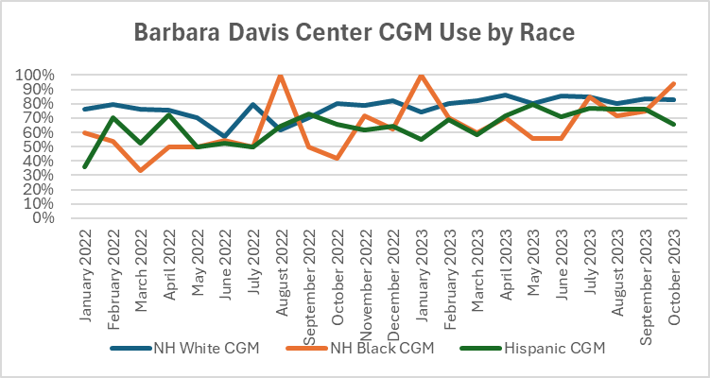
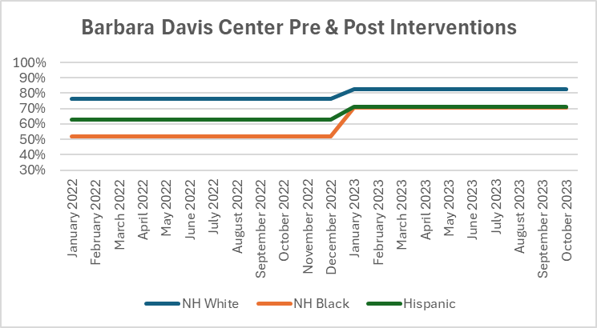
BDC
NHW CGM use increase by 7%
NHW CGM use increase by 19%
Hispanic CGM use increased by 8%
Gap between NHW & NHB closed by 12%

Slide 14
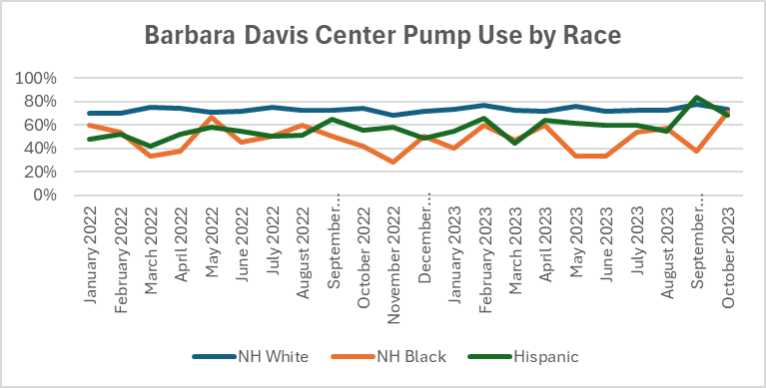
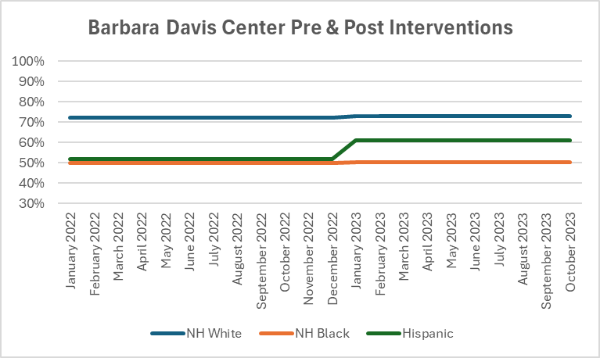
BDC
Hispanic CGM use increased by 9%

Slide 15
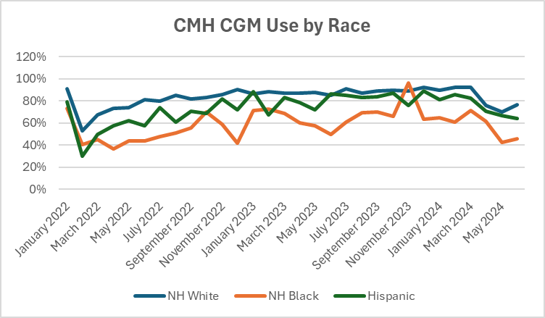
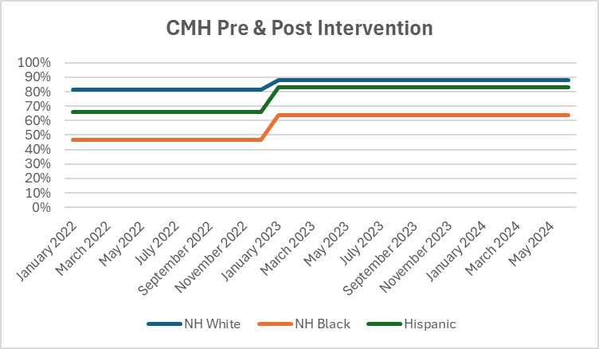
CMH
NHW CGM use increased by 7%
NHB CGM use increase by 17%
Hispanic CGM use increased by 17%
Gap between NHW & NHB closed by 10%
Gap between NHB and Hispanic closed by 10%

Slide 16
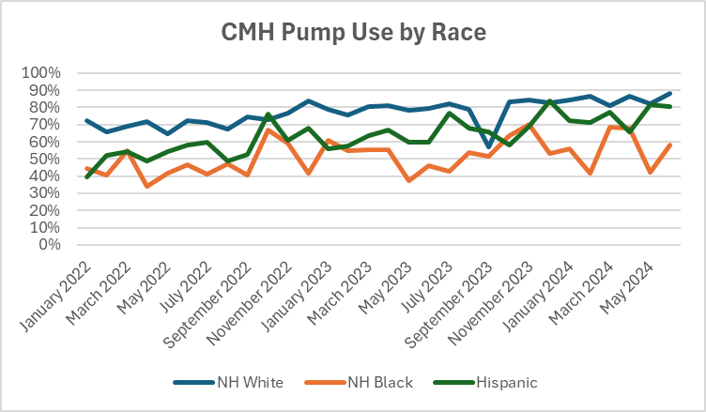
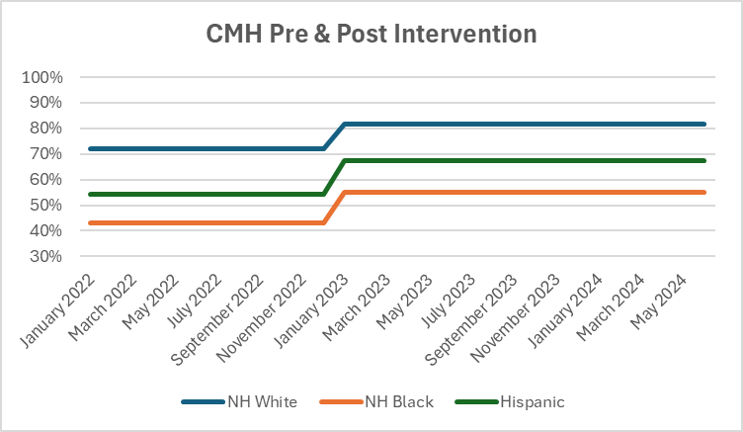
CMH
NHW pump use increased by 10%
NHB pump use increased by 12%
Hispanic pump use increased by 13%
Gap between NHW & NHB closed by 2%
Gap between NHW & Hispanic closed by 3%

Slide 17
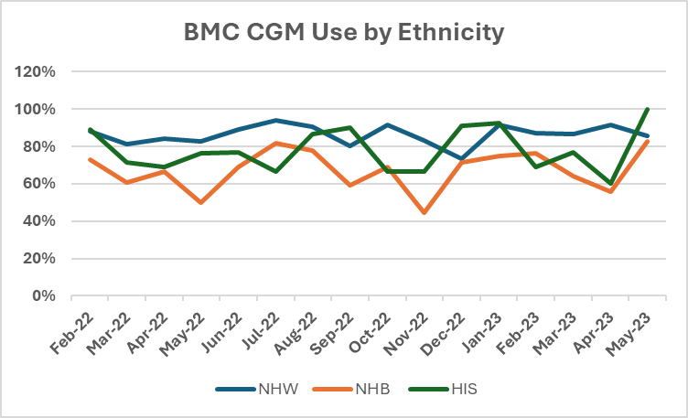
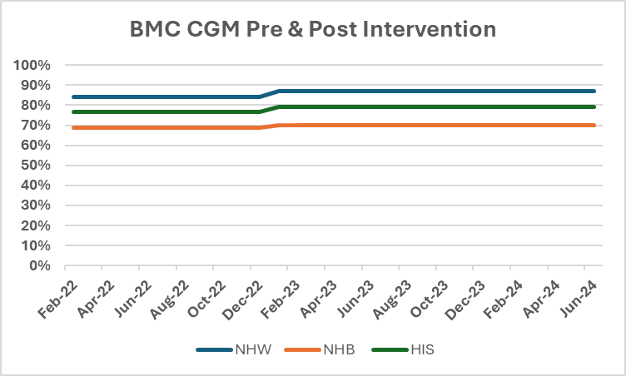
BMC
NHW CGM use increased by 3%
NHB CGM use increased by 3%

Slide 18
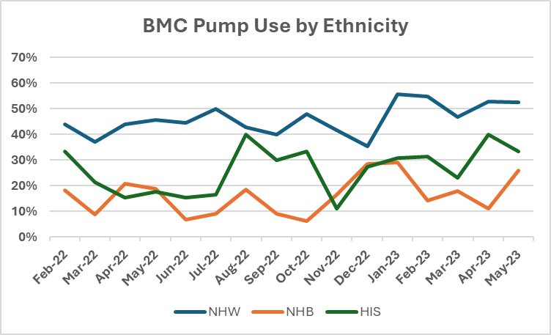
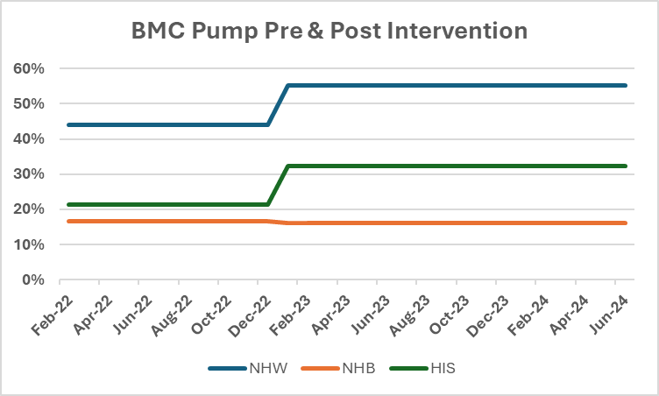
BMC
NHW Pump use increased by 11%
NHB pump use increased by 11%

Slide 19
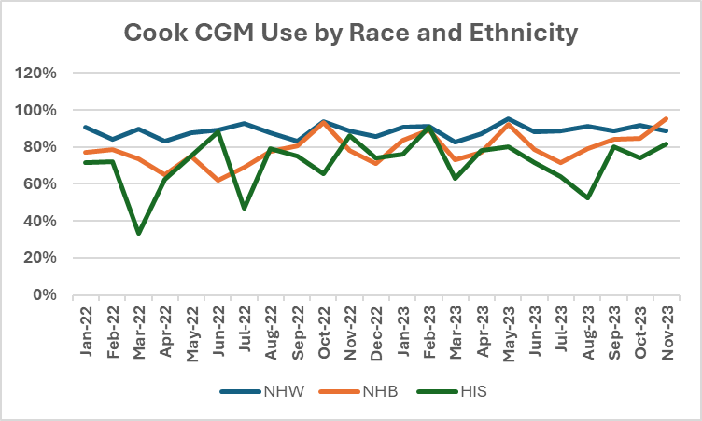
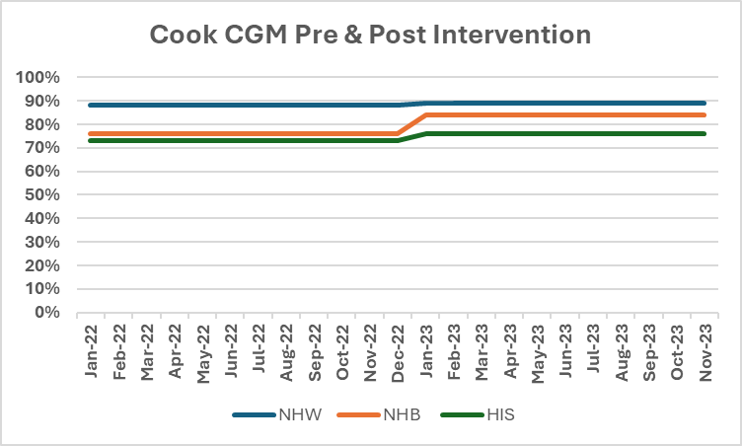
Cook CGM
NHB CGM use increase by 8%
Hispanic CGM use increased by 3%
Gap between NHW & NHB closed by 7%

Slide 20
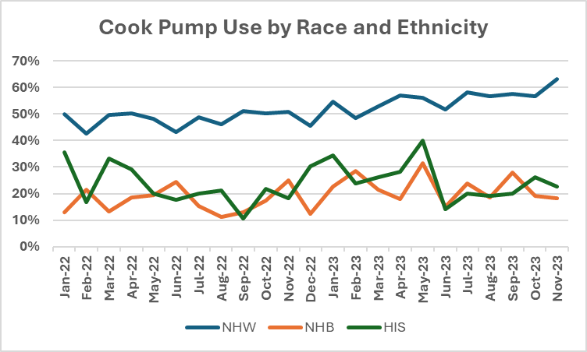
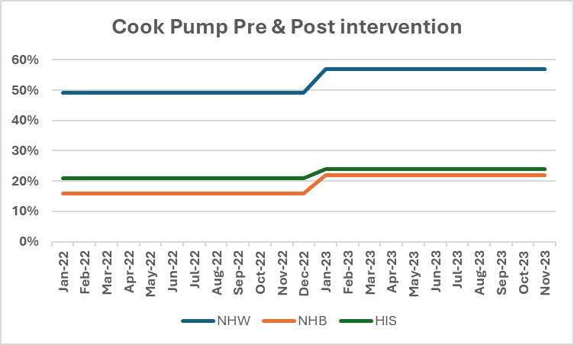
Cook Pump
NHW Pump use increased by 8%
NHB pump use increased by 6%
Hispanic pump use increased by 3%

Slide 21
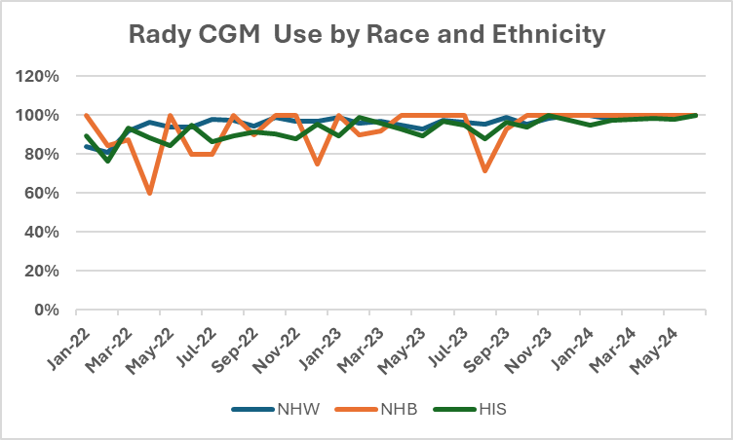
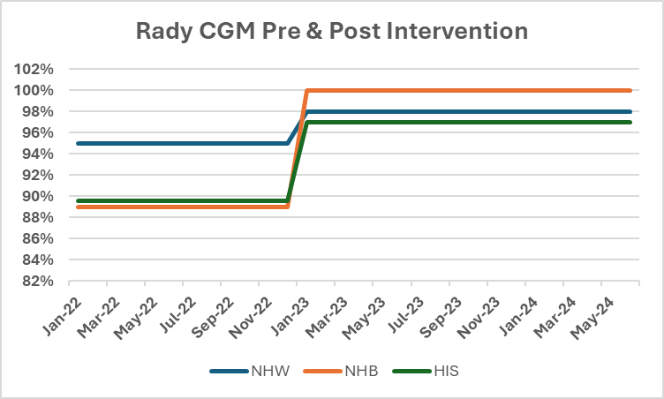
Rady
NHW CGM use increased by 3%
NHB CGM use increased by 11%
Hispanic CGM use increased by 7%
Gap between NHW & Hispanic closed by 4%
Closed Gap between NHW & NHB

Slide 22
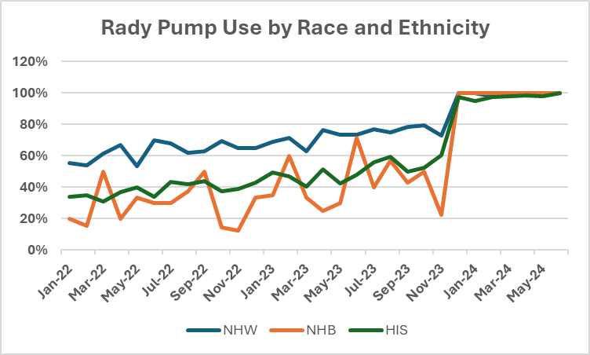
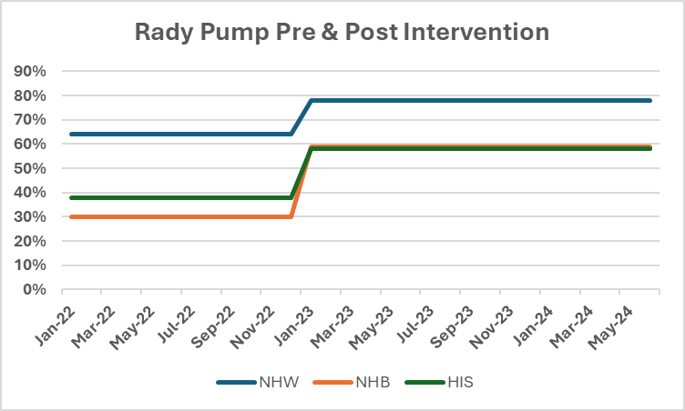
Rady
NHW Pump use increased by 14%
NHB pump use increased by 29%
Hispanic pump use increased by 20%
Gap between NHW & NHB closed by 15%
Gap between NHW & Hispanic closed by 6%

Slide 23
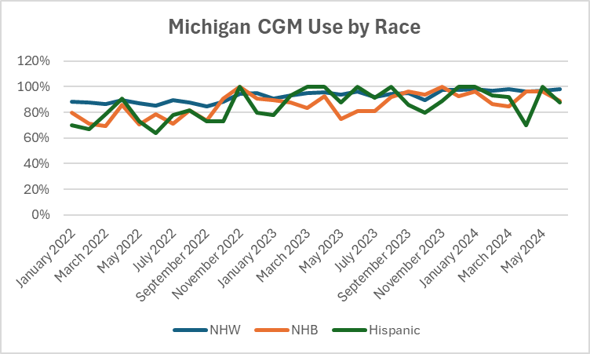
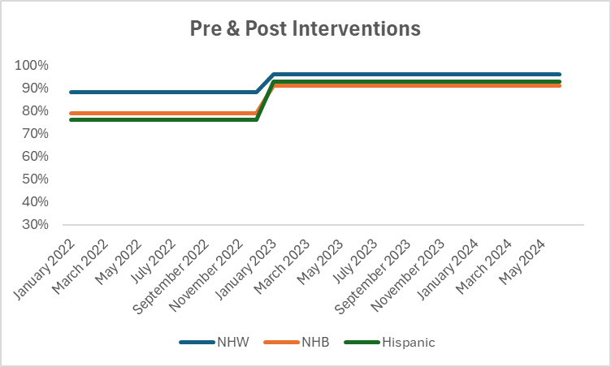
Michigan
NHW CGM use increased by 8%
NHB CGM use increased by 12%
Hispanic CGM use increased by 17%
Gap between NHW & NHB closed by 4%
Gap between NHW & Hispanic closed by 9%

Slide 24
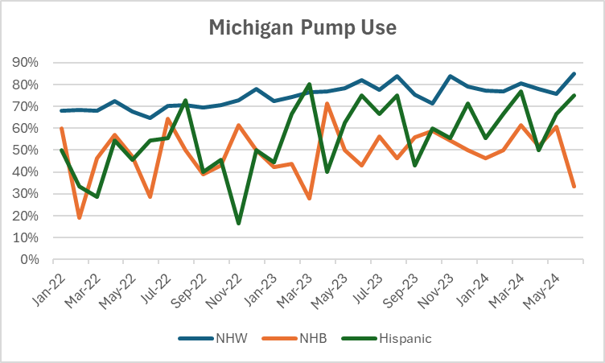
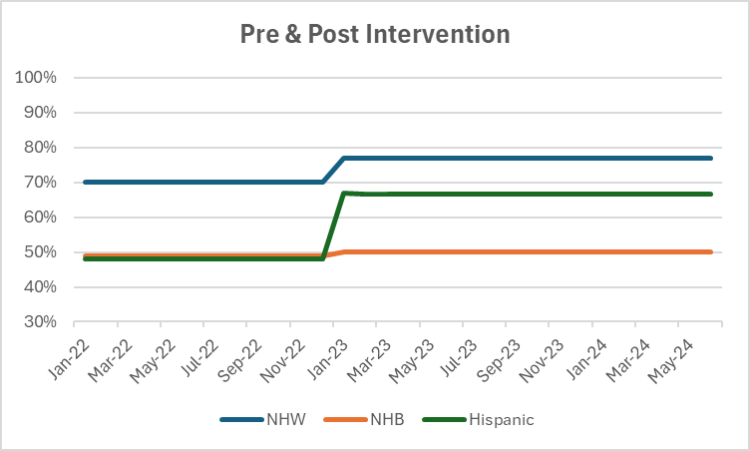
Michigan
NHW Pump use increased by 7%
Hispanic pump use increased by 19%
Gap between NHW & Hispanic closed by 12%

Slide 25
Project Deliverables
Rady – Submitted
Cook- Submitted
BDC - Submitted
Michigan- Pending
Grady- Pending
CMH- Pending
BMC- Not submitting
Miami- Not submitting

