Slide 1
Barrier Reduction in Insulin pump Delivery for Greater Equity (BRIDGE)- an Intervention focused on patients with a primary language of care other than English
QI Leads: Samantha Goldklang, ARNP & Alissa Roberts, MD
Presenter: Yasi Mohsenian, MPH
January 14, 2025

Slide 2
About Our Clinic
Patient Information
Overall:
Total diabetes visits per year: 8,000
Patients living with diabetes: ~2,850
Total new onsets per year: ~425
Type 1:
Patients living with type 1 diabetes: ~2,400
New onsets per year: ~375
Language of Care:
English: 93%​
Spanish: 3.5%​
Somali: 1%​
Russian: 0.06%​
Amharic: 0.04%
Staff
21 Physicians
12 Advanced Practice Practitioners
20 Nurses
8 Dietitians
2 Social Workers
7 MAs/CNAs
1 Clinical Psychologist

Slide 3
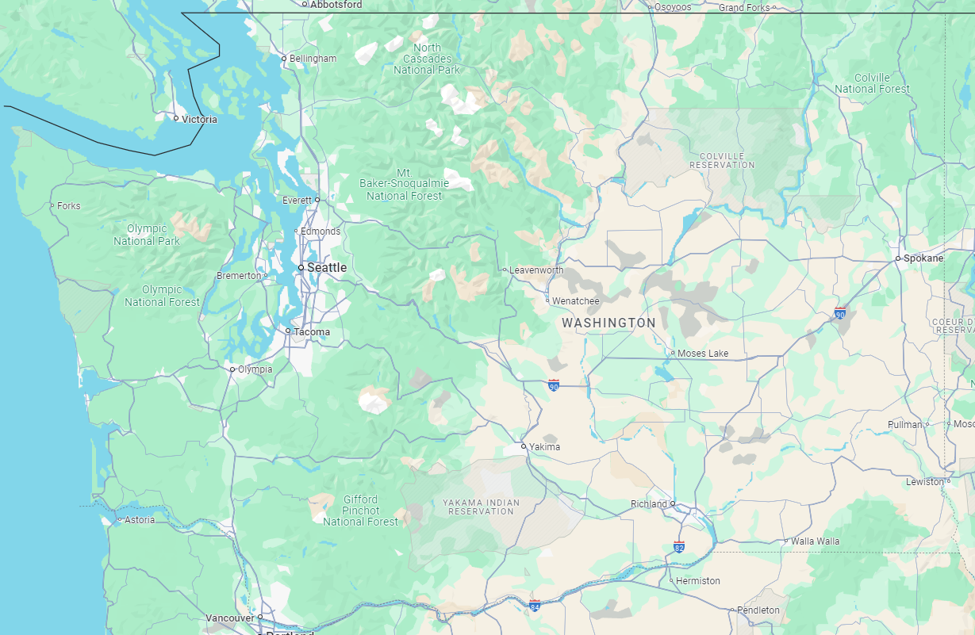
Locations
In-Person Clinics
Provide care to patients from Washington, Alaska, Idaho and Montana
Telehealth offered to patients living anywhere in WA, MT or AK

Slide 4
Background
The use of insulin pumps for management of type 1 diabetes (T1D) in youth is associated with improvement in clinical outcomes such as hemoglobin A1c, time in range, and hypoglycemia
However, there are significant inequities in diabetes technology use by language of care.

Slide 5
Smart Aims
Increase insulin pump use in pediatric patients with type 1 diabetes at Seattle Children's Hospital from 53% to 70% by January 2025.
Increase insulin pump use in patients with language of care other than English (LOE) from 21% to 50% by January 2025.

Slide 6
Where we started:
Process Map for SCH patients with Type 1 Diabetes to start an Insulin Pump
No
New Onset T1DM Track 1a Visit or Inpatient Admission
Track 1b Visit - 1 Week Post Dx
(Patient Usually Starts CGM)
1 Month New Patient Follow-Up
3 month T1DM RV Follow-Up
(f/u every q3 months)
Patient & Provider Discuss Pump Therapy
***
Refer to Pump 101 Class
Yes
Patient Receives Pump
Insurance Approval
RN Notifies Pump Vendor of Patient Interest
Patient Decides to order insulin pump/which pump to order in class
Patient has Pump 101 Class***
Schedule Pump 101 Class
Yes
Patient Sends MyChart Message to RNs with Pump Decision
No
Pump Start Class with Pump Rep / RN
F/U with RN & Pump Rep to Review Numbers
2-3 Week Follow-Up Visit with APP via Telemed
Insurance Approval
Pump vendor sends patient intake form, patient fills out form, vendor sends medical necessity statement, DME specialist completes form and sends to provider, provider signs RX
RN support
Diabetes Tech discussion: Earliest this typically occurs is the first 3 month f/u, Timing/Conversation varies by provider bias/patient understanding, Currently no standard pathway
Pump 101 Class: Only some classes offered in LOC other than English, Try to cohort by language which means a longer way for LOC other than English, other barriers noted are transportation, RN support, Room availability, and pump materials currently only in English
Pain Points***
Notes:
Currently longer wait time for patients with primary LOC other than English to get scheduled for pump 101 class

Slide 7
Key Driver Diagram
Highlight Key:
Completed Interventions
In progress for all interventions
Current Intervention
Primary Drivers
Secondary Drivers
SMART Aims:
Increase insulin pump use in pediatric patients with Type 1 Diabetes at Seattle Childrens Hospital from 54% to 70% by January 2025
Increase insulin pump use in pediatric patients with Type 1 Diabetes with a primary LOC other than English at Seattle Childrens Hospital from 21% to 50% by January 2025
Provider education on insulin pumps/ talking points
Provider bias/knowledge
EPIC smart phrase to put in note/prompt providers to talk about tech
RN Education for more RNs to provide pump education
Standard time for providers to intro tech. (1b visit, 1 month follow up)
Patient bias/knowledge
Barriers hand out filled out by patients w/ LOE not currently on an insulin pump at the start of visit
Low health literacy handout for patients with pump basics/different pumps to be given at standard time
Tech intro at track 1b visit with RN
CGM initiation at track 1b visit
Pump initiation process
Patients receive pump 101 info at any visit, starting with 1st NV follow up
Virtual option for patients needing more education than we have time for day of visit
Pump RX provided at visit
Equity/health disparity
2-3 week pump initiation follow up with APP via telemed
No Hemoglobin A1c requirement for pump initiation
Pump class offered in LOC other than English
RN to follow up with patient with LOC other than English after pump start class
Request in person interpreters for visit
Handouts available in LOC other than English
Notes:
Key: grey: have done
Green: for all interventions- currently in process
Yellow: for upcoming intervention in March/April
Blue: for jUne 2024 intervention
Change yellow/green to grey

Slide 8
Timeline
Intervention 1.1: February 2023
Pump 101 classes offered in LOE, patients wait for cohort
Intervention 2: June 2023
Appointments 2-3 weeks after pump start with APP via telemed
Intervention 3: March 2024
-Train all Diabetes nurses to teach pump education
-Introduce pump therapy at Track 1b Education
-Standard low health literacy handout given to all patients comparing pumps
Intervention 1.2: May 2023
Template built specifically for Spanish Pump class once a month
Intervention 1.3: January 2024
Provided pump education to LOE at clinic visit
Intervention 4: June 2024
Address barriers to pump therapy in patients with primary LOC other than English at clinic visit

Slide 9
Intervention #1:
(Pump 101 Class offered in LOE)
PDSA 1.1 – February 2023: Pump 101 class offered in LOE – youth wait to be cohorted by language
PDSA 1.2 – May 2023: Monthly scheduled Spanish class – youth with other LOE continue to be cohorted
PDSA 1.3 – January 2024: Pump education provided at scheduled clinic visit for patients with LOE who have been waiting to be cohorted
Notes:
Adapted idea from Intermountain childrens hospital

Slide 10
Intervention #2:
(Standard post pump start provider visit)
Aim: to have a touchpoint 2-3 weeks following pump initiation to help adjust pump settings and troubleshoot issues for long term success on pump therapy
June 2023: Implemented via telemedicine with one APP who saw youth with diabetes 2-3 weeks following initiation of pump
September 2023: Expanded to all providers to try to keep continuity of care
Notes:
Adapted idea from Intermountain childrens hospital

Slide 11
Intervention #3:
Revised pump start process: launched
March/April 2024
3 month T1DM RV Follow-Up
(f/u every q3 months)
No
New Onset T1DM Track 1a Visit or Inpatient Admission
Track 1b Visit - 1 Week Post Dx
(Patient Usually Starts CGM between 1a and 1b or at 1b)
Pt Receives Abbreviated Pump 101 Presentation in 1b
1 Month New Patient Follow-Up
Patient & Provider Discuss Pump Therapy
RN Discusses pump therapy with patient after visit
Yes
F/U with RN & Pump Rep to Review Numbers
Pump Start Class with only Pump Rep
Patient Receives Pump
Insurance Approval
RN Notifies Pump Vendor of Patient Interest
Patient Decides to order insulin pump/which pump to order in clinic
Yes
No
2-3 Week Follow-Up Visit with APP via Telemed
Patient Sends MyChart Message to RNs with Pump Decision
Key Changes/ Goals
Key Changes: Removes pump 101 class which was a barrier to staffing & patient getting scheduled for/coming to an extra appointment, Prescribe pump sooner for eligible/interested patients
Goals of Changes: In person interpreter likely present at appointments for education, Individualized approach to pump therapy with provider/patient discussion to find the right fit
Pump vendor sends patient intake form, patient fills out form, vendor sends medical necessity statement, DME specialist completes form and sends to provider, provider signs RX
Insurance Approval
Notes:
Handout
RN education
Revised powerpoint for 1b

Slide 12
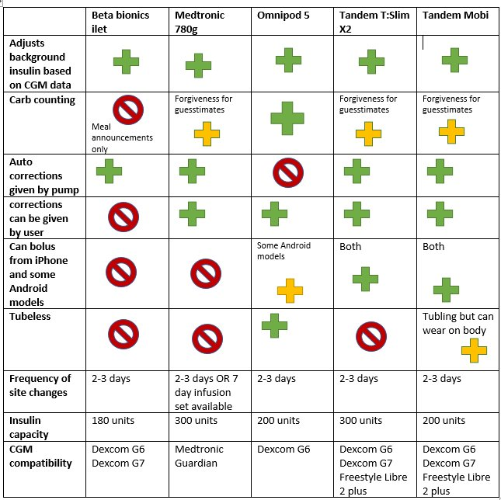
Intervention #3:
(Low health literacy pump comparison handout to be given to all patients at track 1b visit)
*Adapted from Cornell University Pediatric Endocrinology (presented at T1Dx 2023)
Notes:
Adapted idea from Intermountain childrens hospital

Slide 13
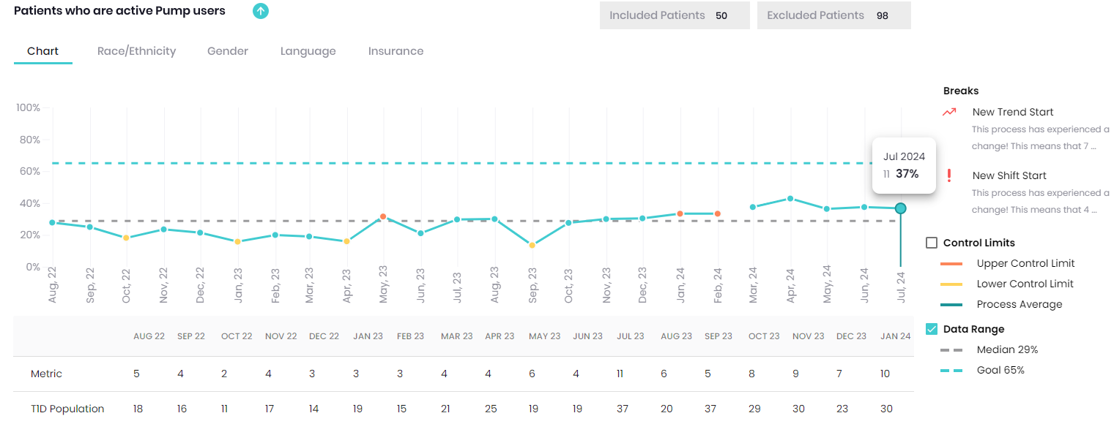
Progress after first 3 interventions
Pump use in patients w/ primary LOC other than English
Standard pump start follow up visit
Provided pump 101 education to LOC other than English patients at clinic visit
Pump 101 class offered in other languages
Monthly Spanish Class

Slide 14
Intervention #4
(June 2024 - BRIDGE: Barrier Reduction in Insulin Delivery for Greater Equity)
Aim: To address barriers to insulin pump therapy in patients with a primary LOC other than English during their clinic visits using a checklist style handout
Notes:
Adapted idea from Intermountain childrens hospital

Slide 15
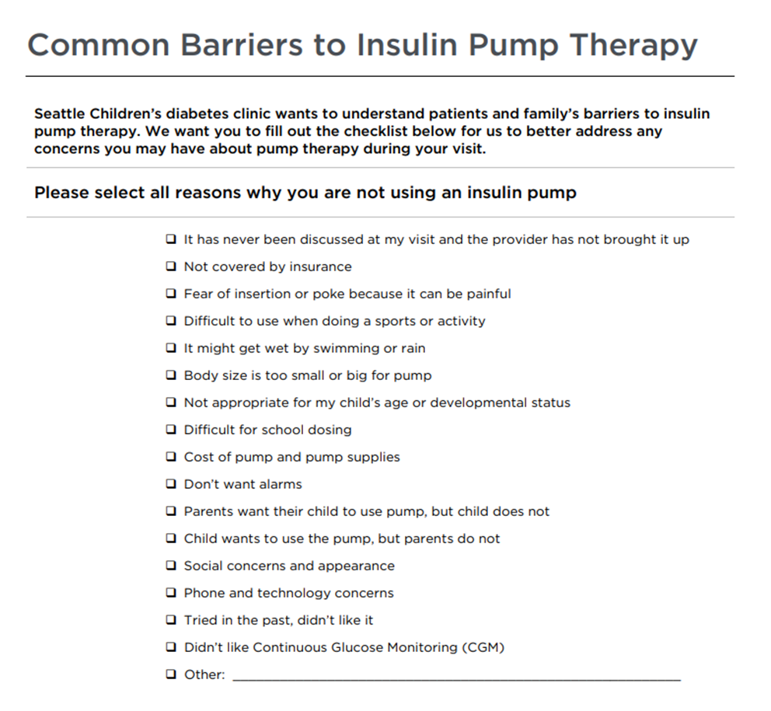
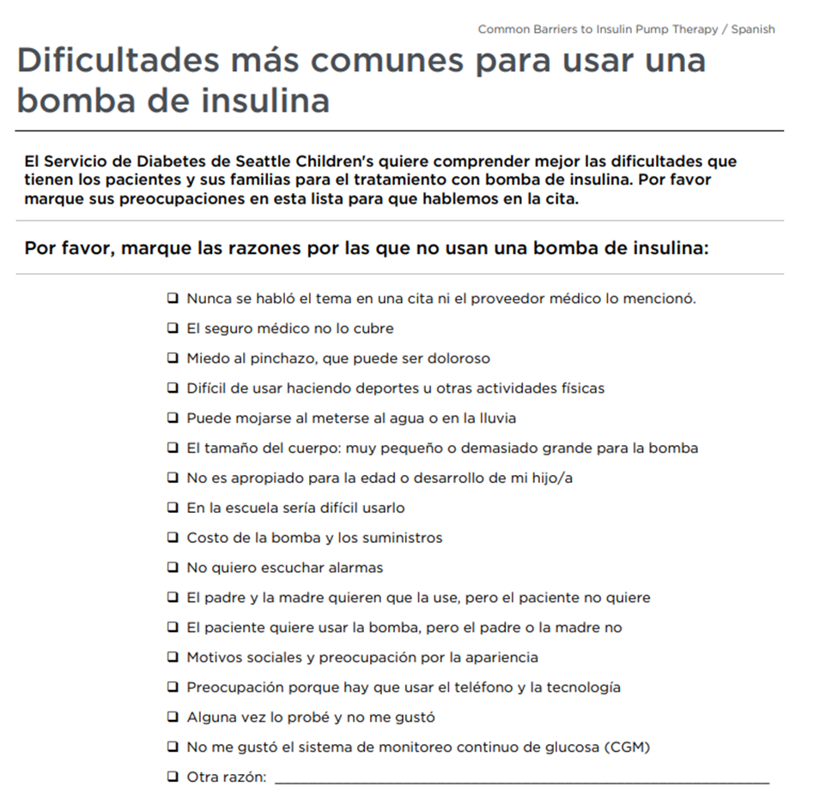
PDSA 1 - Plan
Patient to fill out if they can read English/Spanish or with in person interpreter
Otherwise, wait for RN/provider

Slide 16
PSDA 1 - Do
The week before the patient’s visit, the QI Coordinator will be pulling a list from EPIC of patients with an LOC other than English being seen the following week NOT currently on insulin pump therapy
The QI lead will email the providers who will be seeing those patients, as well as the nurses assigned to partner with them for the clinic day
For main campus, clinic operations manager will add the patients we’ve identified under the daily huddle (will say BRIDGE). The MA or RN will give these patients the handout to fill out when they are roomed
For satellite clinics, provider/RN can ask MA to provide patients with the handout when rooming OR RN can give to patient if they go in first
Clinic prep

Slide 17
Limitations
Small patient population being targeted each week (2-6 patients per week)
Difficult for providers/MAs to remember to provide the handout
Different processes at each site of care

Slide 18
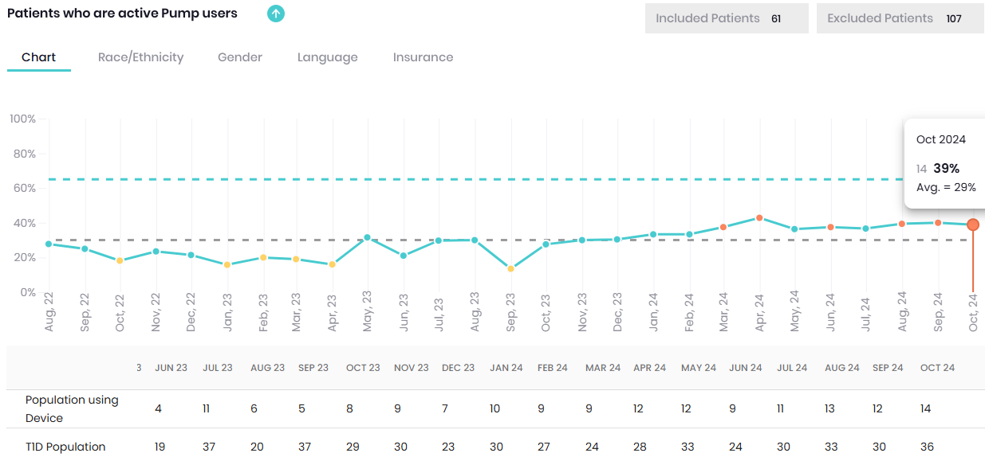
Results as of Oct 2024 Pump use in patients w/ primary LOC other than English

Slide 19
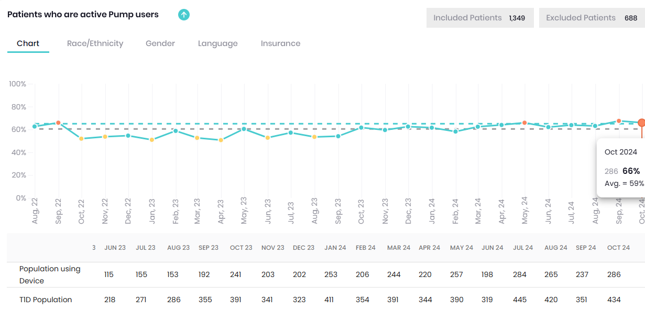
Results as of Oct 2024 Pump use in all patients

Slide 20
Next Steps
Evaluate data from intervention #4
Obtain feedback from staff
Find way to automate process so the questionnaire gets assigned to patients
Determine next PDSA/Intervention

Slide 21
Questions? ☺

