Slide 1
HEAL Committee Meeting
October 10, 2024

Slide 2
Agenda
Welcome and Introductions (Dr. Butler and Dr. Dei-Tutu)
Grant Discussion (Dr. Butler)
ADEPT Agenda Review (Dr. Dei-Tutu)
2024 Annual Center Survey Updates (Dr. Butler)
2025 Annual Survey and Manuscript Brainstorm (Dr. Butler and Dr. Dei-Tutu)

Slide 3
Grant Application Discussion
T1DX-QI has partnered with Eva Garland to apply for a wider range of grants.
How can HEAL committee help support review and application?
Potential Grant Applications:
Connecting Organizations and People to Empower Diabetes Prevention and Treatment (Connections)
Comprehensive Analysis, Surveillance, and Statistics Initiative for Diabetes in the Young (CASSIDY)
Dissemination and Implementation Research in Health (R01 Clinical Trial Optional)
Leveraging Health Information Technology (Health IT) to Address and Reduce Health Care Disparities (R01 Clinical Trial Optional)
Model Continuums of Care Initiative (MCCI) to Advance Health Equity and End Health Disparities Among Women and Girls in Racial/Ethnic Minority and Other Underserved Communities (U34 Clinical Trials Required)

Slide 5
Day 1: November 12, 2024
7:15 – 8:15 AM | Breakfast
8:15-8:30 AM | Welcome Dr. Osagie Ebekozien (Chief Medical Officer, T1D Exchange)
8:30 –8:45 AM 8:45 – 9:00 AM | Opening Remarks Charles Henderson (CEO, American Diabetes Association) David Walton (CEO, T1D Exchange)
9:00-10:15 AM | Panel Discussion: Achieving diabetes equity; are we there yet? Facilitated by Dr. Osagie Ebekozien (Chief Medical Officer, T1D Exchange) Panelists: Terri Wiggins (ADA) Dr. James Gavin (Emory University School of Medicine) Dr. Monica Peek (University of Chicago) Dr. Bryan Buckley (National Committee for Quality Assurance)
10:15-10:30 AM | Break

Slide 6
Day 1: November 12, 2024
Breakout Session 1
10:35-10:55 AM 10:55-11:15 AM 11:15-11:35 AM 11:35-11:55 AM | Track 1 Room 1 (A-C) Moderator: Dr. Juan Espinoza MD (Stanley Manne Children’s Research Institute at Lurie Children’s) | Track 2 Room 2 (F-H) Moderator: Dr. Grazia Aleppo MD(Feinberg School of Medicine, Northwestern University)
 | Topic: Using QI methodology to improve equity Speaker: Dr. Grace Nelson (Le Bonheur Children’s Hospital) | Topic: Supporting underserved patients with T2D Speaker: Dr Sonya Haw (Emory University)
 | Topic: Incorporating health equity into routine improvement efforts. Speaker: Dr. Nana-Hawa Yayah Jones (Cincinnati Children’s Hospital Medical Center) | Topic: Addressing stigma in diabetes and obesity Speaker: Matthew Garza (The diaTribe Foundation)
 | Topic: Improving equity in T1D technology Speaker: Dr. Ananta Addala (Stanford University Children’s Health) | Topic: Supporting children with diabetes and obesity Speaker: Dr. Stephanie Sisley (Baylor College of Medicine, Texas Children’s Hospital)
 | Topic: Improving racial-ethnic equity of CGM uptake in pediatric patients Speaker: Dr. Kajal Gandhi (Nationwide Children’s Hospital) | Topic: ADA Addressing inequities in diabetes obesity Speaker: Dr. Ihuoma Eneli (University of Colorado Anschutz Medical Campus)
12:00-1:00 PM | Lunch and Networking; Meet our Sponsors

Slide 7
Day 1: November 12, 2024
Breakout Session 2
1:05-1:25 PM 1:25-1:45 PM 1:45-2:05 PM 2:05-2:25 PM | Track Room 1 (A-C) Moderator: Dr. Margarita Ochoa Maya (Ascendis Pharma) | Track 2 Room 2 (F-H) Moderator: Dr. Manmohan Kamboj (Nationwide Children’s Hospital)
 | Topic: Kyler Cares Kyle Banks (Kyler Cares) | Topic: Screening for social determinants of health in adults with diabetes Speaker: Dr. Ruth Weinstock (Upstate University Hospital)
 | Topic: Advancing equity in a large urban center Speaker: Dr. Selorm Dei-Tutu (Texas Children’s Hospital, Baylor College of Medicine) | Topic: T1DX-QI Portal Holly Hardison (T1D Exchange)
 | Topic: Using “TechQuity” to reduce inequities in glycemic outcomes in children with T1D Speaker: Dr. Jenise Wong (University of California San Francisco, Benioff Children’s Hospital) | Topic: Grandmothers to the rescue - healthy outcomes through peer educators (HOPE) Speaker: Dr. Eva M. Vivian (University of Wisconsin)
 | Topic: Commercial Insurance Coverage and Diabetes Care Access Speaker: Amy Killelea and Billy Dering (CHIR) | Topic: Diabetes Prevention in the Hispanic Community Speaker: Dr. Tainayah Whitney Thomas (Stanford University)
2:30-3:30 PM | Insights from industry partners Facilitator: Terri Wiggins, (SVP, Health Equity, ADA) Eli Lilly: Kelly R Copes-Anderson (VP of Health Equity for Cardiometabolic Health, Lilly)

Slide 8
Day 1: November 12, 2024
3:30-3:45 PM | Break
3:45-4:45 PM | Screening and prevention of diabetes panel Facilitator: Dr. Carla Demeterco-Berggren (Rady Children’s Hospital) Dr. Anastasia Albanese O’Neill (Breakthrough T1D) Dr. Shideh Majidi (Children’s National Hospital)
4:45-6:00 PM | Networking Light refreshments to be served

Slide 9
Day 2: November 13, 2024
7:30 – 8:30 AM | Breakfast
8:30-9:30 AM | Panel Discussion Learning from our past and advancing towards the future Moderator: Dr. Eugene E. Wright, Jr. MD (South Piedmont AHEC) Dr. James Gavin (Emory University School of Medicine) Dr. Ananta Addala (Stanford University Children’s Health) Dr. Roxie Canon (Novant Health)
Breakout Session 3
9:35-9:55 AM 9:55-10:15 AM 10:15-10:35 AM 10:35-10:55 AM | Breakout Session 3
 | Track 1 Room 1 (A-C) Moderator: Dr. Viral Shah (Indiana University) | Track 2 Room 2 (F-H) Moderator: Dr. Shideh Majidi (Children’s National Hospital)
 | Topic: The role of community-based organizations (CBOs) in advancing health and wellness Speaker: Brandon Cleveland, Executive Director Daniel Payne Legacy Village Foundation | Topic: Using digital health to support health equity in diabetes Speaker: Bola Bukoye (Omada Health)
 | Topic: Implementing and sustaining QI projects to address health equity in diabetes Speaker: Dr. Shivani Agarwal (Albert Einstein, Montefiore College of Medicine) | Topic: Crossing the Digital Divide Speaker: Dr. David Kerr (Sutter Center for Health Systems Research)
 | Topic: Achieving equity for Hispanic patients with T1D Dr. Janine Sanchez (University of Miami, Miller School of Medicine) | Topic: Digital health inequities and diabetes in pregnancy Speaker: Dr. Farnoosh Farrohki (Sutter East Bay Medical Foundation)
 | Topic: Supporting health equity infrastructure Speaker: Dr. Carla Demeterco-Berggren (Rady Children’s Hospital) | Topic: Project ECHO as a model to increase access to specialist care Speaker: Dr. Ashby Walker (University of Florida)

Slide 10
Day2: November 13, 2024
11:00-12:00 PM | Panel Discussion Facilitator: Dr. Jenise Wong (University of California San Francisco, Benioff Children’s Hospital) Dr. Kimberly Spiro (NICH, Oregon Health and Science University)
12:00-12:30 PM | Topic: People, Communities and Populations: The Alpha and Omega for Cardiometabolic Health Equity Dr. Joshua Jospeh (The Ohio State University, Wexner Medical Center)
12:30-12:45 PM | Topic: Conference Closeout and Evaluation Dr. Osagie Ebekozien (Chief Medical Officer, T1D Exchange)

Slide 11
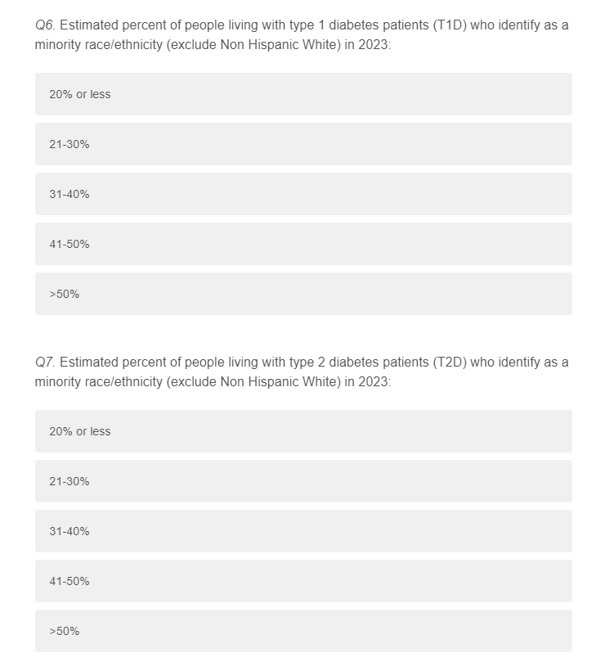
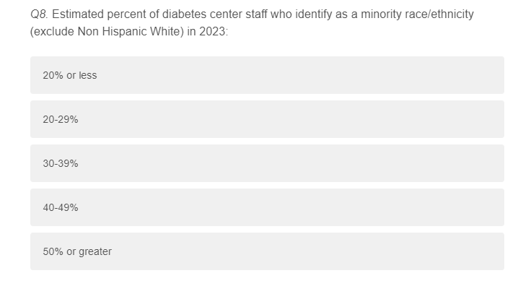
2024 Annual Survey
Edits made based on HEAL feedback:

Slide 12
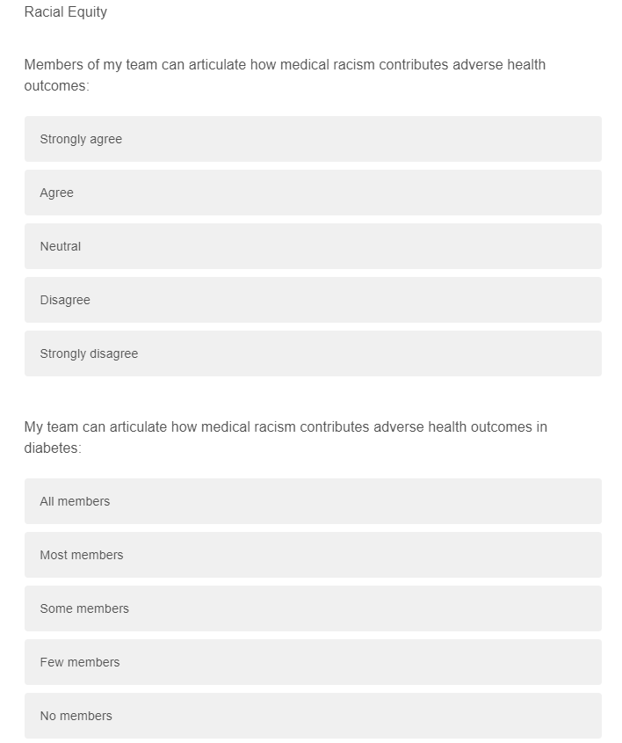
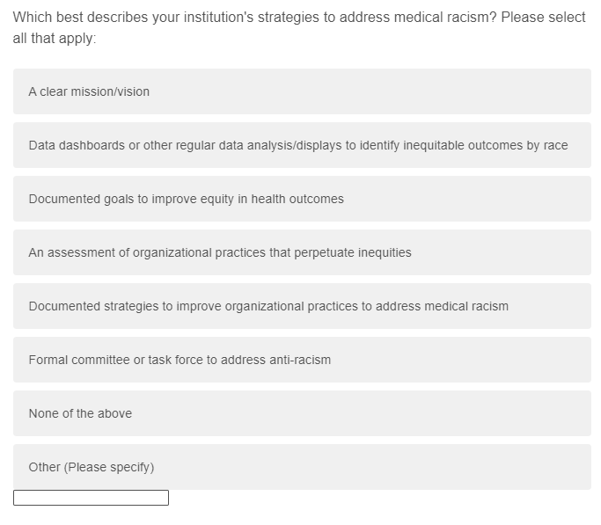
2025 Annual Survey Brainstorm
Questions submitted by Dr. Addala in 2022 survey let to manuscript.

Slide 13
2025 Annual Survey Brainstorm
Questions submitted by Dr. Addala in 2022 survey let to manuscript.

Slide 14
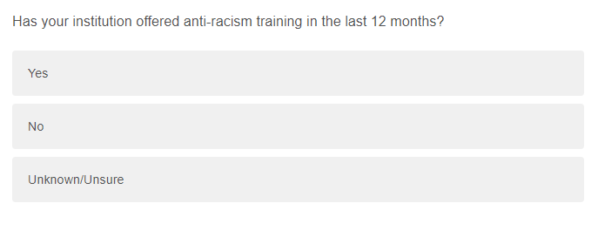
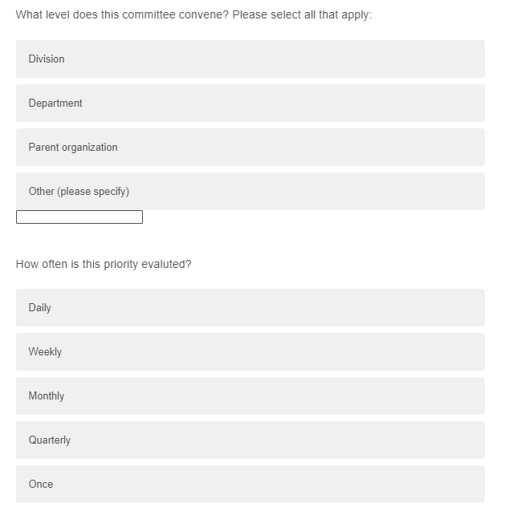
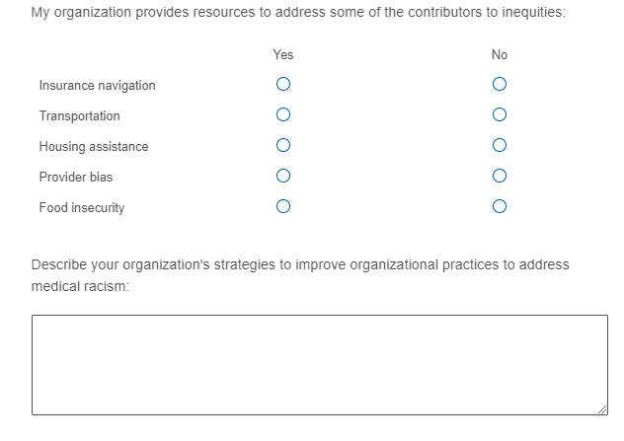
2025 Annual Survey Brainstorm
Questions submitted by Dr. Addala in 2022 survey let to manuscript.

Slide 15
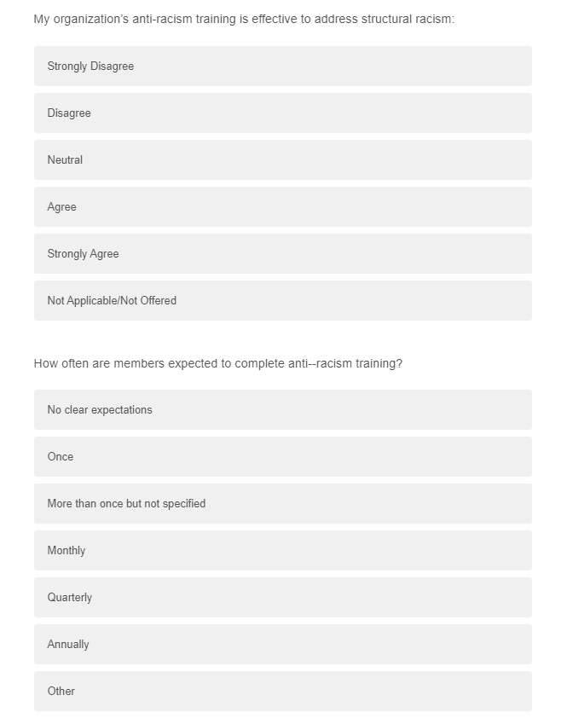
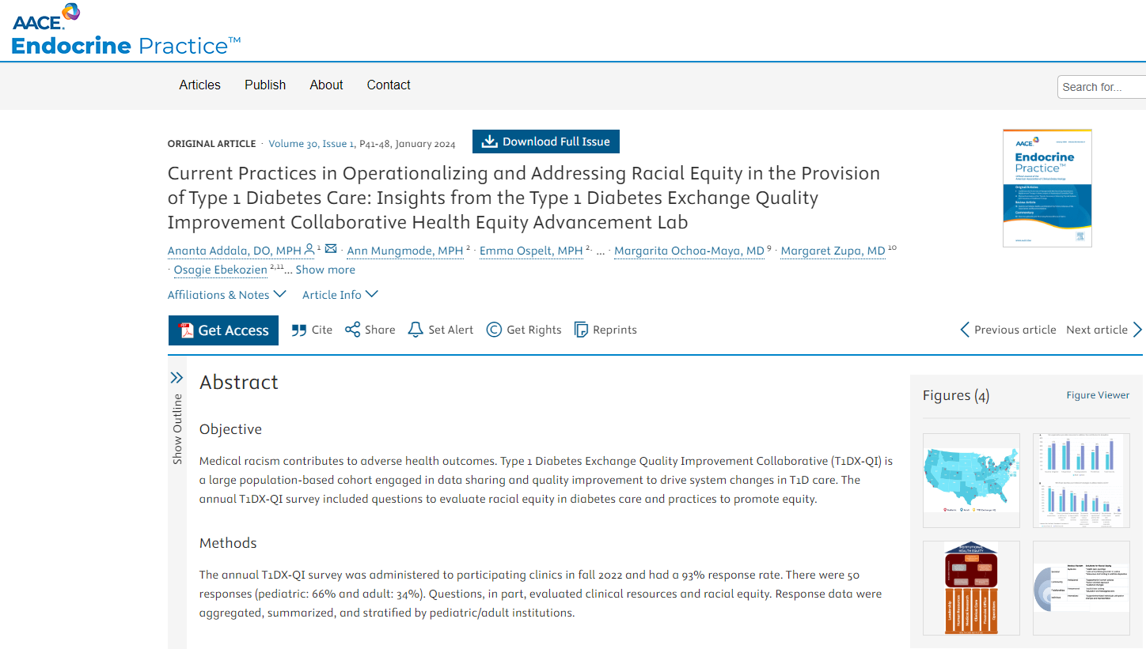
2025 Annual Survey Brainstorm
Questions submitted by Dr. Addala in 2022 survey let to manuscript.

Slide 16
2025 Annual Survey Brainstorm
What questions would HEAL like to submit for 2025?
What types of publications could come out of these questions?
What section of health equity do we want to know from Collaborative centers?

