Slide 1

Increasing access to InPen

Slide 2
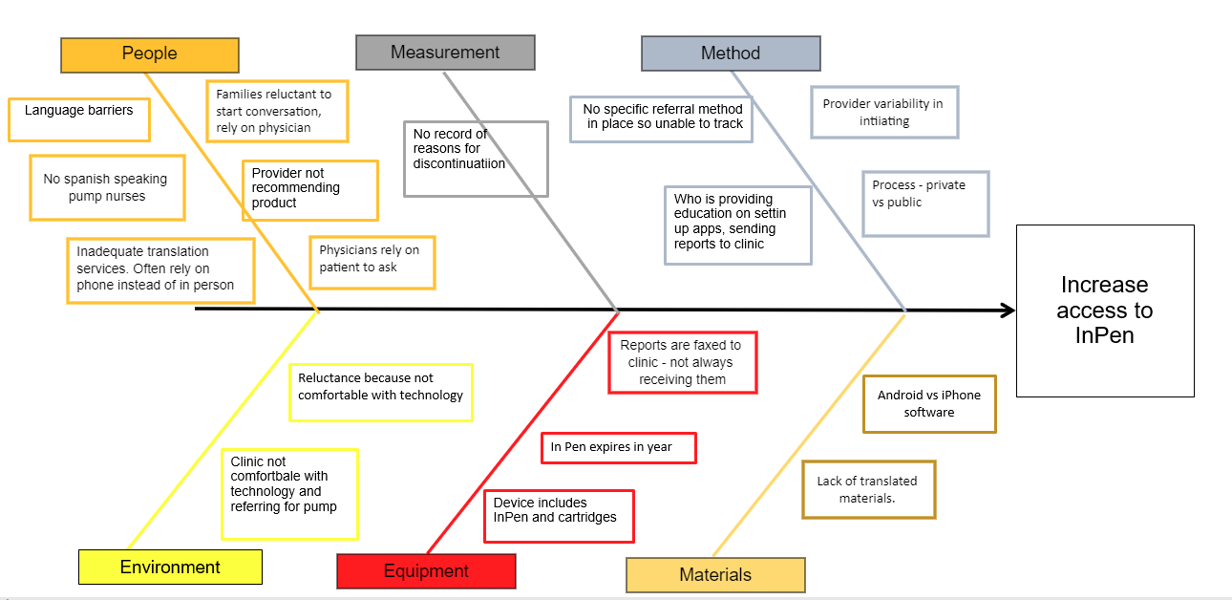

Slide 3
Increasing access to smart pens
Primary Drivers
Change Ideas
Aim
Host technology fair for our diabetes populations - Medtronic rep to be available
Add smart pen slides to guide to pump therapy class in English, Spanish and Arabic
Provide education to inpatient nurses
Address Inequities
Increase the utilization of InPen use by 5% for people with T1D by December 2024
Schedule Medtronic in service with clinic for RN's and provders
Obtain pediatric articles on smart pen usage from Medtronic
Set up meeting with Medtronic to review process of prescribing and training
Inquire about samples of smart pens and purchasing them from clinic patients
Inquire about coverage/copay for both private/public insurance
Clinician Comfort Level with smart pen
Patient Education
Insurance Coverage
Ask hospital outpatient pharmacy to stock insulin cartridges for smart pen usage
Process of prescribing smart pen
Create a process for prescribing smart pens
Create a process for providing smart pen samples in clinic
Create a process for follow up about prescription is sent
Improve smart pen data collection & analysis
Request smart pen usage from IT to obtain baseline date
Analyze date for next steps

Slide 4
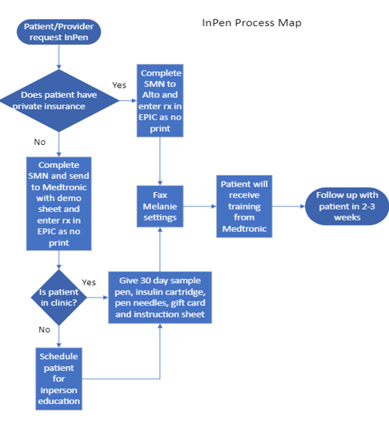
New Process Map
Updated process map
Received samples
Humalog cartridge samples

Slide 5
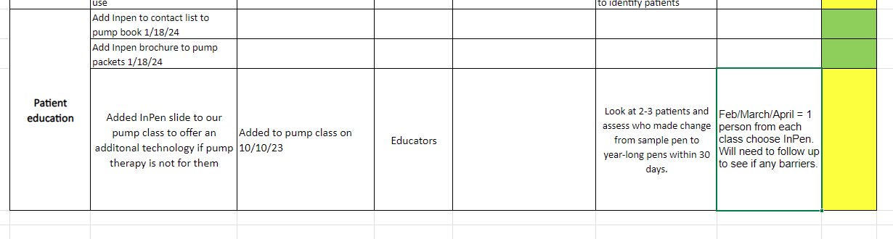
Address Inequities

Slide 6
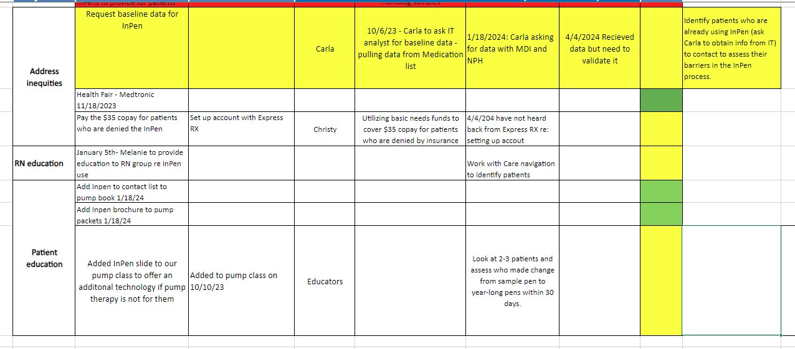

Slide 7
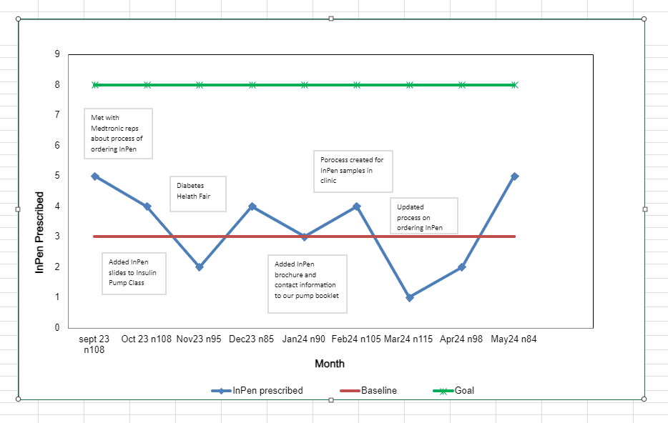

Slide 8
Next Steps/PDSA Cycles
Provide education to our clinic/team
Process of ordering and following up
Address copay/coverage

