Slide 1

Diabetes Technology Equity Project update

Slide 2
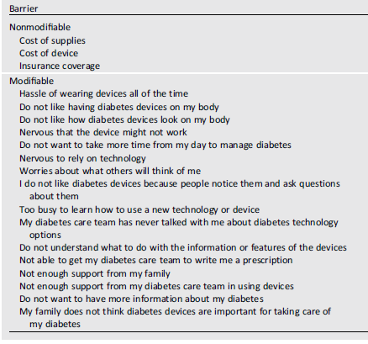
Patient Barrier Assessment Survey
196 established patients
total population is 465
211 required for CI 95% with margin error 5%
Age 40.3 ± 14.9 years
73.3% Hispanic
T1D duration >5 years, 89%
A1c 7.3 ± 1.2%
Tanenbaum, Diabetes Care, 2017

Slide 3
The use of automated insulin delivery (AID) devices is associated with better glycemic control compared to multiple daily injection (MDI) with CGM
7.1 ± 0.9% vs 7.8 ± 1.6%
(p= 0.0020)
n=100 n=47

Slide 4
The use of automated insulin delivery (AID) devices is associated with better glycemic control compared to multiple daily injection (MDI) with CGM
H7.1 ± 0.9% vs 7.8 ± 1.6%
(p= 0.0020 by t-test)
Barriers to the use of technology
AID 23.37%
MDI+CGM 30.23%
(p<0.0001 by Fisher test)
n=100 n=47

Slide 5
The use of automated insulin delivery (AID) devices is associated with better glycemic control compared to multiple daily injection (MDI) with CGM
H7.1 ± 0.9% vs 7.8 ± 1.6%
(p= 0.0020 by t-test)
Barriers to the use of technology
AID 23.37%
MDI+CGM 30.23%
(p<0.0001 by Fisher test)
MDI+CGM group
n=100 n=47

Slide 6
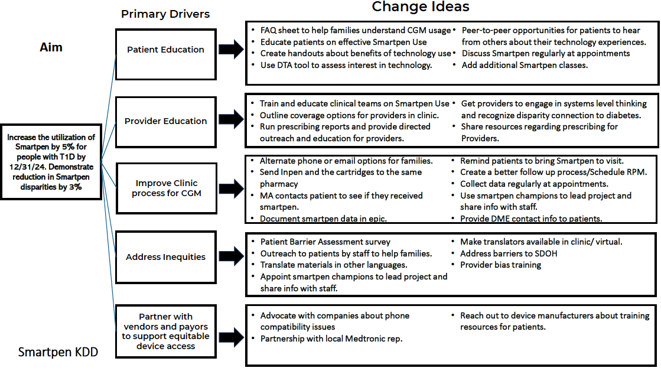

Slide 7
Intervention to implement the use of Smart Insulin Pens (SIP)
Provide education to providers
Send prescription directly to pharmacy
Discuss co-pay using coupon for commercial insurance
Referral to diabetes education for training and verify patient was able to obtain the device

Slide 8
Results of the interventions
4 out of 30 were able to start the use of SIP
Major barriers
-insurance approval
-lack of follow-up from patients
Actions
-Expand the number of providers involved
-Use of smart phrases with guidance for the prescription of SIPs
-Template letter for prior authorizations
-Explore if the manufacture companies can follow-up on the prescriptions

