Slide 1
T1D Insulin Pump/InPen Equity Project

Slide 2
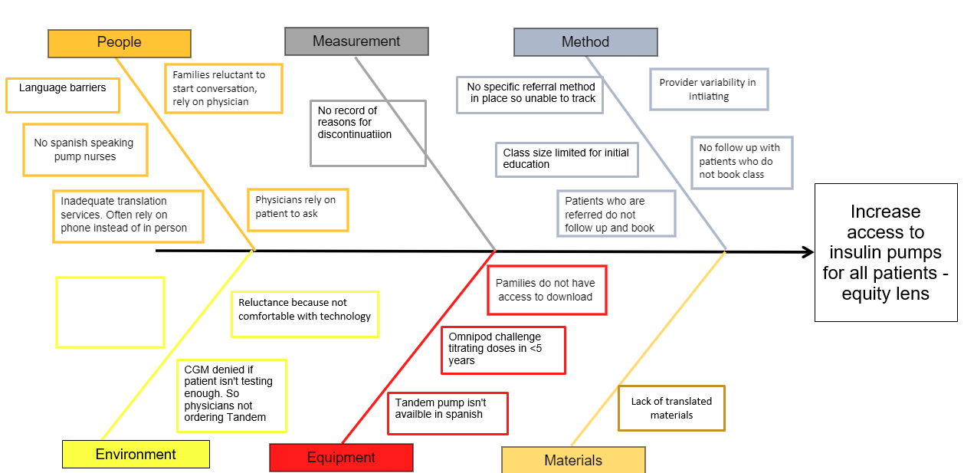
Fishbone

Slide 3
Insulin Pump process map
Patient attends in-person pump class with translation. Pump options discussed
Care Coordinator charts using .prepumpchecklist and gives patient pump class packet (In clean utility)
Yes
Translation services needed?
Provider identifies or patient expresses interest in clinic about starting on an insulin pump
Care coordinator reviews checklist and provides any needed education, signs checklist and puts checklist in nurse educator folder
Would patient benefit from in-person education?
Provider reviews and signs
PrePump checklist and gives to care coordinator
Yes
No
Education needs completed
No
Yes
Care coordinator instructs family to schedule a RN education appointment at checkout
Patient attends Zoom pump class. Pump options discussed
Patient attends in-person pump class. Pump options discussed
No
Knowledge assessment completed with passing result and patient knows what pump they would like
Prescription sent to pharmacy
Omnipod
No
Referred for further education
Is patient 18 years or older?
Is patient a candidate for self paced education?
Self paced packet given
Tandem, Medtronic or iLet
Order entered into parachute

Slide 4
PDSA Cycle #1: 1:1 classes for non-English speaking families
June 2023
1:1 in person 1:1 Zoom class
7 patients attended 4 patients attended
3 patients chose pumps 3 patients chose pump
July 2023
1:1 in person
4 patients attended
3 patients chose pumps
August 2023
1:1 in person
2 patients attended
2 patients chose pump

Slide 5
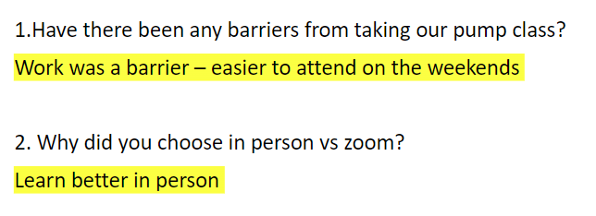
PDSA Cyle #2: In Person Monthly Weekend Classes
July 2023
14 patients attended class
7 patients chose pump
August 2023
9 patients attended class
3 patients chose a pump

Slide 6
PDSA Cycle #3 Increase class size for Zoom pump classes
June 2023
13 patients attended class
9 patients chose a pump
July 2023
15 patients attended class
9 patients chose a pump
August 2023
18 patients attended class
7 patients chose a pump

Slide 7
PDSA Cycle #3
Comments reported back from survey sent to families who have not moved forward on pump therapy.
I am still deciding next steps.
Phil takes mixed martial arts and the pump will be kicked. He teaches for 4 hours
The process of moving forward with pump therapy is too overwhelming.
I am still deciding next steps.
I would like to move forward but I forgot next steps.

Slide 8
Learning Pearls & Next Steps
We have more patients attending pump class, but less moving forward with pump therapy
Calling patients that attended pump classes to see why they didn't move forward with pump therapy

Slide 10
Address Inequities

Slide 11
PDSA #1 (18+): January 2024
Patients >18 years referred to pump class are not deciding on a pump within 3 months of referral
August 2023: 4 referred, 0 decided on pump therapy
September 2023: 6 referred, 0 decided on pump therapy
October 2023: 9 referred, 3 decided
Plan: 1/1/2024: Identify 4 patients > 18 years and have them complete a self-guided packet.
Do:
4 patients given self-guided packet
Study:
2 patients let us know that the QR code that takes them to the knowledge assessment doesn't work
As of 2/1/2024, 2 patients completed packet and decided on pump. 2 patients have not completed the packet
Act:
Get rid of the QR code
Attach knowledge assessment questionnaire to a MyChart message that is sent to the patient when they are referred to self-guided tract

Slide 12
Pump class data May 2023-October 2023
 | Referred | No show | Did not complete process | Decided on pump within 3 month
Number of patients | 186 | 24 (13%) | 75 (40%) | 103(55%)
A1C %(mean) | 9.2% | 9.1% | 8.8% | 8.8%
Age < 5 years | 22 | 1 (4%) | 9 (41%) | 14 (63%)
Age 6-12 years | 65 | 6 (9%) | 24 (37%) | 39 (60%)
Age 13-17 years | 61 | 8 (13%) | 26 (43%) | 34(56%)
Age > 18 years | 38 | 9 (24%) | 16 (42%) | 15 (39%)
White | 110 | 9 (8%) | 41 (37%) | 72(65%)
Hispanic | 31 | 6 (19%) | 16 (52%) | 10(32%)
Non-Hispanic black | 24 | 5 (21%) | 12 (50%) | 9 (38%)
Other | 21 | 4 (19%) | 6 (29%) | 11 (52%)
English speaking | 154 | 22 (14%) | 59 (38%) | 85 (55%)
Non English speaking | 32 | 2 (6%) | 16 (50%) | 16 (50%)
Privately insured | 81 | 4 (5%) | 33 (41%) | 43 (53%)
Publicly insured | 105 | 20 (19%) | 42 (40%) | 43 (41%)

Slide 13
August 2023 Pump referral data
 | Referred | Decided on pump within 3 month
Number of patients | 27 | 12 (44%)
A1C %(mean) | 9.4 | 9.3
Age < 5 years | 4 | 2
Age 6-12 years | 6 | 2
Age 13-17 years | 12 | 7
Age > 18 years | 4 | 0 (0%)
White | 16 | 7
Hispanic | 5 | 2
Non-Hispanic black | 5 | 3 (60%)
Other | 1 | 0
English speaking | 25 | 12
Non English speaking | 2 | 0 (0%)
Privately insured | 12 | 7
Publicly insured | 15 | 5

Slide 14
September 2023 Pump referral data
 | Referred | Decided on pump within 3 month
Number of patients | 23 | 11 (48%)
A1C %(mean) | 9.1 | 9
Age < 5 years | 3 | 2
Age 6-12 years | 4 | 3
Age 13-17 years | 9 | 5
Age > 18 years | 6 | 0 (0%)
White | 11 | 7
Hispanic | 4 | 1
Non-Hispanic black | 5 | 2 (40%)
Other | 3 | 1
English speaking | 17 | 9
Non English speaking | 6 | 2 (33%)
Privately insured | 9 | 6
Publicly insured | 14 | 5

Slide 15
October 2023 Pump referral data
 | Referred | Decided on pump within 3 month
Number of patients | 21 | 10 (48%)
A1C %(mean) | 9.3 | 8.9
Age < 5 years | 1 | 0
Age 6-12 years | 5 | 3
Age 13-17 years | 6 | 4
Age > 18 years | 9 | 3 (33%)
White | 14 | 9
Hispanic | 3 | 0
Non-Hispanic black | 4 | 1 (25%)
Other | 0 | 0
English speaking | 19 | 9
Non English speaking | 2 | 1 (50%)
Privately insured | 8 | 5
Publicly insured | 13 | 5

Slide 16
November 2023 Pump referral data
 | Referred | Decided on pump within 3 month
Number of patients | 21 | 9 (43%)
A1C %(mean) | 8.7 | 8.1
Age < 5 years | 2 | 1
Age 6-12 years | 9 | 4
Age 13-17 years | 8 | 4
Age > 18 years | 2 | 0
White | 11 | 5
Hispanic | 5 | 2
Non-Hispanic black | 1 | 0
Other | 4 | 2
English speaking | 14 | 5
Non English speaking | 7 | 4
Privately insured | 10 | 5
Publicly insured | 11 | 4

Slide 17
Update 5/3/2024

Slide 18
December 2023 Pump referral data
 | Referred | Decided on pump within 3 month
Number of patients | 22 | 8 (36%)
A1C %(mean) | 10 | 10.1
Age < 5 years | 1 | 1
Age 6-12 years | 3 | 3
Age 13-17 years | 13 | 3
Age > 18 years | 5 | 1 (20%)
White | 12 | 6
Hispanic | 2 | 0
Non-Hispanic black | 4 | 1 (25%)
Other | 4 | 1
English speaking | 19 | 8
Non English speaking | 3 | 0
Privately insured | 11 | 5
Publicly insured | 11 | 3

Slide 19
January 2024 Pump referral data
 | Referred | Decided on pump within 3 month
Number of patients | 28 | 16 (57%)
A1C %(mean) | 8.8 | 9.4
Age < 5 years | 4 | 2
Age 6-12 years | 8 | 7
Age 13-17 years | 6 | 4
Age > 18 years | 10 | 3 (30%)
White | 17 | 8
Hispanic | 7 | 6
Non-Hispanic black | 1 | 1
Other | 3 | 1
English speaking | 24 | 12
Non English speaking | 4 | 4
Privately insured | 14 | 9
Publicly insured | 14 | 7

Slide 20
February 2024 Pump referral data
 | Referred | Decided on pump within 3 month
Number of patients | 24 | 11 (46%)
A1C %(mean) | 9.6 | 9.7
Age < 5 years | 4 | 1
Age 6-12 years | 6 | 3
Age 13-17 years | 11 | 7
Age > 18 years | 3 | 0
White | 8 | 4
Hispanic | 10 | 5
Non-Hispanic black | 3 | 2
Other | 3 | 1
English speaking | 21 | 10
Non English speaking | 3 | 1
Privately insured | 9 | 5
Publicly insured | 15 | 6

Slide 21
March 2024 Pump referral data
 | Referred | Decided on pump within 3 month
Number of patients | 24 | 11 (46%)
A1C %(mean) | 9.6% | 9.7%
Age < 5 years | 4 | 1
Age 6-12 years | 6 | 3
Age 13-17 years | 11 | 7
Age > 18 years | 3 | 0
White | 8 | 4
Hispanic | 10 | 4
Non-Hispanic black | 3 | 2
Other | 3 | 1
English speaking | 21 | 10
Non English speaking | 3 | 1
Privately insured | 9 | 5
Publicly insured | 15 | 6

Slide 22
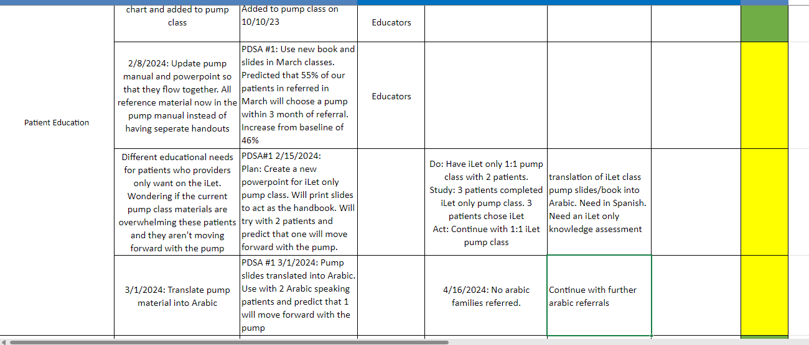

Slide 23
Next intervention
Calling patients 2 weeks after attending pump class to follow up and identify any barriers, reasons why not moving forward or completing process
Continue our class schedule

Slide 24
InPen Equity Project

Slide 25
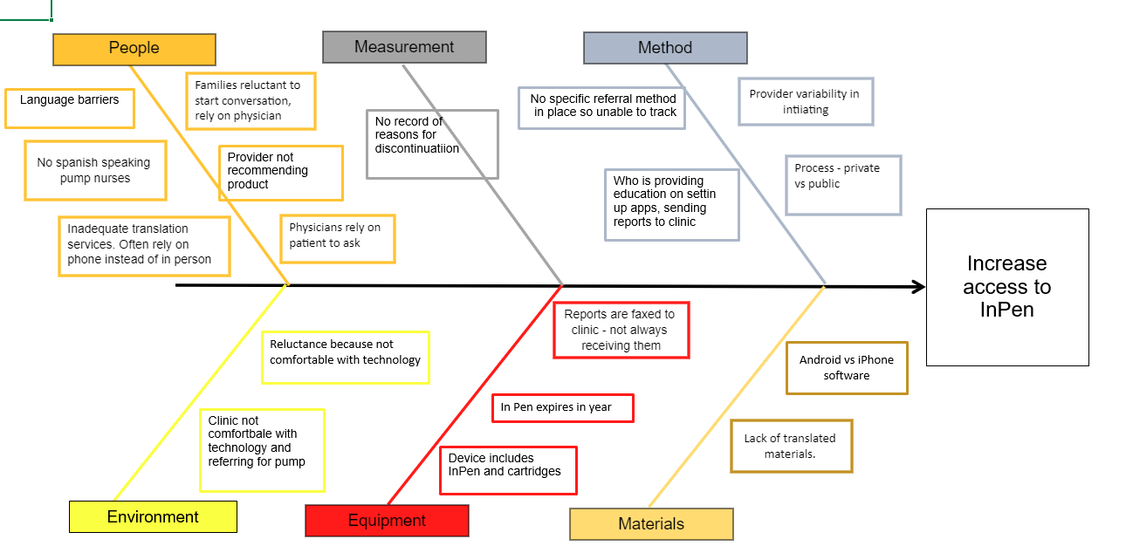
InPen Fishbone

Slide 26
RCHSD InPen PROCESS
Need to send RX to pharmacy for denial
PA sometimes needed from Pharm Tech
= pain point
Patient/ Provider recommends InPen in visit
Public insurance
RN faxes signed InPen order form with provider signature and patient face sheet
YES
Private insurance
RX for insulin cartridges, pen needles sent to local pharmacy
Instruct families not to request insulin cartridges from pharmacy until InPen is shipped or have in hand.
Family to schedule RN education
YES
Provider/RN sends RX to Alto Pharmacy
Prior to education:
family to review in pen tip sheet
Download InPen app
If using dexcom, family to open Apple Health App and add Dexcom and InPen programs

Slide 27
Education with Medtronic reps
Establish rapport with our reps
Process of ordering/education
Discuss having InPen samples in clinic (future PDSA cycle)

Slide 28
We need data!!

Slide 29
PDSA Cycle #1
We added a few slides on InPen to our pump education class
We added an insulin delivery device comparison chart in our exam rooms

Slide 30
Insulin Delivery Devices: Comparison of Features
 | Syringe & Vial | Insulin Pen | InPen | Insulin Pump
Visibility
Smallest deliverable unit | 0.5 units | 0.5 units | 0.5 units | 0.05 units
Number of injections in a day | 2-4 | 3-4 | 3-4 | Every 2-7 days
Compatible with CGM
Link to phone
Bolus calculator
Insulin reminders
Data viewing
Nothing worn on body
Nothing worn on body
Nothing worn on body
Pod or infusion set connected to pump
Tandem,
Omnipod (not iPhone)

Slide 31
Next steps

Slide 32
Next Steps
CKC population
Newly diagnosed inpatient
Inpen samples in clinic

Slide 33
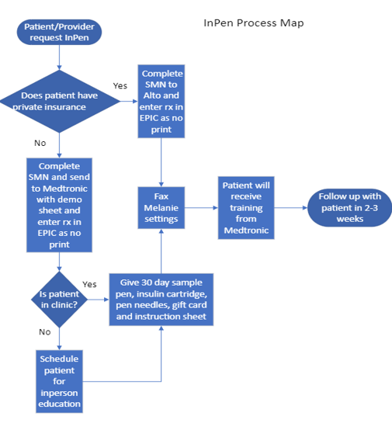
New Process Map
Updated process map
Received samples
Have Humalog cartridge samples

Slide 34
T1D InPen Equity Project- Rolling Action Item List
AIM: Reduce the inequity of in InPen technology access/utilization among White and Black T1D patients
Key Driver | Intervention | PDSA | Point Person | Progress Note | Next Steps | Next Report T1Dx | Status
Provider/Nurse Education | Literature review | Present information to providers about benefits of smartpens at division meeting | Anna/Carla - division meeting | Information on InPen process needs to be presented to providers via email/division meeting | Once the process is finalized present to the team
 | Develop InPen in clinic sample process |  | Kim | 2/1/2024: Process map made for inPen samples in clinic made
 |  |  | Christy | Met with Medtronic representatives 9/21/2023. Received information on InPen process and samples in clinic | Finalize InPen process with step by step information for patients and families - waiting on Medtronic to update contact information
Partnership with Medtronic | Requested data for outcomes |  |  | Medtronic unable to get us data- pulled articles from T1D exchange
 | call pharmacy to see if they carry cartridges |  |  | our inpatient pharmacy does not carry inpen cartridges
 | Set up meeting with Luke and Medtronic to understand process and resources
 | Meeting with Medtronic 12/13/23 Luke and Melanie to inquire about direct purchase of InPens to provide for patients |  | Christy/Carla | Medtronic has relationship with Novo Nordisk to provide cartridge samples. Will need to speak with Eli Lilly rep for Humalog samples | Carly to meet with NovoNordisk to get samples of Novolog/Fiasp for clinic
Address inequities | Request baseline data for InPen |  | Carla | 10/6/23 - Carla to ask IT analyst for baseline data - pulling data from Medication list | 1/18/2024: Carla asking for data with MDI and NPH
 | Health Fair - Medtronic 11/18/2023
 | Pay the $35 copay for patients who are denied the InPen | Set up account with Express RX | Christy | Utilizing basic needs funds to cover $35 copay for patients who are denied by insurance
RN education | January 5th- Melanie to provide education to RN group re InPen use |  |  |  | Work with Care navigation to identify patients
Patient education | Add Inpen to contact list to pump book 1/18/24
 | Add Inpen brochure to pump packets 1/18/24
 | Added InPen slide to our pump class to offer an additonal technology if pump therapy is not for them | Added to pump class on 10/10/23 | Educators |  | Look at 2-3 patients and assess who made change from sample pen to year-long pens within 30 days.

Slide 35
Next Steps
Obtain samples from NovoNordisk
Create account with Express RX
Finalize InPen process
Update Team on process
3 patients identified wanting InPen from pump class

Slide 36
4/5/2024 Updates

Slide 37
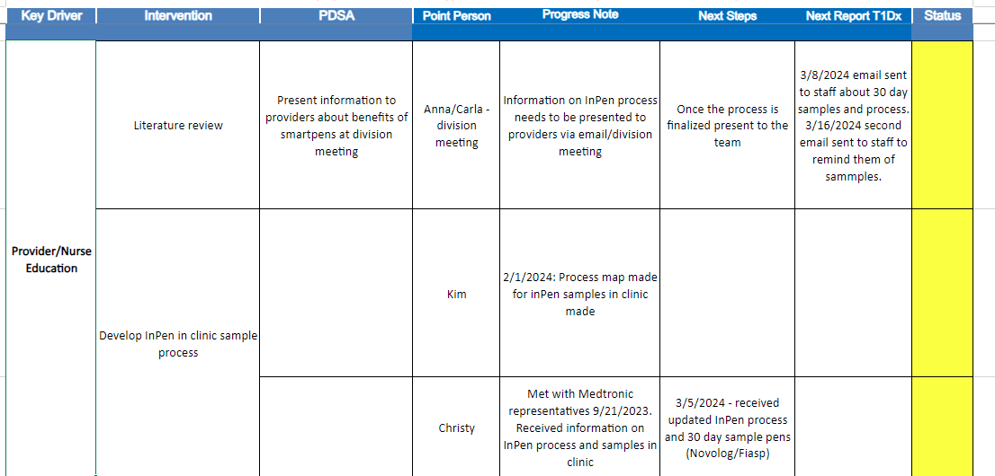

Slide 38
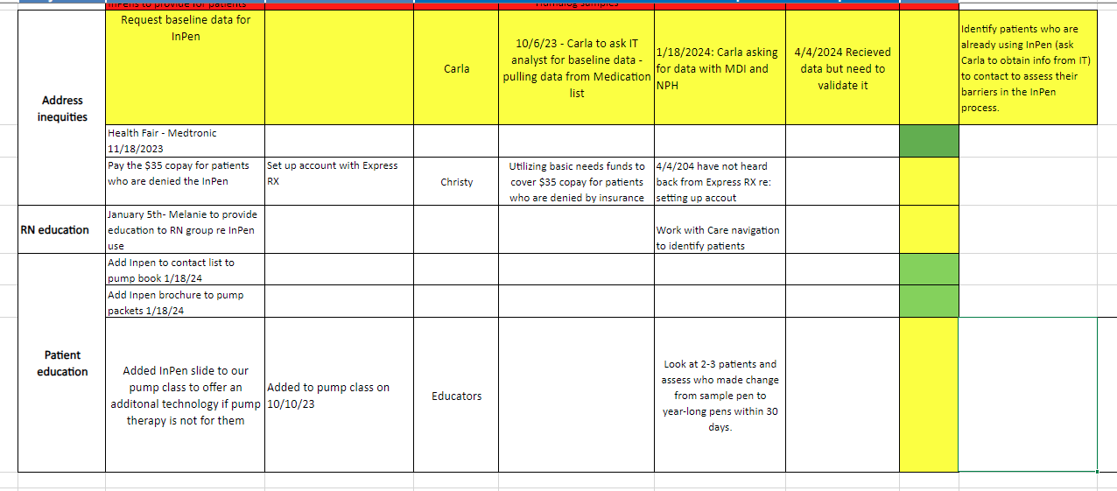

Slide 39
Update 5/3/2024 - InPen

Slide 41
Next Steps
Follow up with patients who have chosen InPen to identify any barriers
Review data on how many of our patients are using InPen to develop baseline

Slide 42
Update 6/7/2024 - Pump

Slide 43
Interventions & Results:
Notes:
Notes:
-August 2022: OP5 released to market. Many patients who were waiting for this to come out started on it thereafter.

Slide 44
InPen update 7/5/24

Slide 45
Patient #1 13y, F, Race – other, public insurance
Attended pump class in April - reached out and requested InPen first before starting OP5. CMN started at that time. Took about 10 days for completed CMN to be faxed to Medtronic.
June – mom sent TDD - sent settings to Medtronic. Mom reports no word on InPen. Sent message to Medtronic re: status - CMN was received but sent to Las Vegas team???
Patient cancelled appointment in June, next appointment 7/26

Slide 46
Patient #2 17y, F, white, private insurance
Attended pump class March 2024. Chose InPen
Sample (Novolog InPen) sent to family - Insulin RX sent to pharmacy, CMN/training orders started. *request sent to our pharm tech (same process for pump) and was returned "we don't follow up on InPens"
Insurance wouldn't cover Novolog, Humalog preferred - New RX for InPen and cartridges sent late April to Medtronic and pharmacy.
June – provided appointment - no mention of Inpen from provider, family or nurse (float)

Slide 47
Patient 3 13y, F, Hispanic, public insurance
Attended pump class in March 2024. Chose InPen
InPen process started
Provider visit in May 2024 – no mention of InPen - ordered Tandem Mobi.

Slide 48
Pain Points
Lessons Learned

Slide 49
Met with Medtronic reps about process of ordering InPen
Process created for InPen samples in clinic
Health Fair
Updated process on ordering InPen
Added InPen slides to Insulin Pump Class
Added InPen brochure and contact information to our pump booklet

Slide 50
 | Jan | Feb | March | April | May
Middle eastern/northern african | 4 | 5 | 5 | 4 | 5
White | 43 | 50 | 59 | 46 | 37
Hispanic | 27 | 29 | 28 | 29 | 27
Decline | 3 | 1 | 2 | 2 | 2
Black | 5 | 12 | 12 | 7 | 7
Other Pacific Islander | 1 | 1
Samoan Other Pacific Islander | 1 |  |  | 1
Asian Indian | 2 |  |  |  | 1
Filipino White | 1 |  | 1
Other Asian | 2 | 2 | 1 | 1
White Black |  |  | 1 | 1
Filipino black white |  |  | 1 | 1
Black Filipino |  |  | 1
Other Asian White |  |  |  | 1
Hispanic White |  |  |  | 2
White Hispanic |  |  |  | 1
Black Hispanic |  |  |  |  | 2
White American Indian or Alaska Native
White Filipino |  |  |  |  | 1
 | 89 | 100 | 111 | 96 | 82

