Slide 1
T1D Exchange update
6/7/2024
Maria Adriana Yanez Bello, MD
Univerisity of Miami PGY-5 Endocrinology Fellow

Slide 2
PDSA– reassessment of patient population
Assess use of diabetes technology in people with T1D attending the Diabetes Research Institute
Administer anonymous questionnaire assessing the use of technology and barriers to its implementation
106 consecutive patients
91 established patients
27 out of 91 (29.6%) using only CGM and 8 out of 91 (8.7 %) using no technology at all. Overall, 38% using CGM only or no diabetes technology at all
The majority 29 out of 35 (82%) are WH, BH or BH
HbA1c average 7.6% (n=26)

Slide 3
Barriers assessment survey

Slide 4
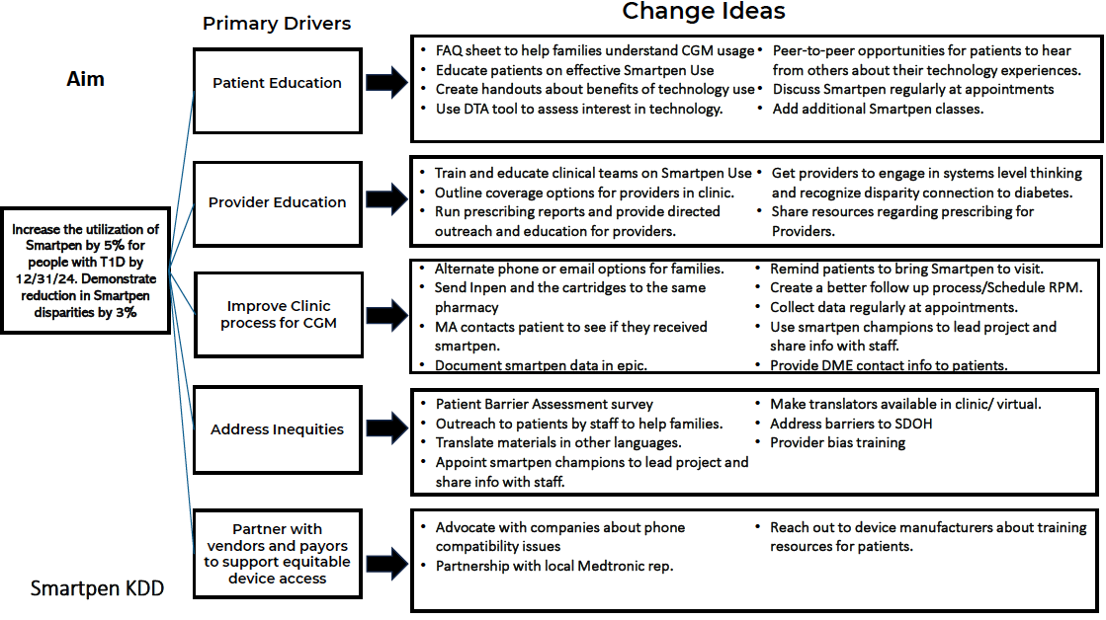

Slide 5
Interventions to implent the use of Smart Insulin Pens
Partner with vendors:
-discuss with vendors if patients can also be referred for carb counting and device training - completed
-ask vendor if samples can be obtained – completed
Patient education
-Flyer to be given at patient at the time of the check in before the visit with the provider – in progress
-Patients referred to education – in progress
Improve clinic process for prescription – in progress

