Slide 1
Lost to follow up pool
PDSA 2 of Lost to Follow Up QI project
May 23, 2024

Slide 2
LTFU Pool
March 6, 2024: Diabetes Clinic Lost to Follow-up pool was created
CDE's notify this pool if a patient no shows (or if refill request and no follow up scheduled, after they contact them once)
Katie, Laura and Rachel reach out to families 3 times (either via phone or portal) and if they do not respond, send letter to home.
Social work is notified if LTFU patients are unreachable and meet following criteria:
< 10 y/o and A1c >10%
10-17 y/o and A1c> 10%, not seen in a year

Slide 3
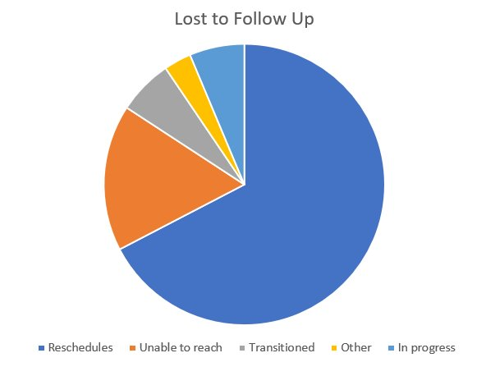
Data for PDSA 2
Contacted 90 patients
6 had previously been rescheduled and no showed that appointment from PDSA 1
4 were contacted twice after having no-showed their first rescheduled appointment in PDSA 2
6 confirmed they transitioned to adult provider
3 listed as "other" - have additional reasons for no follow up (moved, etc.)
64 total reschedules
6 still in progress as of May 23, 2024
16 patients: unable to reach by phone and mailed letter, still no follow up scheduled
7 of those are over 18 and may have transitioned

Slide 4
Points for further discussion
Over age 18 age group: How to facilitate smooth transition to adult provider?
Need for standard policy across clinics regarding how many times patients in this age group can no show and continue to reschedule / how long to authorize refills
Need for clear communication of this standard to patients (in depart)
Plan to collaborate with Transition QI group as well as diabetes team leadership to establish this policy

