Slide 1
Pediatric Annual Visit for Type 1 Diabetes
Isabel Reckson, CDCES, RD, MPH
Alyson Weiner, MD
Elizabeth Gunckle, CPNP
Emily Coppedge, CPNP, CDCES
Zoltan Antal, MD
05/14/2024

Slide 2
Problems, Goals, and Aim
Aim: By January 2025, at least 25% of patients with T1D will have had an annual visit
Goals:
- Improve access to RD and LCSW
45% of patients with T1D were seen by nutrition in 2023
18% of patients with T1D were see by social work in 2023
- Improve SDOH screening
14% of patients with T1D were screened in 2023 (T1DX goal is >50%)
Problems:
- Mental health screening is not diabetes specific
- Increased disordered eating in patients with diabetes observed
- Difficult to streamline transition program

Slide 3
Place:
Space and time to fill out questionnaires in office prior to visit
  If done electronically, will the patients be able to access the questionnaires?
Clinic room availability for patients to have longer visits
Policies and Procedures:
Coordination with clinic staff about patient eligibility and administering screeners
Policy as to how eligible patients are found and scheduled
Appropriate documentation of annual visit and scoring of screeners
Product:
Screeners
  SDOH, eating disorder, PHQ 9, diabetes distress (PAID T)
Can screeners be completed online prior to visit? (Qualtrics, EPIC)
Annual Visit
Process:
Find patients on the schedule who are eligible for annual visit: in-person visits on Mon/Thurs + due for annual labs
Schedule patients with nutrition + social work
At visit, patient is given paper questionnaires by front desk and fills out while waiting to be triaged
Patient sees primary provider, nutrition, social work, and has labs done
Diabetes provider reviews PHQ 9 and PAID T. RD reviews eating disorder screener. Social work reviews SDOH screener
People:
Availability of all providers to be present on same day (MD/NP/RD/LCSW)
Health literacy-different educational backgrounds and understanding of questionnaires
Expanding to languages beyond English
Do we have appropriate resources for if people screen "positive" on screeners?
Equity
- Access to appropriate technology-if screeners are electronic, can all patients access before their appointment?
- Inclusion of people with cognitive or developmental disabilities
- Capture patients of different languages

Slide 4
PDSA Cycles
PDSA 1
PDSA 2
PDSA 3
PDSA 4
Outline annual visit
N=1
Getting the word out
Expanding to all ages
Converting surveys to Qualtrics
PDSA 6
PDSA 5
Incorporating transition program
Notes:
Outline visit- choose screeners, flow
Try with first patient
Newsletter pic

Slide 5
PDSA 1: Outline Annual Visit
Screeners
  Depression:
    PHQ-9
  Diabetes Distress:
    Problem Areas in Diabetes Teen Version (PAID-T)
  SDOH:
    Partners in Care Survey (adapted from Le-Bonheur)
  Disordered Eating:
    The Diabetes Eating Problem Survey Revised (DEPS-R)
Providers
  Diabetes provider (MD/NP)
  Registered Dietitian (RD)
  Social Worker (LCSW)
Annual Blood Work

Slide 6
Criteria for Annual Visit
1. Type 1 diabetes and > 12 years old
2. Diagnosed for > 1 year
3. First visit after patient's birthday
4. Thursday morning diabetes clinic
Annual Visit Implementation Process Map
RN screens diabetes schedule 2-4 weeks in advance to pinpoint patients eligible for Annual Visit
During Visit
Patient fills out screeners in the waiting room (PHQ 9, PAID T, DEPS-R, SDOH)
RN makes sure eligible patients have an appointment with MD/NP, RD/CDCES, and that social work is aware
Lab work
The provider (MD/NP/CDCES) reviews screeners with patient during appointment
Patient meets with:
Diabetes MD/NP
RD/CDCES
Social Work
Morning of the appointment, RN gives packet of screeners to front desk
Front desk gives out screeners to patient upon arrival
Appropriate resources provided and referrals made as needed
Notes:
The team will create a standardized process for referral for patients who test positive

Slide 7
PDSA 2: Starting Small
Observations:
Screeners take a long time to complete
Clinic room availability makes it challenging for longer visits
Provider conflict-must be available at time patient is ready
Visit transparency-we did not inform patient it would be a longer visit
How are screeners scored and documented?
Provider bias
  "This patient doesn't really need social work"
PDSA 1
PDSA 2
Outline annual visit
N=1

Slide 8
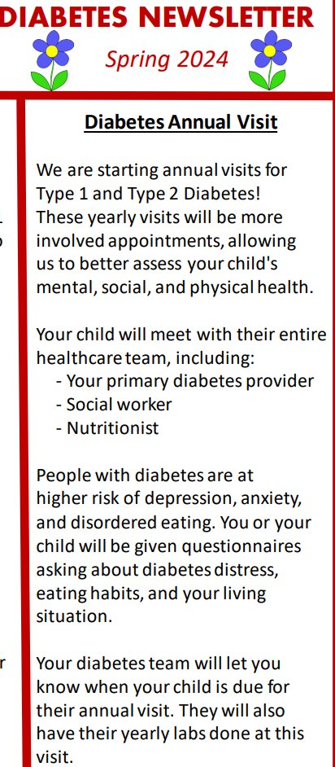
PDSA 3: Getting the word out
PDSA 1
PDSA 2
PDSA 3
Outline annual visit
N=1
Getting the word out (Newsletter and Listserv)

Slide 9
PDSA 4, 5, & 6:
PDSA 1
PDSA 2
PDSA 3
PDSA 4
Outline annual visit
N=1
Getting the word out (Newsletter)
Expanding to all ages
Converting surveys to Qualtrics
PDSA 6
PDSA 5
Incorporating transition program
PDSA 4: Surveys converted to Qualtrics format
  Department feedback is to see if they can be uploaded to EPIC before administering
PDSA 5: Per our transition program, adolescents with T1D are to check-in with social work yearly starting at age 16
  READDY questionnaire, Gottransition.org
PDSA 6: Screeners to adjust for age
  For children 8-12 years, swap the PAID-T for PAID-C
    DEPS-R and PHQ 9 will not be given
  For childen < 8 years, only administer the SDOH screen (to parents)

Slide 10
Criteria for Annual Visit
1. Type 1 diabetes (ALL AGES)
2. Diagnosed for > 1 year
3. When the patient is due for blood work
4. Monday afternoon, Thursday morning diabetes clinic
Annual Visit Implementation Process Map
RN screens diabetes schedule 2-4 weeks in advance to pinpoint patients eligible for Annual Visit
During Visit
If >/= 12 years:
PHQ 9
PAID T
SDOH
DEPS-R
If 8-12 years:
PAID C
SDOH
If < 8 years:
SDOH
RN makes sure eligible patients have an appointment with MD/NP, RD/CDCES, and that social work is aware
The provider (MD/NP/CDCES) reviews screeners with patient during appointment
Lab work
Patient meets with:
Diabetes MD/NP
RD/CDCES
Social Work
Patient fills out screeners in the waiting room
Morning of the appointment, RN gives packet of screeners to front desk
Front desk gives out screeners to patient upon arrival
Appropriate resources provided and referrals made as needed
Ages 16 and up: social work assess transition readiness and administers transition questionnaire

Slide 11
Future Directions:
Technology
  Use of Ipads in clinic for patients to fill out screeners
  Qualtrics vs EPIC screeners
Polices/procedures
  Formalize annual visit documentation via EPIC
    Including appropriate documentation of screener scores
  Consider parent version of screeners
  Improve process of selecting and notifying patients eligible for annual visit
Expansion
  To all patients with T1D (include all clinic days and all providers)
  To patients with T2D
Goal for a community health worker, transition coordinator

Slide 12
Questions?
Isr2007@med.cornell.edu

