Slide 1
Ketone Action Plan
Casey Rust, CDCES

Slide 2
Ketone Action Plan AIM:
Problem: With new AID pumps, we have changed our Ketone Action Plan. Patients don’t know our new protocol.
AIM: Increase knowledge and recall by 10% for new ketone protocol for AID systems for youth ages 2-18 from December 2023 to April 2024.

Slide 3
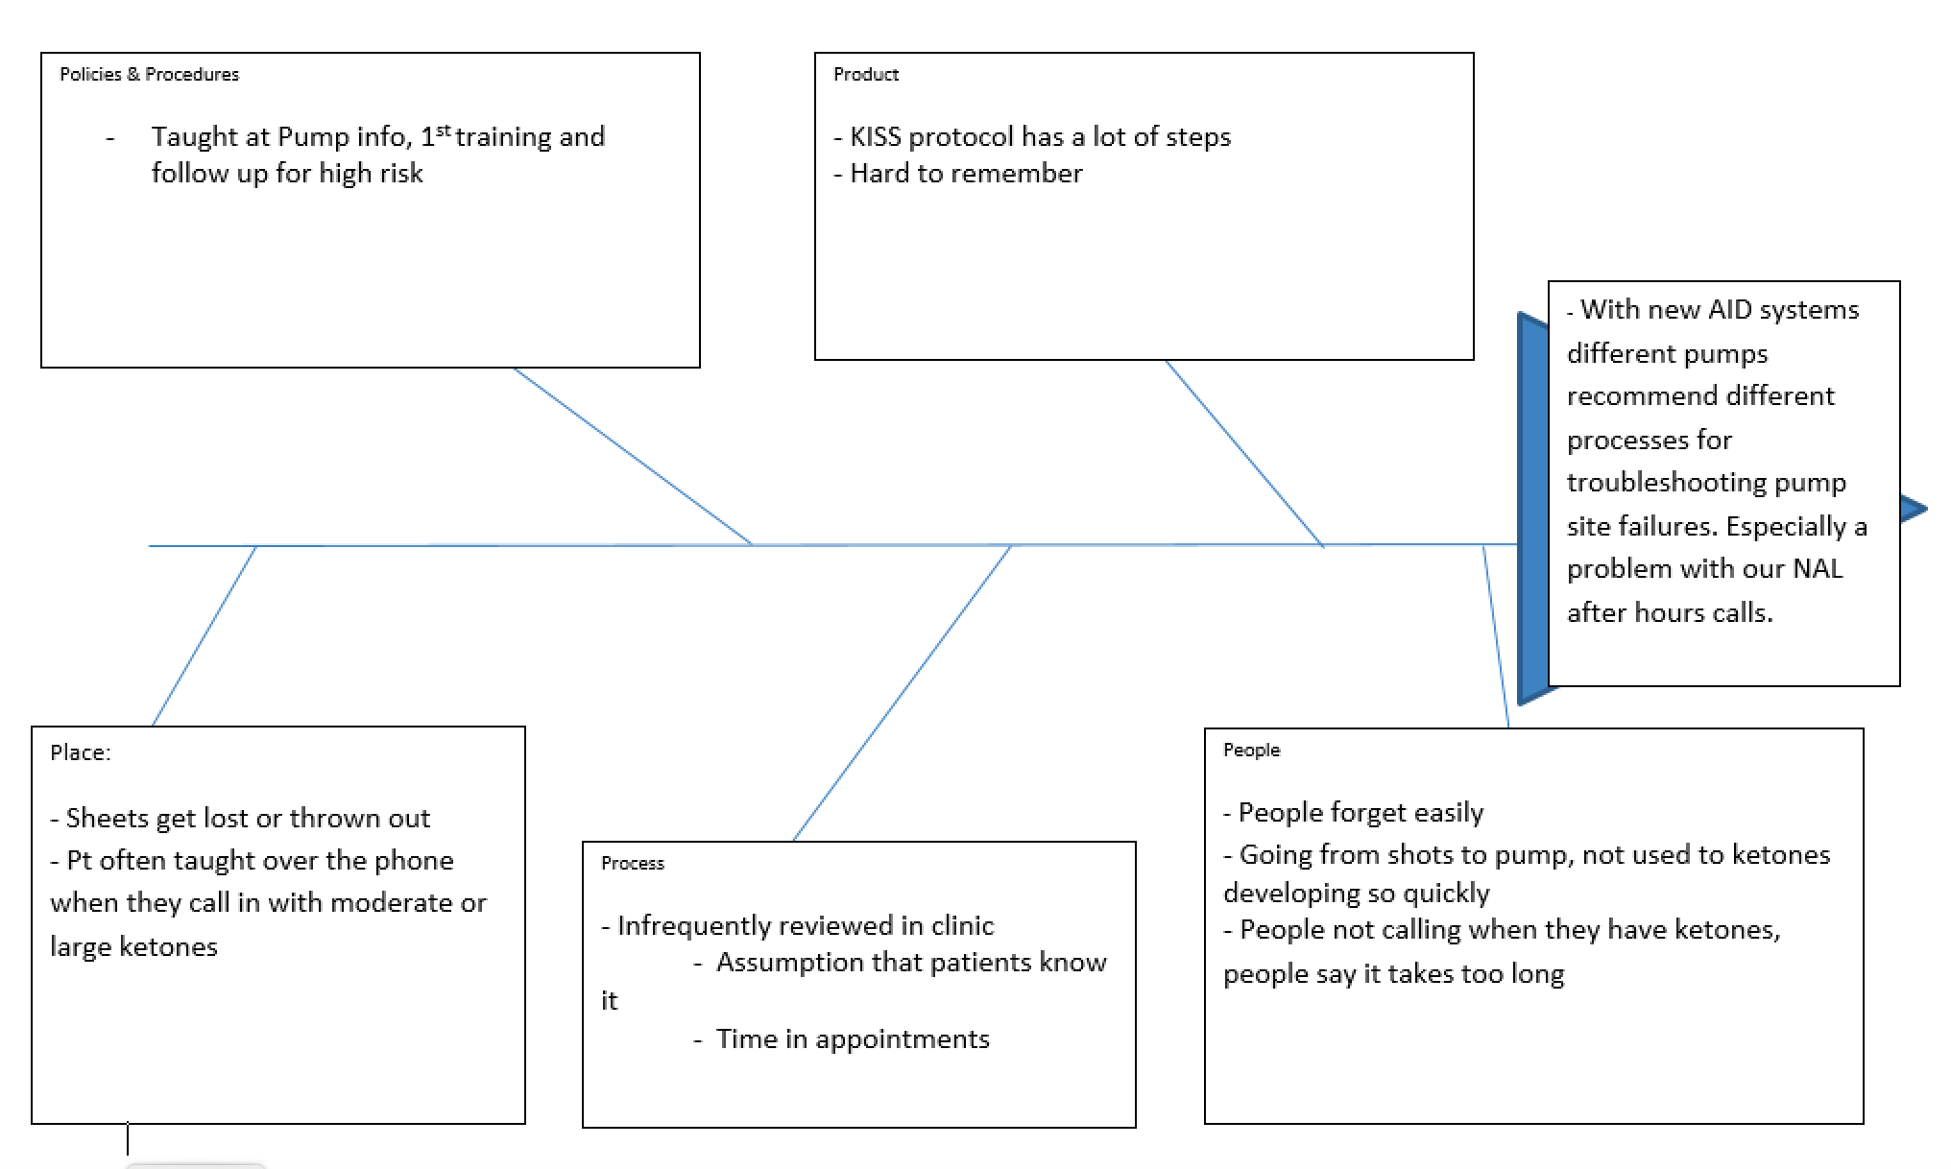
Fishbone

Slide 4
Process
Baseline:
Reviewed Ketone Action Plan with families over 2 days
Call or email family with 5 multiple choice questions, 3 open ended questions
Magnet:
Reviewed Ketone Action Plan magnet with families in clinic
Call or email family with 5 multiple choice questions, 3 open ended questions

Slide 5
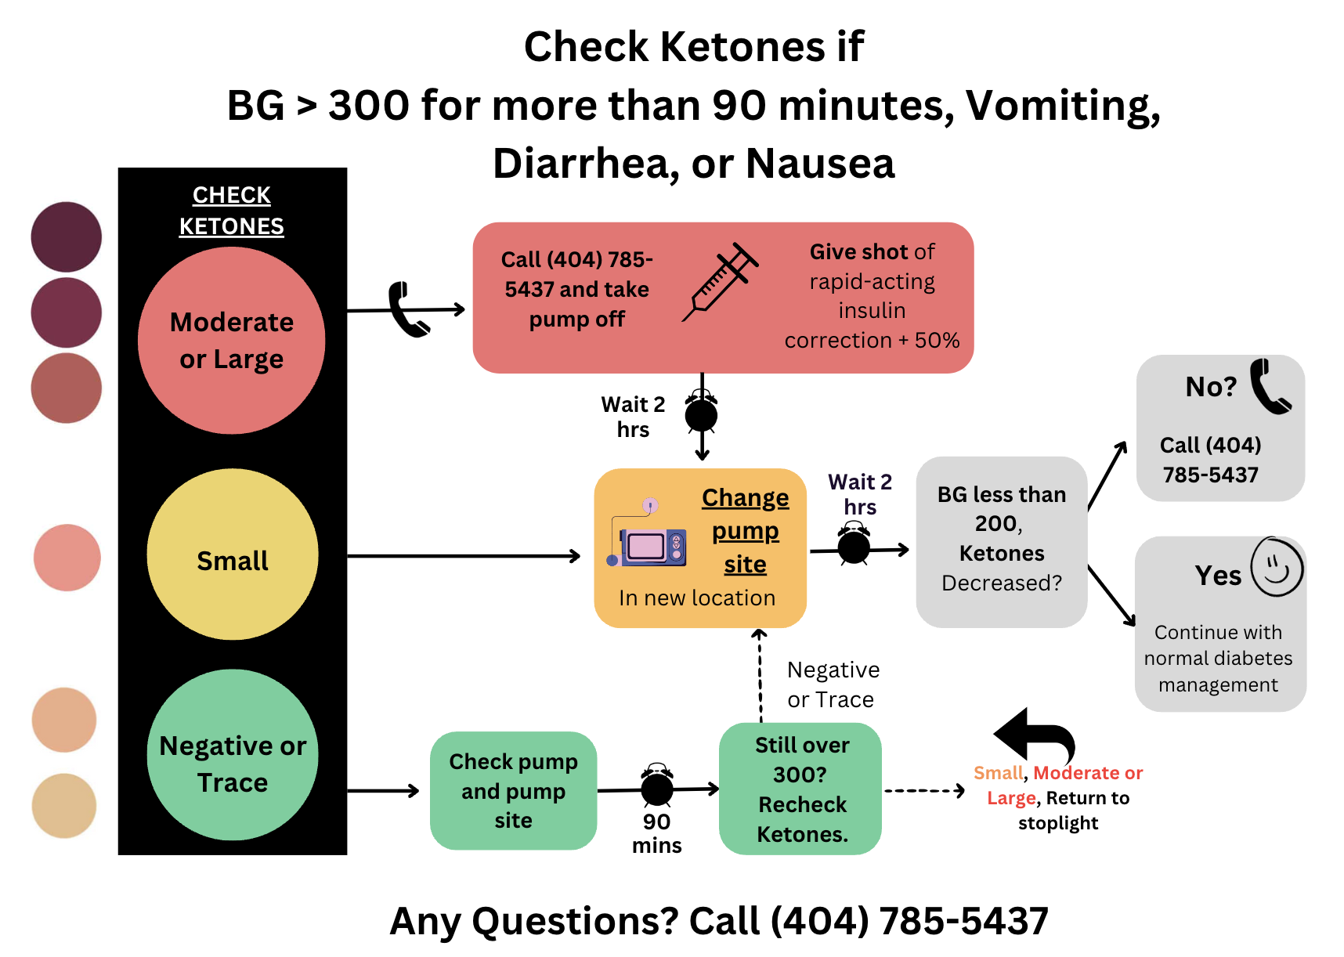
Magnet

Slide 6
PDSA1: Ketone Action Plan
Notes:
December reviewed baseline with 12 families, got 6 responses back
March reviewed magnet with 13 families, got 5 responses back
When do you check for ketones on a pump?
True or False? If I have moderate or large ketones, I can assume I’m getting insulin through the pump?
You have large ketones and BG is 400. You calculate your correction (400-100)/50 = 6u. How much insulin do you give through an injection?
You check blood sugar 2 hours after changing your pump site and it is 289, ketones have gone from large to moderate. What should you do?
What is the first thing you do if you have small ketones?

Slide 7
PDSA1: Ketone Action Plan
Notes:
Baseline 46%
Magnet 55%

Slide 8
Feedback/Next Steps
Did we reach our AIM?
No, but families reported to like it
All families reported knowing where it was in the second group, but most wanted it more accessible when on the go
Adapt: Make when to check ketones clearer with magnet.
Next steps- try and incorporate it into our app to make it more accessible and walk families through
Next PDSA will be at Safety starts
Notes:
Next step – review for in person safety starts

Slide 9
Questions?

