Slide 1
Bridging Health Equity Gaps: Strategies for Transformative Change
Amy Grant, DNP, RN, CPN

Slide 2
Presentation Objectives
Introduce QI Bridging Framework and tools
Share learnings from CGM equity project

Slide 3
QI Bridging Framework
1
Current landscape
2
Ideal environment
3
Bridge for health equity
Explain type 1 diabetes, CGM, and barriers for patients/families
Utilize QI tools to understand current state: sFMEA & detailed process map
Create a narrative about equitable and improved care
Use QI tools to envision an ideal environment: Voice of the Customer
Create bridges for patients, remove barriers, and narrow the health equity gap
Implement QI tools to bridge the gap (narrow the gap!): Bridge tool & PDSAs

Slide 4
Current Landscape

Slide 5
T1D Patient Not On CGM
T1D Patient On CGM

Slide 6
Notes:
NANA
A primary driver of death and disability is related to complications from HYPERglycemia (high BG’s) when insulin is not adequately delivered consistently. The primary outcome we measure to assess glycemic control is hemoglobin A1c. As you can see in this graph, there is a logarithmic rise in the rates of diabetes complications as A1c rises.

Slide 7
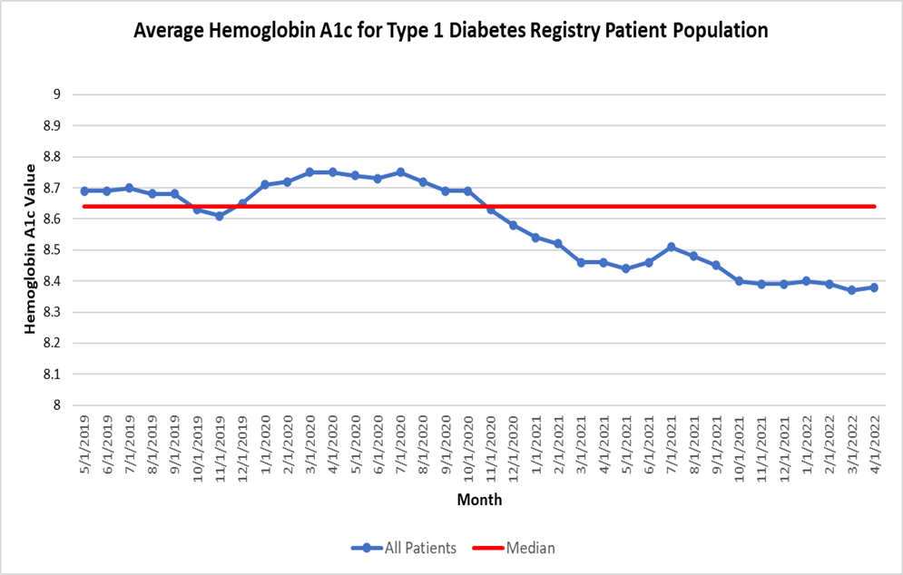
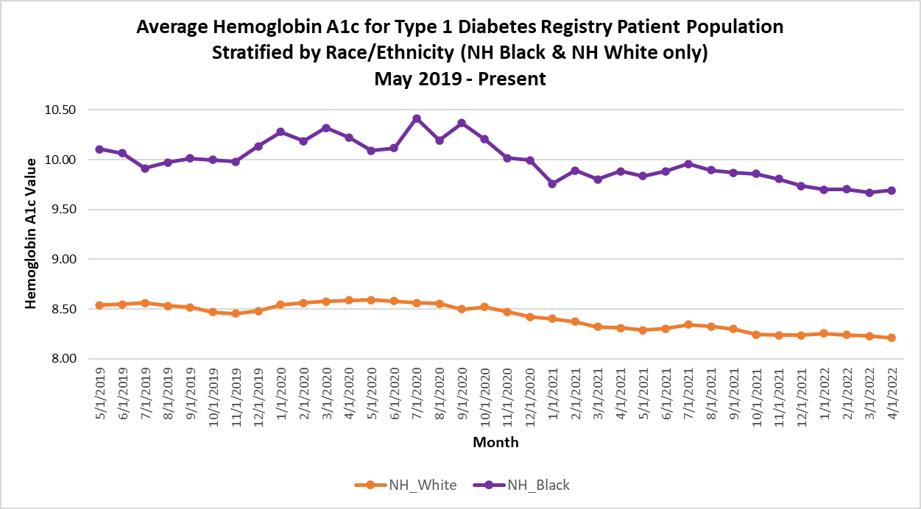
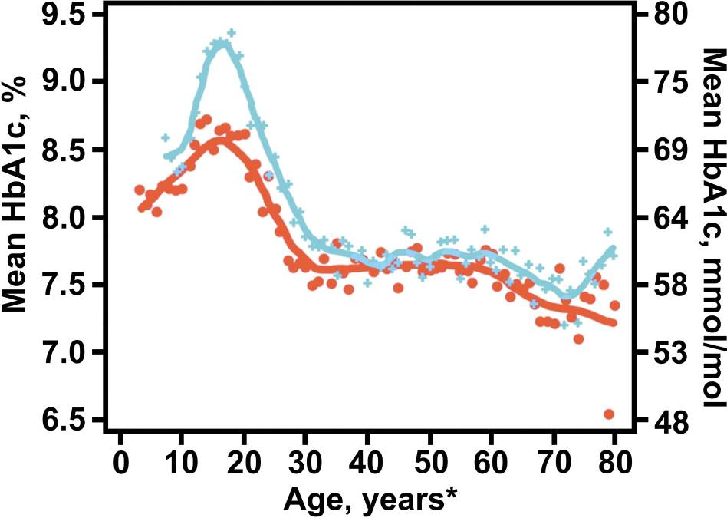
Average HbA1c By Year of Age; 2010 – 2012 Versus 2016 – 2018
Despite improvements in hemoglobin A1c (HbA1c) nationally as reported by T1D Exchange
and locally at Cincinnati Children’s Hospital Medical Center…
Nationally, morbidity and mortality in TID is grossly marred by key disparities and equity gaps
Locally, Black T1D youth and youth on public insurance have higher HbA1c, lower rates of diabetes technology use, less clinic visits and higher rates of hospitalizations.
Notes:
NANA
Fortunately, since the discovery of insulin in the 1920’s by Banting and Best, we have been able to make population level reductions in A1c across all ages. What you are looking at here is an analysis comparing patient data from the T1D Exchange Quality Improvement collaborative (the largest T1D patient registry in the country) comparing 2010/12 data to 2016/18 data with appreciable decrease in A1c’s between those years.
Unfortunately, not all patient groups have experienced those successes. Morbidity and mortality in type 1 diabetes (T1D) is grossly marred by key disparities and equity gaps compounded by social determinants of health (SDH): non-medical factors that influence health outcomes.
Locally, black T1D youth have higher hemoglobin A1c’s (HBA1c), lower rates of diabetes technology use, and higher rates of hospitalizations. The implementation of a social determinants of health (SDH) screen provides a systematic screening tool to target high risk patients.
Nationally and Locally, Black T1D youth and youth on public insurance have higher HbA1c, lower rates of diabetes technology use, less clinic visits and higher rates of hospitalizations (all factors which affect patient outcomes.)

Slide 8
Peek at the data
Here’s the “before” data…
I’ll show the “after” at the end of the presentation!

Slide 9
CGm Equity
CURRENT STATE
IDEAL STATE
FOCUS AREA
Lack of awareness and understanding for patients/families
Social determinants of health are barriers for using CGM
Expensive and time burden to get CGM
Complicated process to get CGM
Providers’ implicit bias
Unsure which patients are on CGM and which aren’t
Not certain which patients picked up CGM from pharm/DME when prescribed
STEP 1
STEP 2
STEP 3
STEP 4
STEP 5
Idea
Idea
Idea
Idea
Idea
INTERVENTIONS/ CHANGE IDEAS
Idea
Idea
Idea
Idea
Idea
Idea

Slide 10
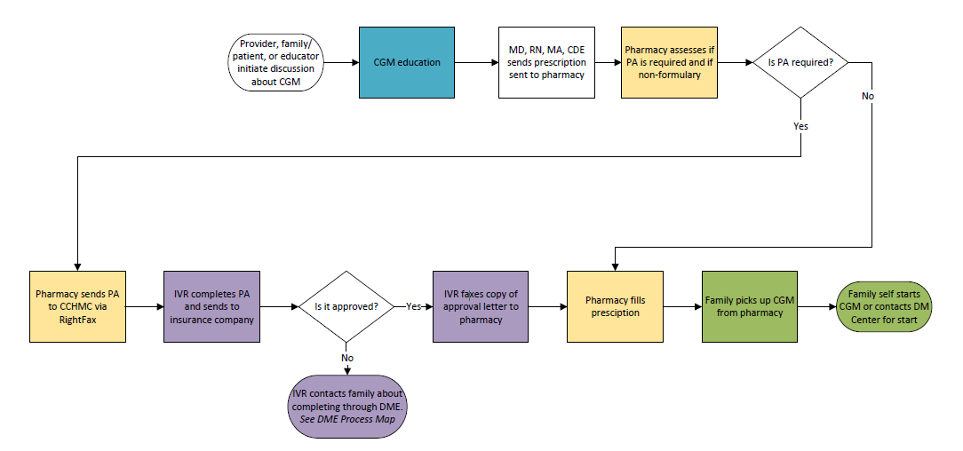
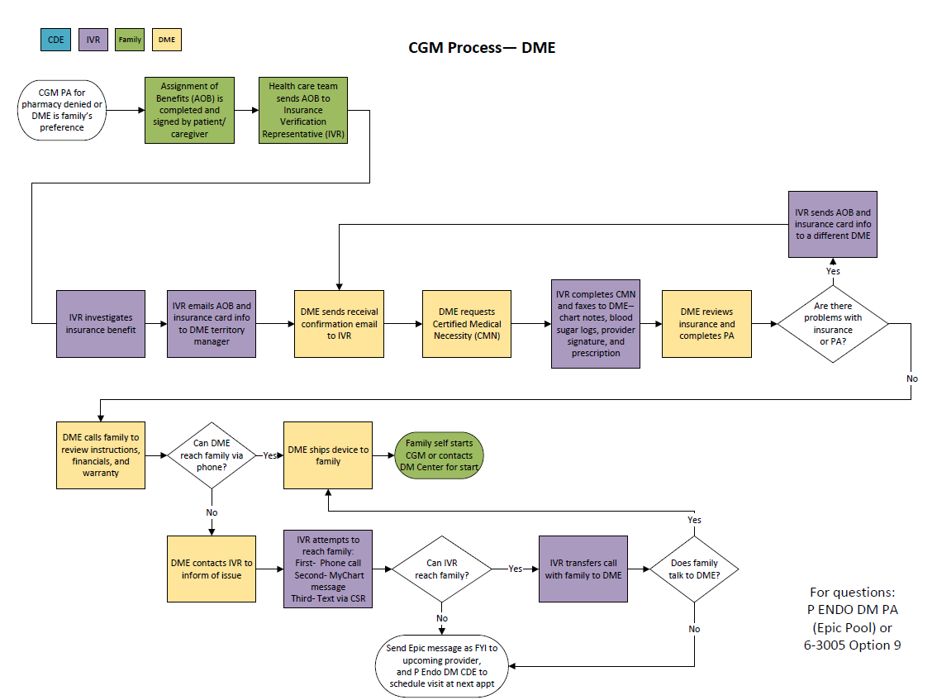
Process Map for Starting CGM

Slide 11
T1Dx CGM Equity Project (Pharmacy Process)-- Simplified Failure Mode Effects Analysis (sFMEA©)
Equity Lens: -Make list of pts without CGM– include race and insurance type -Translate flyers/ education -Standardized handouts about CGM and uptake process (including CGM start)– include info about cost of CGM and appts or how to look up cost -Role play provider exercise -Flyers about CGM or on waiting room/clinic room tv - CGM trial program -Insurance Navigator attend CGM classes
-Technology Barriers added to Epic flowsheet
Equity Lens: SDH Screening and resources for positive screens -Provider print off insurance info from EPIC -Staff help fill out form while pt in clinic
Equity Lens: -Curating pt’s pharmacies is esp important for families that often move -System that can identify closest pharmacy for families based on address and insurance type
-CCHMC pharm carries CGM supplies -In clinic ask family preferred pharmacy
-Nurses routinely clean up list of current pharmacies -Add “confirm pharmacy preferences” to visit checklist/comm. tool
Equity Lens: -Insurance Navigator or Endo staff call to investigate insurance coverage -Have a list of benefits by payer -Ask family on “CGM Readiness Screen” if they know insurance info/benefits -Shared Decision-Making tool/education about insurance options-- Pharm or DME, reviewed by SW CDE, or clinic staff
-Insurance 101/ Check-in at Beyond The Basics class for new onset pts– printed or video education deliverable
Equity Lens: -Create report for S3/M3 (or other subset) patients and check if they need follow-up related to pending CGM prescriptions -Process step for family or staff to call pharmacy to verify coverage/PA need -Revise and recirculate steps sheet for PA process– for providers and staff -Interactive Checklist for managing PA process
Equity Lens:
-SW assist with getting a hold of family or use cellphone to text them
-Educator help family make pharm call when they come back to clinic -CCHMC pharm carries CGM supplies
Equity Lens: -Utilize Dexcom start video w/ families -Phone call with Tech Team -CGM included in Day Hospital new onset bundle -Provider follow-up with family to understand why they don’t want it-- identify barriers & misconceptions -Increase communication that we are here to help with start
INTERVENTIONS
QI tool to identify opportunities and brainstorm solutions
Provider- or patient-initiated discussion about CGM
Assignment of Benefits completed
Prescription sent to Pharmacy
Pharmacy assesses benefits and sends back to DM center if PA needed
DM Center completes PA and sends to insurance company. DM Center contacts pharmacy with approval reference number
Pharmacy fills prescription
Family self starts or contacts DM Center for start
CURRENT
PROCESS
-Provider/pt fails to initiate discussion - Provider has thoughts/bias that are barriers to bringing up CGM -Pt lack of awareness of CGM/Provider doesn’t know pt lacks awareness -Pt/family has thoughts/feelings about CGM that are barriers to uptake -Lack of standardization
-Family feels pressured Inequities: -Provider implicit bias -Health literacy -Technology literacy -Language barriers
-AOB not completed -Family doesn’t know insurance information -Provider unaware AOB needed -Time barrier -Paper AOB not available -Provider lack of awareness of online AOB/internal process Inequities: - Health literacy -Literacy- write/read -Language barriers
-Prescription not sent to pharmacy -Missing prescription (when switching from DME to pharmacy) -Sent to wrong pharmacy -Provider/nurse unaware how -Not in Epic preference list -Time barriers Inequities: -Not available for all patients d/t insurance
-Provider/pt and family not aware of coverage - Insurance company changes benefits -Lack of standardization -Process and criteria too complex -Takes too much time
-CGM denied -DM Center not notified of denial Inequities: -Insurance barriers -Healthcare navigation literacy -Cost
-DM Center doesn’t receive PA request -Refusal to attempt to complete PA -Doesn’t communicate to family if need to fill with DME -Time barrier -Lack of consistent staff to complete -Staff unsure of process -PA denied - PA delayed - Process too complex Inequities: -Insurance barriers
-Family not aware CGM ready and it’s put back -Pharmacy can’t reach family Inequities: -Cost/Can’t afford -Transportation issues -Neighborhood/ Delivery—Stolen, shipped to wrong parent, family has PO box, family homeless, delivered to wrong apt in building -Family doesn’t have reliable phone
-Family doesn’t start using CGM because they didn’t actually want it, felt forced -Busyness of life -Not comfortable to start on own, but don’t call for appt -Family doesn’t know that they can contact DM Center for help Inequities: -Cost of appt
- Health literacy -Literacy- write/read -Language barriers -Variability of caregivers - Home environment
FAILURE MODES
2017 © Cincinnati Children's Hospital Medical Center. All rights reserved. This work is licensed under the Creative Commons Attribution-NonCommercial-ShareAlike 4.0 International License. To view a copy of this license, visit http://creativecommons.org/licenses/by-nc-sa/4.0/ or send a letter to Creative Commons, PO Box 1866, Mountain View, CA 94042, USA. If you have any comments, questions or feedback regarding this tool, please email your feedback to AC4U@cchmc.org. Template created and maintained by The James M. Anderson Center for Health Systems Excellence at Cincinnati Children's Hospital Medical Center.

Slide 12
Ideal Environment

Slide 13
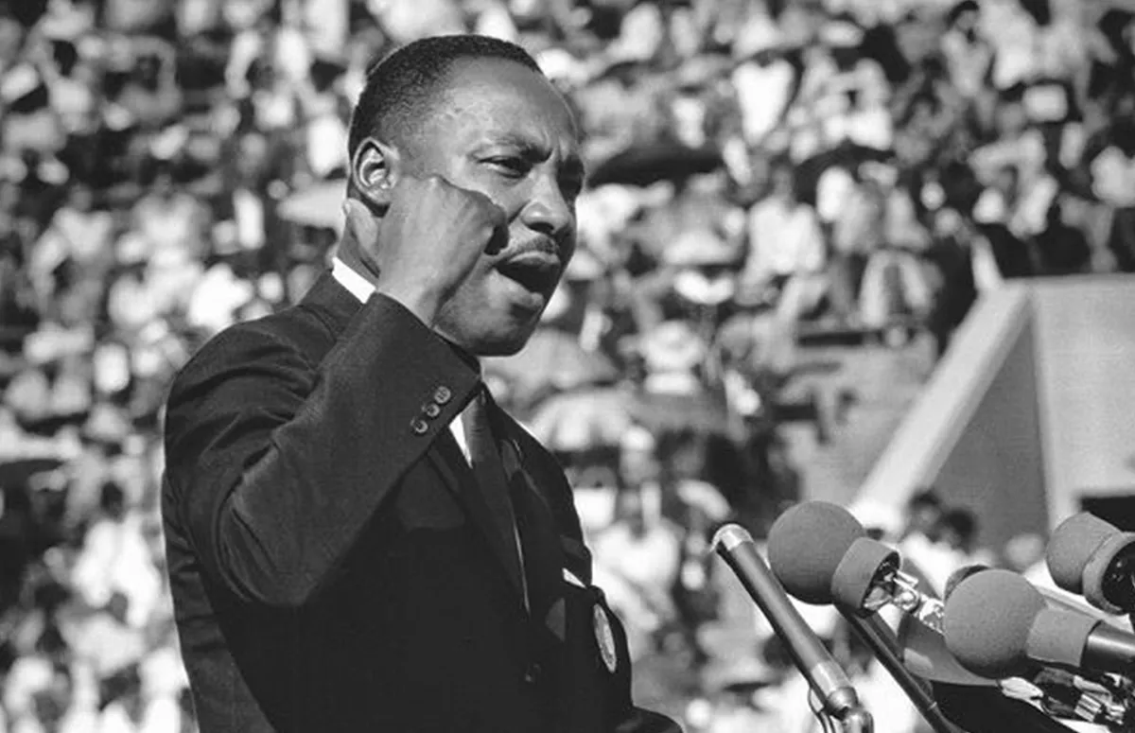
Unwritten Story
“… People of goodwill, whose voices are yet unheard, whose course is yet unclear, whose courageous acts are yet unseen.”
- Martin Luther King Jr.

Slide 14
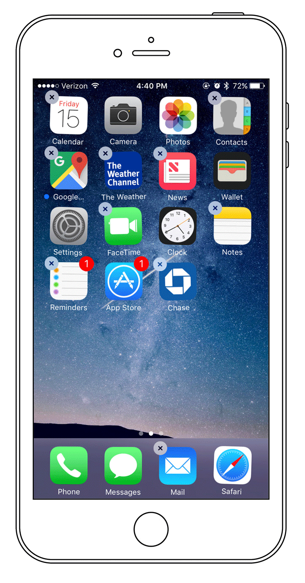
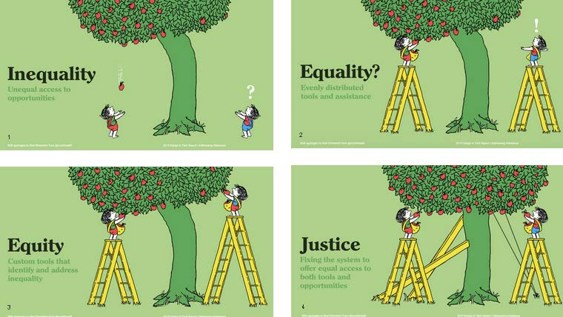
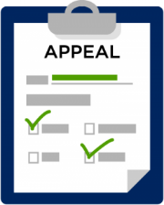
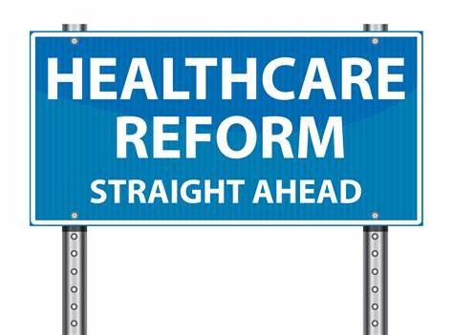
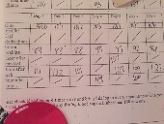
Notes:
NANA
This work is not without its challenges.
Inequality would be unequal access to CGM technology. We know that diabetes technology improves diabetes care yet we see this disparity all the time.
Now let’s say we are equal and both patients have CGM’s – CGM’s are evenly distributed; BUT patient 1 has an iPhone with wifi and hotspot so he gets his readings all the time and so do his parents, his teachers, his coaches and his diabetes providers if they so choose; while patient 2 doesn’t have an iphone and doesn’t have internet access at home. Well, that’s ok, right? He has a transmitter. Not everyone has a phone anyway. But that means neither his caregivers, teachers, coaches or diabetes providers are privy to his daily BG patterns and we can easily see how that difference mediates a deviating outcome. An oh, insurance only covers 1 transmitter every 6 months so if it’s lost or broken, this pt could be without his CGM for weeks to months at a time. And we will only give you 2 transmitters at a time and you must called on the 20th day of the month to get your transmitter refills…
So now let’s say we have identified the custom tools to identify and address inequality and now both patients can have a CGM and a phone. Well those custom tools end up being multiple insurance rejection claims, testing BG’s 4X day before you can get it, wearing it 80% of the time before you can reorder, and innumerous denials and appeals and logs that all of you know all too well.
So where do we go from here? We don’t have the time to talk about social justice BUT the principle is essential. We must FIX THE SYSTEM TO OFFER EQUITABLE ACCESS TO CARE!

Slide 15
CGm Equity
CURRENT STATE
IDEAL STATE
FOCUS AREA
Lack of awareness and understanding for patients/families
Social determinants of health are barriers for using CGM
Expensive and time burden to get CGM
Complicated process to get CGM
Providers’ implicit bias
Unsure which patients are on CGM and which aren’t
Not certain which patients picked up CGM from pharm/DME when prescribed
Affordable
Equitable access
Provider/staff with cultural competency and compassion
Informed, engaged, and involved patients/families
Personalized care
Dedicated time and resources for providers to discuss CGM with patients
Streamlined process to get CGM
CGM as the “standard of care”
All patients using CGM = better health outcomes and quality of life
STEP 1
STEP 2
STEP 3
STEP 4
STEP 5
Idea
Idea
Idea
Idea
Idea
INTERVENTIONS/ CHANGE IDEAS
Idea
Idea
Idea
Idea
Idea
Idea

Slide 16
Voice of the Customer: Problems and Ideas
CGM trial program would have been helpful
For interpreted forms, make sure Spanish-speaking familes check that it is phrased correctly
Introduce CGM when first diagnosed, it shouldn‘t be optional
Give tips for how to keep CGM on.
Call/message patient to check-in days/weeks after starting CGM
A video or handout about others‘ experiences and struggles would be helpful
Don‘t let patients go through all the struggles I did before starting CGM
CCHMC translators help families when they call DME (from home)
Let patients know upfront what to expect– there will be issues... call for help
Provider- or patient-initiated discussion about CGM
Assignment of Benefits is completed
Prescription sent to DME
DM Center facilitates paperwork
DME Contacts family and ships product
Family self starts CGM or contacts DM Center for start
At times, translators don’t understand what provider is saying so guess at translation
I left appt not feeling fully aware of CGM
The sensor looked scary. I was afraid of having something on me
Families don’t know the process, it’s very hard– a HEADACHE
Sometimes insurance company or DME asks for things I don’t understand (mom)– no translator
I didn’t ask for help because I didn’t want to complain
When first started— It felt weird, tight. Painful for about a day
I was afraid of having loud/ obnoxious alarms

Slide 17
Bridge for Health Equity

Slide 18
CGm Equity
CURRENT STATE
IDEAL STATE
FOCUS AREA
Lack of awareness and understanding for patients/families
Social determinants of health are barriers for using CGM
Expensive and time burden to get CGM
Complicated process to get CGM
Providers’ implicit bias
Unsure which patients are on CGM and which aren’t
Not certain which patients picked up CGM from pharm/DME when prescribed
Affordable
Equitable access
Provider/staff with cultural competency and compassion
Informed, engaged, and involved patients/families
Personalized care
Dedicated time and resources for providers to discuss CGM with patients
Streamlined process to get CGM
CGM as the “standard of care”
All patients using CGM = better health outcomes and quality of life
Screen for and address SDOH and tech barriers
List of patients coming to clinic and not on CGM
Video to share patient stories
CGM available at hospital’s pharmacy and DME
CGM started at Diabetes diagnosis
STEP 1
STEP 2
STEP 3
STEP 4
STEP 5
DEI and implicit bias training for providers/staff
Financial counselor, insurance navigator, care coordinator
Trial program for CGM (try before you buy)
Expand tech training to all diabetes educators
Creative solutions for phones
Shared-decision making tool
INTERVENTIONS/ CHANGE IDEAS

Slide 19
Practical strategies that can be applied to any project
1
2
3
4
5
6
CGM At Diagnosis
CGM Trial Program
Shared Decision Making Cards
Onsite Access For CGMs
Creative Phone Solutions
CGM Video
Standardize interventions so they are common practice for all patients
Remove barriers so it’s easier for patients to make healthy choices and try new things
Use shared decision-making to involve patients and families in their care
Bring care closer to patients to make it more accessible and convenient
Be innovative and think outside the
box
Connect patients to each other and care options by sharing patient stories
Notes:
We are so excited about the work we are doing and its affects on patient outcomes. So much so that we are not stopping with these interventions, we continue to work to improve patient outcomes by meeting patients where they are including partnering with our mobile care center, school partnerships, shared decision making and even partnering with our internal pharmacy and DME providers to offer diabetes technology prescriptions in house, so families don’t have the burden of having to travel to pharmacies or deal with the structural barrier inherent in medical supply companies

Slide 20
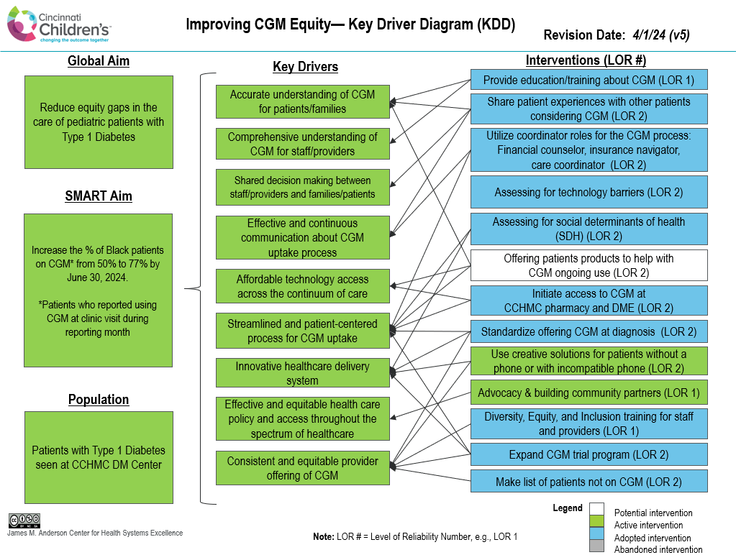

Slide 21
Results
Improved patient outcomes and narrowed the gap:
CGM usage increased from 50% to 82% for black patients
From 77% to 92% for white patients
Narrowed the black-white gap from 27% to 10%.

Slide 22
Call to Action
Is there disparity in health outcomes for patients in racial and ethnic minority groups?
(THERE IS)
Do these patients want to be healthy?
(THEY DO)
Are they counting on us?
(THEY ARE)
Do we want to help them, stand beside them, and fight for them?
(WE DO)
Notes:
AMY

