Slide 1
CGM & Pump Equity Project
March 2024 Update

Slide 2
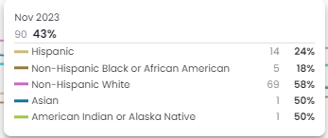
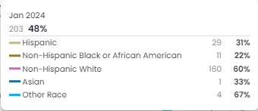
March 2024
Update:
Cook Dashboard:
PDSA 3 Complete – Pump Info Bundles
Provider Refresher Education scheduled – April 22
TX MEDICAID NOW COVERS OMNIPOD 5!!
Next Steps:
Data Correction, Team Follow-up
Notes:
Of the 7 patients, average diagnosis is 2 years!

Slide 3
Cook Children’s Pump Equity Key Driver Diagram
Change Ideas
Primary Drivers
Patient Barrier Assessment Survey
Provider bias survey / Pump Bias Survey
Establish Parent Partnership Group
Ensure support and education available for non-English speakers
Aim
Address Inequities
Increase the utilization of Insulin Pump use by 10% for people with T1D by 12/31/24.
Demonstrate reduction in Insulin Pump disparities by 3%
Improve access to pump data with 10% increase in patients added to HC portals
Early education
Equitable delivery
Pump Interest
Updated approved pump approval guidance
Streamlined approval notice
Pump Access
Virtual Pump Education
Group Vendor Education
1:1 Education for non-English speaking families
Patient Education
Regular review of data on our pump users
Provider to Provider Pump Education Refresher
Regular review of updated resource
Provider Education
Improve Pump
Data Analysis
Efficient access to integrated pump data
Safe storage of patient information (CCMC IT)

Slide 4
“We”… are the Champions! Thank you for your support!

