Slide 1
Insulin pump starts & upgrades to visit with provider
Edelina Cohen, MS RD CDN CDES Center for Diabetes & Metabolic Health at NYU Langone Health New York, NY edelina.bustamante@nyulangone.org
March 12, 2024

Slide 2
QI
Problem/Issue: some patients newly trained on insulin pumps (or completed pump software upgrade) did not have any visits with a DEA provider after they were trained (upgraded) and started on their insulin pump
Primary Drivers
Aim statement:
By May 2024, increase number of patient visits within 2-3 weeks of patient’s insulin pump training or software upgrade by 10-15%
Medication Management/ Device Use
Adjust insulin pump setting
Review and interpret insulin and glucose devices
Provide contact info for technical support
Shared Decision Making
Patient Centered Care
Identify patient priorities and goals
Patient support system
Notes:
medication mgt/device use-→ improve glycemic control→ optimize their basal/bolus settings; provide guidance and support on pump use
Shared decision making→ increased flexibility in managing diabetes→ set diabetes expectations; discuss different pump options: benefits and drawbacks; ongoing education according to lifestyle (eg: pump features like extended bolus)

Slide 3
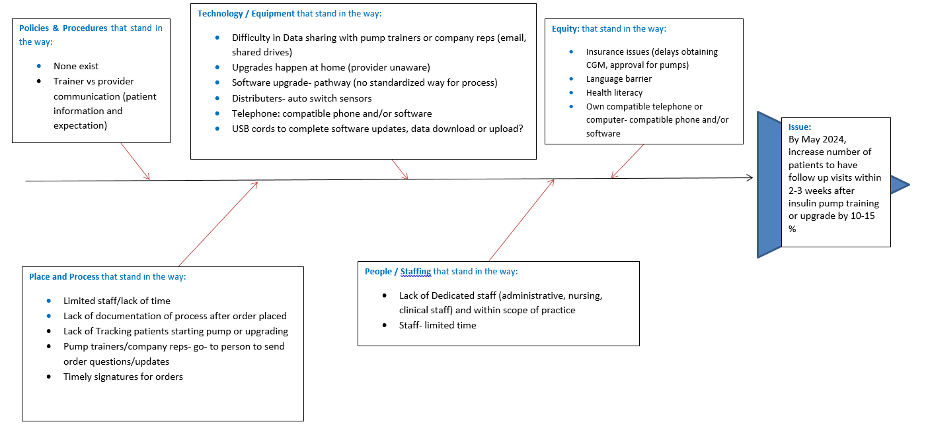
Notes:
Equity- we do offer pumps even if situation is not “ideal”!

Slide 4
Process 1 (baseline)
Revised area of improvement
Tracking file on Excel updated by secretary, RD CDE
Pump trainers train patient on insulin pump
Area of improvement
Provider, Patient: discuss various insulin pump options
MD/midlevel sends notification to secretary- order process start
Secretary sends docs: RX, clinicals, pump start orders
Training scheduled by pump co
Did patient schedule 2-3 week visit with MD/midlevel after?
RNs assist with pump start orders, communicating training or upgrade process to patient
Orders completed, signed, sent back to pump company
YES
NO
Did the patient show up to appt?
Secretary reaches out to schedule post training or upgrade visit ?
Patient met with MD/midlevel within 2-3 weeks after insulin pump training or upgrade
YES
NO
Patient reschedules themselves OR secretary reschedules

Slide 5
PDSA1
Resume or refine tracking of new insulin pump patients or pump upgrades on shared drive (Excel)
Improve tracking process:
RD CDE: update tracker whenever patient identified for insulin pump start or upgrade (late July 2023)
RN, RD CDE: Work with insulin pump company trainer to track orders, training, post training DEA provider visit
Omnipod/Insulet (Aug 2023): shared drive, worksheet
Tandem (late Sep 2023): emailed NYULH patients
Review patients on the list during Monday staff meeting, as needed
Data collected on Excel spreadsheet: (non- Omnipod)
Data collected on shared drive spreadsheet: (only Omnipod)
Color coded according to role

Slide 6
Data
 | Baseline | Current
N | 10 | 10
% male | 50 | 20
% female | 50 | 80
% Diabetes Type 1 | 100 | 90
% Diabetes Type 2 | 0 | 10
Average days from pump training (or upgrade) to visit with provider | 53.6 | 22.6
Data collection:
Pump training date OR pump upgrade date
Post pump training visit with MD/NP/PA/RD-CDE
Baseline (Feb-May2022)
Current (Aug to Nov 2023)
40% improvement, so far
Notes:
Baseline data 53.6 days from insulin pump training or upgrade to visit with provider
Current data 26.3 days from insulin pump training or upgrade to visit with provider (data source: all pumps, upgrades collected from 7/2023- 1/2024)

Slide 7
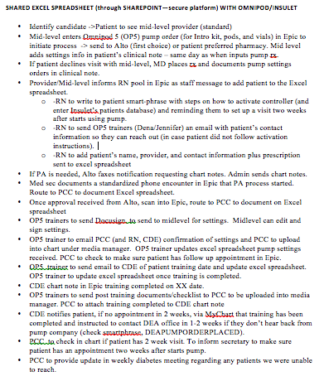
PDSA2
- Started July 2023
- Develop protocol for when patients start on Omnipod & Tandem insulin pumps
led by lead practice RN
Collaborate with leadership (directors, managers, coordinator), secretary, RD CDE, insulin pump reps/trainers
Standardize new insulin pump start process (or upgrades)
Identify each role involved and their responsibilities
Work with Epic IT
- ongoing revision

Slide 8
Next Steps/Future Directions
Ongoing: monitor and adjust data capture strategies, workflow
Improve documentation:
Why/when the pump ordered? Training or upgrade date?→ via EHR, Epic
Pump orders scanned in patient's chart (standardize process)
Improve process for rescheduling cancelled appointments
For now, tracking training date to post pump training/upgrade visit with provider→ track from pump order or pump upgrade order?
Improve signing orders to expedite order and training/upgrade process
Establish protocol: go- to- persons for staff and pump vendors (improve communication)
Establish better process for tracking software updates or upgrades
Reinforce among staff to update/mark diabetes device (s) on patient’s sticky note in Epic
RD CDE pump trainers?
Notes:
Continue tracking to improve process and ensure newly trained or upgraded pump patient is followed closely
- when placed on the list, where is the paper trail- what happened? or is happening to the pump ordering process

Slide 9
References
Lyons SK, Ebekozien O, Garrity A, Buckingham D, Odugbesan O, Thomas S, Rioles N, Gallagher K, Sonabend RY, Lorincz I, Alonso GT, Kamboj MK, Lee JM; T1D Exchange Quality Improvement Collaborative Study Group. Increasing Insulin Pump Use Among 12- to 26-Year-Olds With Type 1 Diabetes: Results From the T1D Exchange Quality Improvement Collaborative. Clin Diabetes. 2021 Jul;39(3):272-277.
Tanenbaum ML, Commissariat PV. Barriers and Facilitators to Diabetes Device Adoption for People with Type 1 Diabetes. Curr Diab Rep. 2022 Jul;22(7):291-299.
Berget C, Messer LH, Forlenza GP. A Clinical Overview of Insulin Pump Therapy for the Management of Diabetes: Past, Present, and Future of Intensive Therapy. Diabetes Spectr. 2019 Aug;32(3):194-204.
Nimri R, Nir J, Phillip M. Insulin Pump Therapy. American Journal of Therapeutics. 2020; 27 (1): e30-e41.

Slide 10
The authors would like to acknowledge and thank our medical secretaries, DEA RNs, midlevels, & DEA MDs for helping to collect data for this QI.

