Slide 1
Survey Based Analysis of T1DM Patient Training Experience with Omnipod 5 Pump
Kaveri Bhargava, BA, Marina Basina, MD
Stanford Adult Endocrinology Clinic
kaverib@stanford.edu

Slide 2
Introduction & Aim
Introduction:
Given the fairly recent FDA-approval of Omnipod 5 pump system (OP5), there is little information regarding its best pump training practices. We conducted a patient survey to evaluate educational needs, training satisfaction, and need for additional pump training sessions.
Aim:
To increase the proportion of adult patients (>18 years) who report initial training as “Sufficient/ Somewhat Sufficient” by 20%, from current baseline of 50% (from self-trained cohort), or 79% (from formally trained cohort), by implementing a follow-up training process by October 2024.

Slide 3
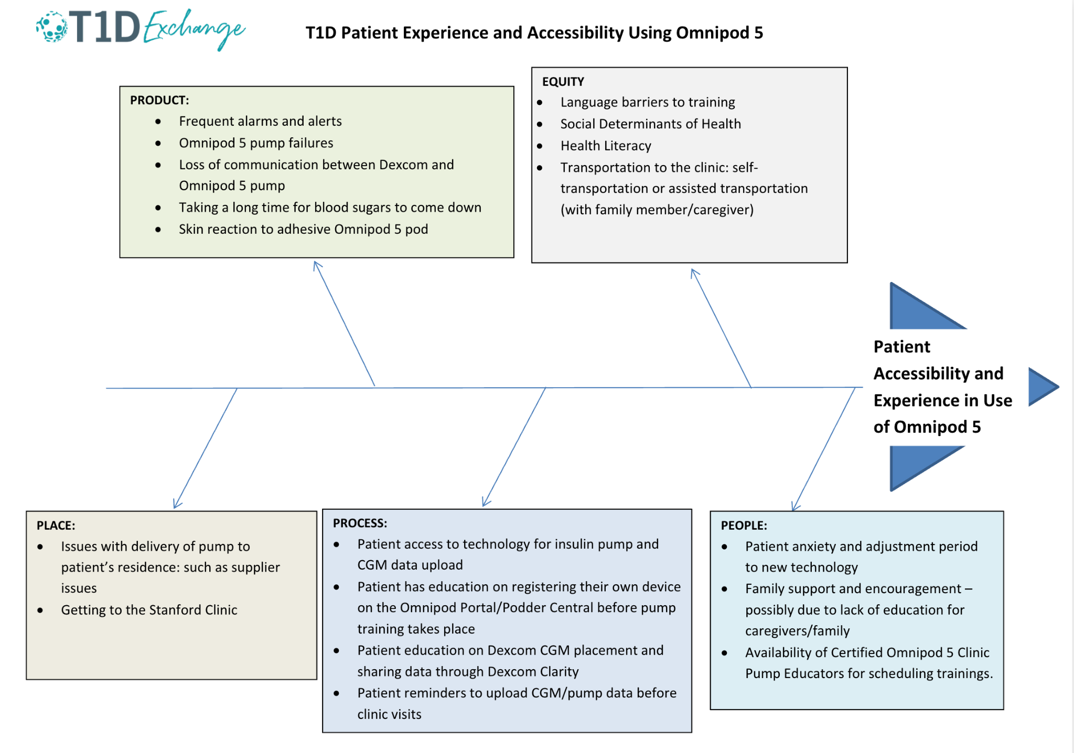
Fishbone Diagram

Slide 4
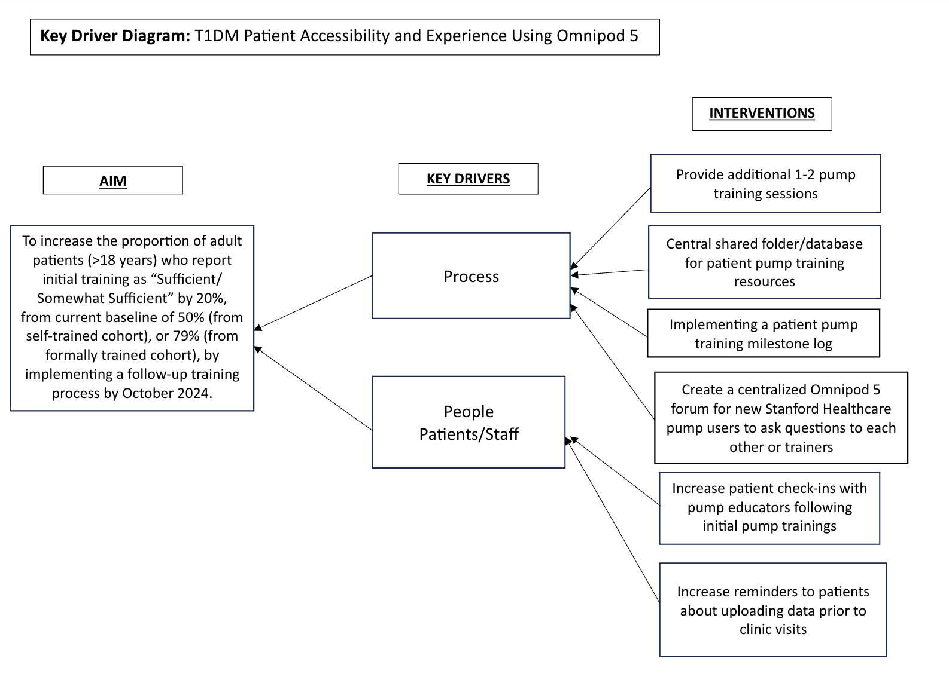
Key Driver Diagram

Slide 5
Methods and Results
Methods:
Following IRB approval, an online REDCap survey was sent via email to patients of an outpatient Endocrinology clinic. Patients over 18 years with Type 1 Diabetes who were prescribed Omnipod 5 were included. Formal in person or virtual pump training was offered and conducted by the same certified clinic pump trainer for those who opted for it.
Results:
Out of 181 invitations sent, 25 survey responses were received (13.8% response rate). Patients were analyzed in two groups: formally trained (FT) (15/25; 60%) and self-trained (ST) using online resources (10/25; 40%). Results shown in Table 1.

Slide 6
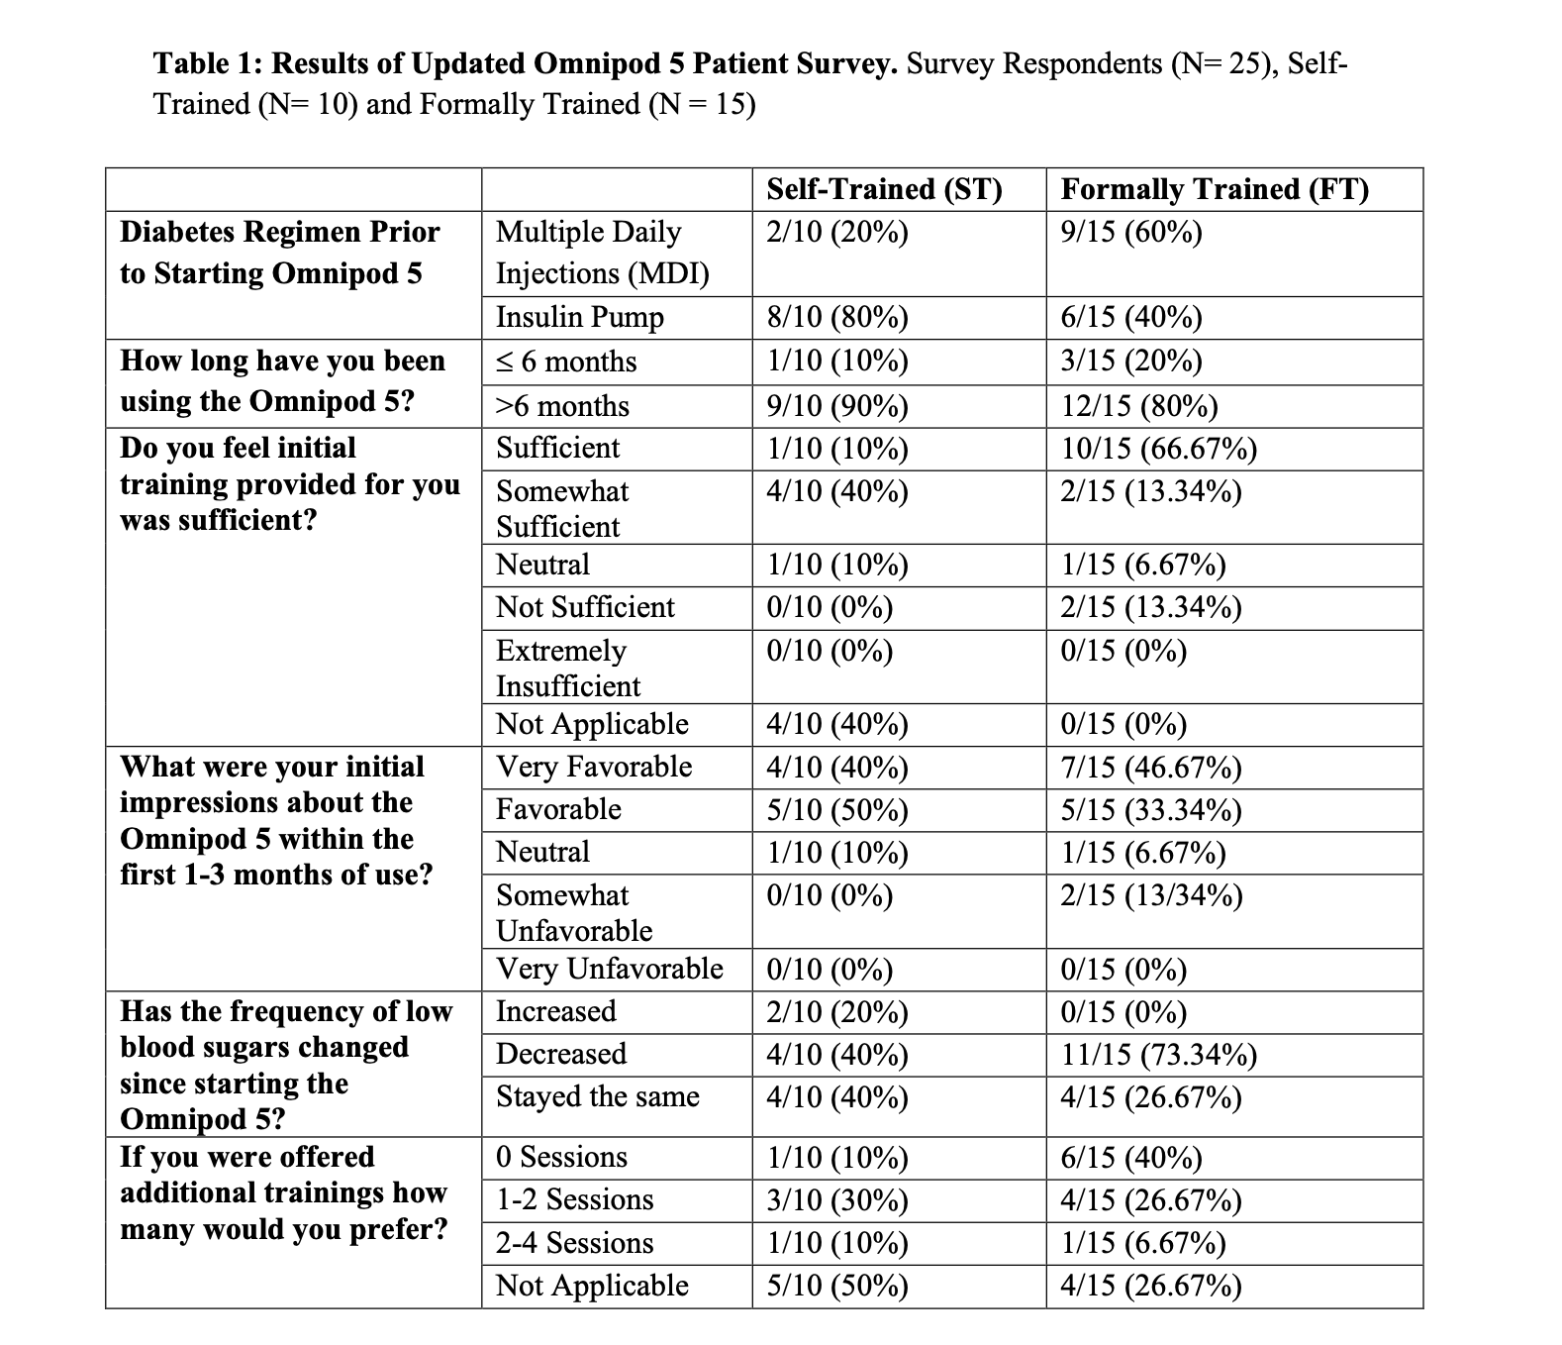
Preliminary Results

Slide 7
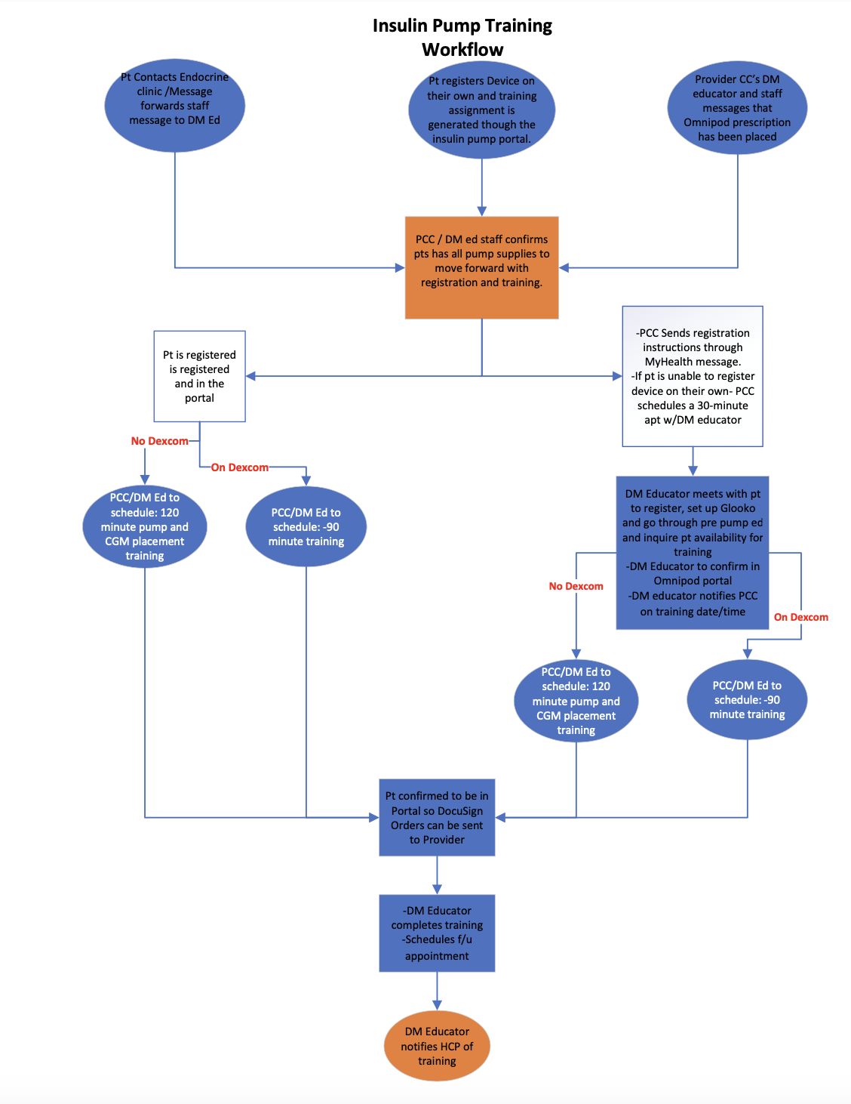
Formal Pump Training Process Map
Credits: Anna Simos and Jillian Ringrose, Diabetes Educators

Slide 8
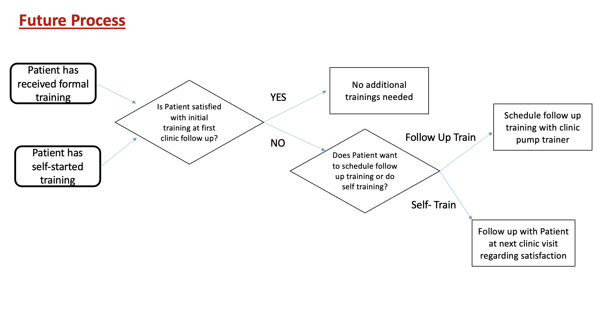
Proposed Intervention

Slide 9
Thank you for listening!

