Slide 1
T1D Technology Equity Project
Grady Memorial Hospital

Slide 2
CGM Access Process 1
Would CGM help patient?
Will patient accept CGM?
Patient have CGM coverage?
On insulin?
Info?
Give info on GoodRx- Libre 2/3 & out-of-pocket costs
Patient sees Provider in Diabetes Clinic
Y
Y
Y
N
N
NO
N
N
Y
Patient interested in CGM
Medicaid Traditional?
Y
N
No CGM prescribed
Follow up SBGM
Y
Who
when
N
Give info on GoodRx- Libre 2/3 & out-of-pocket costs
Who
when
Prescribe/Initiate Prior Authorization
Info?
Info?
Who
when
Determine appropriate DME provider. Initiate application on Parachute until Epic integration
Pharmacy benefit?
N
Y
CDE provides education
No CGM access. Follow up SBGM
Who
when
Who
when
Follow-up with parachute application, make changes as requested
Appeal denied?
Will patient self pay?
Y
Check status of Prior Authorization. Appeal PRN
Y
N
Will patient self pay?
N
Who
when
Provide Prescription CDCES/Nurse provides education
Provide Prescription CDE provides education
Y
Confirm CGM delivered or picked up, comfortable with application
N
No CGM prescribed.
Follow up SBGM
Pain points
No CGM prescribed.
Follow up SBGM
Who
when
Info?
Are data available in clinic?
Determine clinic process 2

Slide 3
Grady KDD
Primary Drivers
Change Ideas
Aim
CGM Classes
Patient education on device use
Peer support groups, technology literacy
Health Literacy/ Education and Support
Among people with T1D,* increase percentage of patients actively using CGM (measuring actual usage vs prescriptions)
Use flow sheets built for capturing data of active CGM use
Use of Data
Culturally Competent Care (offering education/materials in appropriate languages, use of images vs text, etc.)
Social Determinant of Health
Test new workflows to improve device use/device documentation
Device data reviews, staff troubleshoot device
Advertise CGM in waiting rooms, etc.
Provide contact information for device reps/patient support
Device use
Using Parachute for orders and order follow up
Access to Device
*Duration > 1 year, ages 18-75, with at least one in-person or telemedicine visit in the last year

Slide 4
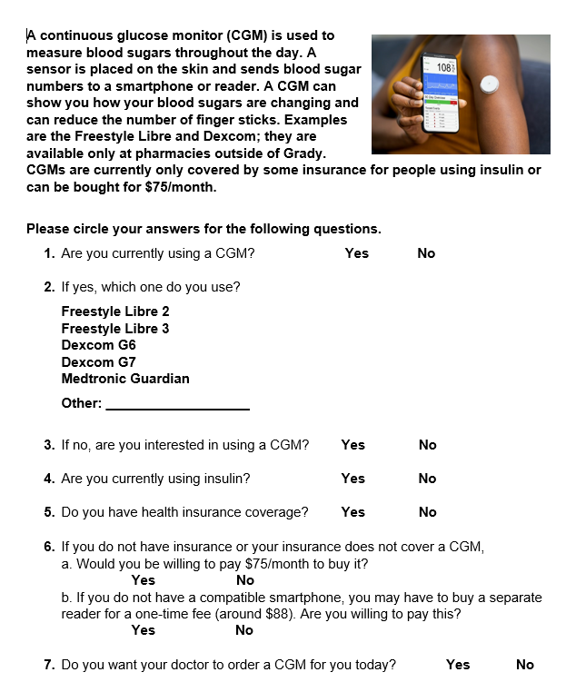
Access and CGM Coverage PDSA 1
Intervention: screening questionnaire
Plan: To implement a patient survey on CGM to improve discussion with providers and reduce bias in offering CGM therapy (in regular clinic not GOC)
Survey developed and implemented over 3-month period
Survey reviewed during visit with provider
We predict an increase in CGM therapy and related increase in CGM prescriptions
Do: screener (see image to right)
Study: 6/1-9/8/2023
4 surveys completed
4 not currently on CGM but want one
3/4 with health insurance
3/4 willing to purchase out of pocket including the 1 without health insurance
All 4 had prescriptions placed for CGM that day by MD. Lots of questions on how to properly place orders
0 out of 4 on CGM by end of this cycle
Act: Issues with provider knowledge of how to properly order CGM therapy. Chart review showed prescriptions were sent for patients when DME was actually supposed to be use. Screening tool also updated. (See PDSA 3)
Notes:
Ended up fixing how the CGMs were prescribed to get these patients on CGM with appropriate coverage

Slide 5
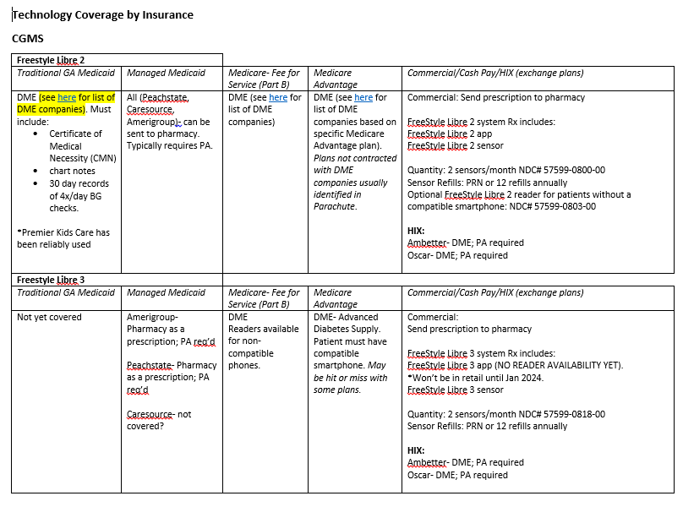
Access and CGM Coverage PDSA 2
Intervention: CGM Mapping Tool for Providers
Plan: To create a resource for providers within the GHS clinics to determine pathway for technology prescriptions (DME vs. Pharmacy)
Resource file created for commonly-encountered insurance plans
Made available to faculty to have in exam room
We predict an increase in CGM therapy and related increase in CGM prescriptions
Do: CGM Mapping Tool (see image to right)
Study: 9/8/2023-current
No current data in QI portal to track increase in prescriptions, but increased numbers of patients in libreview and clarity patient list during this time. Working on gathering this data
Act: Faculty feeling more comfortable with prescribing CGM, but need to train other staff who are responsible for entering prescriptions. Well help streamline follow up on who is receiving technology and allow all staff to start orders through parachute (see PDSA 4)
*Also have section for Dexcom
Notes:
Ended up fixing how the CGMs were prescribed to get these patients on CGM with appropriate coverage

Slide 6
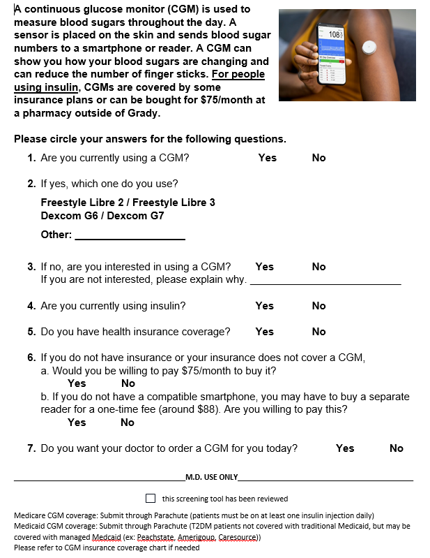
Access and CGM Coverage PDSA 3
Intervention: screening questionnaire- updated
Plan: To implement a patient survey on CGM to improve discussion with providers and reduce bias in offering CGM therapy
Added why patients not interested in CGM
Added signature line to ensure MD reviewed screening tool
Added brief coverage overview
We predict an increase in CGM therapy and related increase in CGM prescriptions
Do: screener (see image to right)
Study: Plan to start Jan 2023 after this has been reviewed by larger team to implement
Act:

Slide 7
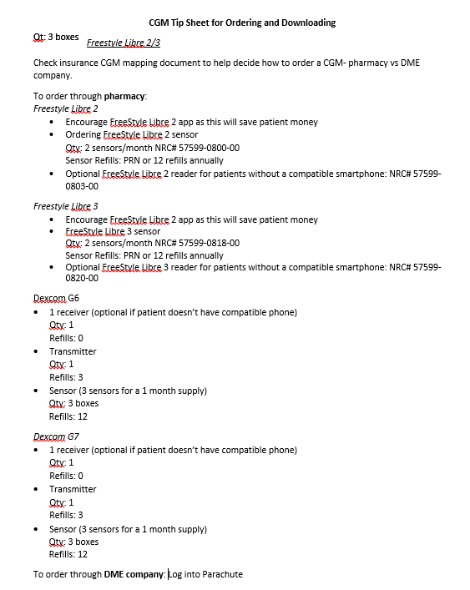
Access and CGM Coverage PDSA 4
Intervention: Staff training on prescribing CGMs. Tip sheet
Plan: To create a resource for staff (nurses, pharm tech, CDCES) within the diabetes center to determine pathway for technology prescriptions (DME vs. Pharmacy)
We predict an increase in CGM therapy and related increase in CGM prescriptions
Do: Prescribing CGM Tipsheet in service for staff (see image to right)
Study: In service scheduled tentatively for 12/12
Act:

Slide 8
Parallel Projects in Place as of 12/01/2023
Working with IT team to get technology flowsheets and smart text in place for efficiency of data capturing through Epic
Re-organization of clinic templates to allow for provider vs education visits. Also to make room for T1D group classes so we can indirectly also have a kind of support group for this population.
CGM patient education via group classes- standardized curriculum being developed

Slide 9
Grady KDD
Primary Drivers
Change Ideas
Aim
CGM Classes
Patient education on device use
Peer support groups, technology literacy
Health Literacy/ Education and Support
Among people with T1D,* increase percentage of patients actively using CGM (measuring actual usage vs prescriptions)
Use flow sheets built for capturing data of active CGM use
Use of Data
Culturally Competent Care (offering education/materials in appropriate languages, use of images vs text, etc.)
Social Determinant of Health
Test new workflows to improve device use/device documentation
Device data reviews, staff troubleshoot device
Advertise CGM in waiting rooms, etc.
Provide contact information for device reps/patient support
Device use
Using Parachute for orders and order follow up
Access to Device
*Duration > 1 year, ages 18-75, with at least one in-person or telemedicine visit in the last year

Slide 10
Health Literacy/Education and Support PDSA 1
Intervention: Schedule patient for more CGM education using existing template
Plan: Use existing GOC template to schedule CDCES classes vs. individualized CGM education appointments
We predict an increase in attendance of CDE-led classes with same-day scheduling as available clinic appointments, as well as increased CDE availability.
Do:
1. Identify patients within the GOC clinic using CGM scheduled for follow up in the next 1-2 months
2. CDCES outreach to schedule identified patients for class sessions on same day as this next appointment (avoids additional appointment)
Study:
1. Low rates of class attendance despite same-day clinic appointments
2. Many patients declined option for CGM education in group class setting
3. Competing scheduling for clinic visits and urgent needs
4. Unanticipated patient conflicts for extended appointments
5. Concern for low interest in group education setting vs. need to change curriculum content
6. Need for clinic template changes overall (unexpected)
Act: Modification of clinic template to cap number of provider visits and create dedicated CDE appointment slots.

Slide 11
Health Literacy/Education and Support PDSA 2
Intervention: Create clinic template for scheduling of CGM education classes instead of individual appointments (process gap)
Plan: Work with QI team and clinic practice manager to come up with template changes that allow for provider and education visits for the Glycemic Optimization Clinic. Right now there is only one template which doesn’t differentiate who is attending for provider visit vs education.
We predict an improvement in clinic workflow, efficient use of CDCES availability for appointments and continuity of CGM use by patients through increased appointment availability for patient education.
Do: Proposed a template that would work for the internal team to the practice manager for approval. Practice manager approved and adjusted template in Epic allowing for proper patient scheduling.
Study: Able to schedule patients for education vs provider visit which helped in dilineation of responsibilities for provider staff. Able to carve out time for the educators to teach a class
Act: Create a more standardized curriculum to make it more manageable to teach in a class setting so we are not overwhelmed with getting into everyone's specific questions related to their AGP report. Use case studies instead to keep a bit more generalized. Will work on creating a powerpoint to streamline the information being taught

Slide 12
Health Literacy/Education and Support PDSA 3
Intervention: Provide structured education on using and interpreting CGM data
Plan: By providing CGM education using Libre and Dexcom patient resource handbook, patients will be able to use their CGM data to better understand how to make decisions related to diabetes management. We predict an increase in TIR and decrease TAR and TBR in patients using CGM going through a CGM class
We predict patients will have a better understanding of the metrics used to monitor time in range and how to increase this metric in between provider visits
Do: 1 participant
1. CGM curriculum created with help of preventative medicine resident
2. All objectives with specific talking points recorded so that any HCP can deliver the content
3. Curriculum was taught to one patient who showed for the class. Went through talking points. Discussion was very individualized as we used patient specific AGP report to assess patterns and address challenges and solutions
Study: TIR increased, TAR decreased 2 weeks post education, but TBR increased (Compared AGP reports before taking the class and two weeks after taking the class
Act: Create a more standardized curriculum to make it more manageable to teach in a class setting so we are not overwhelmed with getting into everyone's specific questions related to their AGP report. Use case studies instead to keep a bit more generalized. Will work on creating a powerpoint to streamline the information being taught

Slide 13
Health Literacy/Education and Support PDSA 4
Intervention: Provide structured education on using and interpreting CGM data
Plan: By providing CGM education using Libre and Dexcom patient resource handbook, patients will be able to use their CGM data to better understand how to make decisions related to diabetes management. We predict an increase in TIR and decrease TAR and TBR in patients using CGM going through a CGM class
We predict patients will have a better understanding of the metrics used to monitor time in range and how to increase this metric in between provider visits
Do: 2 participants
1. Reviewed priorities and objectives of class with the QI team.
2. Refined curriculum to make it more applicable to the scenarios our patients experience. Created a more standardized way of teaching by creating powerpoint with slides.
3. Clarity of projection of slides not great, but patients very interactive during the review of scenarios
4. Post feedback from patients was very positive with one patient saying they wish they had this education earlier
Study:
Act: Plan to enhance powerpoint to make it more visually pleasing (use less words and more pictures) and to present the information in a simpler way. Reviewed content with PharmD, CDCES for feedback on messaging when reviewing the different scenarios with patients about all the possible decisions one can make based on CGM data.

Slide 14
Health Literacy/Education and Support PDSA 5
Intervention: Provide structured education on using and interpreting CGM data
Plan: By providing CGM education using Libre and Dexcom patient resource handbook, patients will be able to use their CGM data to better understand how to make decisions related to diabetes management. We predict an increase in TIR and decrease TAR and TBR in patients using CGM going through a CGM class. We predict patients will have a better understanding of the metrics used to monitor time in range and how to increase this metric in between provider visits
Do: 3 participants
Reviewed priorities and objectives of class with the QI team.
Refined design of powerpoint to include more animations and pictures and less words. We also used process diagrams to review the different approaches to scenarios for better understanding
Clarity of text through projector was still not great, but patients very interactive during the review of scenarios. Some text was not showing through even though it was on the actual powerpoint on the computer.
Post feedback from patients was very positive saying it was helpful to review scenarios and have a better understanding of goals.
Study: TIR increased, TAR decreased 2 weeks post education, but TBR increased (Compared AGP reports before taking the class and two weeks after taking the class
Act: Figure out how to get more clarity with the projector we have and how to get all the text to show when projected. Will try to use USB with projector to see if this helps with projection quality.

