Slide 1
March 12, 2024
T1DX-QI Equity Expansion
U-M Pediatric Diabetes CGM & Smart Pen Projects
Ashley Garrity, MPH, Joyce Lee, MD, MPH, Jackie Fisher, MD, Inas Thomas, MD

Slide 2
U-M Pediatric Diabetes
C.S. Mott Children’s Hospital, University of Michigan
Multidisciplinary Team (FTEs) | Patient Volume & Demographics | Contacts
12 (3.0 cFTE) endocrinologists* 3 (1.5 cFTE) fellows 2.0 dietitians 4.6 RNs (2.6 w/CDCES) 1.5 social workers 1.0 psychologist *Devoted to T1D patient care | Main clinic at academic medical center + 1 satellite clinic 100-150 new onsets annually ~1300 established T1D patients 30% publicly insured | Site PI Joyce Lee, MD, MPH joyclee@med.umich.edu Site Coordinator Ashley Garrity, MPH ashleyna@med.umich.edu
Notes:
Updated March 2024

Slide 3
Baseline Data (January 2023)
Patients with T1D who had a CGM: 81%
Among all patients with CGM, percentage who used it ≥70% of the time in the past 2 weeks: 87.7%
Subset of non-White patients with T1D who had a CGM: 71%
Among non-White patients with CGM, percentage who used it ≥70% of the time: 82.7%
Notes:
~20% of our patient population is non-White which includes Hispanic, Multiracial, NH-Black, and Other (e.g., Asian, American Indian, Pacific Islander).

Slide 4
Aims
To:
1. increase the proportion of all patients with T1D who have a CGM by 5% (goal: 86.3%)
2. increase the proportion of all patients with T1D who use CGM ≥70% of the time by 5% (93.7%)
3. close the gap in CGM adoption and use between White and non-White patients with T1D
by December 31, 2023.

Slide 5
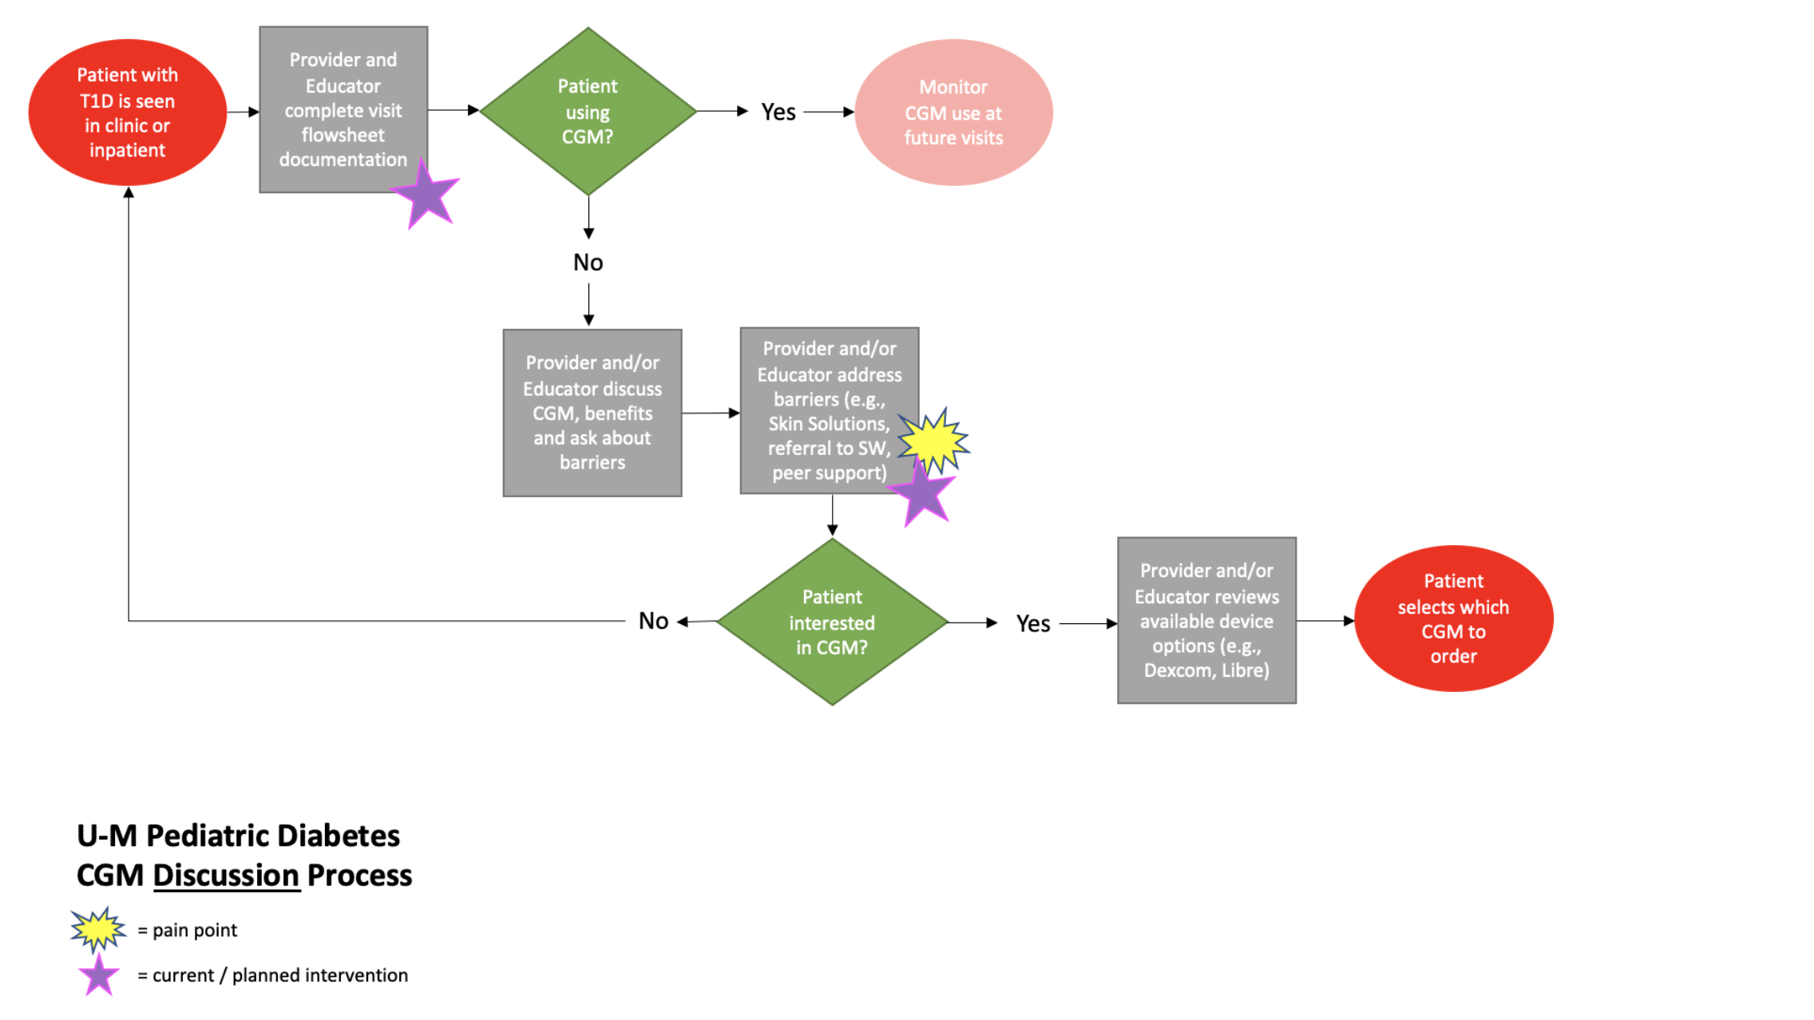

Slide 6
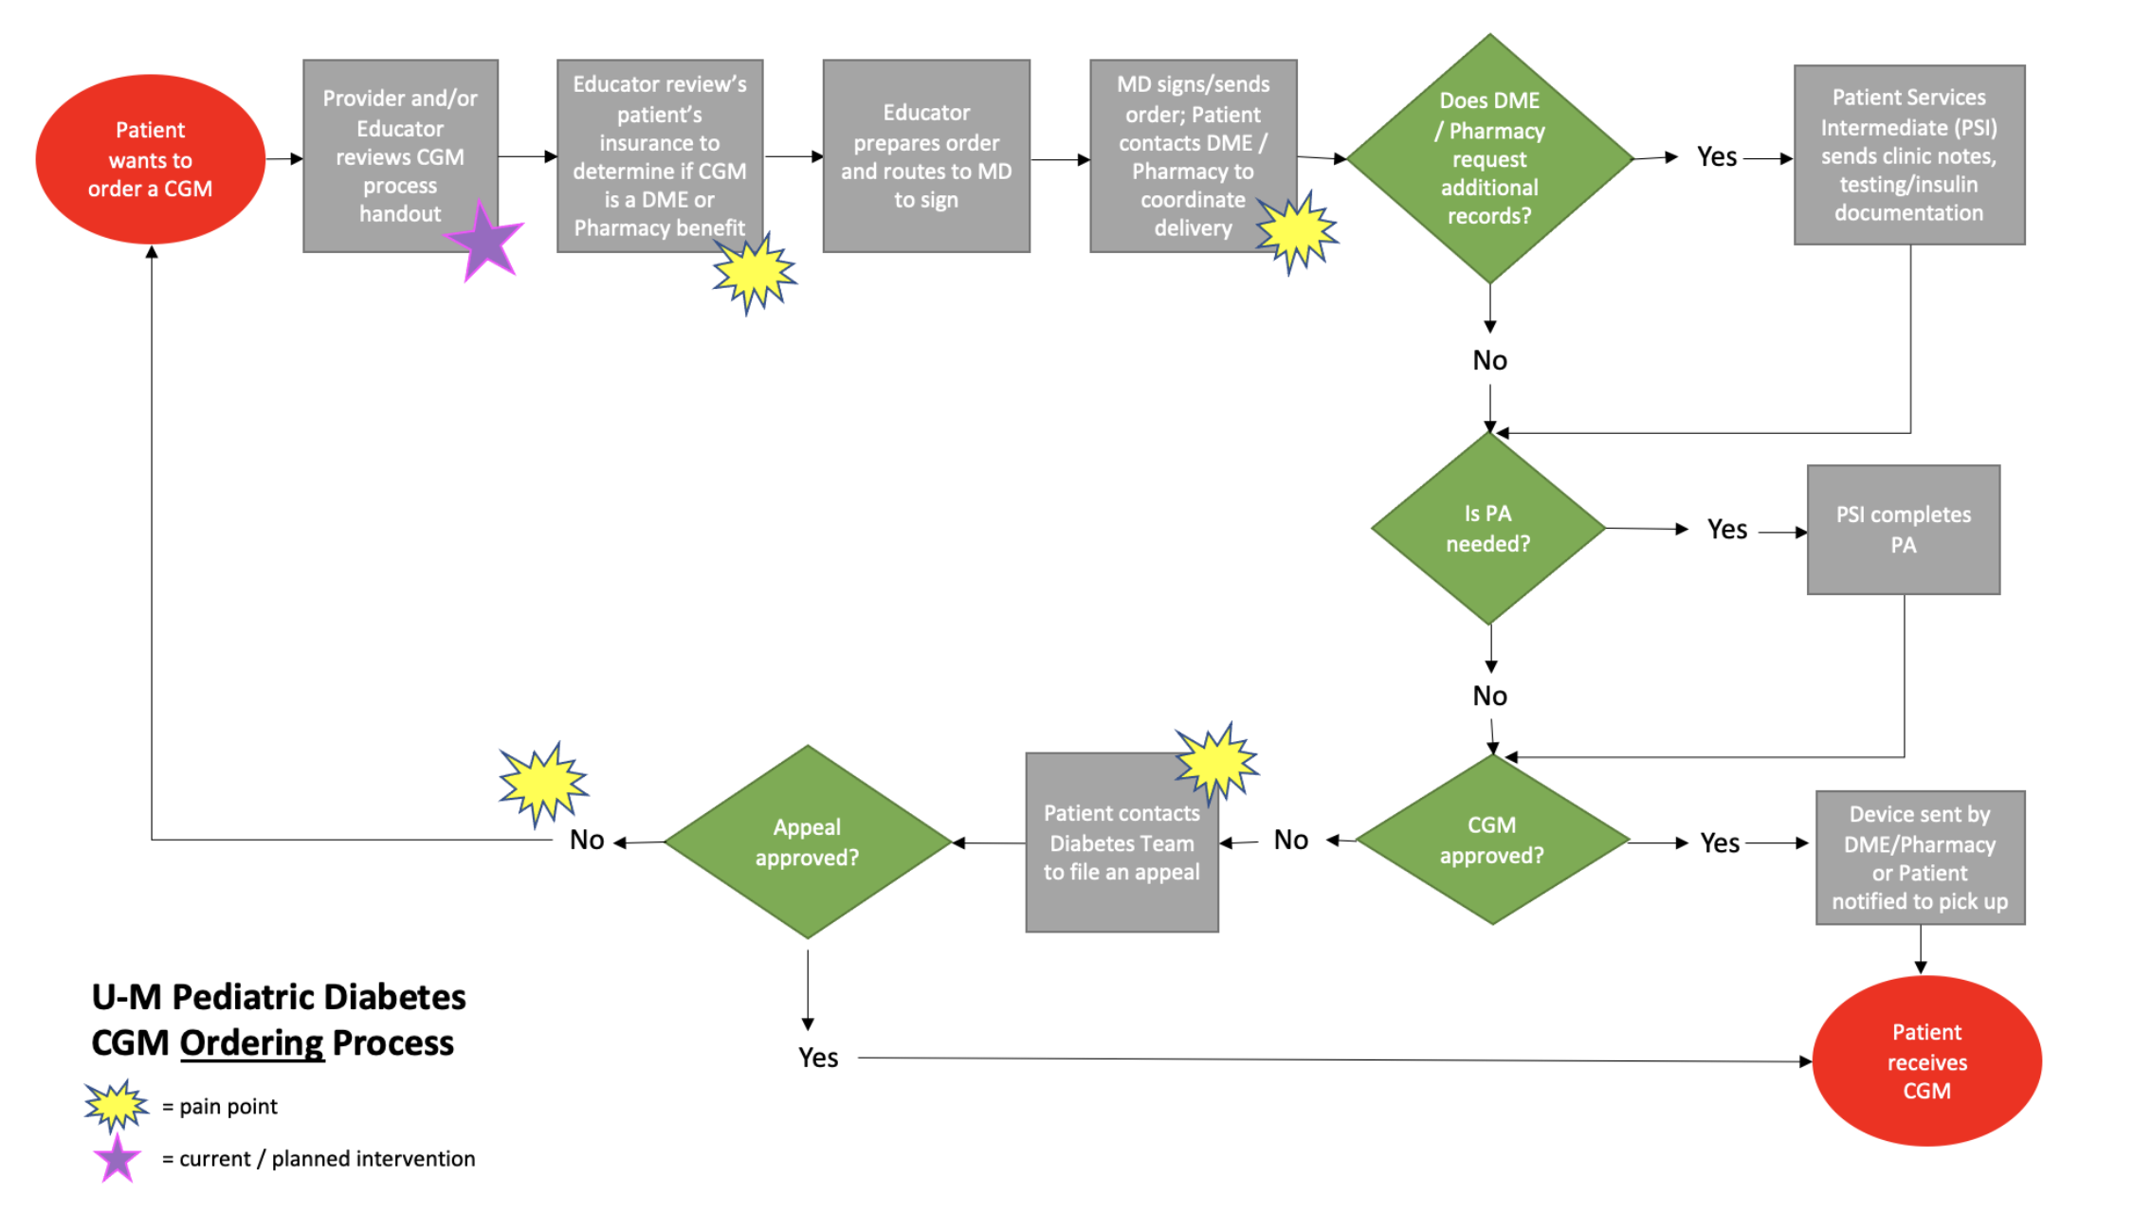

Slide 9
PDSA #1: Flowsheet Revisions
Plan: Using Lurie Children’s flowsheet as an example, revise flowsheet to standardize discussions about CGM, capture CGM adoption and use at point-of-care, and address barriers.
Do: QI Team to collaboratively discuss and decide on flowsheet items (Nov 2022); Joyce to build (Dec 2022 – Jan 2023).
Study: Updated flowsheet items went live 2/8/2023; Revised items allow use to better understand which patients do/do not have CGM and which patients are/are not using CGM ≥70% of them, plus collecting information about barriers helps us know how we might best intervene.
Top barriers: Resistance to wearing device, insurance coverage, and technology issues
Act: Adopt

Slide 10
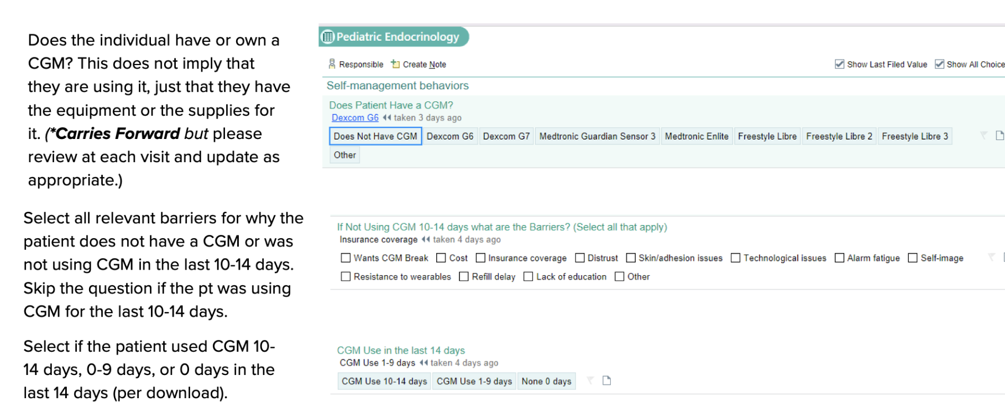
Notes:
Also made similar updates to pump use and barriers flowsheet items.

Slide 11
PDSA #2: Change Data Downloads to Ensure BG Logs on File for CGM Orders
Plan: At intake, if patient is only using a glucometer, MAs will download 30 days of data (instead of 14) to ensure adequate BG logs are on file if patient opts to proceed with CGM order at visit.
Do: MAs to test with next 5 patients using only glucometer, beginning 4/6/2023.
Study: MAs successfully switched from downloading 14 days of meter day to 30 days; First patient ordered CGM at same visit (previously used Dexcom but discontinued due to discomforted and opted to try Libre). Michigan Medicaid revised CGM policy (effective 6/1/2023), no longer requiring BG log documentation for CGM order approval (team was involved in advocacy efforts), but some private insurance plans may still require documentation.
Act: Adopt

Slide 12
PDSA #3: Share Resources & Reminder via Newsletter
Plan: Share resources for patients/families getting started with CGM or new type of device and reminder: “As always, whether you are a new or experienced CGM user, please don't hesitate to contact your U-M Pediatric Diabetes care team with any diabetes device questions.”
Do: Ashley to share information and links to ‘Getting Started’ videos in August 2023 newsletter (sent 8/18/2023)
Study: 6 parents clicked links to Dexcom ’Getting Started’ videos
Act: Adopt

Slide 13
PDSA #4: Discuss CGM During Basic Education Class
Plan: Add CGM slide to Basic Education class regarding all types of CGM and let patients know that if they need assistance with putting on CGM, it’s okay to bring to basic class
Do: Iris & Christina to add slide for teaching; Kelly to tell patients about bringing CGM to Basic Education, if needed, at discharge
Study: Find that most patients who order CGM at diagnosis are already using CGM by the time they attend Basic Ed
Act: Adapt; Still helpful to promote CGM use during Basic Ed for patients/families who weren’t ready to order during admission

Slide 14
PDSA #5: Inpatient CGM Onboarding
Plan: Onboard patient/family to Dexcom apps (G6/G7, Clarity, Follow) including helping set up account and connect to clinic for sharing
Do: Kelly to test with next new onset patient/family who orders a Dexcom prior to discharge
Study: Tested with 1 patient in October 2023 who ordered a Dexcom G6 while inpatient; Successfully helped patient/family install apps and create account; Kelly also notified diabetes educators who sent a sharing invitation
Act: Adopt* (will tailor offering based on patient/family readiness)

Slide 15
PDSA #6: Targeted Outreach
Plan: Notify educator/physician teams of upcoming scheduled patients on insulin who do not have CGM and remind them to discuss CGM during clinic visit
Do: Ashley to prepare lists of patients, by provider, for Dr. Fisher & Dr. Sandberg
Study: Only 9 patients on insulin not using CGM; Of those, only 2 with RVs scheduled (April & May); Both patients have had CGM ordered previously, but have had issues with insurance
Of the remaining 7 patients:
- 3 scheduled for transition visit with adult clinic → 2 of which have tried to get CGM in
past but haven’t been able to due to lack of follow-up + other barriers
- 3 others have all faced insurance coverage barriers
Act: TBD

Slide 16
Baseline Data (January 2023)
Patients with T1D who had a CGM: 81%
Subset of non-White patients with T1D who had a CGM: 71%

Slide 17
Follow-Up Data (January 2024)
All patients with T1D who had a CGM: 81% → 96%
Subset of non-White patients with T1D who had a CGM: 71% → 71%
Notes:
Reached overall goal, but significant racial/ethnic disparity still exists.
Plan to review barriers to CGM adoption endorsed specifically by non-White patients to gain insight into potential areas of opportunity.

Slide 18
Other Ideas

Slide 19
Increasing Smart Pen Use
InPen Orders (2020-present)
January 2024: Released updated handout for glucose monitoring and insulin delivery options
https://www.umpedsdiabetes.com/forms-handouts (Comparing Diabetes Devices)
Added NovoPen 6 and NovoPen Echo Plus; CDCESs working on getting these options added to EMR for ordering

