Slide 1
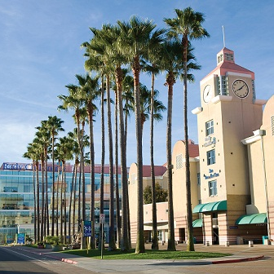
Supporting Type 1 Diabetes Health Equity through QI Initiatives at Rady Children’s Hospital
Carla Demeterco-Berggren M.D., Ph.D.
Director of Quality, Diabetes Clinic, RCHSD
Clinical Professor of Pediatrics,
University of California, San Diego
March 1st, 2024

Slide 2
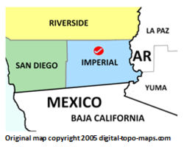
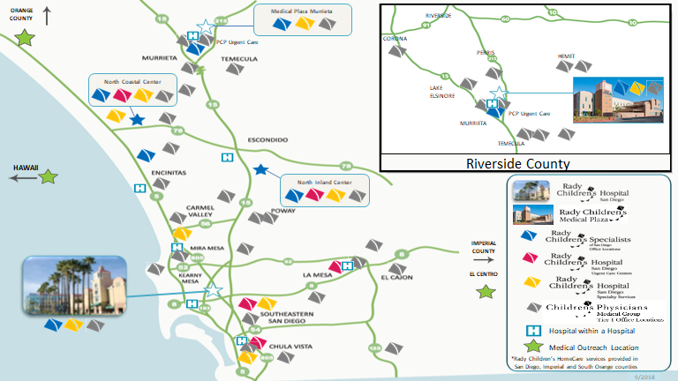
Catchment Area
Rady Children’s Hospital
505-bed nonprofit pediatric care facility
Largest children’s hospital in CA (admissions)
Provides care to 91% of the region’s children
Teaching hospital in affiliation with UCSD
1500 unique patients with T1D
200 TID new onsets / year
4500 Outpatient T1D Visits/year

Slide 3
RCHSD T1D Patients median A1C Public x Private Insurance
Median A1C
Age Group

Slide 4
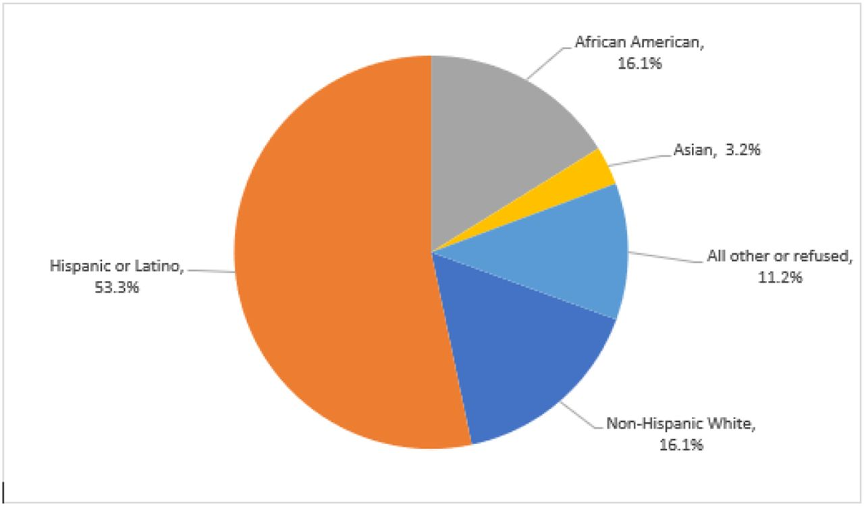
Race and Ethnicity Breakdown
San Diego County, CA
RCHSD Public insured T1D patients
Other
7%
Asian
12%
Non-Hispanic Black
16.1%
Non-Hispanic Black
5%
Non-Hispanic White
43%
Hispanic or Latino
33%
United States Census Bureau, 2019
Keri L. Carstairs et al. Pediatrics 2021;147:641-642
Notes:
California Kid’s Care Race and Ethnicity Breakdown Ages 0 – 18 years: Given the complex nature of these conditions and the health disparities seen in Medicaid populations combined with inequities traditionally seen in the Hispanic and African American populations, CKC offered innovative care navigation and better assess for clinical teams to monitor and meet patients’ needs to close care gaps and improve overall health outcomes.

Slide 5
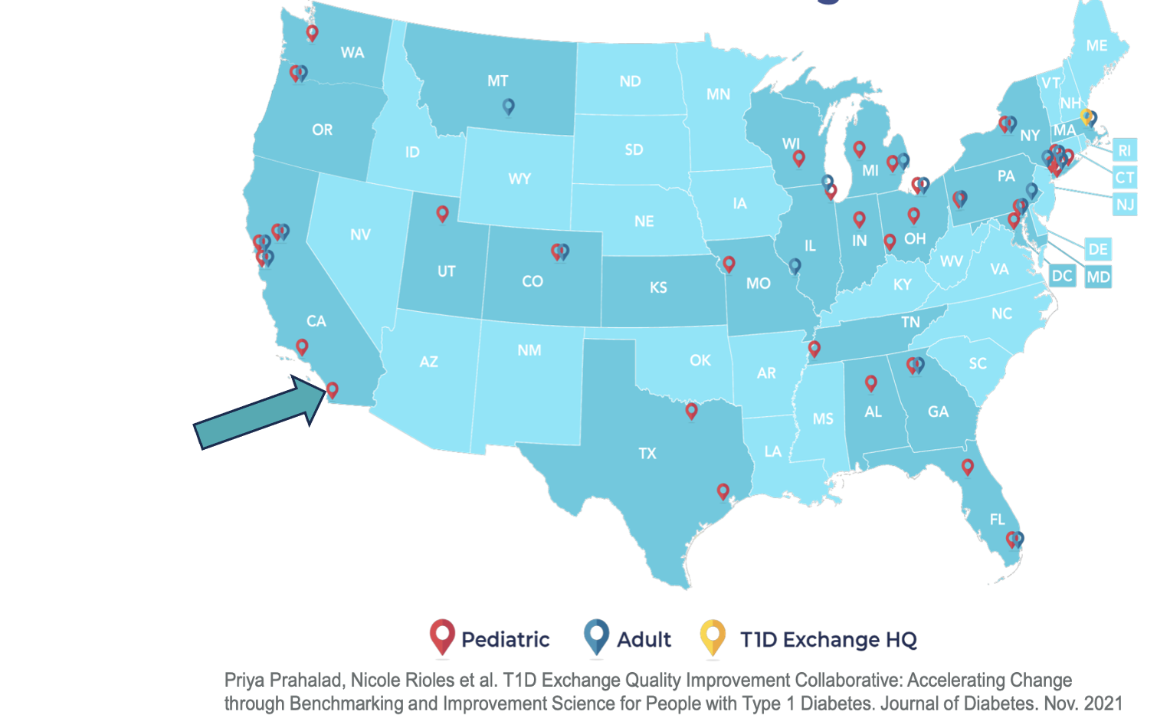
RCHSD Diabetes Clinic QI Team Projects since joining T1DX Collaborative 2020
Increase CGM use among public insured patients ✓ 2020
Inpatient EHR Home-Use Blood Glucose Meter Data Documentation ✓ 2020
Decrease the percentage of public insured T1D patients with AIC>8% ✓ 2021
Increase the frequency of Diabetes Clinic visits in public insured patients ✓2022
Increase the percentage of patients who completed the food insecurity screening and were provided with community resources ✓ 2023
Increase Insulin pump use among public insured patients ✓ 2023
Increase the percentage of patients with known T1D with a DKA post-discharge education visit within 4 weeks 2024
Decrease the rate of DKA readmission in patients with T1D 2024
Increase the percentage of patients with T1D with completed urine micro albumin screening 2024
Increase the percentage of patients with T2D with completed lipid screening 2024
Increase utilization of GLOOKO platform to optimize diabetes technology integration with EHR (ongoing)
Inpatient EHR CGM Data Documentation (ongoing)

Slide 6
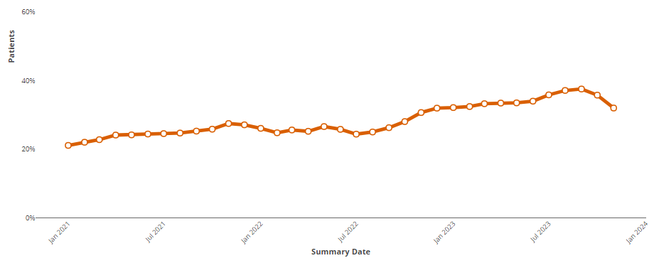
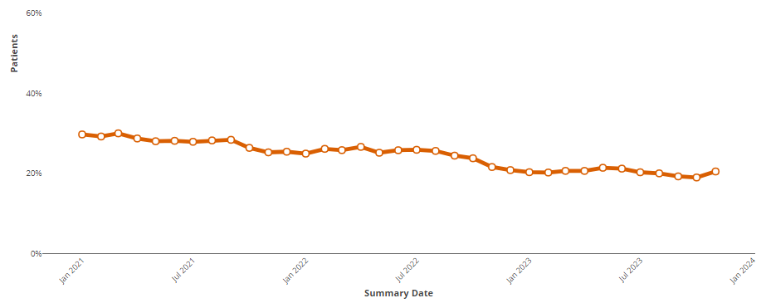
RCHSD Percentage of T1D patients with A1C ⩽7%
(January 2021- 2024)
RCHSD Percentage of T1D patients with A1C ⩾9 %
(January 2021- 2024)
Desired
Direction
29%
29.7%
21.1%
Desired
Direction
22.2%

Slide 7
Percentage of T1D patients with A1C ⩽ 7% by Race/Ethnicity (January 2021- 2024)
n=557
n=51
n=566
39%
25%
12%
All Minority Group includes: (1) American Indian or Alaska Native, (2) Non-Hispanic Black, (3) Hispanic or Latino/Latina/Latinx, (4) Multiracial Hispanic, (5) Multiracial, Non-Hispanic, (6) Patient's Race and Ethnicity Not Listed Here, and (7) Native Hawaiian or Other Pacific Islander patients.

Slide 8
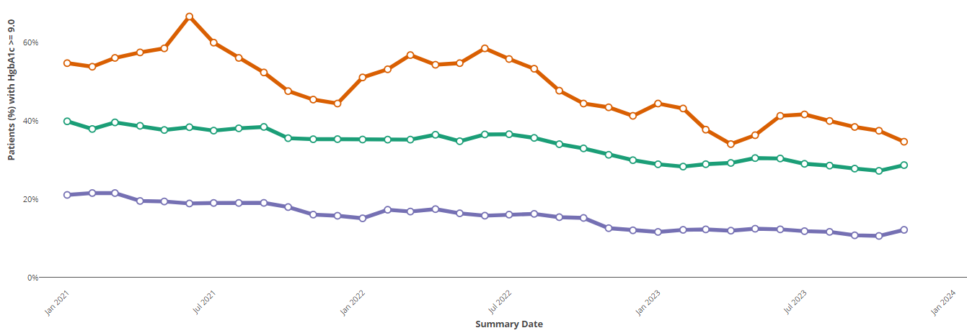
Percentage of T1D patients with A1C ⩾ 9% by Race/Ethnicity (January 2021- 2024)
n=557
n=51
n=566
39%
29%
12%
All Minority Groups includes: (1) American Indian or Alaska Native, (2) Black or African American, (3) Hispanic or Latino/Latina/Latinx, (4) Multiracial Hispanic, (5) Multiracial, Non-Hispanic, (6) Patient's Race and Ethnicity Not Listed Here, and (7) Native Hawaiian or Other Pacific Islander patients.
Notes:
4.5%

Slide 9
Project Charter – Diabetes Health Equity Initiative
Sheet Last Updated on | 1/9/2024
Project Details
Department(s) | Endocrinology
Strategic Alignment | Innovation, Quality
Project Duration | 11/9/2023– 12/31/2025
Team Meeting Frequency | To be determined
Project Sharing Platforms | Health Disparities and SDOH Steering Committee; JQJC
Baseline Data
25% of patients in target group (n=557) have an hbA1c ⩽ 7%, compared to 39% of White and Asian patients (n=566). 29% of patients in target group (n=557) have an hbA1c ⩾ 9%, compared to 12% of White and Asian patients (n=566).
Project Team
Project Champion(s) | Carla Demeterco-Berggren, MD PhD
Executive Sponsor(s) | Charlie Davis, MD; Gail Knight, MD
Project Support | Chelsea Carter; Kendall Sanderson; Vanessa Lopez, Wilfrid Houeto
Data Support | Jacob Parker
Project Team Members | Project team currently being assembled; project team will include Diabetes Quality Improvement Team & Population Health Care Navigators, Diabetes Clinic Case Management ,ECM, Inpatient Nurse Champion
Global Aim (Optional)
Improve glycemic levels and reduce health inequities in children and adolescents with Type 1 Diabetes
SMART Aim(s)
By December 31st, 2025: Increase the percentage of patients in target group with an hbA1c ⩽7% by 1% (from 25% to 26%). Decrease the percentage of patients in target group with an hbA1c ⩾9 % by 1% (from 29% to 28%).
Project Background
At RCHSD, we have implemented multiple projects over the past 3 years to improve Type 1 Diabetes (T1D) outcomes and decrease disparities. Despite the improvement in hbA1c levels for all people with T1D, there is still a gap in HbA1c by race/ethnicity. These findings align with previous work in the US. This initiative is focused on improving hbA1c outcomes for (1) American Indian or Alaska Native, (2) Black or African American, (3) Hispanic or Latino/Latina/Latinx, (4) Multiracial Hispanic, (5) Multiracial, Non-Hispanic, (6) Patient's Race and Ethnicity Not Listed Here, and (7) Native Hawaiian or Other Pacific Islander patients.
Notes:
Strategic Alignment Options: Innovation, Quality, Community,

Slide 10
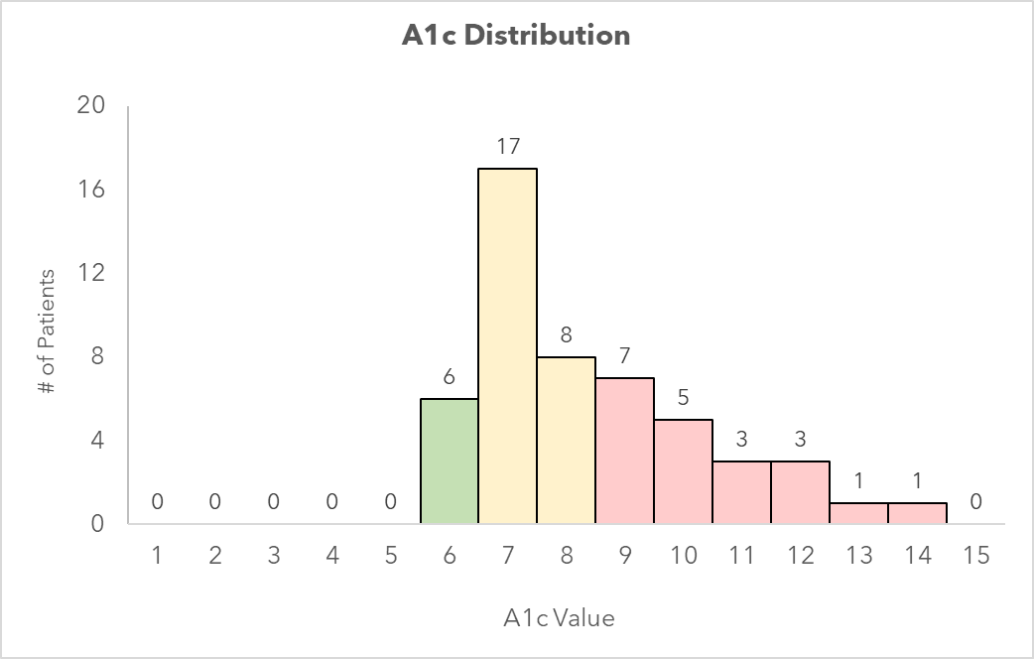
Non-Hispanic Black patients with Type 1 Diabetes
A1C Distribution (n = 51)
12% of patients had an hbA1c value of <7 (6/51).
49% of patients had an hbA1c value between 7 and 9 (25/51).
39% of patients had an hbA1c value between >9 (20/51).
Notes:
Data Last Updated: 2/6/24
4.5%

Slide 11
Non-Hispanic Black patients with Type 1 Diabetes
Demographics (n = 51)
Characteristic | Patients with A1c <7% (n = 6) | Patients With A1c 7-9% (n = 25) | Patients With A1c >9% (n = 20)
Age, years | 14.8 ± 3.8 | 12.45 ± 4.3 | 15.04 ± 3.8
Age Group, years 0-5 6-12 13-18 | 0 (0%) 2 (33%) 4 (67%) | 2 (8%) 10 (40%) 13 (52%) | 2 (10%) 3 (15%) 15 (75%)
Duration of Diagnosis, years | 5.6 ± 3.8 | 4.6 ± 3.2 | 5.9 ± 3.1
Sex Assigned At Birth Female Male | 1 (17%) 5 (83%) | 13 (52%) 12 (48%) | 12 (60%) 8 (40%)
Financial Class Commercial Medi-Care Tricare | 3 (50%) 3 (50%) 0 (0%) | 9 (36%) 13 (52%) 3 (12%) | 1 (5%) 18 (90%) 1 (5%)
CGM use | 6 (100%) | 23 (92%) | 18 (90%)
Insulin pump use | 4 (67%) | 11 (44%) | 7 (35%)
Appointment in previous 6 months No Yes | 1 (17%) 5 (83%) | 2 (8%) 23 (92%) | 3 (15%) 17 (85%)
Notes:
Data Last Updated: 2/6/24

Slide 12
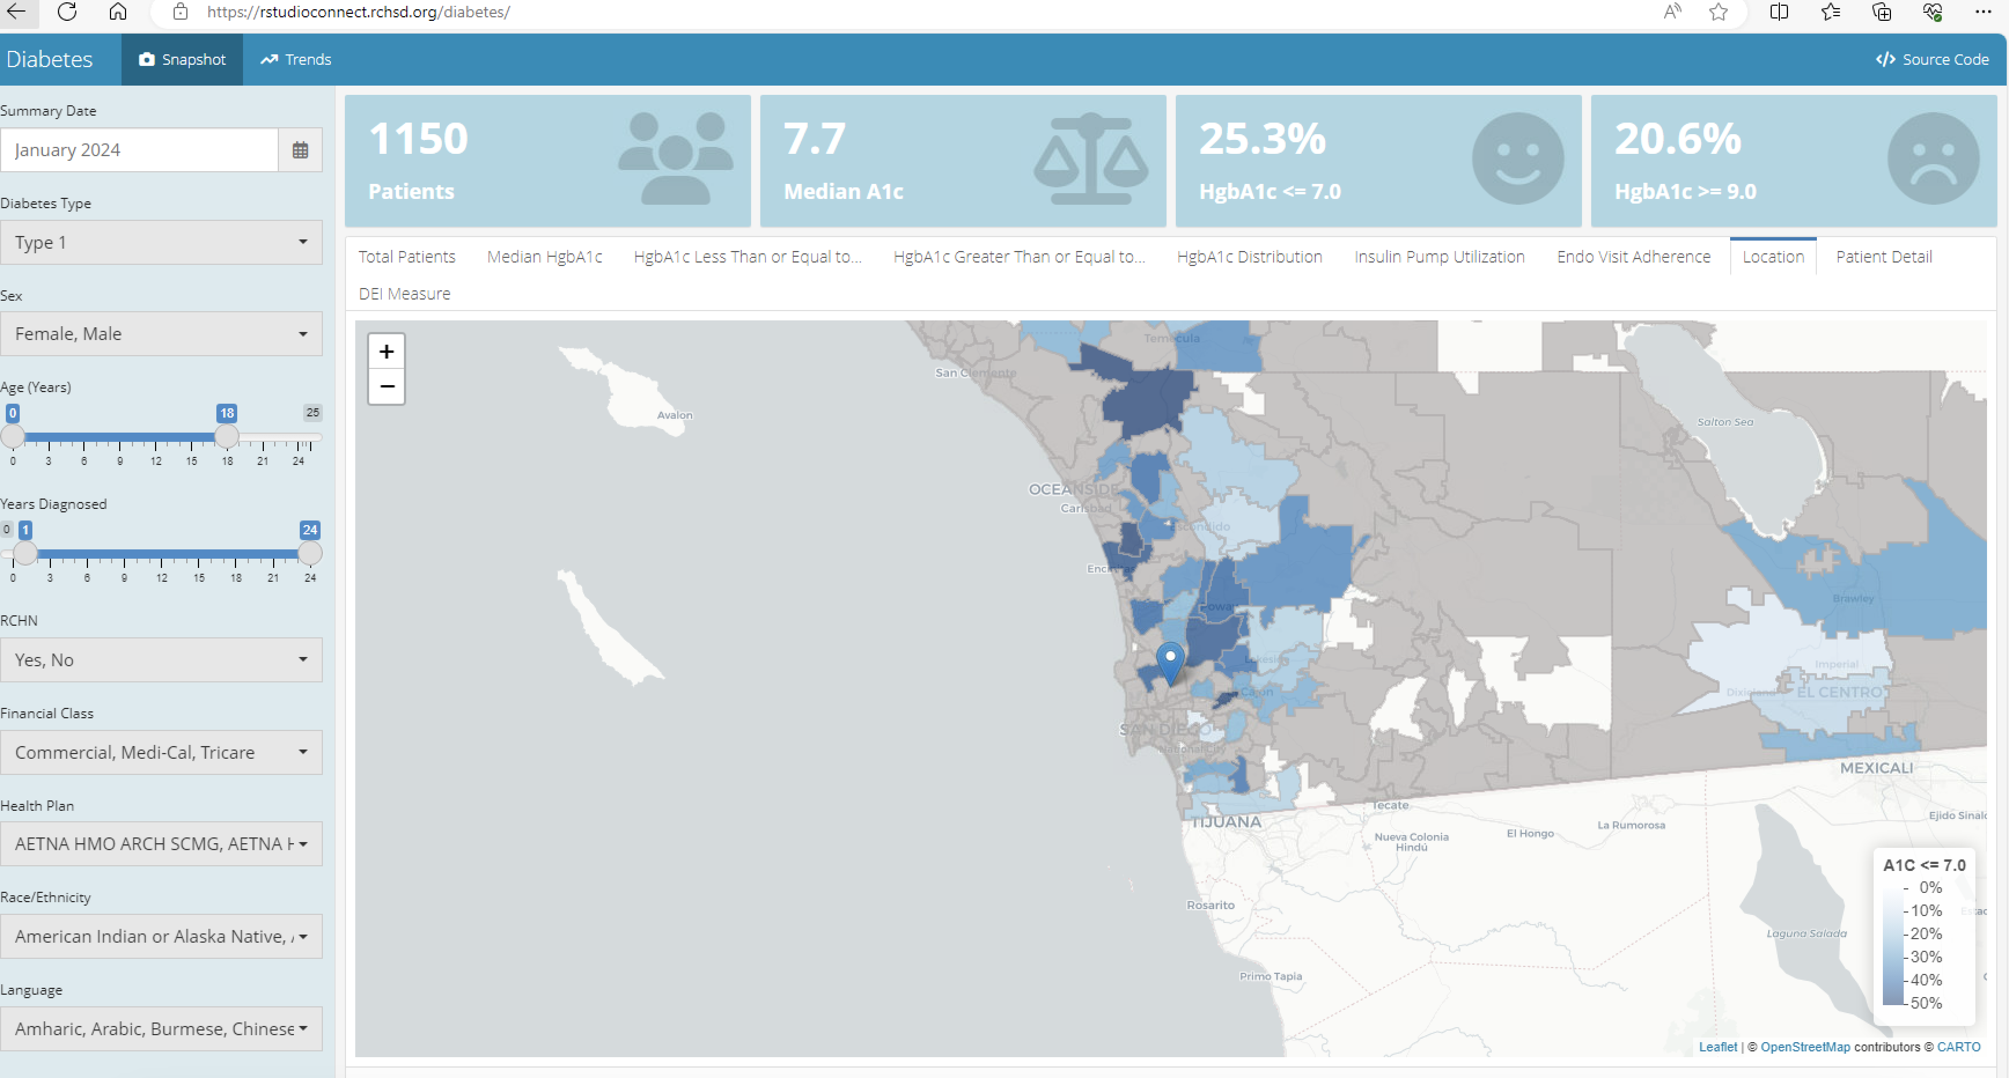
Notes:
R studio

Slide 13
Key Driver Diagram – RCHSD Health Equity Initiative
In Type 1 Diabetes
Sheet Last Updated on | 1/9/2024
Interventions
Key Drivers
Monthly Diabetes Dashboard review and completion of assessment tool for patients not at goal : PHCN, RN case manager, ECM
Ensure Access to care and regular follow-up, Promote health equity
Outreach to ensure access to care, services, education, referrals and prescriptions
SMART Aim
Workflow to improve communication and equitable transition of care between diabetes inpatient and outpatient services
Patient & Family-Centered Care
1. Increase the percentage of patients in target group with an A1C ⩽7% by 1% from 25% to 26% by December 31, 2025
2. Decrease the percentage of patients in target group with a an A1C ⩾ 9% by 1% from 29% to 28% by December 31, 2025.
Equity, unconscious bias, and SDOH training for providers and staff (inpatient and outpatient care)
Equity & Social Determinants of Health (SDOH)
Screen for and document SDOH and provide available resources for positive screens
Discuss CGM and insulin pump at appointments. Provide CGM and insulin pump information in the inpatient and outpatient settings.
Global Aim
Diabetes Technology
Provide CGM and insulin pump education as well as continuous support & problem- solving skills in both English and Spanish
Improve glycemic levels and reduce health inequities in children and adolescents with T1D
Improve Psychological Support
Utilize patient advocates to help talk with technology-hesitant families
Ensure that patients who need psycho-social support receive and complete referrals
Legend | Legend
 |  | Not Started
 |  | In Progress
 |  | Completed

Slide 14
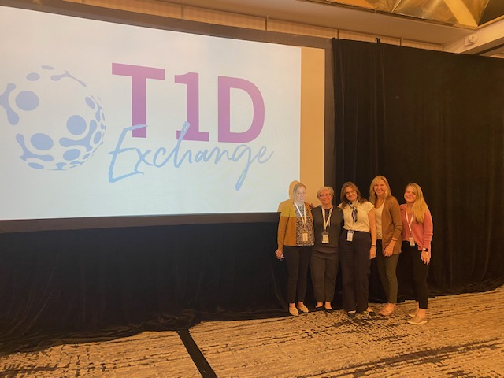
It Takes a Village
Thank you!
Diabetes Clinic
Jennifer Ruiz
Claudia Guzman
Shannan Davis
Natosha Rodriguez
Norma Rodriguez
Rocio Padilla
Melissa Magadan
Alexia Sandoval
Cinthia Perez
Juliana Perez
Population Health
Dr. Keri Carstairs
Rhonda Sparr-Perkins
Donna M Donoghue
Erin Dale
Gail Garcellano
Russell Gagui
Drisana Moss
Karen Anaya,
Yashia Saenz
Erin Carpenter
Dr. Laurel Moyer
Dr. Amy Bryl
Chad Miller
Jacob Parker
Yesenia Parker
Kendall Sanderson
Kyle McBride
Chelsea Carter
Wilfrid Houeto
RCHSD Diabetes Clinic QI Team:
Carla Demeterco-Berggren, MD PhD (PI)
Kim McNamara, RN, BSN, CDCES (Site Coordinator)
Christy Byer-Mendoza, MSN, RN, CPN, CNS (Site Coordinator)
Andrea Huber, RN, BSN, CDCES
Anna Cymbaluk MD

