Slide 1
QI Champions July 2023
Blake Adams, BSN; Grace Nelson, MD
University of Tennessee Health Science Center and LeBonheur Children’s Hospital

Slide 2
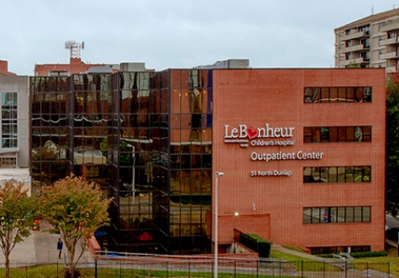
LeBonheur Children’s Hospital
LeBonheur Children’s Hospital is located in Memphis, TN and
serves surrounding areas that include Mississippi, Arkansas and
Missouri. Our Outpatient practice consists of 5 physicians, 1
fellow and 3 Nurse Practitioners.
We have a number of multidisciplinary staff including; 8 nurses, 6 CDCES,
1 social worker, 2 dietitians, 1 community outreach coordinator and 1 child life
specialist.
We serve approximately 800 patients diagnosed with Type 1 Diabetes and
450 with Type 2. For our Type 1 patients we have 54% with public insurance and 42% with private insurance. 37% of our Type 1 Diabetes patients are black.

Slide 3
Insulin pump
We are participating in a special project within T1D to reduce the Inequities in Pump Use between Non-Hispanic White and Non-Hispanic Black T1D Patients from 28% to 14% by June 2022

Slide 4
Baseline Data
6% of NHB patients and 25% of NHW were on insulin pumps
Low percentage of patients on pump and large inequity!!!

Slide 5
Insulin Pump Process- Fishbone Diagram
Policies and Procedure
Product
Patient must be able to upload pump device from home
Insurance coverage
Strict guidelines for insulin pump
Committee (A1C, attending classes and education
Not available in multiple languages
Difficulty working with supply companies and not receiving pump supplies
Family is in charge of calling pump company to schedule pump training
28% and 19% gap
in pump use
between NH
White and NH
Black/Hispanic
patients*,
respectively
Affordability of pump supplies
Insulin pump classes only available at downtown location and infrequently
Lengthy process and lots of communication required of family
Implicit Bias
Culture/Provider and Staff not offering/allowing/suggesting
Fear of attending in person class and appointments due to COVID
Must be on the portal
Patient unaware of technology or distrust of it
Need to have attended all Education classes and SM1
Frequent No-shows and scheduled with different providers
Place
Process
People

Slide 6
Insulin Pump Process Map
Stringent guidelines for insulin pump start that are outdated
-Make the guidelines “looser:
-Make a “pump champion” to help follow up with family
-Add more classes?
Patient is briefly introduced on insulin pump and other technology during Diabetes Complete class at diagnosis
Pump committee assesses for pump readiness
If denied- Create plan with committee to improve self-management
Limited number of classes offered. Time commitment from families
Family has difficulty reaching out to insulin pump companies, and no one is following up to see if it is done
Provider and patient decide to initiate pump process
Some patients seem uncertain about more technology and may not hear about it enough
-Make to option for pump part of each visit
Family decides which pump they want and reaches out to pump company representative
If approved- schedule for Insulin Pump Introduction class
Attend 3hr Insulin Pump class-make contact with insulin pump reps
Appointment with provider in clinic within 2-4 weeks of Insulin Pump start
Family is managed by pump trainer for first 2 weeks after pump start
Family schedules 2hr appointment with company trainer for pump start after receiving insulin pump supplies
Pump company will fax a CMN to clinic if needed by insurance, to be done by nursing or CDE
Pump company reaches out to patient’s insurance company for approval
Pump rep emails clinic CDE to obtain date and time for pump start
Pump company faxes orders for pump start to be signed by Provider
Attend a self Management 1 Class within 6 months of starting insulin pump
Communication and time for another appointment to get things going can be hard
-Make a “pump champion” to help follow up with family
Can be caught in a “circle” of insurance issues for a while at times. Possible to slide through cracks here
-Make a “pump champion” to help follow up with family

Slide 7
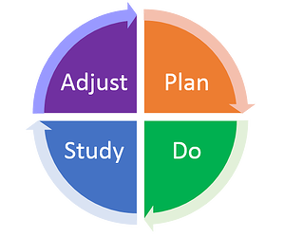
PDSA Cycles- 10
Cycle 5- Survey patients after pump start
Cycle 10- Label and track MDJ forms and hand off project to CDCES
Cycle 4- Change follow up guidelines and utilize rep
Cycle 9- Utilize MDJ form
Cycle 3- Closer follow up after pump class and implicit bias training
Cycle 8- 1-2 week follow up after pump start
Cycle 2- Broaden criteria and recruit staff to join project
**Reached 10 patients**
Cycle 7- Educate staff on pump technology
Cycle 1- Loosen guidelines and find 10 participants
Cycle 6- Stop pump committee and sooner follow up after pump start

Slide 8
Hybrid Closed Loop Insulin Pump Project:
Started with a group of 10 patients (focused on non-white) who would not normally be considered for an insulin pump based on previous clinic standards.
We met with a multidisciplinary group to established criteria and were able to add 10 patients over time to our project.
We monitored them closely throughout the process from CGM start to pump initiation, specifically closer follow up after pump start.
We surveyed staff for insulin pump knowledge and collaborated with CDCES to offer insulin pump education to staff and updated our nursing binder
30 patient, 19 attended class, 14 current HCL users

Slide 9
Hybrid Closed Loop patients

Slide 11
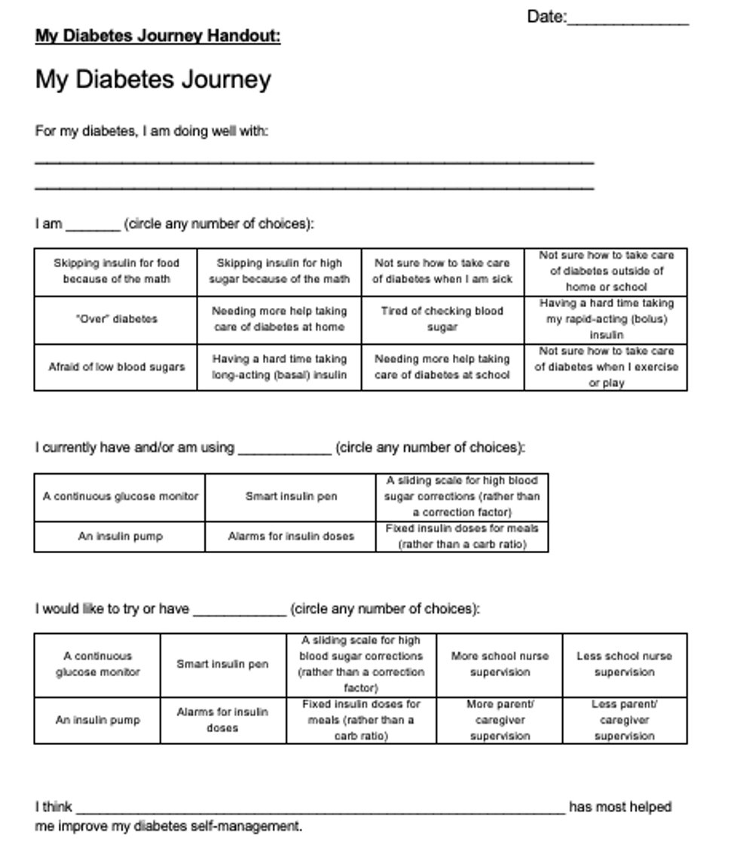
My Diabetes Journey
We incorporated this form to be
an opportunity for shared decision
making between provider and
family, to help guide discussion
during clinic appt. and to introduce
technology in an equitable manner.

Slide 12
New Diabetes Technology form
We created this technology form to be handed out with the
DTA survey as a visual reminder for families with a few
short facts to further technology discussion.
We recently are trialing adding this form to be handed out
with MDJ form in Dr. Nelson’s clinic.
References :
Mathias P, Mahali LP, Agarwal S. Targeting Technology in Underserved Adults With Type 1 Diabetes: Effect of Diabetes Practice Transformations on Improving Equity in CGM Prescribing Behaviors. Diabetes Care. 2022 Oct 1;45(10):2231-2237. doi: 10.2337/dc22-0555. PMID: 36054022.
Bailey R, Donthi S, Markt S, Drummond C, Cullen J. Evaluating Factors Associated With Continuous Glucose Monitoring Utilization With the Type 1 Diabetes Exchange Registry. J Diabetes Sci Technol. 2022 May 3:19322968221091299. doi: 10.1177/19322968221091299. Epub ahead of print. PMID: 35506181.

Slide 13
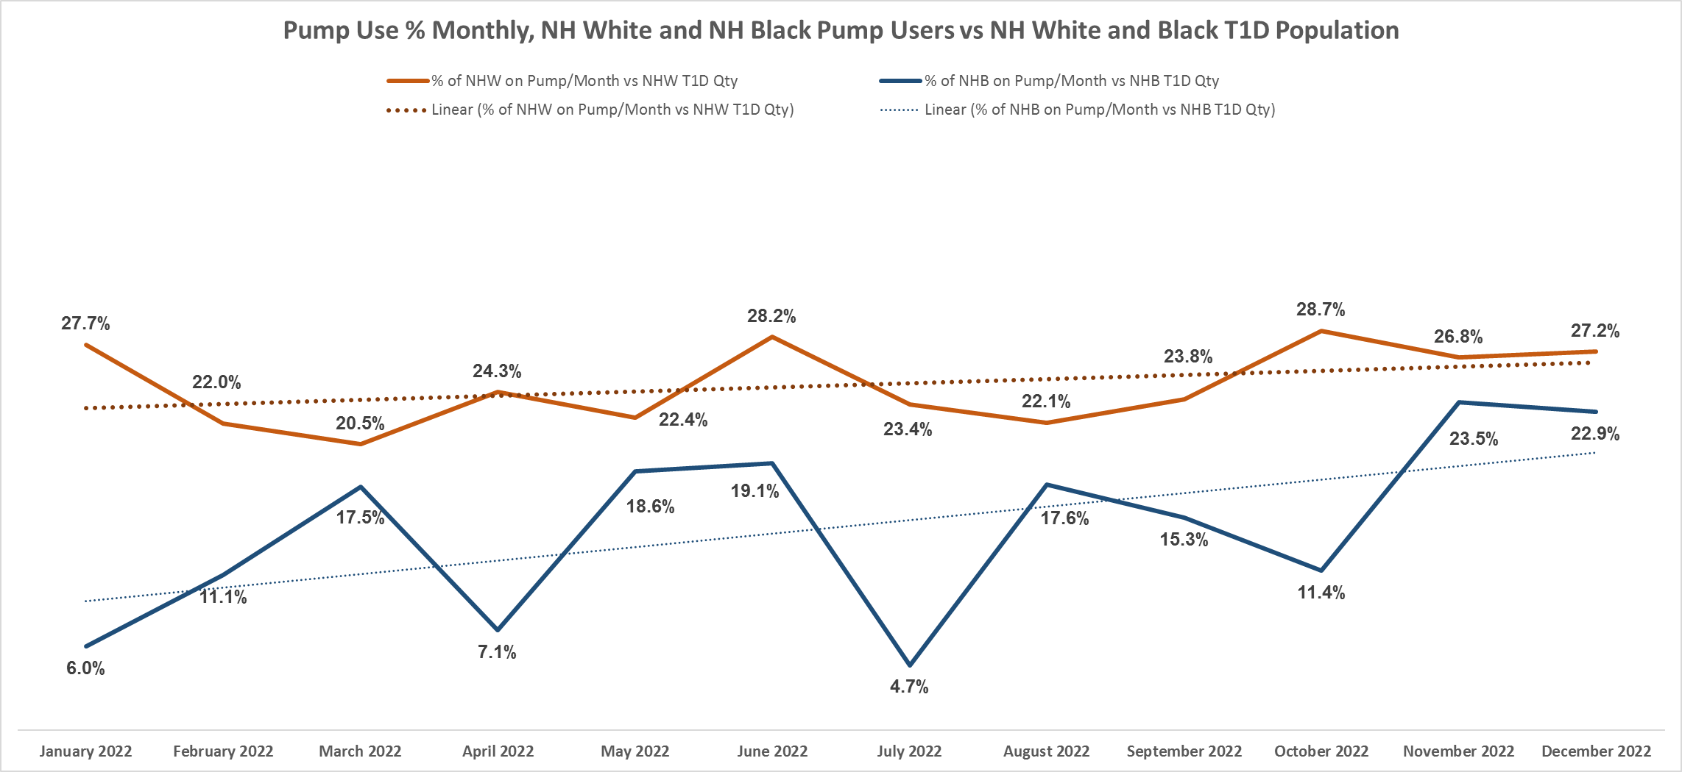
Insulin Pump Use, by Race

Slide 14
Next Steps
Closer follow up with patients with A1c above target with the general CDEs, but not as a limitation to starting pump
Change in Education Curriculum, from Day1 through Pump Education
Post pump start education to review common pitfalls
Currently analyzing reasons behind post pump admissions to help target education

Slide 15
Active QI Projects
Hybrid Closed Loop Insulin pump project
Connected pen use with increased shared decision making
Diabetes Annual Visit
SDOH screening

Slide 16
Questions?

