Slide 1
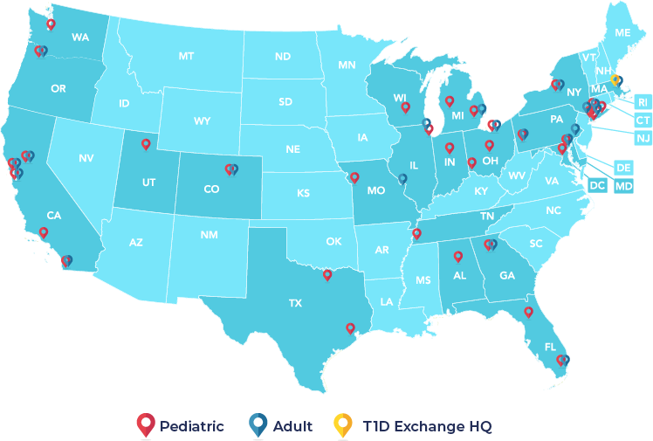
Advancing Quality Improvement Culture among 27 Pediatric and Adult Diabetes Centers
Ann Mungmode, MPH¹; Ori Odugbesan, MD, MPH¹; Victor Elisha¹; Devin Steenkamp², MBChB; Manmohan Kamboj, MD³; Daniel DeSalvo, MD⁴; Rona Sonabend, MD⁴; Anna Neyman, MD⁵; Priyanka Mathias, MD⁶; Lily Chao, MD⁷; Jeniece Ilkowitz, BSN, MA, CDCES⁸; Osagie Ebekozien, MD, MPH^{1,9}
1) T1D Exchange, MA; 2) Boston Medical Center, MA; 3) Nationwide Children’s Hospital, OH; 4) Texas Children’s Hospital, Baylor College of Medicine, TX; 5) Indiana University, Riley Children’s Health, IN; 6) Albert Einstein College of Medicine, NY; 7) Children’s Hospital Los Angeles, CA; 8) Hassenfeld Children’s Hospital at NYU Langone, NY; 9) University of Mississippi School of Population Health, MS
Background
Methods
Discussion
Companies across many industries (including healthcare) have invested heavily in quality improvement (QI) initiatives; despite these investments, quality deficiencies are still common and cost billions of dollars.¹ Quality management will continue to suffer without transformation in an organization’s culture.
Centers completed an annual 20-question self-assessment measuring QI Culture in four evidence-based areas:
QI Team Structure (team roles)
QI Foundation (data collection, training)
Data were collected from the same centers in 2021 (pre-) and 2022 (post-). Differences in pre- and post-QI Culture were calculated using Chi-Square tests.
These findings suggest that being a member of the T1DX-QI for at least 12 months supports diabetes centers in experiencing significant improvement in multiple areas of QI Culture.
Centers report improvements up to 40% in QI Culture scores; reported decreases were small
Improvement was not reported in the area of QI Team Structure; further investigation is necessary, but this may be due in part to the COVID-19 pandemic and broader healthcare staffing trends
Centers with variable resources and capabilities benefit from involvement in this network
QI Capacity (use of QI tools)
QI Success (scaling up and sustaining tests)
Overview
Results
The T1D Exchange Quality Improvement Collaborative (T1DX-QI) is a network of over fifty diabetes centers working to improve health outcomes by implementing QI science.^{2,3} T1DX-QI centers join the T1DX-QI with variable levels of QI experience.
Table 1: Pre- and Post-QI Culture Scores Summary
 | T1DX-QI Centers
Average Difference in Pre- and Post-QI Culture Scores | +8%
Pre- to Post-QI Culture Score Shifts, N (%) Improved (range: 1% - 40% increase) Unchanged (0% change) Decreased (range: 3%-5% decrease) | 16 (59) 6 (22) 5 (19)
Acknowledgement
Figure 1: Overall Pre- and Post-QI Culture Scores
Significant improvement was reported in 2021 versus 2022 results:
On average, center-reported QI Culture improved by 8%
A majority of centers (59%) reported improvement
QI Culture increased by 12% (from 70% to 84%; p ≤ 0.05)
Centers improved in 3 of 4 evidence-based areas (12% to 22% improvement)
This research was supported in part by The Leona M. and Harry B. Helmsley Charitable Trust.
For more information, contact Ann Mungmode, amungmode@t1dexchange.org
References
 | 2021 | 2022 | Overall difference
QI Team | 79 | 77 | -2
QI Foundation | 82 | 90 | +8*
QI Capacity | 63 | 87 | +24*
QI Success | 57 | 79 | +22*
Overall QI Culture | 70 | 84 | +12*
Lesmeister, F. “How to Create a Culture of Quality Improvement.” March 2018 https://www.bcg.com/publications/2018/how-to-create-culture-quality-improvement
Alonso, G. T., Corathers, S., Shah, A., Clements, M., Kamboj, M., Sonabend, R., DeSalvo, D., Mehta, S., Cabrera, A., Rioles, N., Ohmer, A., Mehta, R., & Lee, J. (2020). Establishment of the T1D Exchange Quality Improvement Collaborative (T1DX-QI). Clin Diabetes, 38(2), 141-151. https://doi.org/10.2337/cd19-0032
Prahalad, P. R., N.; Noor, N.; Rapaport, R.; Weinstock, R.; Ebekozien, O. (2021). T1D Exchange Quality Improvement Collaborative: Accelerating change through benchmarking and improvement science for people with type 1 diabetes. Journal of Diabetes. https://onlinelibrary.wiley.com/doi/10.1111/1753-0407.13234
Marks, B. E., Mungmode, A., Neyman, A., Levin, L., Rioles, N., Eng, D., Lee, J. M., Basina, M., Hawah-Jones, N., Mann, E., O’Malley, G., Wilkes, M., Steenkamp, D., Aleppo, G., Accacha, S., Ebekozien, O., & Collaborative, T. D. E. Q. I. (2022). Baseline Quality Improvement Capacity of 33 Endocrinology Centers Participating in the T1D Exchange Quality Improvement Collaborative. Clinical Diabetes, 41(1), 35-44. https://doi.org/10.2337/cd22-0071
This study complements a previous investigation,⁴ and aims to review the QI Culture of 27 diabetes centers involved with the T1DX-QI for over 12 months.
*p-value ≤ 0.05.
Notes:
https://www.npr.org/sections/health-shots/2019/06/11/729314248/to-save-the-science-poster-researchers-want-to-kill-it-and-start-over

