Slide 1
September 1, 2023
T1DX-QI Equity Expansion
U-M Pediatric Diabetes CGM Adoption Project PDSAs
Ashley Garrity, MPH, Joyce Lee, MD, MPH, Jackie Fisher, MD, Inas Thomas, MD

Slide 2
U-M Pediatric Diabetes
C.S. Mott Children’s Hospital, University of Michigan
Multidisciplinary Team (FTEs*) | Patient Volume & Demographics | Contacts
3.0 endocrinologists 1.5 fellows 3.0 dietitians (2.0 w/CDCES) 4.8 RNs (2.8 w/CDCES) 2.0 social workers 1.0 psychologist *Devoted to T1D patient care | Main clinic at academic medical center + 1 satellite clinic 100-150 new onsets annually ~1300 established T1D patients 30% publicly insured | Site PI Joyce Lee, MD, MPH joyclee@med.umich.edu Site Coordinator Ashley Garrity, MPH ashleyna@med.umich.edu

Slide 3
Baseline Data (January 2023)
Patients with T1D who had a CGM: 81.3%
Among all patients with CGM, percentage who used it ≥70% of the time in the past 2 weeks: 87.7%
Subset of non-White patients with T1D who had a CGM: 72.5%
Among non-White patients with CGM, percentage who used it ≥70% of the time: 82.7%

Slide 4
Aims
To:
1. increase the proportion of all patients with T1D who have a CGM by 5% (goal: 86.3%)
2. increase the proportion of all patients with T1D who use CGM ≥70% of the time by 5% (93.7%)
3. close the gap in CGM adoption and use between White and non-White patients with T1D
by December 31, 2023.

Slide 5
PDSA #1: Flowsheet Revisions
Plan: Using Lurie Children’s flowsheet as an example, revise flowsheet to standardize discussions about CGM, capture CGM adoption and use at point-of-care, and address barriers.
Do: QI Team to collaboratively discuss and decide on flowsheet items (Nov 2022); Joyce to build (Dec 2022 – Jan 2023).
Study: Updated flowsheet items went live 2/8/2023; Revised items allow use to better understand which patients do/do not have CGM and which patients are/are not using CGM ≥70% of them, plus collecting information about barriers helps us know how we might best intervene.
Top barriers: Resistance to wearing device, insurance coverage, and technology issues
Act: Adopt

Slide 6
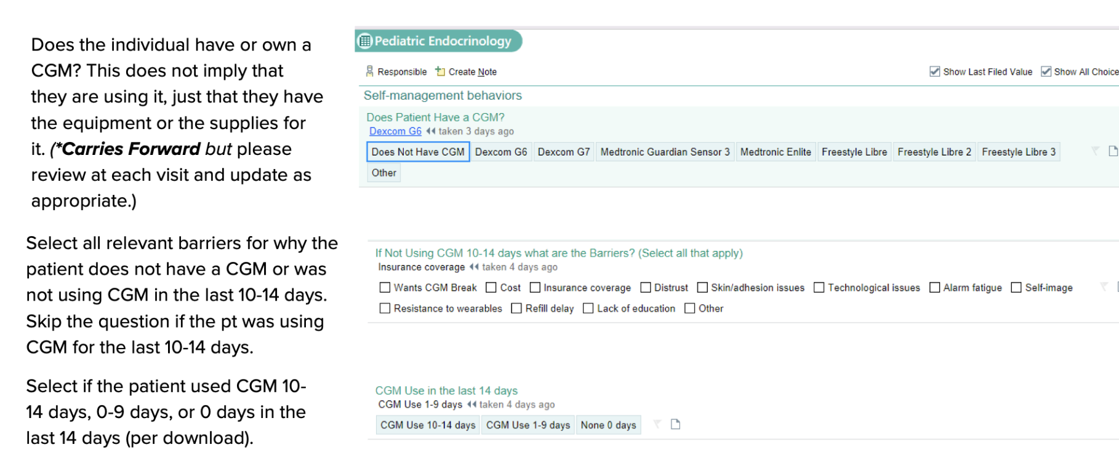
Notes:
Also made similar updates to pump use and barriers flowsheet items.

Slide 7
PDSA #2: Change Data Downloads to Ensure BG Logs on File for CGM Orders
Plan: At intake, if patient is only using a glucometer, MAs will download 30 days of data (instead of 14) to ensure adequate BG logs are on file if patient opts to proceed with CGM order at visit.
Do: MAs to test with next 5 patients using only glucometer, beginning 4/6/2023.
Study: MAs successfully switched from downloading 14 days of meter day to 30 days; First patient ordered CGM at same visit (previously used Dexcom but discontinued due to discomforted and opted to try Libre). Michigan Medicaid revised CGM policy (effective 6/1/2023), no longer requiring BG log documentation for CGM order approval. (Team was involved in advocacy efforts.)
Act: Abandon

Slide 8
PDSA #3: Share Resources & Reminder via Newsletter
Plan: Share resources for patients/families getting started with CGM or new type of device and reminder: “As always, whether you are a new or experienced CGM user, please don't hesitate to contact your U-M Pediatric Diabetes care team with any diabetes device questions.”
Do: Ashley to share information and links to ‘Getting Started’ videos in August 2023 newsletter (sent 8/18/2023)
Study: 6 parents clicked links to Dexcom ’Getting Started’ videos
Act: Continue studying / adopt

Slide 9
PDSA #4: Discuss CGM During Basic Education Class
Plan: Add CGM slide to Basic Education class regarding all types of CGM and let patients know that if they need assistance with putting on CGM, it’s okay to bring to basic class
Do: Iris & Christina to add slide for teaching at August/September classes; Kelly to tell patients about bringing CGM to Basic Education, if needed, at discharge
Study: In progress
Act: TBD

Slide 10
Other Ideas

